Slide 1
CMSC 28100 Introduction to Complexity Theory Winter 2024 Instructor: William Hoza
7 |  |  |  |  |  |  | 5 | 3
 |  |  |  |  |  |  |  | 4
 | 4 | 8 |  | 3 |  | 1 | 2
8 |  | 1 | 3 |  |  | 2 | 7 | 5
 | 9 |  | 1 |  |  |  | 4
 | 5 |  |  |  |  | 3
2 |  | 5 |  | 8 | 4
1 | 3 | 4 |  | 5

Slide 2
Administrative stuff
Problem set 3 is posted (due Thursday 1/25)
Grades/feedback for problem set 1 will be available soon
Office hours going forward:
Mondays, 10:30 – 11:30, JCL 205 (Chris)
Tuesdays, 1pm – 2pm, JCL 205 (Tapan)
Wednesdays, 10:30am – 12:30pm, JCL 311 (William)
Wednesdays, 3:30 – 4:30pm, JCL Common Area 2A (Nico and Rohan) [canceled]

Slide 3
What are Turing machines capable of?

Slide 4

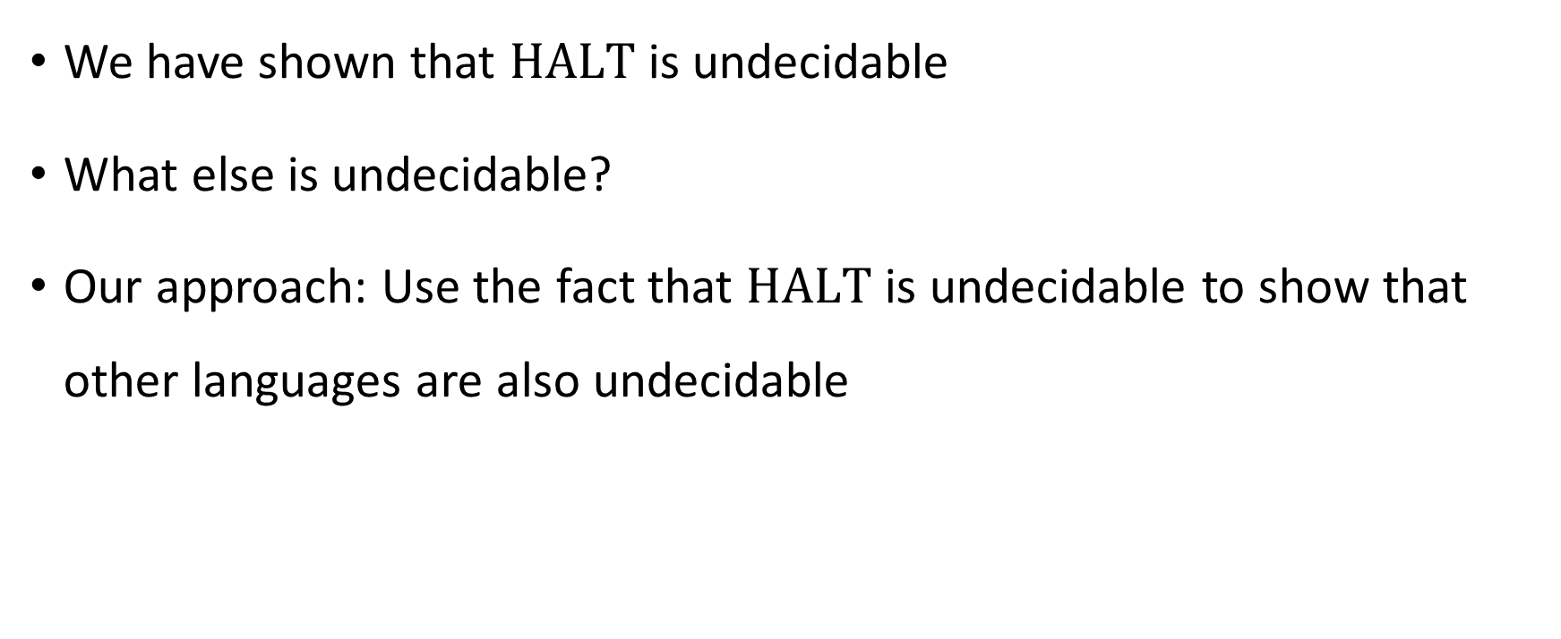
Undecidability
We have shown that $\text{HALT}$ is undecidable
What else is undecidable?
Our approach: Use the fact that $\text{HALT}$ is undecidable to show that other languages are also undecidable

Slide 5
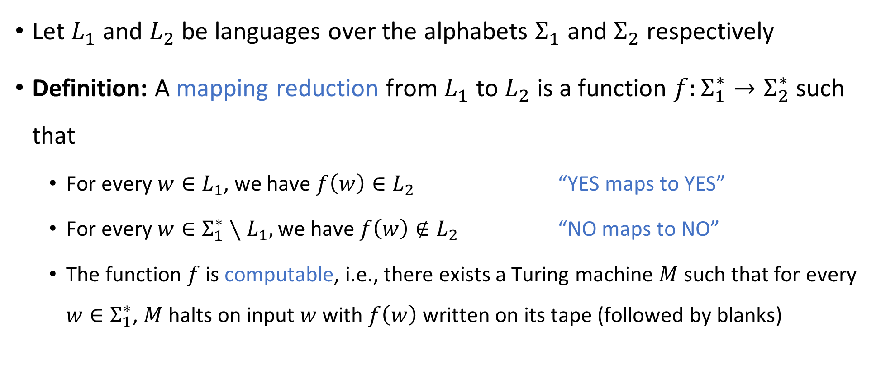
Reductions
Let $L_{1}$ and $L_{2}$ be languages over the alphabets $Σ_{1}$ and $Σ_{2}$ respectively
Definition: A mapping reduction from $L_{1}$ to $L_{2}$ is a function $f:Σ_{1}^{∗}→Σ_{2}^{∗}$ such that
For every $w∈L_{1}$, we have $f\left(w\right)∈L_{2}$ “YES maps to YES”
For every $w∈Σ_{1}^{∗}∖L_{1},$ we have $f\left(w\right)∉L_{2}$ “NO maps to NO”
The function $f$ is computable, i.e., there exists a Turing machine $M$ such that for every $w∈Σ_{1}^{∗}$, $M$ halts on input $w$ with $f\left(w\right)$ written on its tape (followed by blanks)

Slide 6





Reductions
Informally, a mapping reduction from $L_{1}$ to $L_{2}$ is a way of converting instances of $L_{1}$ into equivalent instances of $L_{2}$
Note: Any string $w∈Σ^{∗}$ is called an “instance” of $L⊆Σ^{∗}$
$$L_{2}$$
$$L_{1}$$
$$Σ_{1}^{∗}$$
$$Σ_{2}^{∗}$$

Slide 7
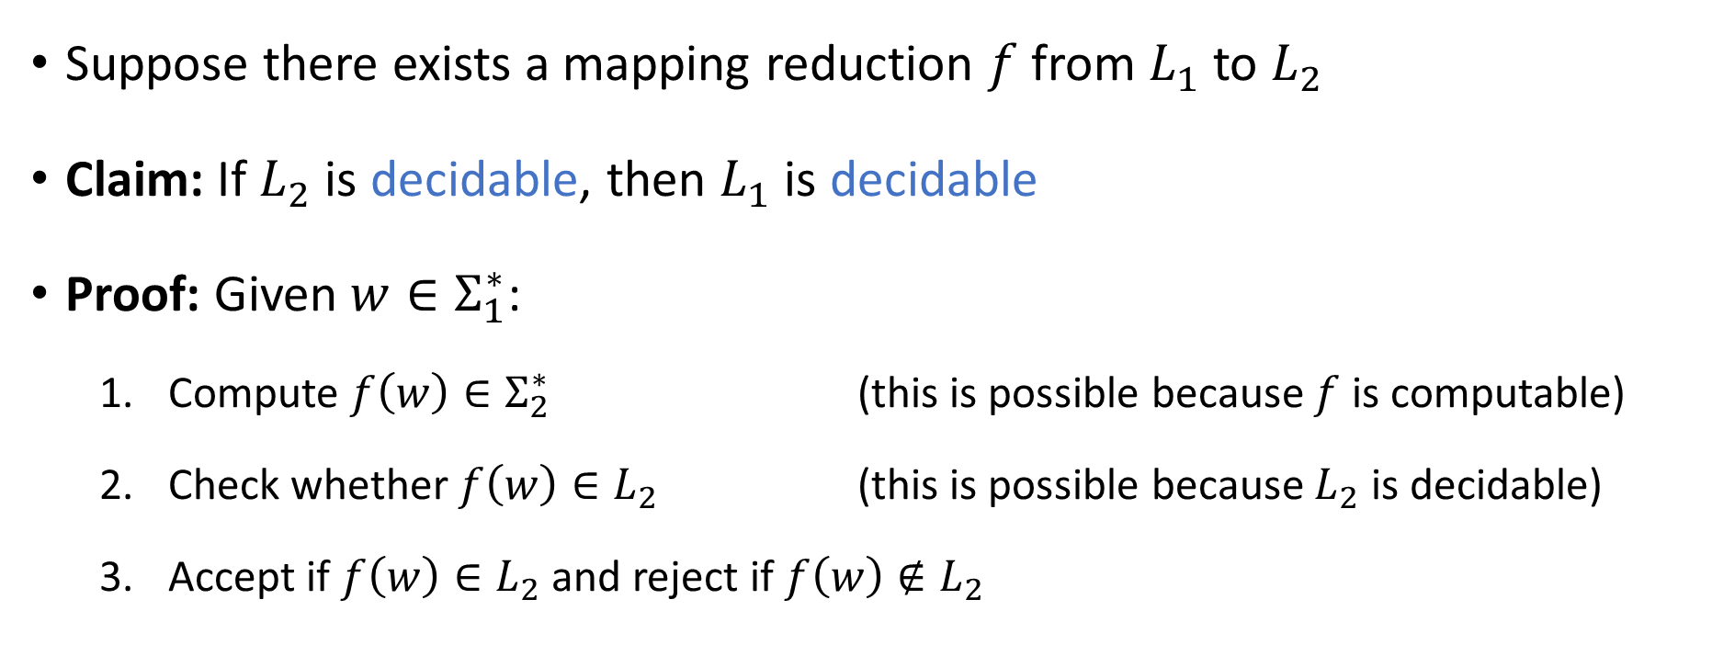
Using reductions to prove decidability
Suppose there exists a mapping reduction $f$ from $L_{1}$ to $L_{2}$
Claim: If $L_{2}$ is decidable, then $L_{1}$ is decidable
Proof: Given $w∈Σ_{1}^{∗}$:
Compute $f\left(w\right)∈Σ_{2}^{∗}$ (this is possible because $f$ is computable)
Check whether $f\left(w\right)∈L_{2}$ (this is possible because $L_{2}$ is decidable)
Accept if $f\left(w\right)∈L_{2}$ and reject if $f\left(w\right)∉L_{2}$

Slide 8

Using reductions to prove undecidability
Suppose there exists a mapping reduction $f$ from $L_{1}$ to $L_{2}$
Claim: If $L_{1}$ is undecidable, then $L_{2}$ is undecidable
Proof: This is the contrapositive of the previous claim

Slide 9

Using reductions to prove undecidability
Strategy for proving that some language $L$ is undecidable:
Identify a suitable language $L_{HARD}$ that we previously proved is undecidable
Design a mapping reduction $f$ from $L_{HARD}$ to $L$

Slide 10
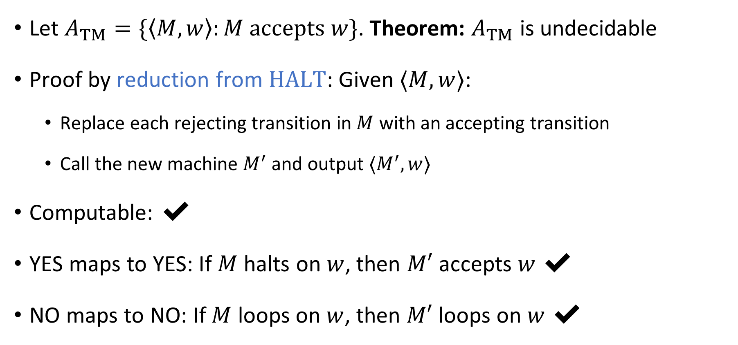
Acceptance problem for Turing machines
Let $A_{TM}=\{\left\langle M,w\right\rangle :M \text{accepts} w\}$. Theorem: $A_{TM}$ is undecidable
Proof by reduction from $\text{HALT}$: Given $⟨M,w⟩$:
Replace each rejecting transition in $M$ with an accepting transition
Call the new machine $M^{′}$ and output $⟨M^{′},w⟩$
Computable: ✔️
YES maps to YES: If $M$ halts on $w$, then $M′$ accepts $w$ ✔️
NO maps to NO: If $M$ loops on $w$, then $M′$ loops on $w$ ✔️

Slide 11
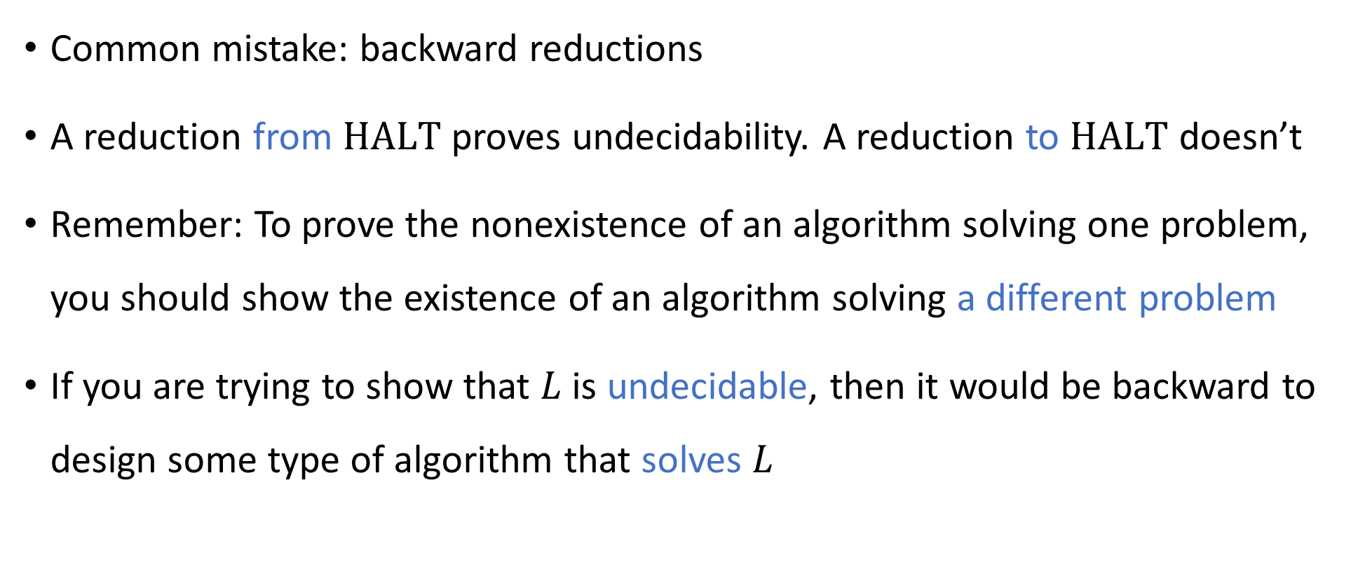
Avoiding backward reductions
Common mistake: backward reductions
A reduction from $\text{HALT}$ proves undecidability. A reduction to $\text{HALT}$ doesn’t
Remember: To prove the nonexistence of an algorithm solving one problem, you should show the existence of an algorithm solving a different problem
If you are trying to show that $L$ is undecidable, then it would be backward to design some type of algorithm that solves $L$

Slide 12
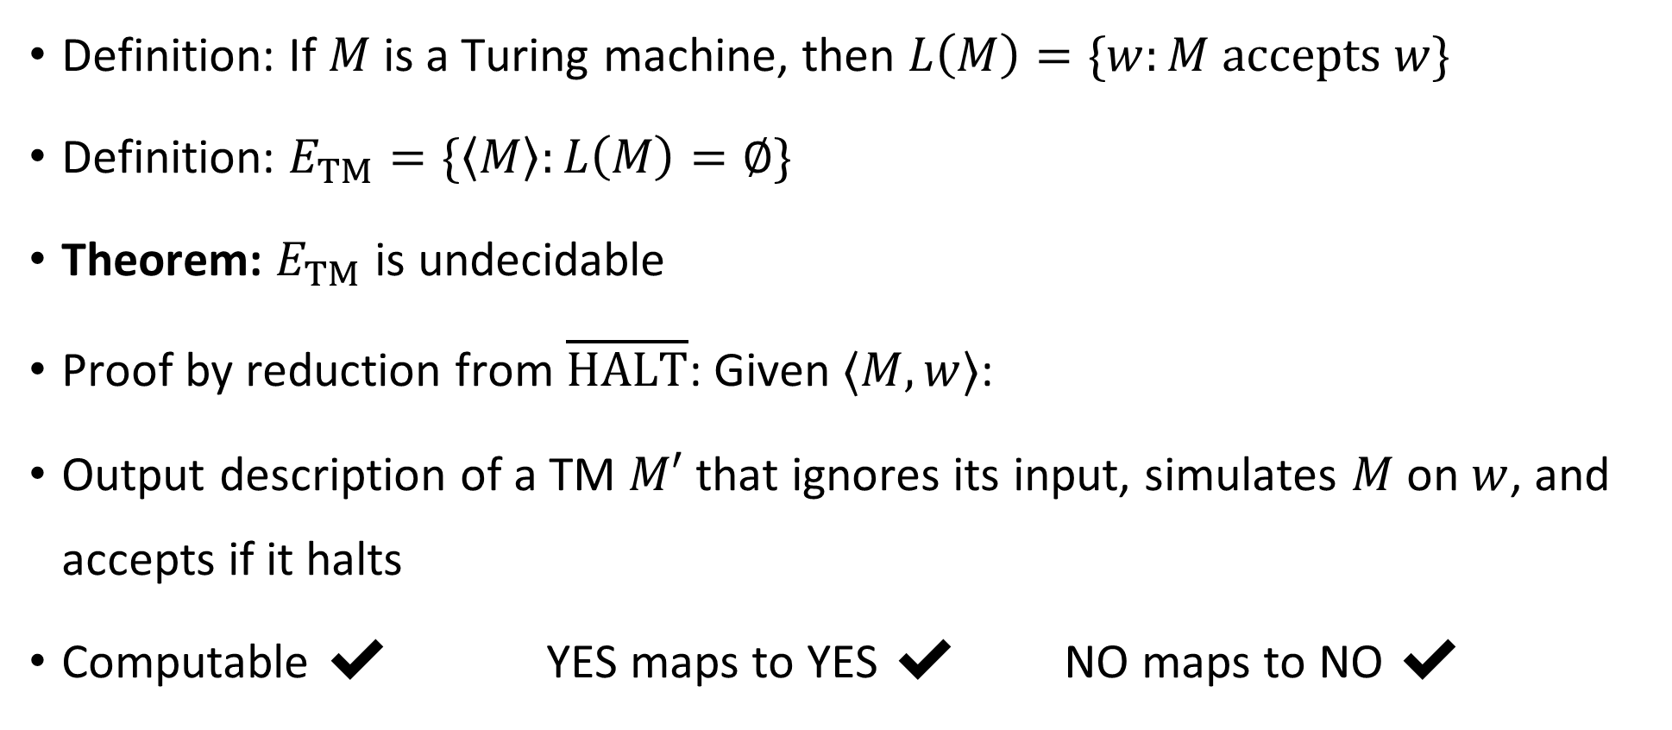
Emptiness problem for Turing machines
Definition: If $M$ is a Turing machine, then $L\left(M\right)=\{w:M \text{accepts} w\}$
Definition: $E_{TM}=\{\left\langle M\right\rangle :L\left(M\right)=∅\}$
Theorem: $E_{TM}$ is undecidable
Proof by reduction from $\overline{\text{HALT}}$: Given $⟨M,w⟩$:
Output description of a TM $M′$ that ignores its input, simulates $M$ on $w$, and accepts if it halts
Computable ✔️ YES maps to YES ✔️ NO maps to NO ✔️

