Slide 1
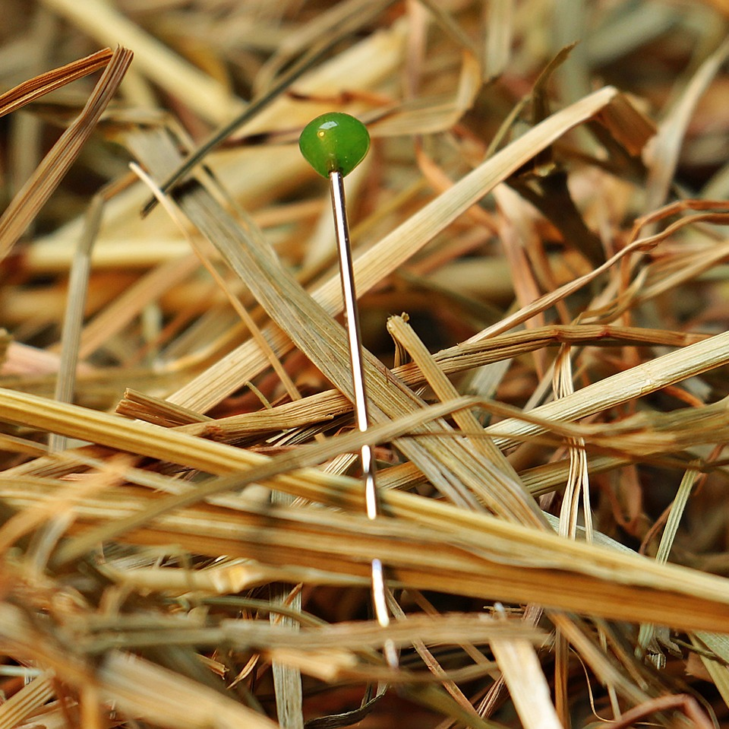
CMSC 28100 Introduction to Complexity Theory Spring 2025 Instructor: William Hoza

Slide 2
Which problems can be solved through computation?

Slide 3
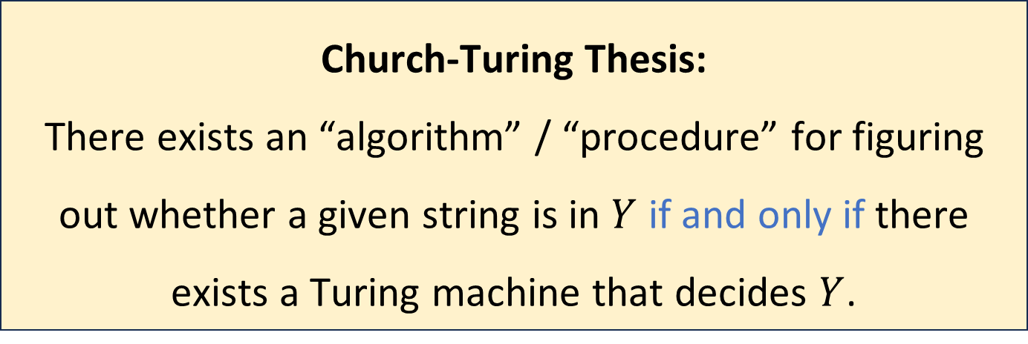
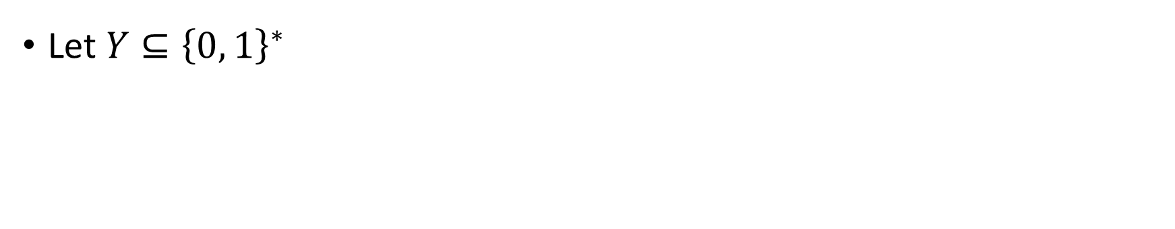
The Church-Turing Thesis
Let $Y⊆{\left\{0, 1\right\}}^{∗}$
Church-Turing Thesis:
There exists an “algorithm” / “procedure” for figuring out whether a given string is in $Y$ if and only if there exists a Turing machine that decides $Y$.
Intuitive notion
Mathematically precise notion

Slide 4






Multi-tape Turing machines
$$⋯$$
1
1
0
$$⊔$$
$$⊔$$
$$⋯$$
0
#
1
$
$$⊔$$
$$q$$

Slide 5
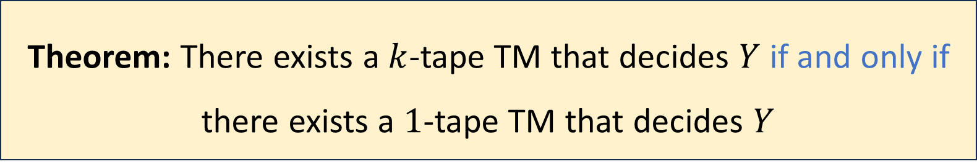

Multi-tape Turing machines
Let $k$ be any positive integer and let $Y$ be a language
Theorem: There exists a $k$-tape TM that decides $Y$ if and only if there exists a $1$-tape TM that decides $Y$

Slide 6

TMs can simulate all “reasonable” machines
We could add various other bells and whistles to the basic TM model
The ability to observe the two neighboring cells
The ability to “teleport” back to the initial cell in a single step
A two-dimensional tape
None of these changes has any effect on the power of the model
🔔

Slide 7

The Church-Turing Thesis
Let $Y⊆{\left\{0, 1\right\}}^{∗}$
Church-Turing Thesis:
There exists an “algorithm” / “procedure” for figuring out whether a given string is in $Y$ if and only if there exists a Turing machine that decides $Y$.
Intuitive notion
Mathematically precise notion

Slide 8





Turing machines vs. your laptop
OBJECTION:
“Each individual Turing machine can only solve one problem.
My laptop is a single device that can run arbitrary computations.
Therefore, Turing machines don’t properly model my laptop.”
Email machine??
General purpose computer
Zoom machine??
Tetris machine??
Photoshop machine??

Slide 9
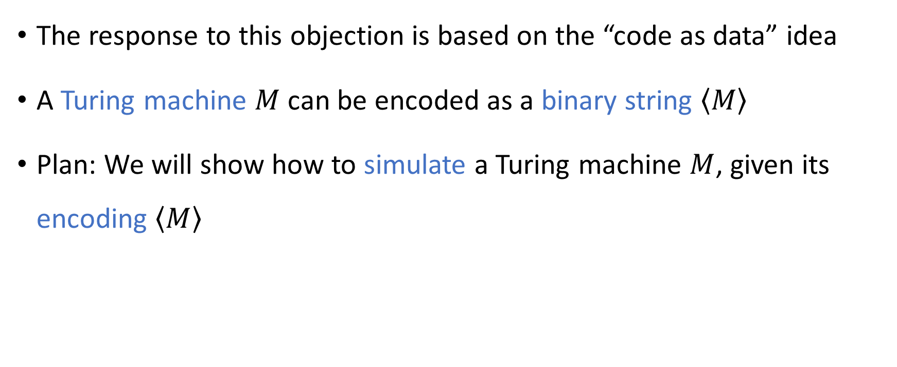
Code as data
The response to this objection is based on the “code as data” idea
A Turing machine $M$ can be encoded as a binary string $\left\langle M\right\rangle$
Plan: We will show how to simulate a Turing machine $M$, given its encoding $\left\langle M\right\rangle$

Slide 10
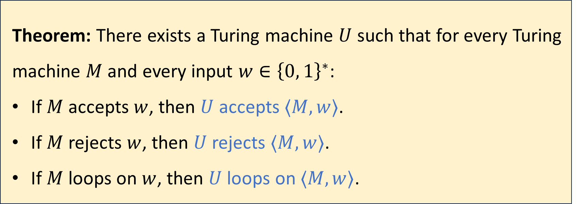
Universal Turing machines
Theorem: There exists a Turing machine $U$ such that for every Turing machine $M$ and every input $w∈{\left\{0, 1\right\}}^{∗}$:
If $M$ accepts $w$, then $U$ accepts $⟨M,w⟩$.
If $M$ rejects $w$, then $U$ rejects $⟨M,w⟩$.
If $M$ loops on $w$, then $U$ loops on $⟨M,w⟩$.
One super-algorithm that contains all other algorithms inside it!

Slide 11
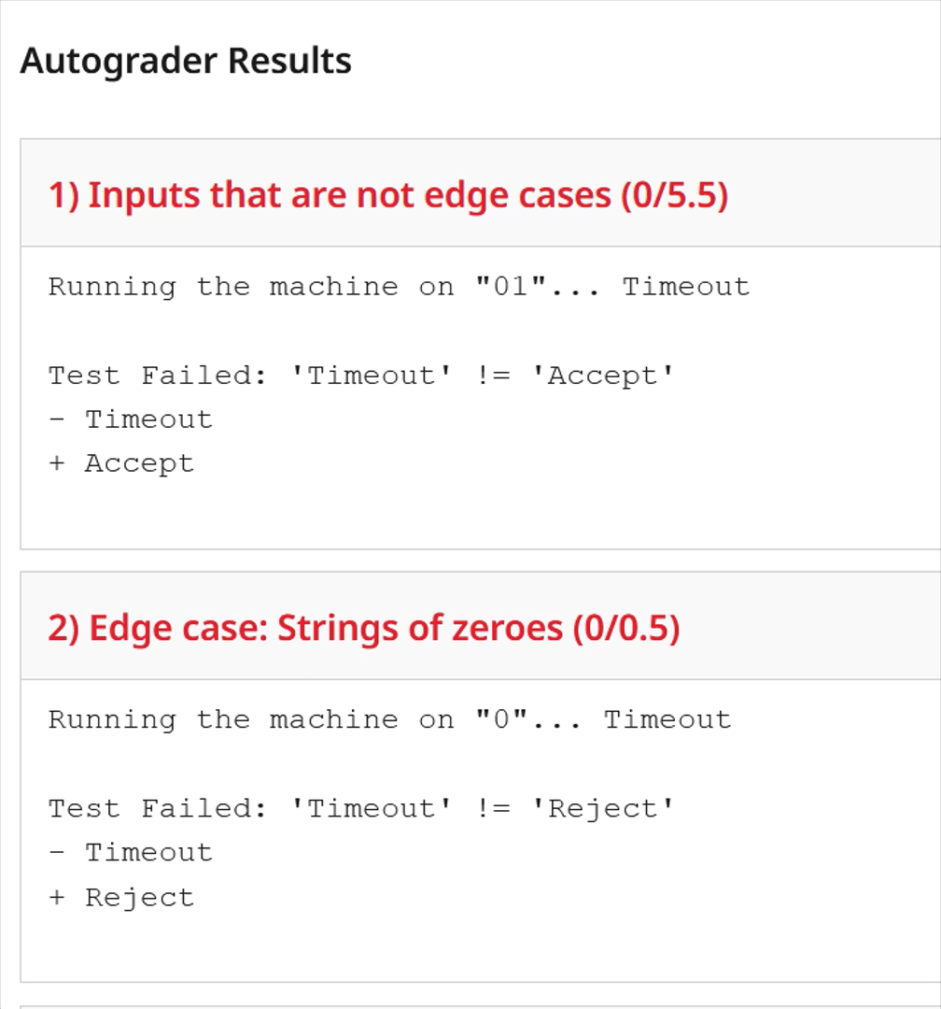
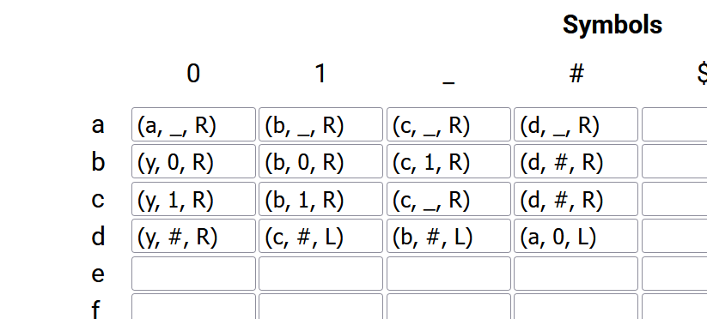





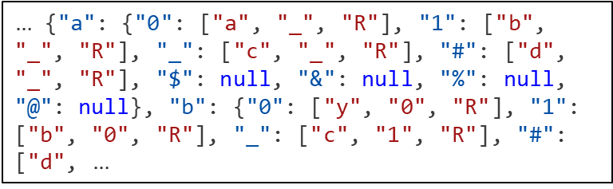




Example: Exercise 4
$$M$$
$$⇓$$
$$⇒$$
$$⇓$$
$$⇑$$
$…$ {"a": {"0": ["a", "_", "R"], "1": ["b", "_", "R"], "_": ["c", "_", "R"], "#": ["d", "_", "R"], "$": null, "&": null, "%": null, "@": null}, "b": {"0": ["y", "0", "R"], "1": ["b", "0", "R"], "_": ["c", "1", "R"], "#": ["d", $…$
$$\left\langle M\right\rangle$$
$$≈U$$

Slide 12
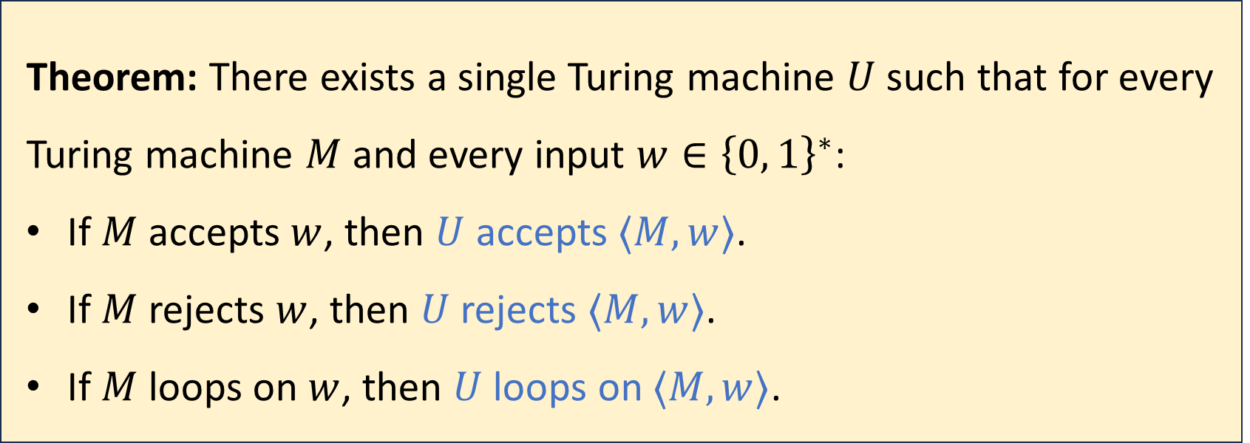
Universal Turing machines
Theorem: There exists a single Turing machine $U$ such that for every Turing machine $M$ and every input $w∈{\left\{0, 1\right\}}^{∗}$:
If $M$ accepts $w$, then $U$ accepts $⟨M,w⟩$.
If $M$ rejects $w$, then $U$ rejects $⟨M,w⟩$.
If $M$ loops on $w$, then $U$ loops on $⟨M,w⟩$.
To properly prove it, we need to clarify how $\left\langle M\right\rangle$ is defined

Slide 13
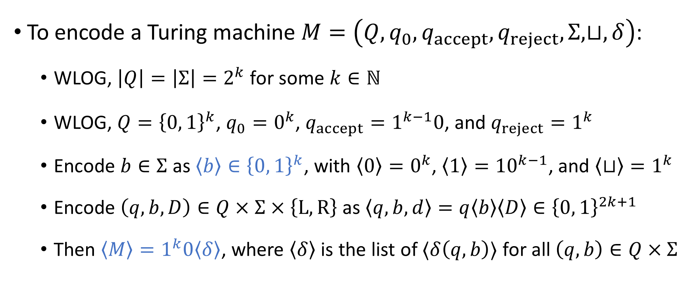
Encoding a Turing machine as a string
To encode a Turing machine $M=\left(Q,q_{0},q_{accept},q_{reject},Σ,⊔,δ\right)$:
WLOG, $\left|Q\right|=\left|Σ\right|=2^{k}$ for some $k∈ℕ$
WLOG, $Q={\left\{0, 1\right\}}^{k}$, $q_{0}=0^{k}$, $q_{accept}=1^{k−1}0$, and $q_{reject}=1^{k}$
Encode $b∈Σ$ as $\left\langle b\right\rangle ∈{\left\{0, 1\right\}}^{k}$, with $\left\langle 0\right\rangle =0^{k}$, $\left\langle 1\right\rangle ={10}^{k−1}$, and $\left\langle ⊔\right\rangle =1^{k}$
Encode $\left(q,b,D\right)∈Q×Σ×\left\{\text{L},\text{R}\right\}$ as $\left\langle q,b,d\right\rangle =q\left\langle b\right\rangle \left\langle D\right\rangle ∈{\left\{0, 1\right\}}^{2k+1}$
Then $\left\langle M\right\rangle =1^{k}0\left\langle δ\right\rangle$, where $\left\langle δ\right\rangle$ is the list of $⟨δ\left(q,b\right)⟩$ for all $\left(q,b\right)∈Q×Σ$

Slide 14
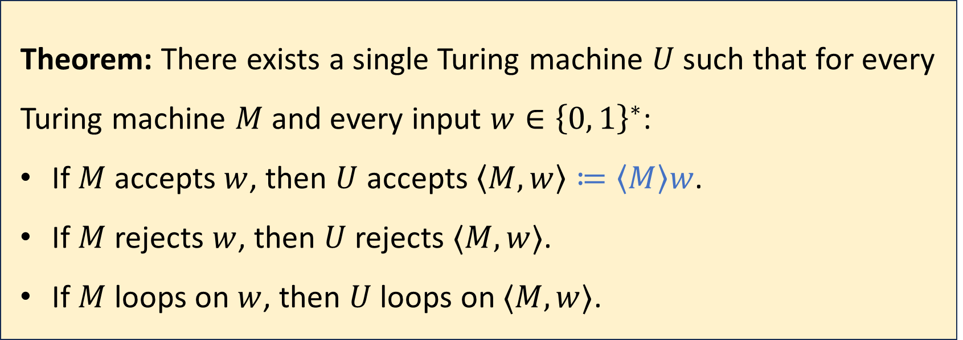
Universal Turing machines
Theorem: There exists a single Turing machine $U$ such that for every Turing machine $M$ and every input $w∈{\left\{0, 1\right\}}^{∗}$:
If $M$ accepts $w$, then $U$ accepts $\left\langle M,w\right\rangle ≔\left\langle M\right\rangle w$.
If $M$ rejects $w$, then $U$ rejects $⟨M,w⟩$.
If $M$ loops on $w$, then $U$ loops on $⟨M,w⟩$.
Proof sketch: Next two slides

Slide 15

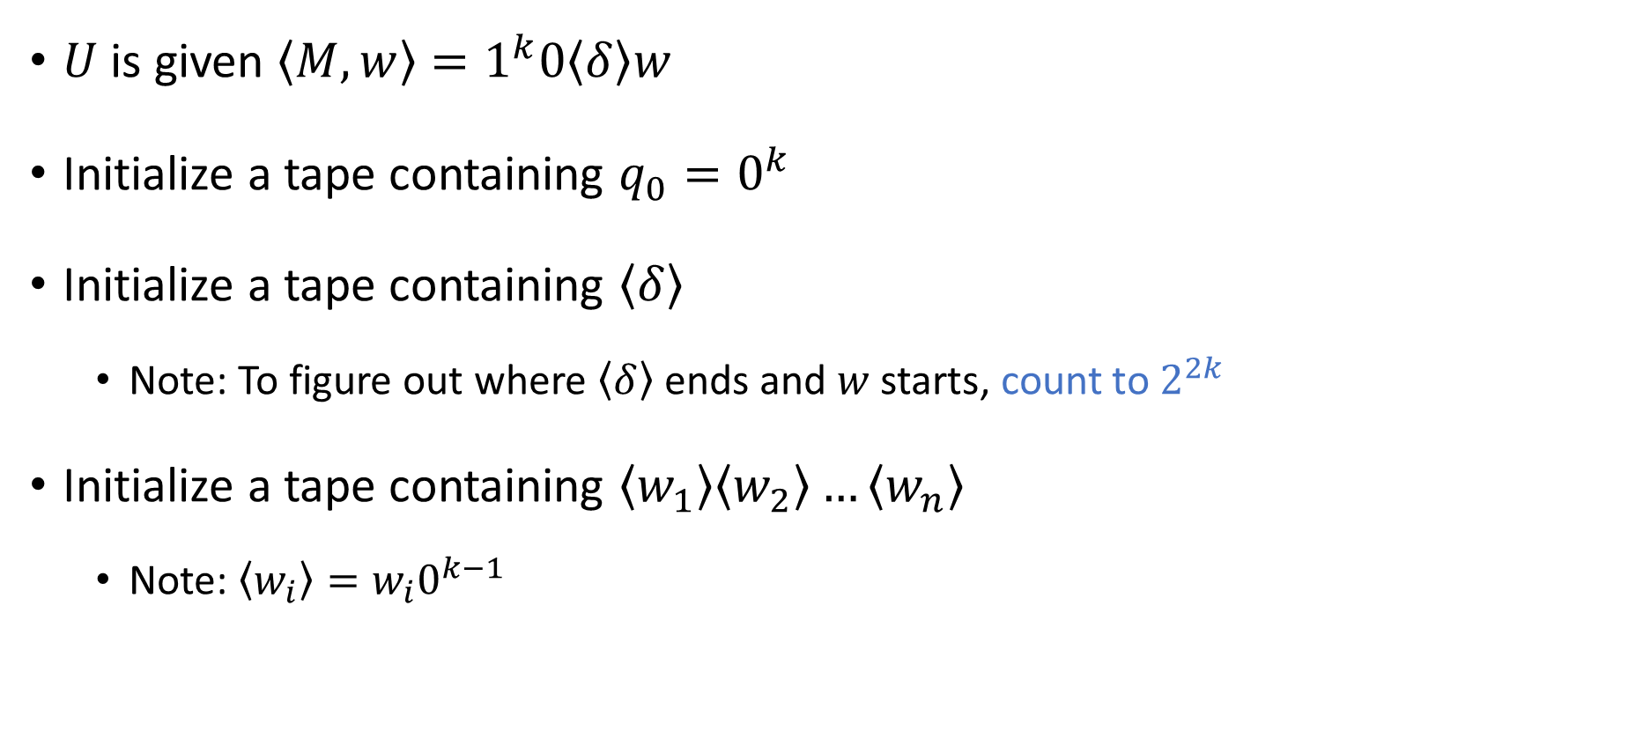



Initializing the simulation
$$1^{k}0\left\langle δ\right\rangle w$$
$$q_{0}$$
$U$ is given $\left\langle M,w\right\rangle =1^{k}0\left\langle δ\right\rangle w$
Initialize a tape containing $q_{0}=0^{k}$
Initialize a tape containing $\left\langle δ\right\rangle$
Note: To figure out where $\left\langle δ\right\rangle$ ends and $w$ starts, count to $2^{2k}$
Initialize a tape containing $\left\langle w_{1}\right\rangle \left\langle w_{2}\right\rangle …\left\langle w_{n}\right\rangle$
Note: $\left\langle w_{i}\right\rangle =w_{i}0^{k−1}$
$$\left\langle δ\right\rangle$$
$$\left\langle w_{1}\right\rangle \left\langle w_{2}\right\rangle …⟨w_{n}⟩$$

Slide 16

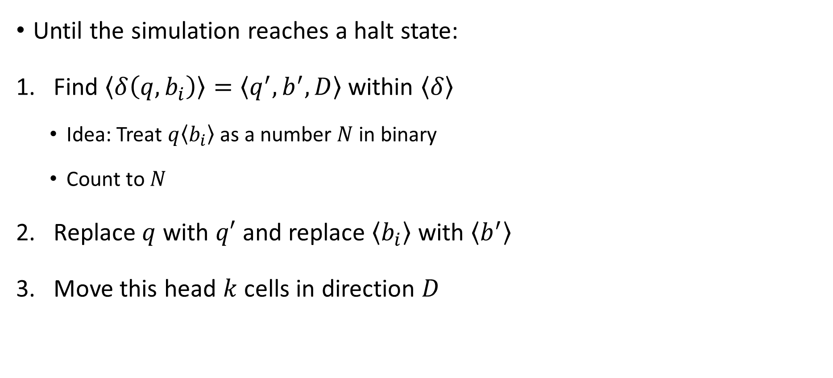



Advancing the simulation
$$1^{k}0\left\langle δ\right\rangle w$$
$$q$$
Until the simulation reaches a halt state:
Find $\left\langle δ\left(q,b_{i}\right)\right\rangle =\left\langle q^{′}, b^{′},D\right\rangle$ within $\left\langle δ\right\rangle$
Idea: Treat $q\left\langle b_{i}\right\rangle$ as a number $N$ in binary
Count to $N$
Replace $q$ with $q′$ and replace $\left\langle b_{i}\right\rangle$ with $\left\langle b^{′}\right\rangle$
Move this head $k$ cells in direction $D$
$$\left\langle δ\right\rangle$$
$$…\left\langle b_{i−2}\right\rangle \left\langle b_{i−1}\right\rangle \left\langle b_{i}\right\rangle \left\langle b_{i+1}\right\rangle \left\langle b_{i+2}\right\rangle …$$

Slide 17
Interpretation of universal Turing machines
A universal Turing machine can be “programmed” to do anything that is computationally possible
This is why you don’t need a separate laptop for each task
If you want to build a computer from scratch in some post-apocalyptic future, then your job is to build a universal Turing machine

Slide 18
The Church-Turing Thesis
Let $Y⊆{\left\{0, 1\right\}}^{∗}$
Church-Turing Thesis:
There exists an “algorithm” / “procedure” for figuring out whether a given string is in $Y$ if and only if there exists a Turing machine that decides $Y$.
Intuitive notion
Mathematically precise notion

Slide 19
Which problems can be solved through computation?

Slide 20
What are Turing machines capable of?

Slide 21
Which languages are decidable?

Slide 22
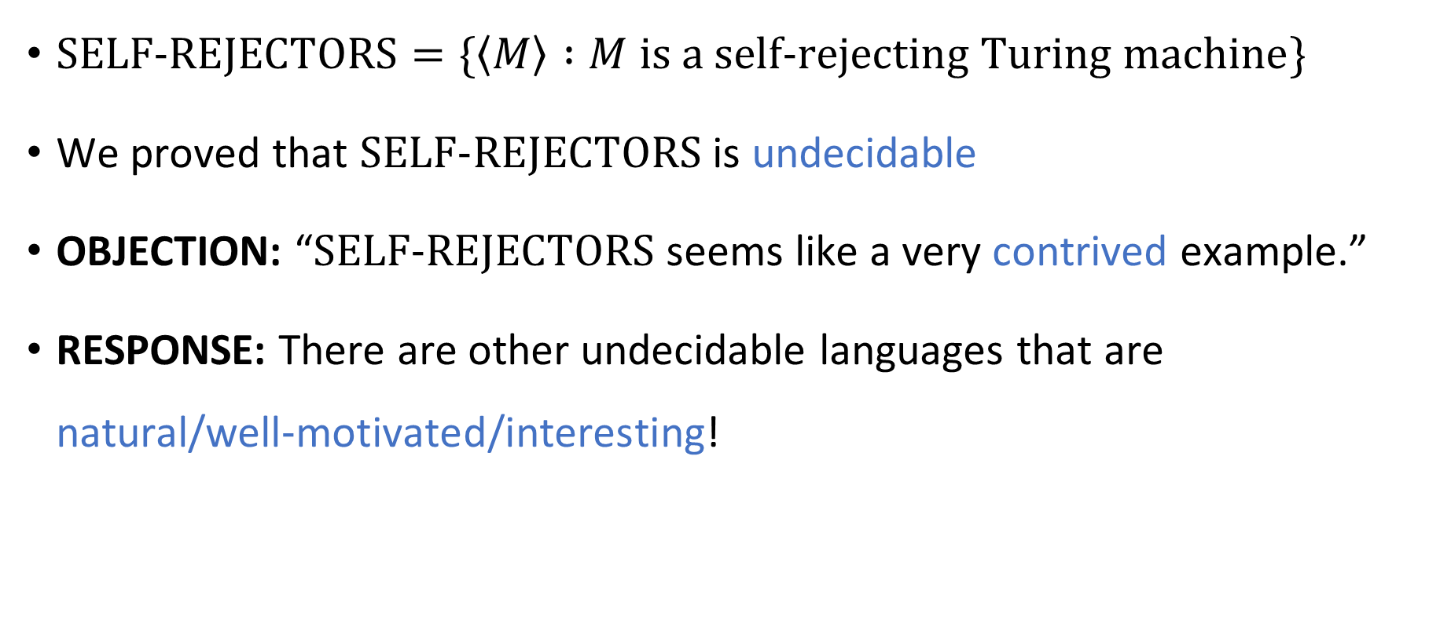
Contrived vs. natural
$\text{SELF}‑\text{REJECTORS}=\{\left\langle M\right\rangle :M \text{is} \text{a} \text{self}‑\text{rejecting} \text{Turing} \text{machine}\}$
We proved that $\text{SELF}‑\text{REJECTORS}$ is undecidable
OBJECTION: “$\text{SELF}‑\text{REJECTORS}$ seems like a very contrived example.”
RESPONSE: There are other undecidable languages that are natural/well‑motivated/interesting!

Slide 23
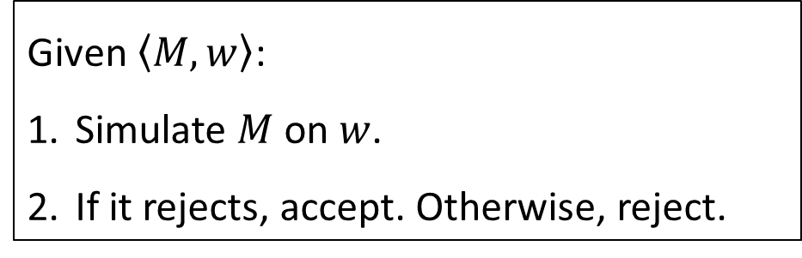

The rejection problem
Does the proposed algorithm successfully decide $\text{REJECT}$?
A: No. Step 1 isn’t legal, so the algorithm isn’t well-defined
B: No. Step 2 isn’t legal, so the algorithm isn’t well-defined
Informal problem statement: Given a Turing machine $M$ and an input $w$, determine whether $M$ rejects $w$.
The same problem, formulated as a language:
$$\text{REJECT}=\left\{\left\langle M,w\right\rangle :M \text{is} \text{a} \text{Turing} \text{machine} \text{that} \text{rejects} w\right\}$$
Attempted algorithm:
C: Yes
D: No. The algorithm behaves incorrectly in some cases
Respond at PollEv.com/whoza or text “whoza” to 22333
Given $\left\langle M,w\right\rangle$:
Simulate $M$ on $w$.
If it rejects, accept. Otherwise, reject.

Slide 24


The rejection problem is undecidable
$\text{REJECT}=\{\left\langle M,w\right\rangle :M \text{is} \text{a} \text{Turing} \text{machine} \text{that} \text{rejects} w\}$
How should we prove it?
Theorem: $\text{REJECT}$ is undecidable.

Slide 25

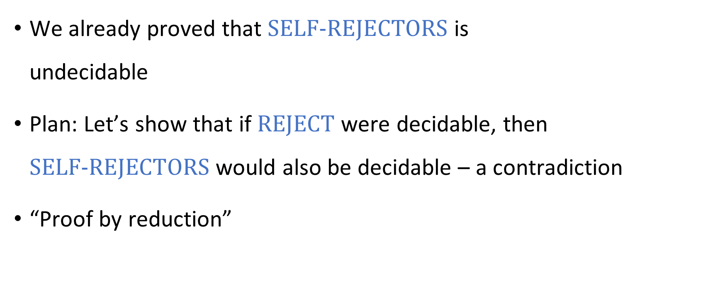
Reductions
We already proved that $\text{SELF}‑\text{REJECTORS}$ is undecidable
Plan: Let’s show that if $\text{REJECT}$ were decidable, then $\text{SELF}‑\text{REJECTORS}$ would also be decidable – a contradiction
“Proof by reduction”

Slide 26





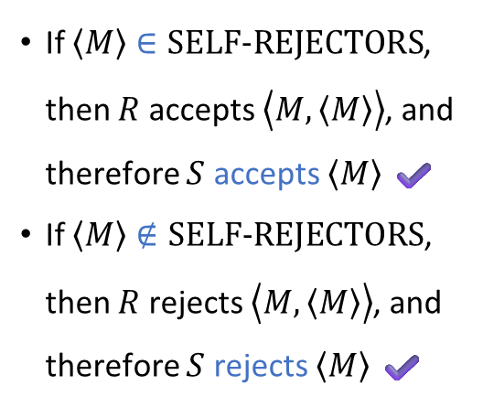
Proof that $\text{REJECT}$ is undecidable
Assume for the sake of contradiction that there is some Turing machine $R$ that decides $\text{REJECT}$
Let’s construct a new TM $S$ that decides $\text{SELF}‑\text{REJECTORS}$
Given the input $\left\langle M\right\rangle$:
“Copy and paste” to construct the string $\left\langle M, \left\langle M\right\rangle \right\rangle$
Simulate $R$ on $\left\langle M,\left\langle M\right\rangle \right\rangle$
If $R$ accepts, accept. If $R$ rejects, reject.
If $\left\langle M\right\rangle ∈\text{SELF}‑\text{REJECTORS}$, then $R$ accepts $\left\langle M,\left\langle M\right\rangle \right\rangle$, and therefore $S$ accepts $\left\langle M\right\rangle$ ✔️
If $\left\langle M\right\rangle ∉\text{SELF}‑\text{REJECTORS}$, then $R$ rejects $\left\langle M,\left\langle M\right\rangle \right\rangle$, and therefore $S$ rejects $\left\langle M\right\rangle$ ✔️
$$S$$

