Slide 1
Analysis of Boolean Functions
Autumn 2025
Course Summary & Review
Instructor: William Hoza
The University of Chicago

Slide 2
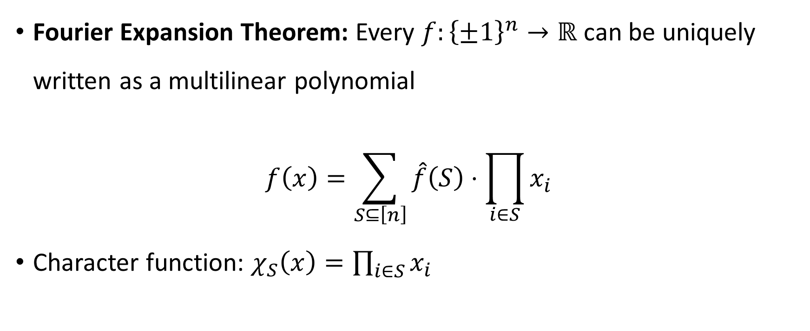
Fourier expansion
Fourier Expansion Theorem: Every $f:{\left\{±1\right\}}^{n}→ℝ$ can be uniquely written as a multilinear polynomial
$$f\left(x\right)=\sum_{S⊆\left[n\right]}{\hat{f}\left(S\right)⋅\prod_{i∈S}{x_{i}}}$$
Character function: $χ_{S}\left(x\right)=\prod_{i∈S}{x_{i}}$

Slide 3
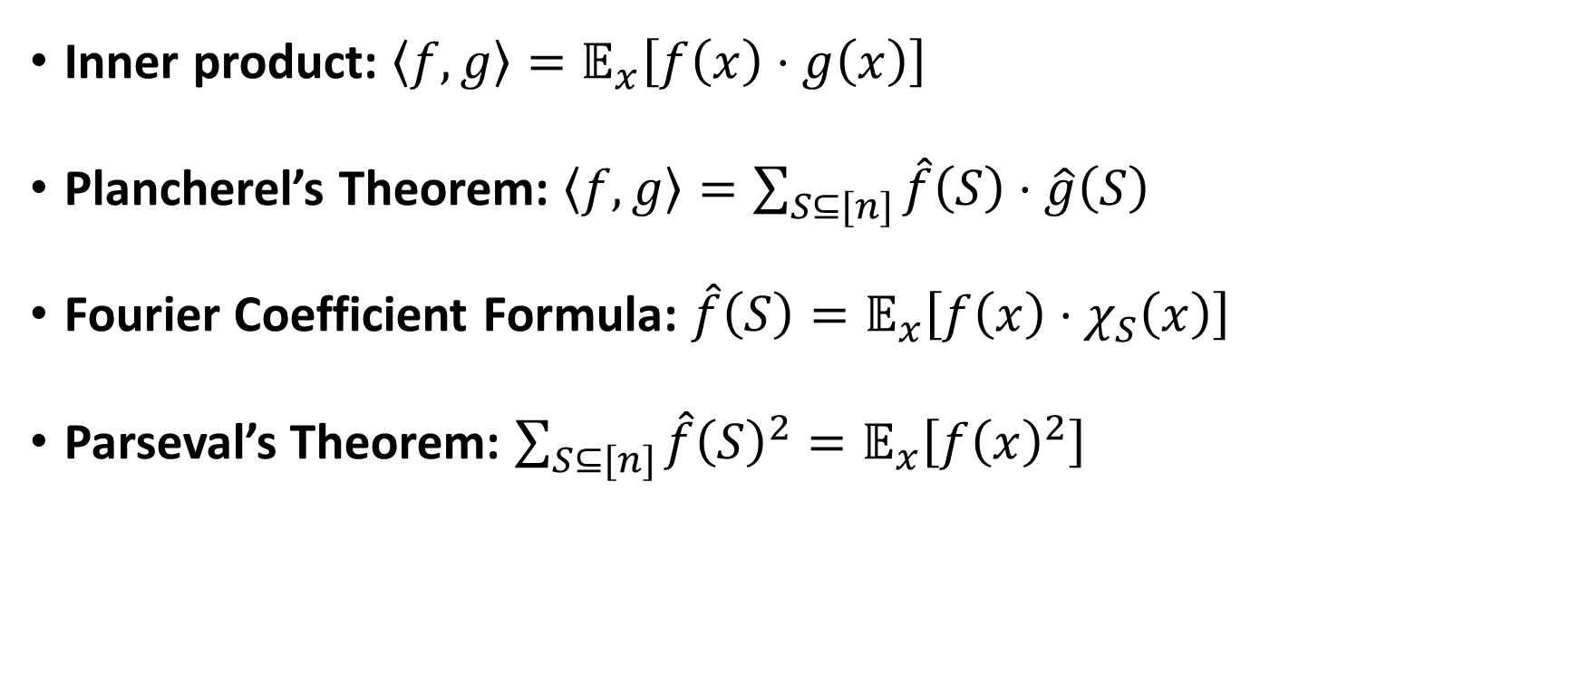
Inner product space of functions
Inner product: $\left\langle f,g\right\rangle =𝔼_{x}\left[f\left(x\right)⋅g\left(x\right)\right]$
Plancherel’s Theorem: $\left\langle f,g\right\rangle =\sum_{S⊆[n]}{\hat{f}\left(S\right)⋅\hat{g}\left(S\right)}$
Fourier Coefficient Formula: $\hat{f}\left(S\right)=𝔼_{x}\left[f\left(x\right)⋅χ_{S}\left(x\right)\right]$
Parseval’s Theorem: $\sum_{S⊆[n]}{\hat{f}{\left(S\right)}^{2}}=𝔼_{x}\left[f{\left(x\right)}^{2}\right]$

Slide 4

Interpreting the Fourier spectrum
$𝔼\left[f\right]=\hat{f}\left(∅\right)$
$\text{Var}\left[f\right]=\sum_{S≠∅}{\hat{f}{\left(S\right)}^{2}}$
If $f:\{±1\}^{n}→\{±1\}$, then $\hat{f}\left(S\right)=1−2⋅\text{dist}\left(f,χ_{S}\right)$

Slide 5
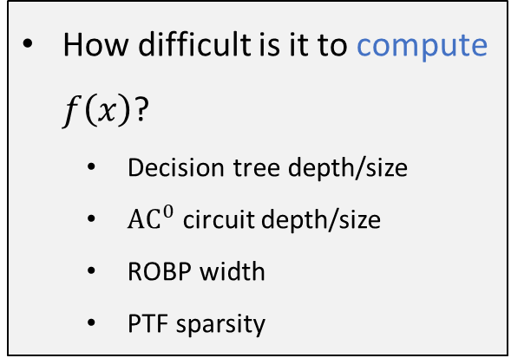
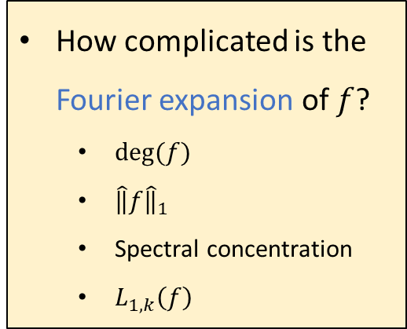
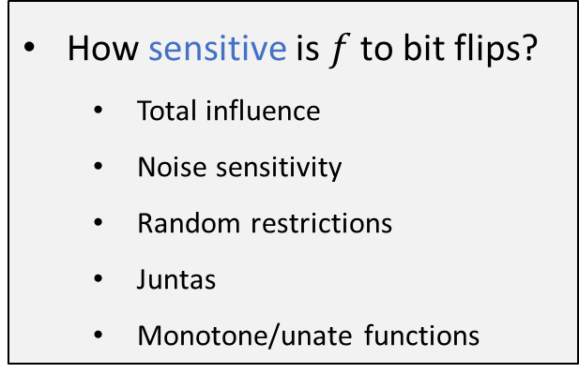
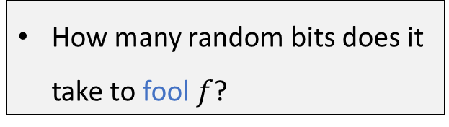
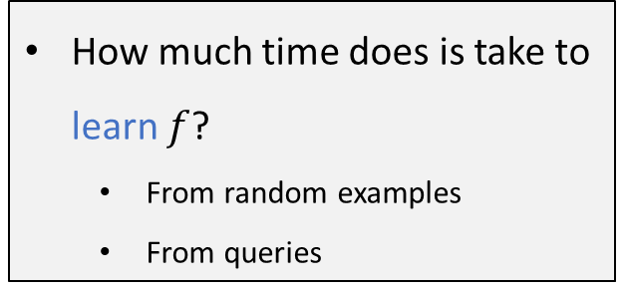
Complexity measures
How much time does is take to learn $f$?
  From random examples
  From queries
How difficult is it to compute $f\left(x\right)$?
  Decision tree depth/size
  ${\text{AC}}^{0}$ circuit depth/size
  ROBP width
  PTF sparsity
How complicated is the Fourier expansion of $f$?
  $deg⁡(f)$
  $\hat{‖}f{\hat{‖}}_{1}$
  Spectral concentration
  $L_{1,k}\left(f\right)$
How sensitive is $f$ to bit flips?
  Total influence
  Noise sensitivity
  Random restrictions
  Juntas
  Monotone/unate functions
How many random bits does it take to fool $f$?

Slide 6

Monotonicity
Simplification under random restrictions
Fourier 1-norm bound
Total influence bound
Noise sensitivity bound
Spectral concentration
Fourier growth bound
Learnability
PRG

Slide 7
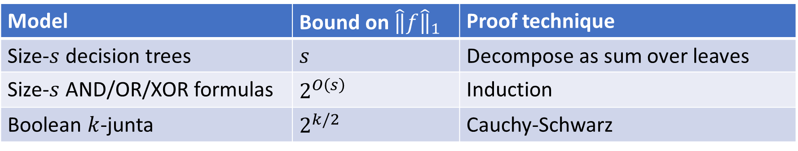

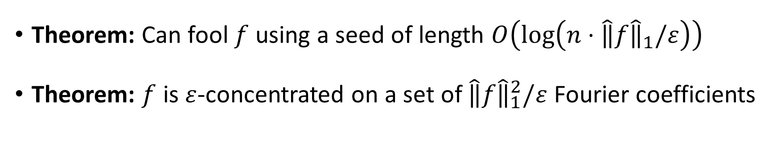
Fourier $1$-norm: $\hat{‖}f{\hat{‖}}_{1}=\sum_{S}{\left|\hat{f}\left(S\right)\right|}$
Model | Bound on $\hat{‖}f{\hat{‖}}_{1}$ | Proof technique
Size-$s$ decision trees | $s$ | Decompose as sum over leaves
Size-$s$ AND/OR/XOR formulas | $2^{O\left(s\right)}$ | Induction
Boolean $k$-junta | $2^{k/2}$ | Cauchy-Schwarz
Theorem: Can fool $f$ using a seed of length $O\left(\log\left(n⋅\hat{‖}f{\hat{‖}}_{1}/ε\right)\right)$
Theorem: $f$ is $ε$-concentrated on a set of $\hat{‖}f{\hat{‖}}_{1}^{2}/ε$ Fourier coefficients

Slide 8
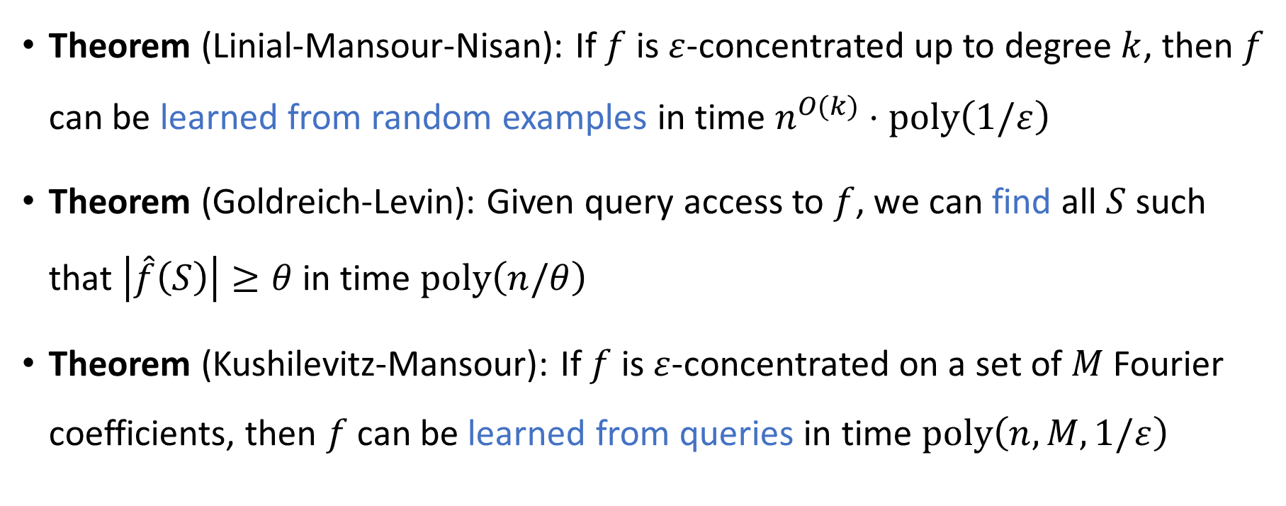


Concentration $⇒$ Learnability
$$f$$
Theorem (Linial-Mansour-Nisan): If $f$ is $ε$-concentrated up to degree $k$, then $f$ can be learned from random examples in time $n^{O(k)}⋅\text{poly}\left(1/ε\right)$
Theorem (Goldreich-Levin): Given query access to $f$, we can find all $S$ such that $\left|\hat{f}\left(S\right)\right|≥θ$ in time $\text{poly}\left(n/θ\right)$
Theorem (Kushilevitz-Mansour): If $f$ is $ε$-concentrated on a set of $M$ Fourier coefficients, then $f$ can be learned from queries in time $\text{poly}\left(n,M,1/ε\right)$

Slide 9
Monotonicity
Simplification under random restrictions
Fourier 1-norm bound
Total influence bound
Noise sensitivity bound
Spectral concentration
Fourier growth bound
Learnability
PRG

Slide 10
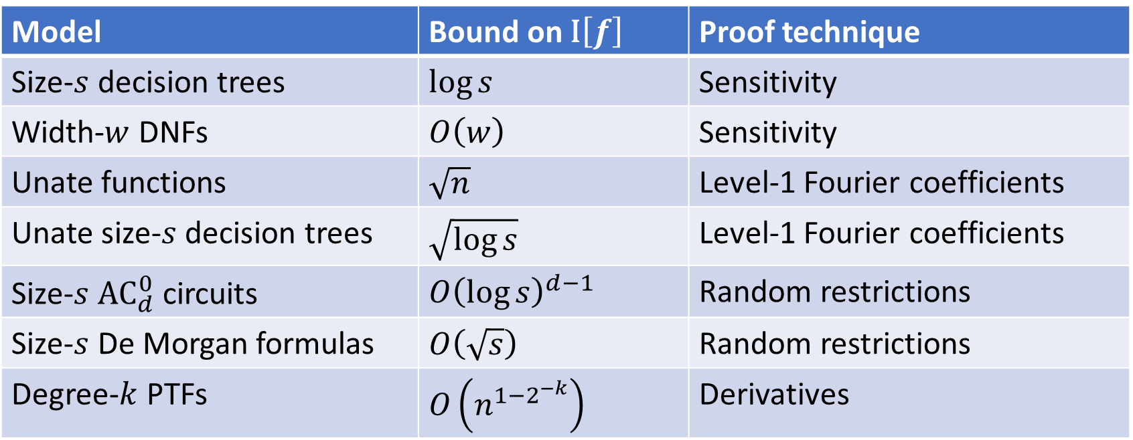
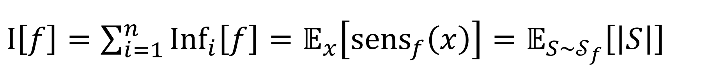
$\text{I}\left[f\right]=\sum_{i=1}^{n}{{\text{Inf}}_{i}\left[f\right]}=𝔼_{x}\left[{\text{sens}}_{f}\left(x\right)\right]=𝔼_{S∼𝒮_{f}}\left[\left|S\right|\right]$
Model | Bound on $\text{I}\left[f\right]$ | Proof technique
Size-$s$ decision trees | $\log{s}$ | Sensitivity
Width-$w$ DNFs | $O\left(w\right)$ | Sensitivity
Unate functions | $\sqrt{n}$ | Level-1 Fourier coefficients
Unate size-$s$ decision trees | $\sqrt{\log{s}}$ | Level-1 Fourier coefficients
Size-$s$ ${\text{AC}}_{d}^{0}$ circuits | $O{\left(\log{s}\right)}^{d−1}$ | Random restrictions
Size-$s$ De Morgan formulas | $O\left(\sqrt{s}\right)$ | Random restrictions
Degree-$k$ PTFs | $O\left(n^{1−2^{−k}}\right)$ | Derivatives

Slide 11
Monotonicity
Simplification under random restrictions
Fourier 1-norm bound
Total influence bound
Noise sensitivity bound
Spectral concentration
Fourier growth bound
Learnability
PRG

Slide 12
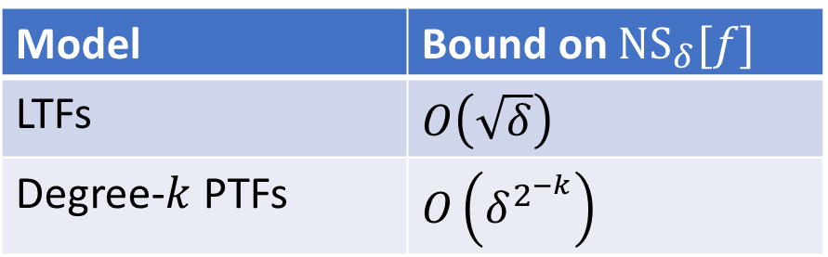

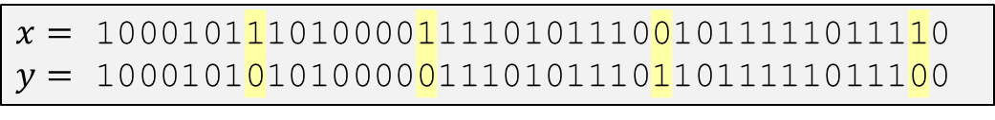
Noise sensitivity
$x=$ 1000101110100001111010111001011111011110
$y=$ 1000101010100000111010111011011111011100
${\text{NS}}_{δ}\left[f\right]=\operatorname{Pr}\left[f\left(x\right)≠f\left(y\right)\right]$, where $x$ is uniform and $y_{i}=−x_{i}$ with prob $δ$
Theorem: $f$ is $O\left({\text{NS}}_{1/k}\left[f\right]\right)$-concentrated up to degree $k$
Model | Bound on ${\text{NS}}_{δ}[f]$
LTFs | $O\left(\sqrt{δ}\right)$
Degree-$k$ PTFs | $O\left(δ^{2^{−k}}\right)$

Slide 13
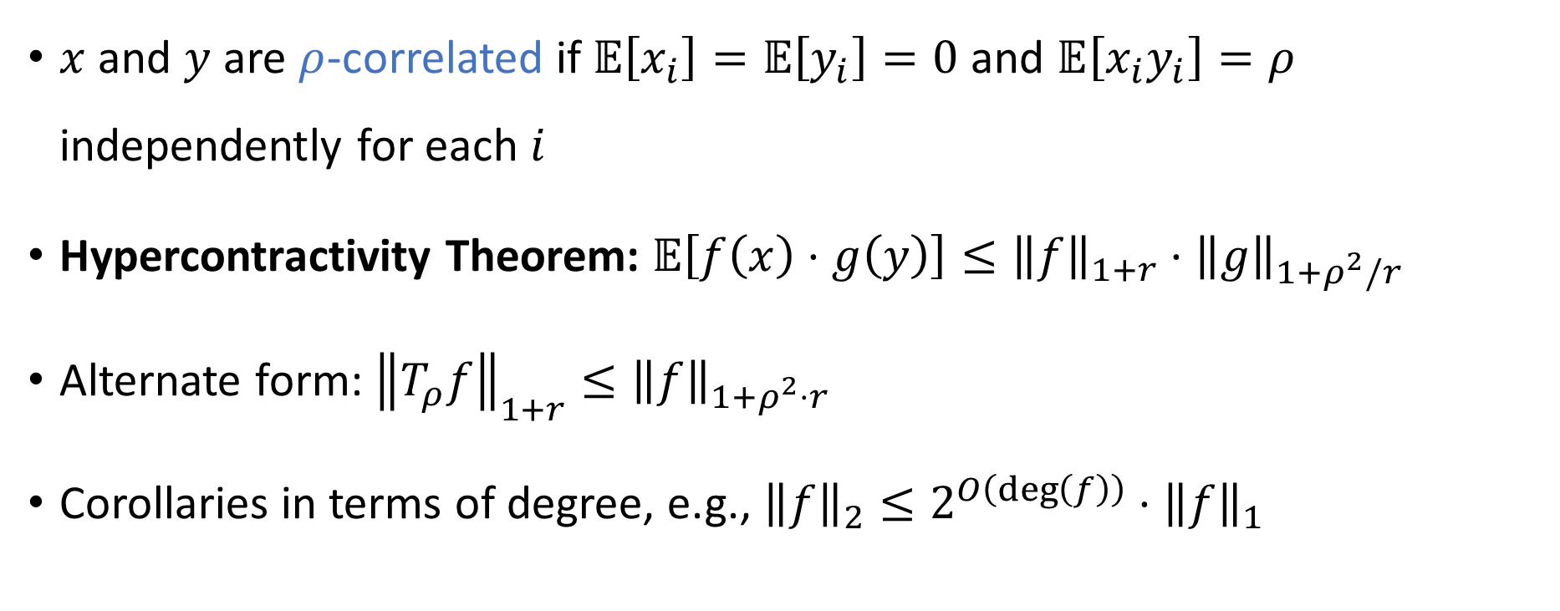
Hypercontractivity
$x=$ 1000101110100001111010111001011111011110
$y=$ 1000101010100000111010111011011111011100
$x$ and $y$ are $ρ$-correlated if $𝔼\left[x_{i}\right]=𝔼\left[y_{i}\right]=0$ and $𝔼\left[x_{i}y_{i}\right]=ρ$ independently for each $i$
Hypercontractivity Theorem: $𝔼\left[f\left(x\right)⋅g\left(y\right)\right]≤{\left\|f\right\|}_{1+r}⋅{\left\|g\right\|}_{1+ρ^{2}/r}$
Alternate form: ${\left\|T_{ρ}f\right\|}_{1+r}≤{\left\|f\right\|}_{1+ρ^{2}⋅r}$
Corollaries in terms of degree, e.g., ${\left\|f\right\|}_{2}≤2^{O\left(\deg\left(f\right)\right)}⋅{\left\|f\right\|}_{1}$

Slide 14

Friedgut’s junta theorem
Let $f:\{±1\}^{n}→\{±1\}$
Friedgut’s Junta Theorem: $f$ is close to a $k$-junta where $k=2^{O\left(I\left[f\right]\right)}$

Slide 15

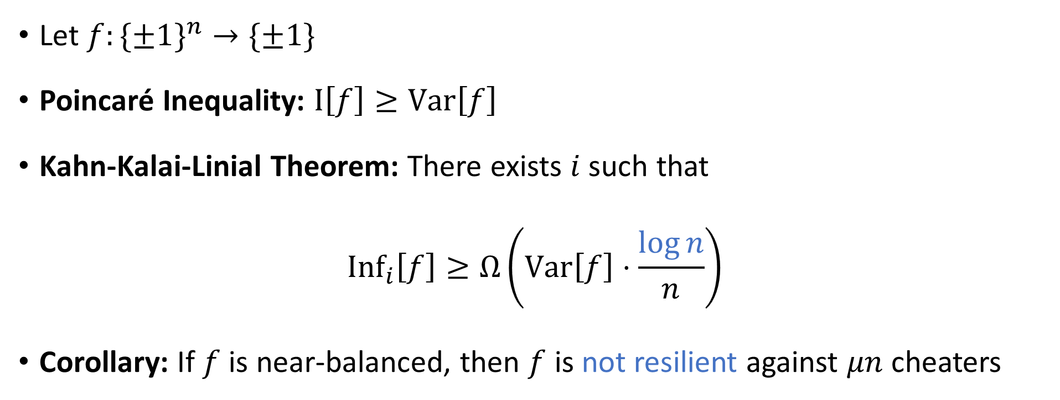
Collective coin flipping
🙂
🙂
😈
🙂
Let $f:\{±1\}^{n}→\{±1\}$
Poincaré Inequality: $\text{I}\left[f\right]≥\text{Var}\left[f\right]$
Kahn-Kalai-Linial Theorem: There exists $i$ such that
$${\text{Inf}}_{i}\left[f\right]≥Ω\left(\text{Var}\left[f\right]⋅\frac{\log{n}}{n}\right)$$
Corollary: If $f$ is near-balanced, then $f$ is not resilient against $μn$ cheaters
🙂
Heads/Tails

Slide 16
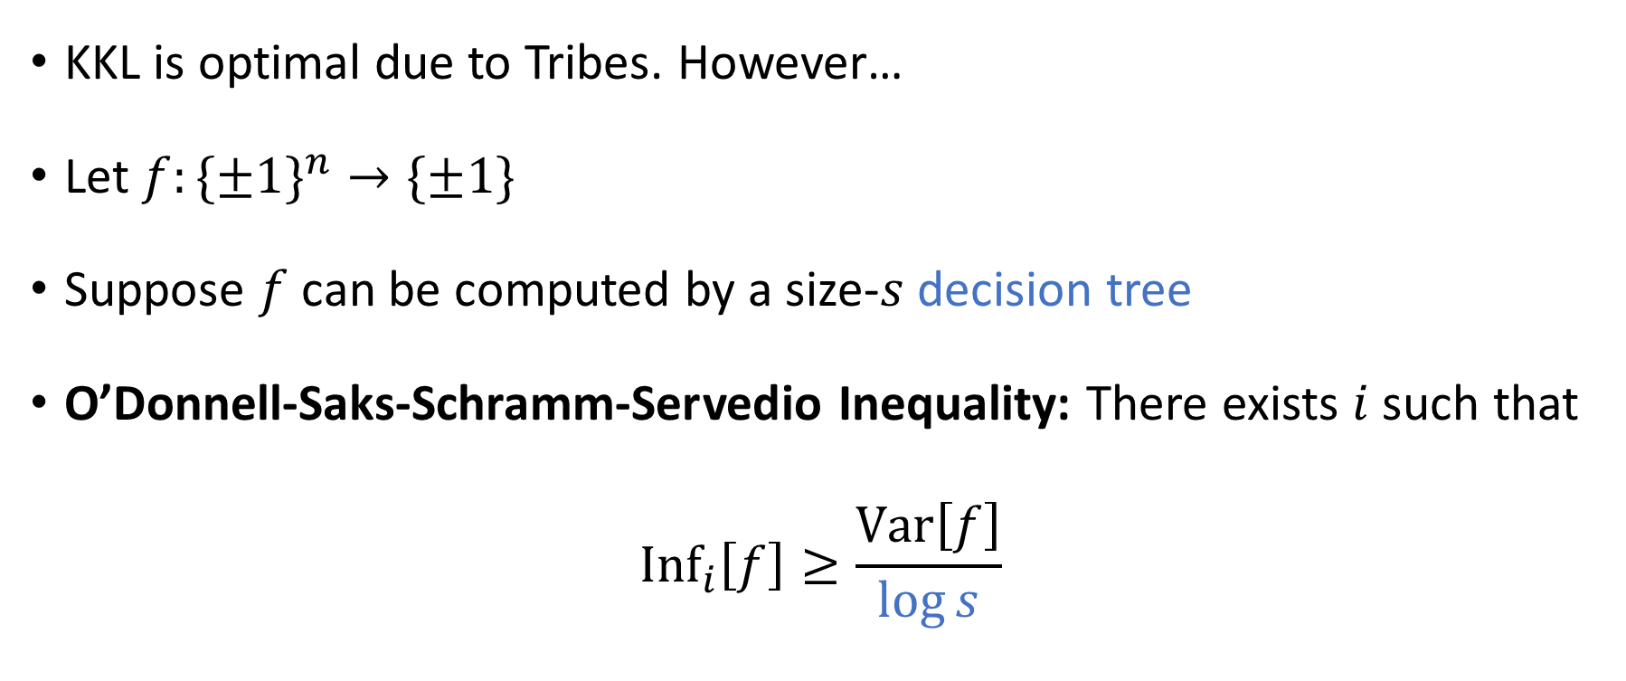
Collective coin flipping
🙂
🙂
😈
🙂
KKL is optimal due to Tribes. However…
Let $f:\{±1\}^{n}→\{±1\}$
Suppose $f$ can be computed by a size-$s$ decision tree
O’Donnell-Saks-Schramm-Servedio Inequality: There exists $i$ such that
$${\text{Inf}}_{i}\left[f\right]≥\frac{\text{Var}\left[f\right]}{\log{s}}$$
🙂
Heads/Tails

Slide 17



Collective coin flipping
🙂
🙂
😈
🙂
Hypercontractivity
🙂
$$⇒$$
Heads/Tails
Friedgut’s Junta Theorem
$$⇒$$
KKL Theorem
OSSS Inequality
$$⇒$$
Limitations of Resilient Functions

Slide 18
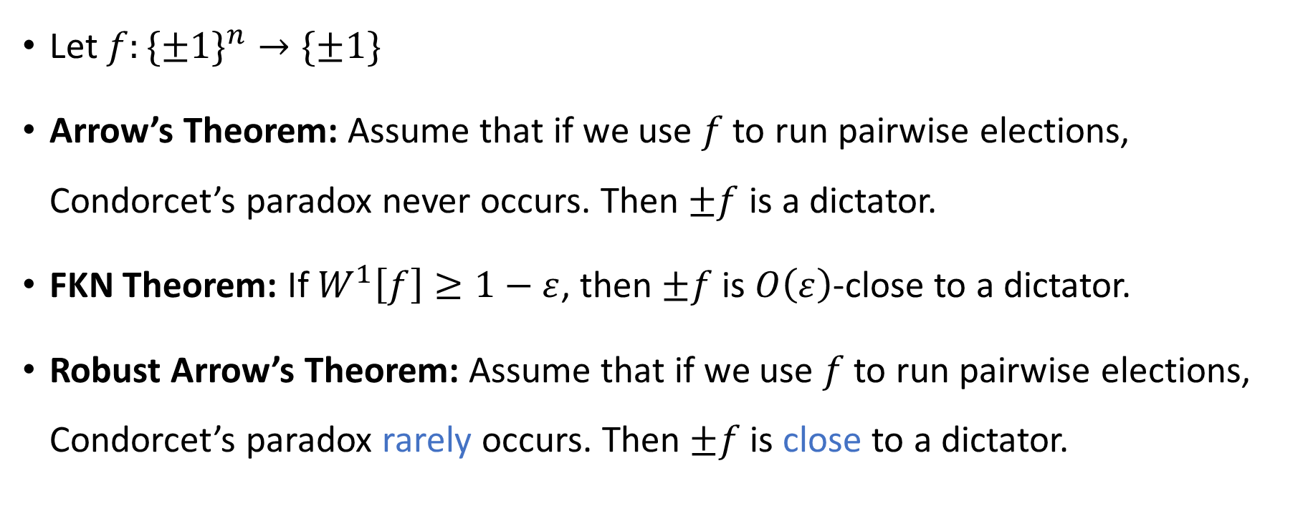
Arrow’s theorem
🗳️
Let $f:\{±1\}^{n}→\{±1\}$
Arrow’s Theorem: Assume that if we use $f$ to run pairwise elections, Condorcet’s paradox never occurs. Then $±f$ is a dictator.
FKN Theorem: If $W^{1}\left[f\right]≥1−ε$, then $±f$ is $O\left(ε\right)$-close to a dictator.
Robust Arrow’s Theorem: Assume that if we use $f$ to run pairwise elections, Condorcet’s paradox rarely occurs. Then $±f$ is close to a dictator.

Slide 19

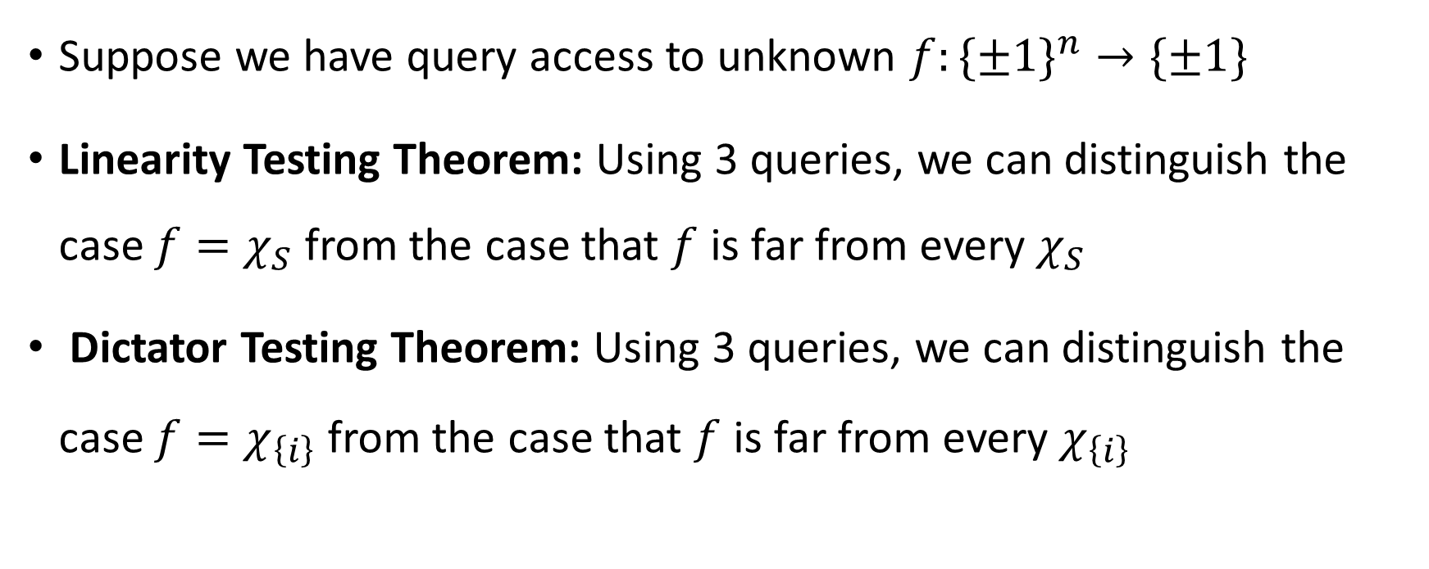
Property testing
Suppose we have query access to unknown $f:\{±1\}^{n}→\{±1\}$
Linearity Testing Theorem: Using 3 queries, we can distinguish the case $f=χ_{S}$ from the case that $f$ is far from every $χ_{S}$
Dictator Testing Theorem: Using 3 queries, we can distinguish the case $f=χ_{\left\{i\right\}}$ from the case that $f$ is far from every $χ_{\left\{i\right\}}$

Slide 20
Monotonicity
Simplification under random restrictions
Fourier 1-norm bound
Total influence bound
Noise sensitivity bound
Spectral concentration
Fourier growth bound
Learnability
PRG

Slide 21
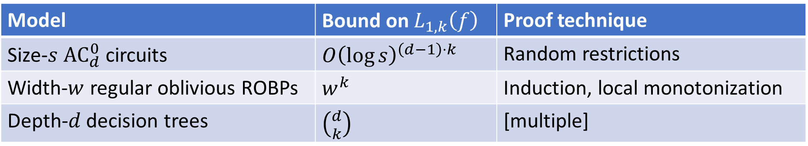

Fourier growth: $L_{1,k}\left(f\right)=\sum_{\left|S\right|=k}{\left|\hat{f}\left(S\right)\right|}$
Model | Bound on $L_{1,k}\left(f\right)$ | Proof technique
Size-$s$ ${\text{AC}}_{d}^{0}$ circuits | $O{\left(\log{s}\right)}^{\left(d−1\right)⋅k}$ | Random restrictions
Width-$w$ regular oblivious ROBPs | $w^{k}$ | Induction, local monotonization
Depth-$d$ decision trees | $\left({d \atop k}\right)$ | [multiple]
Note: Fourier growth bounds do not imply spectral concentration
This can be a good thing!

Slide 22

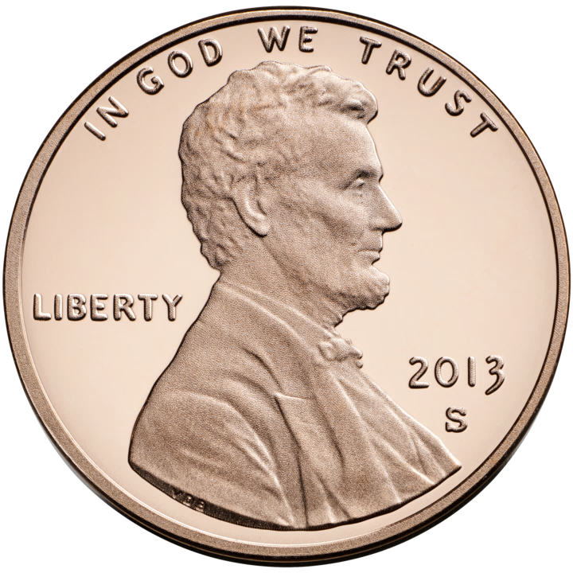

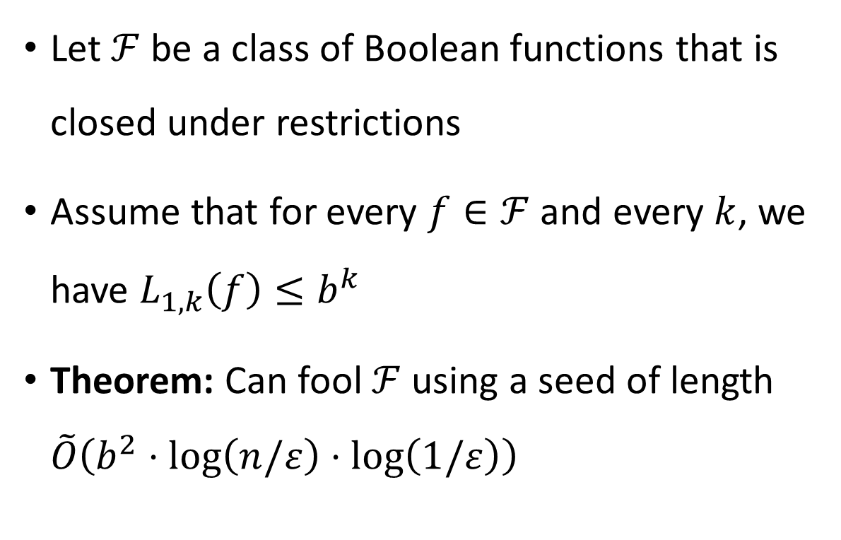

Fourier growth bound $⇒$ PRG
$$G$$
Let $ℱ$ be a class of Boolean functions that is closed under restrictions
Assume that for every $f∈ℱ$ and every $k$, we have $L_{1,k}\left(f\right)≤b^{k}$
Theorem: Can fool $ℱ$ using a seed of length $\tilde{O}\left(b^{2}⋅\log\left(n/ε\right)⋅\log\left(1/ε\right)\right)$

Slide 23

A few of the many topics we didn’t discuss
Gaussian space and the invariance principle
$p$-biased Fourier analysis
Threshold phenomena
Expansion of noisy hypercube

Slide 24
Property Testing
Social Choice and Voting
Pseudorandom
Generators
Analysis of Boolean Functions
Learning Theory
Cryptography
Neural Networks
Distributed Computing
Circuit Complexity

Slide 25

Thank you!
The End
Being your instructor has been a privilege
I look forward to reading your expositions
Please fill out the Graduate Course Feedback Form using My.UChicago (deadline is Sunday, December 14)

