Slide 1
CMSC 28100 Introduction to Complexity Theory Winter 2024 Instructor: William Hoza
7 |  |  |  |  |  |  | 5 | 3
 |  |  |  |  |  |  |  | 4
 | 4 | 8 |  | 3 |  | 1 | 2
8 |  | 1 | 3 |  |  | 2 | 7 | 5
 | 9 |  | 1 |  |  |  | 4
 | 5 |  |  |  |  | 3
2 |  | 5 |  | 8 | 4
1 | 3 | 4 |  | 5

Slide 2

Secure communication
Public communication channel
😈
How can Bob send a private message to Alice?
E.g., credit card number
It seems impossible, because Alice and Eve receive all the same information from Bob!
A clever approach: Try to force Eve to solve an intractable problem
Online
store
Customer
Eve
Alice
Bob

Slide 3
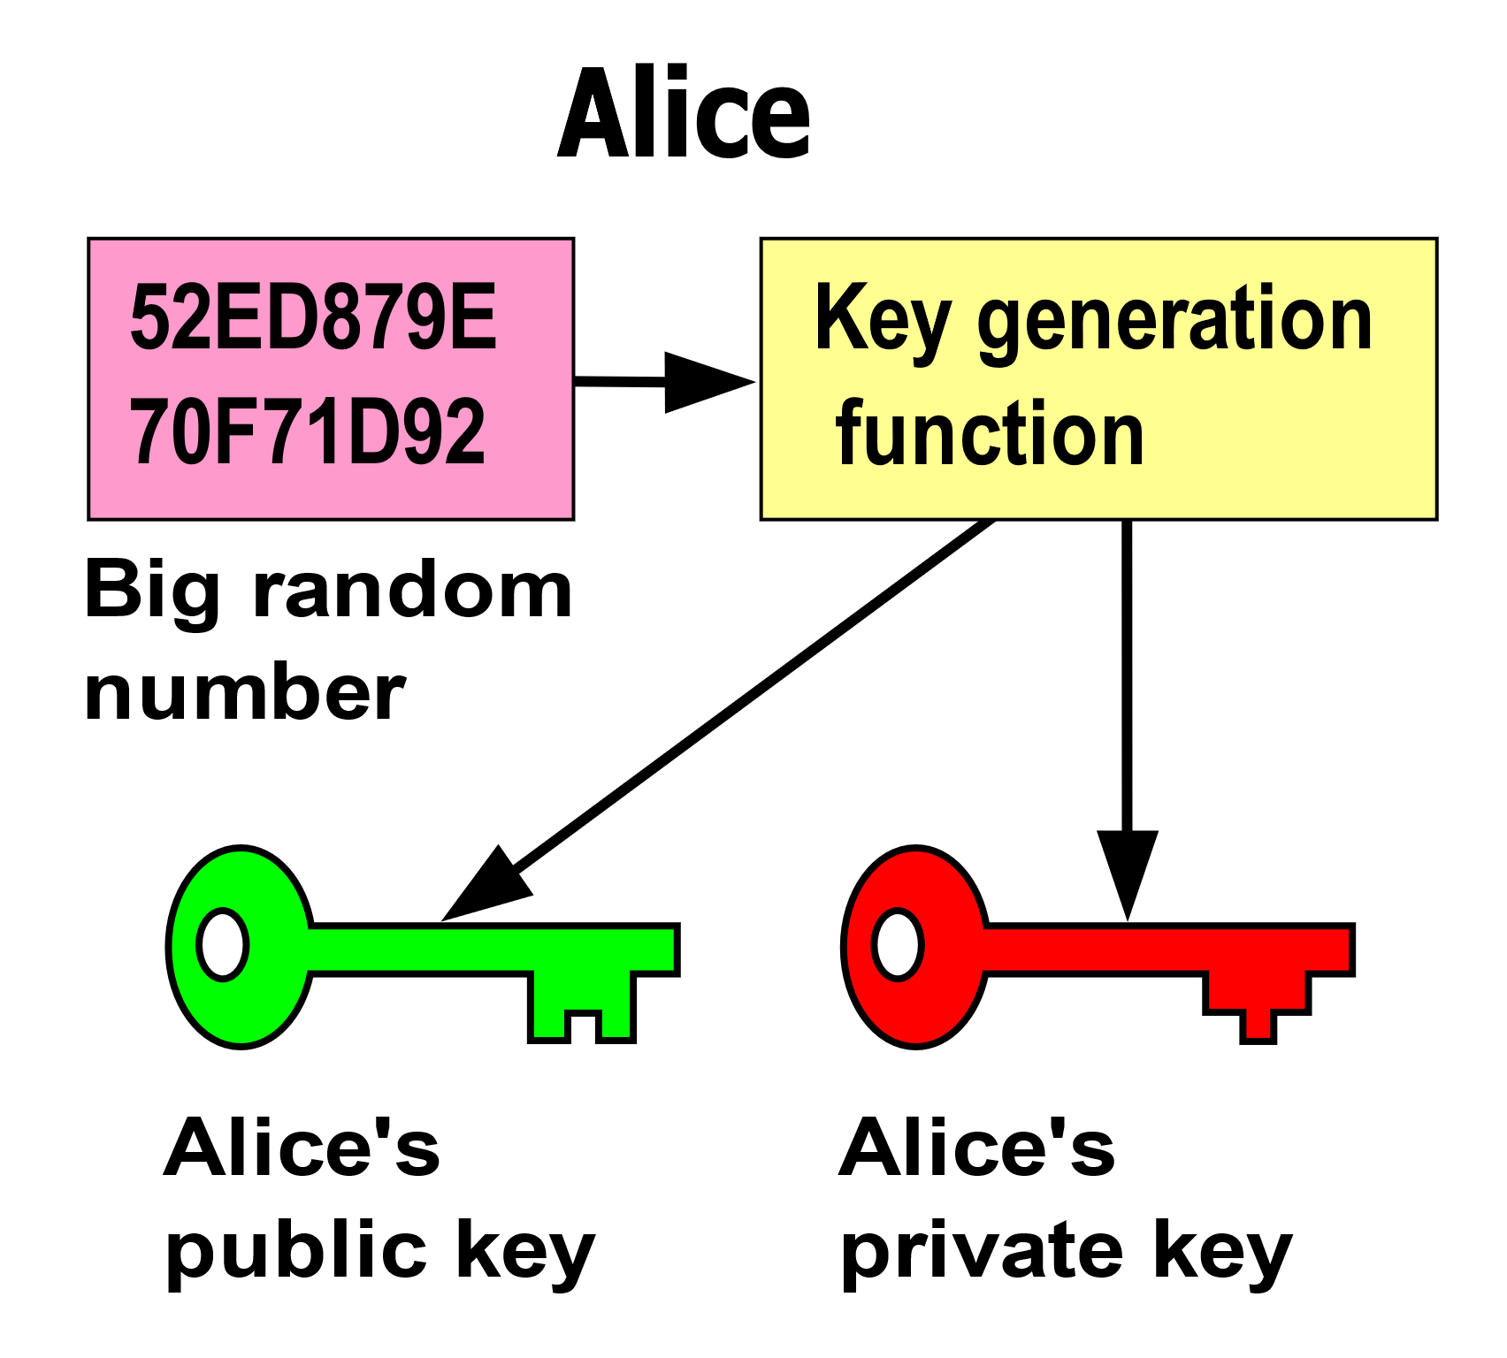
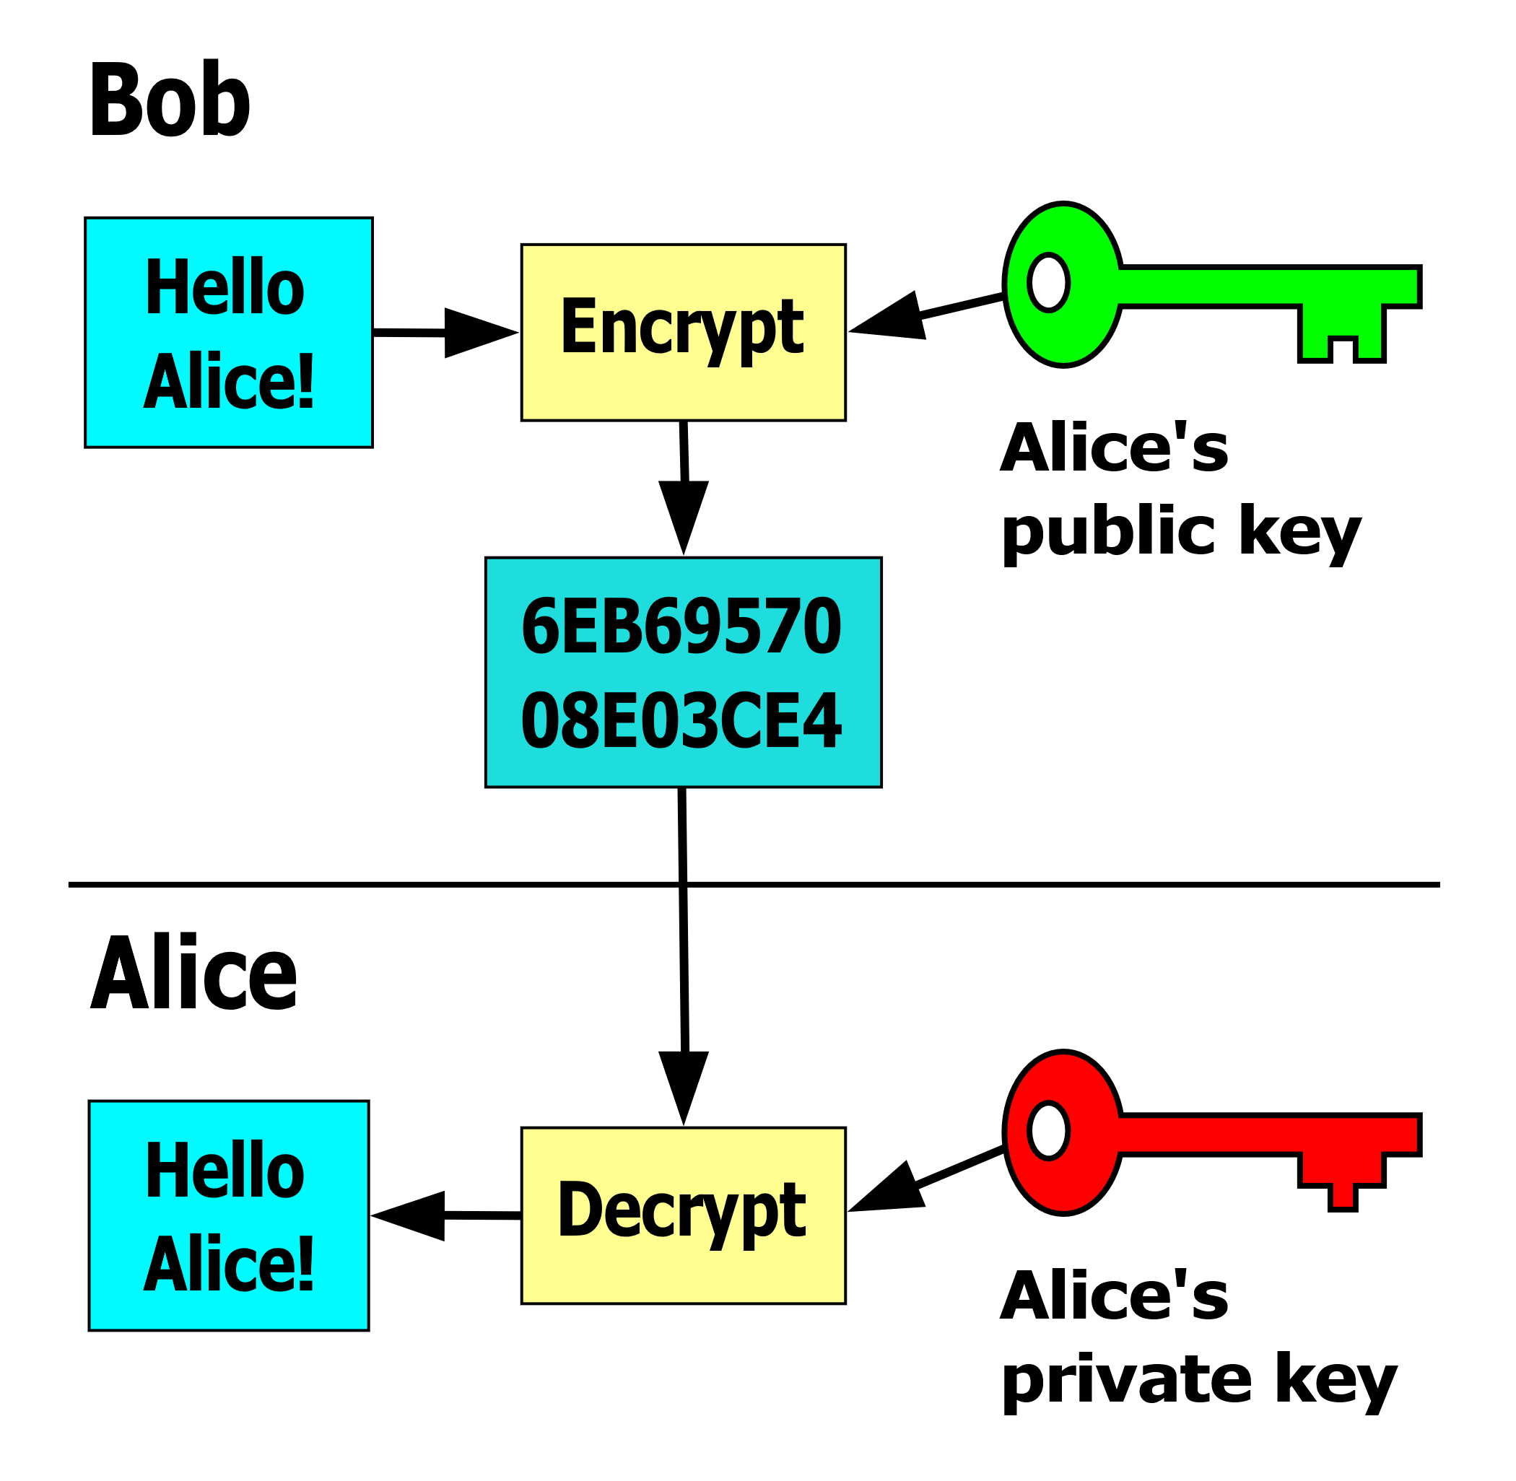
Public-key encryption
Alice’s advantage over Eve: Alice knows the private key and Eve doesn’t

Slide 4
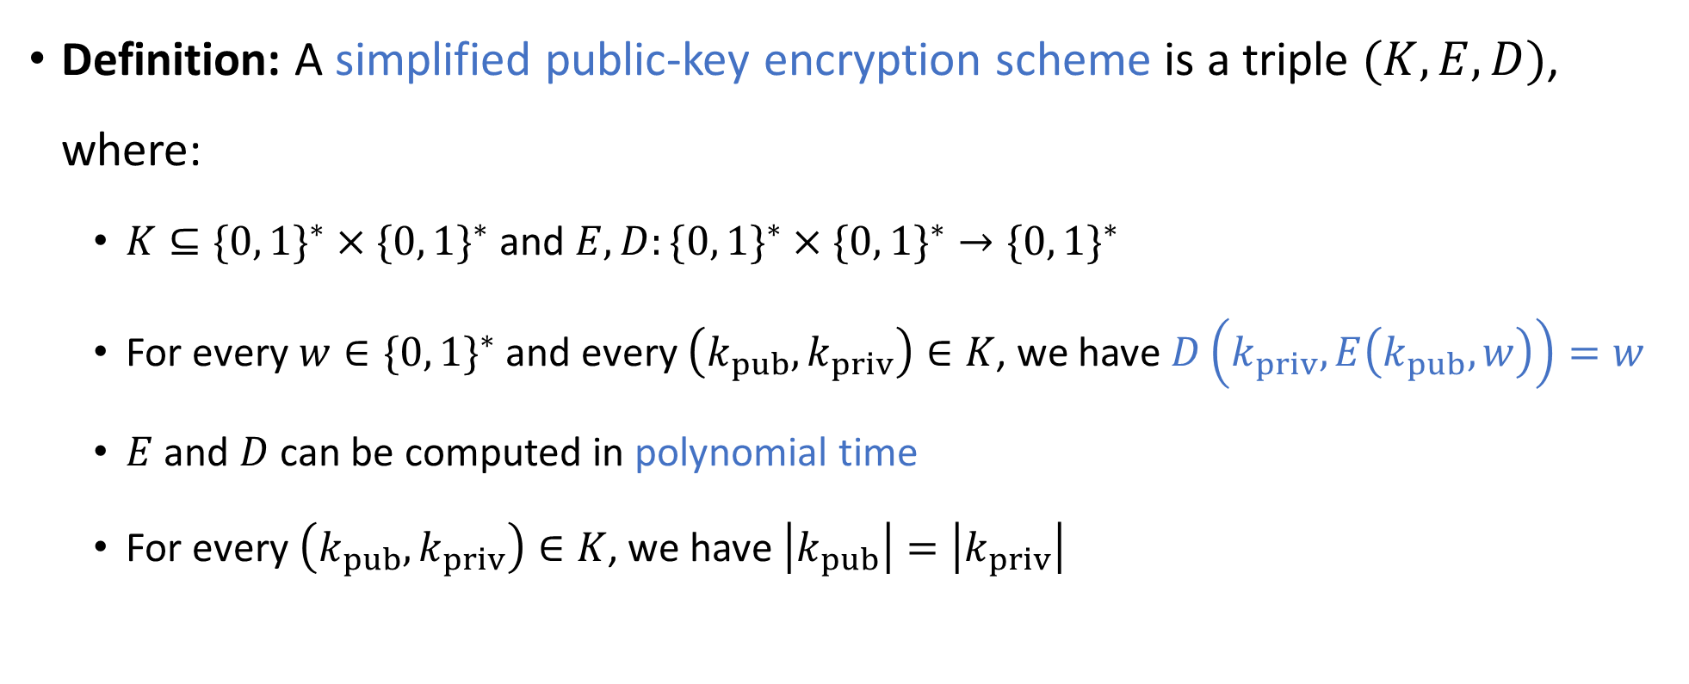
Public-key encryption scheme
“encrypt”
“keys”
“decrypt”
Definition: A simplified public-key encryption scheme is a triple $(K,E,D)$, where:
$K⊆\{0, 1\}^{∗}×\{0, 1\}^{∗}$ and $E,D:\{0, 1\}^{∗}×\{0, 1\}^{∗}→\{0, 1\}^{∗}$
For every $w∈\{0, 1\}^{∗}$ and every $\left(k_{pub},k_{priv}\right)∈K$, we have $D\left(k_{priv},E\left(k_{pub},w\right)\right)=w$
$E$ and $D$ can be computed in polynomial time
For every $\left(k_{pub},k_{priv}\right)∈K$, we have $\left|k_{pub}\right|=\left|k_{priv}\right|$
Notes:
Justifying the last condition: This means that E and D have the same time budget

Slide 5
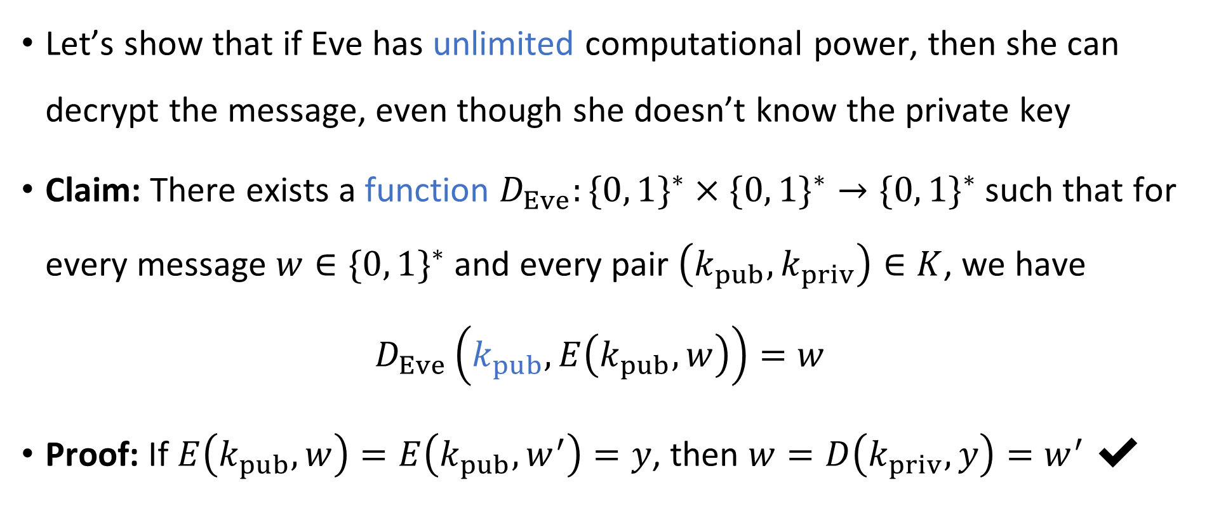
If Eve is computationally unbounded
Let’s show that if Eve has unlimited computational power, then she can decrypt the message, even though she doesn’t know the private key
Claim: There exists a function $D_{Eve}:\{0, 1\}^{∗}×\{0, 1\}^{∗}→\{0, 1\}^{∗}$ such that for every message $w∈\{0, 1\}^{∗}$ and every pair $\left(k_{pub},k_{priv}\right)∈K$, we have
$$D_{Eve}\left(k_{pub},E\left(k_{pub},w\right)\right)=w$$
Proof: If $E\left(k_{pub},w\right)=E\left(k_{pub},w^{′}\right)=y$, then $w=D\left(k_{priv},y\right)=w^{′}$ ✔️

Slide 6
What if Eve is computationally bounded?
Inevitably, it is possible in principle to decrypt without the private key
Amazing fact: There are known public-key encryption schemes such that decrypting without the private key seems to be intractable! Example: “RSA”
(*Better: There are schemes such that it is apparently intractable to “occasionally” “partially” decrypt without the private key. Making this precise is beyond the scope of our course)
These amazing encryption schemes make our modern internet experience possible! Can we prove that they are secure?

Slide 7

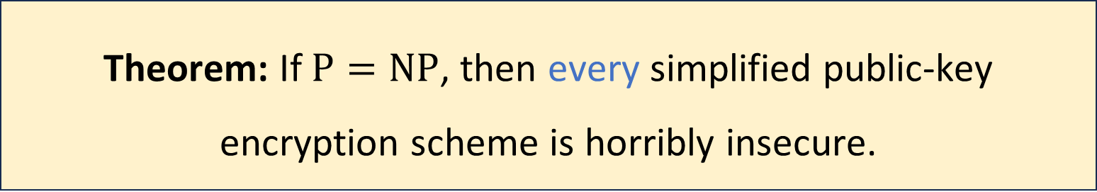
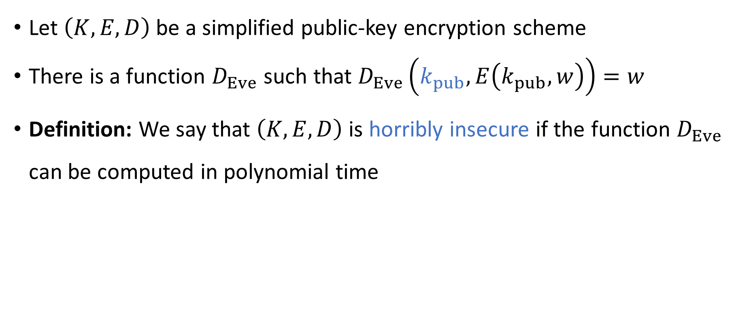
Cryptography and $\text{P}$ vs. $\text{NP}$
Let $\left(K, E, D\right)$ be a simplified public-key encryption scheme
There is a function $D_{Eve}$ such that $D_{Eve}\left(k_{pub}, E\left(k_{pub},w\right)\right)=w$
Definition: We say that $\left(K,E,D\right)$ is horribly insecure if the function $D_{Eve}$ can be computed in polynomial time
Theorem: If $\text{P}=\text{NP}$, then every simplified public-key encryption scheme is horribly insecure.
Notes:
Technicality: D_Eve isn’t completely well-defined, due to invalid public keys. Bare-minimum security says that *every completion* of D_Eve cannot be computed in polynomial time.

Slide 8

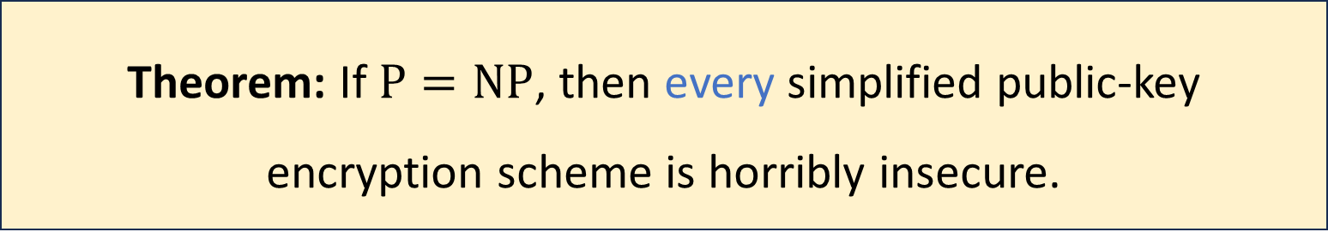
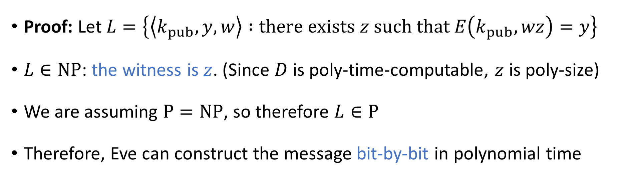
Cryptography and $\text{P}$ vs. $\text{NP}$
Theorem: If $\text{P}=\text{NP}$, then every simplified public-key encryption scheme is horribly insecure.
Proof: Let $L=\left\{\left\langle k_{pub},y,w\right\rangle :\text{there} \text{exists} z \text{such} \text{that} E\left(k_{pub},wz\right)=y\right\}$
$L∈\text{NP}$: the witness is $z$. (Since $D$ is poly-time-computable, $z$ is poly-size)
We are assuming $\text{P}=\text{NP}$, so therefore $L∈\text{P}$
Therefore, Eve can construct the message bit-by-bit in polynomial time
Notes:
Technicality: We are showing that there *exists* a completion of D_Eve such that L is in NP. Thus we only need to reason about valid public keys.

Slide 9
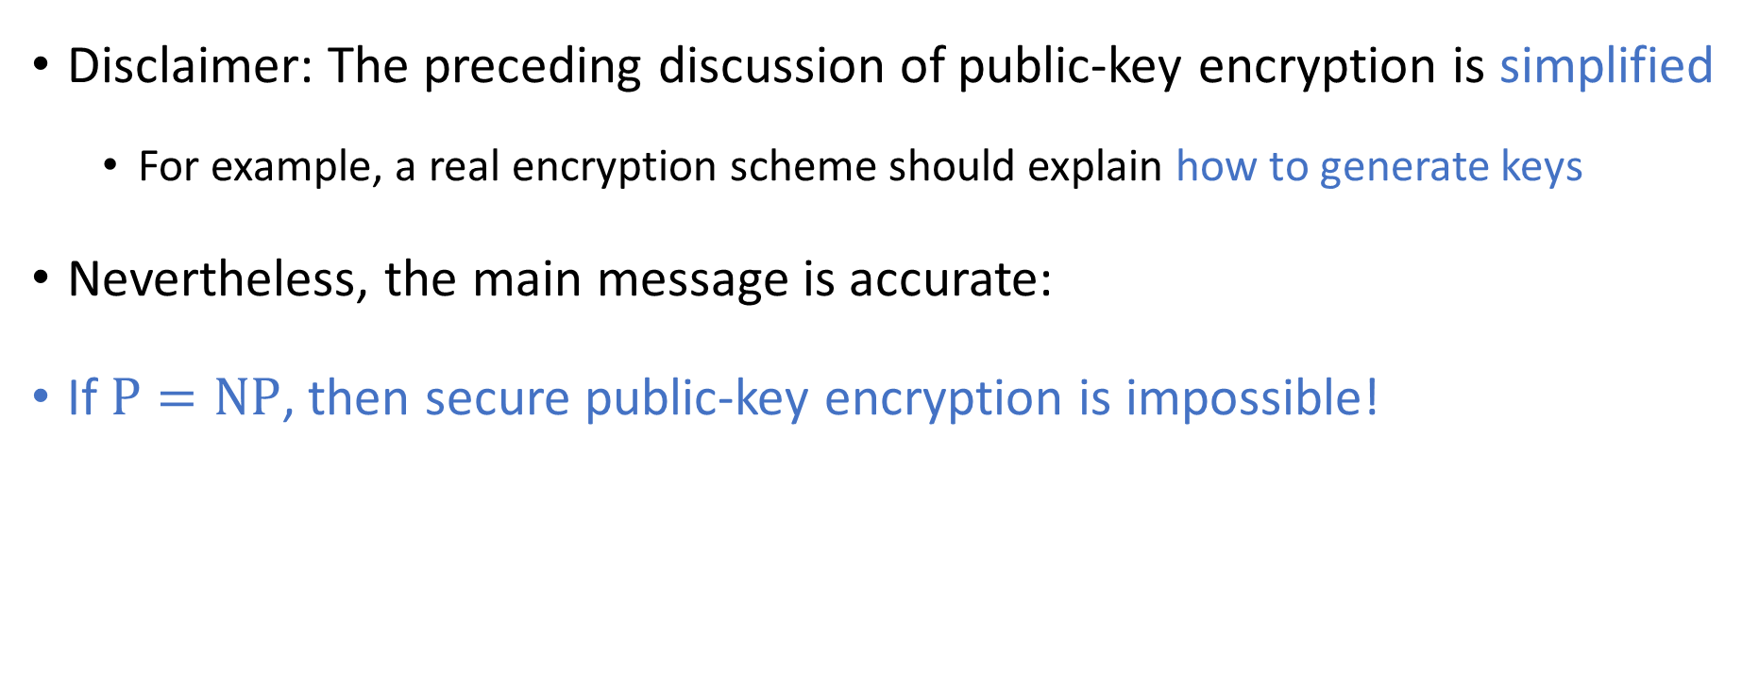

Cryptography and $\text{P}$ vs. $\text{NP}$
Disclaimer: The preceding discussion of public-key encryption is simplified
For example, a real encryption scheme should explain how to generate keys
Nevertheless, the main message is accurate:
If $\text{P}=\text{NP}$, then secure public-key encryption is impossible!

Slide 10
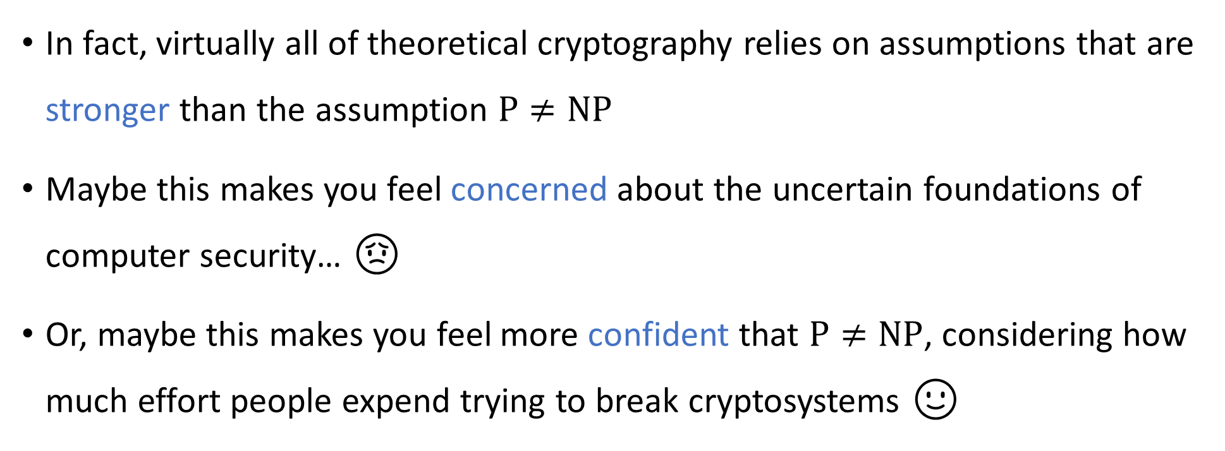
Cryptography and $\text{P}$ vs. $\text{NP}$
In fact, virtually all of theoretical cryptography relies on assumptions that are stronger than the assumption $\text{P}≠\text{NP}$
Maybe this makes you feel concerned about the uncertain foundations of computer security… 😟
Or, maybe this makes you feel more confident that $\text{P}≠\text{NP}$, considering how much effort people expend trying to break cryptosystems 🙂

Slide 11
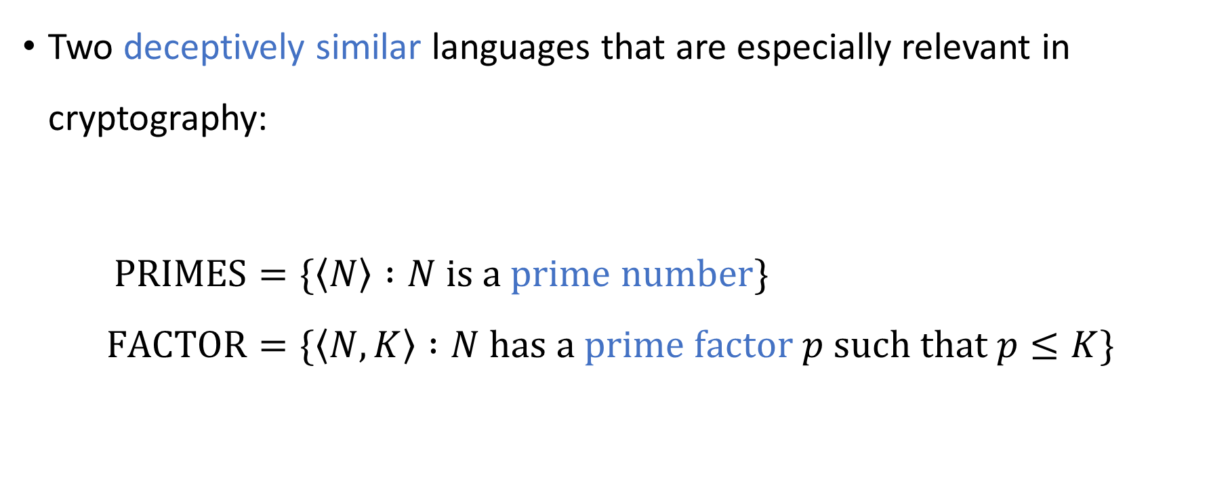
Prime numbers and prime factors
Two deceptively similar languages that are especially relevant in cryptography:
$$\text{PRIMES}=\{\left\langle N\right\rangle :N \text{is} \text{a} \text{prime} \text{number}\} \\ \text{FACTOR}=\{\left\langle N,K\right\rangle :N \text{has} \text{a} \text{prime} \text{factor} p \text{such} \text{that} p≤K\}$$

Slide 12

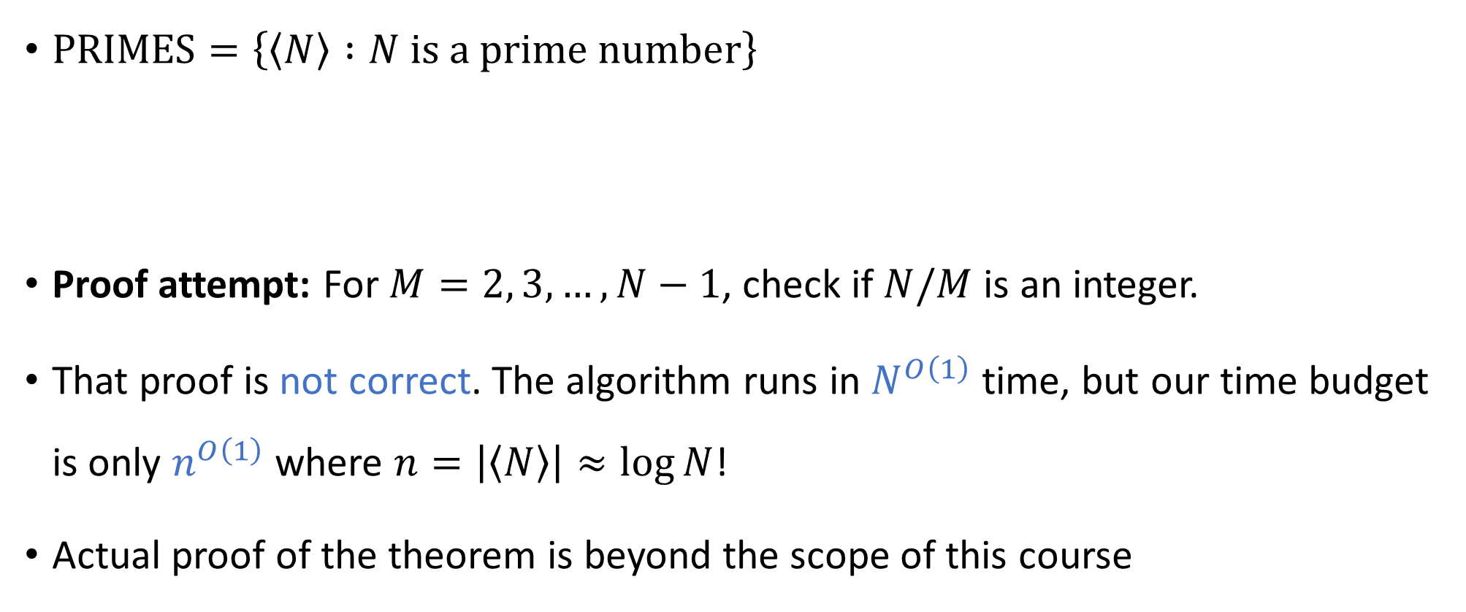
Complexity of primality testing
$\text{PRIMES}=\left\{\left\langle N\right\rangle :N \text{is} \text{a} \text{prime} \text{number}\right\}$
Proof attempt: For $M=2, 3, …, N−1$, check if $N/M$ is an integer.
That proof is not correct. The algorithm runs in $N^{O\left(1\right)}$ time, but our time budget is only $n^{O\left(1\right)}$ where $n=\left|\left\langle N\right\rangle \right|≈\log{N}$!
Actual proof of the theorem is beyond the scope of this course
AKS Theorem: $\text{PRIMES}∈\text{P}$

Slide 13
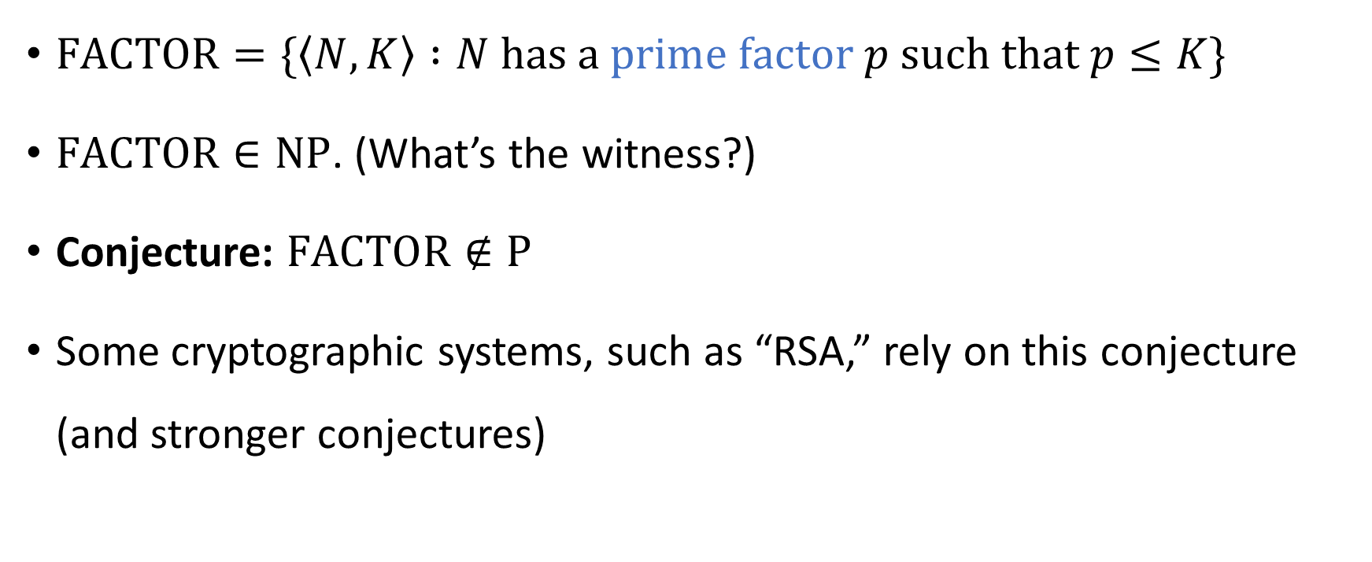
Complexity of factoring integers
$\text{FACTOR}=\{\left\langle N,K\right\rangle :N \text{has} \text{a} \text{prime} \text{factor} p \text{such} \text{that} p≤K\}$
$\text{FACTOR}∈\text{NP}$. (What’s the witness?)
Conjecture: $\text{FACTOR}∉\text{P}$
Some cryptographic systems, such as “RSA,” rely on this conjecture (and stronger conjectures)

Slide 14
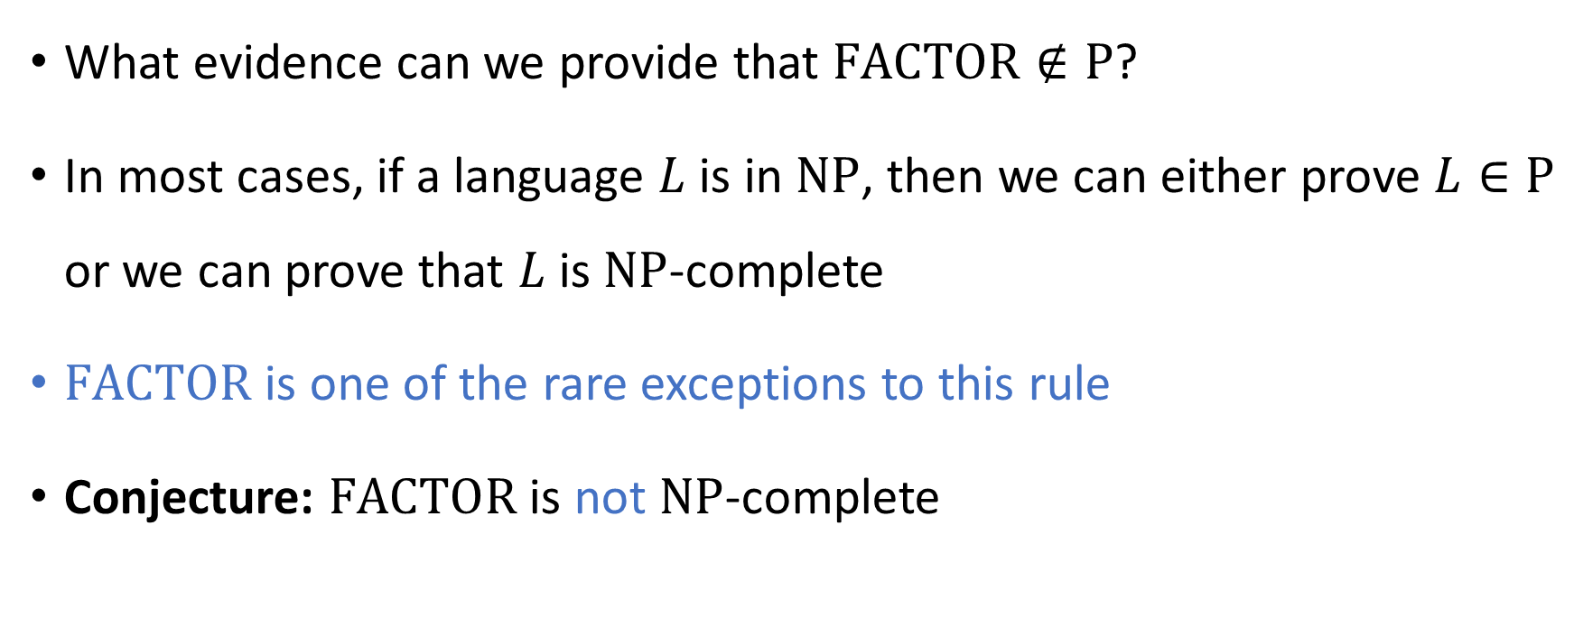
Complexity of factoring integers
What evidence can we provide that $\text{FACTOR}∉\text{P}$?
In most cases, if a language $L$ is in $\text{NP}$, then we can either prove $L∈\text{P}$ or we can prove that $L$ is $\text{NP}$-complete
$\text{FACTOR}$ is one of the rare exceptions to this rule
Conjecture: $\text{FACTOR}$ is not $\text{NP}$-complete

Slide 15


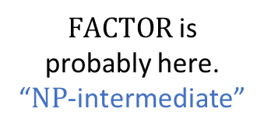




$\text{NP}$-hard
$$\text{3‑}\text{SAT}$$
$\text{NP}$-complete
$\text{FACTOR}$ is probably here. “$\text{NP}$-intermediate”
$$\text{NP}$$
$$\text{P}$$
$$\text{PRIMES}$$

Slide 16

Complexity of factoring integers
To explain why we believe that $\text{FACTOR}$ is not $\text{NP}$-complete, we now introduce another complexity class, called $\text{coNP}$

Slide 17
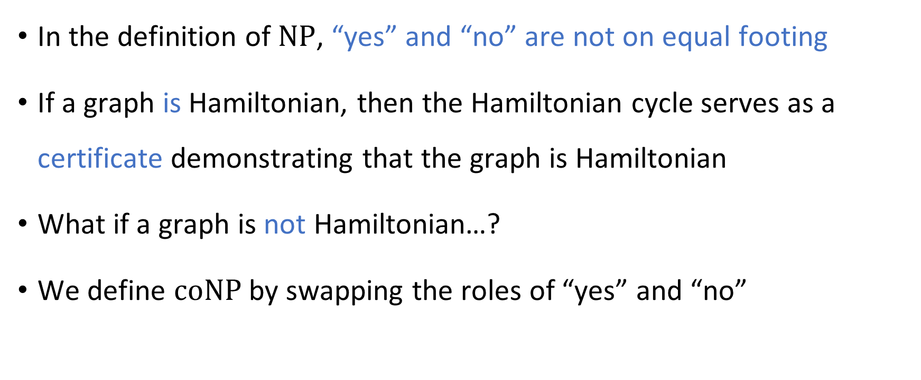

The complexity class $\text{coNP}$
In the definition of $\text{NP}$, “yes” and “no” are not on equal footing
If a graph is Hamiltonian, then the Hamiltonian cycle serves as a certificate demonstrating that the graph is Hamiltonian
What if a graph is not Hamiltonian…?
We define $\text{coNP}$ by swapping the roles of “yes” and “no”

Slide 18
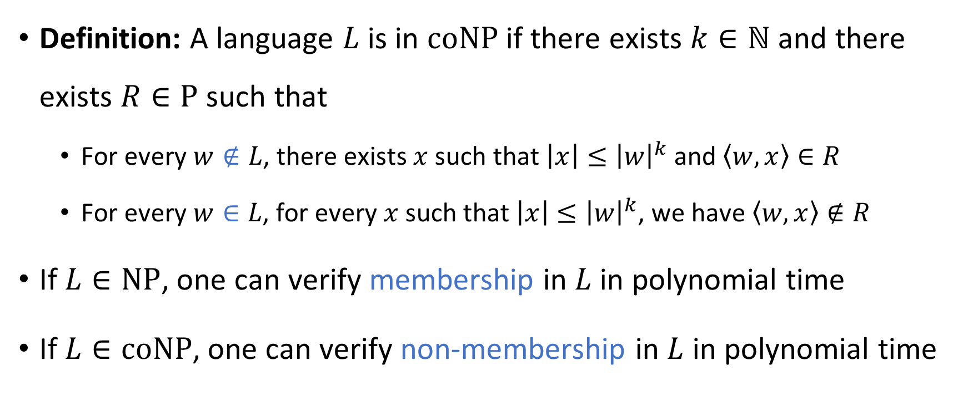

The complexity class $\text{coNP}$
Definition: A language $L$ is in $\text{coNP}$ if there exists $k∈ℕ$ and there exists $R∈\text{P}$ such that
For every $w∉L$, there exists $x$ such that $\left|x\right|≤{\left|w\right|}^{k}$ and $\left\langle w,x\right\rangle ∈R$
For every $w∈L$, for every $x$ such that $\left|x\right|≤{\left|w\right|}^{k}$, we have $\left\langle w,x\right\rangle ∉R$
If $L∈\text{NP}$, one can verify membership in $L$ in polynomial time
If $L∈\text{coNP}$, one can verify non-membership in $L$ in polynomial time

Slide 19
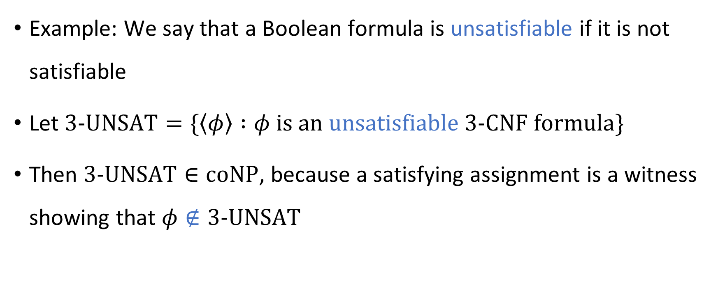
The complexity class $\text{coNP}$
Example: We say that a Boolean formula is unsatisfiable if it is not satisfiable
Let $\text{3‑}\text{UNSAT}=\{\left\langle φ\right\rangle :φ is an unsatisfiable \text{3‑}\text{CNF} formula\}$
Then $\text{3‑}\text{UNSAT}∈\text{coNP}$, because a satisfying assignment is a witness showing that $φ∉\text{3‑}\text{UNSAT}$

Slide 20
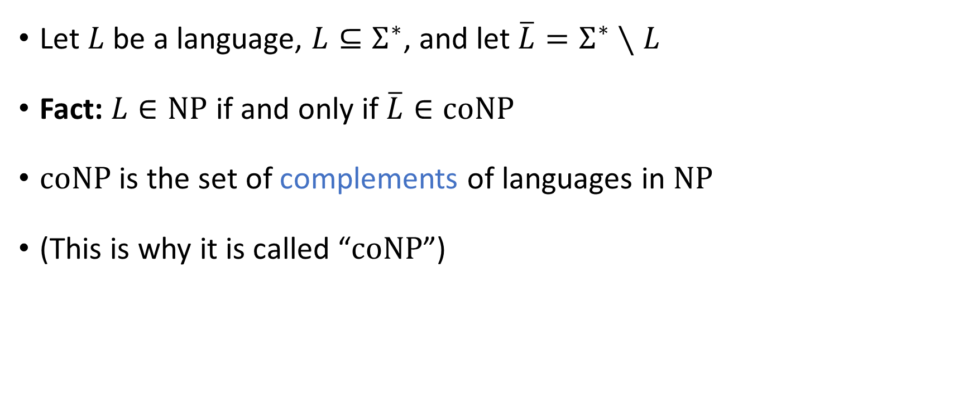
The complexity class $\text{coNP}$
Let $L$ be a language, $L⊆Σ^{∗}$, and let $\overline{L}=Σ^{∗}∖L$
Fact: $L∈\text{NP}$ if and only if $\overline{L}∈\text{coNP}$
$\text{coNP}$ is the set of complements of languages in $\text{NP}$
(This is why it is called “$\text{coNP}$”)

