Slide 1

CMSC 28100 Introduction to Complexity Theory Spring 2025 Instructor: William Hoza

Slide 2
Which problems can be solved through computation?

Slide 3
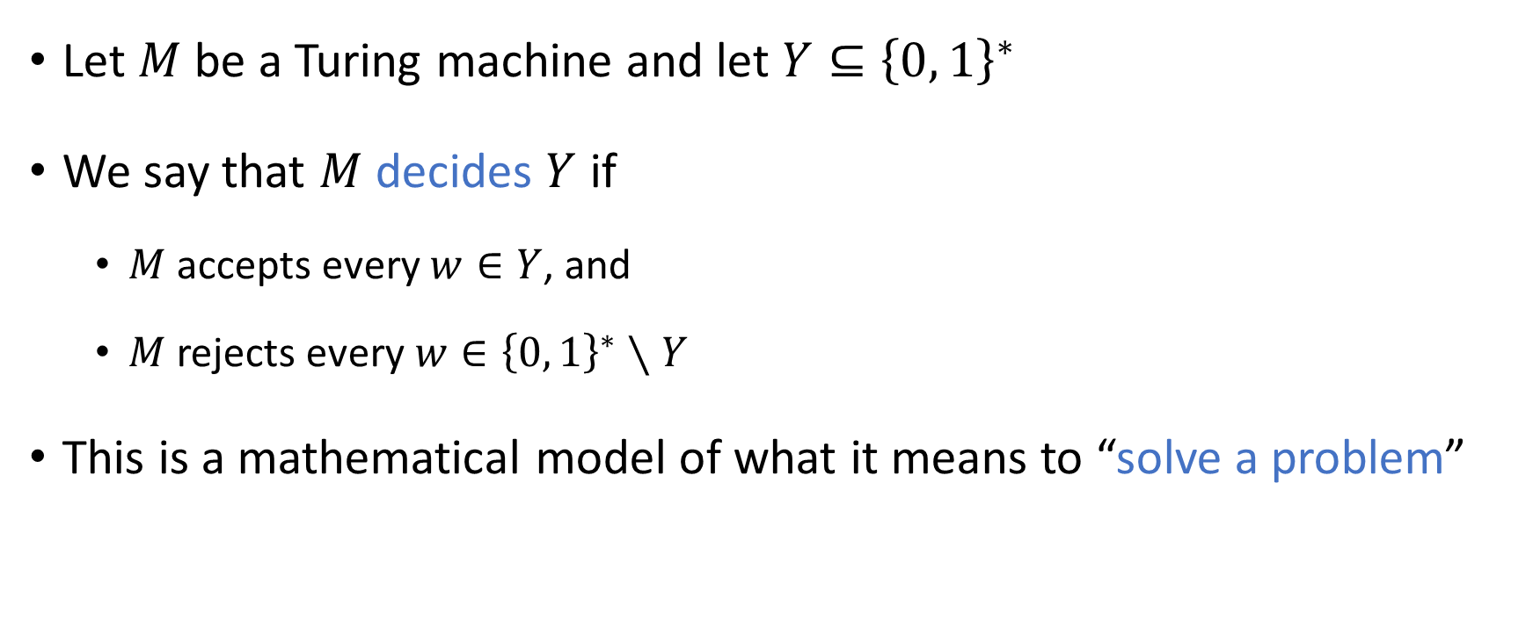
Deciding a language
Let $M$ be a Turing machine and let $Y⊆{\left\{0, 1\right\}}^{∗}$
We say that $M$ decides $Y$ if
$M$ accepts every $w∈Y$, and
$M$ rejects every $w∈{\left\{0, 1\right\}}^{∗}∖Y$
This is a mathematical model of what it means to “solve a problem”

Slide 4
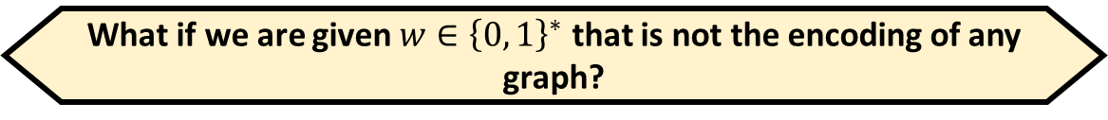

Invalid inputs
Informal problem statement: “Given a graph $G$, determine whether it is connected”
The same problem, formulated as a language:
$$\text{CONNECTED}=\left\{\left\langle G\right\rangle :G \text{is} \text{a} \text{connected} \text{graph}\right\}$$
Suppose we want to decide $\text{CONNECTED}$
If we are given $\left\langle G\right\rangle$ where $G$ is a connected graph, we should accept
If we are given $\left\langle G\right\rangle$ where $G$ is a disconnected graph, we should reject
What if we are given $w∈{\left\{0, 1\right\}}^{∗}$ that is not the encoding of any graph?
A: This situation cannot occur
B: It doesn’t matter what we do
C: We can accept or reject, but we must not loop
D: We must reject
Respond at PollEv.com/whoza or text “whoza” to 22333

Slide 5
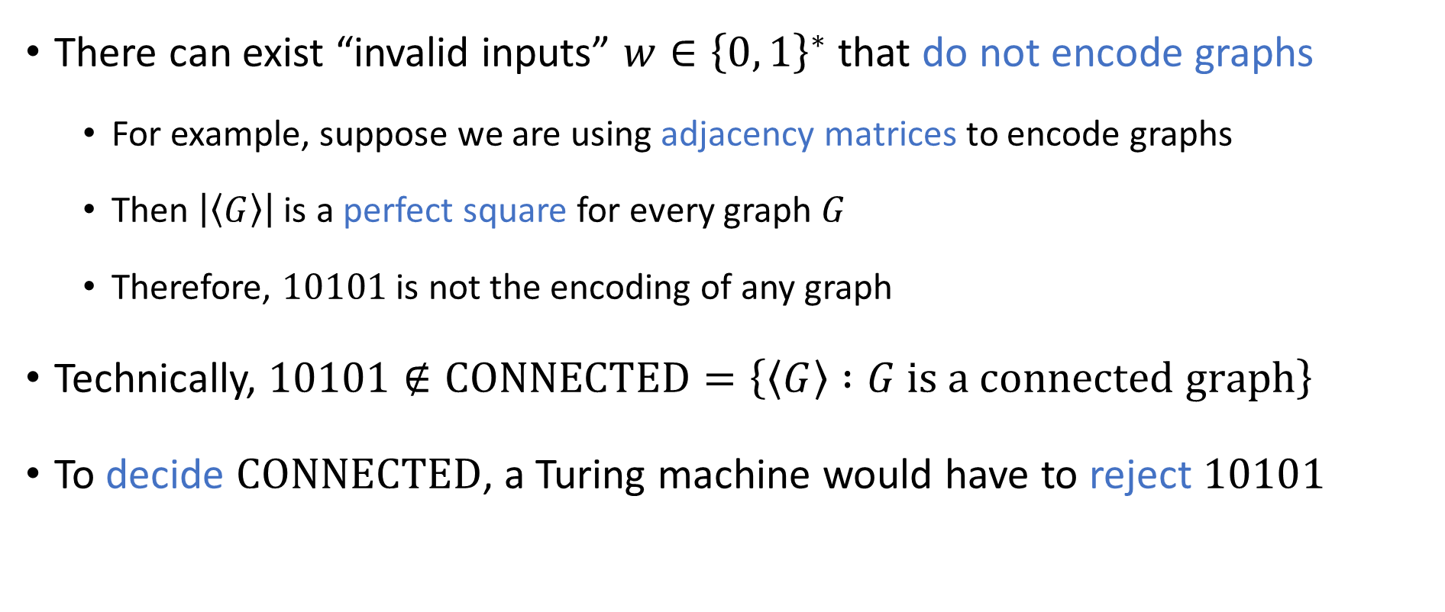
Invalid inputs
There can exist “invalid inputs” $w∈{\left\{0, 1\right\}}^{∗}$ that do not encode graphs
For example, suppose we are using adjacency matrices to encode graphs
Then $\left|\left\langle G\right\rangle \right|$ is a perfect square for every graph $G$
Therefore, $10101$ is not the encoding of any graph
Technically, $10101∉\text{CONNECTED}=\left\{\left\langle G\right\rangle :G \text{is} \text{a} \text{connected} \text{graph}\right\}$
To decide $\text{CONNECTED}$, a Turing machine would have to reject $10101$

Slide 6
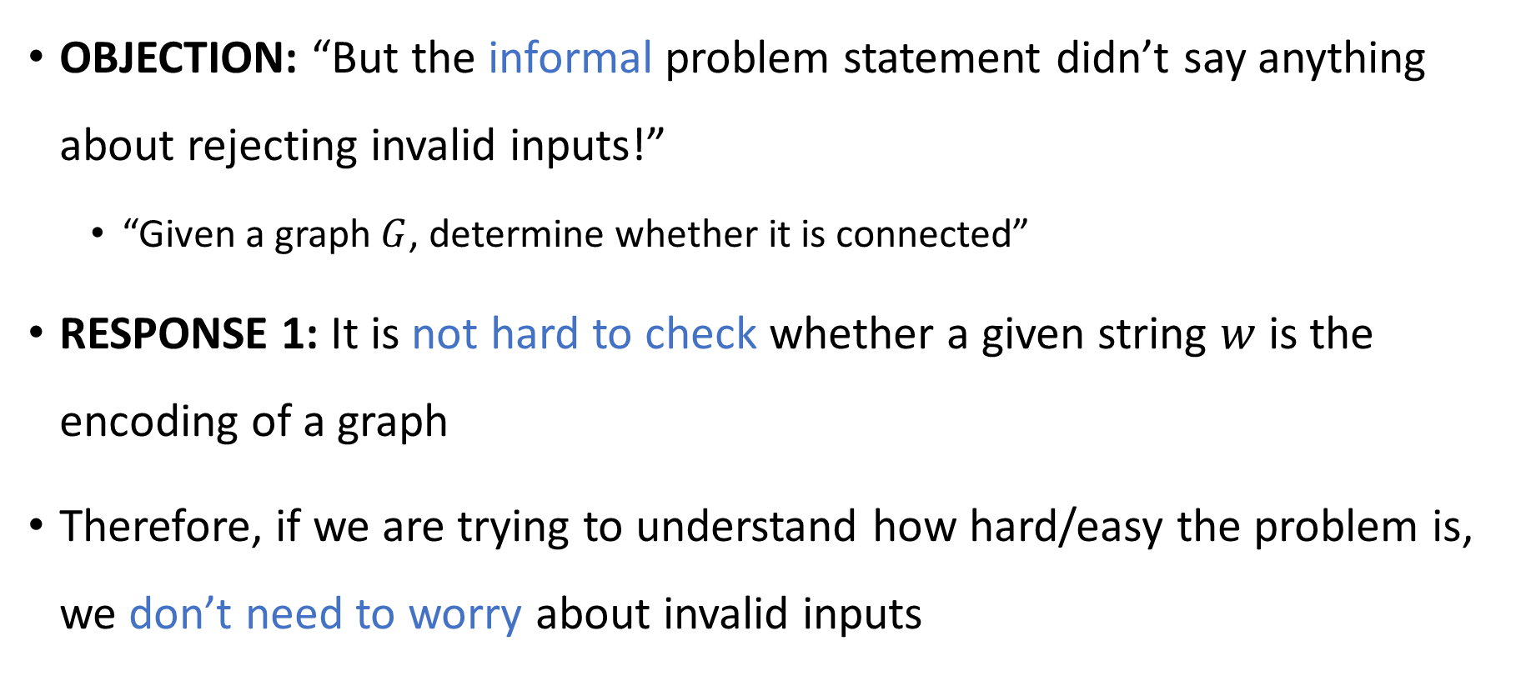
Checking for validity
OBJECTION: “But the informal problem statement didn’t say anything about rejecting invalid inputs!”
“Given a graph $G$, determine whether it is connected”
RESPONSE 1: It is not hard to check whether a given string $w$ is the encoding of a graph
Therefore, if we are trying to understand how hard/easy the problem is, we don’t need to worry about invalid inputs

Slide 7

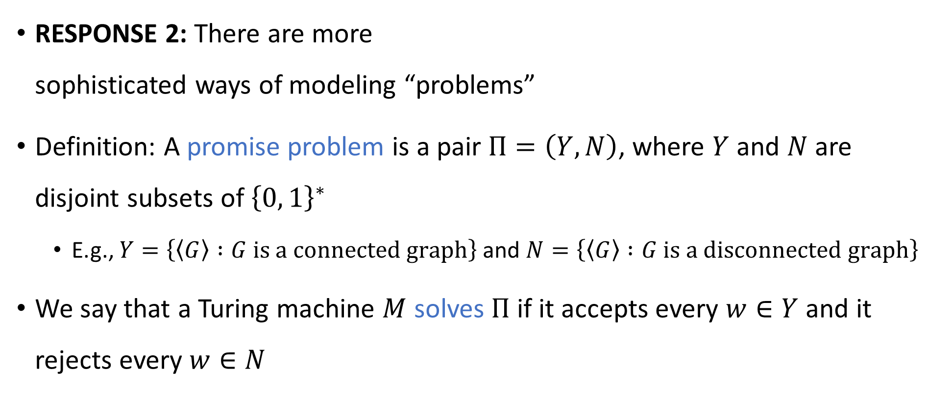


Promise problems
$$N$$
$$Y$$
RESPONSE 2: There are more sophisticated ways of modeling “problems”
Definition: A promise problem is a pair $Π=\left(Y,N\right)$, where $Y$ and $N$ are disjoint subsets of ${\left\{0, 1\right\}}^{∗}$
E.g., $Y=\left\{\left\langle G\right\rangle :G \text{is} \text{a} \text{connected} \text{graph}\right\}$ and $N=\left\{\left\langle G\right\rangle :G \text{is} \text{a} \text{disconnected} \text{graph}\right\}$
We say that a Turing machine $M$ solves $Π$ if it accepts every $w∈Y$ and it rejects every $w∈N$
$${\left\{0, 1\right\}}^{∗}$$

Slide 8
Ignoring invalid inputs
In this course, for simplicity’s sake and for historical reasons, we will focus on languages rather than promise problems
However, for simplicity’s sake, we will mostly ignore the issue of invalid inputs

Slide 9
Summary
“Deciding a language” is not a perfect mathematical model of “solving a problem”…
But it is a pretty good model

Slide 10
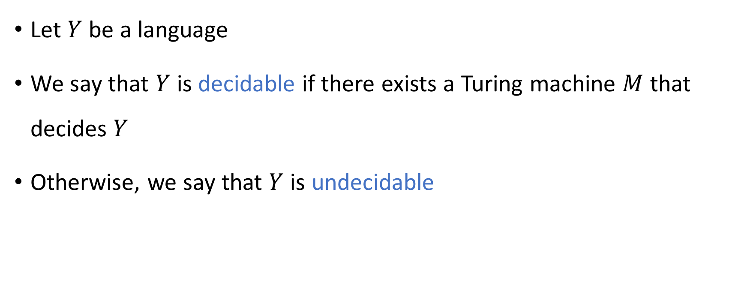
Decidable and undecidable
Let $Y$ be a language
We say that $Y$ is decidable if there exists a Turing machine $M$ that decides $Y$
Otherwise, we say that $Y$ is undecidable

Slide 11
Which problems can be solved through computation?

Slide 12
Which languages are decidable?

Slide 13

Examples
$\text{PALINDROMES}=\left\{w∈{\left\{0, 1\right\}}^{∗} :w \text{is} \text{the} \text{same} \text{forward} \text{and} \text{backward}\right\}$
$\text{PARITY}=\left\{w∈{\left\{0, 1\right\}}^{∗} :w \text{has} \text{an} \text{odd} \text{number} \text{of} \text{ones}\right\}$
$Y=\left\{0^{K}\left\langle K\right\rangle :K \text{is} \text{a} \text{positive} \text{integer}\right\}$
Out of those three languages, how many are decidable?
A: Zero
B: One
C: Two
D: Three
Respond at PollEv.com/whoza or text “whoza” to 22333

Slide 14
Is every language decidable?

Slide 15
Undecidability
Theorem: There exists an undecidable language.
To prove this theorem, we need to rule out all possible Turing machines!
How can we possibly do this?

Slide 16
The liar paradox
Are you selecting option B as your answer to this question?
A: Yes
B: No
C: Yes
D: Yes
Respond at PollEv.com/whoza or text “whoza” to 22333

Slide 17
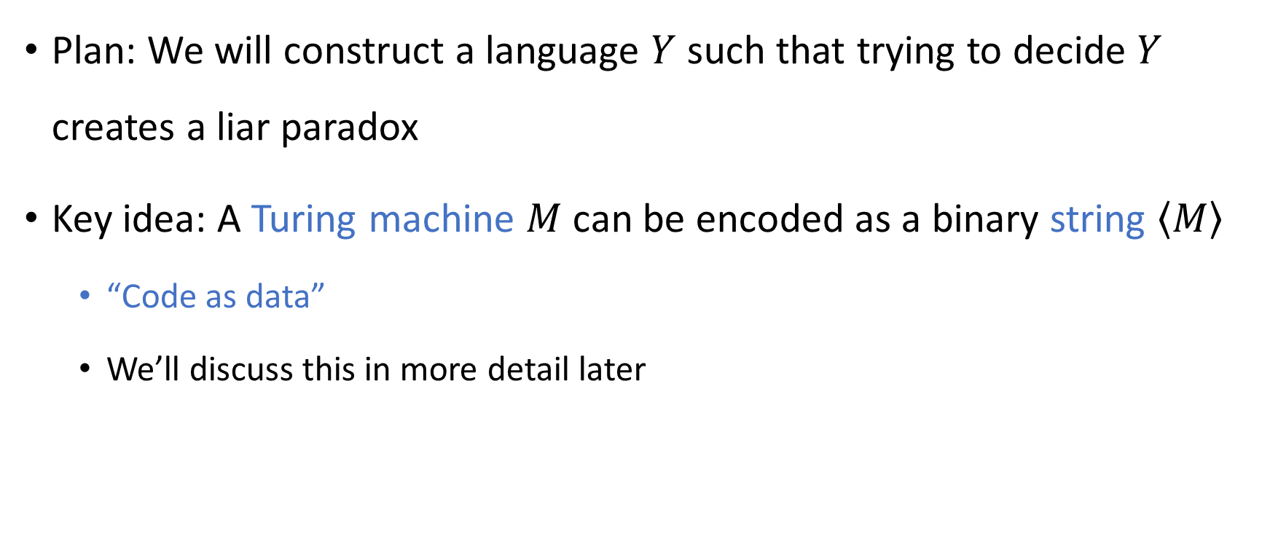
Code as data
Plan: We will construct a language $Y$ such that trying to decide $Y$ creates a liar paradox
Key idea: A Turing machine $M$ can be encoded as a binary string $\left\langle M\right\rangle$
“Code as data”
We’ll discuss this in more detail later

Slide 18

Turing machines analyzing Turing machines
After encoding a Turing machine $M$ as a binary string $\left\langle M\right\rangle$…
We can use $\left\langle M\right\rangle$ as the input for another Turing machine!
Compilers, syntax highlighting, linters…

Slide 19
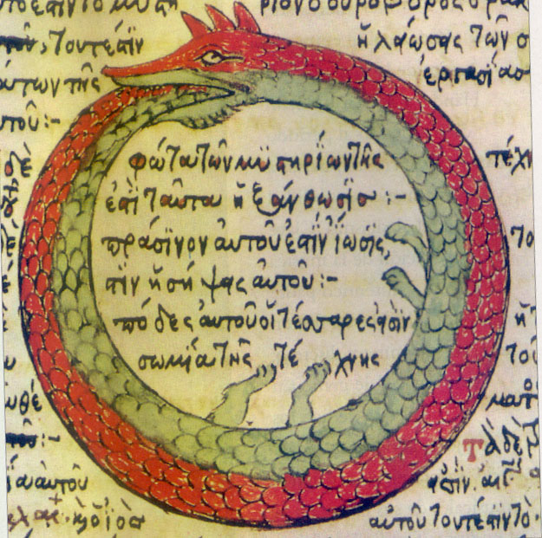
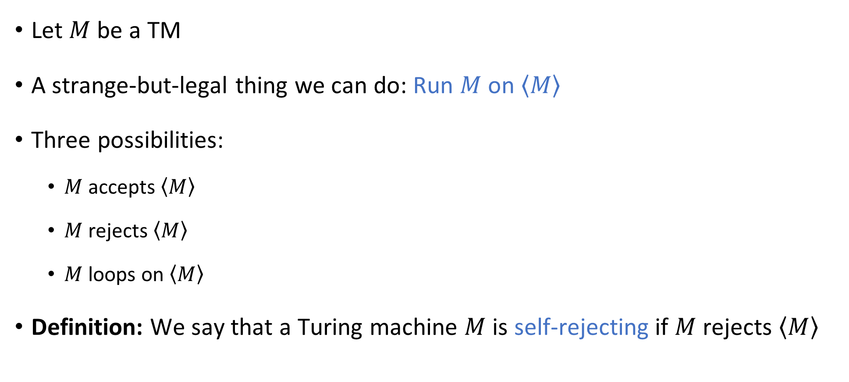
Self-rejecting Turing machines
Let $M$ be a TM
A strange-but-legal thing we can do: Run $M$ on $\left\langle M\right\rangle$
Three possibilities:
$M$ accepts $\left\langle M\right\rangle$
$M$ rejects $\left\langle M\right\rangle$
$M$ loops on $\left\langle M\right\rangle$
Definition: We say that a Turing machine $M$ is self-rejecting if $M$ rejects $\left\langle M\right\rangle$

Slide 20
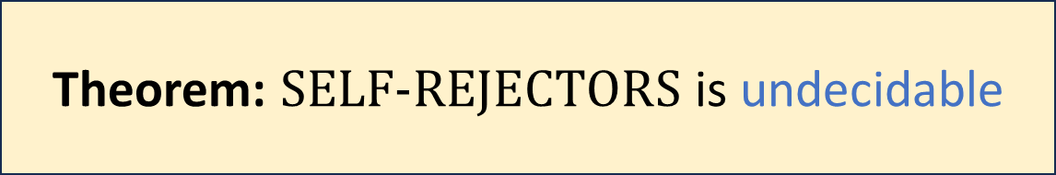

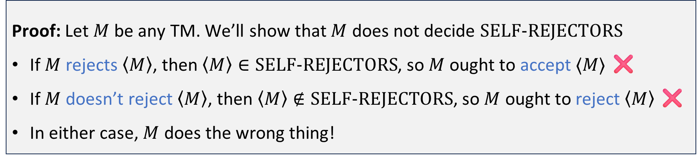
Self-rejecting Turing machines
Let $\text{SELF}‑\text{REJECTORS}=\left\{\left\langle M\right\rangle :M \text{is} \text{a} \text{self}‑\text{rejecting} \text{Turing} \text{machine}\right\}$
Theorem: $\text{SELF}‑\text{REJECTORS}$ is undecidable
Proof: Let $M$ be any TM. We’ll show that $M$ does not decide $\text{SELF}‑\text{REJECTORS}$
If $M$ rejects $\left\langle M\right\rangle$, then $\left\langle M\right\rangle ∈\text{SELF}‑\text{REJECTORS}$, so $M$ ought to accept $⟨M⟩$ ❌
If $M$ doesn’t reject $\left\langle M\right\rangle$, then $\left\langle M\right\rangle ∉\text{SELF}‑\text{REJECTORS}$, so $M$ ought to reject $\left\langle M\right\rangle$ ❌
In either case, $M$ does the wrong thing!

Slide 21
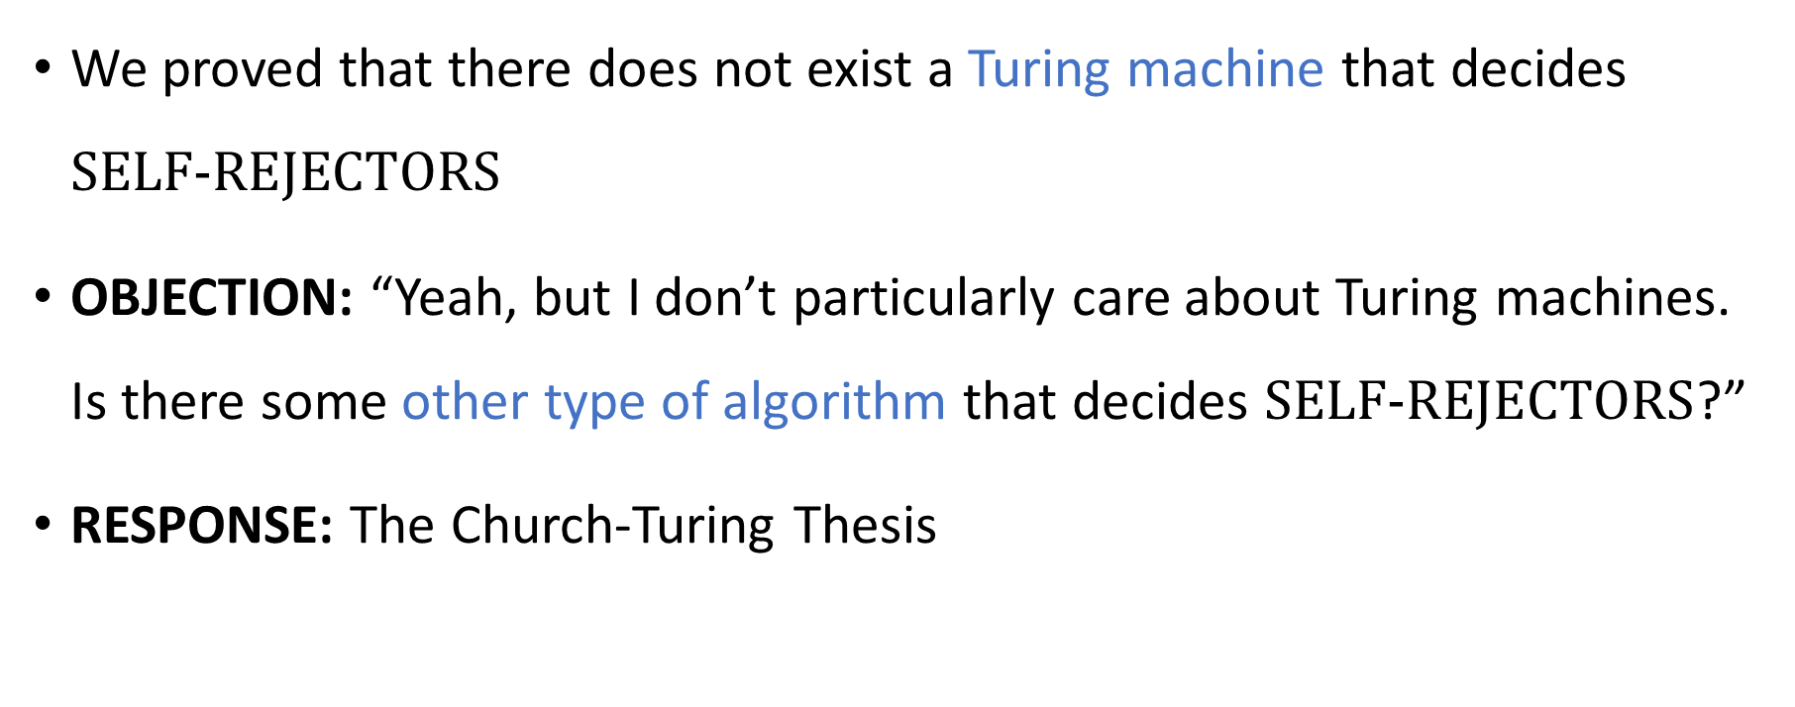
Interpreting the theorem
We proved that there does not exist a Turing machine that decides $\text{SELF}‑\text{REJECTORS}$
OBJECTION: “Yeah, but I don’t particularly care about Turing machines. Is there some other type of algorithm that decides $\text{SELF}‑\text{REJECTORS}$?”
RESPONSE: The Church-Turing Thesis

Slide 22
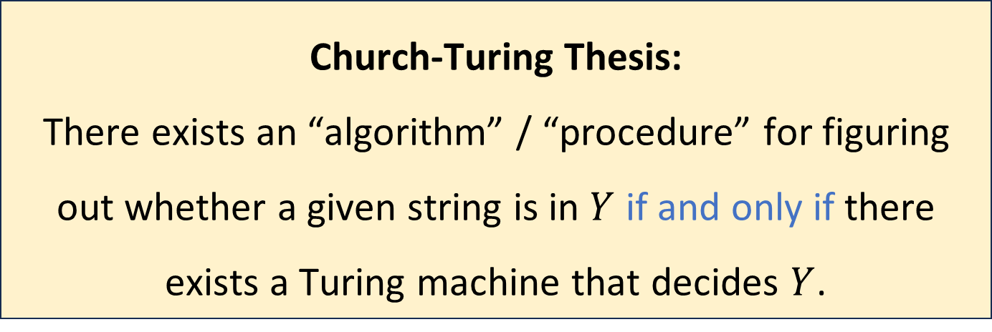
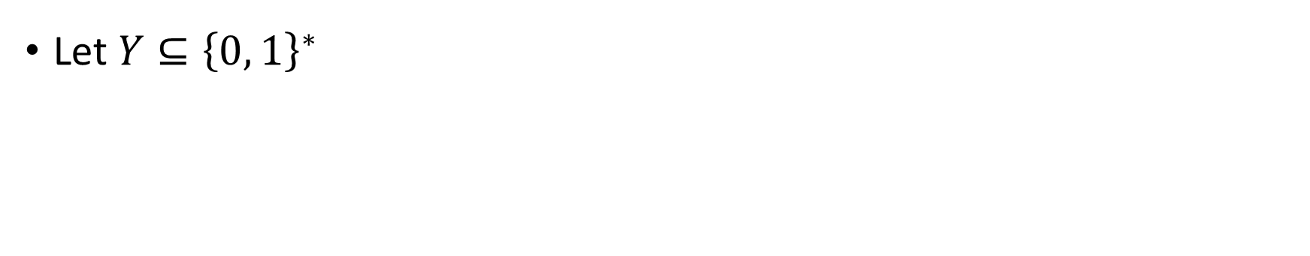
The Church-Turing Thesis
Let $Y⊆{\left\{0, 1\right\}}^{∗}$
Church-Turing Thesis:
There exists an “algorithm” / “procedure” for figuring out whether a given string is in $Y$ if and only if there exists a Turing machine that decides $Y$.
Intuitive notion
Mathematically precise notion

Slide 23
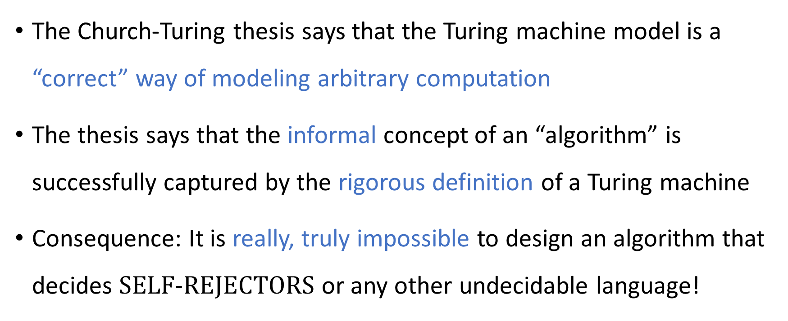
The Church-Turing Thesis
The Church-Turing thesis says that the Turing machine model is a “correct” way of modeling arbitrary computation
The thesis says that the informal concept of an “algorithm” is successfully captured by the rigorous definition of a Turing machine
Consequence: It is really, truly impossible to design an algorithm that decides $\text{SELF}‑\text{REJECTORS}$ or any other undecidable language!

Slide 24

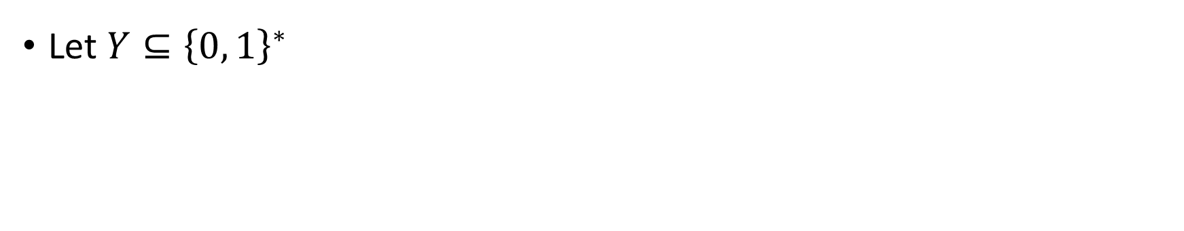
The Church-Turing Thesis
Let $Y⊆{\left\{0, 1\right\}}^{∗}$
Church-Turing Thesis:
There exists an “algorithm” / “procedure” for figuring out whether a given string is in $Y$ if and only if there exists a Turing machine that decides $Y$.
Intuitive notion
Mathematically precise notion

Slide 25

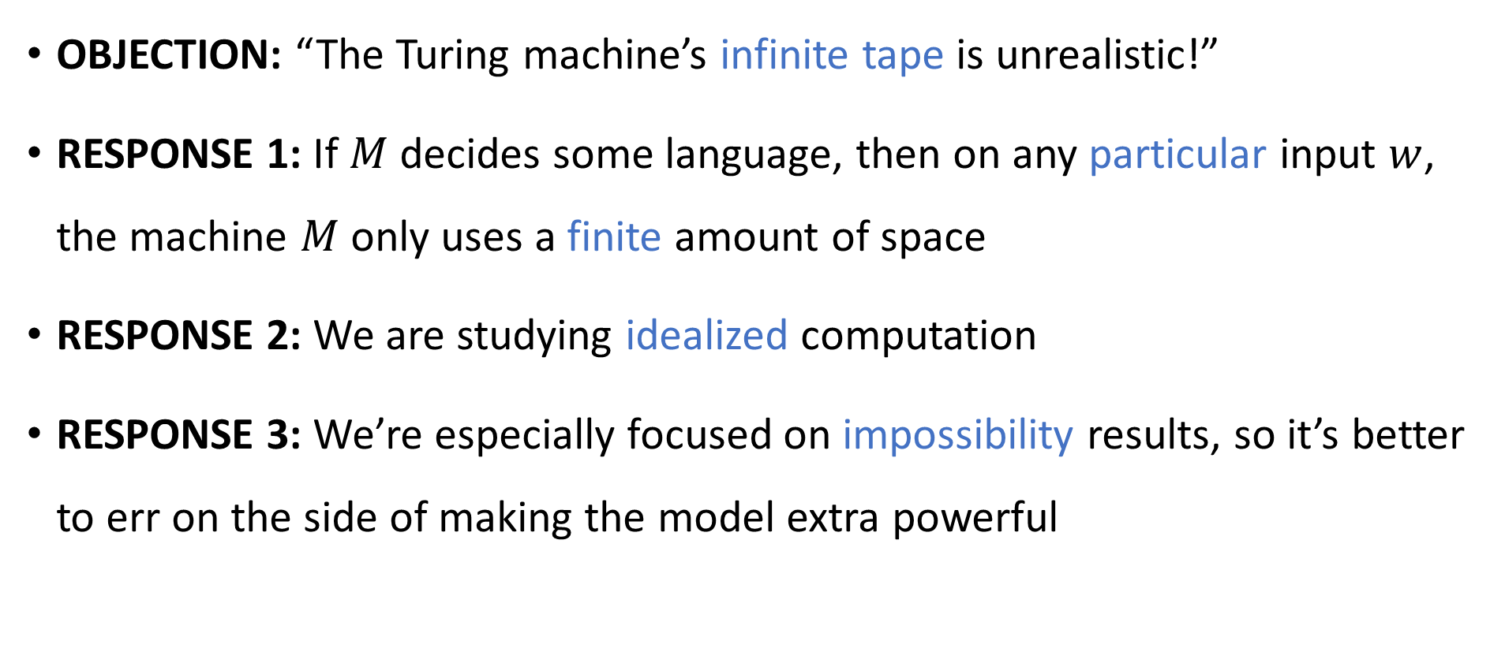
Are Turing machines too powerful?
$$∞$$
OBJECTION: “The Turing machine’s infinite tape is unrealistic!”
RESPONSE 1: If $M$ decides some language, then on any particular input $w$, the machine $M$ only uses a finite amount of space
RESPONSE 2: We are studying idealized computation
RESPONSE 3: We’re especially focused on impossibility results, so it’s better to err on the side of making the model extra powerful

Slide 26

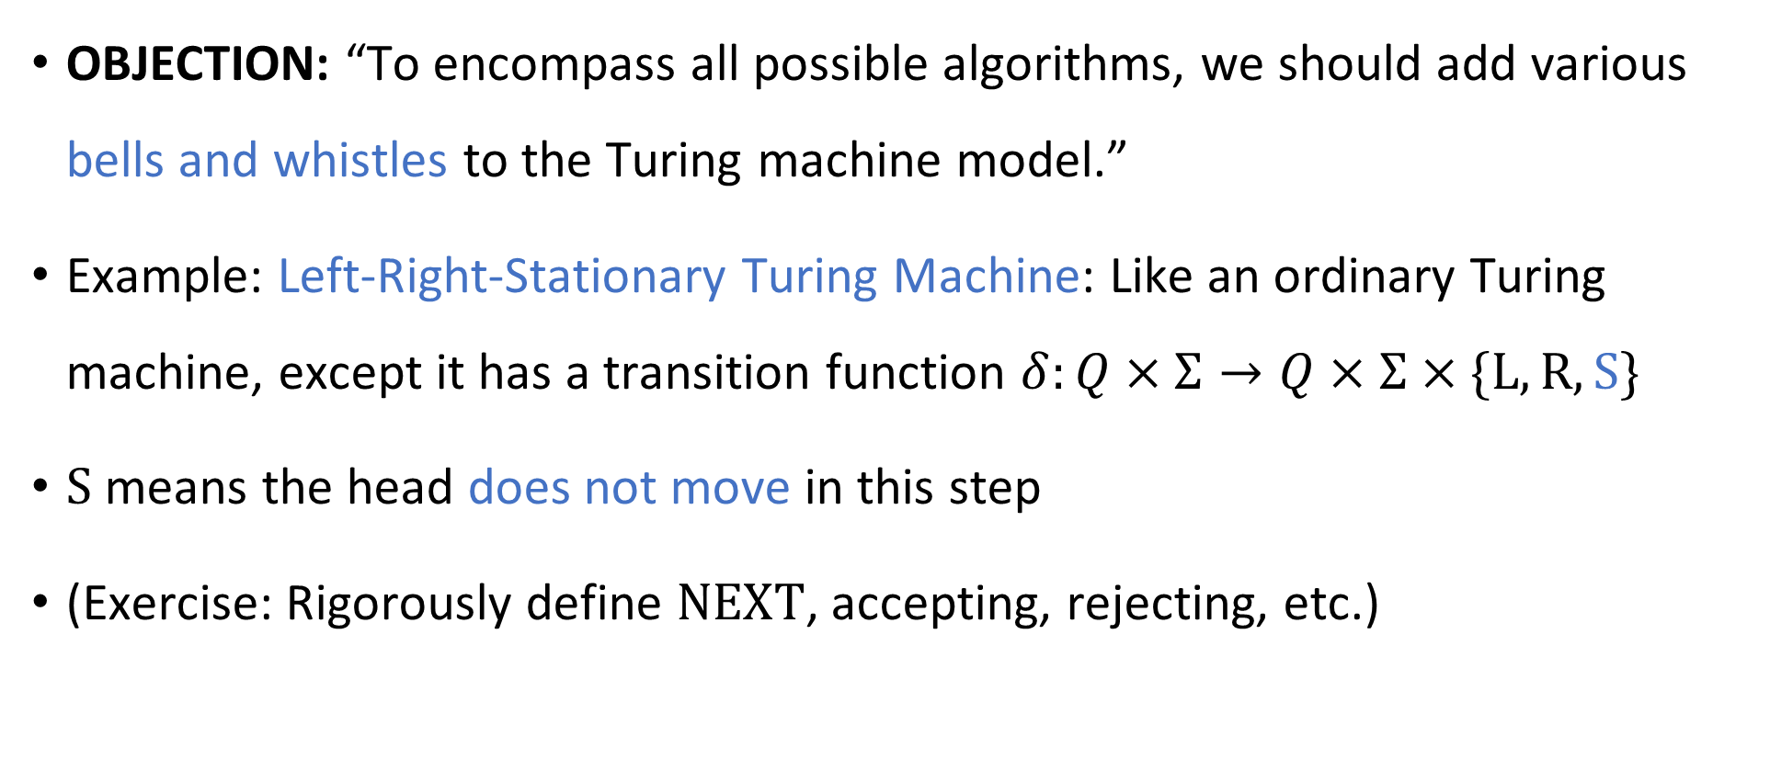
Are Turing machines powerful enough?
🔔
OBJECTION: “To encompass all possible algorithms, we should add various bells and whistles to the Turing machine model.”
Example: Left-Right-Stationary Turing Machine: Like an ordinary Turing machine, except it has a transition function $δ:Q×Σ→Q×Σ×\{\text{L},\text{R},\text{S}\}$
$\text{S}$ means the head does not move in this step
(Exercise: Rigorously define $\text{NEXT}$, accepting, rejecting, etc.)

Slide 27
Left-right-stationary Turing machines
🔔
The left-right-stationary Turing machine model is still realistic, even though we added an extra feature
Is it a counterexample to the Church-Turing thesis?
No!
Let’s prove that the left-right-stationary Turing machine model is equivalent to the original Turing machine model

Slide 28
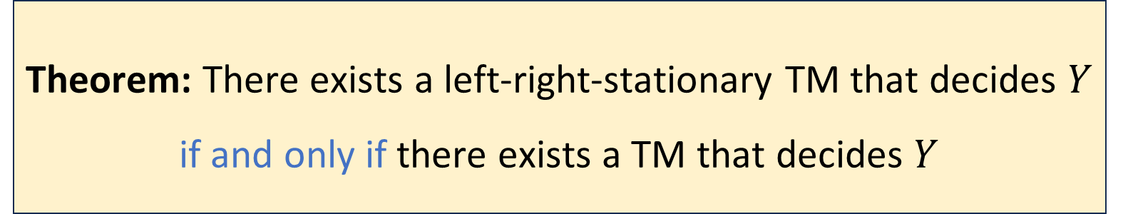

Left-right-stationary Turing machines
🔔
Let $Y$ be a language
Proof: (3 slides) The “$⇐$” direction is trivial
Theorem: There exists a left-right-stationary TM that decides $Y$ if and only if there exists a TM that decides $Y$

Slide 29
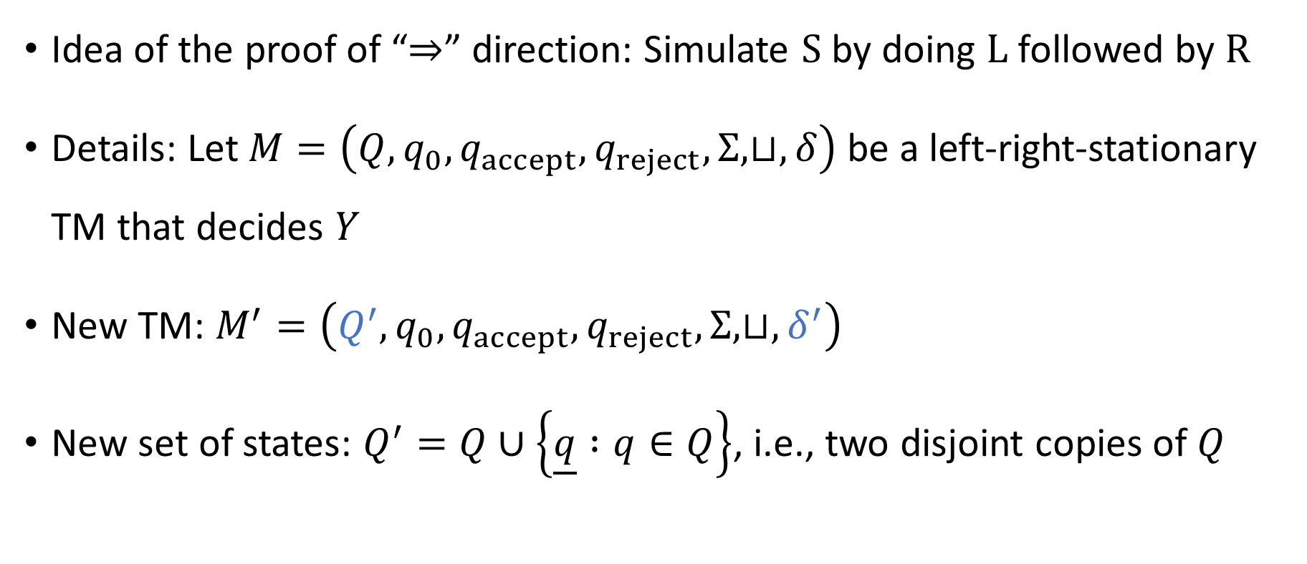
Left-right-stationary Turing machines
🔔
Idea of the proof of “$⇒$” direction: Simulate $\text{S}$ by doing $\text{L}$ followed by $\text{R}$
Details: Let $M=\left(Q, q_{0},q_{accept},q_{reject},Σ,⊔,δ\right)$ be a left‑right‑stationary TM that decides $Y$
New TM: $M^{′}=\left(Q^{′},q_{0},q_{accept},q_{reject},Σ,⊔,δ^{′}\right)$
New set of states: $Q^{′}=Q∪\left\{\underline{q} :q∈Q\right\}$, i.e., two disjoint copies of $Q$

Slide 30
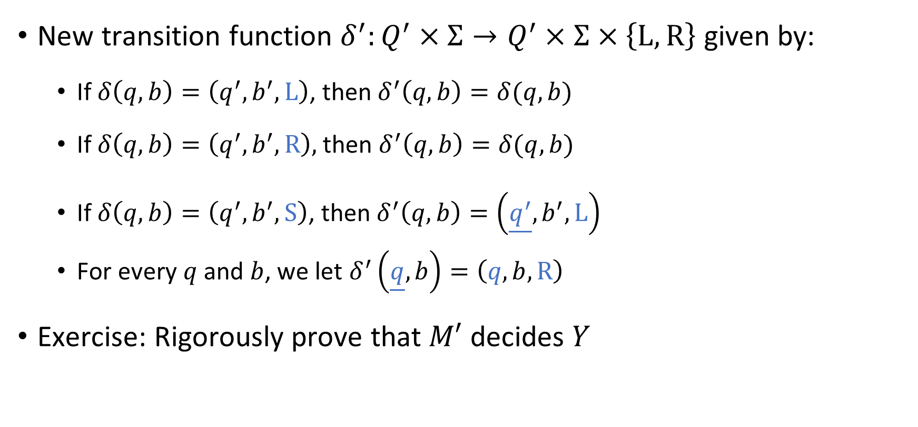
Left-right-stationary Turing machines
🔔
New transition function $δ^{′}:Q^{′}×Σ→Q^{′}×Σ×\left\{\text{L},\text{R}\right\}$ given by:
If $δ\left(q, b\right)=\left(q^{′},b^{′},\text{L}\right)$, then $δ^{′}\left(q,b\right)=δ(q, b)$
If $δ\left(q,b\right)=\left(q^{′},b^{′},\text{R}\right),$ then $δ^{′}\left(q,b\right)=δ(q,b)$
If $δ\left(q,b\right)=\left(q^{′},b^{′},\text{S}\right)$, then $δ^{′}\left(q,b\right)=\left(\underline{q^{′}},b^{′},\text{L}\right)$
For every $q$ and $b$, we let $δ^{′}\left(\underline{q},b\right)=\left(q,b,\text{R}\right)$
Exercise: Rigorously prove that $M′$ decides $Y$

Slide 31
The Church-Turing Thesis
Let $Y⊆{\left\{0, 1\right\}}^{∗}$
Church-Turing Thesis:
There exists an “algorithm” / “procedure” for figuring out whether a given string is in $Y$ if and only if there exists a Turing machine that decides $Y$.
Intuitive notion
Mathematically precise notion

