Slide 1
CEM Planner Results

Slide 2
Experiment #1:
1. Obtain start state from the environment
2. Compute the cost of the skill sequence by rolling out skill sequence using TAWM and then finding the minimum distance to the goal
3. Sample epsilon sequences and then refit distribution to the top k
4. Take the actual skill and execute it with the low-level policy for 40 timesteps
(Steps 1-4 repeated for the new state)

Slide 3
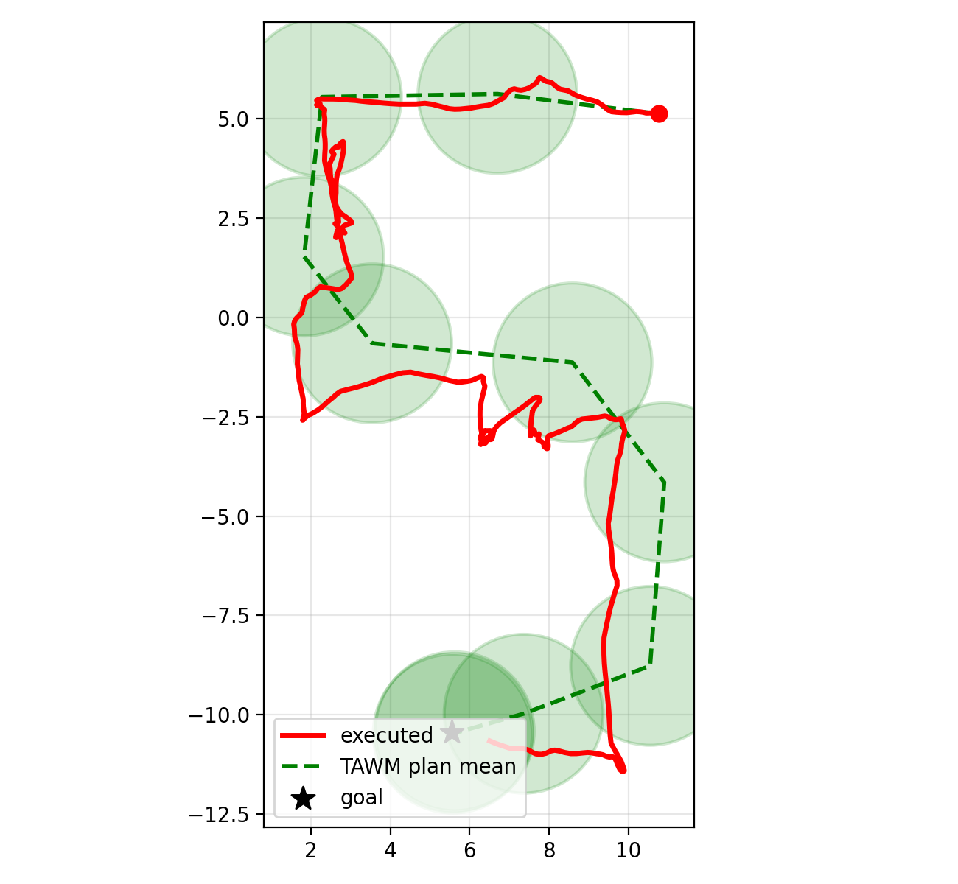

Slide 4
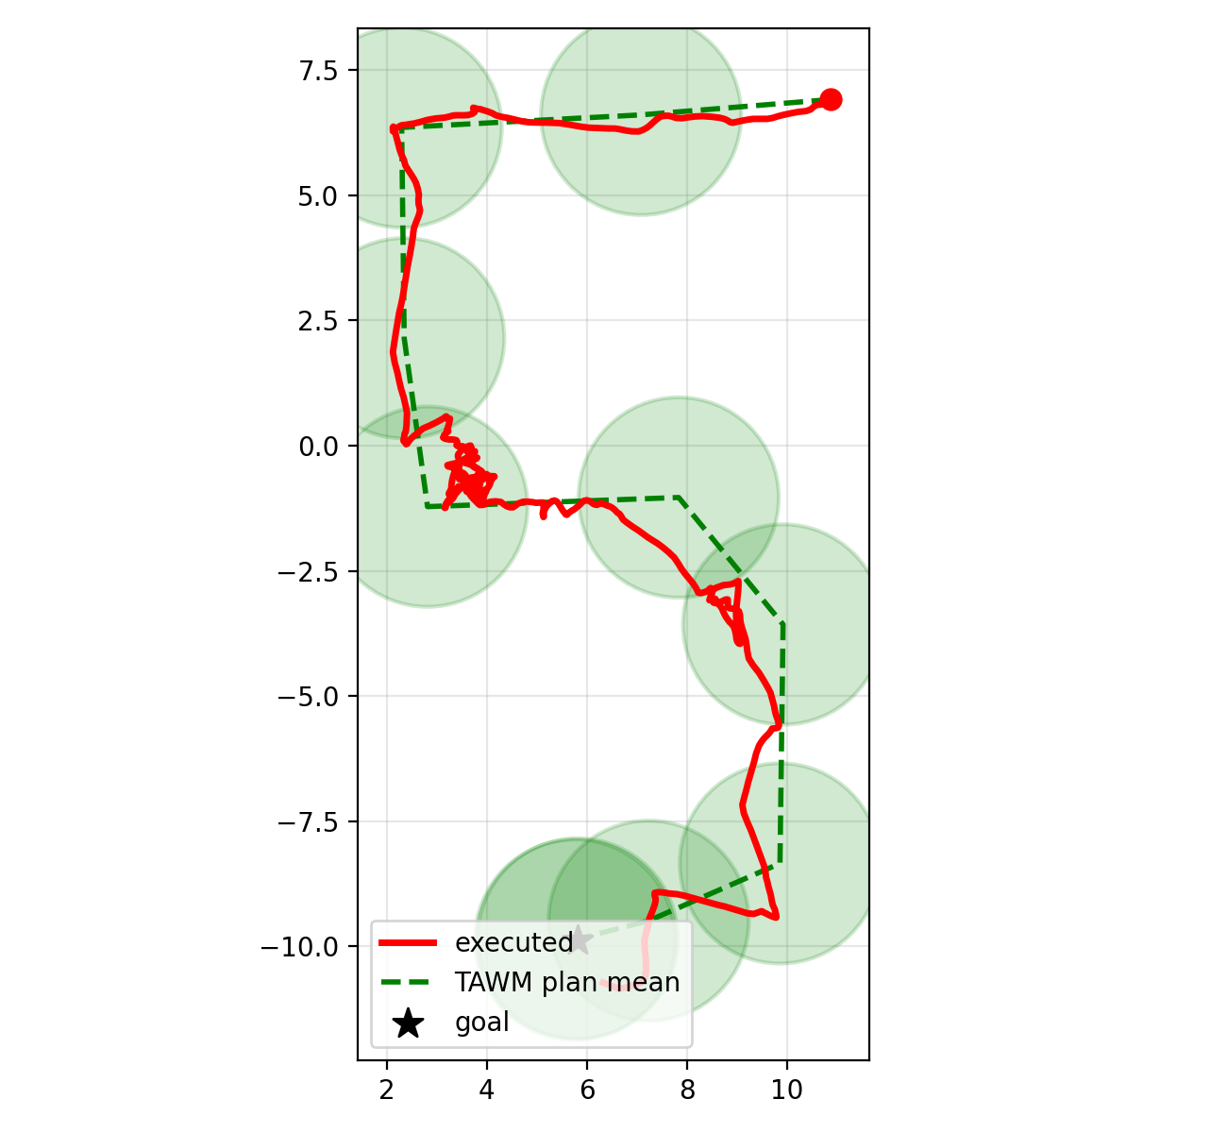

Slide 5
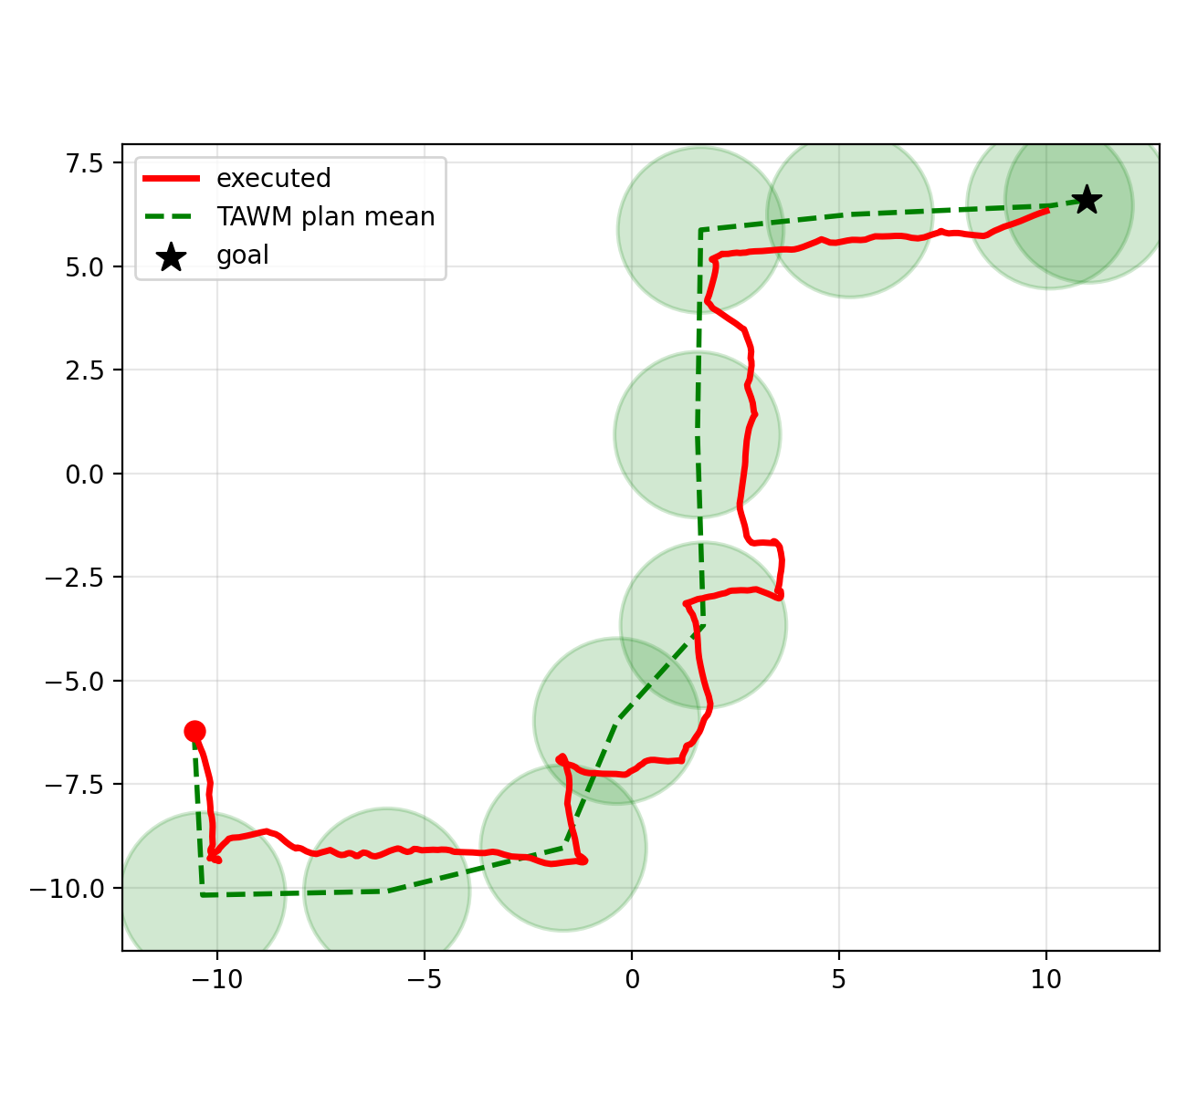

Slide 6
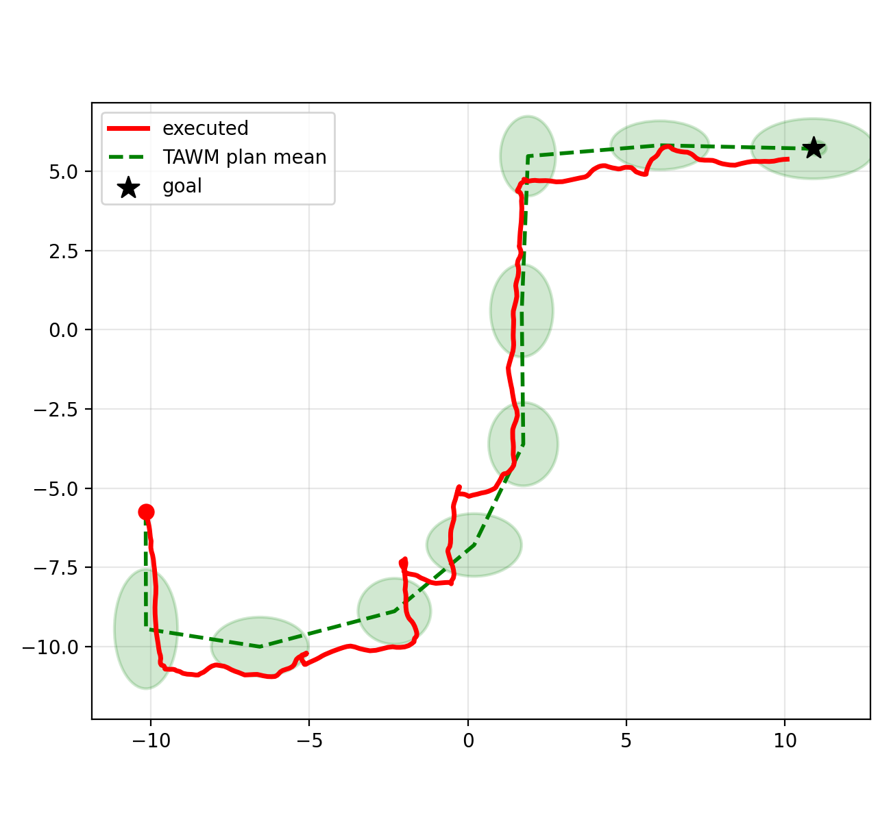

Slide 7
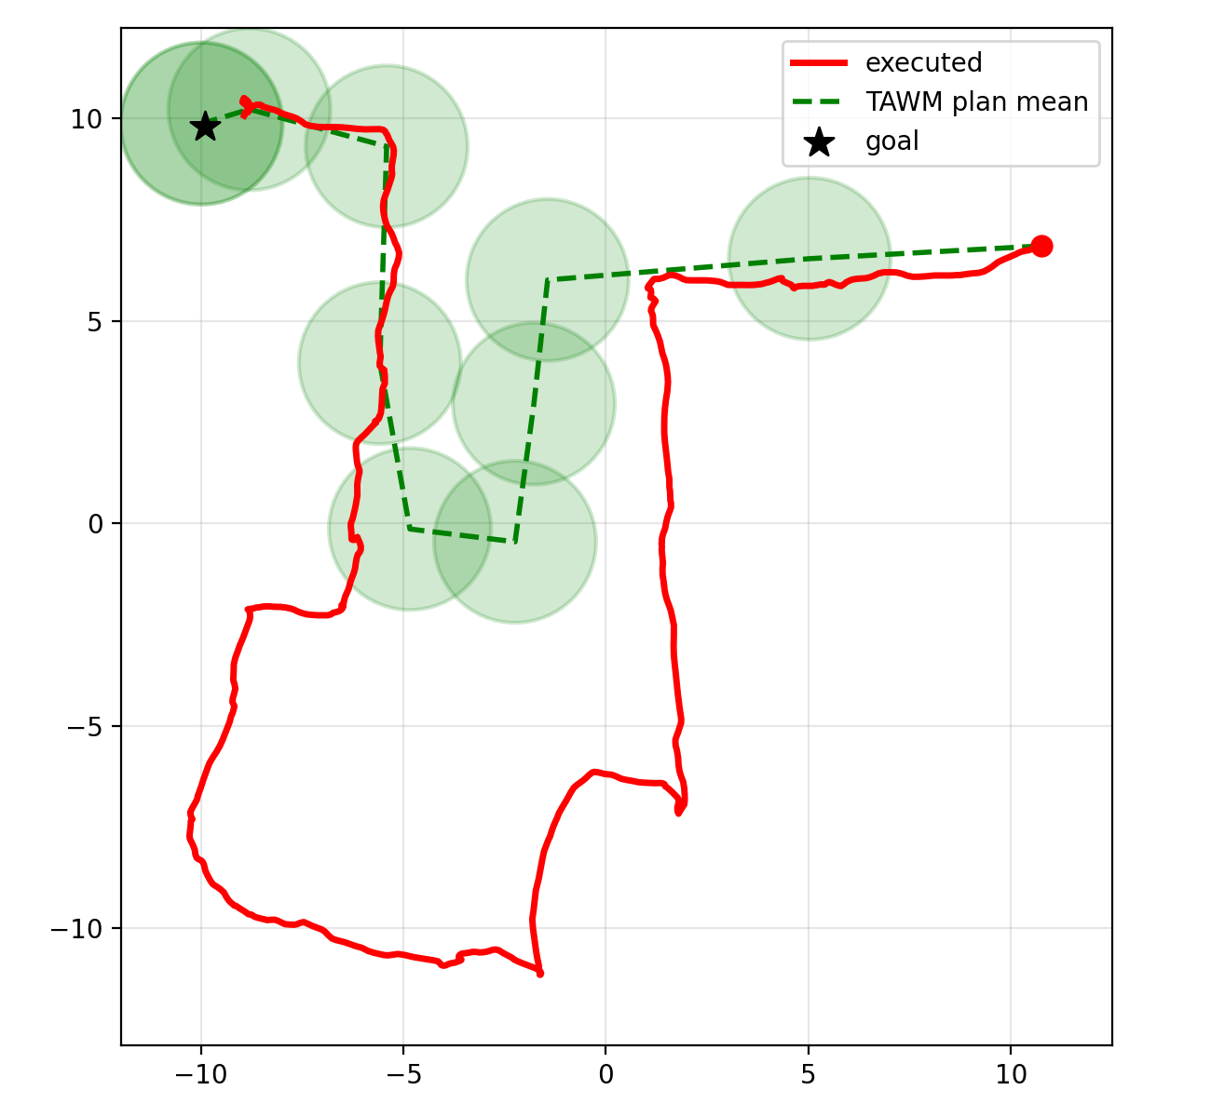

Slide 8
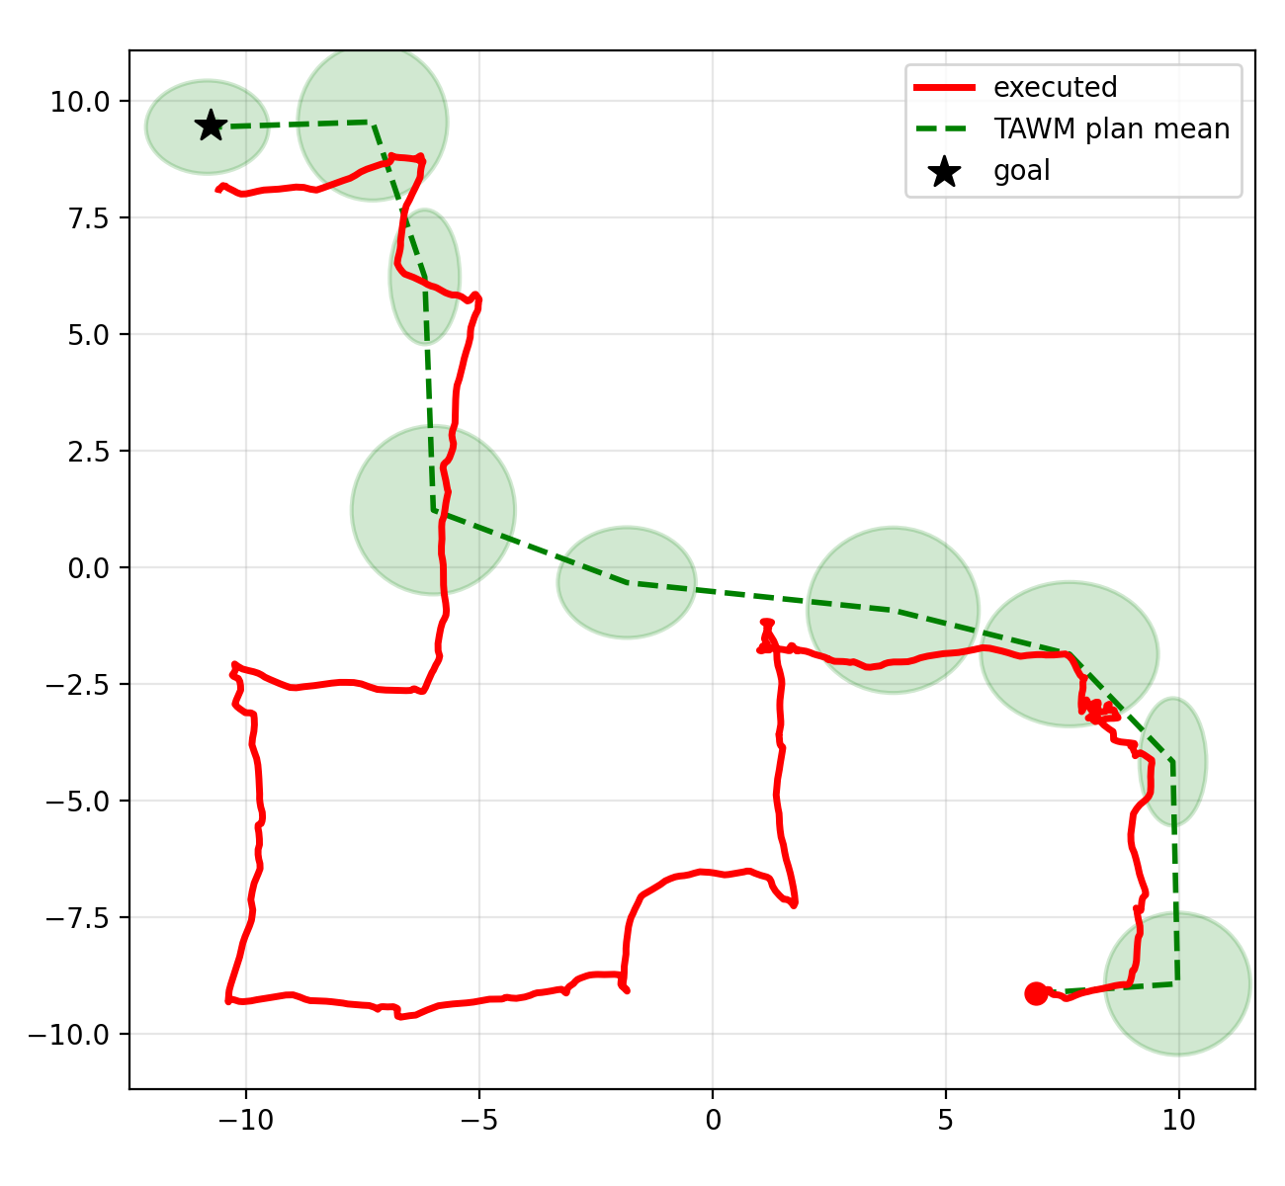

Slide 9
