Slide 1
Meeting Updates 2/22

Slide 2
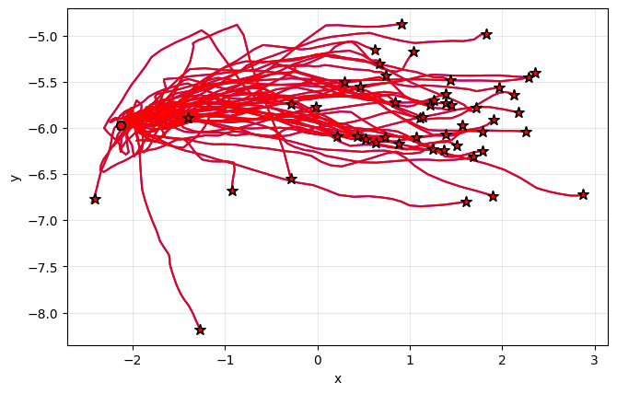
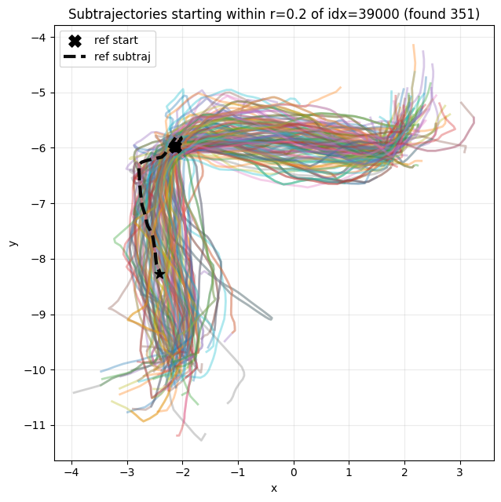
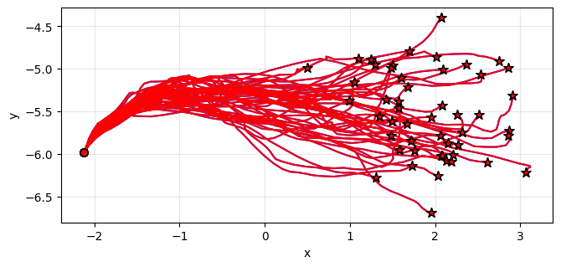
Multimodal Behavior
Rollouts of Skills Sampled from Prior Conditioned on Nearby States
Dataset Trajectories

Slide 3
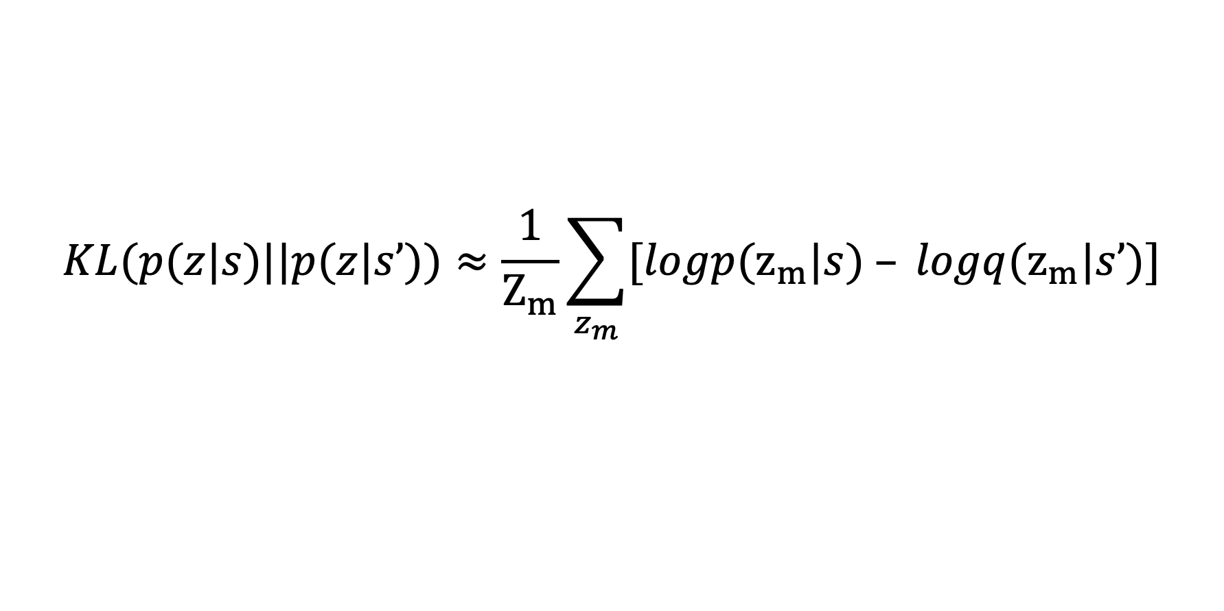
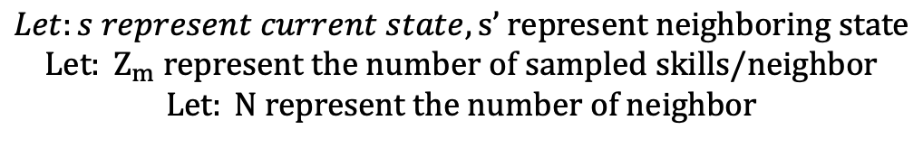
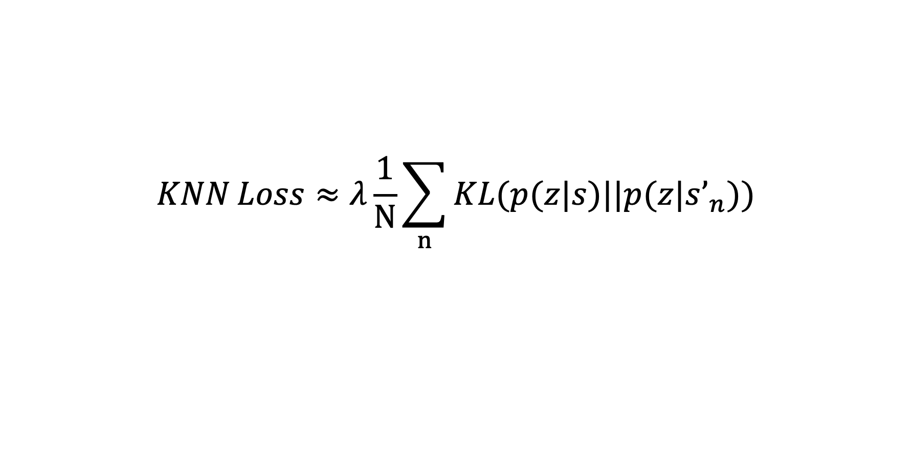
KNN Loss
$$Let:s represent current state, s’ represent neighboring state$$
$$Let: Z_{m} represent the number of sampled skills/neighbor$$
$$Let: N represent the number of neighbor$$
$$KL(p(z|s)||p(z|s’))≈\frac{1}{Z_{m}}\sum_{z_{m}}{[logp(z_{m}|s) – logq(z_{m}|s’)]}$$
$$KNN Loss≈λ\frac{1}{N}\sum_{n}{KL(p(z|s)||p(z|s’_{n}))}$$

Slide 4
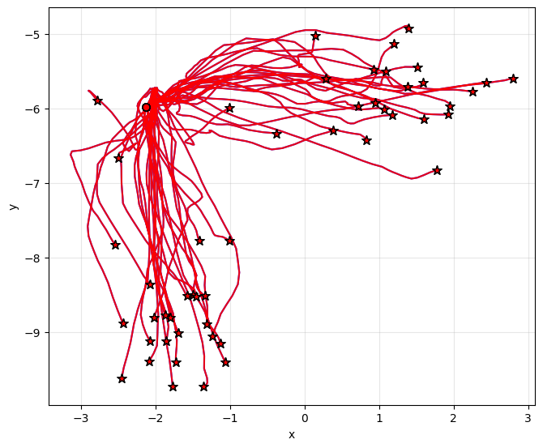
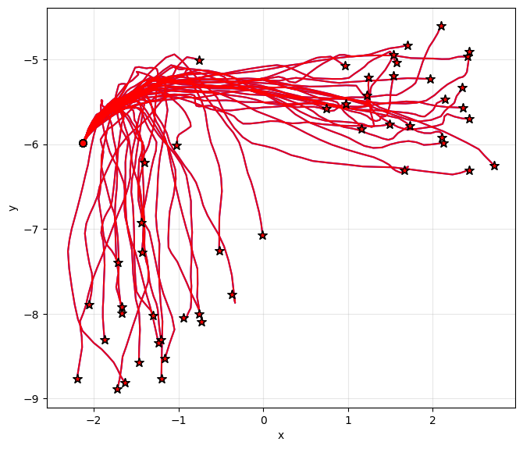
Multimodal Behavior
Rollouts of Skills Sampled from Prior Conditioned on Nearby States
Dataset Trajectories

Slide 5
Is the KNN loss necessary?
Do we want to simply deem similarity as being close in x-y position? (velocity could play a role in why skill prior does not exhibit multimodal behavior)
How well does the MoG skill prior perform in states where multimodal behavior is truly needed (approaching an intersection)?

Slide 6
Test 1: The Role of Velocity
How does multimodal behavior change when we plot nearby subtrajectories that are close in BOTH x-y location and velocity?
Subtrajectories plotted given s0:
Within radius of 0.2 from s0
Cosine similarity between velocity vectors (x_vel, y_vel, z_vel) above 0.5

Slide 7
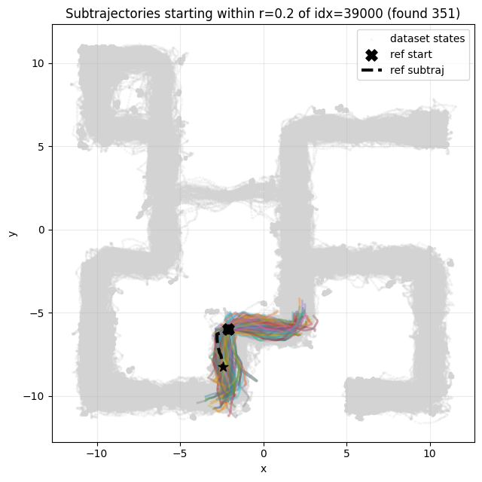
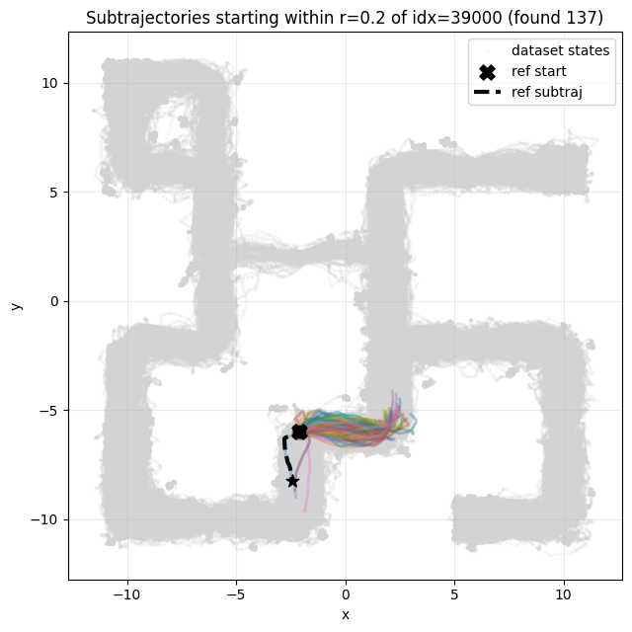

Slide 8
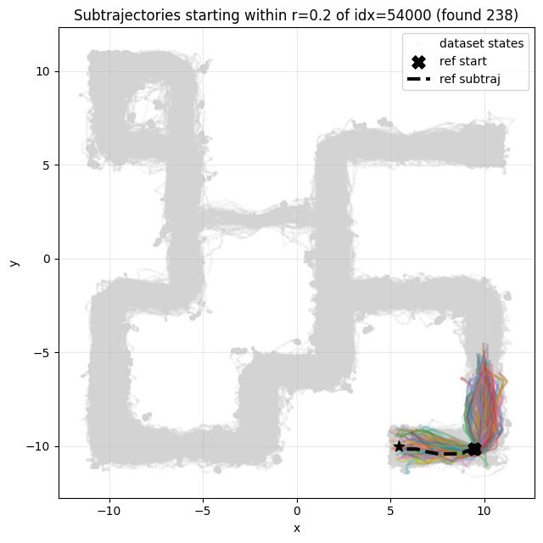
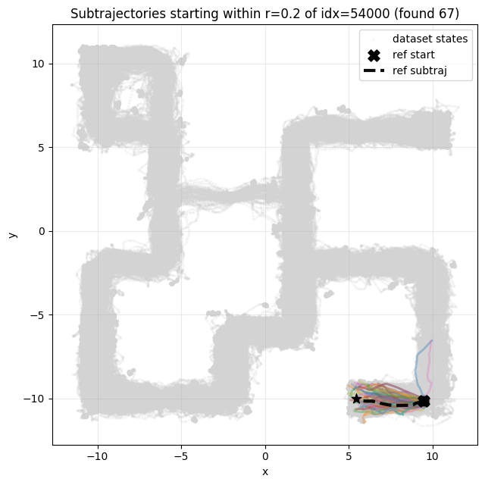
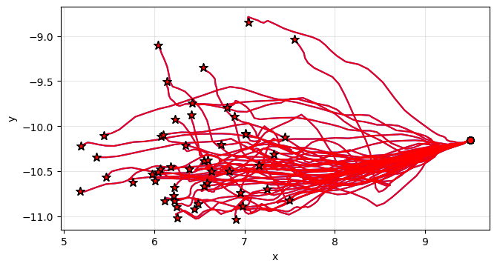

Slide 9
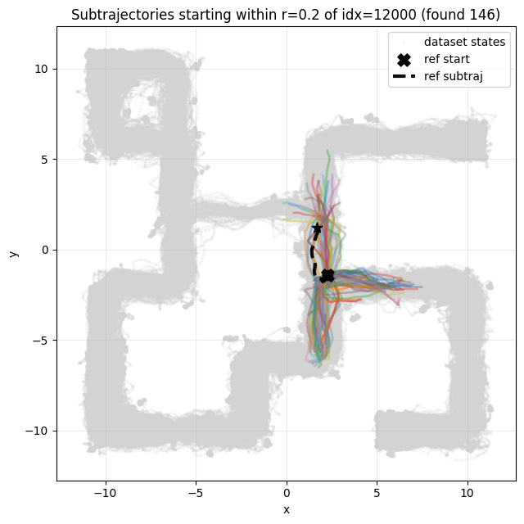
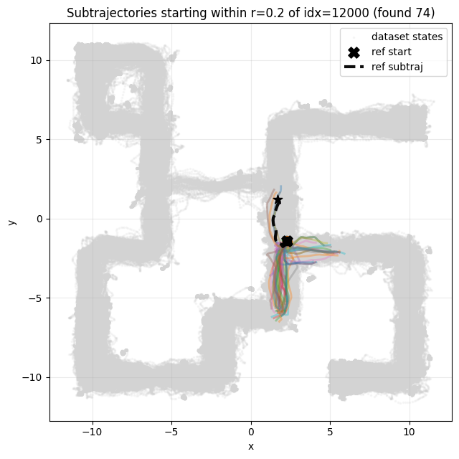
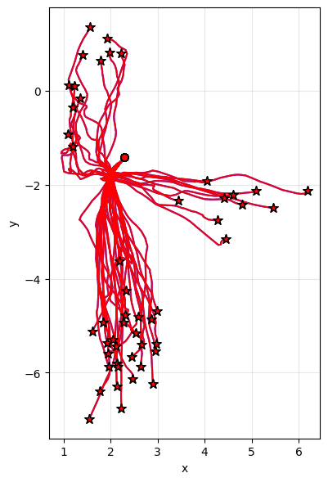

Slide 10
Test 2: MoG Prior Skills Performance in True Multimodal Scenarios
Do the skills sampled from the prior exhibit multimodal behavior when approaching branching scenarios?

Slide 11
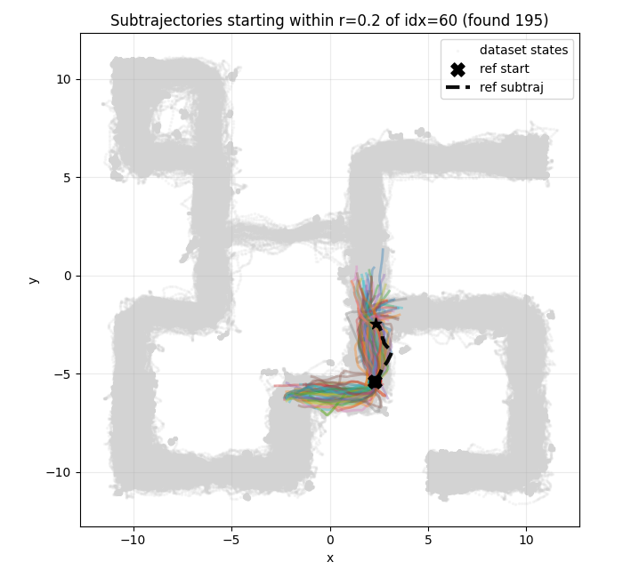
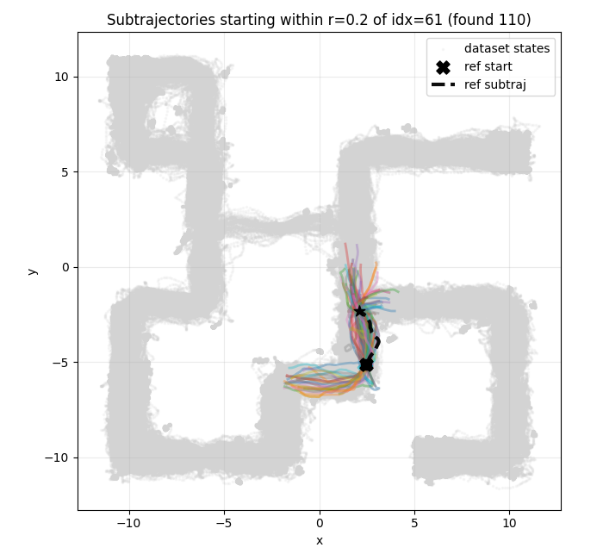

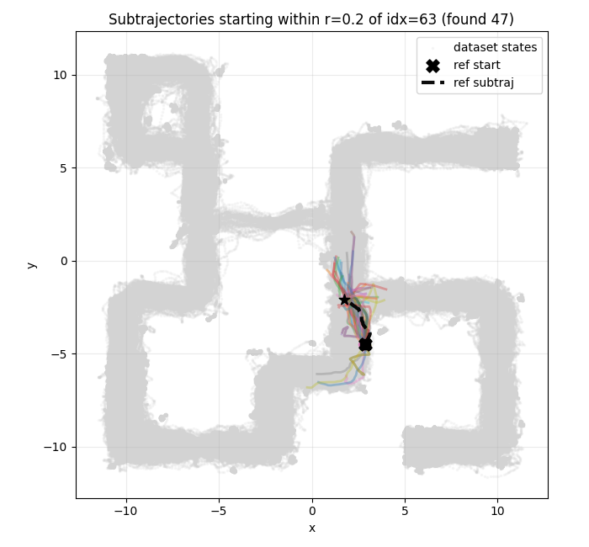
True Subtrajectories Sampled from the Training Dataset that Approach a T-Section

Slide 12
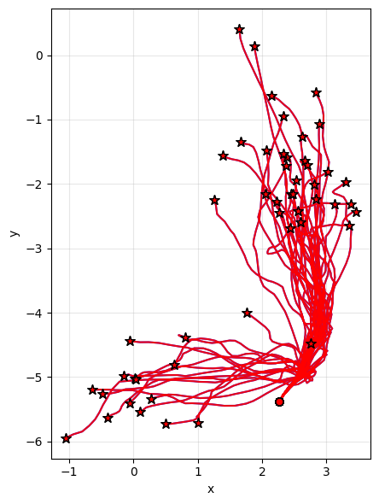
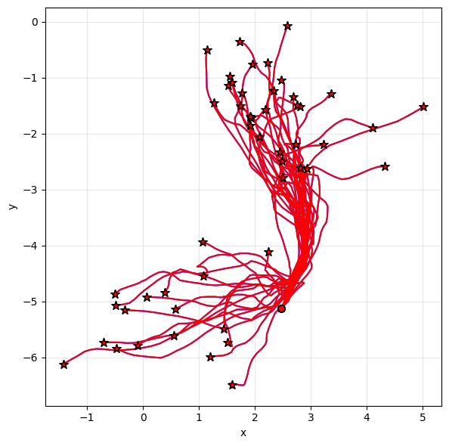
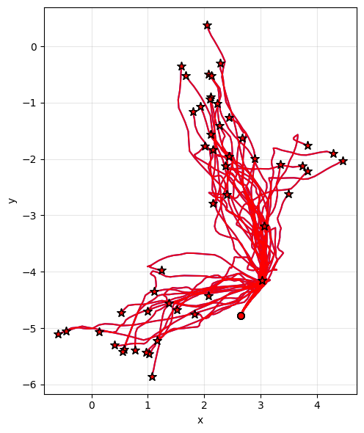
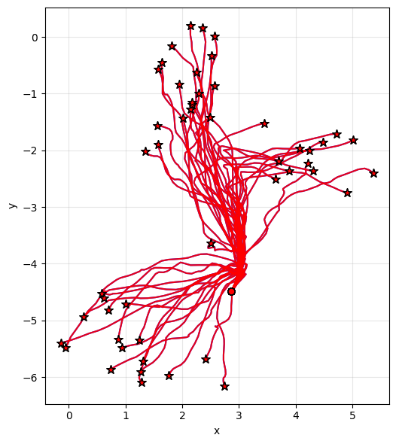
True Subtrajectories Sampled from the Training Dataset that Approach a T-Section
Skills Sampled from Corresponding Subtrajectory Start State

Slide 13
Planner Experiments
Calculated the success rate of reaching goal within 2000 policy timesteps over 500 plans
Success Rate ~ 10%

Slide 14
Changes Made (Model)
Training for more epochs
Playing around w/ the beta/gamma parameter
Reduced stride of dataset creation from 3 to 1

Slide 15
Changes Made (Planner)
Warm Start Epsilon Sequence (execute one skill eps_mean[0], then next CEM iteration gets eps_mean[1:] + zero vector for last eps
Added a cost s.t. skill sequences that get to goal earlier in plan are rewarded
Deterministic sampling from prior rather than random

Slide 16
