Slide 1
Get a Quote! State Farm Sponsored
Huy Bui
Phi Thuan Au
Duy Pham

Slide 2
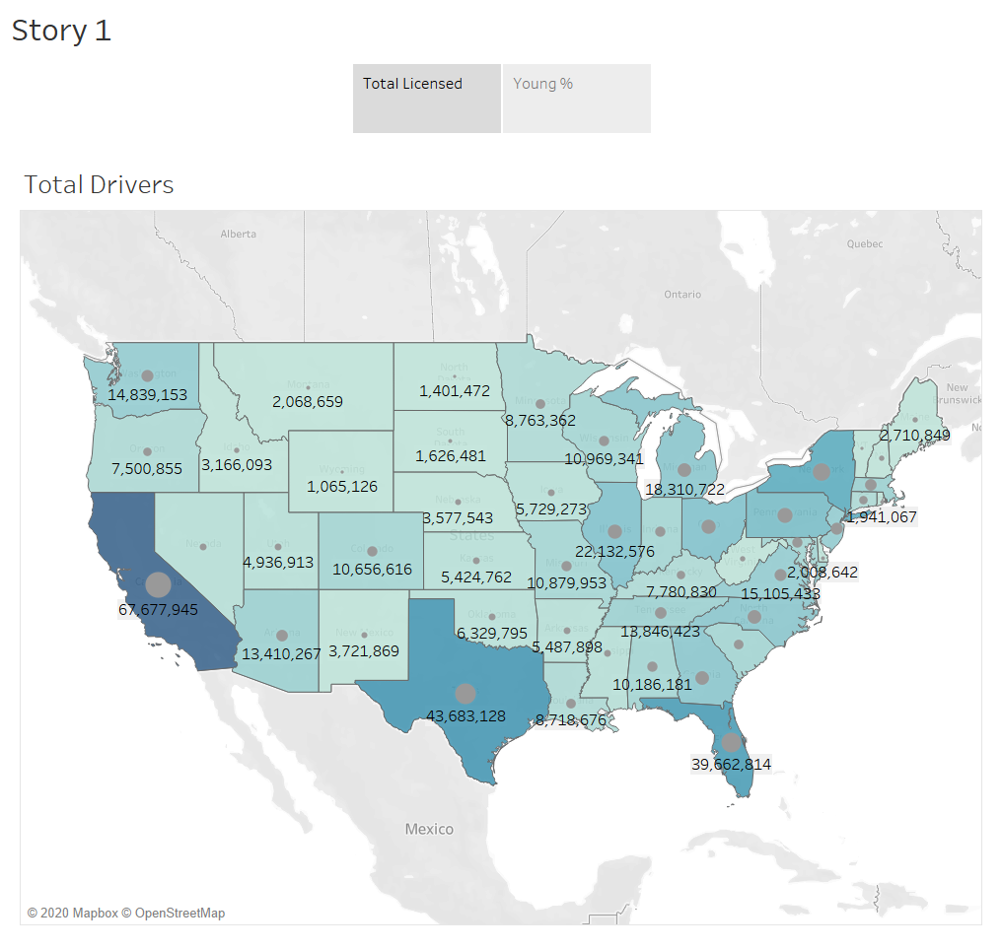

Slide 3
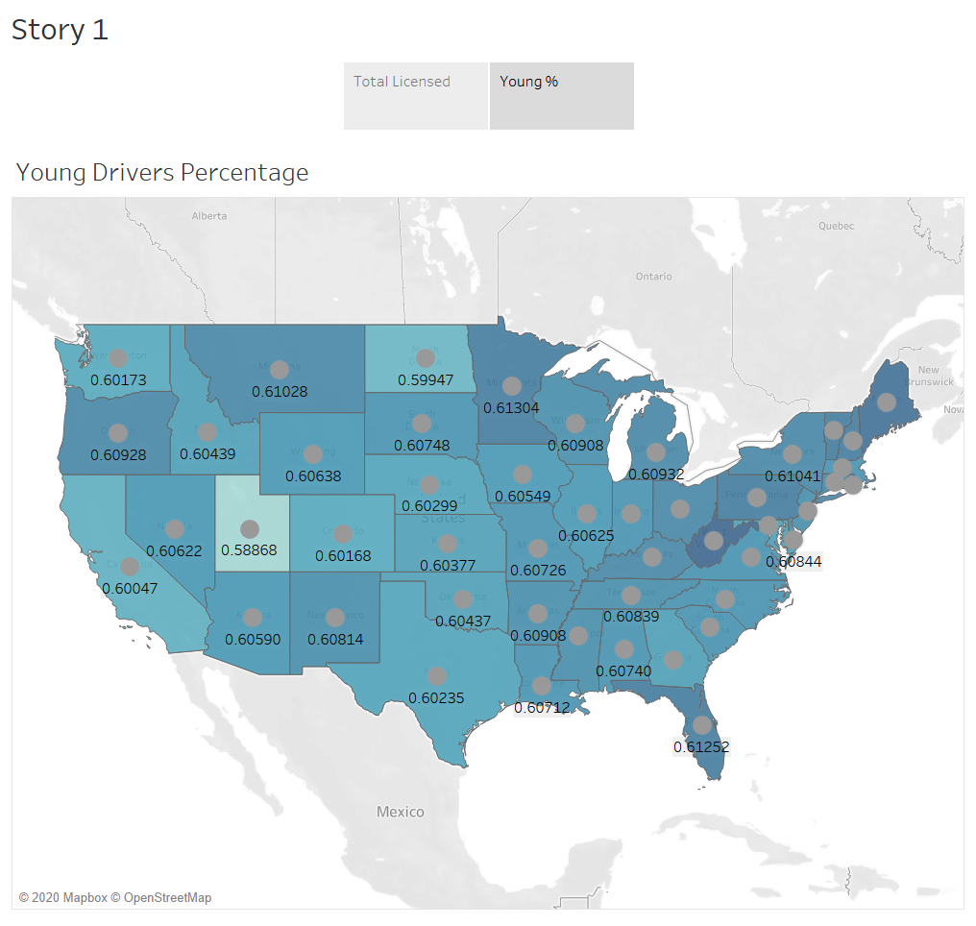

Slide 4
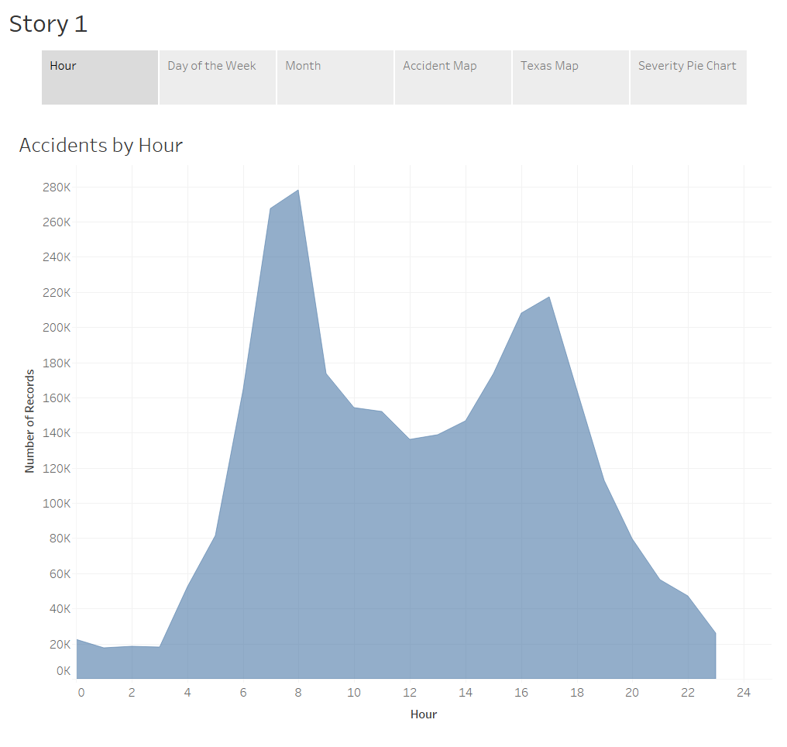

Slide 5
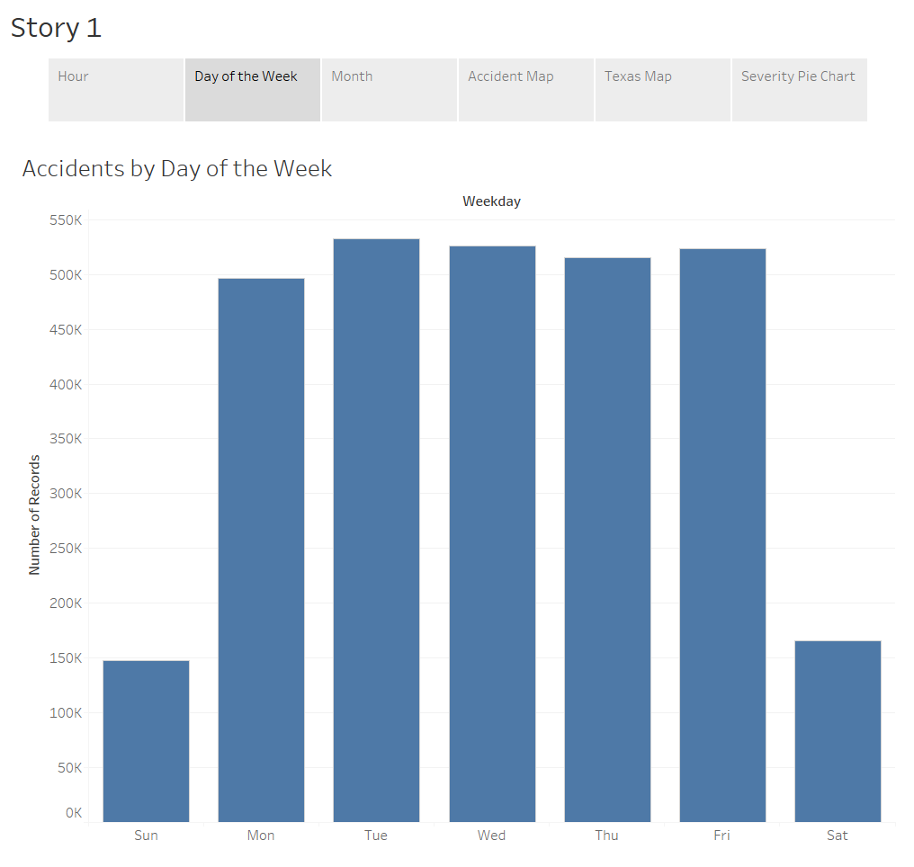

Slide 6
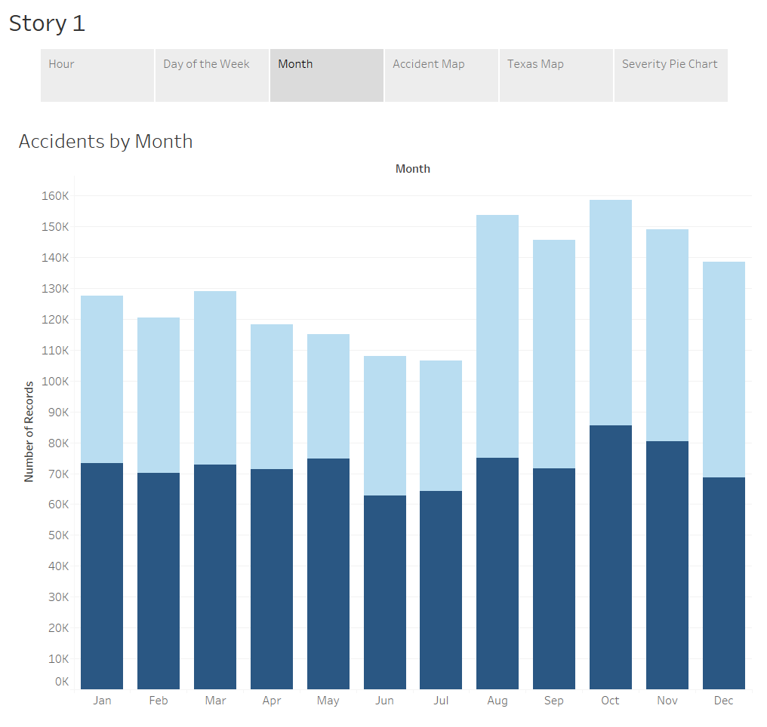

Slide 7
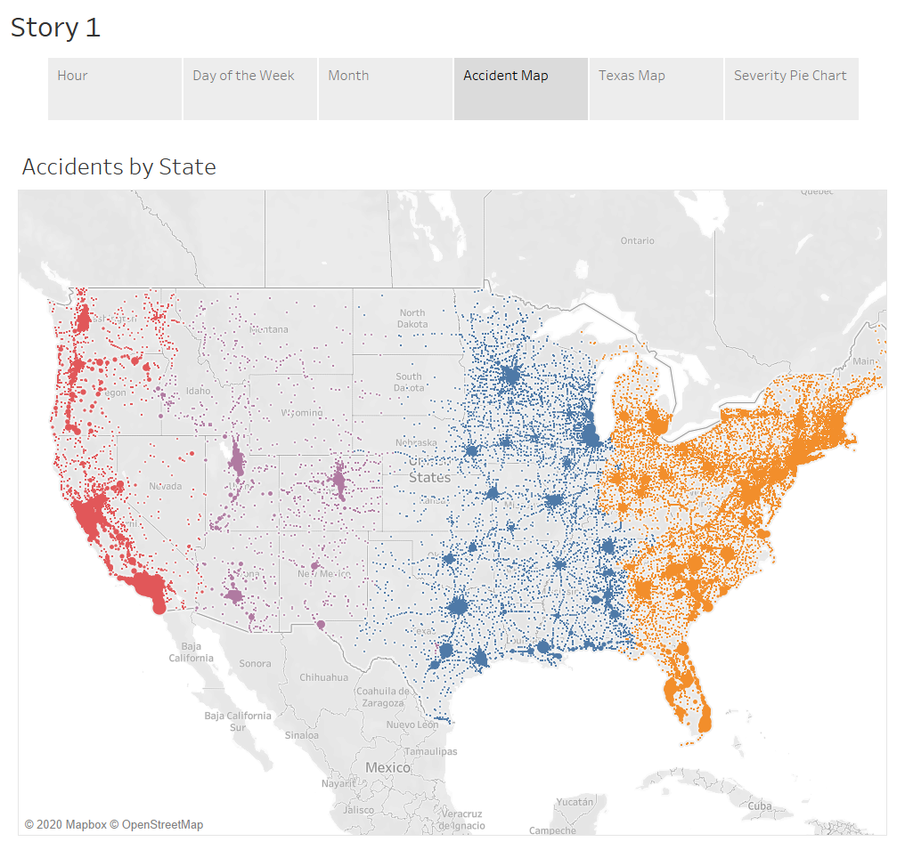

Slide 8
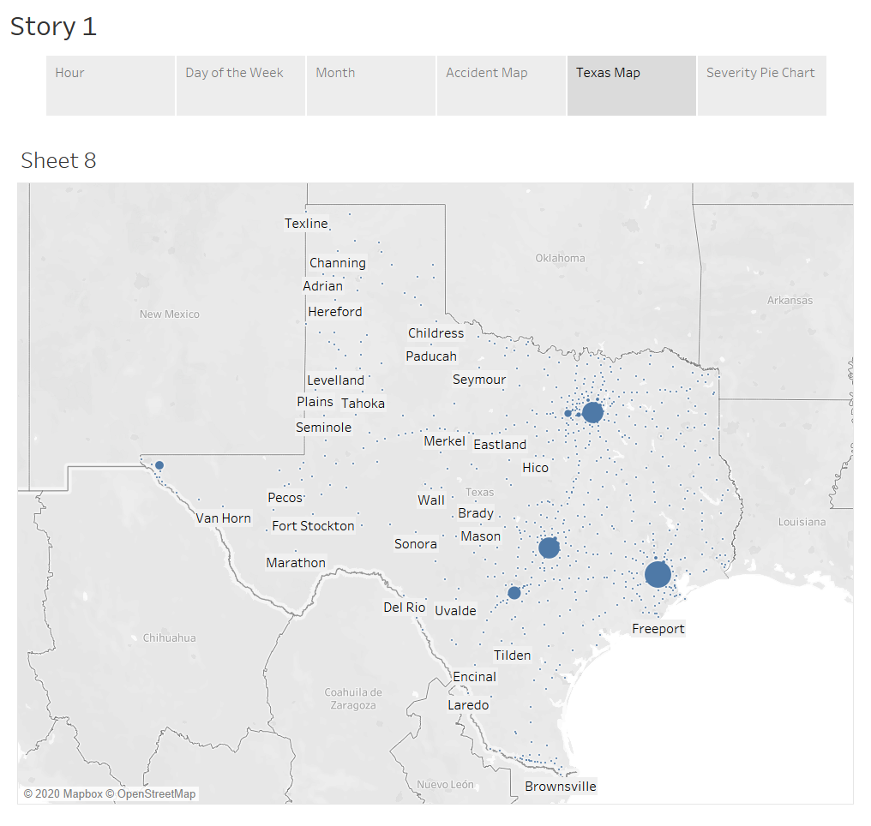

Slide 9
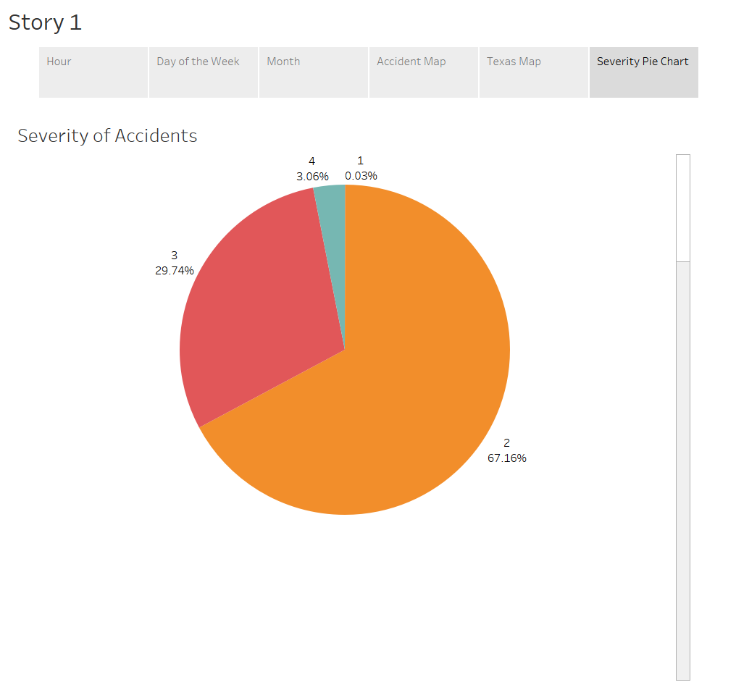

Slide 10
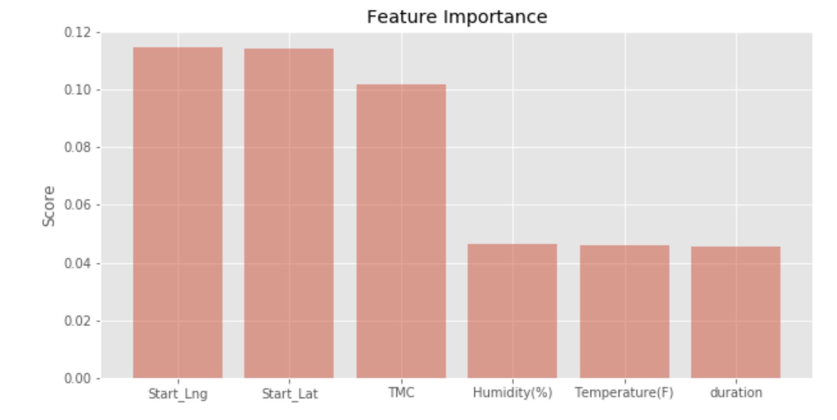

Slide 11
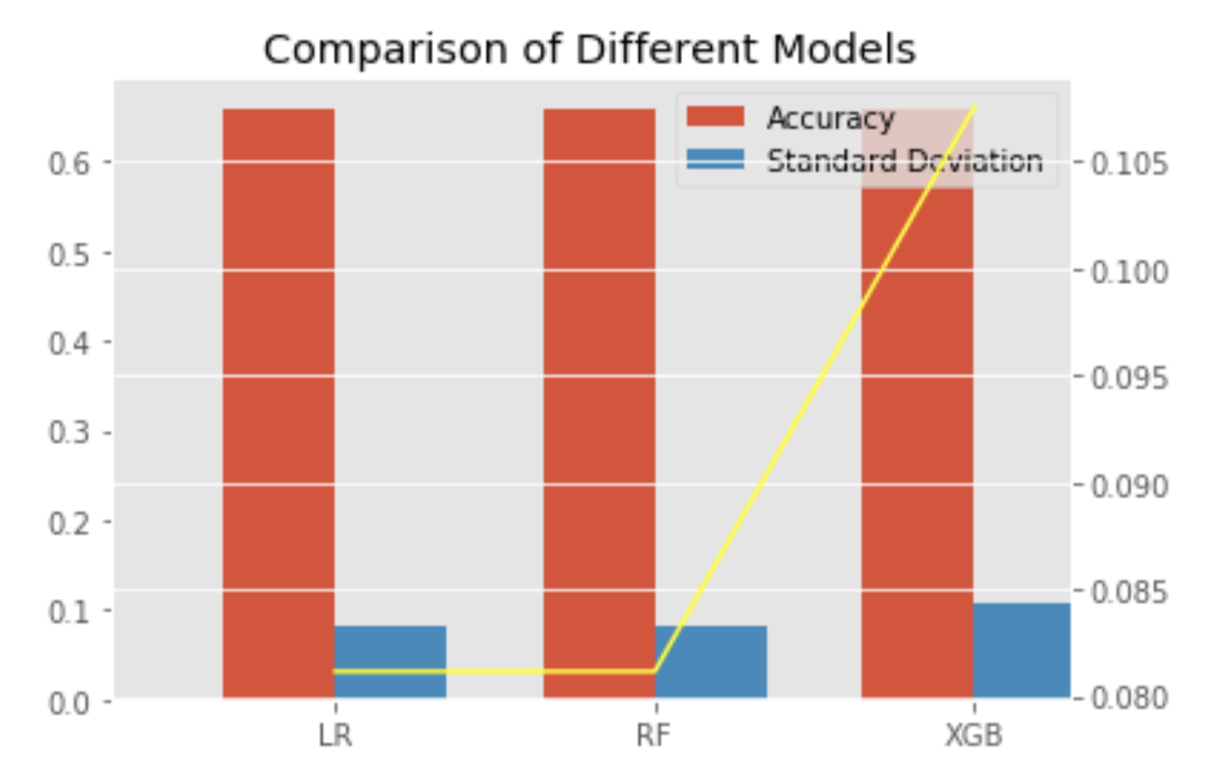

Slide 12
Machine Learning
Data: 291294 observation and 82 features
Target: Severity with 4 targets
Preprocess: handling missing values, remove outliners, feature importance, apply different encoding schemes
Model: logistic regression, Random forest, and XGB
Result: Best model is Random forest with accuracy 66% and standard deviation of 0.079

