Slide 1
Socially Responsible Investing: ESG Factor Selection using Lasso Regression
Will noone

Slide 2
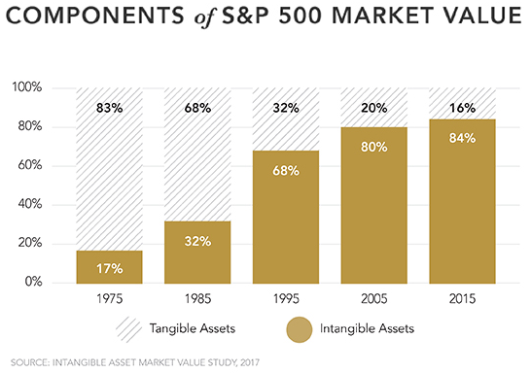
Market Values ~ Ideas & Reputation
Intangible asset (non physical)
Corporate intellectual property (patents, trademarks, copyrights and business methodologies), brand recognition, & goodwill.
What is goodwill?
In accounting terms, value of goodwill typically arises in an acquisition when a target company is purchased by an acquirer. The amount the acquiring company pays for the target company over the target’s book value usually accounts for the value of the target’s goodwill.

Slide 3
What is Socially Responsible Investing (SRI)?
SRI Firm characterized by corporate practices :
Promotion: environmental stewardship, consumer protection, human rights, and diversity.
Avoidance: production in alcohol, tobacco, fast food, gambling, pornography, weapons, contraception/abortifacients/abortion, fossil fuel refinement or the military.
Industry acronym: ESG factors- Environment, Social, Corporate Governance.
ESG indicators measure:
Environment: carbon emissions, climate change effect, pollution, waste disposal, renewable energy, resource depletion, supply chain
Social: political contributions, discrimination, diversity, community relations, human rights
Governance: cumulative voting, executive compensation, shareholders’ rights, takeover defense, staggered boards, and independent directors.

Slide 4
Question(s)
Given that intangible assets account for a significant portion of firm value, can we use LASSO coefficient estimation to determine of the available ESG factors which have the greatest impact upon market capitalization or equity price?
Comparing OLS and LASSO regression methods, which has better predictive power in terms of RMSE for our sample?

Slide 5
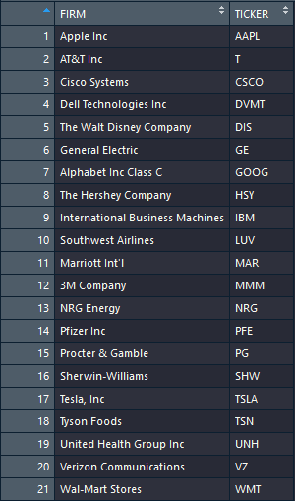
Data Sourcing
Source: Bloomberg terminal
Term: 1980 – 2017
Type: Year End measurements for (21) publicly traded firms on S&P500
Data Points: Financial line items, ESG factor measures
Challenges: ESG data is expensive, only available 2007 – present, data reporting inconsistently across firms
Assumptions: Each sequence of time series observations by firm to be stationary, each observation to be a unique instance of a firm occurring at the same moment in time
Desired Result: Increase size of data (# years * # firms), impute data gaps with median value by attribute by firm as a proxy

Slide 6
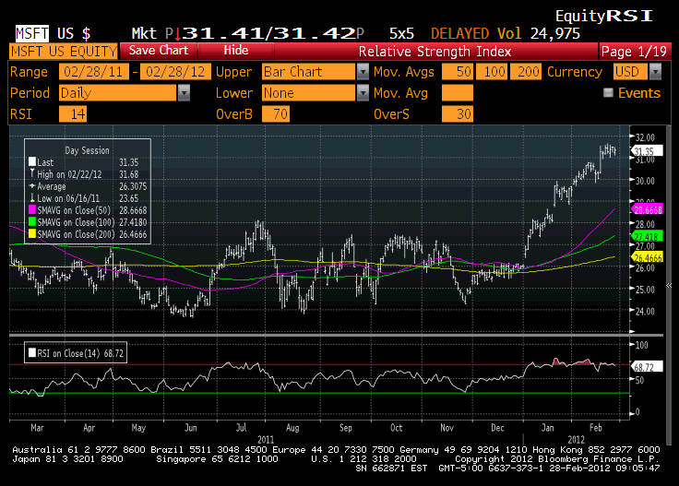
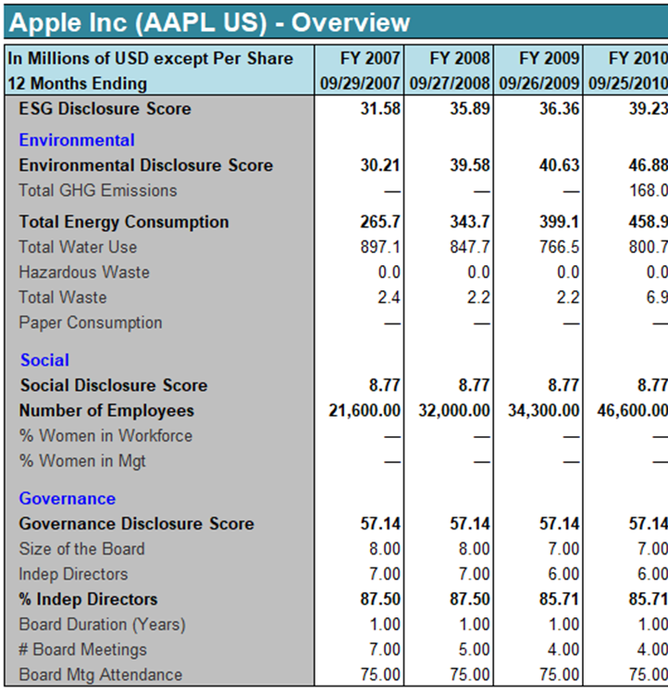
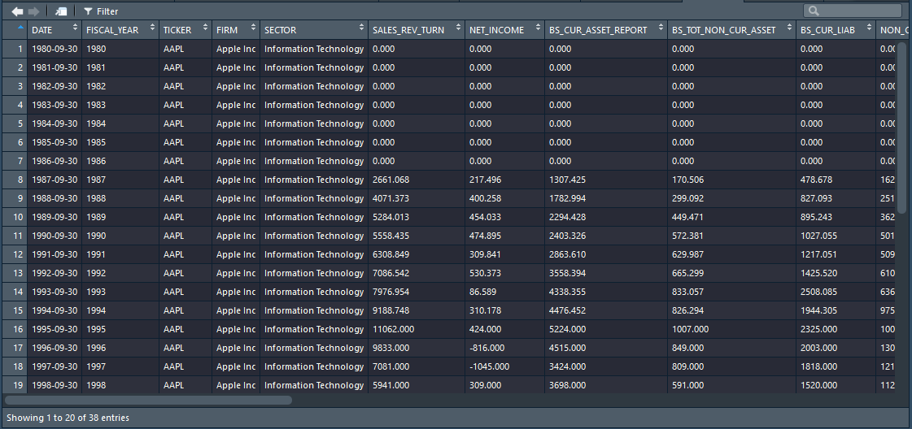
Data Preparation
Steps
Query Bloomberg terminal by TICKER
Export .xlsx reports
Consolidate to data frames using R (DYPLR) package
Impute median for NA values by TICKER
Create Feature and Target sets

Slide 7
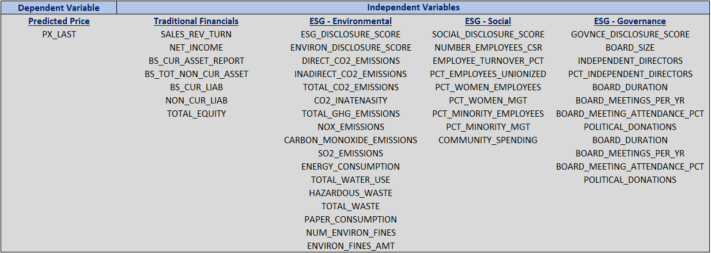
Available for Multivariate Analysis

Slide 8
Model Selection & Iterations
Perform OLS as baseline
Identify statistically significant coefficients to compare against LASSO estimates
(b) Perform Two LASSO iterations – Random Mix vs Moving Window Split Criteria
Develop a model using the standard random sample approach with a 66% Training split proportion
Develop a model using a “moving window” approach with a 66% Training split proportion representing years prior to 2004, then a Test set representing 2005 - 2017. The aim is to simulate the actual investment activity of repeated decision points based on model training immediately prior to that time.

Slide 9
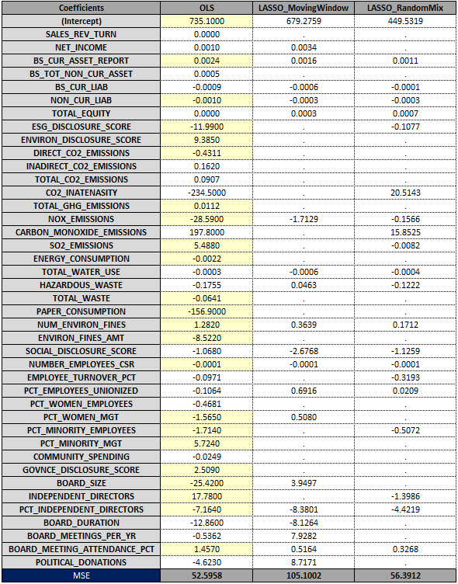
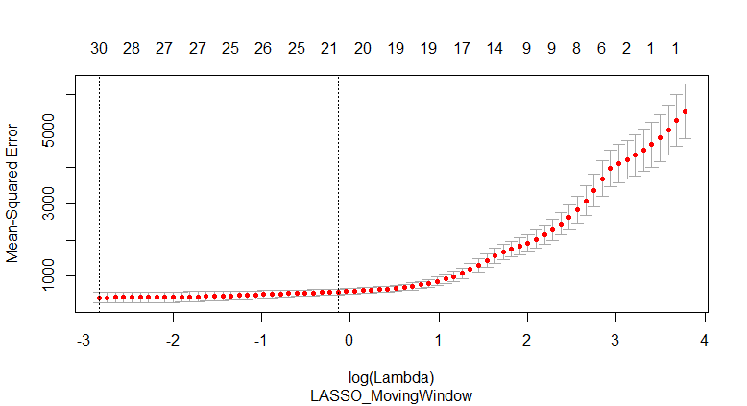
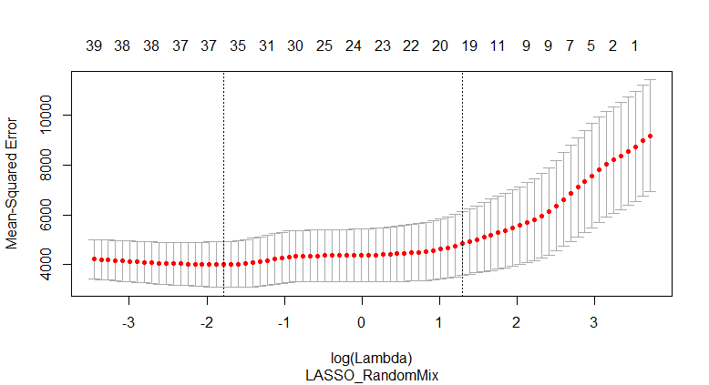
Results & Prediction

Slide 10
Ideas for Process Improvement
Limit observations to same year ~ interest rates, market sentiment, policies vary by decade
Increase data set to include 1000 - 5000 firms ~ 21 firms is too small of sample
Find firms with complete ESG data ~ median imputation could be improved upon
Compare against other regression methods ~ Ridge, Random Forest
Consider other dependent variable measures ~ volatility, market capitalization
Incorporate macroeconomic independent variables

