Slide 1


Top 50 pga Tour Earners – Chart.js
William Holmes

Slide 2
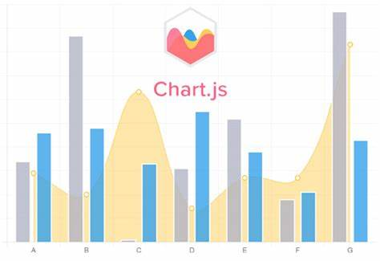
Chart.js
What is it?
A free, open-source JavaScript data visualization library
What is it useful for?
Creating responsive and interactive charts and graphs for web use.
When was it released?
Originally released in April 2013

Slide 3
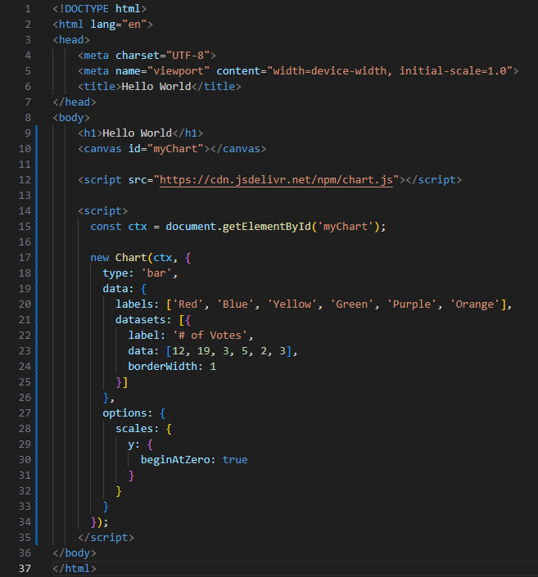
Hello world
A simple bar chart
Uses HTML Canvas
Connects to Chart.js via CDN in <script>
No Install required!
Create labels and data within new Chart object

Slide 4
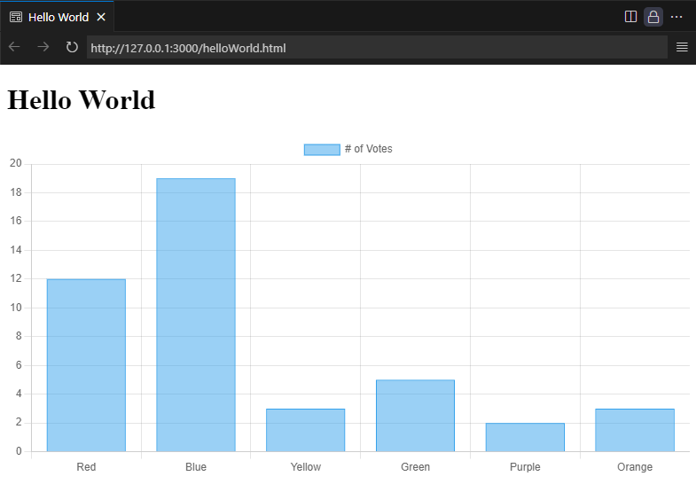

Slide 5
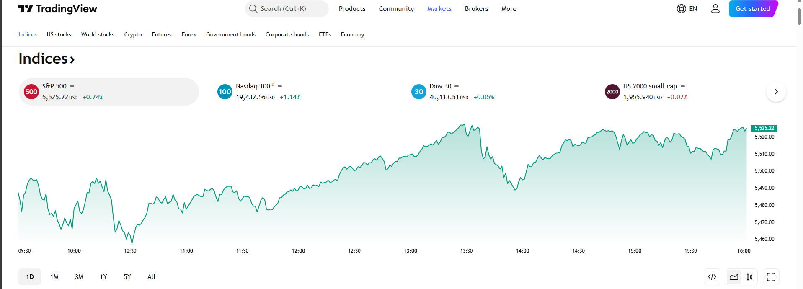
TradingView
Notes:
Markets Today — Quotes, Charts, and Events — TradingView

Slide 6
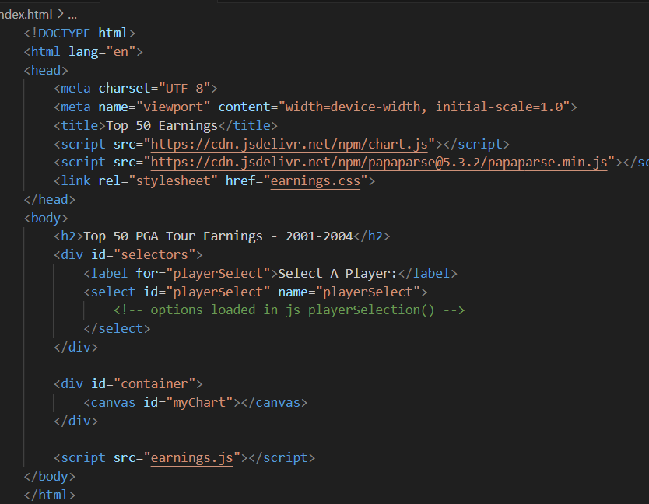
My project
Used publicly available PGA Tour dataset (.csv), to create a dynamic chart showing the Top 50 highest earning players from 2001-2024.
Used Papa.parse() to load and read the data as a csv file, then stored as an array.
Sorted to the top 50 highest earning players
Created dropdown including each top 50 player

Slide 7
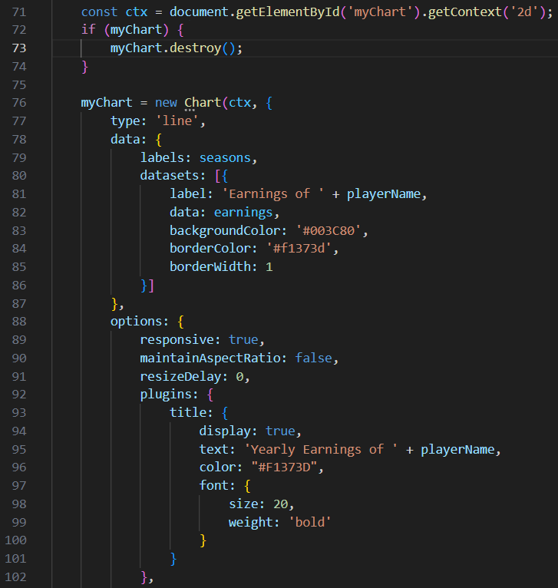
My Project
Created new line chart with sorted data
new Chart(context, config)
X-axis: Seasons (years)
Y-axis: Earnings in dollars

Slide 8
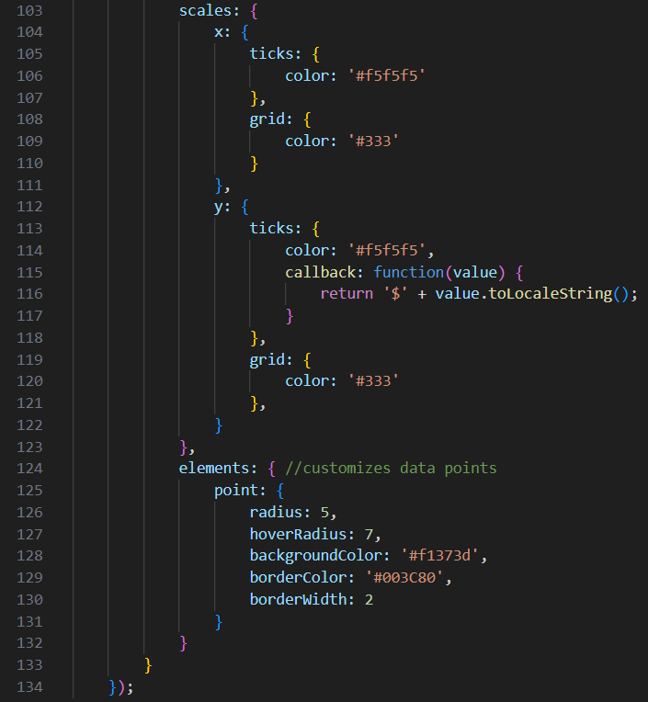
My project
Customized Axis
Titles
Values
Grid Lines
Tick Marks
Data Points

Slide 9
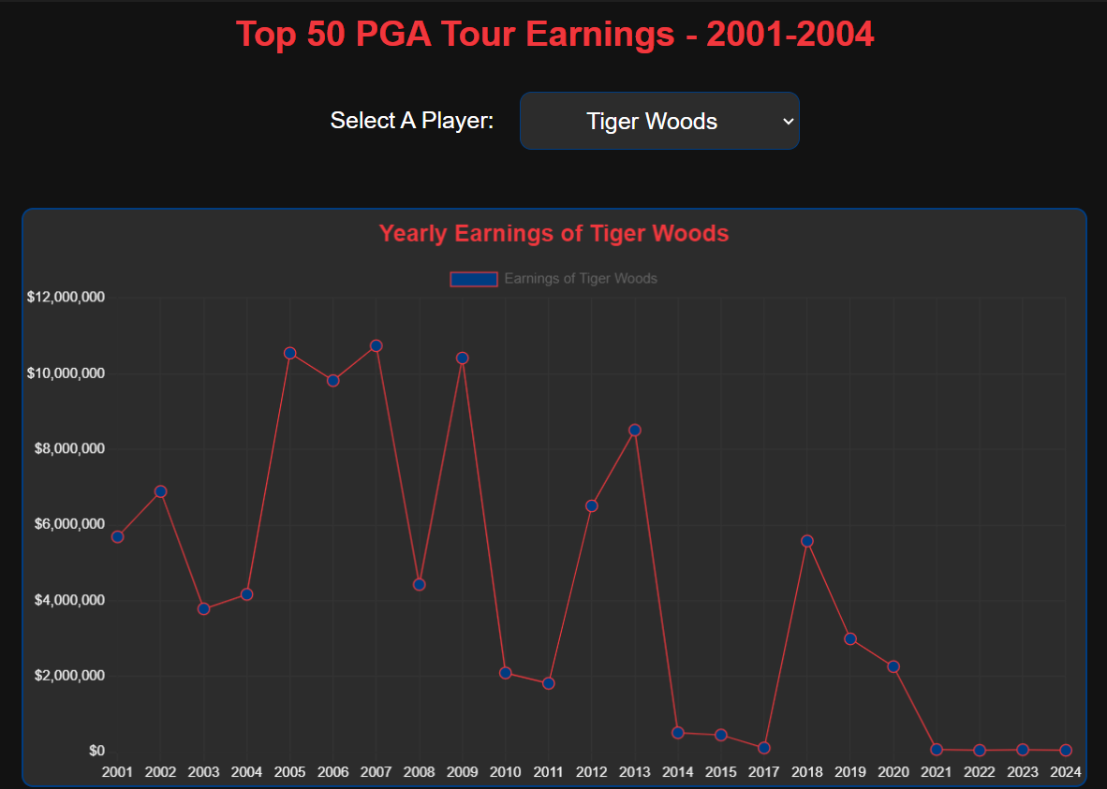
My project
After sorting, created a random player selection from the top 50 on load
Used an event listener on change to create a new chart when a new player is selected from the dropdown menu
CSS styles using PGA Tour color scheme with a modern dark theme.

Slide 10
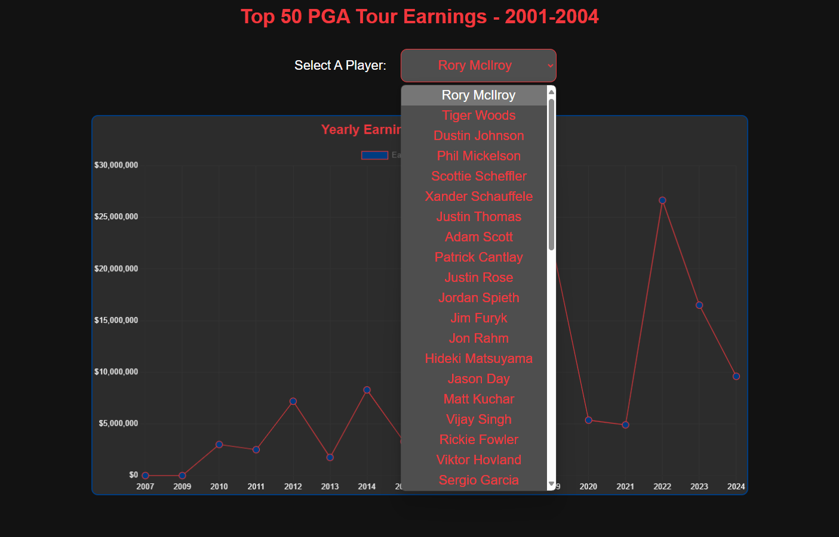

Slide 11
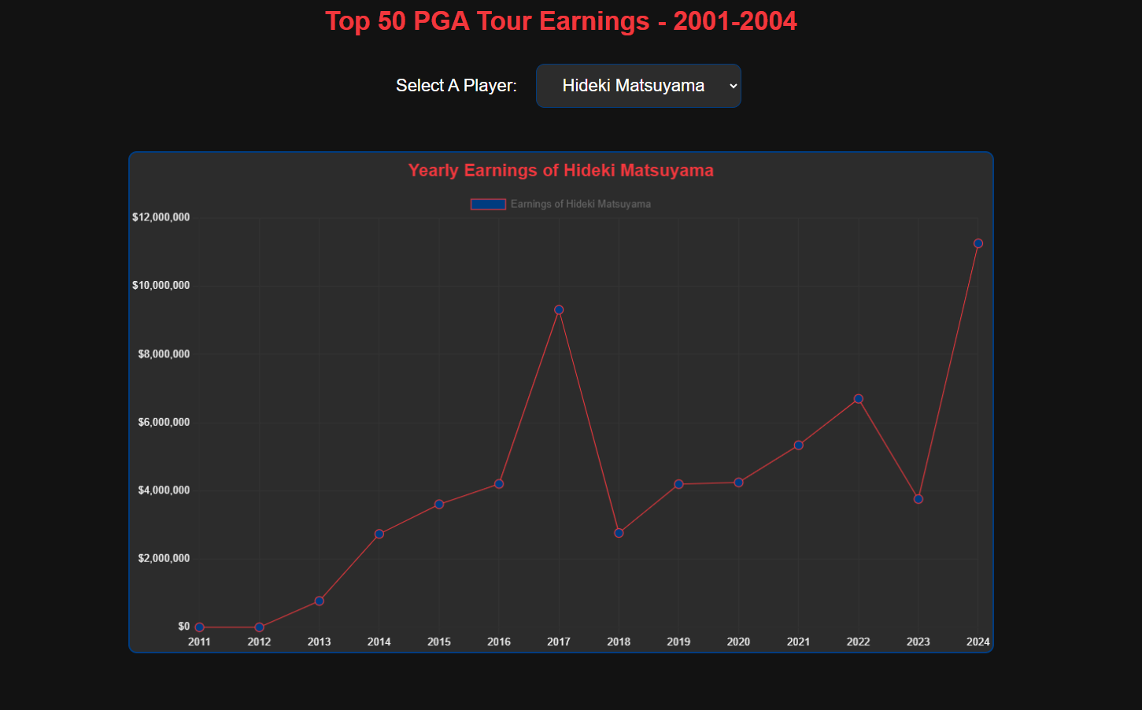
Notes:
Top 50 Earnings

