Slide 1
04/05/2023

Slide 2
This Week
Derivation Details
Plots of Melt per MYA

Slide 3

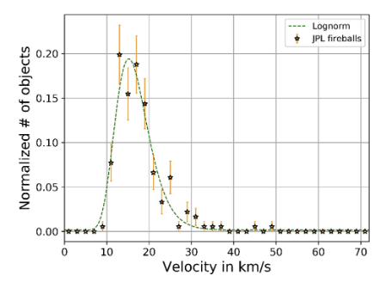
Asteroid Impact Velocity Distribution
Velocities between 9 km/s to 49 km/s are assigned to each impactor based on this distribution. Monte Carlo RNG method used to assign asteroid impactors.

Slide 4
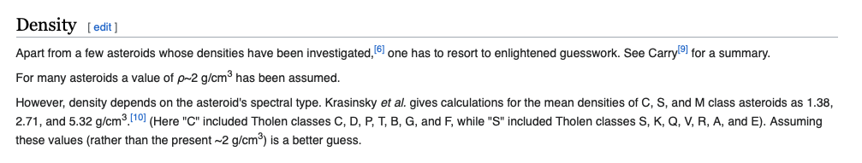
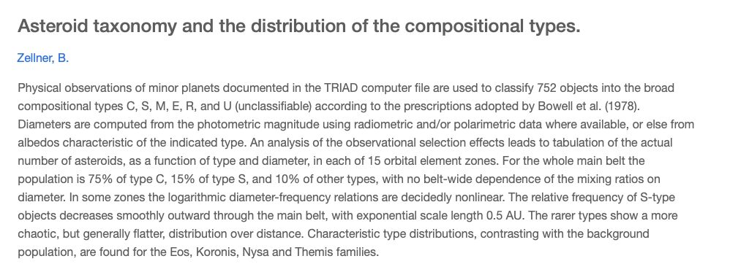
Density Distribution

Slide 5

Melosh (1989) – CH 7 & 8
$$Π_{D }={\left(\frac{πH_{at}}{8D_{at}}\right)}^{1/3}Π_{V}^{\frac{1}{3}} {\left(sinθ\right)}^{1/3 }$$
$$Π_{D }=C_{D}Π_{2}^{−β}$$
$$Π_{V}=\frac{ρ_{t}V_{disp}}{m_{p}}=\frac{m_{disp}}{m_{p}}$$
$$C_{D}=1.6 and β=0.22 for Competent Rock (Table 7.1)$$
$$\frac{m_{melt}}{m_{disp}}=\left(1.6×{10}^{−7}\right){\left(gD_{at}\right)}^{0.83}v_{i}^{0.33}$$
$$D_{at}=1.8ρ_{p}^{0.11}ρ_{t}^{−\frac{1}{3}}g^{−0.22}L^{0.13}W^{0.22}$$
$$V_{p}=\frac{4}{3}π{\left(\frac{L}{2}\right)}^{3}$$
$$m_{p}=ρ_{p}V_{p}$$
$$W=\frac{1}{2}m_{p}v_{i}^{2}$$
$$\frac{H_{at}}{D_{at}}=\frac{1}{2.7} (For Simple Craters)$$
$$m_{melt}=m_{p}{\left(1.6{\left(\frac{1.61gL}{v_{i}^{2}}\right)}^{−0.22}{\left(\frac{π}{8}⋅\frac{1}{2.7}\right)}^{−\frac{1}{3}}{\left(\sin\left(θ\right)\right)}^{−\frac{1}{3}}\right)}^{3}\left(1.6×{10}^{−7}\right){\left(gD_{at}\right)}^{0.83}v_{i}^{0.33}$$

Slide 6
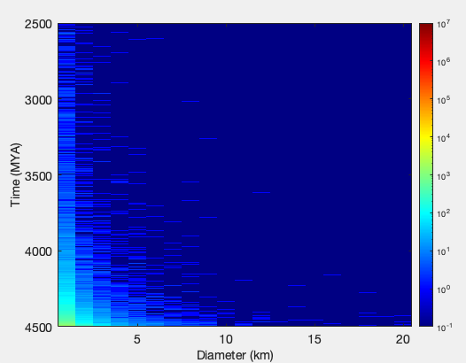
Asteroid count per diameter (1-20km) per MYA

Slide 7
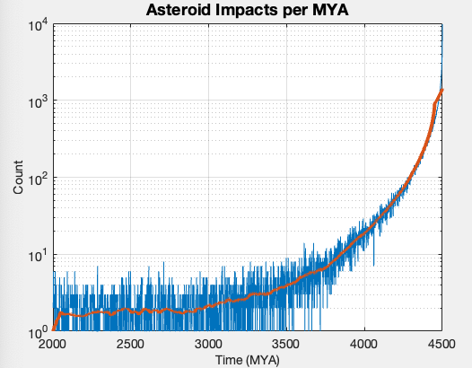
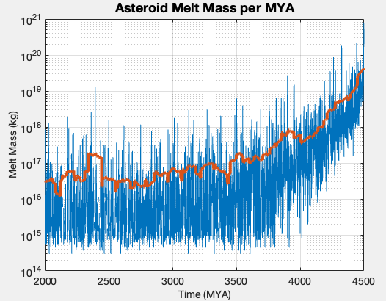
Asteroid Impacts and Melt Mass per MYA

Slide 8
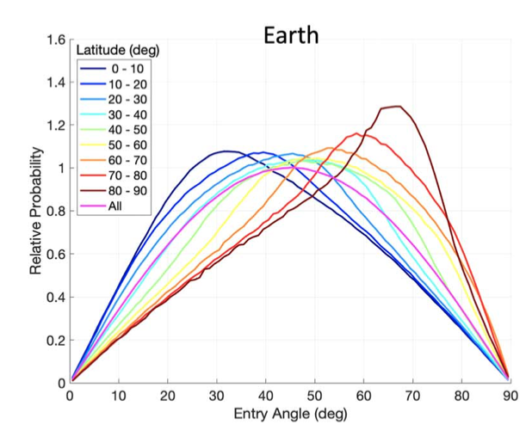
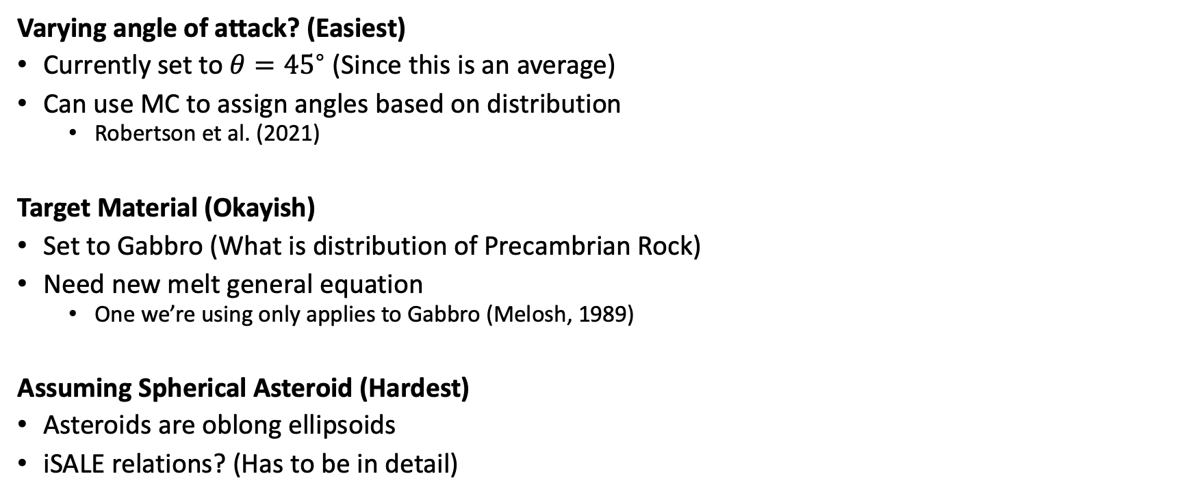
Possible Improvements to Constants
Varying angle of attack? (Easiest)
Currently set to ${θ=45}^{∘}$ (Since this is an average)
Can use MC to assign angles based on distribution
Robertson et al. (2021)
Target Material (Okayish)
Set to Gabbro (What is distribution of Precambrian Rock)
Need new melt general equation
One we’re using only applies to Gabbro (Melosh, 1989)
Assuming Spherical Asteroid (Hardest)
Asteroids are oblong ellipsoids
iSALE relations? (Has to be in detail)

Slide 9
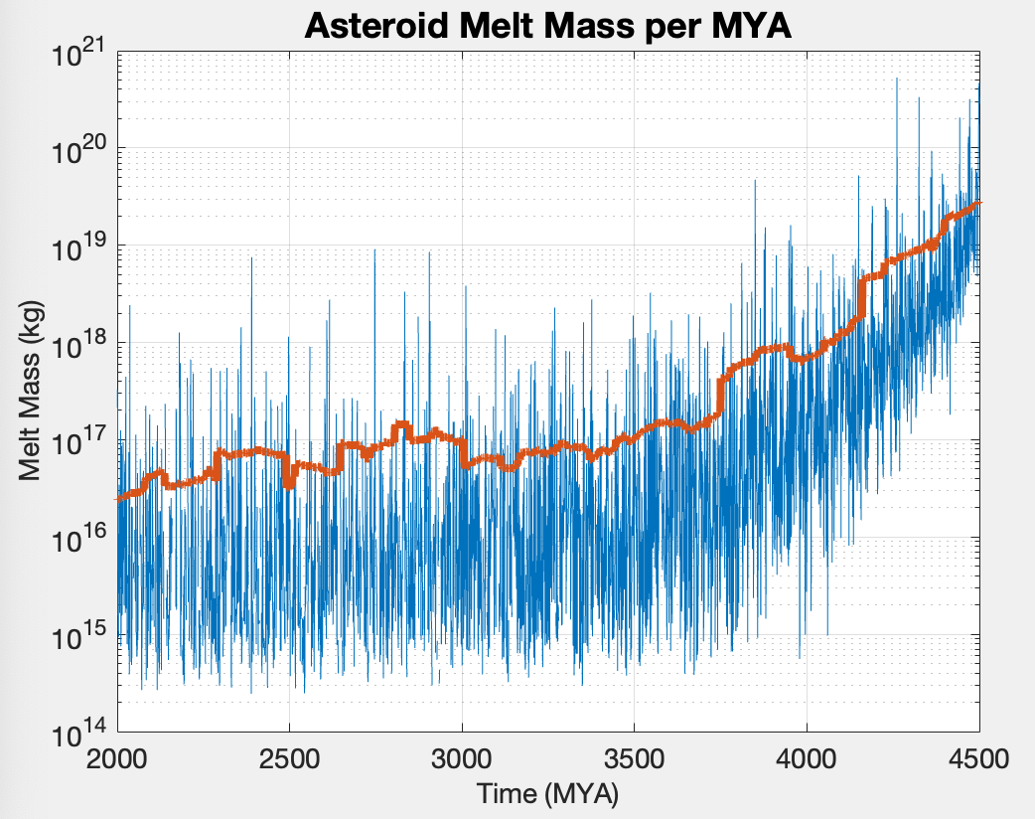
Asteroid Impacts and Melt Mass per MYA (Angle Variation Included)
Notes:
Andrew Moodie - Tim's website

Slide 10
Next Steps

