Slide 1
04/10/2023

Slide 2
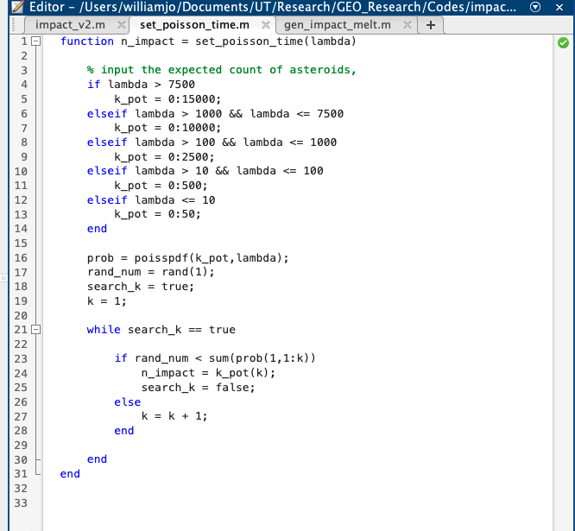

New Changes
Implemented Poisson Process
MATLAB has specific function called
Poisspdf(k_pot, lambda)
Cannot do our own because Matlab cannot multiply big numbers by big numbers.

Slide 3
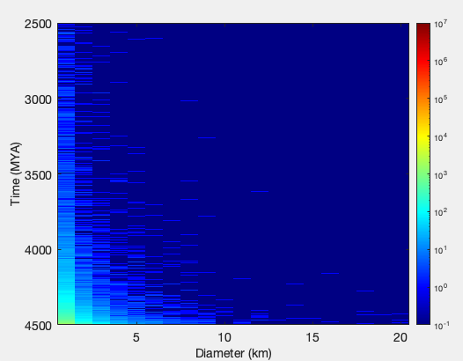
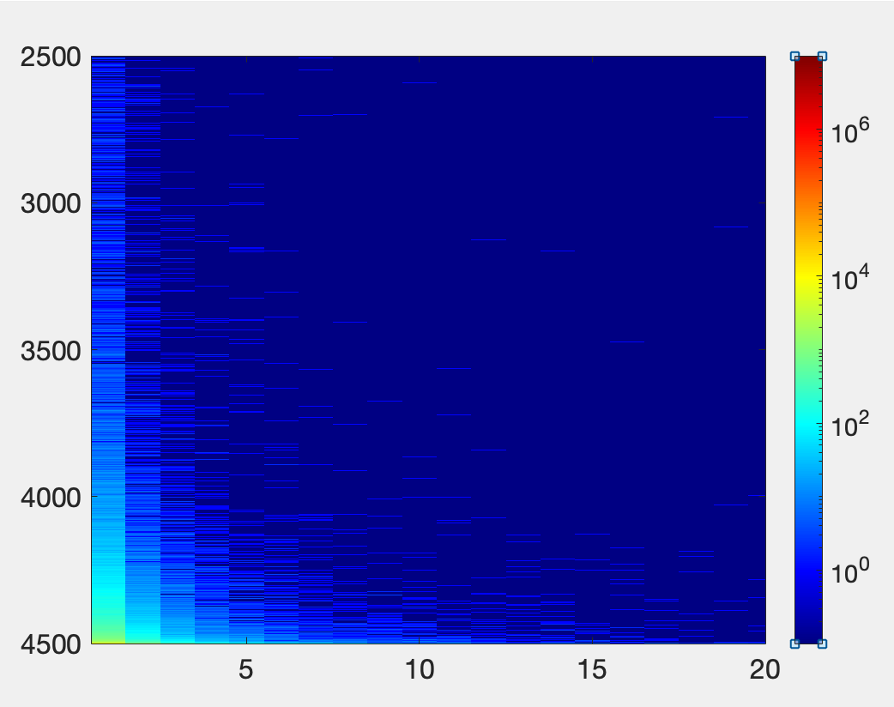
Asteroids
BEFORE
AFTER

Slide 4
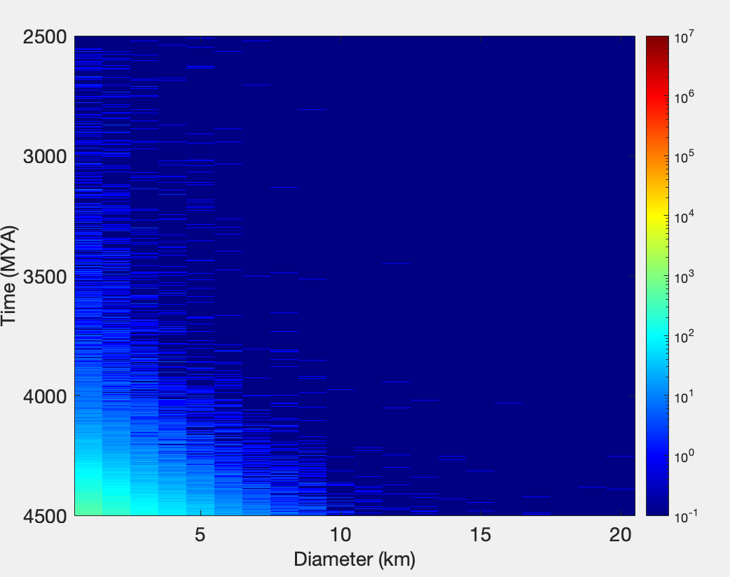
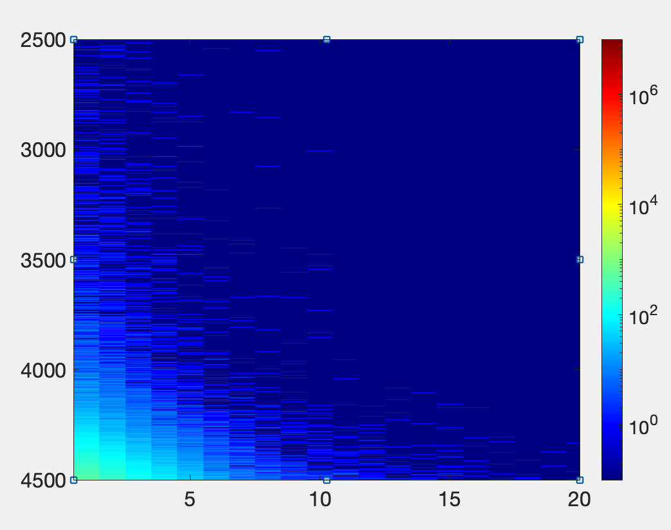
Comet
BEFORE
AFTER

Slide 5
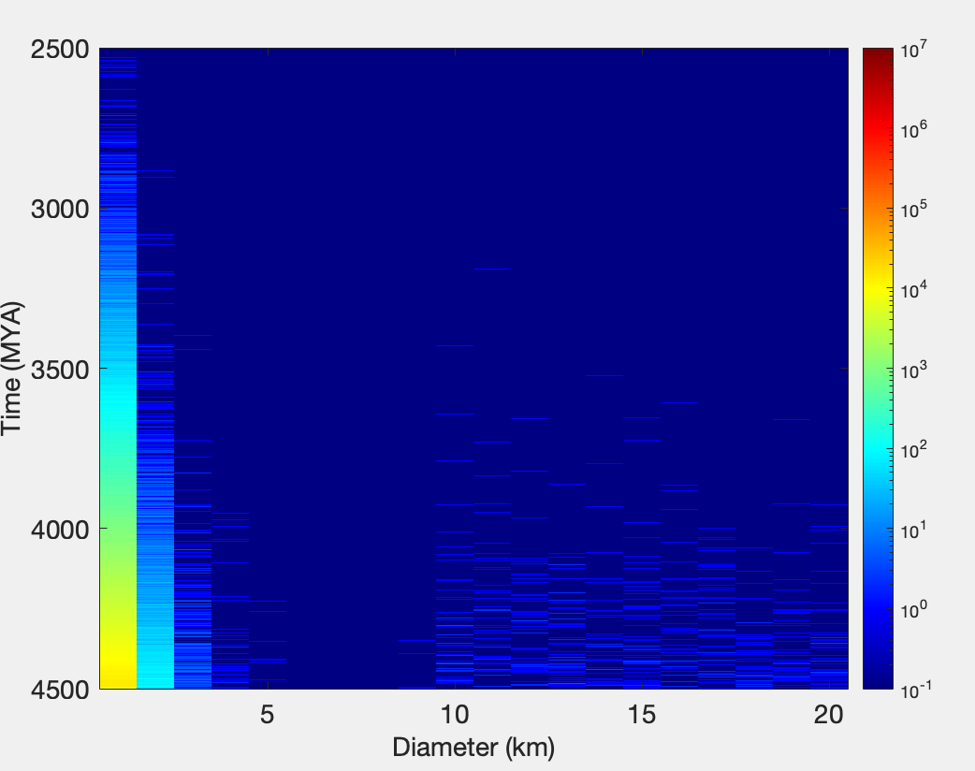
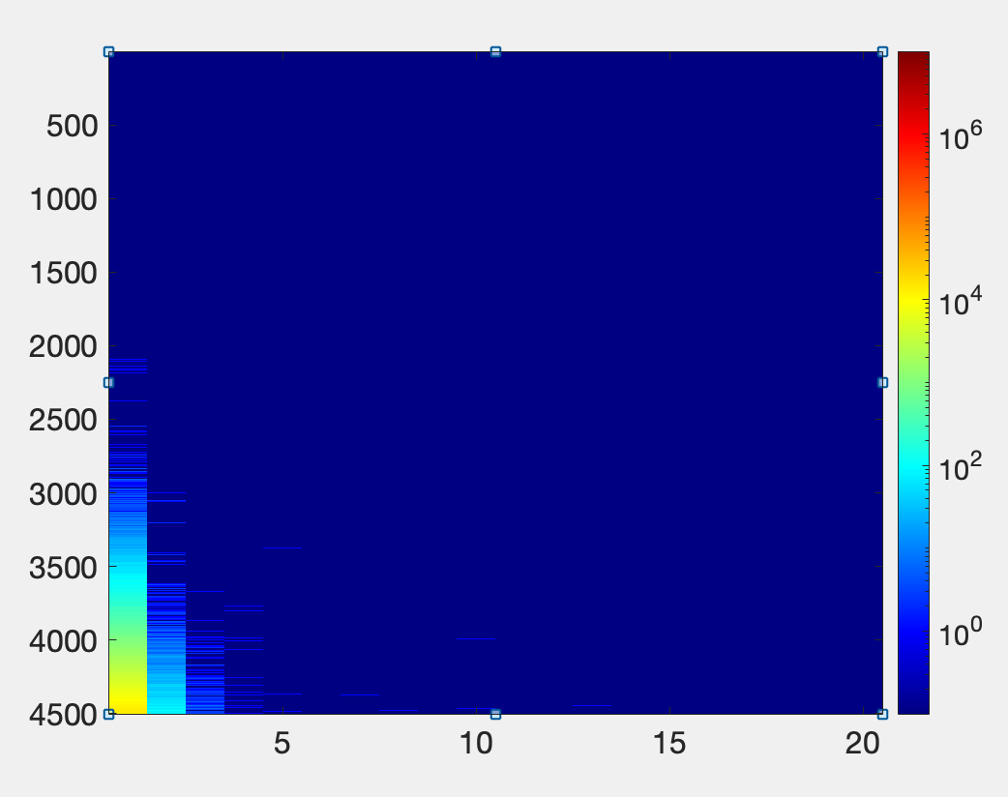
Planetesimal
BEFORE
AFTER

Slide 6
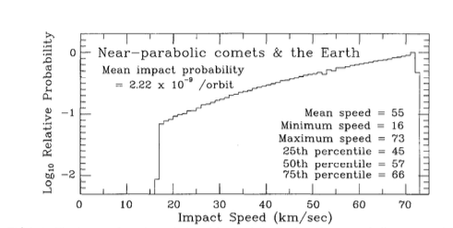
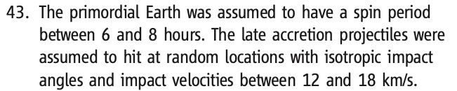
Assumptions & Sources
Comet Velocity Distribution
Planetesimal Velocity Distribution
Steel (1997) - Distributions and moments of asteroid and comet impact speeds upon the Earth and Mars
Bottke et al. (2010) - Stochastic Late Accretion to Earth, the Moon, and Mars

Slide 7
Assumptions and Sources
Comet Density Distribution
Weissmann et al (2008) - Structure and Density of Cometary Nuclei
Planetesimal Density Distribution
Kokubo and Ida (2012) – Dynamics and Accretion of Planetestimals

Slide 8
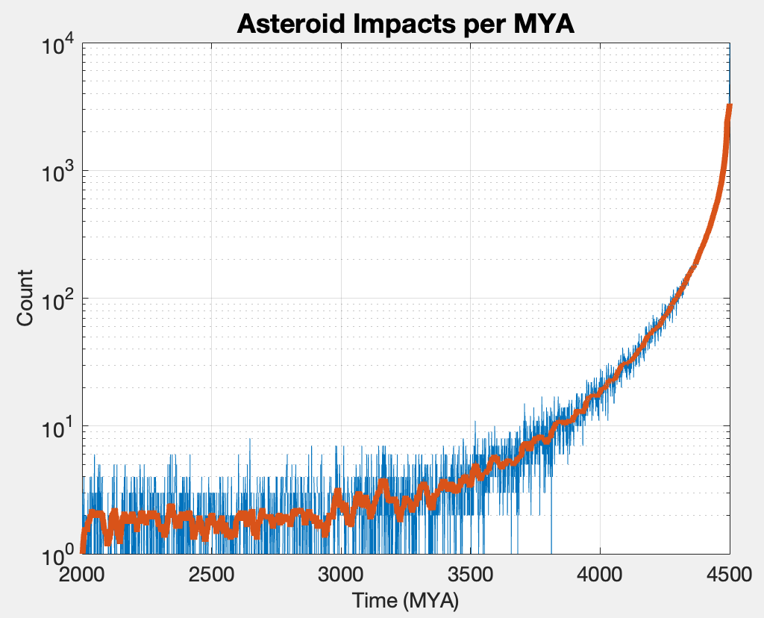
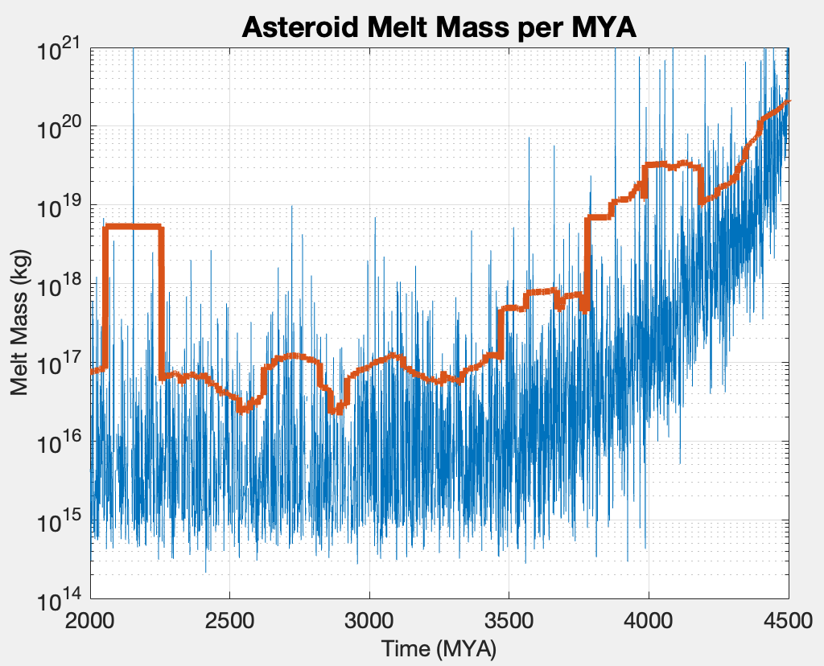
Melt Mass Per MYA - Asteroids

Slide 9
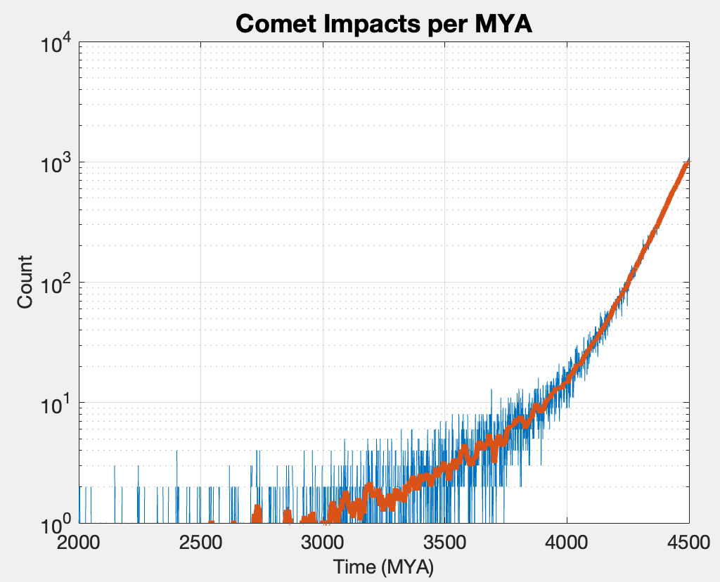
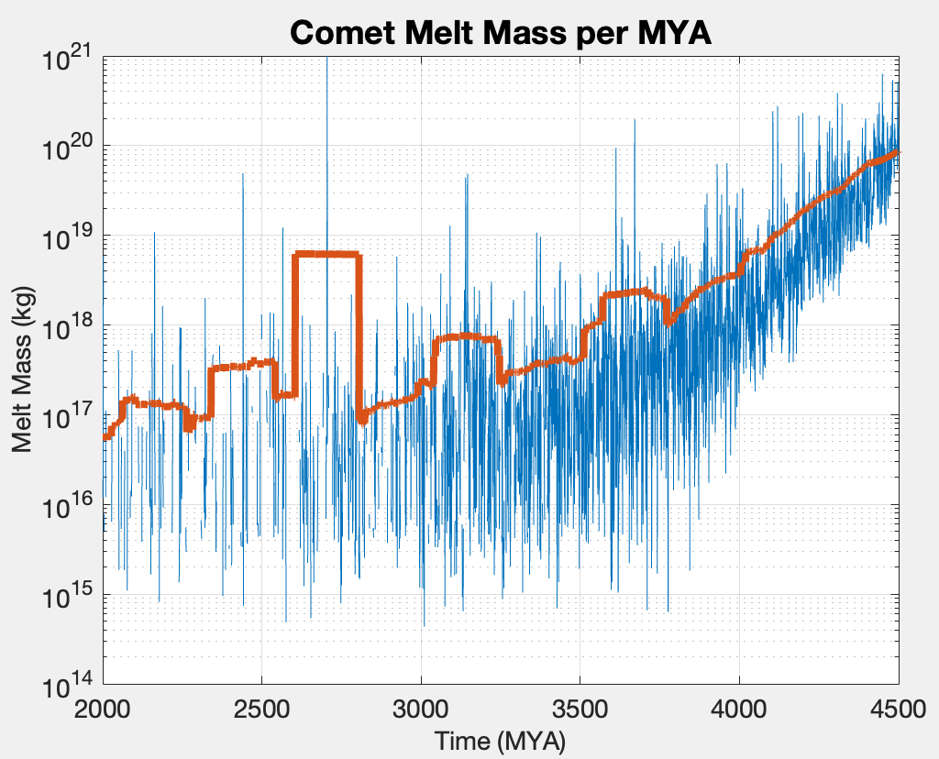
Melt Mass Per MYA - Comets

Slide 10
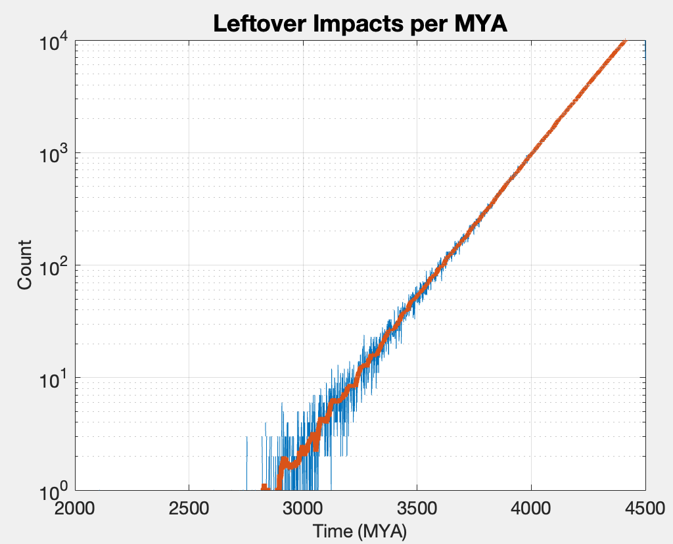
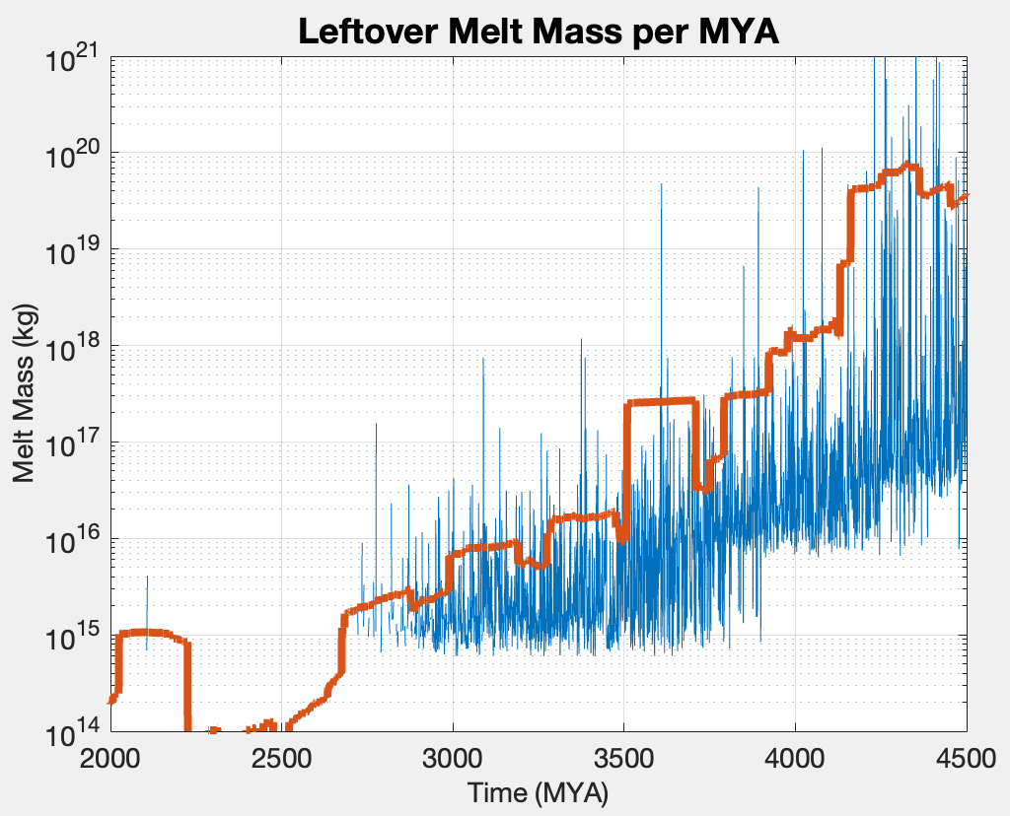
Melt Mass Per MYA - Leftovers

Slide 11
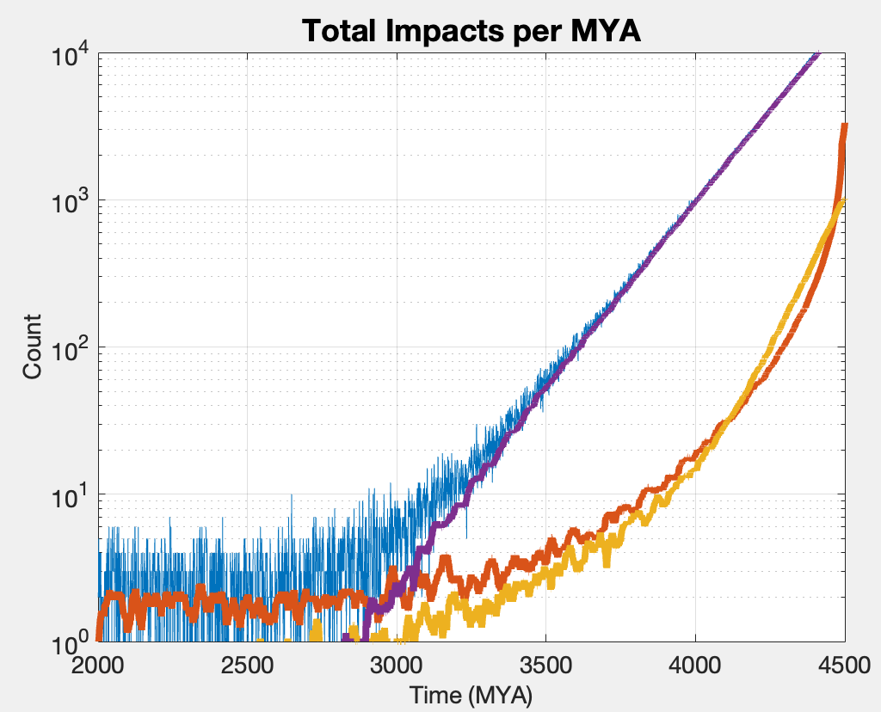
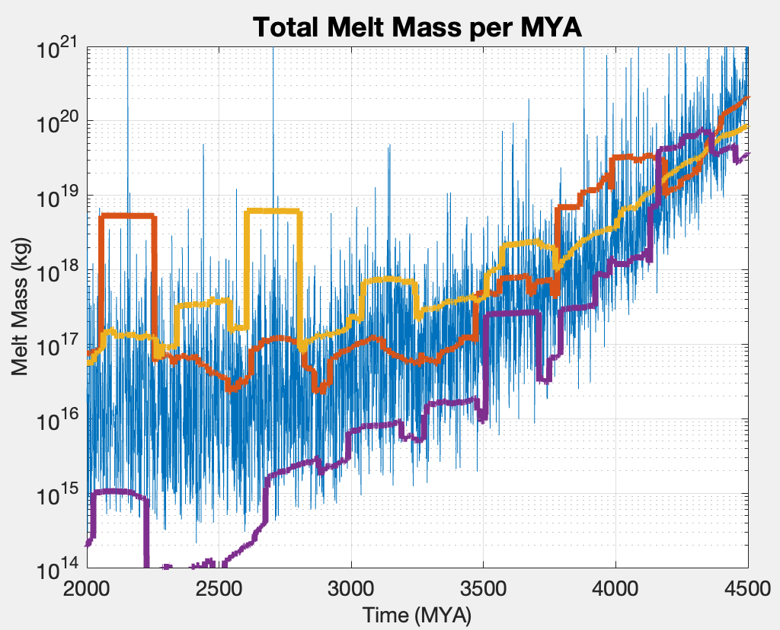
Total Melt Mass

Slide 12
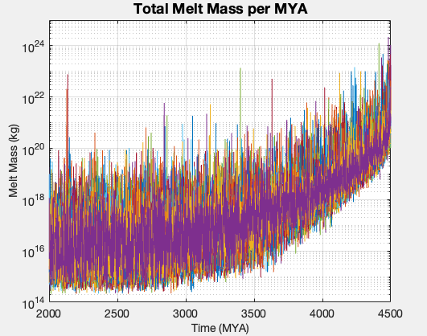
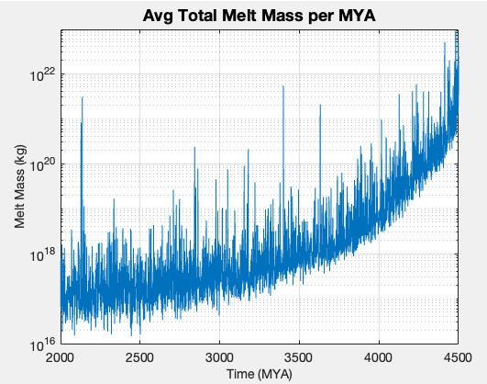
Average – 25 Seeds

Slide 13
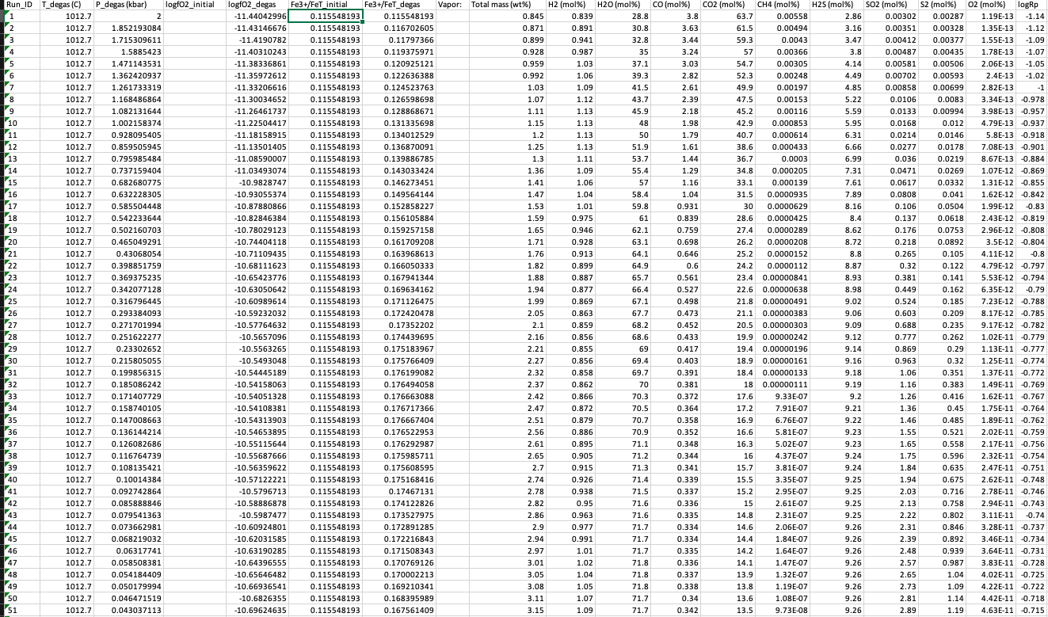
CHOS – Output Variables
How do I interpret outputs from melt to mass % over time?
Temperatures remain constant but P is changing?

Slide 14
Oceanic Depth Effects

