Slide 1
May 8th

Slide 2
Review
Last time:
Demonstrated collecting asteroid counts from 4.5 to 2.0 GYA from diameters D from 1-10 km and D > 10 km
Computed asteroid melt masses generated per MYA.
Current Progress:
Melt masses for comets and planetesimals.
Potential O2 sink mass @ every 1 MYA through MAGEC.
Paper writing.

Slide 3
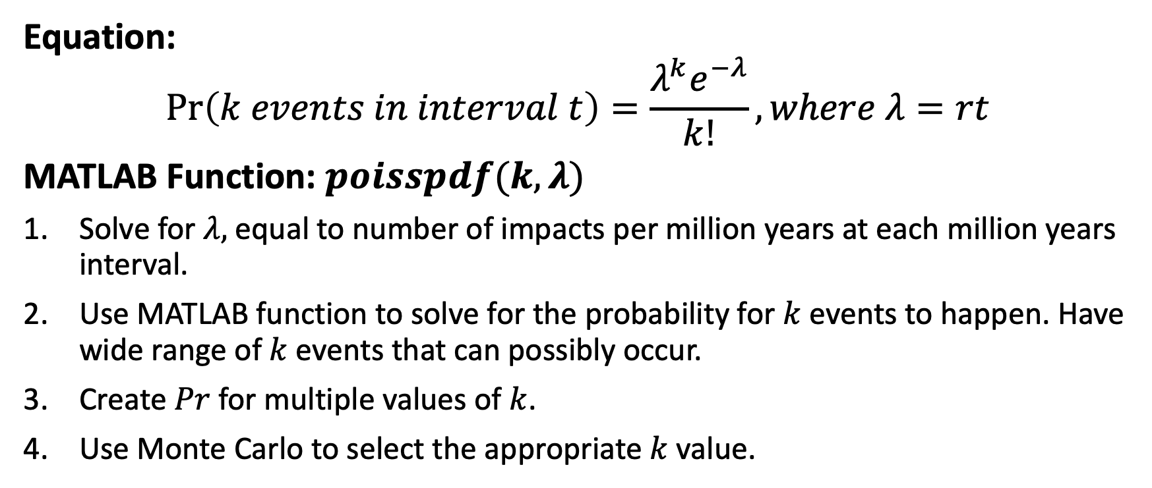
Poisson Process Implementation
Equation:
$$\operatorname{Pr}\left(k events in interval t\right)=\frac{λ^{k}e^{−λ}}{k!}, where λ=rt$$
MATLAB Function: $poisspdf(k,λ)$
Solve for $λ,$ equal to number of impacts per million years at each million years interval.
Use MATLAB function to solve for the probability for $k$ events to happen. Have wide range of $k$ events that can possibly occur.
Create $Pr$ for multiple values of $k$.
Use Monte Carlo to select the appropriate $k$ value.
Note: Can only be used with time intervals.

Slide 4
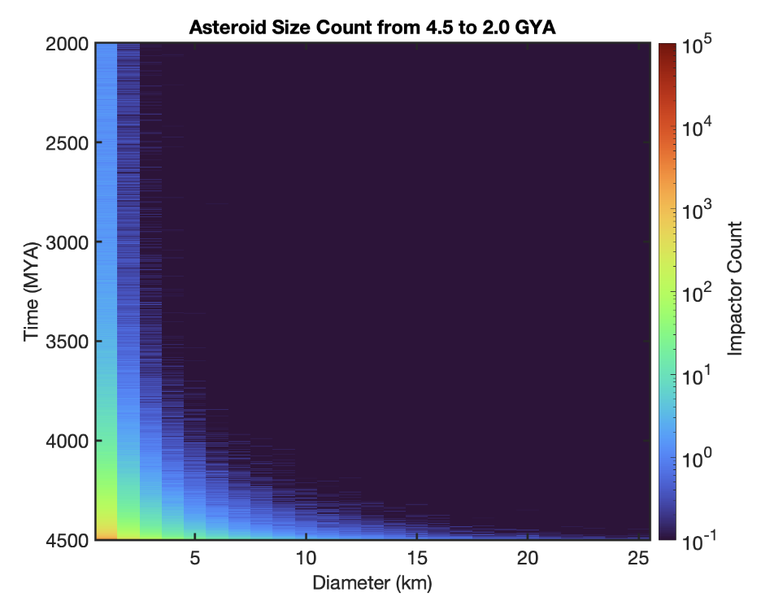
Asteroid Size Count Contour Mapping of D > 1km:
Averaged over 50 Simulations.
Rates appear to be constant after 3.0 GYA
Small asteroids counts dominate over larger ones

Slide 5
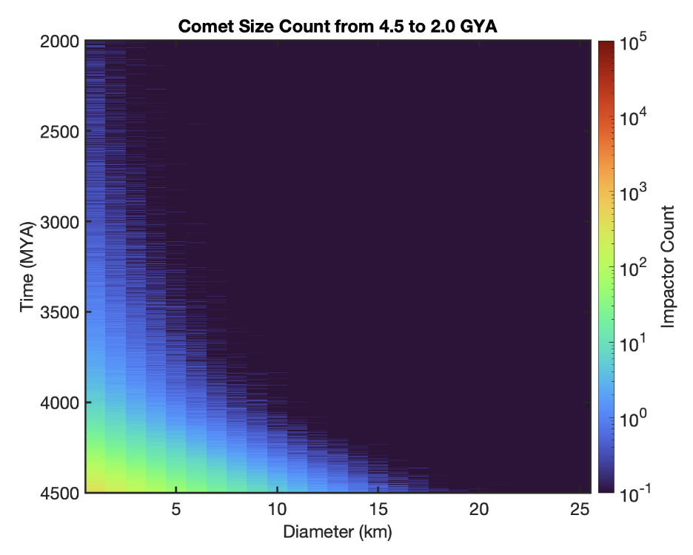
Comet Size Count Contour Mapping of D > 1km:
Averaged over 50 Simulations.
Larger population of larger comets than asteroids before 3.5 GYA, but sparse after 3.0 GYA.

Slide 6
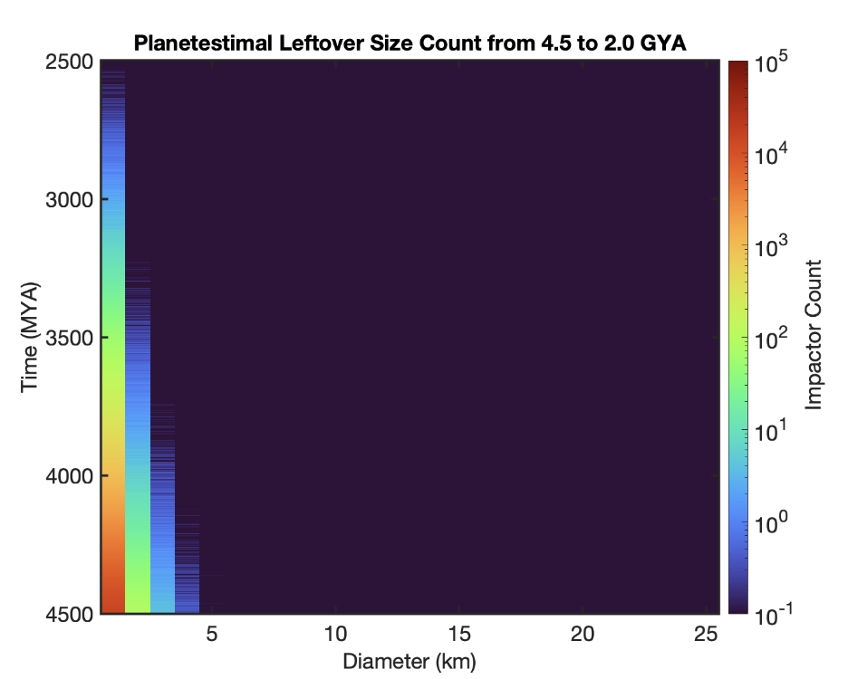
Leftover Size Count Contour Mapping of D > 1km:
Averaged over 50 Simulations.
Most planetesimals leftovers around 1-2km in diameter.
Little variation in the impactor sizes, smaller than asteroids and planetesimals
Note: computer models such as those from Bottke et al. (2007) and Weidenschilling (2011) create a protoplanetary disk containing rocky objects of an initial size and simulate the growth and collision of planetesimals over a period.

Slide 7
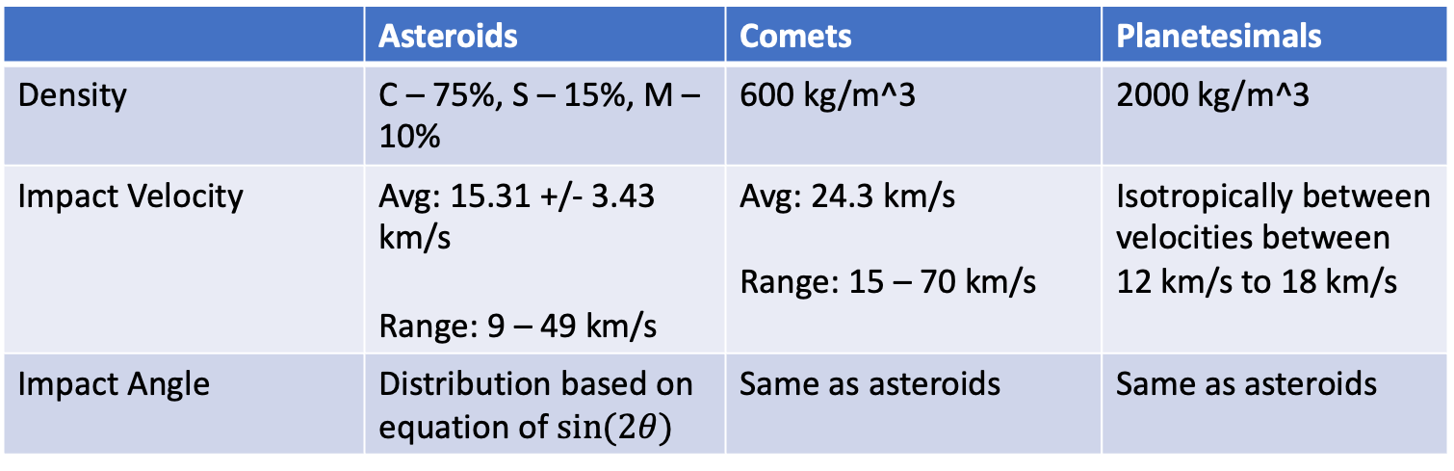
Melt Mass
$$m_{melt}=m_{p}{\left(1.6{\left(\frac{1.61gL}{v_{i}^{2}}\right)}^{−0.22}{\left(\frac{π}{8}⋅\frac{1}{2.7}\right)}^{−\frac{1}{3}}{\left(\sin\left(θ\right)\right)}^{−\frac{1}{3}}\right)}^{3}\left(1.6×{10}^{−7}\right){\left(gD_{at}\right)}^{0.83}v_{i}^{0.33}$$
 | Asteroids | Comets | Planetesimals
Density | C – 75%, S – 15%, M – 10% | 600 kg/m^3 | 2000 kg/m^3
Impact Velocity | Avg: 15.31 +/- 3.43 km/s Range: 9 – 49 km/s | Avg: 24.3 km/s Range: 15 – 70 km/s | Isotropically between velocities between 12 km/s to 18 km/s
Impact Angle | Distribution based on equation of $sin⁡(2θ)$ | Same as asteroids | Same as asteroids

Slide 8
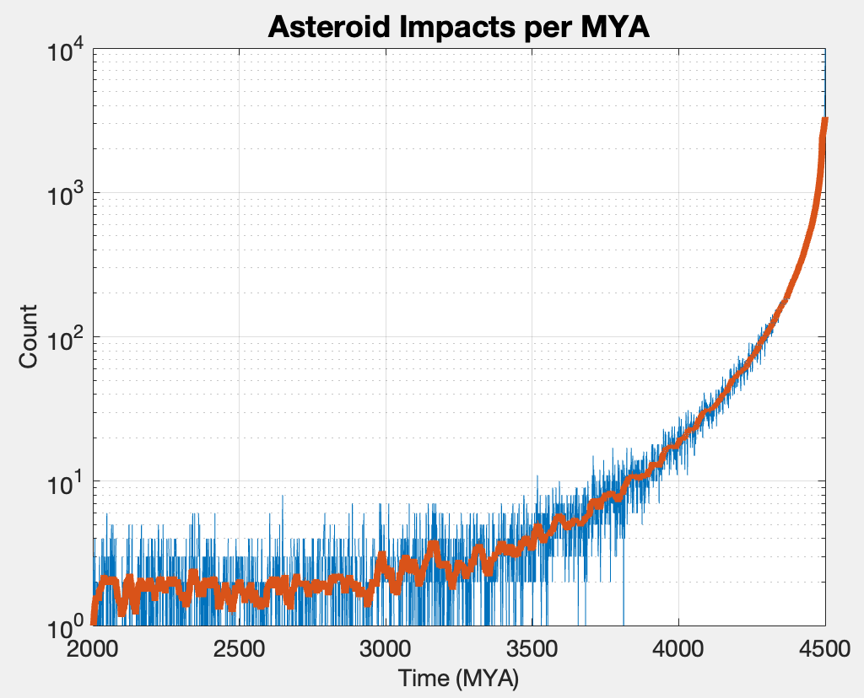
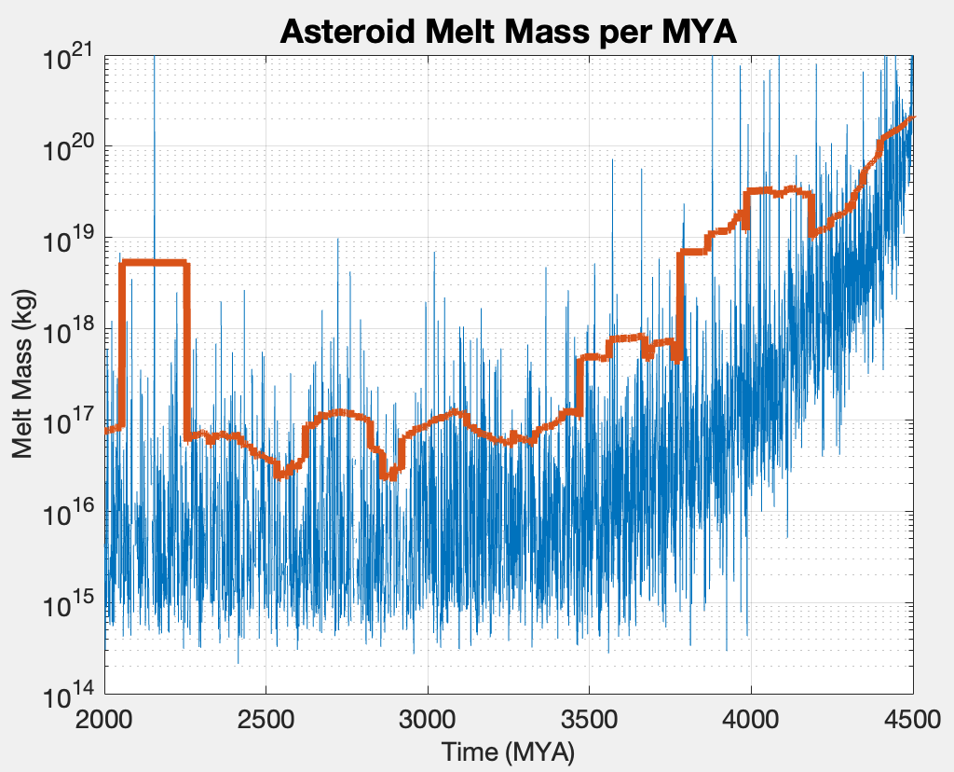
Melt Mass Per MYA - Asteroids

Slide 9
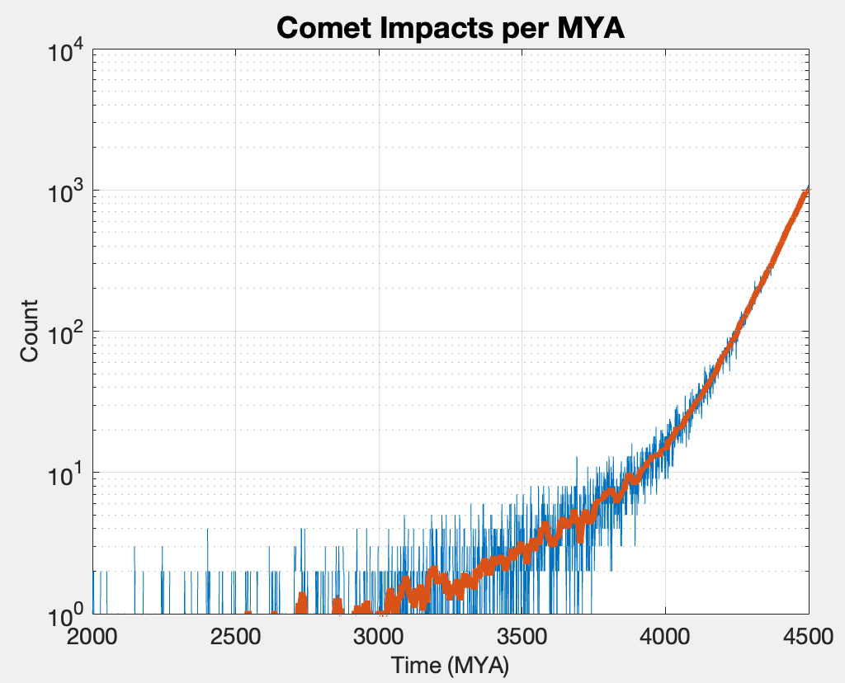
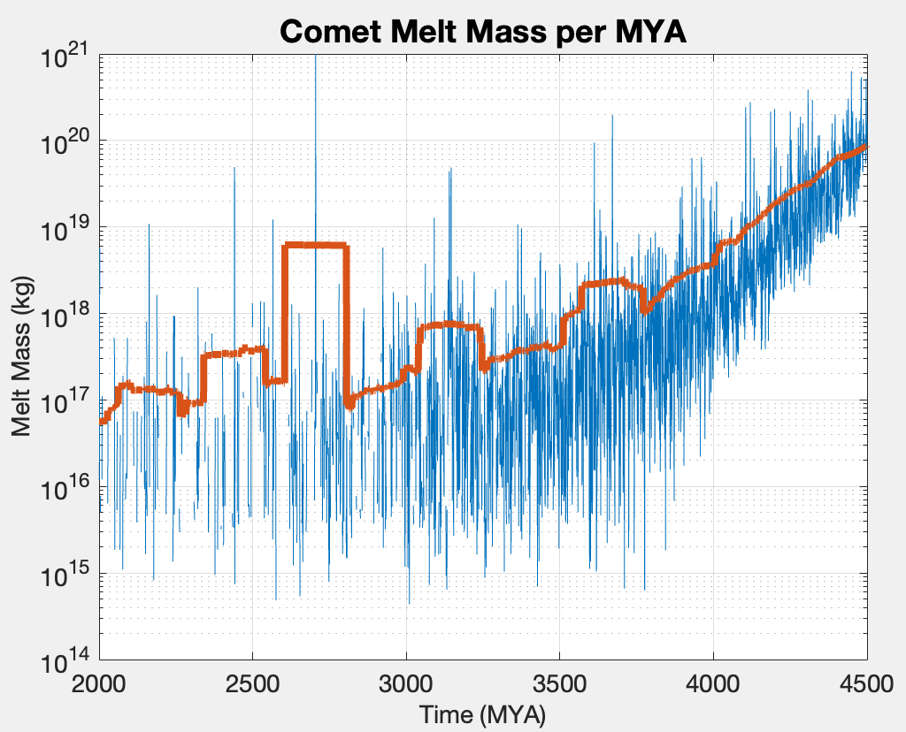
Melt Mass Per MYA - Comets

Slide 10
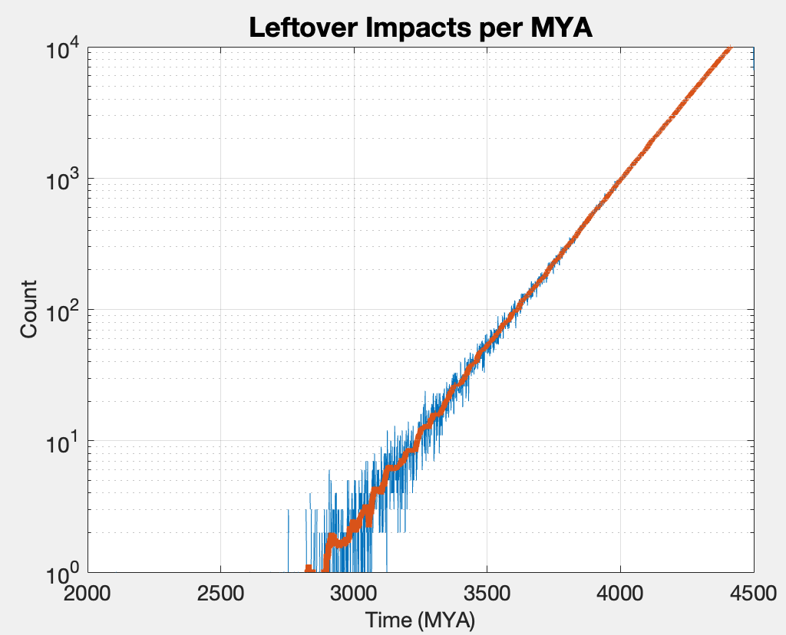
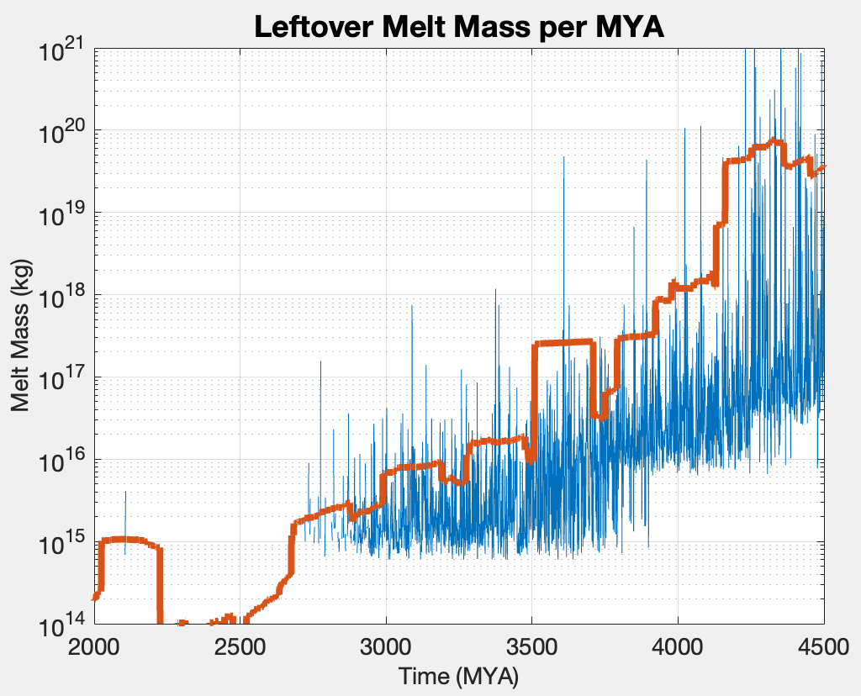
Melt Mass Per MYA - Leftovers

Slide 11
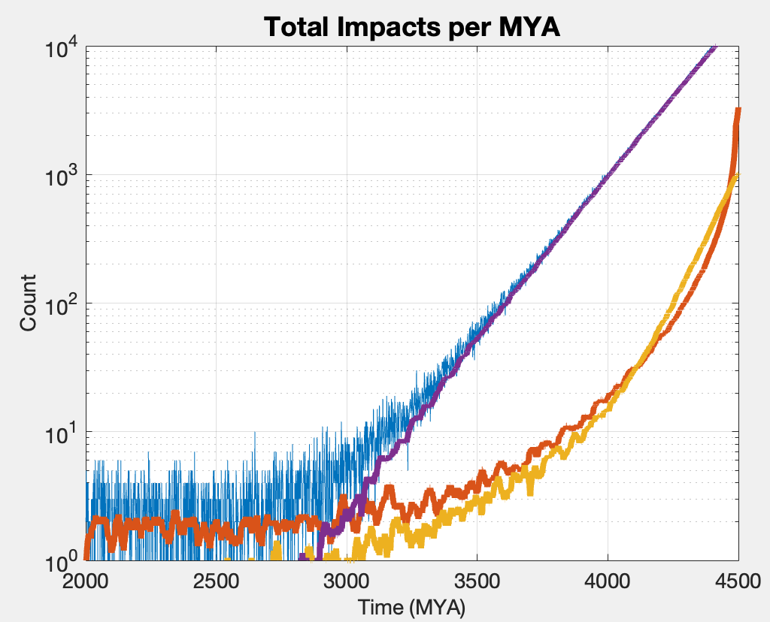
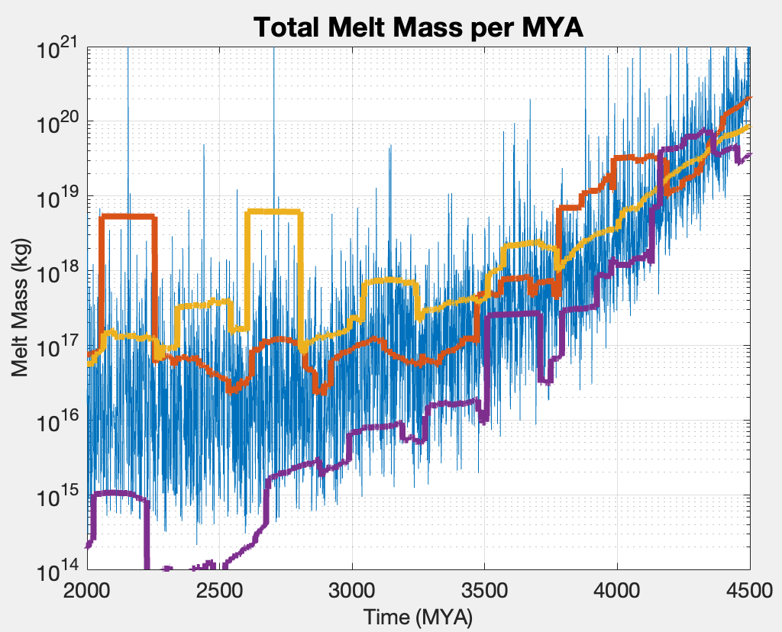
Total Melt Mass

Slide 12
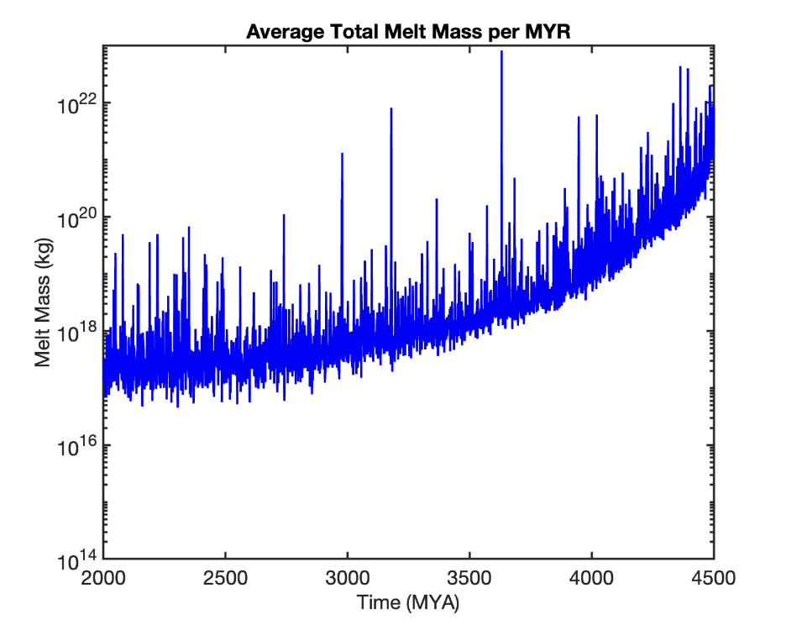
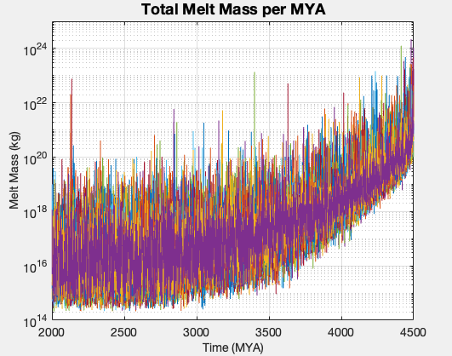
Ensemble Averaged Over 50 Simulations

Slide 13
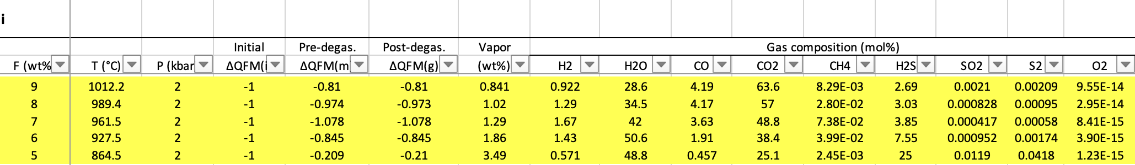
MAGEC
Assume gas-melt fractions of 0.5% to 3%, pressure of the melt equal to 2kbar, buffer for quartz-fayalite-magnetite (QFM) equal to -1.
Given melt mass -> choose a gas-melt fraction (0.5 to 3%) & solve for mass of gas -> Use MAGEC to compute the molar components of the gas -> compute moles of O2 consumed -> solve for mass of O2 consumed.

Slide 14
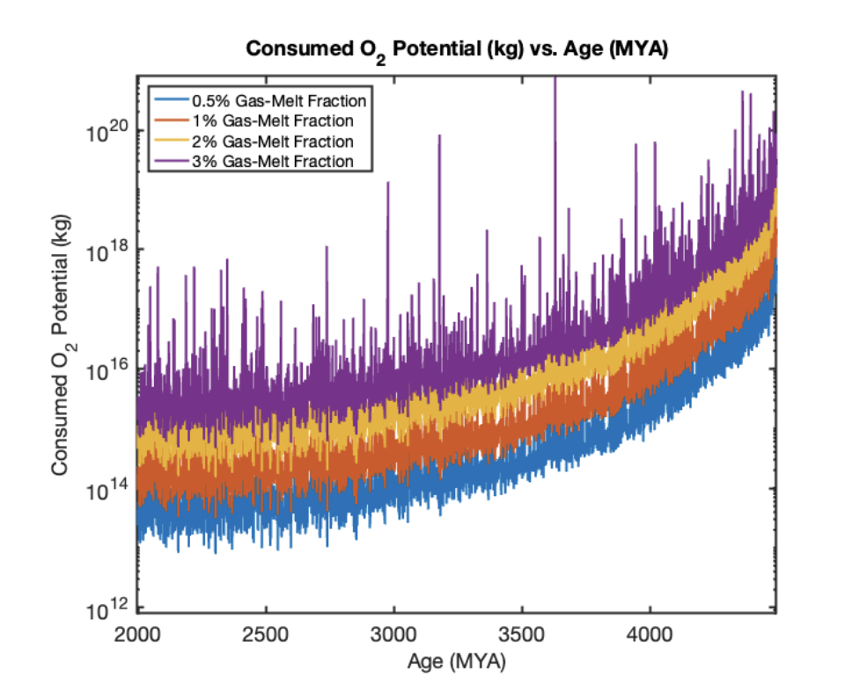

Slide 15
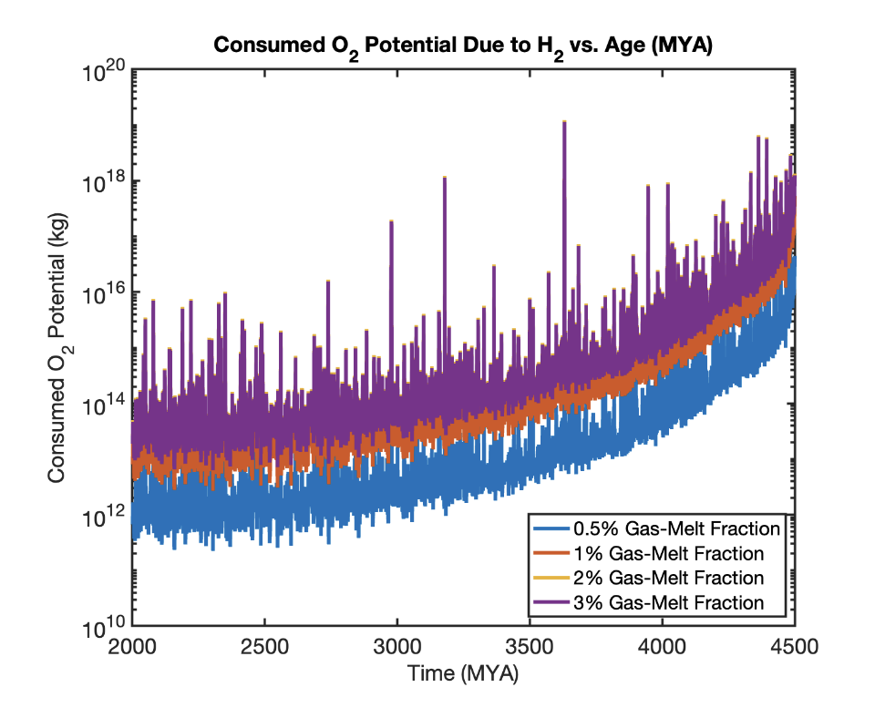
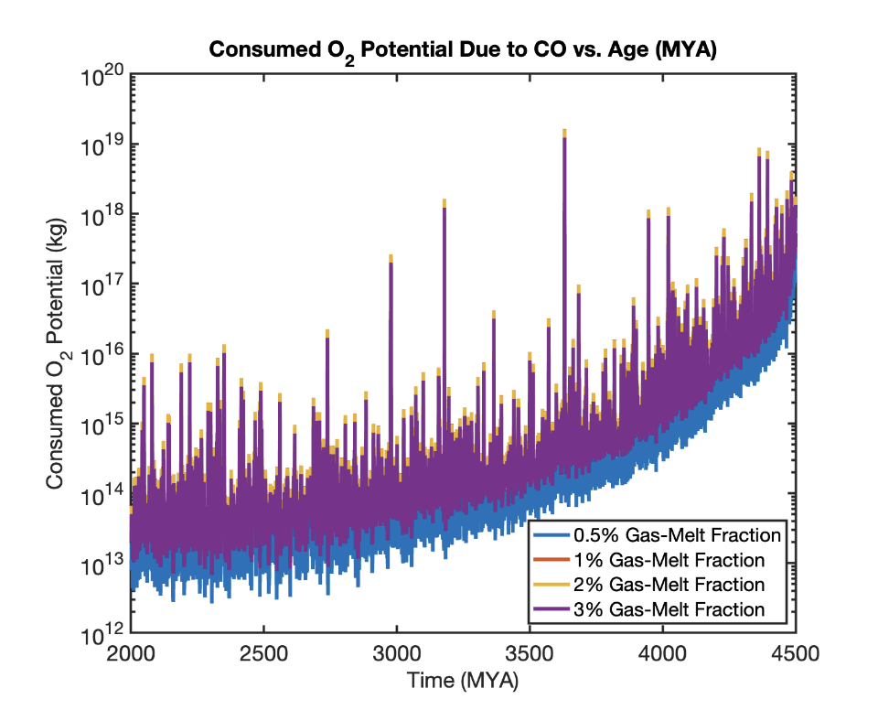
Consumed O2 Potential due to H2
Consumed O2 Potential due to CO

Slide 16
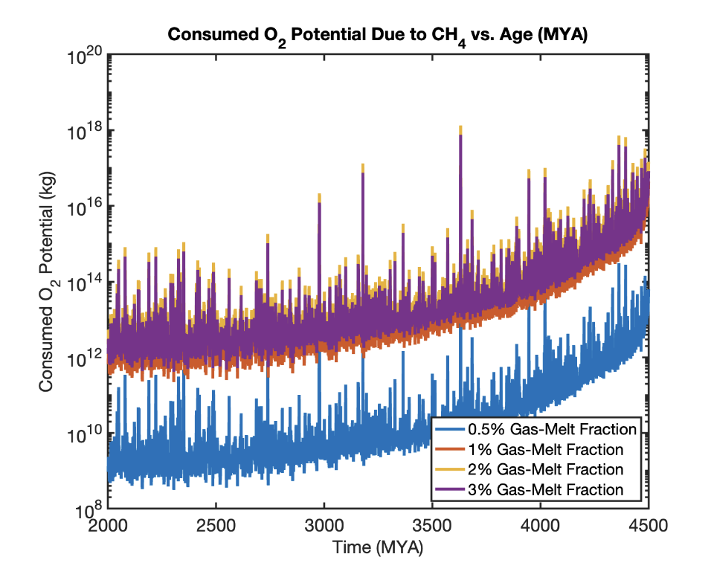
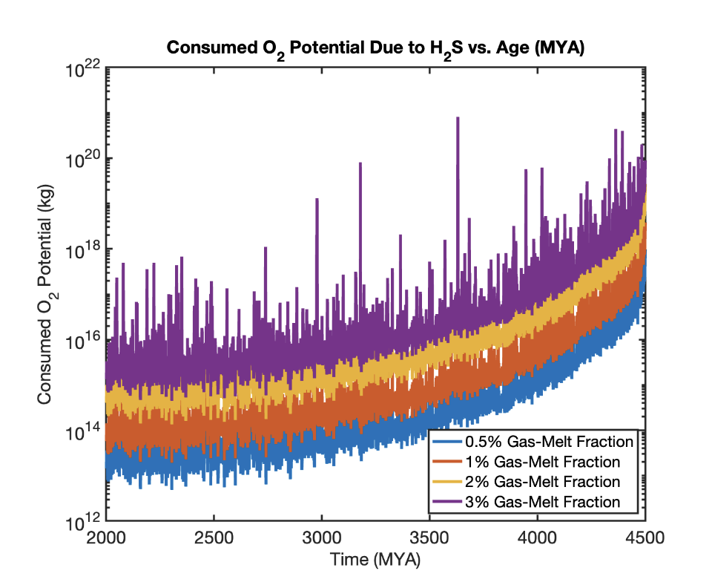
Consumed O2 Potential due to CH4
Consumed O2 Potential due to H2S

Slide 17
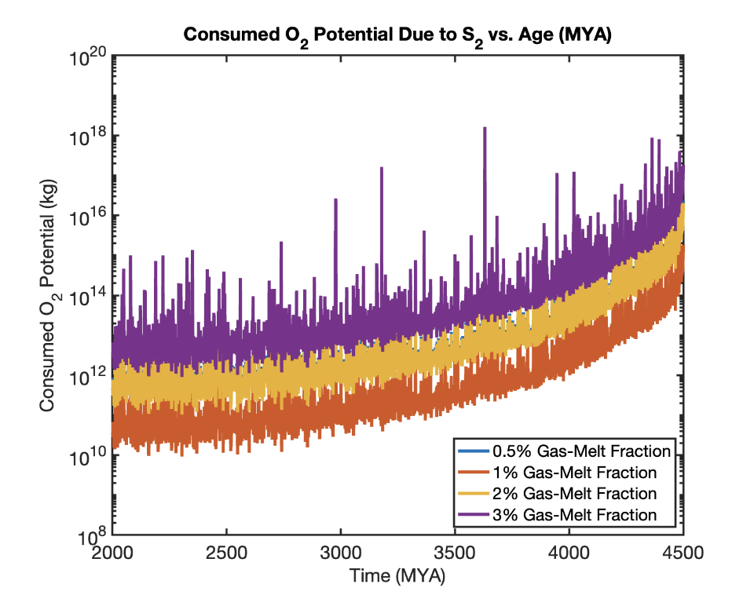
To do in Overleaf:
Discussion of O2 potential due to each volatile at each gas-melt fraction.
Finish conclusion writeup.
Expand of MAGEC subsection.
Target submission: End of June 2023
Consumed O2 Potential due to S2

Slide 18
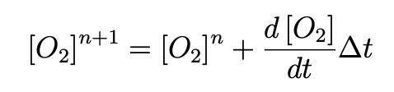
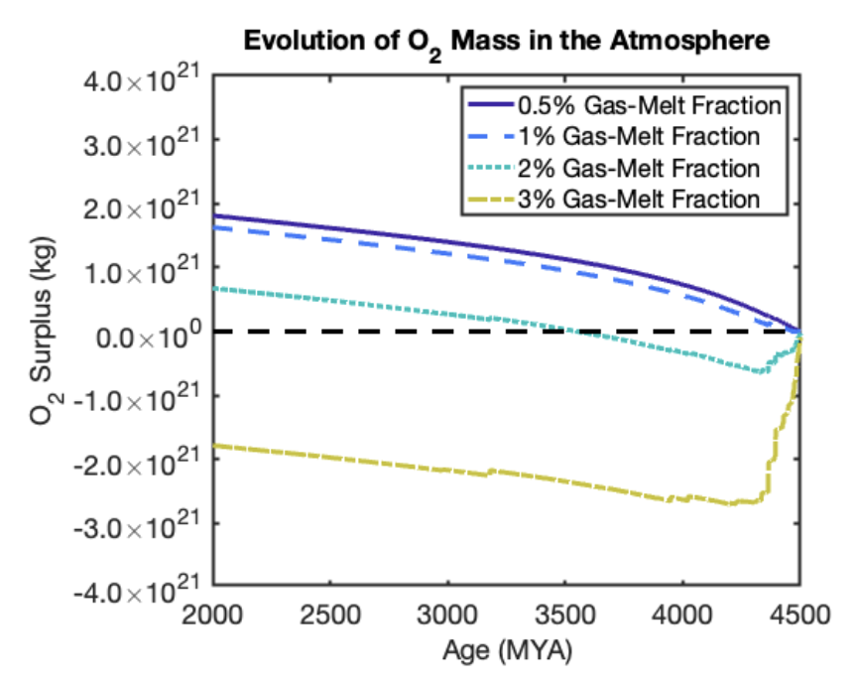
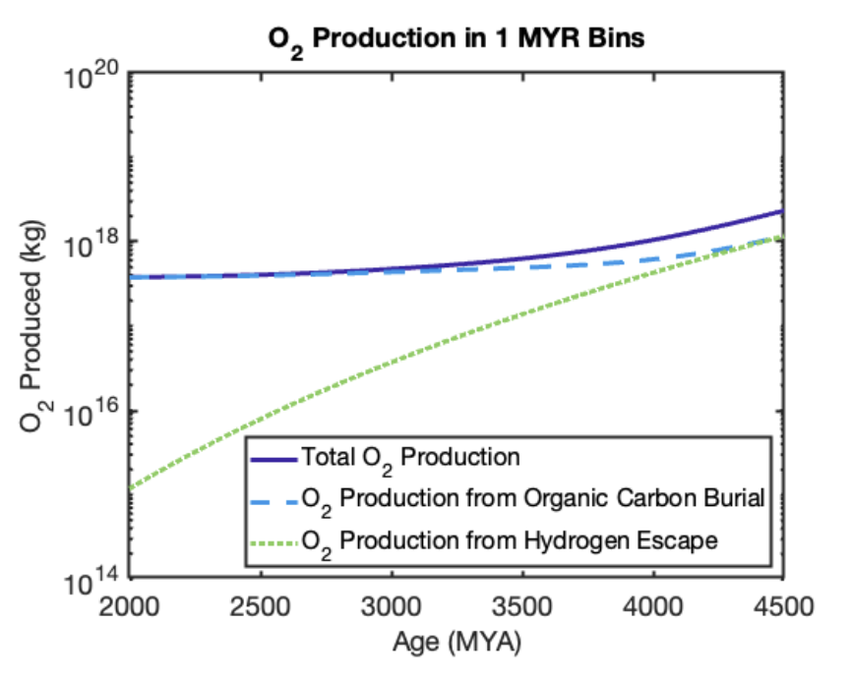
Extra Stuff (Will not be in paper)
Issues:
Notes: Outside scope of paper, O2 source model is complex unlike model used for this analysis.
With more research, could be good for future work (2nd paper) or a starting point for others.

