Slide 1
Real Estate prediction IOWA
Key facts about your topic
“Ask a home buyer to describe their dream house, and they probably won't begin with the height of the basement ceiling or the proximity to an east-west railroad. But this playground competition's dataset proves that much more influences price negotiations than the number of bedrooms or a white-picket fence.”- Kaggle
“With 81 explanatory variables describing (almost) every aspect of residential homes in Ames, Iowa, this competition challenges you to predict the final price of each home.” - Kaggle
Death Line: Sunday June 3, 2018
Project: House Pricing
State: IOWA
Dataset: Kaggle
Group: Wlliam Lee, Fan Zhang, Eddie Lee
NY Data Science Academy
Notes:
QuickStarter has created an outline to help you get started on your presentation. Some slides include information here in the notes to provide additional topics for you to research.
More key facts:
Colleges and universities: University of Paris, Paris-Sorbonne University, Le Cordon Bleu, École normale supérieure, Sciences Po, American University of Paris, Pierre and Marie Curie University, Conservatoire de Paris, Paris Diderot University, Pantheon-Sorbonne University, Institut national des langues et civilisations orientales, Paris Dauphine University, University of Paris III: Sorbonne Nouvelle, Collège de France, Panthéon-Assas University, Conservatoire national des arts et métiers, Paris School of Economics, Institut Catholique de Paris, Paris 8 University, Mines ParisTech, School for Advanced Studies in the Social Sciences, Supélec, Paris Descartes University, École des ponts ParisTech, American Graduate School in Paris, Agro ParisTech, Arts et Métiers ParisTech, ENSTA ParisTech, École normale supérieure Paris-Saclay, University of France, Institut supérieur du commerce de Paris, Telecom Business School, École nationale supérieure des arts décoratifs, College of Sorbonne, École Spéciale des Travaux Publics, CNSAD, ISG Business School, Institut supérieur d'électronique de Paris, St. Sergius Orthodox Theological Institute, ESIEE Paris, European Business School Paris, IAE Paris, École Boulle, ESPCI ParisTech, École Spéciale d'Architecture, Chimie ParisTech, Institut national agronomique Paris Grignon, Ecole de Management Léonard De Vinci, Centre Sèvres

Slide 2

Housing Pricing
Predict Sale Price
Group: William Lee, Fan Zhang, Eddie Lee

Slide 3
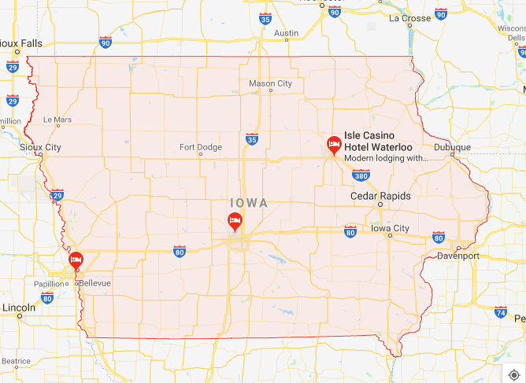

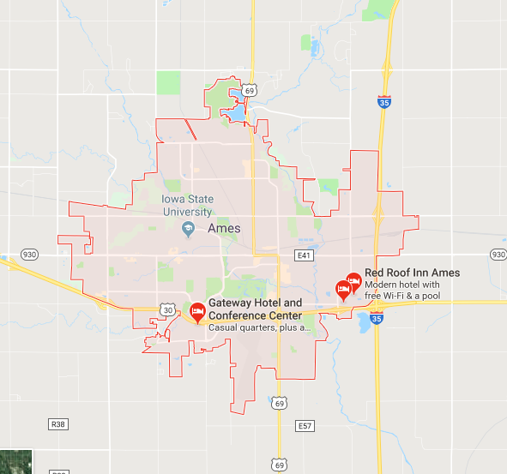
IOWA
Train set / Test set / Sale Price
From: AMES, IOWA
Notes:
Consider talking about:
Employment
Incomes

Slide 4
Contents
Objective: Goal
Explore Dataset
Cleaning (Detected Missing Value, Outlier)
Classified Numerical / Categorical
Variable Correlated to Sale Price
Identified significant N-variables to predict Sale Price
Supervised Learning
Visualization
Lasso /Ridge
Modelling /cross validation / Xgboost
Tuning the models
Test: predictable value

Slide 5
Objective:
The objective of the project is to built a model (ML) to predict accurate Housing price in Ames IOWA.
Group objective:
Understand the concept of Machine Learning in Python
Notes:
The main goal of the project is to built a algorithm (ML) to predict the value of the sales price for test set house.

Slide 6
Strategy
Simple strategy - comparison
Determine top 10 N variables (strong correlation)
Find missing value /repalce to 0
Test with all numerical variable (Lasso/Ridge) – (0.136/ 0.139)
Clean outliers / Re define / select N variable
Test (Lasso/Ridge) – (0.1258 / 0.1289)
Scale categorical variable / redefine / select N variable
Test (Lasso/Ridge) (0.1212 / 0.1255)
Change model – Xgboots (RSME - )
Test and finalize.

Slide 7
Machine Learning
Supervised
Unsupervised
Classification
Regression
Cross Validation
Linear Regression
Lasso/ Ridge
Notes:
Supervised Learning: build model that able to learn by comparing its actual housing price sale with predicted housing prices – find the error and manipulate the dataset for better prediction

Slide 8
Steps
Raw data
Explore data
Method & Model
Test
Clean, manipulate data
Explore other Method & Model
Method & Model
Test II
Get data from Kaggle, explore dataset, find correlation between variable
Clean data (Missing value, Outlier)
Methods & Model
Test
Tuning the data set and re test
Notes:
Consider talking about:
Libraries

Slide 9

Missing Values
Find missing variables that can potentially impact predictive relationships
Label (scale)
Notes:
Consider talking about:
Cleaning:
What method use to clean the data set
Talk about the missing values: converted to …

Slide 10
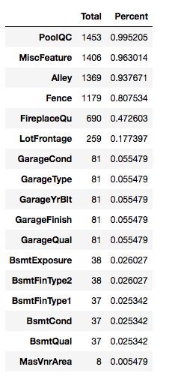
First step:
Determine Numerical and categorical variables.

Slide 11

Numerical / Categorical values
Look in the slide notes below for topics to consider talking about
Notes:
Consider talking about:
Numerical / Categorical values
How was made the specific selection of columns for categorical?
For loop all the categorical columns (specific columns)
Graph
What we found

Slide 12
Categorical – scales(Label)
Numerical
Data
set
0
Categorical
1
2
3
4
5

Slide 13

Correlations
Selecting variable
Y – dependent (Sale Price)
X- independent (All variables)
Notes:
Consider talking about:
X – independent
Which variable were more important ?

Slide 14
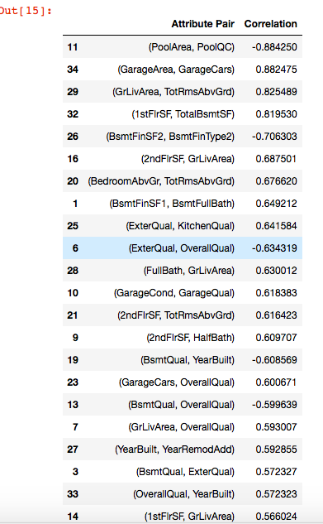
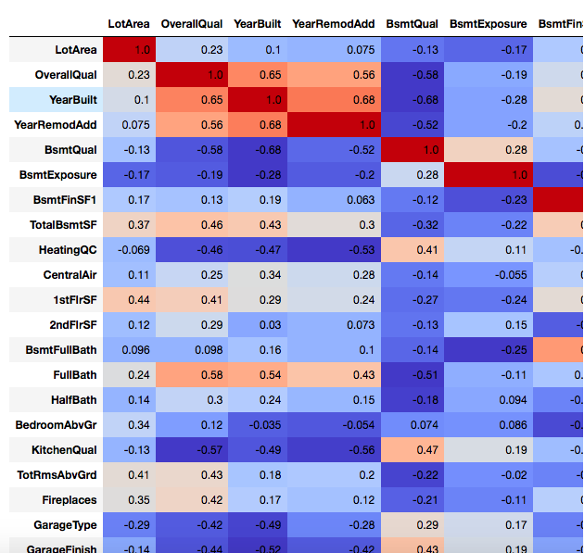
Correlation Sale Price / Variables

Slide 15
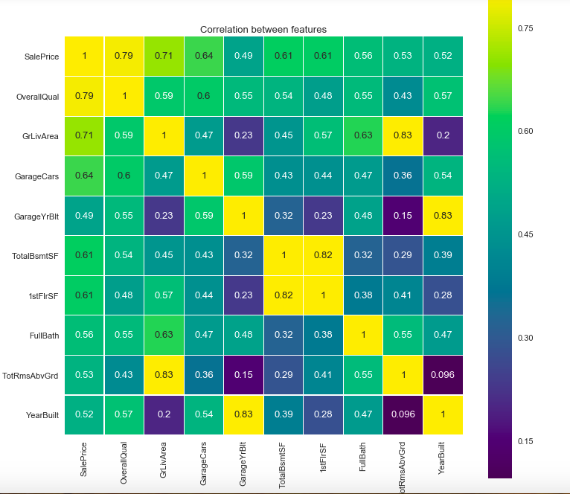
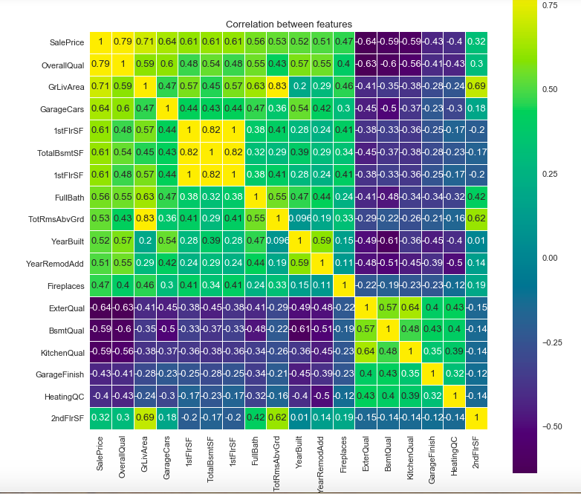
Scaling Categorical variable

Slide 16
Feature Engineering / tuning
1. Scale Variable /
2. Clean outlier
3. log
4. Dummify

Slide 17
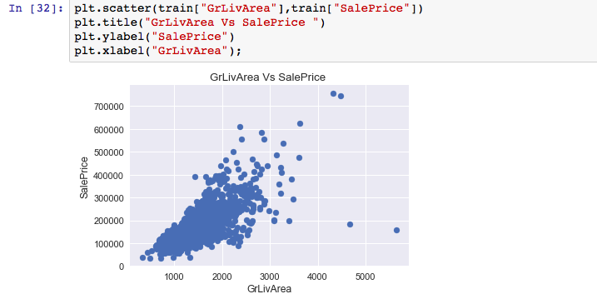
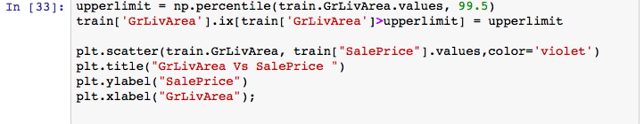
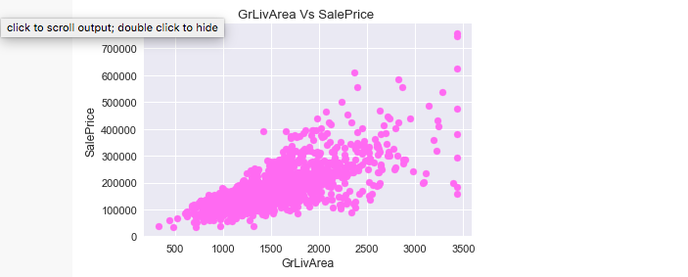
Outlier cleaning – [TotalBsmtSF, GarageArea

Slide 18
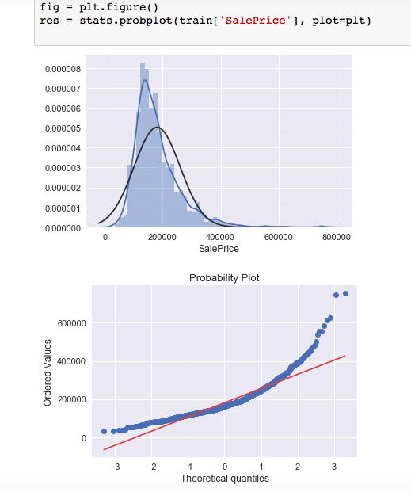
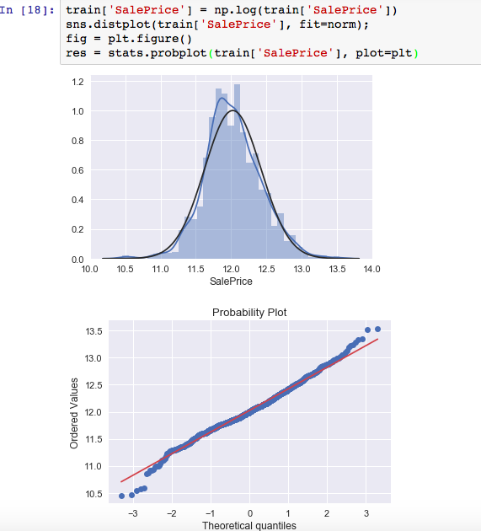

Slide 19
Sale Condition
SaleType
Fence
PoolQC GarageCond
GarageQual
GarageFinish
KitchenQual
GarageType
FireplaceQu
HeatingQC
BsmtExposure
BsmtCond
BsmtQual
ExterCond
ExterQual
OverallCond
OverallQual
LandSlope
LotShape
Sale Condition
PoolQC
Garage Condition
Garage Quality
Kitchen Quality
Fire Place Quality
Heating Quality
Bsmt Condition
Bsmt Quality
Exterior Condition
Exterior Quality
Notes:
Scale

Slide 20
Techniques
Regression analysis : measure the relation between the mean value of one value of one variable and corresponding values of other variables
(Sale Prices and N-x variable)
* Regression: predict the housing sale price using training data
Regularization: minimize the sum of the squared error of the model on the training data (using ordinary least squares) , reduce complexity of the model (size of the sum of all coefficients in the model).
Such as: Lasso regression: Ordinary Least Squares / minimize absolute sum of coefficients
Ridge Regression: Ordinary Least Squares / minimize the square absolute sumof the coefficients.

Slide 21
Machine Learning
Supervised
Unsupervised
Classification
Regression
Cross Validation
Linear Regression
Lasso/ Ridge
XGboosting
Notes:
Supervised Learning: build model that able to learn by comparing its actual housing price sale with predicted housing prices – find the error and manipulate the dataset for better prediction

Slide 22
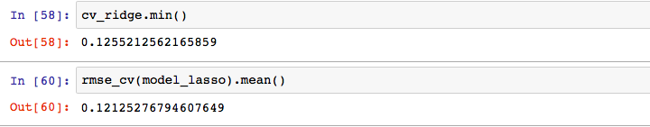
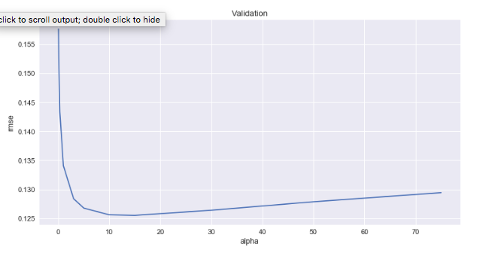
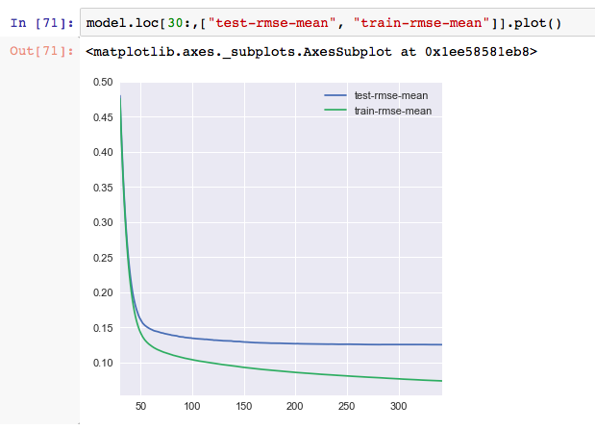
Lasso/ Ridge – finally XGboost
Notes:
Root Mean Square Error (RMSE) measures how much error there is between two data sets. In other words, it compares a predicted value and an observed or known value. It's also known as Root Mean Square Deviation and is one of the most widely used statistics in GIS

Slide 23

Models
Model
Lasso: 0.12125
Ridge: 0.12552
XGboot: added to the last minute to test – copy and paste from kaggle
Notes:
Knn – pattern recognition model – classification or regression
Decision tree learning – visually represent decisions – predict model (features to choose , condition to use for splitting, understanding the ending of the tree decision)

Slide 24
How was the ML project?
We learned that
– Profound knowledge in Statistics – have great Advantage in building great model
- Good skill in python coding – less - consumption - time
We Lack
- All of the above. (just kidding)
- We need more time and practice.
Notes:
Algorithms
Supervised

