Slide 1

Analysing Pollution
Presented by: John Truong, James Rydlewski, Wei Ke, Karissa Malseed, Callum Linnegan

Slide 2
Introduction
Who are we?
What is our objective?
How did we get there?
Notes:
Initially we tried to use openweather’s AQI to evaluate pollution and weather trends but had a pay wall for previous data. This sparked the use for WAQI which allowed us to grab not only information from many cities around the world but had a breakdown of potent elements for each city. This AQI was also quite refined so navigating was a breeze.
We wanted to evaluate pollution data to investigate any relationships could occur between other variables,

Slide 3
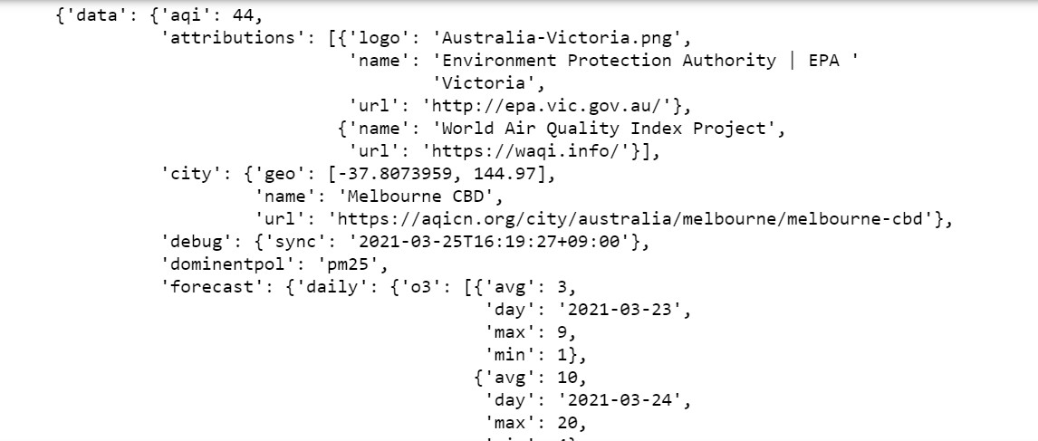
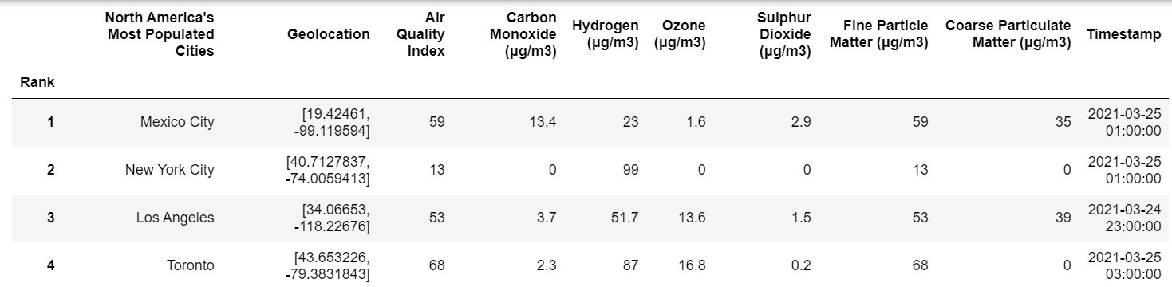
Data Gathering
Insights
Incomplete data

Slide 4
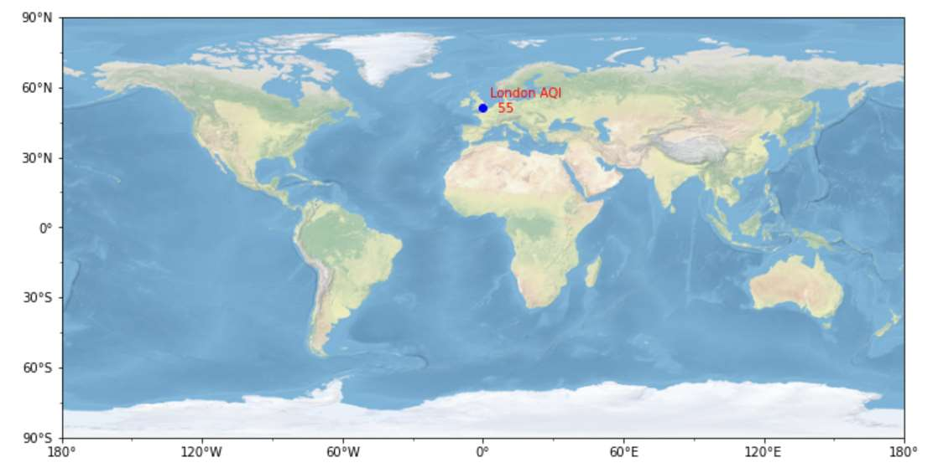
Data Exploration: Single Location

Slide 5
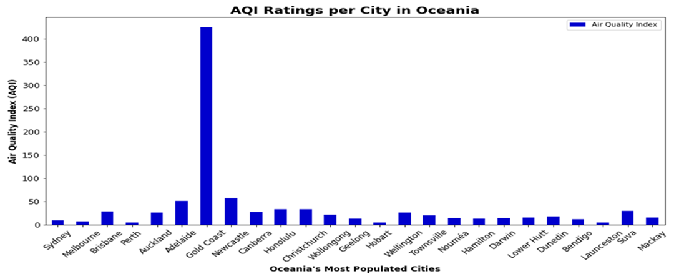
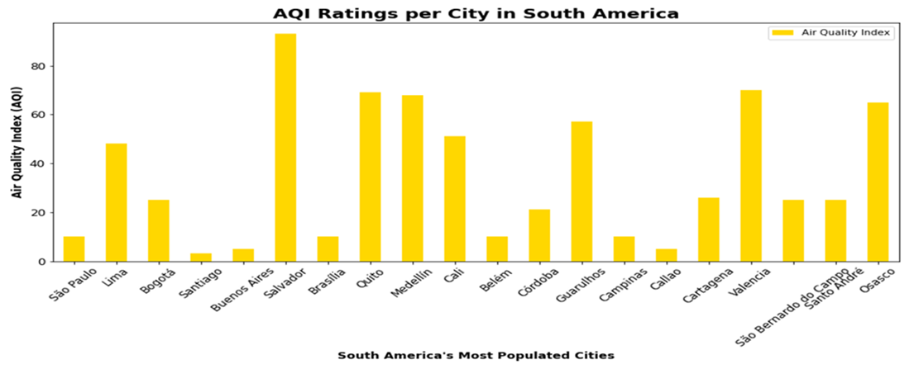
Data Exploration: Global
How do other regions stack up?
Consistency vs Outliers

Slide 6
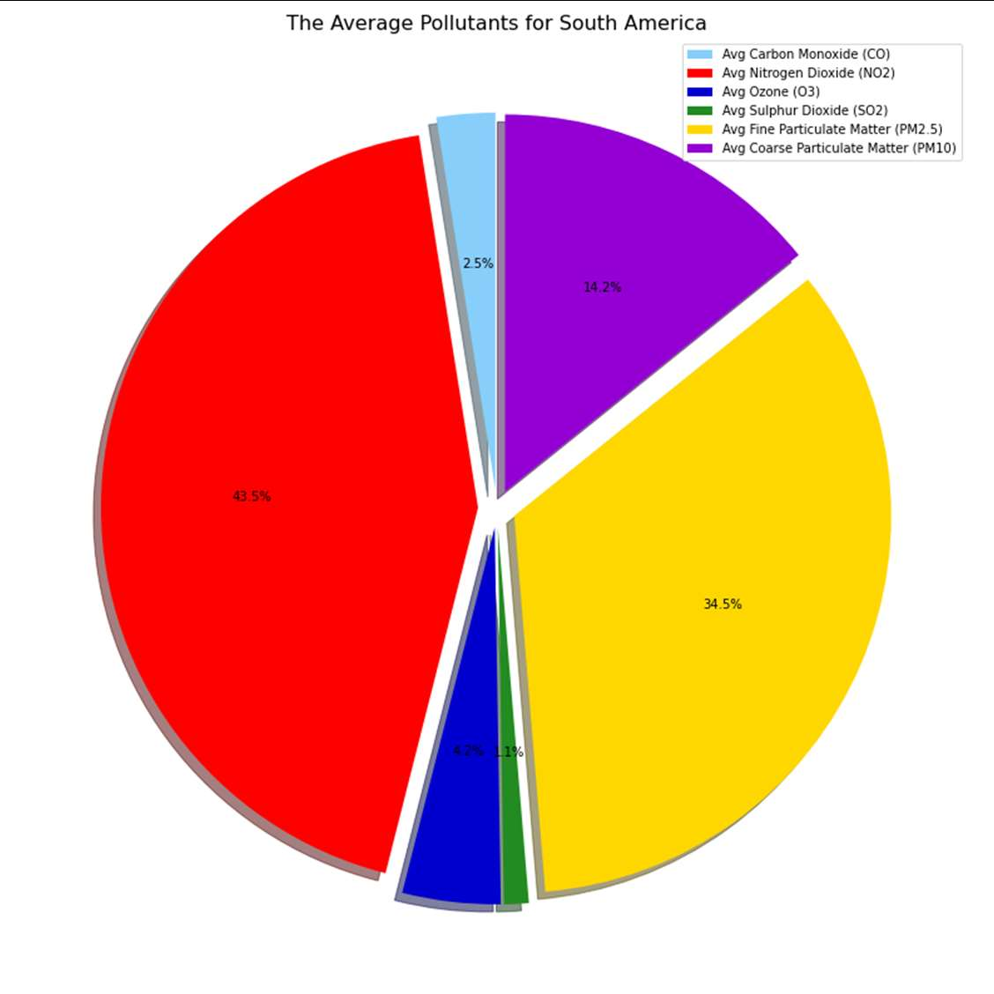
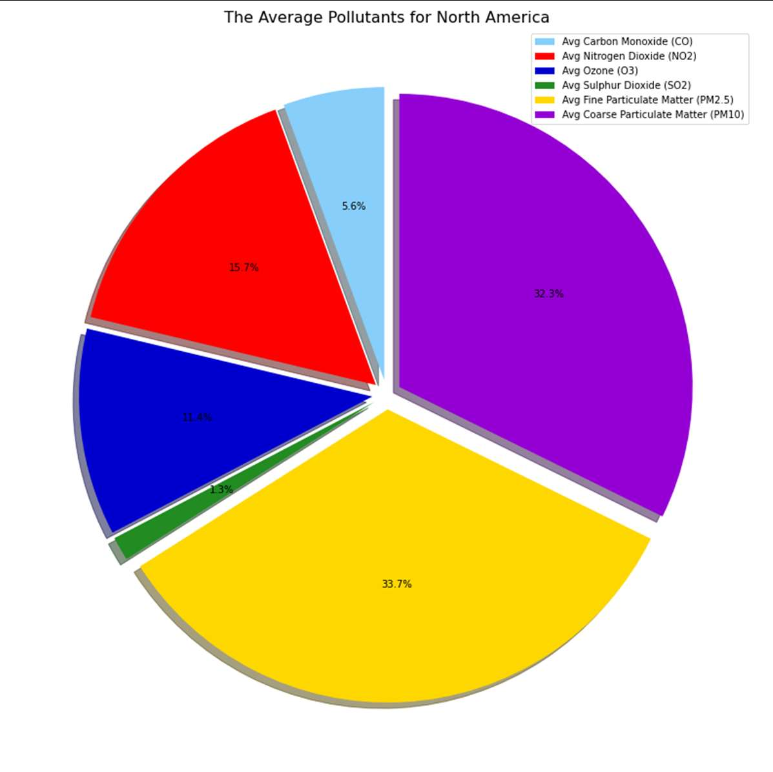
Pollution Characteristics

Slide 7
Questions & Data
Does AQI performance correlate to continent?
How do the extremities of pollution differ based on location?
If pollution levels correlate, then which pollutants corallite closely and which do not
If PM 25 and PM 10 have a strong correlation, then the r value will be over 0.7
If SO2 and PM 25have a strong correlation, then the r value will be over 0.7
If O3 and PM 25 have a strong correlation, then the r value will be over 0.7
Notes:
What kind of data do we need?
Initially we needed to grab the locations latitude, longitude and country so that the cities can be saved. Then use the previous information to grab any pollution information such as the distribution of chemicals.
For each region and sort the data in descending order based on the AQI value, then grab the last 10 cities that have data. If the city does not have all the data, then it needs to be removed from the city search.

Slide 8
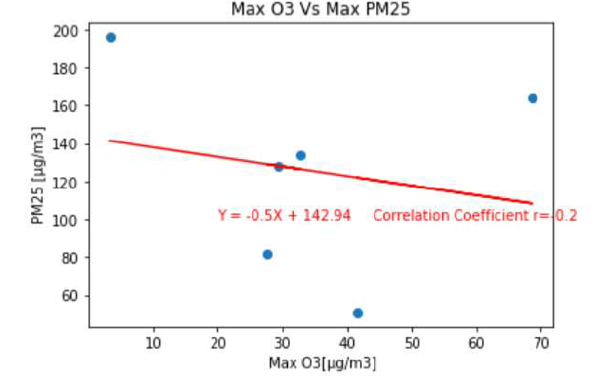
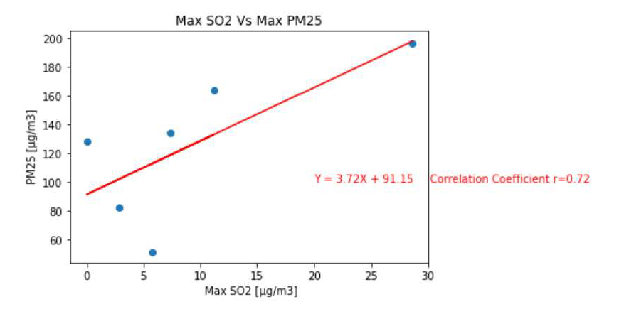
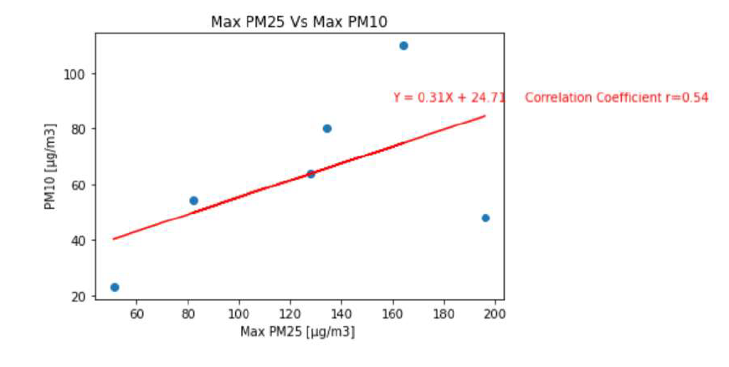
Discussion
Findings
Expectations vs Reality
General Conclusions

Slide 9
Difficulties & Future Exploration
Difficulties
Lots of zeros!!
Future Exploration
Did COVID-19 have any affect on areas with a high AQI?
How does AQI change overtime?
Notes:
The biggest problem that we encountered were the number of locations that had missing data, unfortunately any city that was missing even just 1 column of data had to be removed. This meant that regions such as Africa and Europe had to have their sample sizes increased every time, as we would have to remove numerous locations. To make this more difficult some AQI’s had set values for N/A’s so these would have to be manually set to have a unanimous values.

Slide 10

Conclusions

Slide 11
Thanks for listening!

