Slide 1
MoodLang A Programming Language That Feels Things

Slide 2
agenda
INTRODUCTION 3
Syntax + Semantics 5
Ecosystem 7
Challenges 8

Slide 3
What is MoodLang? A creative, emotion-based programming language where moods like "excited", "focused", and "curious" control logic and flow. Why was it created? To make coding more fun and human. MoodLang turns logic into storytelling and helps learners explore programming through natural expression. Target audience: New coders, creative thinkers, or anyone curious about how language design can feel more alive.

Slide 4
How MoodLang Works

Slide 5
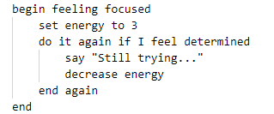
Code Snippet:
Highlights:
set, increase, decrease: variable control
say: output
now I feel ...: sets internal emotional state
if I feel X, do it again if I feel Y: conditionals and loops driven by mood

Slide 6
Side-by-side comparison:
MoodLang
set x to 5
if i feel happy
say "hi"
Python Equivalent
x = 5
if mood == 'happy’:
print("hi")

Slide 7
Ecosystem
Built with:
textX (Python meta-language toolkit)
CLI interpreter (planned)
Code coloring (future work)

Slide 8
Challenges:
Parsing natural-feeling phrases cleanly
Avoiding ambiguity in emotional terms
Balancing expressiveness with simplicity

Slide 9
thank you
Chi Kien Phung
CS-420
Professor Dominic Dabish

