Slide 1
MoodLang A Programming Language That Feels Things

Slide 2
INTRODUCTION 3
Syntax + Semantics 5-7
Ecosystem 9
Challenges 10

Slide 3
What is MoodLang? A creative, emotion-based programming language where moods like "excited", "focused", and "curious" control logic and flow. Why was it created? To make coding more fun and human. MoodLang turns logic into storytelling and helps learners explore programming through natural expression. Target audience: New coders, creative thinkers, or anyone curious about how language design can feel more alive.

Slide 4
How MoodLang Works

Slide 5
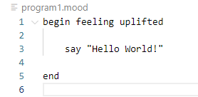
Code Snippet 1:
HIGHLIGHT:
begin feeling “define your mood”
say : to print string statement
end : exit program

Slide 6
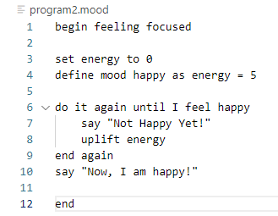
Code Snippet: 2
Highlights:
set: variable control define mood ….. As …. Var =Int : To tie a mood to a specific condition
do it again until I feel happy:
say: output
uplift: to increment

Slide 7
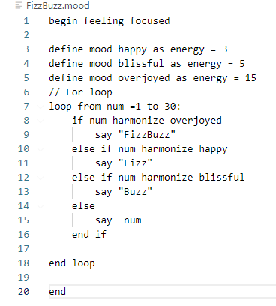
Code Snipet 3:
HIGHLIGHT
Define mood … as var =int
Loop from num =…. To ….
Harmonize : modulo

Slide 8
Side-by-side comparison:
MOODLANG
set x to 5
if i feel happy
say "hi"
Python Equivalent
x = 5
if mood == 'happy’:
print("hi")

Slide 9
Ecosystem
Built with: textX (Python meta-language toolkit) and Python
Libraries: standard library for string manipulation and moods, os and webrowser library for unique features.
Extensions: Can scale more to support plugins like emotion-driven animations or mood-based music triggers.

Slide 10
Challenges:
Parsing natural-feeling phrases cleanly
Avoiding ambiguity in emotional terms
Balancing expressiveness with simplicity

Slide 11
THANK YOU
CHI KIEN PHUNG
CS-420
PROFESSOR DOMINIC DABISH

