Slide 1
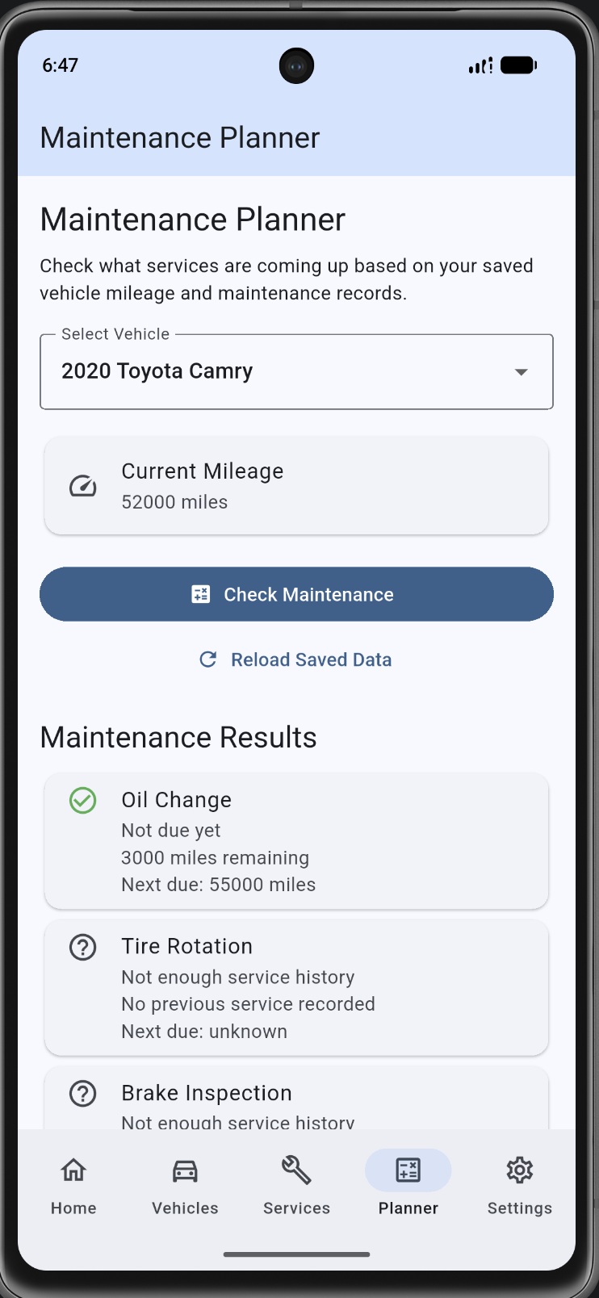
PROJECT ONE
Vehicle Maintenance Log
A Flutter app for tracking vehicle service history and upcoming maintenance.
Presenters: Will Davis
Notes:
[0:00–0:35] Introduce the team, the app, and the purpose. Every teammate needs a speaking part. Confirm team name and presenters before recording.

Slide 2
What we will cover
The problem
What users enter and what the app shows
How we built it
Flutter screens, state, SQLite and SharedPreferences
Maintenance helper
Rules, baseline, examples and user controls
Testing
CRUD, edge cases, offline restart and bugs
Demo and Q&A
Running app, code, team contributions
Notes:
[0:35–1:05] Explain the order. This is one recorded team presentation with Q&A included, not a separate question video.

Slide 3
Why we picked this app
The problem
Our goal
• Service dates and odometer readings are easy to forget.
Save vehicles and service history locally, then estimate when a service is due using mileage.
• People with more than one vehicle need separate records.
• A basic reminder should still work without internet.
Target user: someone who wants a simple personal maintenance log, not a full repair shop system.
Notes:
[1:05–1:55] Tie the topic to an everyday problem. Mention that no account or cloud database is required.

Slide 4
Requirements: inputs and outputs
User enters
App displays
• Vehicle make, model and year
• Vehicle and service lists
• Current odometer mileage
• Service count and total spending
• Service type, date and mileage
• Next estimated service mileage
• Cost and optional notes
• Due-soon / overdue / no-data results
• Warning distance / display settings
• Explanations and editable preferences
Notes:
[1:55–2:45] Explain validations: blank vehicle fields, negative mileage, and negative cost are not allowed. Inputs are saved locally.

Slide 5
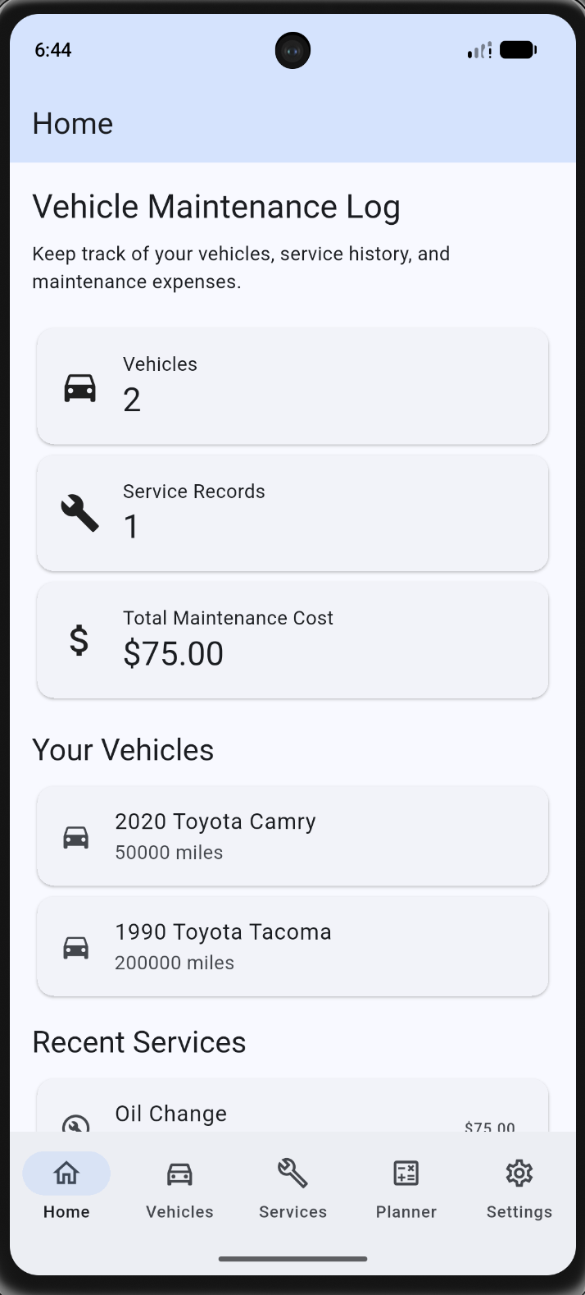
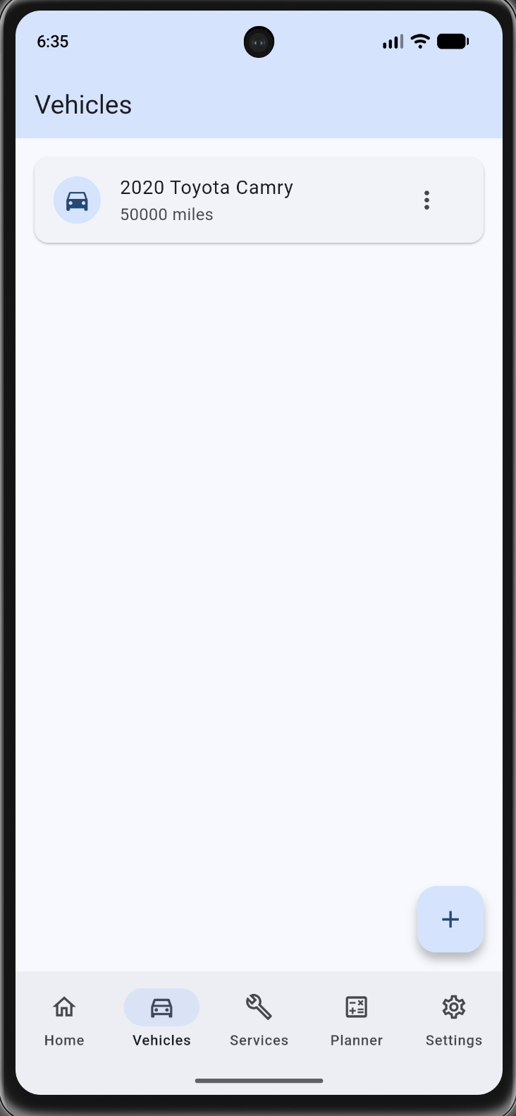
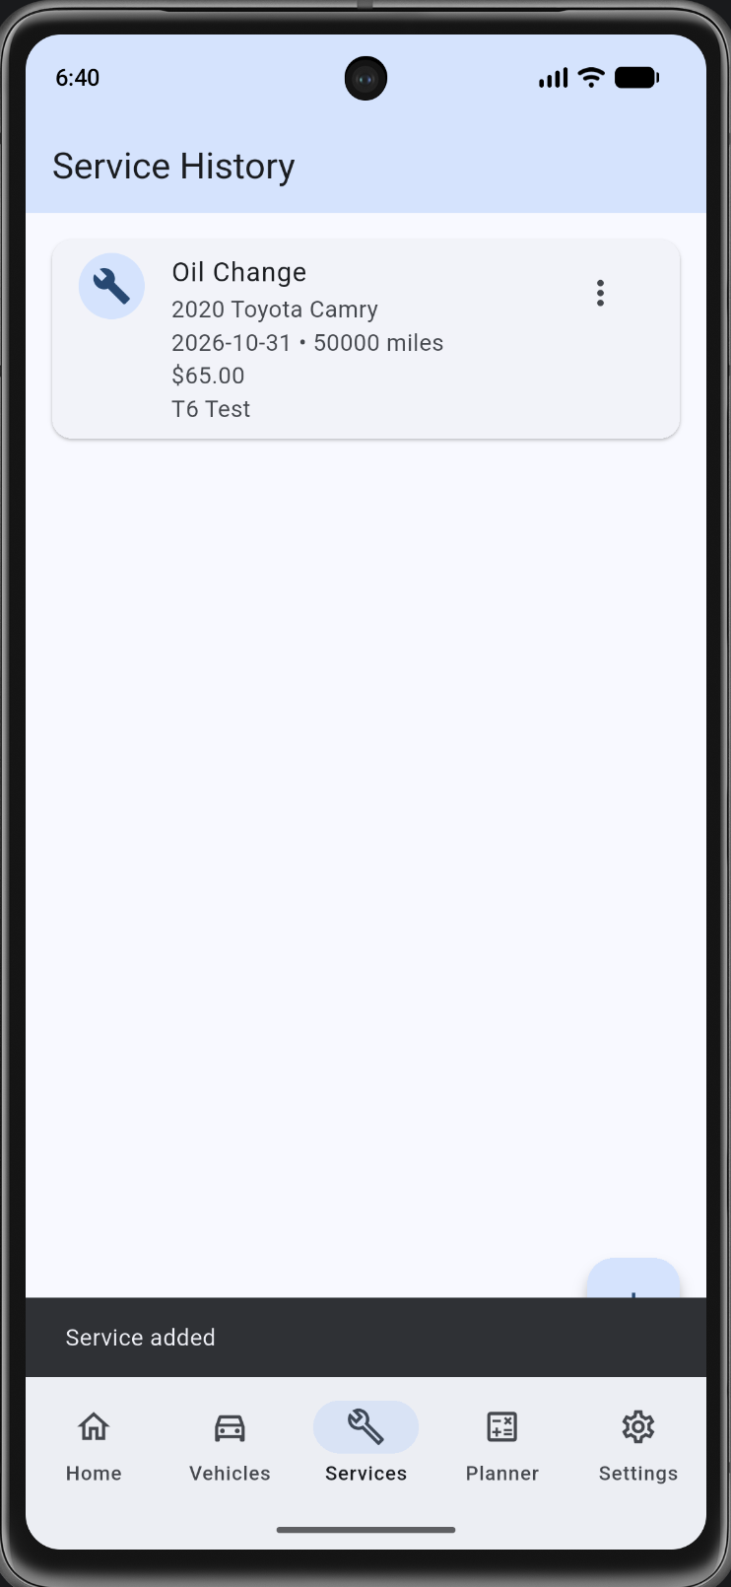
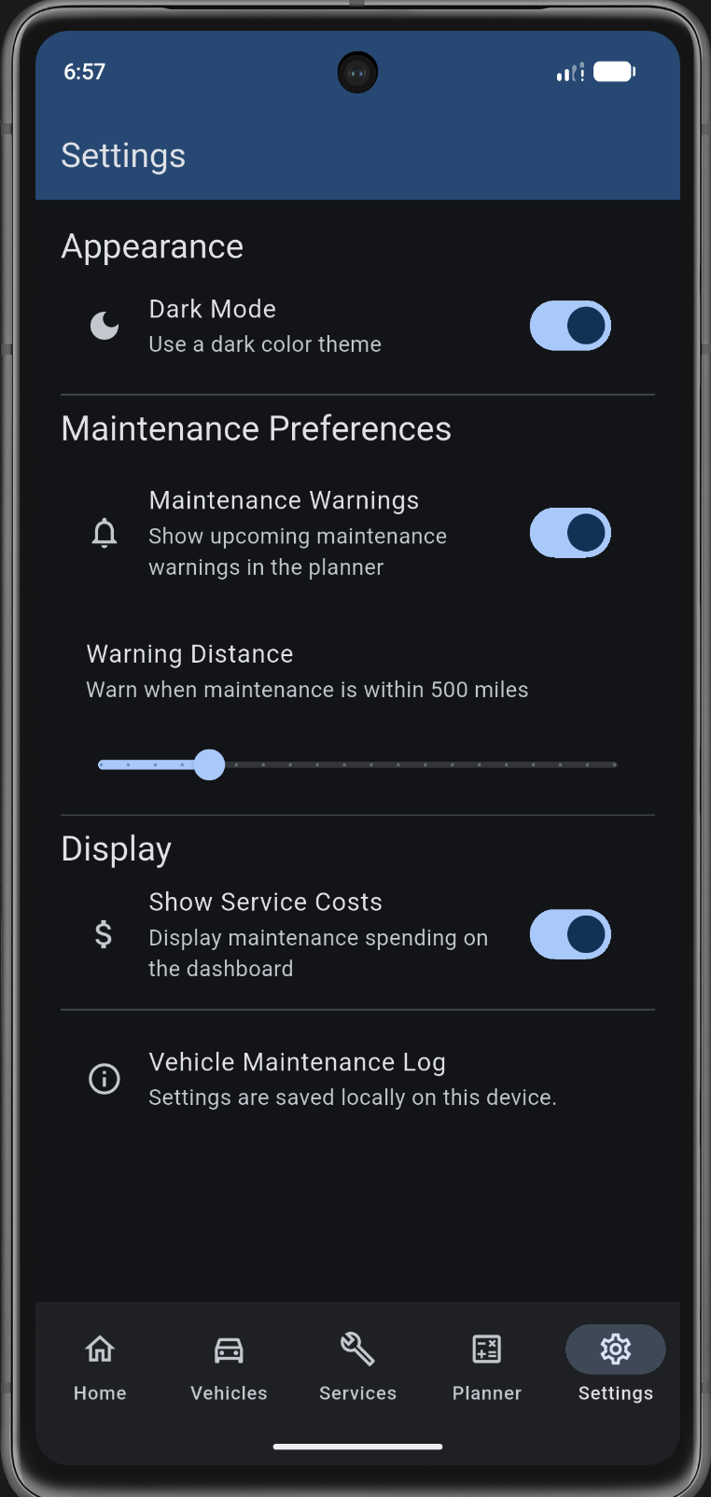
Five main screens
Home
Vehicles
Services
Planner
Settings
Notes:
[2:45–3:35] Explain the five roles. Bottom NavigationBar changes screens; the screens are separate widgets. These are actual emulator screenshots.

Slide 6
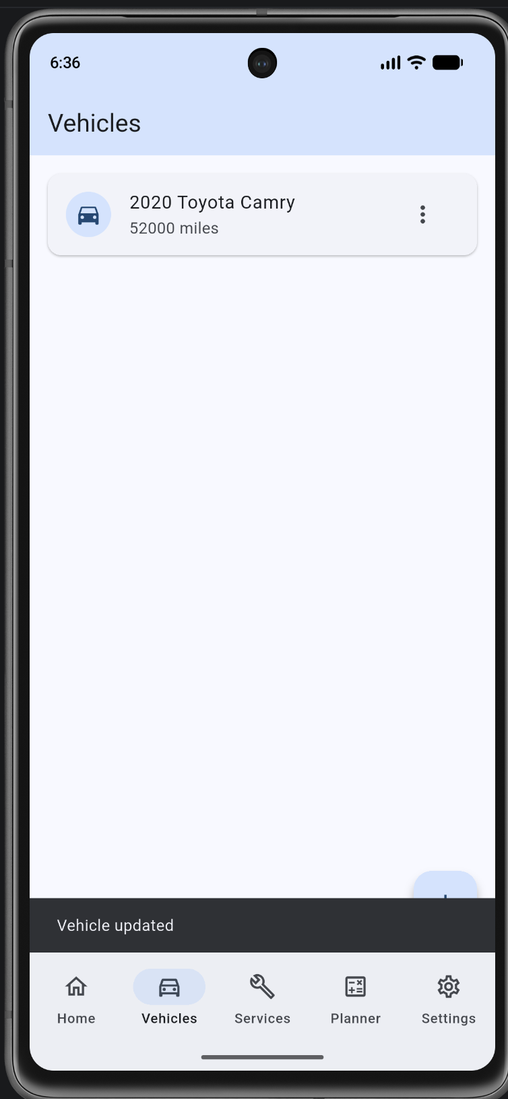
Vehicle management: add and edit
Vehicle data
• Make and model
• Model year
• Current mileage
• Edit and delete options
T1 and T3: vehicle added, then mileage edited to 52,000.
Notes:
[3:35–4:20] Show the add form and the list. Open the menu and explain editing. Screenshot T3 confirms the updated mileage and feedback.

Slide 7
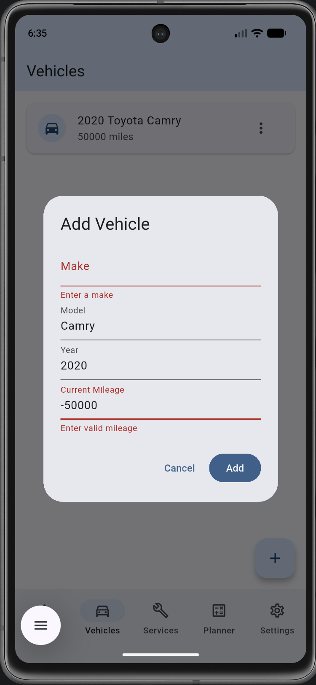
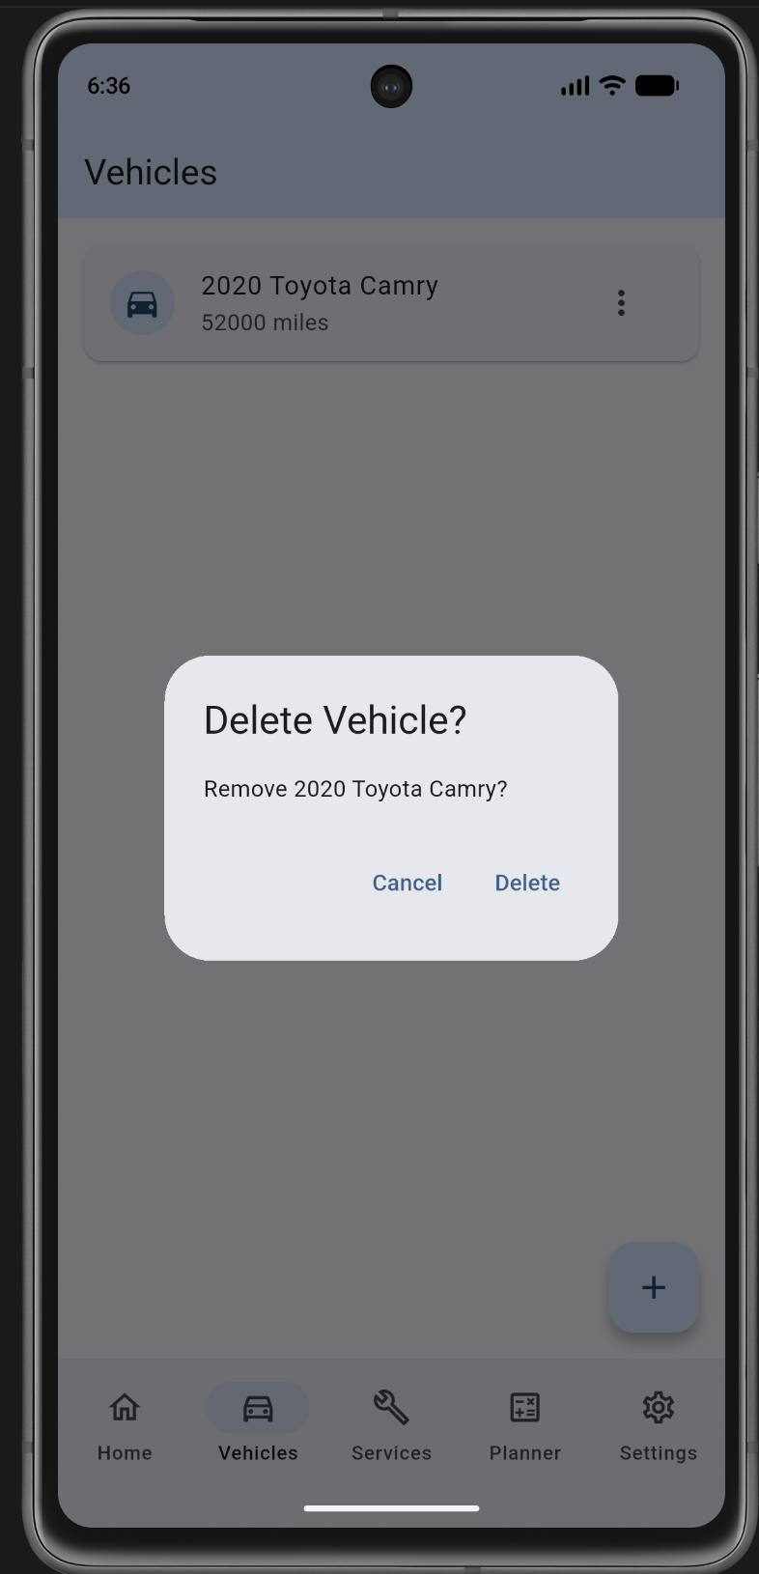
Validation and delete confirmation
What we checked
• Blank make is rejected.
• Negative mileage is rejected.
• Delete asks for confirmation.
• Cancel leaves the record alone.
Tests T2 and T4
Notes:
[4:20–5:05] T2 shows specific error messages. T4 screenshot shows the confirmation dialog; cancel behavior was separately reported in the test checklist.

Slide 8
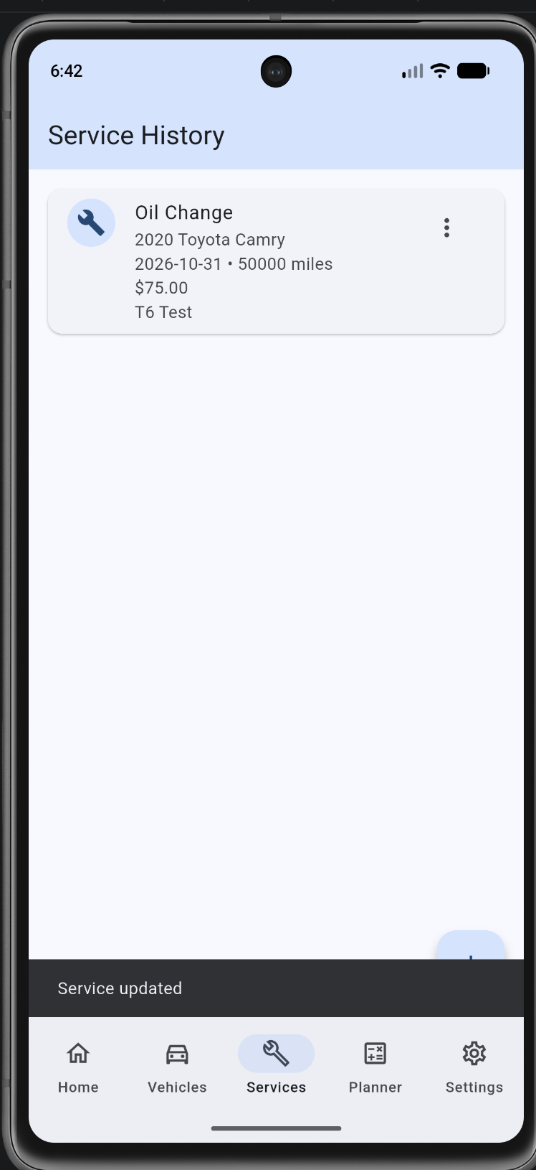
Service history is linked to vehicles
Service record fields
• Vehicle and service type
• Mileage and service date
• Cost and optional notes
• Add, edit and delete
T6: oil change saved at $65
T8: cost updated to $75
Notes:
[5:05–5:55] Service history is the second CRUD entity. Demonstrate editing one service while preserving the vehicle relationship.

Slide 9
Data model and UML class overview
Vehicle
ServiceRecord
id: int (PK)
make, model: String
year: int
mileage: int
1 → many
id: int (PK)
vehicle_id: int (FK)
service_type, date, notes
mileage: int; cost: double
DatabaseHelper provides SQL CRUD methods. Deleting a vehicle cascades to its related services.
Notes:
[5:55–6:50] Explain the parent and child entities. The foreign key is vehicle_id and ON DELETE CASCADE deletes a vehicle’s related services. This is the core diagram; demonstrate the actual classes in VS Code.

Slide 10
How records are stored — SQLite
await db.execute('''
CREATE TABLE services (
id INTEGER PRIMARY KEY AUTOINCREMENT,
vehicle_id INTEGER NOT NULL,
service_type TEXT NOT NULL,
mileage INTEGER NOT NULL,
cost REAL NOT NULL DEFAULT 0,
service_date TEXT NOT NULL,
notes TEXT NOT NULL DEFAULT '',
FOREIGN KEY (vehicle_id)
REFERENCES vehicles(id) ON DELETE CASCADE
)
''');
Source: lib/database_helper.dart • SQLite version 2 with migration from the original vehicles table
Notes:
[6:50–7:45] Explain SQLite because vehicle and service records are structured and related. New database version 2 adds services without dropping saved vehicles.

Slide 11
Database writes and safety checks
return db.update(
'vehicles',
{
'make': make,
'model': model,
'year': year,
'mileage': mileage,
},
where: 'id = ?',
whereArgs: [id],
);
Why this matters
• Update one vehicle by ID.
• Values are passed as arguments.
• After saving, the list reloads.
• Errors show a message instead of silently failing.
From lib/database_helper.dart: updateVehicle()
Notes:
[7:45–8:30] Show the parameterized WHERE clause. It targets one record and avoids mixing SQL with values. Discuss what happens if update returns zero rows.

Slide 12
Flutter structure and state
AppNavigation
Screens
AppSettings
StatefulWidget
selectedIndex changes as tabs change
Separate widgets for Home, Vehicles, Services, Planner and Settings
ChangeNotifier
Notifies the theme and settings screens
Forms use TextEditingController and dispose it after the dialog closes. SQLite data is reloaded after writes.
Notes:
[8:30–9:18] Cover stateful versus stateless, which widget owns selectedIndex, and why controllers are disposed. The app intentionally separates screen code into files.

Slide 13
Navigation code from main.dart
body: IndexedStack(
index: selectedIndex,
children: pages,
),
bottomNavigationBar: NavigationBar(
selectedIndex: selectedIndex,
onDestinationSelected: (index) {
setState(() {
selectedIndex = index;
});
},
),
setState() tells Flutter that the selected tab changed.
IndexedStack preserves each tab’s state.
Notes:
[9:18–10:00] Explain the state change and UI rebuild. Point to the actual main.dart in VS Code when recording.

Slide 14
The maintenance calculation
int? get nextMileage {
if (lastMileage == null) return null;
return lastMileage! + interval;
}
int? get milesLeft {
if (nextMileage == null) return null;
return nextMileage! - currentMileage;
}
String get status {
if (milesLeft == null) return 'Not enough service history';
if (milesLeft! < 0) return 'Overdue';
if (milesLeft! <= dueSoonMiles) return 'Due soon';
return 'Not due yet';
}
From lib/maintenance_planner.dart • the original calculation is separate from the UI
Notes:
[10:00–10:55] Example: an oil change recorded at 50,000 with a 5,000 mile interval is due at 55,000. At 52,000 it has 3,000 remaining; at 56,000 it is 1,000 overdue.

Slide 15
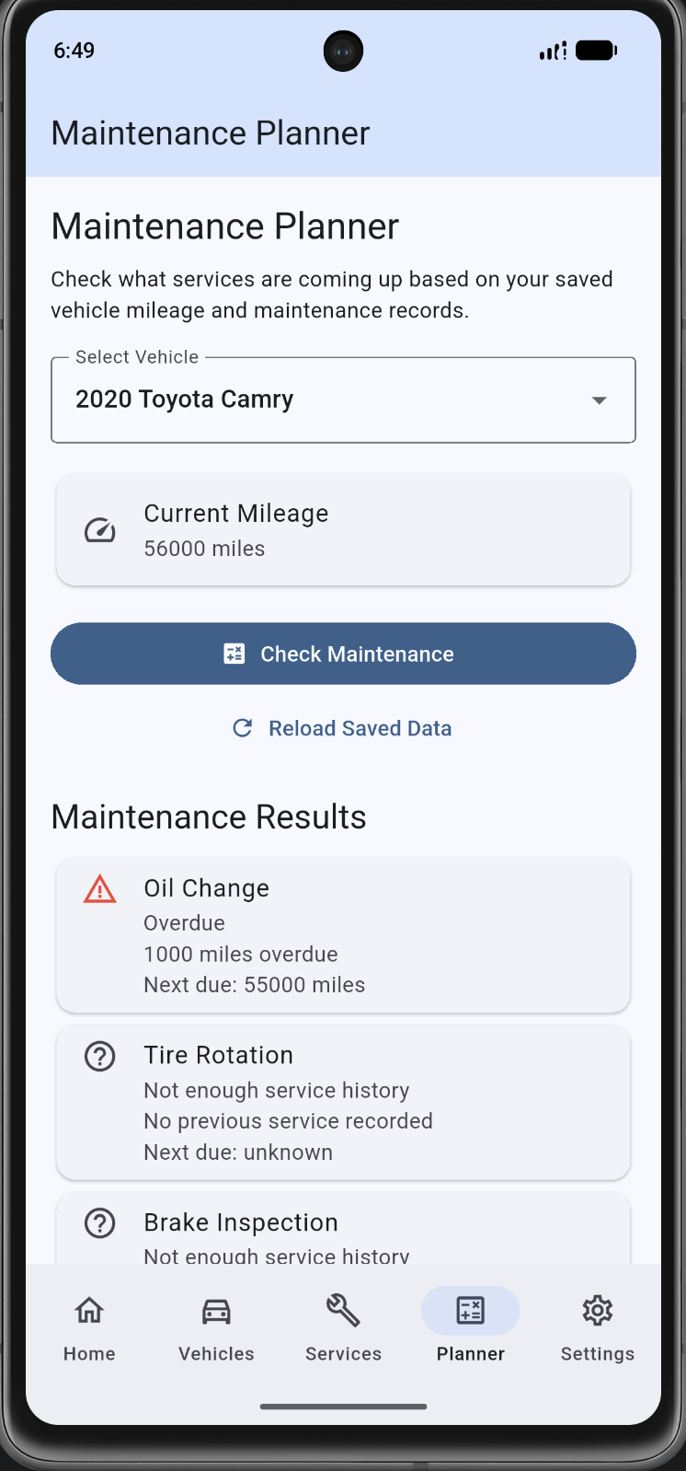
Planner results with real records
Oil change example
Last service: 50,000 mi
Due at: 55,000 mi
Current: 52,000 → 3,000 left
Current: 56,000 → 1,000 overdue
T12 normal case and T14 overdue case
Notes:
[10:55–11:40] Show the two outcomes. Note the no-data states are different from overdue; the app does not invent service dates when no record exists.

Slide 16
Required smart helper — how it works
Rule-based and fully on the device
Input
Mileage, the most recent valid service record and a warning distance
Logic
Find the next estimated service and compare miles left to a threshold
Output
Overdue, Upcoming or On track — plus an explanation
Control
Dismiss the suggestion or temporarily change the threshold
This is a rules-based helper, not a trained ML model. No internet connection or external AI API is needed.
Notes:
[11:40–12:35] Explain why simple rules fit this task: no training dataset, predictable behavior, easy to explain and test. The term “smart helper” here means rules, not generative AI.

Slide 17
Smart helper decision code
known.sort(
(a, b) => a.milesLeft!.compareTo(b.milesLeft!),
);
final next = known.first;
final remaining = next.milesLeft!;
if (remaining < 0) {
return MaintenanceSuggestion(
service: next.name, priority: 'Overdue', ...
);
}
if (remaining <= warningMiles) {
return MaintenanceSuggestion(
service: next.name, priority: 'Upcoming', ...
);
}
Notes:
[12:35–13:20] Explain that the helper sorts records that have known milesLeft, chooses the earliest, then assigns a priority. All outputs are deterministic.

Slide 18
Helper compared with a simple baseline
Same vehicle and service: Camry at 54,000 mi, oil change at 50,000 mi
Fixed baseline
Adjustable helper
Warning distance: 500 miles
Warning distance: 1,200 miles
Result: On track
Result: Upcoming
The estimated service is 1,000 miles away. Changing the warning threshold changes the warning, not the saved service record.
T16 was reported passed. The provided screenshot does not independently display both comparison labels.
Notes:
[13:20–14:12] This is the counterexample scenario required by the rubric. Discuss why a fixed 500 mile threshold and a 1,200 mile user preference have different labels for the same mileage. User reports passing T16; screenshot of both labels would improve evidence.

Slide 19
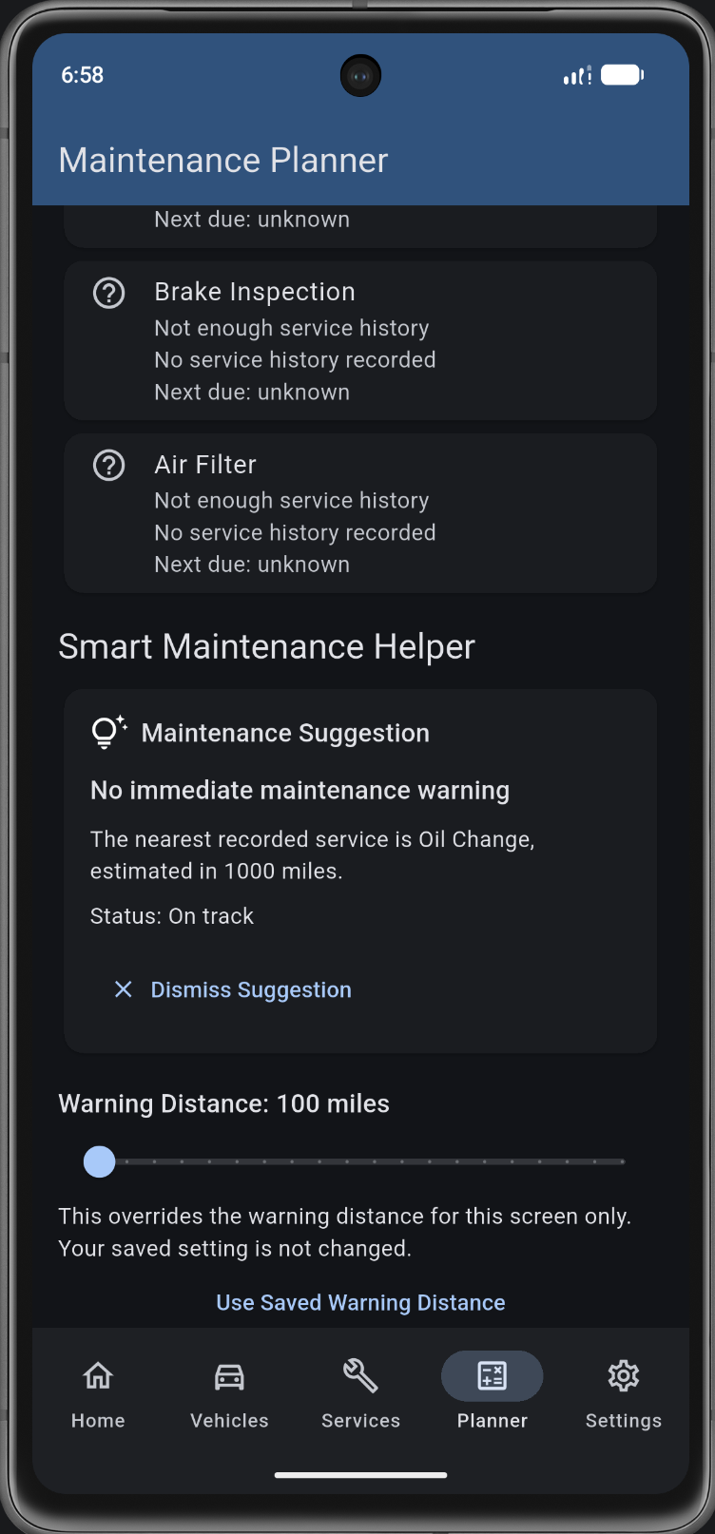
User control and explaining results
A user can disagree with the warning
• The helper states the reason for its recommendation.
• Dismiss Suggestion hides the helper card.
• A slider changes warning distance for this screen only.
• Use Saved Warning Distance restores the setting.
• The helper never edits a saved service automatically.
Screenshot T19 • user-adjustable warning
Notes:
[14:12–14:58] The screenshot shows the helper card, explanation and temporary slider. Dismissing and restoring behavior is reported passed by the user.

Slide 20
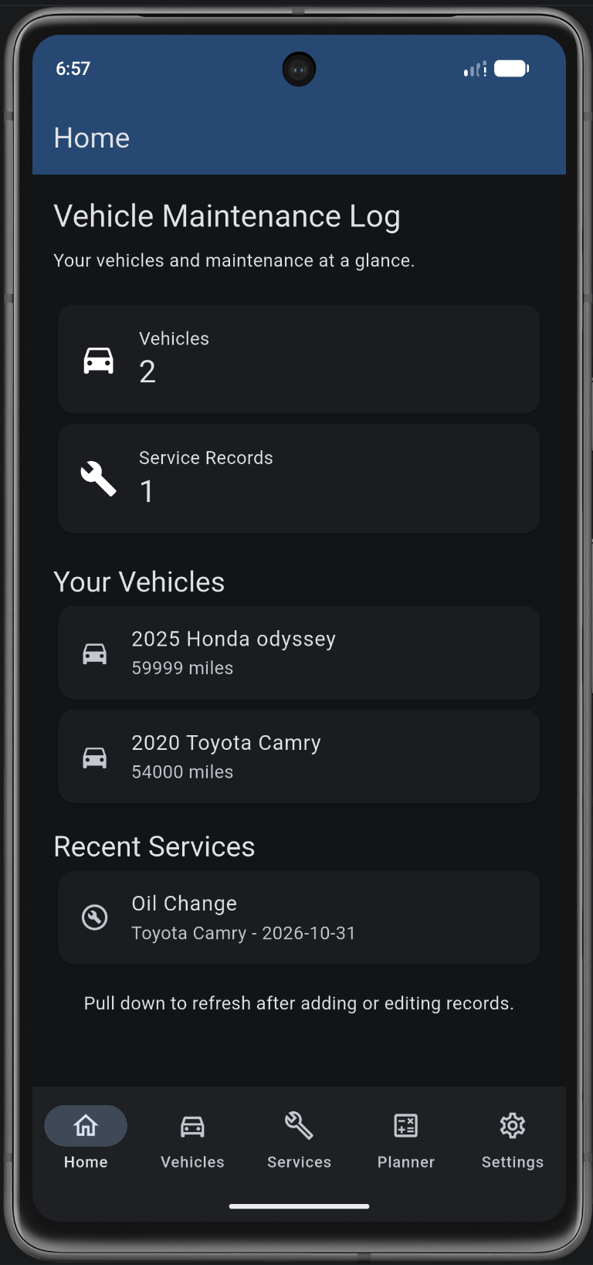
Settings saved with SharedPreferences
final prefs = await SharedPreferences.getInstance();
darkMode = prefs.getBool('darkMode') ?? false;
warningMiles = prefs.getDouble('warningMiles') ?? 500;
await prefs.setBool('darkMode', value);
Dark mode and cost visibility are optional. Preferences stay saved locally.
Notes:
[14:58–15:53] T17: dark mode. T18: dashboard hides costs when showCosts is turned off. SharedPreferences is used for simple key/value preferences, while SQLite handles related records.

Slide 21
How I tested the app
20 manual test cases reported passed
T1–T20
T1–T5
Vehicles: add, edit, validation and delete
T6–T9
Services: add, invalid cost, edit and delete
T10–T11
Offline restart and cascade deletion
T12–T16
Helper: normal, boundary, overdue, no-data and comparison
T17–T20
Preferences, override and responsive layout
Screenshots show selected results. Actions such as restart and cancel were confirmed in the test log.
Notes:
[15:53–16:45] Explain manual testing categories and how expected and actual results were recorded. Each of the 20 tests was reported passed by the student; screenshots document selected screen states.

Slide 22
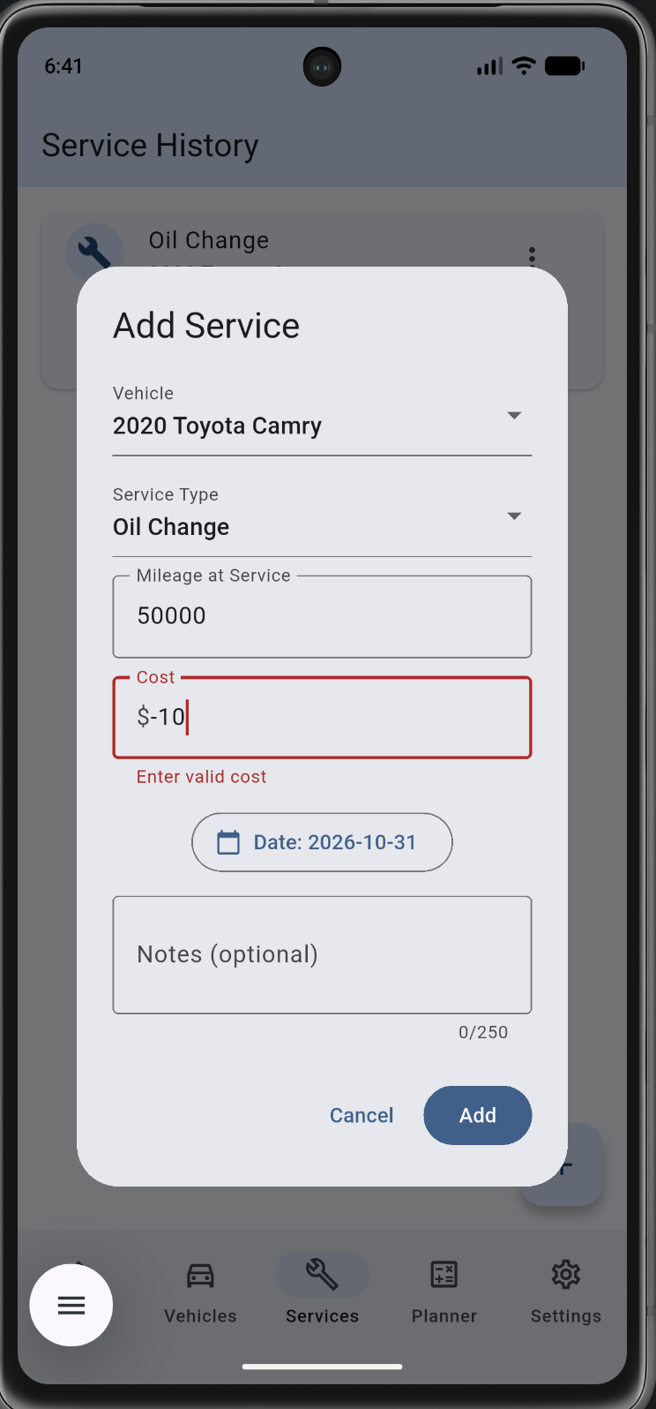
Testing: bad input should not save
What we observed
• Vehicle form rejects blank make and negative mileage.
• Service form rejects a negative cost.
• The form stays open so the value can be corrected.
T2 and T7
Notes:
[16:45–17:30] Walk through invalid inputs. The screenshots show red validation messages, no accepted record, and the user still has the chance to correct their values.

Slide 23
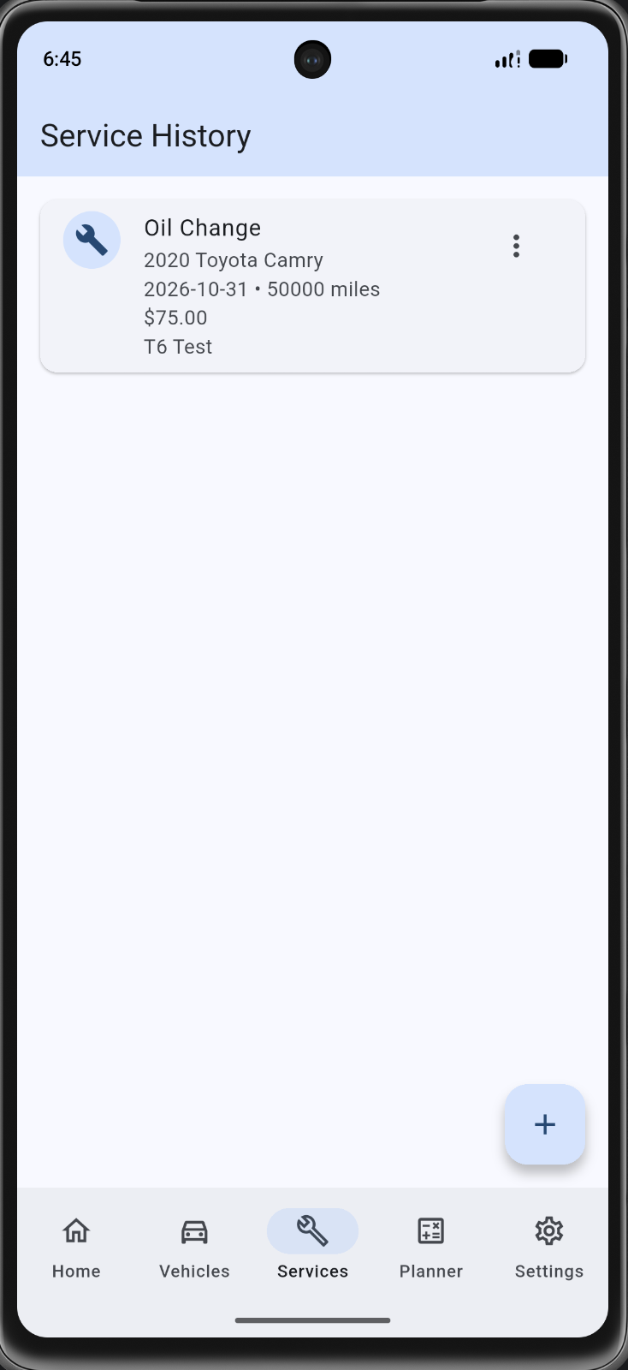
Offline storage and related records
Two useful checks
• T10: records remained after an offline restart.
• T11: deleting a temporary vehicle removed its linked service.
• The Camry service was still shown afterward.
After-action screenshots
Notes:
[17:30–18:20] Explain the observed post-restart and post-delete states. The photos were taken after the actions, not during. The app uses SQLite with foreign key cascade enabled.

Slide 24
Testing gaps and known limitations
Automated runs
flutter analyze and flutter test need final recorded terminal results.
Device coverage
Current screenshots are from an Android emulator; a second device test should be documented.
Maintenance estimates
These are example mileage intervals, not vehicle manufacturer schedules.
Usability
Manual refresh is sometimes needed after editing data on another tab.
Helper evaluation
The baseline comparison should be captured with both labels visible.
Notes:
[18:20–19:10] Be candid about limits. The automated checks may be completed later; this deck does not claim results without logs. A peer usability observation and a documented revision should be added if completed.

Slide 25
Project workflow and team contribution
GitHub and ClickUp track what each person worked on.
Example completed trace
ClickUp task [work on navigation that uses router] → app navigation route in lib/main.dart → Git commit 5102b94 → tab navigation check
Notes:
[19:10–19:55] Demonstrate real ClickUp work and a code/test trace; the example commit 5102b94 for navigation was confirmed in chat. Do not invent missing historical snapshots or teammate contributions. Each member must participate.

Slide 26
Integrated Q&A — required topics
The curated bank requires I1, I2, D1, D2 and R4. Use the exact question wording when recording.
I1 / I2
Implementation: explain Flutter widgets, state changes and navigation.
D1 / D2
Data: explain why SQLite + SharedPreferences, and how CRUD/restart works.
R4
Required smart-helper question: rules, baseline, evidence, limitation, user control.
Notes:
[19:55–21:05] Integrate questions and show proof in the live app/VS Code. The exact words from the curated question bank were inaccessible while drafting. Replace with the selected full questions before recording and include all 10–15 selected questions.

Slide 27
Other Q&A topics for the recording
Choose 7 more from the official bank to reach 12 total; confirm at least two from each category.
1. Why does AppNavigation need state?
5. How is the next service calculated?
2. When do controllers get disposed?
6. How does the baseline compare to the helper?
3. How do vehicles and services connect?
7. What happens with missing history?
4. How is invalid input rejected?
8. What test failed or revealed a limitation?
Notes:
[21:05–22:05] These are practice prompts; choose IDs and exact text from the official curated bank before presentation. The bank calls for 10–15 questions total and at least two per category. Do not treat these eight suggestions as already selected bank questions.

Slide 28
Demo and final submission
• Run through all five screens
Submit
• Add/edit a vehicle and a service
• GitHub link
• YouTube link
• Release APK
• Project ZIP
• PowerPoint
• Signed statement
• Docs + evidence
• Show the planner and its helper
• Change settings and confirm local persistence
• Show code, testing evidence and ClickUp trace
Notes:
[22:05–23:00] Show the final submission checklist and end. Record with Zoom/Teams/Discord, include everyone, upload to YouTube, and make sure both links open.

