Slide 1
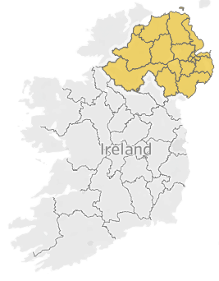


Northern ireland (NI) Brexit, religion & reunification
William Mollers
IRON HACK
DATA ANALYTICS
DECEMBER 2020

Slide 2
GOALS
Identify electorates in NI that YES campaigners should target
Determine whether there is correlation between religious identity and voting patterns

Slide 3


TECHNICAL THING-A-ME-BOBS
WHERE: Data from Govt Sites (NISRA, EONI)
TOOLS: Python / Pandas / Seaborn / Matplotlib / Excel / Tableau
WHAT: Exploration / Cleaning / Wrangling /
Web Scraping / Correlation / Data Visualisation
SUMMARISED: I LOVE SPREADSHEETS

Slide 4
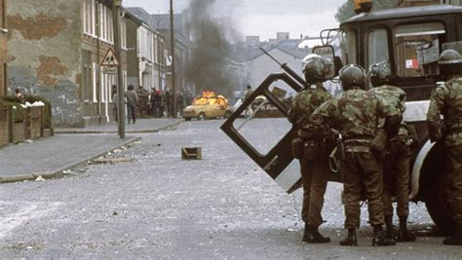
A brief history lesson
1600 Ireland colonised by English (Protestants)
1845 Potato Famine
1916 Independence War
1922 Partition of Ireland
1969 – 1998 Troubles
1998 Good Friday Agreement (GFA)
2016 Brexit
2020 Worries about Brexit

Slide 5

DATA
Population Estimate 2019/2016/2011
1.9 Million Total
1.45 Million Adults
Religion 2011
Catholic 45%
Protestant 48%
Other 7%
Brexit 2016
Votes Cast
Leave 45%
Remain 55%
Total Eligible Pop
Didn’t vote 44%
Leave 25%
Remain 31%
UK Election 2019
Votes Cast
Neutral 18%
Republican 39%
Unionist 43%
Total Eligible Pop
Didn’t vote 45%
Neutral 10%
Republican 21%
Unionist 24%

Slide 6
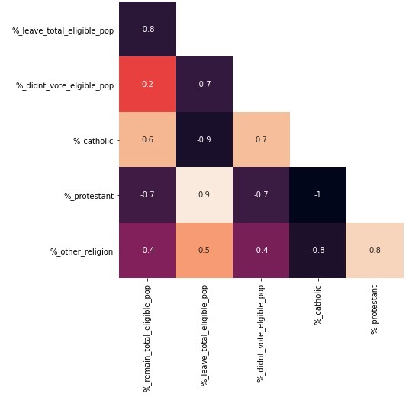
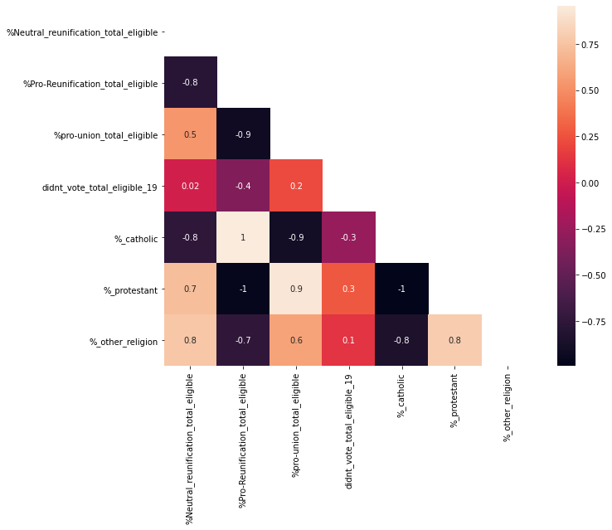
CORRELATION

Slide 7
THERE IS A STRONG CORRELATION BETWEEN RELIGION AND VOTING PATTERNS
BREXIT
CATHOLIC - REMAIN (0.6) & OTHER / PROTESTANT - LEAVE (0.5, 0.9)
CATHOLIC MORE LIKELY TO NOT VOTE (0.7 vs. -0.7)
UK ELECTION 2019
NEUTRAL HIGHEST AMONGST PROTESTANTS / OTHER (0.7, 0.8)
REPUBLICAN AND CATHOLIC PERFECT CORRELATION (1.0)
OTHER LEANED MORE UNIONIST (0.6)
PROTESTANTS MORE LIKELY TO NOT VOTE (0.3)

Slide 8
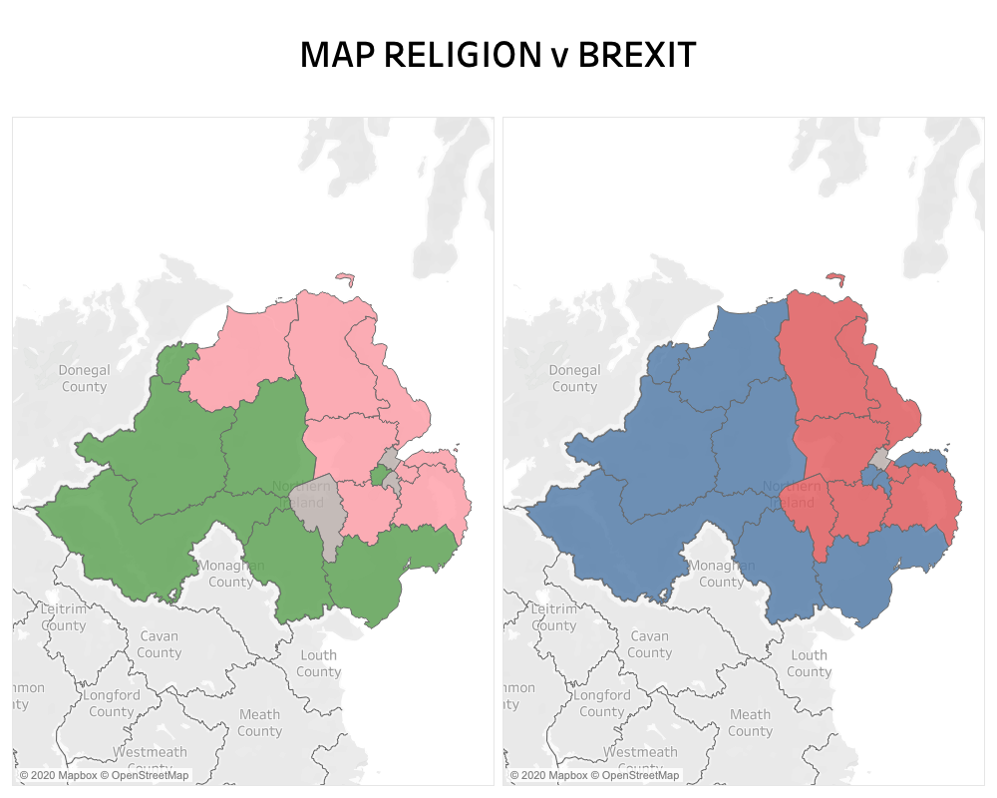
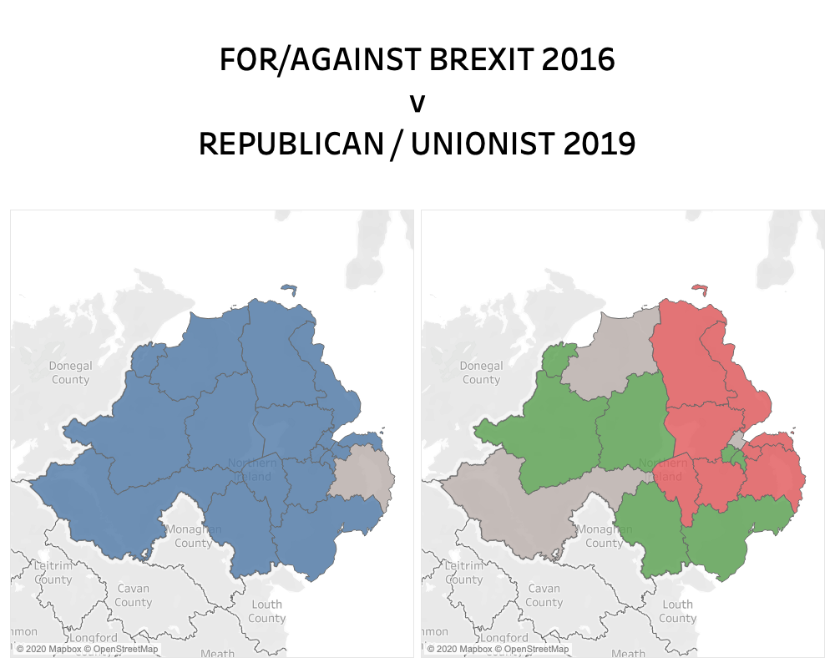

Slide 9
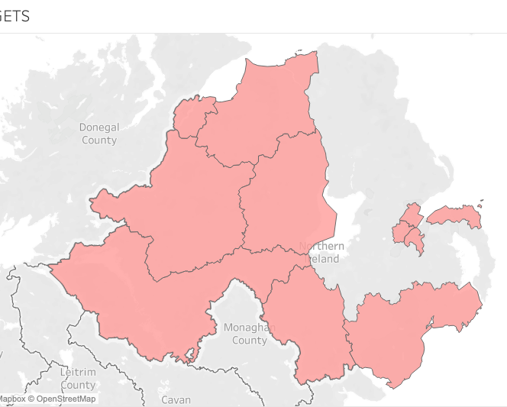
WHO TO TARGET?
CATHOLICS IN LOW TURNOUT AREAS
(8 ELECTORATES)
PROTESTANT MAJORITY / NO MAJORITY RELIGION &
HIGH REMAIN VOTE
(3 ELECTORATES)

Slide 10
LIMITATIONS
POSITIVES
DATA DIFFERENT YEARS
>= 18 AGGREGATED
ELECTORATE LEVEL
45% DON’T VOTE
RELIABLE DATA SOURCES
ENOUGH PEOPLE VOTE TO MAKE SOME GENERALISATIONS
PLENTY OF GREAT PLACES TO START

Slide 11

GITHUB / LINKEDIN / TWITTER:
williammollers
hi@williammollers.com

