Slide 1

☕
BRIGHT COFFEE
Sales Performance Review
An Exploratory Data Analysis of transactions across three New York stores
January – June 2023 | Prepared for Bright Coffee Leadership
Notes:
1

Slide 2
Six Months in Numbers
149,116 transactions across three stores form the basis of this analysis
$
#
≡
Ø
$698,812
149,116
214,470
$4.69
Total revenue
Transactions
Items sold
Average order value
Revenue nearly doubled between January ($81.7K) and June ($166.5K), driven by steady growth in transaction volume rather than higher prices — a sign the customer base itself is expanding.
Data source: Bright Coffee point-of-sale export, Jan 1 – Jun 30, 2023 (3 store locations)
BRIGHT COFFEE • SALES PERFORMANCE REVIEW
2
Notes:
2

Slide 3
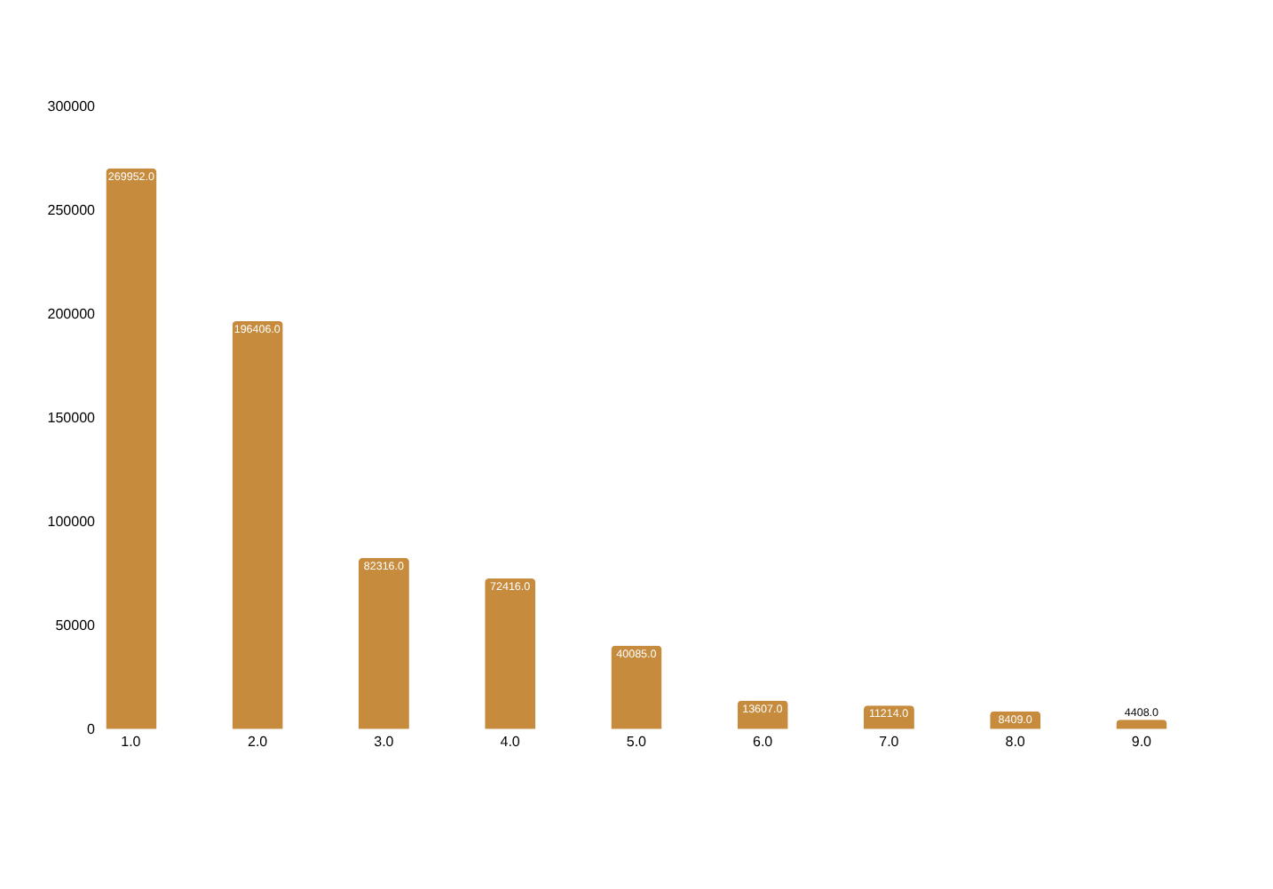
Coffee and Tea Drive Two-Thirds of Revenue
Total revenue by product category, Jan–Jun 2023
38.6%
of all revenue comes from Coffee alone
28.1%
comes from Tea, the second-largest category
Long tail
Bakery, chocolate and beans round out the remaining third
BRIGHT COFFEE • SALES PERFORMANCE REVIEW
3
Notes:
3

Slide 4
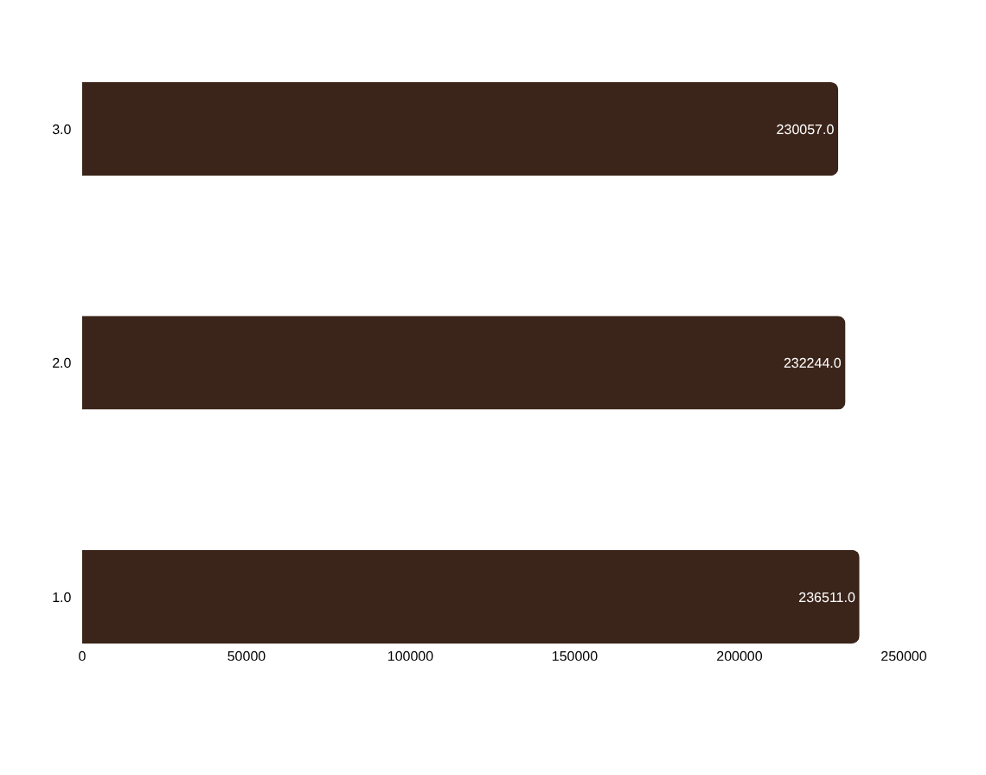
Performance Is Balanced Across All Three Stores
Total revenue by store location, Jan–Jun 2023
Only a 2.8% spread
separates the highest- and lowest-earning store, and the category mix within each is nearly identical.
Coffee revenue
$88.9K – $91.2K per store
Tea revenue
$63.9K – $67.8K per store
Coffee beans
Hell's Kitchen leads at $18.6K
BRIGHT COFFEE • SALES PERFORMANCE REVIEW
4
Notes:
4

Slide 5
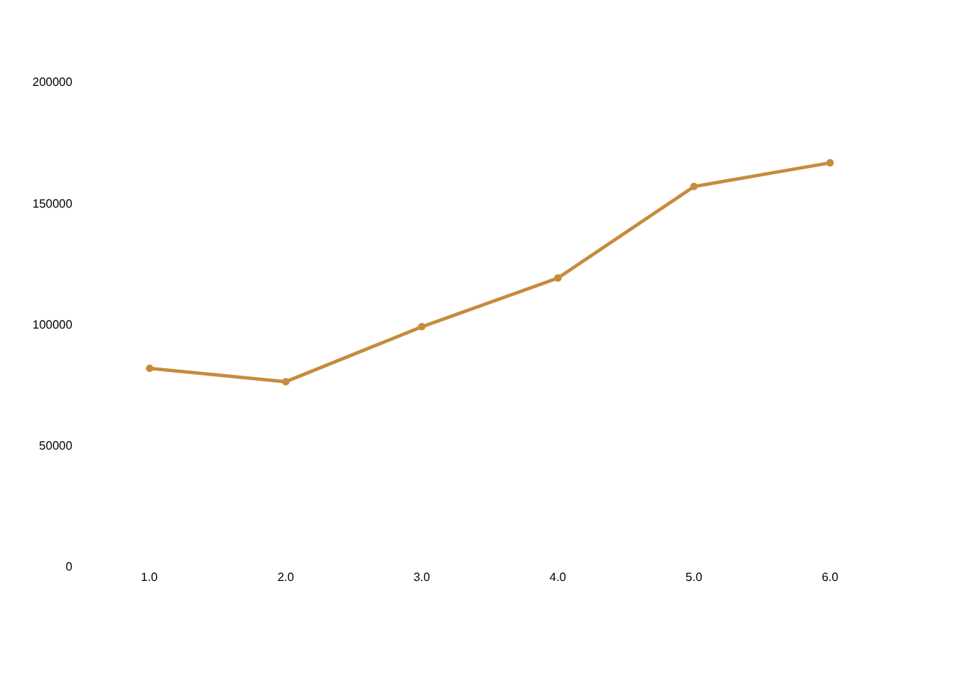
Revenue and Traffic Both Accelerated Every Month
Monthly revenue vs. transaction count, Jan–Jun 2023
+104%
growth in transaction count from January to June
Jan
17,314
Feb
16,359
Mar
21,229
Apr
25,335
May
33,527
Jun
35,352
Growth in both revenue and transactions — not just average spend — points to a genuinely expanding customer base rather than seasonal price effects.
BRIGHT COFFEE • SALES PERFORMANCE REVIEW
5
Notes:
5

Slide 6
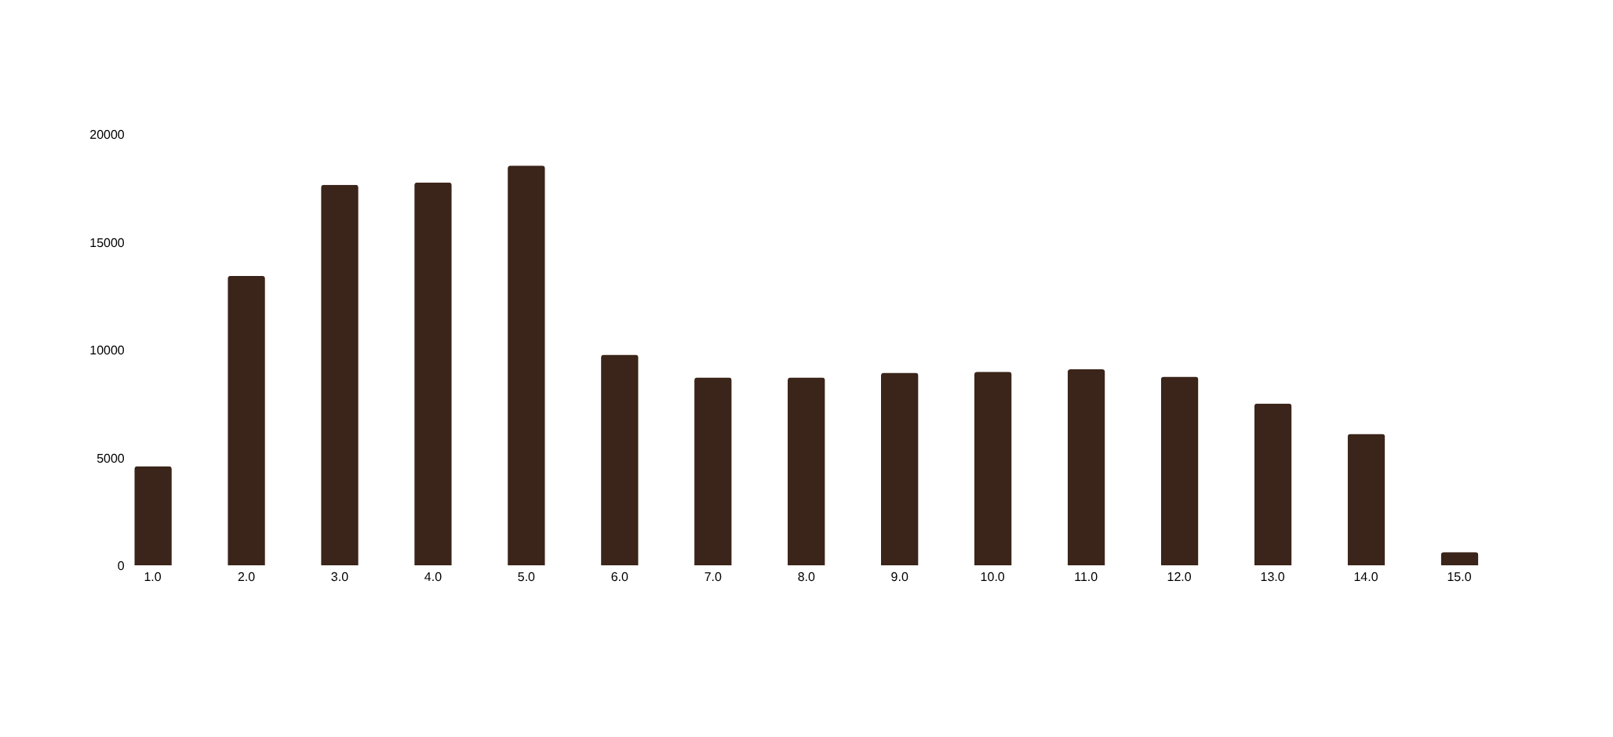
The Morning Commute Is Peak Trading Time
Transactions by hour of day, all stores combined
7–10am accounts for roughly 45% of the day's transactions
Volume stays flat through the afternoon rather than spiking again at lunch, then tapers off after 6pm.
BRIGHT COFFEE • SALES PERFORMANCE REVIEW
6
Notes:
6

Slide 7
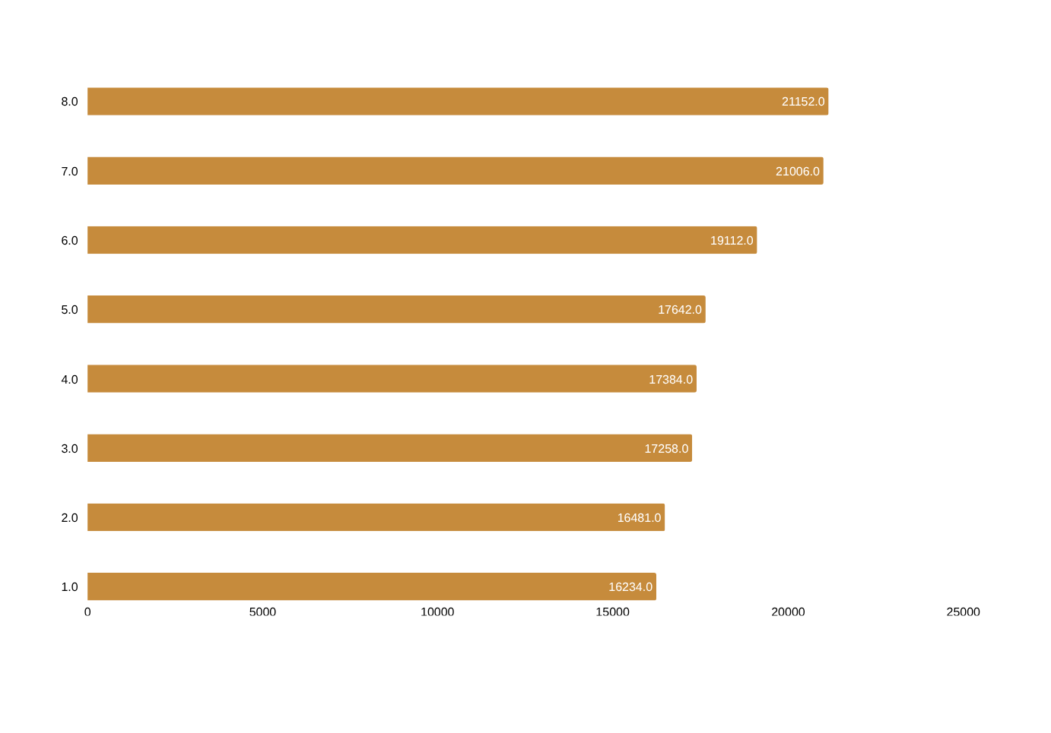
Eight Products Anchor a Wide, Varied Menu
Top products by total revenue, Jan–Jun 2023
★
No single hit product
The top 8 items span coffee, tea and chocolate and each contribute a similar $16–$21K — revenue is spread across a broad menu rather than concentrated in one bestseller.
Large-size drinks (“Lg”) dominate this list, suggesting upsizing is already a strong habit among regulars.
BRIGHT COFFEE • SALES PERFORMANCE REVIEW
7
Notes:
7

Slide 8
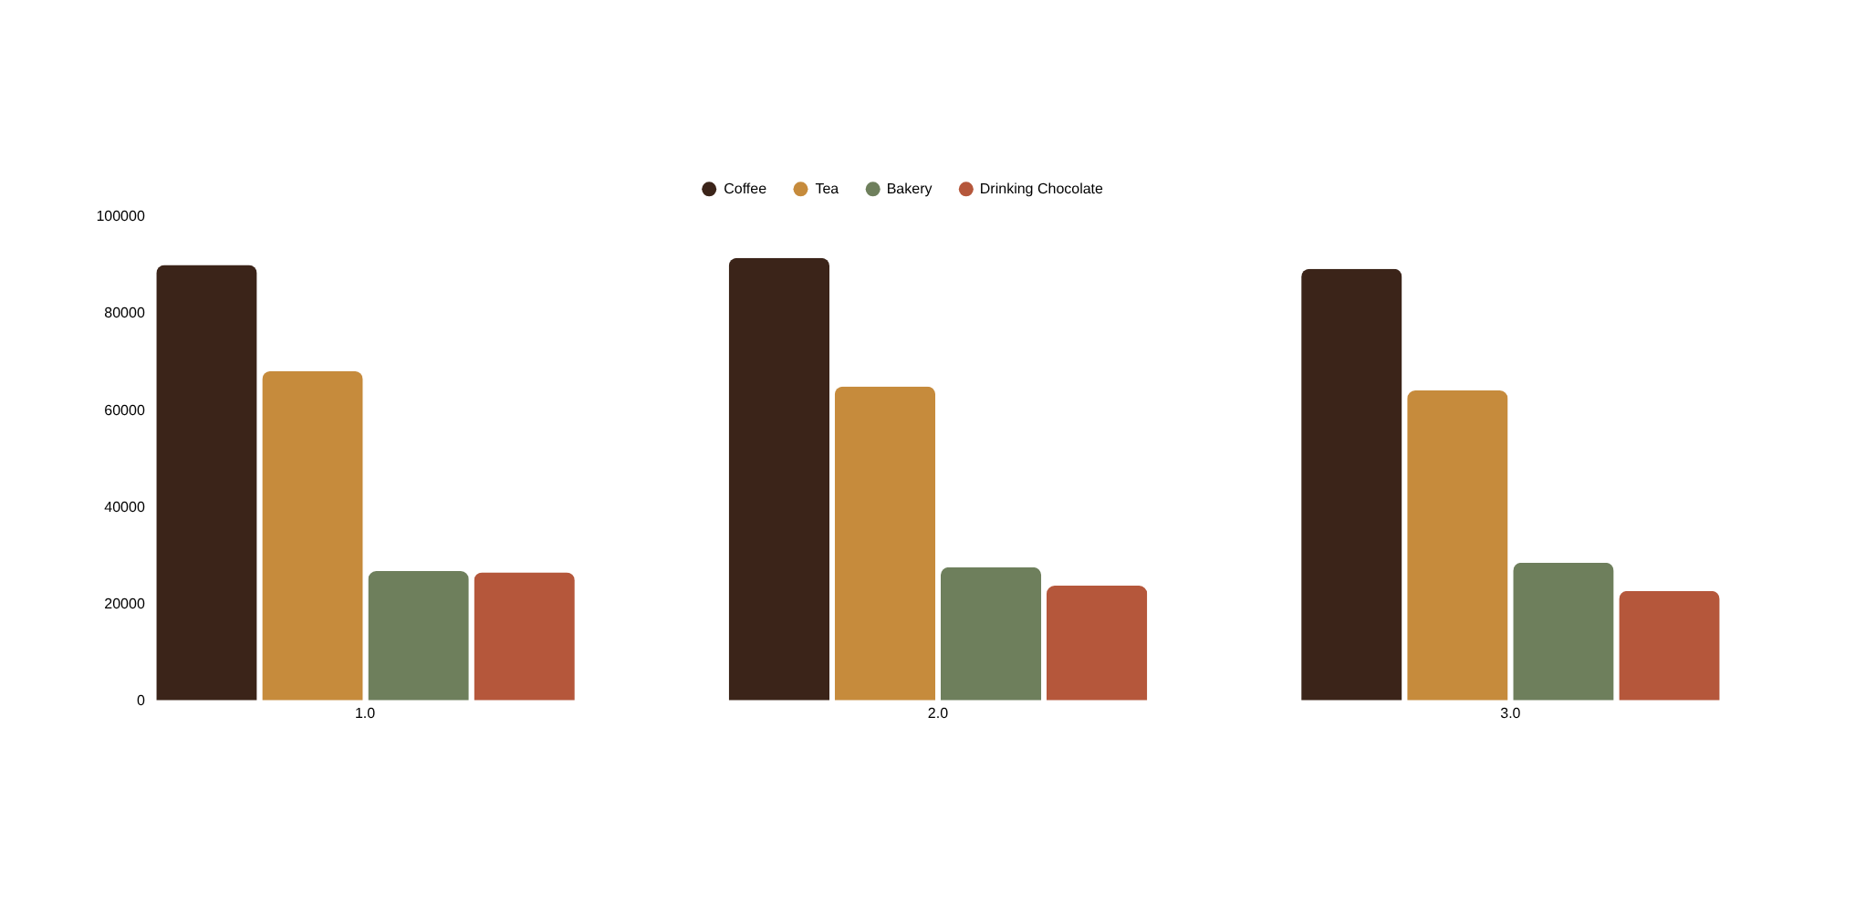
Every Store Sells the Same Way
Revenue by store and top product categories, Jan–Jun 2023
The ranking of categories — Coffee, then Tea, then Bakery and Chocolate — holds at all three locations, so successful playbooks can be shared across stores with minimal adaptation.
BRIGHT COFFEE • SALES PERFORMANCE REVIEW
8
Notes:
8

Slide 9
What This Means for Bright Coffee
Key insights and recommended actions
☕
Coffee and tea are the growth engine
⏰
Staff and stock for the morning rush
Together they drive 67% of revenue. Prioritize promotions, seasonal drinks and loyalty offers on these two categories first.
7–10am drives roughly 45% of daily transactions. Ensure peak staffing and inventory are set before doors open, not after.
↑
The customer base is genuinely growing
⇄
Replicate what works, store to store
Transactions rose 104% from January to June while spend-per-order held steady — invest in capacity to sustain the trend.
Category performance is nearly identical across all three locations, so successful promotions can roll out chain-wide with confidence.
BRIGHT COFFEE • SALES PERFORMANCE REVIEW
9
Notes:
9

Slide 10
☕
Thank You
Questions and discussion welcome
Analysis based on Bright Coffee POS data, Jan–Jun 2023
Notes:
10

