Slide 1

CVM DATA ANALYTICS CASE STUDY
BRIGHTTV
VIEWERSHIP ANALYTICS
Turning viewing behaviour into subscriber growth
Prepared for: BrightTV Customer Value Management Team Data source: User Profiles & Viewership transactions, Q1 2016 (SA time)
BRIGHTTV VIEWERSHIP ANALYTICS
01 / 18
Notes:
Welcome the CVM team. BrightTV's CEO has set a clear objective this financial year: grow the subscription base. This deck walks through what the user and viewership data actually shows, and turns it into concrete recommendations for this team. Data covers Q1 2016, all times converted to South African time.

Slide 2




THE BRIEF
A Subscription Growth Mandate
BrightTV's CEO has set a clear objective for this financial year: grow the subscription base. To meet that target, the Customer Value Management (CVM) team needs to understand who is watching, when they watch, and what drives engagement — before designing the initiatives that will attract and retain subscribers.
Grow Subscribers
Expand BrightTV's active subscriber base this financial year
Increase Engagement
Lift session frequency and viewing on the weakest days
This analysis translates raw user and session data into evidence the CVM team can act on.
Data-Led Decisions
Give CVM a factual foundation for content & campaign choices
BRIGHTTV VIEWERSHIP ANALYTICS
02 / 18
Notes:
Frame the brief: the CEO wants subscriber growth, and CVM has been asked to ground that push in data. Three things this analysis needs to deliver: who's watching, what's driving engagement, and where the growth opportunities are. Everything that follows builds toward those three outcomes.

Slide 3


WHAT THIS ANALYSIS ANSWERS
Four Questions Guiding This Work
01
02
What are the main user and usage trends of BrightTV?
What factors are associated with consumption?
03
04
What content should be recommended to lift low-consumption days?
What initiatives can further grow BrightTV's user base?
BRIGHTTV VIEWERSHIP ANALYTICS
03 / 18
Notes:
This case study is structured around four questions set out in the brief: user and usage trends, factors associated with consumption, content for low-consumption days, and growth initiatives. Keep these four in mind — every section maps back to one of them.

Slide 4




HOW WE GOT HERE
Data & Methodology
Two linked datasets
Time standardisation
User Profiles — 5,375 records: demographics (gender, age, province) Viewership — 10,000 raw session records, Jan–Mar 2016, joined by UserID
All session timestamps were supplied in UTC and converted to South African time (UTC+2) before any day-of-week or hour-of-day analysis.
Cleaning & aggregation steps
3.99% of users (175) have no matched demographic profile and are excluded from gender/age percentages.
Removed 5 exact duplicate session records (10,000 → 9,995 valid sessions)
Converted RecordDate from UTC to SAST (+2 hours)
Joined sessions to user profiles on UserID for demographic analysis
Aggregated sessions by day, hour, channel, gender, age and province
BRIGHTTV VIEWERSHIP ANALYTICS
04 / 18
Notes:
Two datasets: User Profiles (5,375 records) and Viewership (10,000 raw session records). We removed 5 exact duplicate rows, leaving 9,995 valid sessions. All timestamps were converted from UTC to SA time before any day/hour analysis, as instructed. Note: about 4% of users in the viewership data have no matching demographic profile, so gender/age percentages are based on the 96% who do.

Slide 5





AT A GLANCE
Executive Overview
Six numbers that frame the rest of this analysis.
4,386
9,995
2.28
Unique users
Valid sessions
Sessions per user
1,673
956
17:00
Friday sessions — busiest day
Monday sessions — quietest day
Peak viewing hour, SA time
BRIGHTTV VIEWERSHIP ANALYTICS
05 / 18
Notes:
Six numbers to anchor the rest of the talk: 4,386 unique users generated 9,995 sessions, averaging 2.28 sessions per user. Friday is the busiest day, Monday the quietest, and 17:00 SA time is the daily peak. We'll unpack each of these in turn.

Slide 6


WHO'S WATCHING
A Strongly Male-Skewed Audience
84.9%
of the audience is male
11.1%
of the audience is female
Female viewers are under 12% of the base — a clear acquisition opportunity for growth campaigns.
BRIGHTTV VIEWERSHIP ANALYTICS
06 / 18
Notes:
BrightTV's audience is heavily male — 84.9% versus 11.1% female, with the remainder unclassified. This is one of the clearest patterns in the data and a direct input into the growth recommendations later in the deck.

Slide 7
WHO'S WATCHING
Core Audience Is 25–44
40.56%
are aged 25–34 — the single largest segment
67.53%
of all users fall in the combined 25–44 core demographic
BRIGHTTV VIEWERSHIP ANALYTICS
07 / 18
Notes:
25–34 year-olds are the single largest segment at 40.6% of users, and the broader 25–44 band makes up 67.5% of the entire base. This is BrightTV's core demographic and should anchor most content and marketing decisions.

Slide 8


WHERE THEY'RE WATCHING FROM
Gauteng Leads, But Reach Is National
1,607 users
Gauteng is BrightTV's largest observed audience base
Western Cape (770) is a distant second — audience is concentrated but present in every province.
BRIGHTTV VIEWERSHIP ANALYTICS
08 / 18
Notes:
Gauteng is home to the largest observed user base at 1,607 users, well ahead of Western Cape at 770. That said, every province is represented, so there's a real opportunity to grow smaller regional pockets, not just double down on Gauteng.

Slide 9
WHEN THEY'RE WATCHING
Friday Peaks, Monday Dips
1,673
Friday sessions — the highest-viewing day of the week
956
Monday sessions — the lowest-viewing day, ~43% below Friday
BRIGHTTV VIEWERSHIP ANALYTICS
09 / 18
Notes:
Friday is the highest-viewing day at 1,673 sessions; Monday is the lowest at 956 — about 43% fewer sessions than Friday. This gap is the starting point for the Monday-specific analysis later in the deck.

Slide 10

WHEN THEY'RE WATCHING
Evenings Own Prime Time
17:00
Peak hour — 648 sessions, SA time
Viewing builds steadily from 07:00, sustains through the evening, and troughs overnight around 03:00–04:00.
BRIGHTTV VIEWERSHIP ANALYTICS
10 / 18
Notes:
Viewing is low overnight, builds through the morning, and stays high from midday through evening, peaking at 17:00 with 648 sessions. This is prime time for BrightTV and the natural window for promoted content and push notifications.

Slide 11

WHAT THEY'RE WATCHING
Sport Content Leads Overall
1,637
sessions on Supersport Live Events — the top channel
The ICC Cricket World Cup 2011 (1,465 sessions) confirms major live sporting events are a strong draw.
BRIGHTTV VIEWERSHIP ANALYTICS
11 / 18
Notes:
Sport dominates overall consumption — Supersport Live Events leads with 1,637 sessions, and the ICC Cricket World Cup 2011 alone drew 1,465. This confirms live sport and major events are BrightTV's strongest draw across the week as a whole.

Slide 12
READING THE PATTERNS
What's Associated With Higher Consumption?
Day of week
Time of day
Content genre
Audience profile
Geography
Friday (1,673) far outpaces Monday (956) in sessions
Evenings dominate; 17:00 is the daily peak (648 sessions)
Live sport & major events (e.g. ICC CWC 2011) draw the most sessions
25–44 core, strongly male-skewed viewership
Sessions concentrate where Gauteng users are based
These are OBSERVED ASSOCIATIONS in the data, not proven causes. Confirming what actually drives consumption would require controlled testing (e.g., content or scheduling A/B trials).
BRIGHTTV VIEWERSHIP ANALYTICS
12 / 18
Notes:
Bringing the patterns together: day of week, time of day, content genre, audience profile, and geography all show clear associations with consumption. Important caveat — and I want to be explicit about this — these are observed associations in the data, not proven causes. We haven't run controlled tests, so we can describe patterns but shouldn't claim any one factor causes higher or lower viewing.

Slide 13
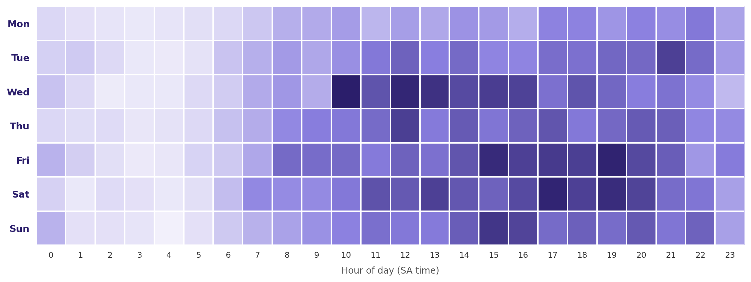

THE MONDAY PROBLEM
Why Does Monday Fall Behind?
Sessions by day × hour (SA time)
956
Monday sessions — the lowest of any day
22:00
Monday's own peak hour (73 sessions) — later than the 17:00 weekly peak
On Monday, Channel O (136) and Trace TV (115) outrank Supersport Live Events (98) — the reverse of the overall ranking.
BRIGHTTV VIEWERSHIP ANALYTICS
13 / 18
Notes:
Zooming into Monday specifically: it's the lowest day overall, and the heatmap shows it's consistently lighter across almost every hour, not just one dip. Two details stand out: Monday's own peak hour is 22:00, three hours later than the weekly peak of 17:00, and the channel mix flips — Channel O and Trace TV outrank Supersport Live Events on Mondays, the reverse of the overall ranking.

Slide 14

THE OPPORTUNITY
Lean Into Music & Entertainment on Mondays
Anchor Monday programming around Channel O & Trace TV–style music/entertainment blocks
Schedule promoted content for the 20:00–23:00 window — Monday's actual peak, not 17:00
Time push notifications and reminders to Monday evening, when this audience is actually online
BRIGHTTV VIEWERSHIP ANALYTICS
14 / 18
Notes:
Because music and entertainment channels actually lead on Mondays, the recommendation is to lean into that rather than fight it with more sport programming. Three concrete moves: anchor Monday content around Channel O and Trace TV-style entertainment, schedule promotion for the 20:00–23:00 window since that's when Monday's audience is actually online, and time push notifications to match — not to the 17:00 weekly peak.

Slide 15

GROWING THE BASE
Six Initiatives To Grow Subscribers
Target the 25–44 core
Close the gender gap
Advocacy & referral
Content bundles and offers built around BrightTV's largest, most engaged demographic
Female-focused content and marketing to grow the 11.1% female share
Mobilise highly-engaged 18–34 users as referral champions
Regional expansion
Promote major events
Monday engagement push
Targeted campaigns in under-represented provinces beyond Gauteng
Lead acquisition campaigns with proven high-draw sport content (e.g. ICC CWC)
Entertainment programming + evening-timed campaigns to lift the weakest day
BRIGHTTV VIEWERSHIP ANALYTICS
15 / 18
Notes:
Six initiatives that follow directly from the data: double down on the 25–44 core, run a targeted campaign to close the gender gap, mobilise engaged younger users for referrals, expand regional marketing beyond Gauteng, lead acquisition with major sport and event content, and run a Monday-specific engagement push. Each ties back to a finding we've already covered.

Slide 16
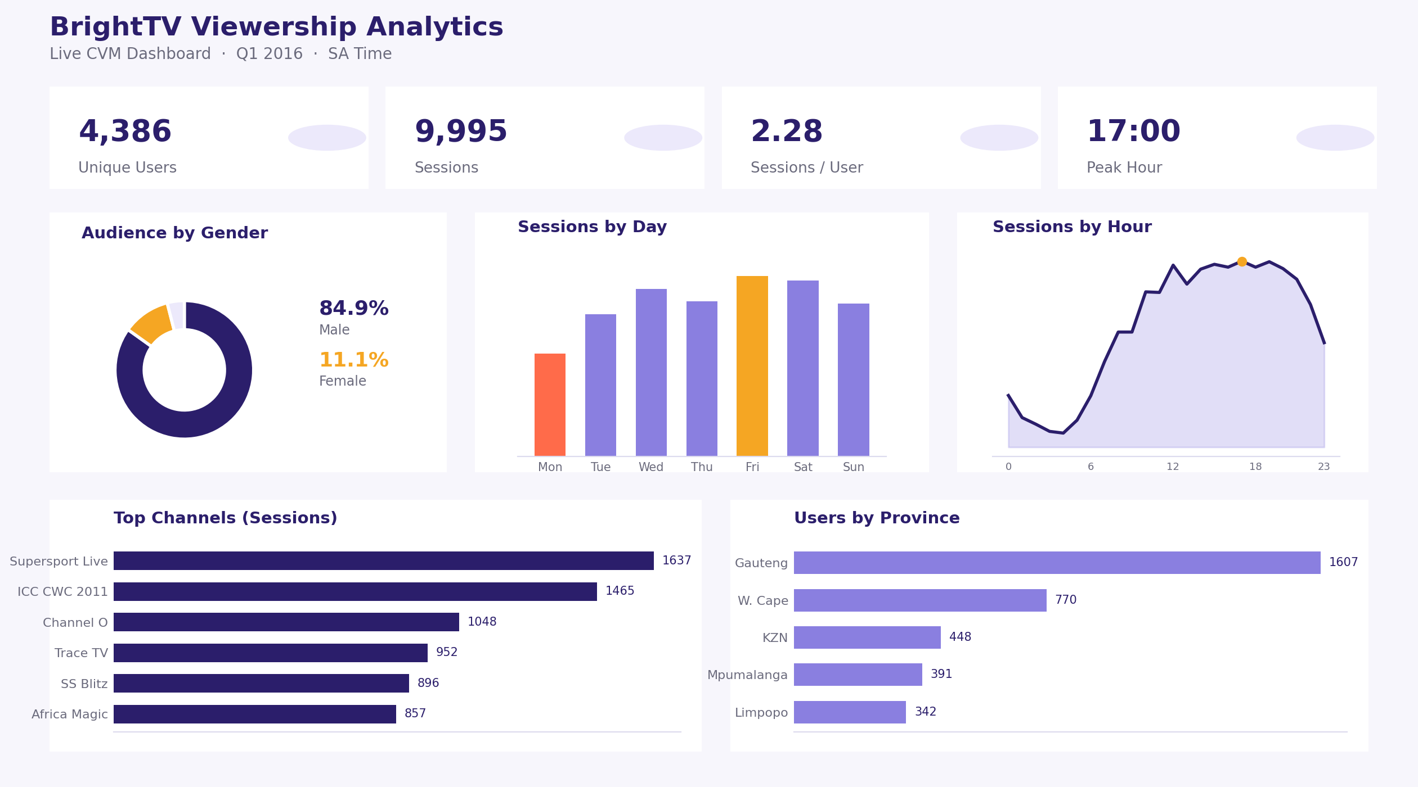
BEYOND THE SLIDES
An Interactive Dashboard For The CVM Team
Concept preview
Built as a companion concept for this case study, in the spirit of a Lovable-style app.
A live build would let the CVM team filter by day, channel, province and demographic in real time — turning this deck into an ongoing, self-serve tool.
BRIGHTTV VIEWERSHIP ANALYTICS
16 / 18
Notes:
To make this analysis usable day-to-day rather than a one-off deck, we've mocked up a companion interactive dashboard concept, in the spirit of a tool like Lovable. A live version would let the CVM team filter by day, channel, province, and demographic themselves, and refresh the view as new data comes in.

Slide 17
BRINGING IT TOGETHER
Key Findings & Recommendations
FINDINGS
RECOMMENDATIONS
4,386 users generated 9,995 sessions (2.28 per user) across Q1 2016
Deepen engagement with the 25–44 core via tailored bundles
Audience skews strongly male (84.9%) and core-aged 25–44 (67.5%)
Launch a female-focused acquisition & content campaign
Gauteng is the largest observed province, but reach is national
Build referral/advocacy programmes around engaged younger users
Friday (1,673) is the peak day; Monday (956) is the weakest
Expand regional marketing beyond Gauteng
17:00 is the daily peak hour; sport content leads overall viewing
Lead growth campaigns with major sport/event content
On Monday specifically, music/entertainment beats sport
Run Monday-specific entertainment programming & evening pushes
BRIGHTTV VIEWERSHIP ANALYTICS
17 / 18
Notes:
A quick recap side-by-side: six key findings on the left, six matching recommendations on the right. This slide is designed to be the one people screenshot — it's the whole story in one view.

Slide 18
THANK YOU
Questions & Discussion
Data-led insight for BrightTV's CVM team — to grow the subscriber base, lift Monday engagement, and deepen the 25–44 core audience.
BRIGHTTV VIEWERSHIP ANALYTICS
18 / 18
Notes:
Thank you — happy to take questions. The core message: BrightTV has a large, engaged, but narrow audience today. Growth means widening that base — more women, more provinces beyond Gauteng — while protecting what already works, and specifically fixing the Monday gap with entertainment-led programming.

