Slide 1

Intro to Python
Led by William Munnich
Friday 2/22/2025
A My Path MN and BDPATCF Collaboration

Slide 2
Python Error: SyntaxError
Error Name | Description | Example | Common Causes | Suggested Fixes
SyntaxError | Occurs when code violates Python's syntax rules, like missing colons or parentheses. | if x = 5: print(x) (missing == for comparison) | Typos, missing punctuation, incorrect indentation. | Check error messages for line and caret location.
python:
print("Hello"
Terminal Output:
File "<stdin>", line 1
print("Hello"
^
SyntaxError: '(' was never closed
python:
if x = 5:
print("x is 5")
Terminal Output:
File "<stdin>", line 1
if x = 5:
^
SyntaxError: invalid syntax
python:
if True
print("Hello")
Terminal Output:
File "<stdin>", line 1
if True
^
SyntaxError: expected ':'

Slide 3
Python Error: IndentationError
Error Name | Description | Example | Common Causes | Suggested Fixes
IndentationError | Raised when indentation is inconsistent, critical for Python's block structure. | if True: print("Hello") else print("World") (missing indent after if). | Mixing tabs and spaces, incorrect nesting. | Use formatters like Black, ensure consistent 4-space indentation.
def say_hello():
print("Hello")
print("Start")
print("Why am I here?")
Terminal Output:
File "script.py", line 2
print("Hello")
^
IndentationError: expected an indented block after function definition on line 1
Terminal Output:
File "script.py", line 2
print("Why am I here?")
^
IndentationError: unexpected indent

Slide 4
Python Error: NameError
Error Name | Description | Example | Common Causes | Suggested Fixes
NameError | Raised when an undefined variable or function is used. | print(x) where x is not defined. | Typos, variable not initialized, scope issues. | Define variables before use, check spelling, use linters for early detection.
print(x)
number = 42
print(nubmer)
Terminal Output:
File "script.py", line 1, in <module>
print(x)
NameError: name 'x' is not defined
Terminal Output:
File "script.py", line 2, in <module> print(nubmer) NameError: name 'nubmer' is not defined

Slide 5
Python Error: UnboundedLocalError
Error Name | Description | Example | Common Causes | Suggested Fixes
UnboundLocalError | Occurs when a local variable is referenced before assignment, a NameError subtype. | def func(): print(x); x = 5 (using x before assignment). | Scope confusion, modifying globals without declaration. | Assign values before use, use global for globals if needed.
def process_list():
for i in range(3):
total += i # total isn’t initialized
print(total)
process_list()
def increment():
print(x) # Trying to use x before assigning x = 5 increment()
Terminal Output:
File "script.py", line 2, in increment
print(x)
UnboundLocalError: cannot access local variable 'x' where it is not associated with a value
Terminal Output:
File "script.py", line 3, in process_list
total += i
UnboundLocalError: cannot access local variable 'total' where it is not associated with a value

Slide 6
Python Error: TypeError
Error Name | Description | Example | Common Causes | Suggested Fixes
TypeError | Raised when an operation is applied to an inappropriate type. | "hello" + 5 (trying to add string and integer). | Incorrect type usage, mismatched function arguments. | Ensure correct types, use type conversion, check documentation.
num = 5
text = "hello"
result = num + text
number = 123
print(number[0]) # Integers don’t support indexing
Terminal Output:
File "script.py", line 3, in <module> result = num + text TypeError: unsupported operand type(s) for +: 'int' and 'str'
Terminal Output:
File "script.py", line 2, in <module> print(number[0]) TypeError: 'int' object is not subscriptable

Slide 7
Python Error:ValueError
Error Name | Description | Example | Common Causes | Suggested Fixes
ValueError | Occurs when a function gets correct type but invalid value. | int("abc") (trying to convert non-numeric string to int). | Passing invalid values, user input errors. | Validate inputs, use try-except for handling, check function docs.
text = "hello"
number = int(text) # Can’t convert "hello" to int
a, b = [1] # Only one value, but expecting two
Terminal Output:
File "script.py", line 2, in <module>
number = int(text)
ValueError: invalid literal for int() with base 10: 'hello'
Terminal Output:
File "script.py", line 1, in <module>
a, b = [1]
ValueError: not enough values to unpack (expected 2, got 1)

Slide 8
Python Error: KeyError
Error Name | Description | Example | Common Causes | Suggested Fixes
KeyError | Raised when accessing a non-existent key in a dictionary. | my_dict["missing"] where "missing" isn't a key. | Typo in key name, key not added to dictionary. | Use dict.get() with default value, verify keys before access.
my_dict = {"name": "Alice", "age": 25} print(my_dict["gender"]) # "gender" isn’t a key
data = {"color": "blue"}
print(data["colour"]) # Typo: "colour" vs. "color"
Terminal Output:
File "script.py", line 2, in <module>
print(my_dict["gender"])
KeyError: 'gender'
Terminal Output:
File "script.py", line 2, in <module> print(data["colour"])
KeyError: 'colour'

Slide 9
Python Error: IndexError
Error Name | Description | Example | Common Causes | Suggested Fixes
IndexError | Raised when accessing an index outside sequence range. | my_list[10] where my_list has length 5. | Index out of range, off-by-one errors. | Use len() to check range, ensure index within bounds.
my_list = [10, 20, 30]
print(my_list[3]) # Only indices 0, 1, 2 exist
empty_list = []
print(empty_list[0]) # No items to index
Terminal Output:
File "script.py", line 2, in <module> print(my_list[3]) IndexError: list index out of range
Terminal Output:
File "script.py", line 2, in <module> print(empty_list[0]) IndexError: list index out of range

Slide 10
Python Error: AttributeError
Error Name | Description | Example | Common Causes | Suggested Fixes
AttributeError | Occurs when accessing a non-existent attribute or method. | my_list.lower() (lists don't have lower()). | Typo in attribute name, method not available. | Verify attribute/method with dir(object), use static analysis tools like Mypy.
number = 42 number.append(10) # Integers don’t have append
text = "hello" print(text.lenght) # Typo: should be "length"
Terminal Output:
File "script.py", line 2, in <module>
number.append(10)
AttributeError: 'int' object has no attribute 'append'
Terminal Output:
File "script.py", line 2, in <module>
print(text.lenght)
AttributeError: 'str' object has no attribute 'lenght'

Slide 11
Python Error: ImportError
Error Name | Description | Example | Common Causes | Suggested Fixes
ImportError | Raised when a module cannot be imported, including ModuleNotFoundError in Python 3. | import non_existent_module (module not installed). | Module not installed, typo in name, path issues. | Check installation with pip, verify module name, ensure __init__.py for packages.
import maht # Typo: should be "math"
from random import shuffle, randomize # "randomize" isn’t in random
Terminal Output:
File "script.py", line 1, in <module>
import maht
ImportError: No module named 'maht'
Terminal Output:
File "script.py", line 1, in <module>
from random import shuffle, randomize
ImportError: cannot import name 'randomize' from 'random' (/usr/lib/python3.10/random.py)

Slide 12
What If There is No Error But it Just Doesn’t Work? Debugging!
When in doubt, use print statements in between. 👍
total = 0
for i in range(5):
total += i
print(f"Final is: {i}")
#prints
Final is: 5
total = 5
for i in range(5):
print(f"Loop iteration: {i}")
total += i
print(f"Final is: {i}")
#prints
Loop iteration: 0
Loop iteration: 1
Loop iteration: 2
Loop iteration: 3
Loop iteration: 4
Final is: 5

Slide 13
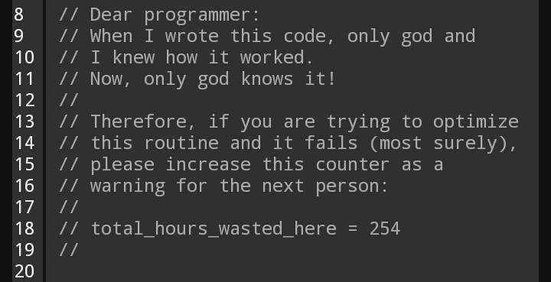
The Importance of Commenting Your Code

Slide 14
Pseudocode
-Not required but it's good practice and has benifits
-Written in pure comments if in a program file or HOWEVER is clear to you
-For clarity
-Planning things out
-Maybe you don’t know how to program it yet but you know how conceptually it will work

