Slide 1


Slide 2

C++ training Concurrency

Slide 3
Concurrency
std::thread, std::jthread
std::mutex
Lock free
Wait free
std::async, std::future

Slide 4
std::thread
std::thread::hardware_concurrency()
Seperation of concern, on a single core
Offload work, execute a functor in another context
Early termination: std::jthread

Slide 5
std::jthread
Main thread: 139903523612480
Working in thread: 139903520208448
Working in thread: 139903520208448
Thread interrupted. Stopping...
Back in the main thread.
void myFunction(std::stop_token stoken) {
for (int i = 0; i < 5; ++i) {
if (stoken.stop_requested()) {
std::cout << "Thread interrupted. Stopping...\n";
return;
}
std::cout << "Working in thread: " << std::this_thread::get_id() << "\n";
std::this_thread::sleep_for(std::chrono::seconds(1));
}
}
int main() {
std::cout << "Main thread: " << std::this_thread::get_id() << "\n";
{
std::jthread myJThread(myFunction);
std::this_thread::sleep_for(std::chrono::seconds(2));
myJThread.request_stop();
}
std::cout << "Back in the main thread.\n";
return 0;
}

Slide 6
std::condition_variable
Wake up and take lock, useful when a thread is waiting for another thread for a notification
Thread will be suspended until condition_variable is notified.

Slide 7
std::mutex mtx;
std::condition_variable cv;
bool isReady = false;
void waitForCondition() {
std::unique_lock<std::mutex> lock(mtx);
cv.wait(lock, []{ return isReady; });
std::cout << "Condition met! Continuing with the task." << std::endl;
}
void notifyCondition() {
std::this_thread::sleep_for(std::chrono::seconds(2));
{
std::lock_guard<std::mutex> lock(mtx);
isReady = true;
}
cv.notify_one();
}
int main() {
std::thread waitingThread(waitForCondition);
std::thread notifyingThread(notifyCondition); waitingThread.join();
notifyingThread.join(); return 0;
}

Slide 8
std::mutex
synchronization primitive
std::lock_guard, non moveable lock
Acquire mutex in ctor
Release mutex in dtor
std::unique_lock, moveable lock

Slide 9
std::mutex myMutex;
int sharedData = 0;
void worker(int id) {
std::lock_guard<std::mutex> lock(myMutex);
sharedData++;
}
int main() {
std::thread threads[2];
for (int i = 0; i < 2; ++i) {
threads[i] = std::thread(worker, i + 1);
}
for (int i = 0; i < 2; ++i) {
threads[i].join();
}
return 1;
}

Slide 10
ex1.cpp
shared mutex between multiple threads, auto clean up mutex/data when done

Slide 11
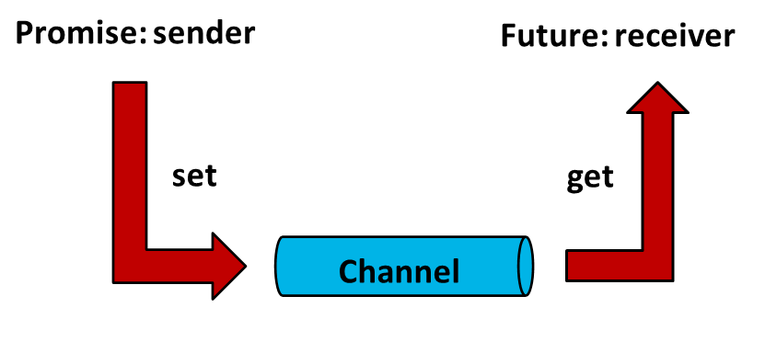
Tasks
Execute functor in another context. Get result back
Pipeline to task using std::promise and std::future
https://www.modernescpp.com/index.php/promise-and-future/

Slide 12
std::future std::promise
int add(int a, int b) {
std::cout << "Adding numbers: " << a << " and " << b << std::endl;
return a + b;
}
int main() {
std::promise<int> resultPromise;
std::future<int> resultFuture = resultPromise.get_future();
std::thread worker([&resultPromise]() {
int result = add(10, 20);
resultPromise.set_value(result);
});
worker.join();
int result = resultFuture.get();
std::cout << "Result: " << result << std::endl;
return 0;
}

Slide 13
std::packaged_task
wrapper for std::future and std::promise
std::promise used internally, return value of task functor is used to update future which notifies future

Slide 14
struct AddFunctor {
int operator()(int a, int b) const {
std::cout << "Adding numbers: " << a << " and " << b << std::endl;
return a + b;
}
};
int main() {
std::packaged_task<int(int, int)> task(AddFunctor{});
std::future<int> resultFuture = task.get_future();
std::thread worker(std::move(task), 10, 20);
worker.join();
int result = resultFuture.get();
std::cout << "Result: " << result << std::endl;
return 0;
}

Slide 15
ex2.cpp
Running on worker thread, create tasks from functor

Slide 16
Source of your technology

