Slide 1


Slide 2

C++ Training Reference semantics

Slide 3
Ownership
Resource management. Owner of a resource.
Responsible for
acquiring the resource
releasing the resource
std::string x = “some string”;

Slide 4
std::string
Relates heap allocated memory to a variable on the stack.
When the string instance is destructed, the memory used to store the text data is released.
Owns the memory
Owns the lock
Owns the file handle
Own the thread handle…

Slide 5
RAII
Resource acquisition is initialization
Acquire resource in constructor (initialization)
Release resource in destructor
Example: Execute around pointer
Proxy object owns a lock

Slide 6
class ThreadsafeVector {
public:
using T = std::vector<int>;
class Proxy {
public:
Proxy (T* v) : vector (v) {
std::cout << "Take lock"<<std::endl;
}
T* operator -> () {
std::cout << "Returning T*"<< std::endl;
return vector; }
~Proxy () {
std::cout << "Release lock"<<std::endl;}
private:
T* vector;
};
ThreadsafeVector (T *v) : vector(v) {}
Proxy operator -> () {
return Proxy (vector);
}
private:
T* vector;
};

Slide 7
Impossible to access vector without lock.
Compiler must keep applying operator -> until pointer-like type is encountered
int main()
{
std::vector<int> unsafeVector;
ThreadsafeVector safeVector(&unsafeVector);
safeVector->push_back(10);
}
Take lock
Returning T*
Release lock

Slide 8
Ownership transfer < c++ 11
int main()
{
std::string s = “12345678910111213141516171819202122232425";
std::string s2; std::cout << "s.data() " << (void*)s.c_str() << std::endl;
std::cout << "s2.data() " << (void*)s2.c_str() << std::endl;
s.swap(s2);
std::cout << "s.data() " << (void*)s.c_str() << std::endl;
std::cout << "s2.data() " << (void*)s2.c_str() << std::endl; std::cout << "s " << s << std::endl;
std::cout << "s2 " << s2 << std::endl;
}
Program returned: 0
s.data() 0xbfd2b0
s2.data() 0x7fffb187f540
s.data() 0x7fffb187f560
s2.data() 0xbfd2b0
s
s2 xxxxxxxxxxxxxxxxxxxxxxxx

Slide 9
class PDF
{
PDF(std::string title);
PDF(std::string const& title);
PDF(char * const title);
};
How to indicate that the PDF class takes ownership of title’s data?
Convention is not compiler enforced.

Slide 10



Move semantics; moving ownership
struct Blob{
Blob(std::size_t size):
_buffer(size){
}
void print() const{
std::cout << this << " "<< &_buffer[0] << " size: "<< _buffer.size()<< std::endl;
}
private:
std::vector<std::byte> _buffer;
};

Slide 11




Blob readBlobFromFile(std::string const& path){
Blob b(1000/*some big file size*/);
b.print();
return b;
}
int main(){
std::multimap<std::string, Blob> storage;
std::string path = “/bin/cp”;
Blob b = readBlobFromFile(path);
storage.insert ( {path, b} );
storage.find(path)->second.print();
return 1;
}
0x7ffc7b89a7d8 0x560409ea42b0 size: 1000
0x560409ea5ae0 0x560409ea56b0 size: 1000

Slide 12




Move semantics: No No problem
Blob* readBlobFromFile(std::string const& path){
Blob* b = new Blob(1000/*some big file size*/);
b->print();
return b;
}
0xfaaeb0 0xfaaed0 size: 1000
0xfaaeb0 0xfaaed0 size: 1000
void print() const{
std::cout << this << " "<< &_buffer[0] << " size: "<< _buffer.size()<< std::endl;
}

Slide 13
Move semantics: Ok it really is a problem
Ownership – who frees the allocated memory?
Pointer becomes semantically meaningless
Memory fragmentation

Slide 14




std::move
int main(){
std::multimap<std::string, Blob> storage;
std::string path = "jaimeloignon";
Blob b = readBlobFromFile(path);
storage.insert ( {path, std::move(b)} );
storage.find(path)->second.print();
return 1;
}
0x7ffcf99442f0 0x886eb0 size: 1000
0x8882f0 0x886eb0 size: 1000

Slide 15
std::move
std::move does not actually move anything
std::move casts its argument to a temporary
A temporary has a temporary lifetime

Slide 16


Potentially stupid things
int main(){
std::multimap<std::string, Blob> storage;
std::string path = "jaimeloignon";
Blob b = readBlobFromFile(path);
storage.insert ( {path, std::move(b)} );
storage.find(path)->second.print();
b.print();
return 1;
}
Program returned: 1
Program stdout
0x7ffd18158c80 0x23f2eb0 size: 1000
0x23f4eb0 0x23f2eb0 size: 1000
0x7ffd18158c80 0 size: 0

Slide 17


Definitely stupid tings
void print() const{
std::cout << this << " "<< _buffer[0] << " size: "<< _buffer.size()<< std::endl;
}
Program returned: 139
Program stdout
0x7ffe8cc72b20 0 size: 1000
0x8bdeb0 0 size: 1000

Slide 18
Temporary that has been moved from
Valid destructible state
What is possible -> implementation defined.
Worked on GCC, might crash on msvc

Slide 19
std::move
std::move unconditionally casts input to movable reference
std::move does not actually do the move (only casts)
GCC implementation:
template<typename T> std::remove_reference_t<T>&& move(T &&t) noexcept { return static_cast<std::remove_reference_t<T>&&>(t); }
Notes:
Move does not actually move the object.
It just makes it possible that overload resolution select the move overload

Slide 20
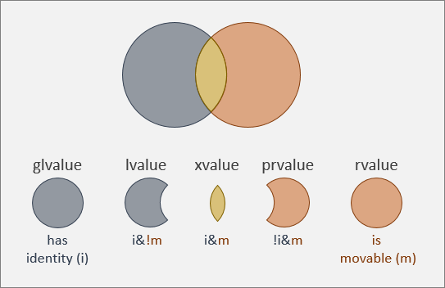

Slide 21
std::move

Slide 22

Thou shalt move only when it is unquestionably safe to do so.

Slide 23
Special member functions
Move constructor
Move assignment operator
A(A &&a) = default;
A& operator==(A &&a) = default;

Slide 24
Special member functions
struct A { A(); A(A &&a) noexcept; A& operator=(const A &&a); LargeResource *v; std::vector<B> w; };
A(A &&a) noexcept { v = a.v; w = std::move(a.w); a.v = nullptr; };

Slide 25
Special member functions
struct A { A(); A(A &&a) noexcept; A& operator=(const A &&a); LargeResource *v; std::vector<B> w; };
A& operator=(const A &&a) { delete v; v = a.v; w = std::move(a.w); a.v = nullptr; return *this; };

Slide 26
#include <iostream>
struct Blob
{
Blob(){}
Blob(Blob const& lvalue){std::cout << "lvalue ctor" << std::endl;}
Blob(Blob && rvalue){std::cout << "rvalue ctor" << std::endl;}
};
int main()
{
Blob b;
Blob b2(b);
Blob b3(std::move(b));
}
lvalue ctor
rvalue ctor
Converts lvalue ‘b’ to xvalue(rvalue). Allowing compiler to call rvalue ctor when creating b3.

Slide 27
struct X {
X(std::size_t capacity){
std::cout << "ctor" << std::endl;
_container.reserve(capacity);
}
X(X const& other) {
_container = other._container;
std::cout << "copy ctor" << std::endl;
}
X(X&& other) {
_container = std::move(other._container);
std::cout << "move ctor" << std::endl;
}
std::vector<int> _container;
};
X test(){
return X{1};
}
int main() {
X x = test();
}
ctor
Mandatory since c++17.

Slide 28
int main()
{
X const& v(test());
X a(v);
X b(std::move(v));
}
int main()
{
X v(X());
}
ctor copy ctor move ctor
ctor move ctor

Slide 29
class A {};
int main()
{
std::cout << std::boolalpha;
std::cout << std::is_lvalue_reference<A>::value << '\n';
std::cout << std::is_lvalue_reference<A&>::value << '\n';
std::cout << std::is_lvalue_reference<A&&>::value << '\n';
std::cout << std::is_lvalue_reference<int>::value << '\n';
std::cout << std::is_lvalue_reference<int&>::value << '\n';
std::cout << std::is_lvalue_reference<int&&>::value << '\n';
}
false
true
false
false
true
false
false
false
true
false
false
true

Slide 30
Special member functions
The default move assignment & constructor are generated if no copy assignment, constructor or destructor is defined by user
Note: =default and =delete count as user defined

Slide 31
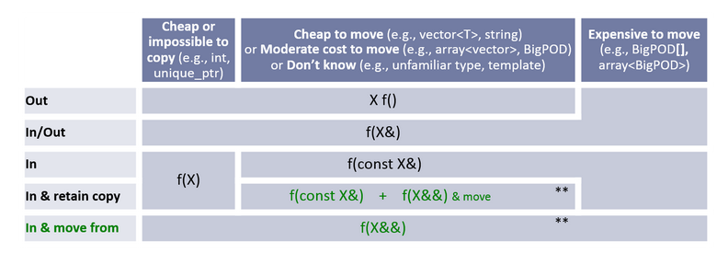
Parameter convention
https://www.modernescpp.com/index.php/c-core-guidelines-how-to-pass-function-parameters/

Slide 32
move_semantics/ex1.cpp
move_semantics/ex2.cpp

Slide 33
C++ training Forwarding references

Slide 34
Perfect forwarding
template <typename T, ???> unique_ptr<T> make_unique(???) { return unique_ptr<T>(new T(???)); }
What should we replace the ??? with?

Slide 35
Perfect forwarding
template <typename T, typename Arg> unique_ptr<T> make_unique(Arg && arg) { return unique_ptr<T>(new T(arg)); }
One problem, arg is an lvalue now

Slide 36
Perfect forwarding
template <typename T, typename Arg> unique_ptr<T> make_unique(Arg && arg) { return unique_ptr<T>(new T(std::forward<Arg>(arg))); }
Repeat the template type

Slide 37
Perfect forwarding: std::forward
template< class T > constexpr T&& forward( std::remove_reference_t<T>& t ) noexcept;
template< class T > constexpr T&& forward( std::remove_reference_t<T>&& t ) noexcept;

Slide 38
Perfect forwarding
template <typename T, typename Arg> unique_ptr<T> make_unique(Arg && arg) { return unique_ptr<T>(new T(std::forward<Arg>(arg))); }
class A; A a; auto b = make_unique<A>(a);
unique_ptr<A> make_unique(A& && arg) { return unique_ptr<A>(new A(std::forward<A&>(arg))); }
unique_ptr<A> make_unique(A& && arg) { return unique_ptr<A>(new A(static_cast<A& &&>(arg))); }

Slide 39
Perfect forwarding
class A; auto a = make_unique<A>(A());
unique_ptr<A> make_unique(A&& && arg) { return unique_ptr<A>(new A(std::forward<A&&>(arg))); }
unique_ptr<A> make_unique(A&& && arg) { return unique_ptr<A>(new A(static_cast<A&& &&>(arg))); }

Slide 40
When things go wrong
struct A { A(const std::string &a); template<typename T> A(T &&t); };
A a1("str");

Slide 41
When things go wrong
struct A { A(const std::string &a); // (1) template<typename T> A(T &&t); // (2) };
A a1("str"); // calls ctor (2) // argument type is char[4]

Slide 42
When things go wrong
struct A { A(const std::string &a); // (1) template<typename T> A(T &&t); // (2) };
std::string str("str"); A a2(str);

Slide 43
When things go wrong
struct A { A(const std::string &a); // (1) template<typename T> A(T &&t); // (2) };
std::string str("str"); A a2(str); // calls ctor (2) // because the argument is NOT const

Slide 44
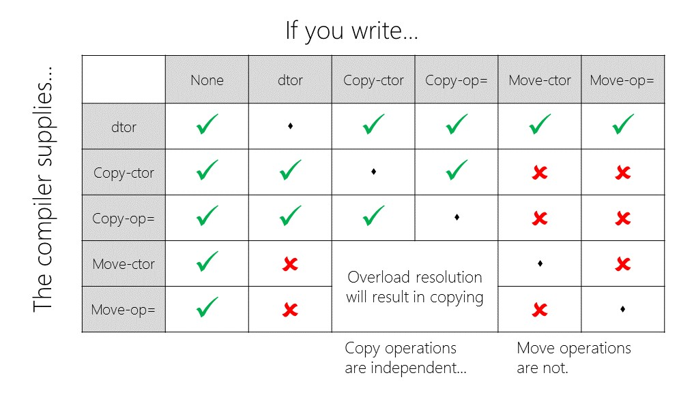
When things go wrong
1
2
3
4
5
struct A { A(const std::string &a); // (1) template<typename T> A(T &&t); // (2) };
A a3(a2);

Slide 45
When things go wrong
struct A { A(const std::string &a); // (1) template<typename T> A(T &&t); // (2) };
A a3(a2); // calls ctor (2) // because the argument is NOT const // and the default generated copy ctor accepts a “const A&”

Slide 46
Overloading
void fun( A& ) { std::cout << "fun (1)\n"; } void fun(const A& ) { std::cout << "fun (2)\n"; } void fun( A&&) { std::cout << "fun (3)\n"; } void fun(const A&&) { std::cout << "fun (4)\n"; } template<typename T> void fun(T &&) { std::cout << "fun (5)\n"; } template<typename T> void fun(const T &&) { std::cout << "fun (6)\n"; } int main() { A a{}; fun(a); }

Slide 47
Overloading
void fun( A& ) { std::cout << "fun (1)\n"; } (1) void fun(const A& ) { std::cout << "fun (2)\n"; } (3) void fun( A&&) { std::cout << "fun (3)\n"; } void fun(const A&&) { std::cout << "fun (4)\n"; } template<typename T> void fun(T &&) { std::cout << "fun (5)\n"; } (2) template<typename T> void fun(const T &&) { std::cout << "fun (6)\n"; } int main() { A a{}; fun(a); }

Slide 48
Overloading
void fun( A& ) { std::cout << "fun (1)\n"; } void fun(const A& ) { std::cout << "fun (2)\n"; } void fun( A&&) { std::cout << "fun (3)\n"; } void fun(const A&&) { std::cout << "fun (4)\n"; } template<typename T> void fun(T &&) { std::cout << "fun (5)\n"; } template<typename T> void fun(const T &&) { std::cout << "fun (6)\n"; } int main() { const A a{}; fun(a); }

Slide 49
Overloading
void fun( A& ) { std::cout << "fun (1)\n"; } void fun(const A& ) { std::cout << "fun (2)\n"; } (1) void fun( A&&) { std::cout << "fun (3)\n"; } void fun(const A&&) { std::cout << "fun (4)\n"; } template<typename T> void fun(T &&) { std::cout << "fun (5)\n"; } (2) template<typename T> void fun(const T &&) { std::cout << "fun (6)\n"; } int main() { const A a{}; fun(a); }
template<typename T> void fun(T && t) {
std::cout << "fun (5): " << std::is_const_v<std::remove_reference_t<T>>;
}
Program returned: 0
Program stdout
fun (5): 1

Slide 50
Overloading
void fun( A& ) { std::cout << "fun (1)\n"; } void fun(const A& ) { std::cout << "fun (2)\n"; } void fun( A&&) { std::cout << "fun (3)\n"; } void fun(const A&&) { std::cout << "fun (4)\n"; } template<typename T> void fun(T &&) { std::cout << "fun (5)\n"; } template<typename T> void fun(const T &&) { std::cout << "fun (6)\n"; } A get(); int main() { fun(get()); }

Slide 51
Overloading
void fun( A& ) { std::cout << "fun (1)\n"; } void fun(const A& ) { std::cout << "fun (2)\n"; } (5) void fun( A&&) { std::cout << "fun (3)\n"; } (1) void fun(const A&&) { std::cout << "fun (4)\n"; } (3) template<typename T> void fun(T &&) { std::cout << "fun (5)\n"; } (2) template<typename T> void fun(const T &&) { std::cout << "fun (6)\n"; } (4) A get(); int main() { fun(get()); }

Slide 52
Overloading
Effective Modern C++, Item26: Avoid overloading on universal references.

Slide 53
Exam (Q1)
struct A { template<typename T> A(T&& t) : m_b(std::move(t)) {} B m_b; };

Slide 54
Exam (Q1)
struct A { template<typename T> A(T&& t) : m_b(std::forward<T>(t)) {} B m_b; };

Slide 55
Exam (Q2)
template<typename T> struct A { A(T&& t) : m_b(std::forward<T>(t)) {} B m_b; };

Slide 56
Exam (Q2)
CLASS template
template<typename T> struct A { A(T&& t) : m_b(std::move(t)) {} B m_b; };
Rvalue reference not a forwarding reference
Notes:
The code itself compiles and will work, but will probably not do what you want, pass everything to construct a B.
You will only notice this mistake if you want to pass a lvalue to the constructor.

Slide 57
Exam (Q3)
struct A { template<typename T> A(T&& t) : m_b(std::forward<T>(t)) , m_c(std::forward<T>(t)) {} B m_b; C m_c; };

Slide 58
Exam (Q3)
struct A { template<typename T> A(T&& t) : m_b(t) , m_c(std::forward<T>(t)) {} B m_b; C m_c; };
Notes:
Possible duplicate move if t is passed as an rvalue.

Slide 59
move_semantics/ex3.cpp
move_semantics/ex4.cpp
move_semantics/ex6.cpp

Slide 60
C++ training Library support

Slide 61
Ownership
unique_ptr
shared_ptr
weak_ptr

Slide 62
unique_ptr
Expresses single ownership
Own the pointer or own the resource
RAII (memory allocation, sockets, files, …)
NOT only memory, can provide custom destructor to deal with other types.

Slide 63
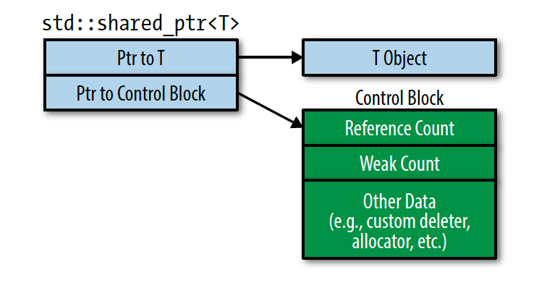
shared_ptr, weak_ptr
Shared ownership

Slide 64
Strategy - pimpl
Swap implementation based on some constraint
Liskov substitution
Not a sussy log
nwodhcuot a ekil ecnad ym od nac I
#include "sink.h"
int main(){
Sink defaultLogger(0);
defaultLogger.write(std::string("Not a sussy log"));
Sink secretLogger(1);
secretLogger.write(std::string("I can do my dance like a touchdown"));
return 1;
}

Slide 65
Sink.h
#include <memory>
#include <string>
struct Sink{
Sink(int);
~Sink();
void write(std::string const& in);
struct Encryptor;
private:
std::unique_ptr<Encryptor> pEncryptionImpl;
void _write(std::string const& in);
};

Slide 66
Sink.cpp
#include "sink.h"
#include <algorithm>
#include <iostream>
//can be stateful
struct Sink::Encryptor{
virtual std::string encrypt(std::string const& in) = 0;
virtual ~Encryptor(){};
};
struct NullEncrypt: Sink::Encryptor{
std::string encrypt(std::string const& in) final{
return in;
}
};
struct GigaEncrypt: Sink::Encryptor{
std::string encrypt(std::string const& in) final{
std::string _v= in;
std::reverse(std::begin(_v), std::end(_v));
return _v;
}
};

Slide 67
Sink.cpp cont.
//needs to be defined in cpp
Sink::~Sink(){
}
Sink::Sink(int encryptionLevel){
//doesnt have to be invariant
if(!encryptionLevel){
pEncryptionImpl = std::make_unique<NullEncrypt>();
}
else{
pEncryptionImpl = std::make_unique<GigaEncrypt>();
}
}
void Sink::write(std::string const& in){
std::string encrypted = pEncryptionImpl->encrypt(in);
_write(encrypted);
}
void Sink::_write(std::string const& in){
std::cout << in << std::endl;
}

Slide 68
Single responsibility
Sink; it writes, it encrypts. Or does it?
If we want to change the way things are encrypted we don’t have to change sink
If we want to change how things are written to output, we NEED to change sink. Output strategy?

Slide 69
Taking ownership of C pointers
#include <memory>
void* create_rpc() {
return new int();
}
void free_rpc(void* p){
delete (int*) p;
}
int main()
{
std::unique_ptr<void, void(*)(void*)> managedRpc(create_rpc(), free_rpc);
return sizeof(managedRpc);
}
Program returned: 16

Slide 70
Taking ownership of C pointers
Size of pointer is increased: 16. 64 bit system, should be 8.
Cannot inherit from function pointer
Need a struct with an operator that takes in pointer as parameter, aka lambda

Slide 71
#include <memory>
#include <iostream>
void* create_rpc() {
return new int();
}
void free_rpc(void* p){
delete (int*) p;
}
int main()
{
std::unique_ptr<void, void(*)(void*)> managedRpc(create_rpc(), free_rpc);
std::cout << "function ptr. size: "<< sizeof(managedRpc) << std::endl;
auto free_rpc_lambda = [](void* p){delete (int*) p;};
std::unique_ptr<void, decltype(free_rpc_lambda)> managedRpc2(create_rpc());
std::cout << "lambda. size: "<< sizeof(managedRpc2) << std::endl;
std::unique_ptr<void, decltype([](void* p){return free_rpc(p);})> managedRpc3(create_rpc());
std::cout << "lambda. size: "<< sizeof(managedRpc3) << std::endl;
}
function ptr. size: 16
lambda. size: 8
lambda. size: 8

Slide 72
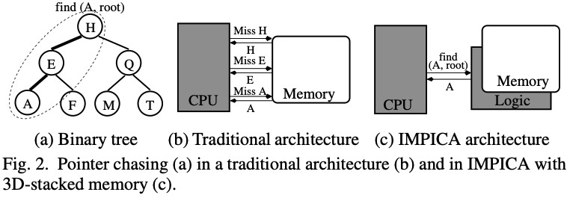
Move
Move semantics are about
Saving time and space by avoiding allocations
Expressing ownership – resource is being passed around

Slide 73
GCC
Empty base optimization
Empty string optimization

Slide 74
Empty base optimization
Hijack some member variable to instantiate a strategy/inject a policy.
Empty base class (no member vars) does not increase size of derived class.
struct _Alloc_hider : _Alloc
{
_Alloc_hider(_CharT* __dat, const _Alloc& __a) _GLIBCXX_NOEXCEPT
: _Alloc(__a), _M_p(__dat) { }
_CharT* _M_p; // The actual data
};

Slide 75
struct Allocator {
void allocate(){}
void deallocate(){}
};
struct MyString {
char* _M_p;
Allocator _M_a;
};
struct MyStringSmall {
struct Hider : Allocator
{
char* _M_p;
};
Hider _M_hider;
};
int main() {
std::cout << "MyString: "<< sizeof(MyString) << std::endl;
std::cout << "MyStringSmall: "<<sizeof(MyStringSmall) << std::endl;
}
MyString: 16
MyStringSmall: 8

Slide 76
Small buffer optimization
Template <typename T>
struct CustomAllocator
{
T* allocate(std::size_t n)
{
auto ptr = std::malloc(n * sizeof(T));
std::cout << "allocate " << std::hex<< ptr<< std::endl;
return static_cast<T*>(ptr);
}
void deallocate(T* ptr, std::size_t n)
{
std::cout << "deallocate " << std::hex<< (void*)ptr<< std::endl;
std::free(ptr);
}
};
using MyString = std::basic_string<char, std::char_traits<char>, CustomAllocator<char>>;

Slide 77
Small buffer allocation
int main(){
MyString a("this is the tale of captain "),b("jack sparrow");
std::cout << a << b << std::endl;
}
Program returned: 0
Program stdout
allocate 0x1967eb0
this is the tale of captain jack sparrow
deallocate 0x1967eb0
No allocation b

Slide 78
template<typename _CharT, typename _Traits, typename _Alloc>
template<typename _InIterator>
void basic_string<_CharT, _Traits, _Alloc>::_M_construct(_InIterator __beg, _InIterator __end, std::forward_iterator_tag)
{
// NB: Not required, but considered best practice.
if (__gnu_cxx::__is_null_pointer(__beg) && __beg != __end)
std::__throw_logic_error(__N("basic_string::_M_construct null not valid"));
size_type __dnew = static_cast<size_type>(std::distance(__beg, __end));
if (__dnew > size_type(_S_local_capacity))
{
_M_data(_M_create(__dnew, size_type(0)));
_M_capacity(__dnew);
}
...
_M_set_length(__dnew);
}

Slide 79
union
{
_CharT _M_local_buf[_S_local_capacity + 1];
size_type _M_allocated_capacity;
};
_M_local_buf overlaps with _M_allocated_capacity
Save storage, no allocation, less fragmentation.
Std::function, std::vector

Slide 80
Which constructor do I write?
Move / copy constructor, most optimal
Often I only do copy ctor, definitely in case of strings
#include "mystring.h"
struct X
{
X(MyString const& s):_s(s){}
MyString _s;
}; int main() {
MyString b("this is the tale of tony montana");
X x2(std::move(b));
}
Program returned: 0
Program stdout
allocate 0x1b8eeb0
allocate 0x1b8fef0
deallocate 0x1b8fef0
deallocate 0x1b8eeb0

Slide 81
Take a copy, allocate less
#include "mystring.h"
struct X
{
X(MyString s):_s(std::move(s)){}
MyString _s;
};
int main(){
MyString b("this is the tale of tony montana");
X x2(std::move(b));
}
Program returned: 0
Program stdout
allocate 0x2034eb0
deallocate 0x2034eb0

Slide 82
Copy then move if L-value (you have to copy anyway)
Move then Move if R-value
L&R value ctor. No extra move in both cases.
Justifiable, but you will get into discussion. At least I do. Maybe I am the problem
R value: temporary lifetime extension makes const& work but at the cost of an extra copy

Slide 83
move_semantics/ex5.cpp

Slide 84
Source of your technology

