Slide 1


Slide 2

Value semantics

Slide 3
Value vs reference semantics
Pass by value
  Copies state of object
  Independent mutable state
void do_something(std::vector<int>)
Copies whole vector.

Slide 4
Move semantics facilitate performant value semantics
std::vector<std::string> getPoems()
{
std::vector<std::string> ans;
// fill ans;
return ans;
}
int main(){
std::vector<std::string> poems = getPoems();
}

Slide 5
Copy elision
class GFG {
public:
GFG() { std::cout << "Ctor"<<std::endl; }
GFG(const GFG&){ std::cout << "Copy Ctor"<<std::endl; }
GFG(GFG&&){ std::cout << "Move Ctor"<<std::endl; }
};
GFG func()
{
return GFG(); // RVO example
}
int main()
{
GFG G = func();
}
Program stdout
Ctor

Slide 6
Pass by reference
  Copy reference to object state
  Multiple references to same instance possible, race conditions
  Lifetime complexity
void do_something(int*, int size)
Copies reference to vector

Slide 7
Value semantics are preferred, language is evolving in this direction.
Nr of bugs, ownership and concurrency have a strong correlation.
Internal inheritance (e.g. vtable) requires reference semantics out of necessity. value semantics would slice base object.
void do_something(base&)
Notes:
Type slicing todo

Slide 8
Library support
std::variant: closed type, open operation set polymorphism, single dispatch unlike typical double dispatch visitor implementations
std::optional
std::expected
std::any: void* with runtime safety

Slide 9
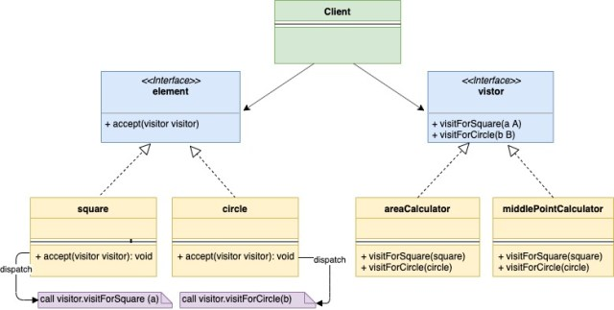
dispatch
We can add these easily

Slide 10
#include <iostream>
#include <variant>
template<class... Ts> struct overloaded : Ts... { using Ts::operator()...; };
using VariantType = std::variant<int, std::string>;
std::string get(VariantType v){
return std::visit(overloaded {
[](int arg) { return std::to_string(arg); },
[](const std::string& arg) { return arg;},
}, v);
}
int main(){
VariantType v = {"dro"};
std::cout<<get(v)<<std::endl;
v={10};
std::cout<<get(v)<<std::endl;
}
dro
10

Slide 11
Complexity
Deep copying
  Produces a new, independent object; object (member) values are copied
  std::vector O(N) copies vs O(1) copies when using reference semantics
  Move semantics, copy elision reduces overhead.
Copy on write
  Shared mutable state accessible from distinct contexts complicates the concurrency model. When should the shared object be deconstructed?

Slide 12
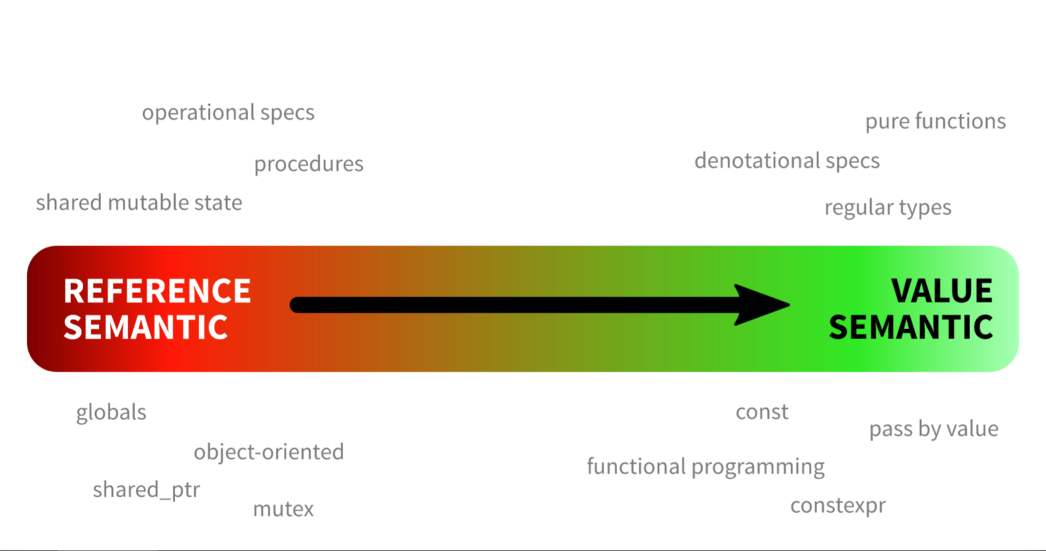

Slide 13
ex1.cpp
ex2.cpp
ex3.cpp

Slide 14
Dynamic polymorphism and value types

Slide 15
Slicing
Slicing occurs when vtable info is lost
Slicing blocks the combination of value semantics and classic inheritance
Base& a = get_some_reference();
Base b = a;
Notes:
How do we get value semantics with base classes.
In this case we will get slicing

Slide 16
Value semantics for class hierarchy
What we want
Derived a;
Base &b = a;
auto c = b;
std::vector<Base> v;
v.emplace_pack(Derived1());
v.emplace_pack(Derived2());
v.emplace_pack(Derived3());
Notes:
What we want is that in this example “c” is an instance of the derived class.
Or that we can add derived classes to a Base container (preserving the value semantics)

Slide 17
Type erasure
We want to generalize the concrete types to a common interface without any vtable like inheritance

Slide 18
Type erasure (Goal)
int main()
{
std::vector<Animal> v;
v.emplace_back(Dog());
v.emplace_back(Cat());
for (auto &a : v)
a.speak();
}
Notes:
The goal from the example we are going to make is to have two independent types that both support “speak” to live together in a container.

Slide 19
Type erasure
struct Vtable
{
void (*speak)(void *ptr);
void (*destroy)(void *ptr);
};
Notes:
We need to start out with our own vtable that contains all the behavior we require from our other types.

Slide 20
Type erasure
template <class Concrete>
constexpr Vtable vtable_for { };
Notes:
Now we need to fill-in this vtable for the types we want to support.
We create a global variable for every type “Concrete” that will have the behaviour we want.

Slide 21
Type erasure
template <class Concrete>
constexpr Vtable vtable_for
{
[](void *ptr){ static_cast<Concrete*>(ptr)->speak(); },
[](void *ptr){ delete static_cast<Concrete*>(ptr); },
};
Notes:
Lamdas without state decay to C-style function pointers

Slide 22
Type erasure
struct Animal
{
Animal(const T& t);
~Animal();
void speak();
void *m_concrete;
const Vtable *m_vtable;
};
Notes:
Now we need to define our ‘base’class
Constructor that takes in an arbitrary type.
A “speak”function
Two members:
a void pointer to the actual implementation
A pointer to the vtable

Slide 23
Type erasure
template<class T>
Animal(const T& t)
: m_concrete(new T(t))
, m_vtable(&vtable_for<T>)
{};
Notes:
Templated constructor.
You normally want to limit the type we get passed here.
We use out global variable as the vtable pointer
We now use ‘new’ but this can be changed with a small buffer implementation.

Slide 24
Type erasure
~Animal()
{
if (m_vtable)
m_vtable->destroy(m_concrete);
}
void speak()
{
if (m_vtable)
m_vtable->speak(m_concrete);
}
Notes:
Templated constructor.
You normally want to limit the type we get passed here.
We now use ‘new’but this can be changed with a small buffer implementation.

Slide 25
Type erasure
struct Dog
{
void speak() { std::cout << "Woof\n"; }
};
struct Cat
{
void speak() { std::cout << "Meow\n"; }
};
Notes:
We now create two independent types that both have the “speak” gift.

Slide 26
Type erasure
int main()
{
std::vector<Animal> v;
v.emplace_back(Dog());
v.emplace_back(Cat());
for (auto &a : v)
a.speak();
}
Notes:
Our example now works

Slide 27
Other use-cases
You can’t extend a class with interfaces
Cleanup class hierarchy
Template cleanup
…

Slide 28
Source of your technology

