Slide 1


Slide 2

C++ training Containers and algorithms

Slide 3
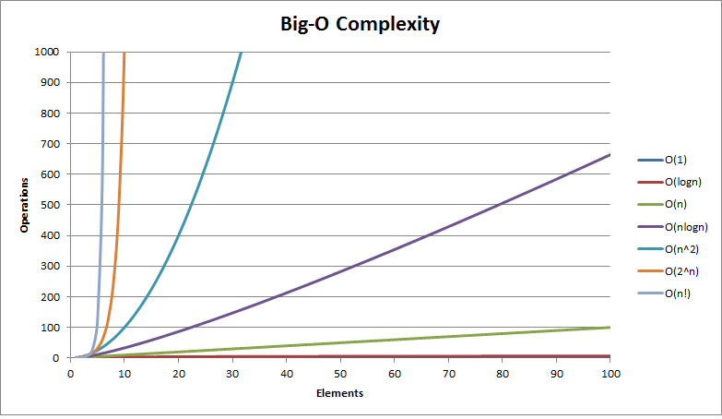
Scaling complexity

Slide 4
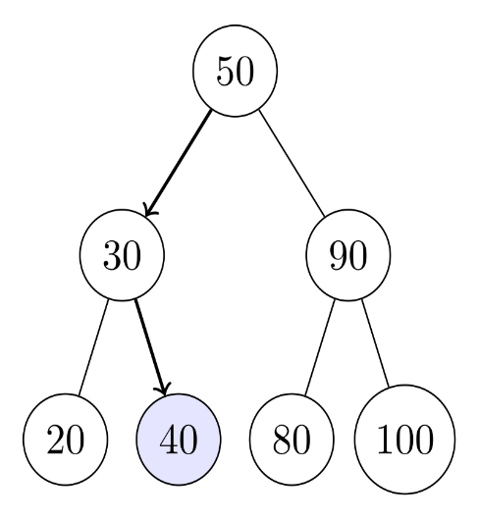
Time complexity
O(1). “Regardless of #elements, operation takes constant time”
O(n). Loop over each item and do an operation, print all items
O(log(n)+c). Base 2. Binary search
Size 7. Worst case search complexity log(7) -> 3

Slide 5
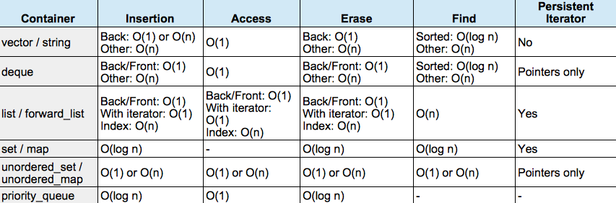
STL containers – Time complexity

Slide 6
std::array vs std::vector
std::array. Fixed size memory
std::vector = heap. Dynamic Size
Back insert → slow if std::vector out of capacity
Binary search complexity (when sorted)

Slide 7
#include <vector>
#include <iostream>
void print(auto const& x)
{
std::cout << "capacity: "<< x.capacity() << " "<< &x[0]<<std::endl;
}
int main()
{
std::vector<int> v;
for(int i = 0; i< 10; i++)
{
v.push_back(i);
print(v);
}
}
Program stdout
capacity: 1 0xa53eb0
capacity: 2 0xa54ee0
capacity: 4 0xa53eb0
capacity: 4 0xa53eb0
capacity: 8 0xa54f00
capacity: 8 0xa54f00
capacity: 8 0xa54f00
capacity: 8 0xa54f00
capacity: 16 0xa54f30
capacity: 16 0xa54f30

Slide 8
std::list / std::forward_list
Double linked list (forward and backwards traversable)
Search is linear in complexity even when sorted.
Useful for stacks, list priorities etc.
No random access (linear when not using iterator)

Slide 9
std::deque
Hybrid between std::vector and std::list
Linked list like structure, each node(bucket) of the list has the capacity to store more than 1 element.
The O(1) access complexity of std::deque is paid for by increasing space complexity.
Notes:
Inserting and removing elements at some position X is not O(1) due to fact that all elements at position >X have to be copied into new buckets.

Slide 10
std::deque
template<
class T,
class Allocator = std::allocator<T>
> class deque;
Bucket size ?
Larger objects (e.g. sizeof(T) == sizeof(Bucket)), std::deque turns into a convoluted std::list, which may perform worse if random access is not a requested feature

Slide 11
GCC
#ifndef _GLIBCXX_DEQUE_BUF_SIZE
#define _GLIBCXX_DEQUE_BUF_SIZE 512
#endif
_GLIBCXX_CONSTEXPR inline size_t
__deque_buf_size(size_t __size)
{
return (__size < _GLIBCXX_DEQUE_BUF_SIZE ? size_t(_GLIBCXX_DEQUE_BUF_SIZE / __size) : size_t(1));
}

Slide 12
std::set / std::map
std::set is an std::map where the value is also used as key/comparator implementation
log(n) across the board -> rb tree
Not contiguous in memory

Slide 13
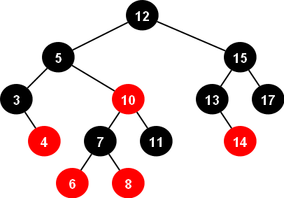
Red-black trees
Left child node is smaller than parent node
Right child node is larger than parent node
Self-balancing on insert/erase
Finding an element -> half of the tree can be ignored
log(n) search property.
Rebalancing the tree is log(n)

Slide 14
std::unordered_map
O(1) achieved by hashing. Hashing can be expensive
If you need to store unique elements and care about order → std::set.
Store unique elements and do not care about order → set::unordered_set.

Slide 15
Unordered set/unordered map
Hashing algorithm allows O(1) lookup speed.
template<
class Key,
class Hash = std::hash<Key>,
class KeyEqual = std::equal_to<Key>,
class Allocator = std::allocator<Key>
> class unordered_set;
template<
class Key,
class Compare = std::less<Key>,
class Allocator = std::allocator<Key>
> class set;
Find bucket
Find element in bucket

Slide 16
Space complexity
The table below shows the memory allocated when storing a 64-bit element.
Container | Storage(in bytes) | Contiguous
std::vector | 8 | Yes
std::deque | size of block | No
std::list | 24 | No
std::set | 8 + 3* 8 + 8 | No

Slide 17
template <typename T>
class MyAllocator
{
public:
using value_type = T;
T* allocate(std::size_t n) {
std::cout << "Allocating: " << n * sizeof(T) << " bytes"<<std::endl;
return static_cast<T*>(::operator new(n * sizeof(T)));
}
void deallocate(T* p, std::size_t n) {
::operator delete(p);
}
}; int main() {
using MySet = std::set<uint64_t, std::less<uint64_t>, MyAllocator<uint64_t>>;
MySet mySet;
mySet.insert(20); return 0;
}
Program returned: 0
Allocating: 40 bytes
https://gcc.gnu.org/onlinedocs/libstdc++/libstdc++-html-USERS-4.1/structstd_1_1___rb__tree__node.html

Slide 18
template <typename T>
struct CustomAllocator {
using value_type = T;
CustomAllocator() noexcept = default;
template <typename U>
CustomAllocator(const CustomAllocator<U>&) noexcept {}
T* allocate(std::size_t n) {
std::cout << "Allocating " << this << " name="<< typeid(T).name() <<" n="<< n << " T="<< sizeof(T) << std::endl;
if (auto p = static_cast<T*>(std::malloc(n * sizeof(T)))) {
return p;
}
throw std::bad_alloc();
}
void deallocate(T* p, std::size_t) noexcept {
std::cout << "Deallocating" <<std::endl;
std::free(p);
}
};

Slide 19
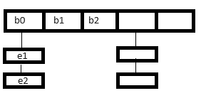
int main() {
using T = std::string;
using MySet = std::unordered_set<T, std::hash<T>, std::equal_to<T>, CustomAllocator<T>>;
CustomAllocator<T> myAllocator;
MySet mySet({}, 1, std::hash<T>(), std::equal_to<T>(), myAllocator);
std::cout << "created bucket"<<std::endl;
mySet.insert("a");
std::cout << "inserted element"<<std::endl;
for (const auto& element : mySet) {
std::cout << "value="<<element << " hash=" << std::hash<T>()(element)<< std::endl;
}
return 0;
}
Allocating 0x7ffc3ef5dc8f name=PNSt8__detail15_Hash_node_baseE n=2 T=8
created bucket
Allocating 0x7ffc3ef5de50 name=NSt8__detail10_Hash_nodeINSt7__cxx1112basic_stringIcSt11char_traitsIcESaIcEEELb1EEE n=1 T=48
inserted element
value=a hash=4993892634952068459
Deallocating
Deallocating

Slide 20
ex1.cpp
Simple pool allocator implementation. Reduce number of heap allocations.

Slide 21
Data locality
Decrease time complexity, increase space complexity
Increased space complexity could reduce performance due to decreased data locality.
If an important use-case of a container is to iterate over all elements of a container, an std::vector will be more interesting than an std::set due to increased data locality and access is typically cache hot

Slide 22
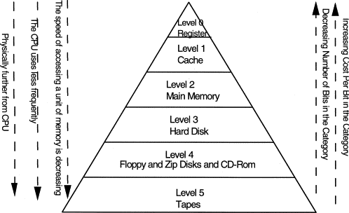
Data locality

Slide 23
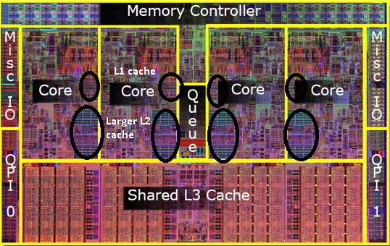
https://medium.com/software-design/why-software-developers-should-care-about-cpu-caches-8da04355bb8a
Pointer chasing kills the performance since the data is probably not in cache.

Slide 24
Data is transferred from memory to cache in blocksize = cache line
Cache lines are invalidated on data write
L1 cache lines are not shared
False sharing
william@vbox:~$ getconf LEVEL1_DCACHE_LINESIZE
64

Slide 25

CORE-0 writes to uint64_t #1
CORE-1 writes to uint64_t #7
Cache line constantly invalidated, constantly reshared between cores,
CPU does not know which byte in cache line is invalidated, it only knows that block of bytes needs to be synced

Slide 26
Avoid false sharing by allocating on cache line boundary
Aligning memory can be done by using alignas
int main() {
alignas(sizeof(uint64_t)*8) uint64_t a;
alignas(sizeof(uint64_t)*8) uint64_t c;
std::cout << &a << std::endl;
std::cout << &c << std::endl;
std::cout << (&a - &c) << std::endl;
}
0x7ffc876e9c40
0x7ffc876e9c00
8

Slide 27
ex2.cpp
False sharing example
duration: 605 microseconds
0x55ac861ea180
0x55ac861ea1c0
duration: 597 microseconds
0x56160a67c180
0x56160a67c1c0
william@vbox:~/shared/cpptraining-medior/exercises/containers$ g++ --std=c++20 ex10.cpp
william@vbox:~/shared/cpptraining-medior/exercises/containers$ while true; do ./a.out; done
Thread 1 duration: 1980 microseconds
0x562f5cd54154
0x562f5cd54158
64 = 0x40

Slide 28
Array of structures vs structure of arrays
False sharing is an issue
Consider a set of Layer 2 network packets
Rewrite source port to some other value eg NAT
SIMD vectorization
struct L2 {
uint16_t sourcePort;
uint16_t destinationPort;
uint64_t sourceMacAddress;
uint64_t destinationMacAddress;
};

Slide 29
struct L2 {
uint16_t sourcePort;
uint16_t destinationPort;
uint64_t sourceMacAddress;
uint64_t destinationMacAddress;
};
int main() {
const size_t packetCount = 100;
std::array<L2, packetCount> stream;
for (int i = 0; i < packetCount; ++i) {
if (stream[i].sourcePort == 123) {
stream[i].sourcePort = 0;
}
}
return 0;
}

Slide 30
struct Stream
{
std::vector<uint16_t> sourcePort;
std::vector<uint16_t> destinationPort;
std::vector<uint64_t> sourceMacAddress;
std::vector<uint64_t> destinationMacAddress;
};
int main()
{
const size_t packetCount = 100;
Stream stream;
for (int i = 0; i < packetCount; ++i) {
if (stream.sourcePort[i] == 123) {
stream.sourcePort[i] = 0;
}
}
return 0;
}
Don’t need destination port in cache line, only source port
Only source port is in cache

Slide 31
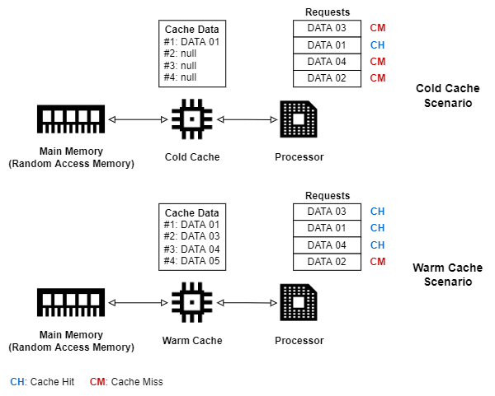
Performance
Profile your code
Change layout of data members
Measure cache misses in hot path cachegrind
Avoid allocating in hot path
Manage algorithmic complexity

Slide 32
Algorithms
Make code more expressive: raises the level of abstraction
Avoid common mistakes; empty containers, too complex
Rely on tested algorithms used by many developers

Slide 33
Heaps
Binary tree variant called a heap
No memory overhead, retrieval of the maximum or minimum(depending on heap configuration) element with O(1) complexity
Unlike RB-trees, not possible to find random elements using O(log n) complexity. Inserting an element is O(log n) complex.

Slide 34
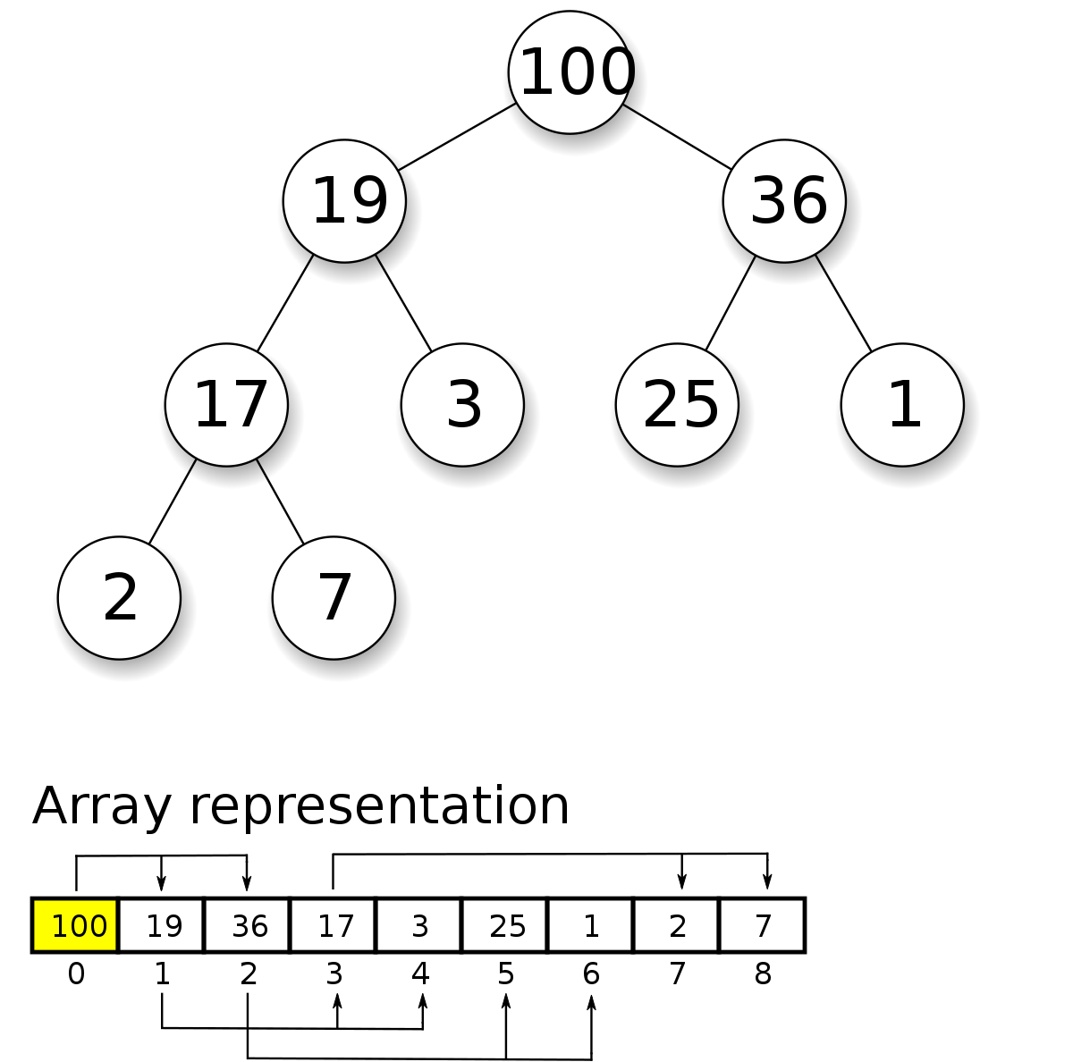
Heap
The main property of this tree is that child nodes are smaller than parent nodes.

Slide 35
void print(auto container)
{
for(auto const& e:container)
{
std::cout << e<< ' ';
}
std::cout << std::boolalpha<<std::is_heap(std::begin(container), std::end(container)) <<std::endl;
}
int main()
{
std::vector<int> x = {4,7,-1, 5, 4, 3};
print(x);
std::make_heap(std::begin(x), std::end(x));
print(x);
x.push_back(100);
print(x);
std::push_heap(std::begin(x), std::end(x));
print(x);
}
Program stdout
4 7 -1 5 4 3 false
7 5 3 4 4 -1 true
7 5 3 4 4 -1 100 false
100 5 7 4 4 -1 3 true

Slide 36
Use-case of a heaps is to make measurements, store the measurements and get O(1) access to largest/smallest measurement

Slide 37
Sorting
The standard requires std::sort to do max O(n log(n)) comparisons at most.
Introsort provides this worst-case performance complexity and is used by for example gcc.

Slide 38
void print(auto container)
{
for(auto e:container)
{
std::cout << e<< ' ';
}
std::cout << std::boolalpha<<std::is_sorted(std::begin(container), std::end(container)) <<std::endl;
}
int main()
{
std::vector<int> x = {4,7,-1, 5, 4, 3};
print(x);
std::sort(std::begin(x), std::end(x));
print(x);
std::cout << "Has element: "<< (std::find(std::begin(x), std::end(x), 4) != std::end(x)) << std::endl;
std::cout << "Has element: "<< std::binary_search(std::begin(x), std::end(x), 4) << std::endl;
}
4 7 -1 5 4 3 false
-1 3 4 4 5 7 true
Has element: true
Has element: true

Slide 39
It is possible to find an element using std::find: O(n)
std::binary_search and std::lower_bound O(log(n)) -> requires sorted range. Undefined behaviour if range is unsorted

Slide 40
Partitioning
std::partition partitions a range in 2 parts based on some predicate. std::stable_partition makes sure that internal position of elements in both parts is maintained.

Slide 41
4 7 -1 5 4 3 false
5 7 -1 4 4 3 false
7 5 4 -1 4 3 false
void print(auto const& container)
{
for(auto const& e:container)
{
std::cout << e<< ' ';
}
std::cout << std::boolalpha<<std::is_sorted(std::begin(container), std::end(container)) <<std::endl;
}
int main()
{
std::vector<int> x = {4,7,-1, 5, 4, 3};
print(x);
auto backup_x = x;
std::partition(std::begin(x), std::end(x), [](auto e){ return e > 4;});
print(x);
std::stable_partition(std::begin(backup_x), std::end(backup_x), [](auto e){ return e > 4;});
print(backup_x);
}

Slide 42
Transform/reduce
std::transform is used to type convert while looping over a collection.
std::reduce/std::accumulate collapses a range into 1 element by applying a functor.

Slide 43
struct Equity
{
std::string name;
int value;
};
int main()
{
std::vector<Equity> equities = {{"goog",100}, {"aapl", 200}};
std::vector<int> values(std::size(equities));
std::transform(std::begin(equities), std::end(equities), std::back_inserter(values), [](auto e){return e.value;});
int total_value = std::reduce(std::begin(values), std::end(values));
std::cout << "Total equity value: "<< total_value << std::endl;
int total_value_2 = std::transform_reduce(std::begin(equities), std::end(equities), 0,
std::plus<>(), [](auto e){return e.value;});
std::cout << "Total equity value: "<< total_value_2 << std::endl;
}
Total equity value: 300
Total equity value: 300

Slide 44
Generate, fill and copy
std::generate, executes a functor for each element in the container and assigned its return value to that value.
std::fill assigns an identical value to each element
std::copy, copies element from one container to another.

Slide 45
void print(auto container)
{
for(auto e:container)
{
std::cout << e<< ' ';
}
std::cout << std::endl;
}
auto generator = [i = 0]() mutable {return i++;};
int main()
{
std::vector<int> x(10);
std::fill(std::begin(x), std::end(x), 1);
print(x);
std::generate(std::begin(x), std::end(x), generator);
print(x);
std::copy(std::begin(x), std::begin(x)+2, std::begin(x)+2);
print(x);
}
1 1 1 1 1 1 1 1 1 1
0 1 2 3 4 5 6 7 8 9
0 1 0 1 4 5 6 7 8 9

Slide 46
There are issues though
STL algorithms often require pipelining
When transforming elements from one vector into another, you may not want to transform each element. e.g. some element is null.
You can create a custom iterator
Stl algorithms are not lazy.
Ranges!

Slide 47
template<class C, class F>
class conditional_back_insert_iterator {
protected:
C* container;
F f;
public:
using container_type = C;
using iterator_category =std::output_iterator_tag;
using value_type=void;
using difference_type=void;
using pointer=void;
using reference=void;
explicit conditional_back_insert_iterator( C& __x, F __f ) :
container( &__x ), f(std::move(__f)) { }
conditional_back_insert_iterator& operator=(typename C::value_type const& v)
{
if (f(v)){
container->push_back(v);
}
return *this;
}

Slide 48
struct Element{
int x;
};
int main(){
auto filter = [](int i) { return i < 5; };
auto transform = [](int i) -> Element { return Element{i}; }; std::vector<Element> filtered_elements; std::vector<int> container = {1, 2, 3, 4, 5, 6, 7, 8}; std::transform(
std::begin(container),
std::end(container),
conditional_back_insert_iterator(filtered_elements,
[](Element e){return e.x < 5;}), [](int x){return Element{x};}); print(std::begin(filtered_elements), std::end(filtered_elements)); std::cout << std::endl; auto lazy_evaluation = container | std::views::filter(filter) | std::views::transform(transform); print(std::begin(lazy_evaluation), std::end(lazy_evaluation)); }
Notes:
Transform from in to Element, then conditionally apply transform

Slide 49
template <typename T>
void print(T begin, T end)
{
for(auto it = begin; it !=end; it++)
{
Element const& e = *it;
std::cout << e.x<< ' ';
}
}

Slide 50
Source of your technology

