Slide 1
Global economic crisis – the Framework and
South Africa’s response
Presentation to Portfolio Committee and Select Committee
Minister of Economic Development
Draft – check against delivery

Slide 2
Background and roots
Causes of the crisis lay in a range of policies over past 30 years
Complex and interconnected factors, incl
  Gross imbalances and inequities in the global economic system
  Impact of financialisation of economies
  Ineffectual regulation in key economies
  Poor business practices

Slide 3
A number of smaller crises
Financial crises in US – Savings & Loans
East Asian Financial Crisis
Latin American Financial crisis
Russian crisis

Slide 4
A big crisis
September 2008 meltdown
Lehman Bros bankrupt
AIG teeters on bankruptcy – systemic risk
Freddie Mac and Fanny Mae
Wall Street crashes
American economy goes into recession
Impact across the world is dramatic and rapid

Slide 5
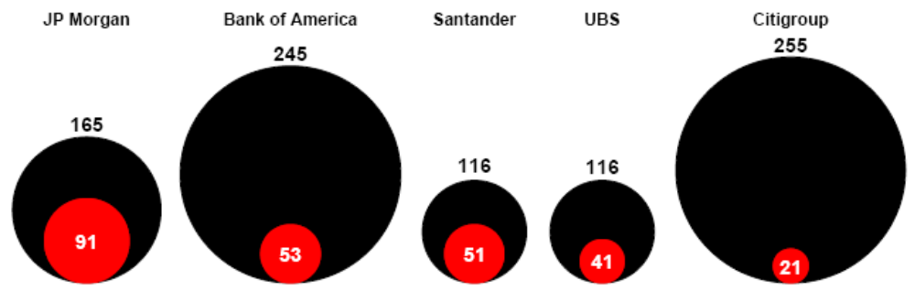
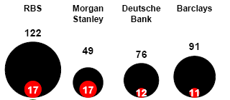
Market capitalisation: various banks
(Jun 2007 vs Jan 2009) (US$ bn)

Slide 6
Consequences
Price of oil and many minerals fall sharply
Aggregate demand drops substantially
Factories slow down and many close
Credit to companies dry up
Fifty million workers estimated to be made jobless
Rural poverty deepens
Many people lose homes and property

Slide 7
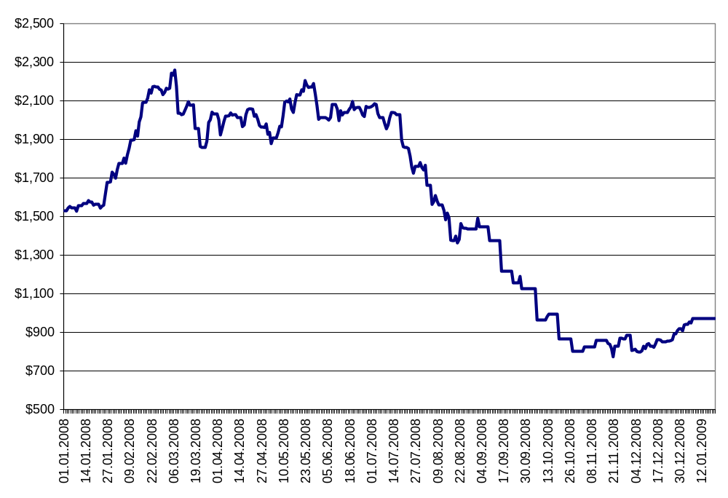
Platinum price (US Dollars)
Jan 2008 – Feb 2009

Slide 8
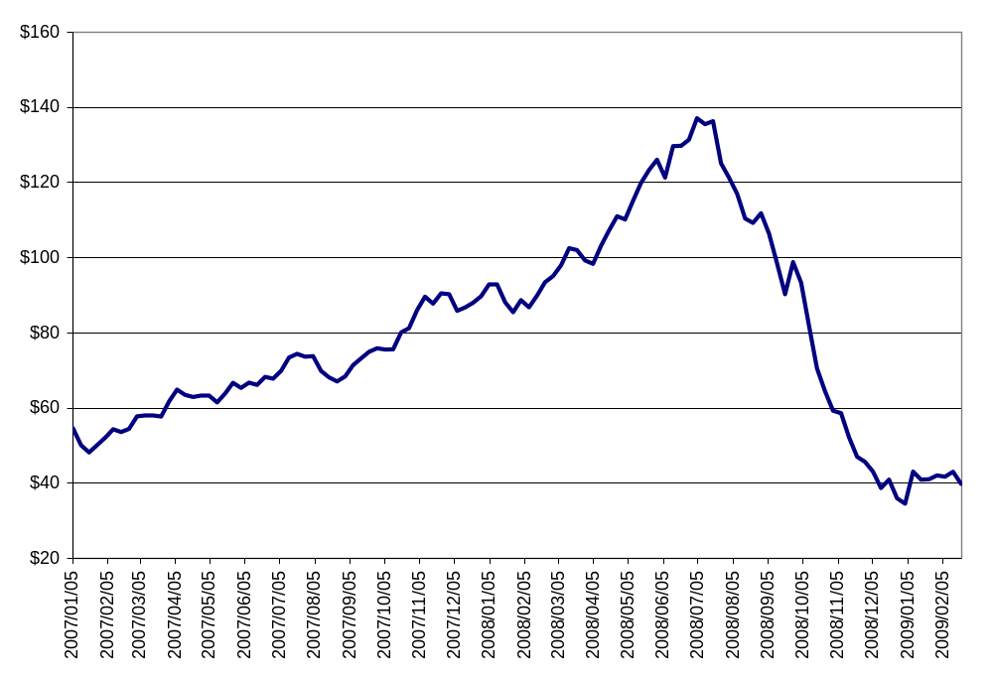
Oil price (US Dollar per barrel)
(Jan 2007 – Feb 2009)

Slide 9
Reactions by governments
American government intervenes to an extent that overturns all the ‘rules’
Bail-out of banks and insurance company
Part nationalisation of finance sector
Rescue of auto sector
Massive stimulus package (fiscal and monetary) to try to stop the recession
Global coordination to pump liquidity into the market

Slide 10
China announces stimulus package as its economy slows down
European countries follow
The crisis rapidly spreads in spite of these efforts
Initial talk of SA being ‘decoupled’ from the crisis but evidence from real economy groups contradict this
This triggers an SA response

Slide 11
Framework Agreement
December 2008 meeting called by then President Motlanthe
Task team set up with labour, business and community orgs
Proposals formulated in mid-December
Negotiations from 19 Jan to 19 Feb 2009
A Framework for SA’s response was developed and agreed, which set out principles and broad programmes

Slide 12
Framework: principles
Principles
  Protect the poor, the vulnerable, the unemployed and low-income workers
  Strengthen capacity to grow decent work in future
  Maintain high levels of investment
  Interventions that are timely, tailored and targeted
  Bold stimulus package

Slide 13
Framework overview
Six main features
  Maintain high levels of investment
  Deploy macroeconomic policies
  Industrial and trade policies
  Employment measures
  Social measures
  Address global roots of crisis

Slide 14
Framework: public investment
Government will spend R787 billion on improving public infrastructure such as housing construction, energy generation, hospitals and health clinics, schools and training colleges, railways, roads, dams, running water, in rural and urban areas.
Maintain, and if possible expedite, in context of economic challenges
Identify additional resources
DFIs to provide finance/technical support

Slide 15
Framework: macro-economic measures
Fiscal and monetary policy measures to be
  Used counter-cyclically
  Used aggressively where required
  Used In combination
  Aligned to each other
  Complemented by trade & industrial policies

Slide 16
Business and labour and community organisations to meet with the Reserve Bank to discuss
  interest rate regime
  lowering cost of capital
  reduce real interest rate gap
Recognition of the value of a competitive exchange rate to boost the economy
Tax relief – reference to Budget of February 2009

Slide 17
Framework: industrial & trade measures
Industries affected by the crisis must be helped.
Avoid de-industrialisation and rebuild local industrial capacity
Identifies small businesses and list of vulnerable and distressed sectors as well as a ‘definition’ of vulnerable sectors
  Sectors with high employment and labour intensity with large planned or actual job losses and company closures

Slide 18
Rescue packages to be developed
National Jobs Initiative must be launched
DFI: mandates and support for distressed sectors
Promote green jobs
Promote local procurement
Combat illegal imports
Targeted trade measures
Maintain flow of credit to real economy

Slide 19
Framework: employment measures
Private sector
CEOs to avoid retrenchments of workers and explore alternatives
Restraint on excessive executive pay
Unions and employers to consider training layoffs as an alternative to retrenchment
Maintain fair labour standards in responding to the crisis

Slide 20
Public sector
Improve employment intake in public sector in key delivery areas
Review outsourcing by government
Use expanded public works programmes
  Scale up the programme
  Increase the duration of contracts
  Combine it with training
  Bring in community partners
  Additional government funding

Slide 21
Framework: social measures
Social plans by business and labour at sector and plant level
Enhance UIF benefits
Food prices: competition measures, special programmes and emergency food relief
Increase the child grant progressively to age 18
Strengthen coops as a response to the crisis: employment and services

Slide 22
Framework: global coordination
Recognise deep weaknesses in governance of globalisation
Develop global responses, with other countries
Review global financial and social architecture
Support prudent regulation of SA capital market and retention of capital controls

Slide 23
Advocate measures to enhance financial market stability and penalise predatory and risky behaviour
  Consider measures to discourage short-term, speculative investment
Address issues of global macro-economic imbalances
Propose that development assistance to developing countries should not be scaled-down

Slide 24
G20: proposals and process of shaping SA’s positions – strong involvement by social partners
WTO: promote a developmental agenda that supports employment, vulnerable sectors, decent work and policy space for SA
IMF and World Bank – review mandates and governance
Strengthen ILO

Slide 25
Political mandate
President Zuma elected and sets out vision in State of the Nation Address
“The creation of decent work will be at the centre of our economic policies and will influence our investment attraction and job-creation initiatives. In line with our undertakings, we have to forge ahead to promote a more inclusive economy.”
Endorses Framework Agreement as basis of response

Slide 26
Impact on SA
Full impact on SA reflected in economic data from May
Income from exports of minerals drops
Economic growth slows down dramatically and manufacturing sector shrinks by 20%
Job losses in one area affects other sectors (multiplier effect)
Rand crashes against the dollar, then rises rapidly (volatility)
Credit becomes more difficult to obtain
Current account (BoP) deficit pressures continue

Slide 27
Employment
QES records 179 000 job losses in first three months of the year.
LFS records 267 000 job losses in second three months of the year and 302 000 additional people who are discouraged work-seekers
Evidence from business and unions show the same trend

Slide 28
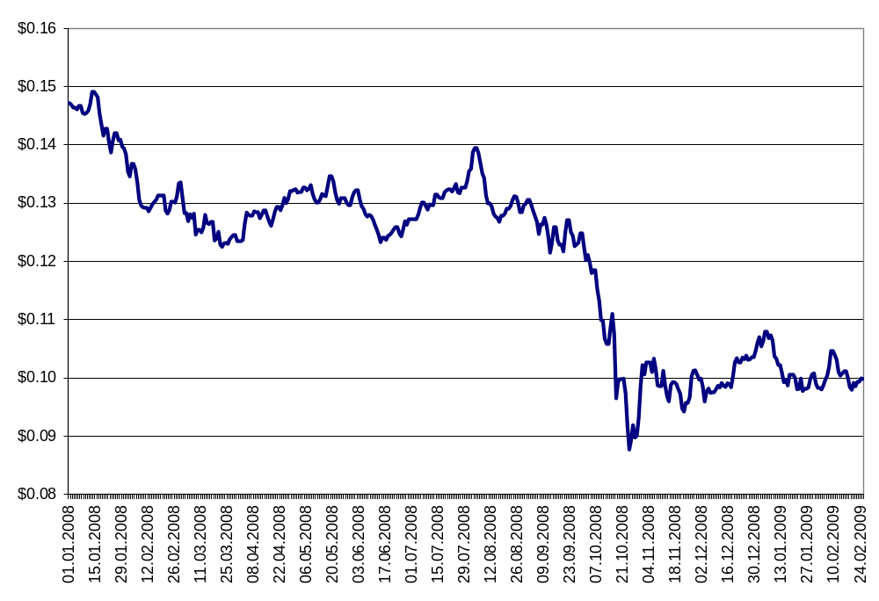
Dollar/Rand Exchange Rate
(Jan 2008 – Feb 2009)

Slide 29
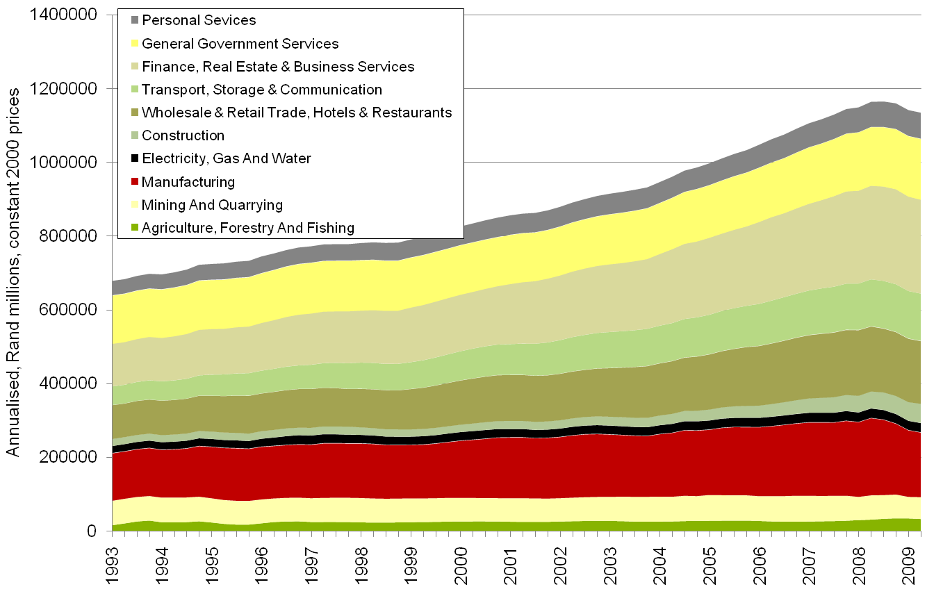
Gross Domestic Product quarterly (seasonally adjusted)

Slide 30
Three quarters of declining GDP (on seasonally adjusted basis)
Taking into account sector size, the biggest losses by far in GDP is in manufacturing
Manufacturing activity now back at levels of 2004
Major contractions also in other sectors such as mining

Slide 31
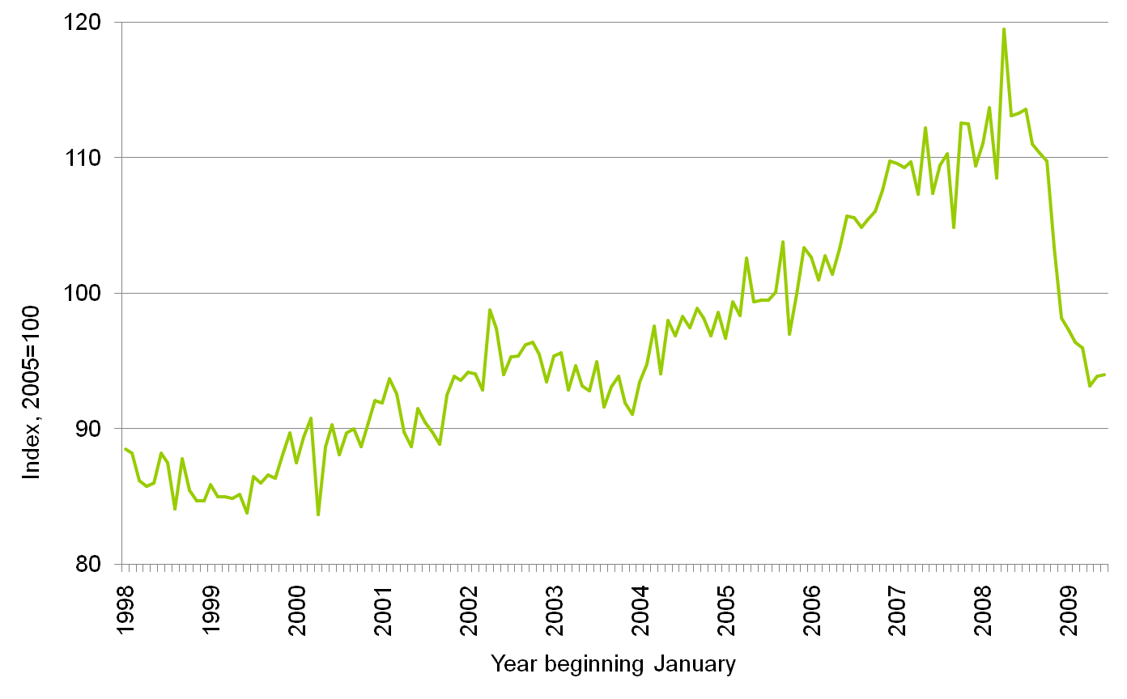
Manufacturing index of physical volume of production

Slide 32
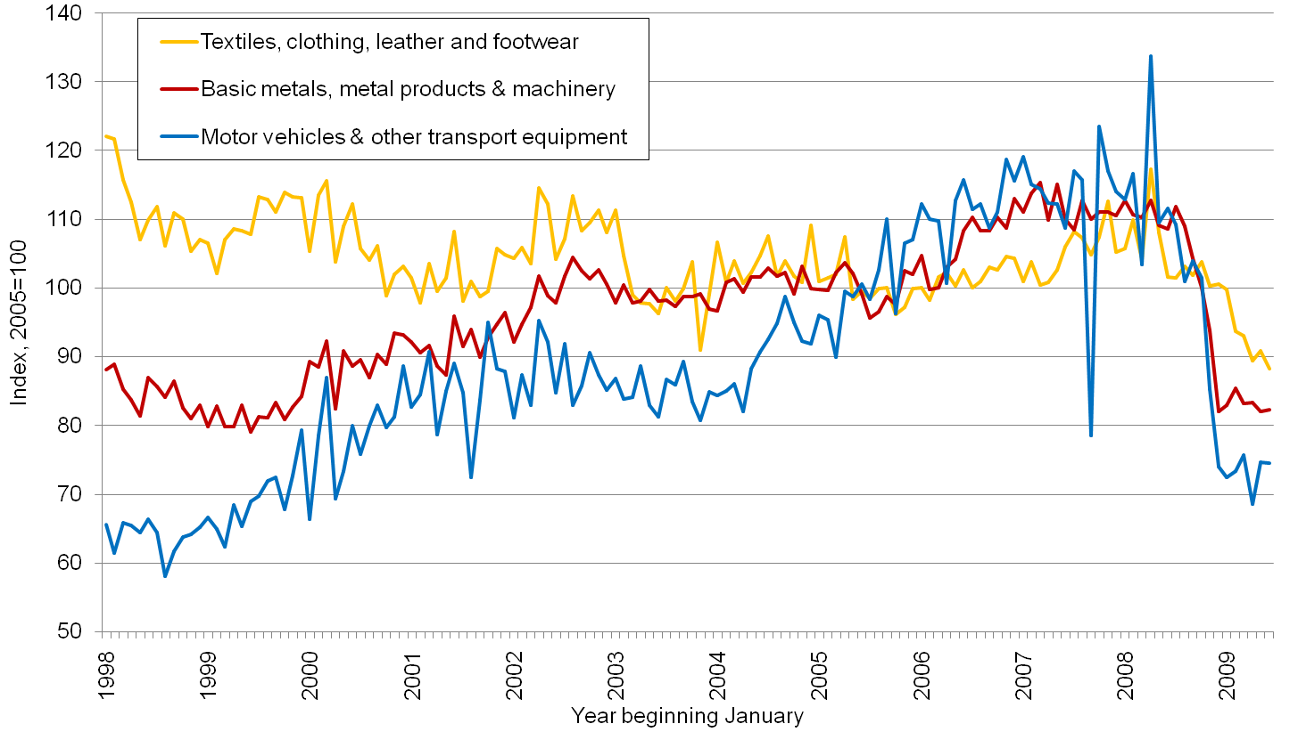
Large sectors of manufacturing most affected by recession: metals & machinery and motor vehicles at production levels last seen in 2000; further contraction of textiles & clothing

Slide 33
Response by SA – sequence
February: Framework Agreement
March: Discussion on implementation
April: Global discussions in G20 and elections
May: new cabinet and Cabinet Lekgotla, recession is ‘official’
June: SONA: Framework confirmed by Pres Zuma as basis of response
July: a set of priority measures identified
August: Announcements of six measures

Slide 34
Training layoff
Concept: an extended training period as an alternative to retrenchment
Funding: National Jobs Fund with R2,4b allocated to it
Available: to workers earning up to R180 000 per annum
Payment: a training allowance of 50% of basic salary up to R6 239 per month
Employer: pay basic social package (funeral, death, disability)

Slide 35
Period: 3 months with flexibility on the structure: either full layoffs or partial layoffs (short-time)
Training: left to sector and workplace to determine, but three guidelines
  Company-usable skills
  Generic skills and literacy/numeracy
  Information and Communication Technology skills
Trigger: workplace agreement and via CCMA

Slide 36
SETAs: training courses, administration and funding conduit
DoL: coordinate and do implementation guide
Other partners: business organisations, unions, EDD and dti.

Slide 37
Customs fraud
Illegal imports and customs fraud led to many thousands of job losses
SARS has stepped up its actions
More resources made available
Action against companies suspected of smuggling, round-tripping, export-incentive abuse, counterfeits, quota fraud, rebate item abuse and under-declaration

Slide 38
Clothing sector example - investigations
Smuggling: 4 companies
Round-tripping: 15 companies
Export-incentive abuse: 14 companies and some duties recovered
Counterfeits: a number of raids
Quota fraud: 4 companies will be charged
Rebate abuse: 3 companies
Under-declaration: 5 will be charged

Slide 39
IDC support
IDC has made R6 billion over two years available to companies in distress due to recession – credit and working capital
49 funding applications in pipeline
Since 1 April, 11 financing applications totalling R743m approved

Slide 40
Distressed sectors
Work done with social partners since March
Packages developed for:
  automotives,
  clothing & textiles,
  capital equipment, transport equipment and metals fabrication (CETEMF)
A number of measures to address immediate problems

Slide 41
Support for auto industry linked to conditionalities on jobs, affordability, environment and modest pay and dividends
Increased incentives for CETEMF
Clothing & Textile: a possible different incentive scheme
Implementation: the dti and its agencies

Slide 42
Food prices and competition action
Goal: reduce food price pressures on consumers
Method; step up action against companies colluding or partaking in anti-competitive action
Focus on seven parts of food supply-chain
  Bread
  Milling (maize)
  Dairy
  Poultry
  Fertilisers
  Fats & oils
  Supermarkets

Slide 43
Debt management
Goal: address the pressure on over-indebted consumers
National Debt Mediation Association – a business venture
Provide rules, standards and processes to address debt restructuring

Slide 44
Going forward
Implement six measures effectively
Develop a new set of issues
Progress policy discussions on the shape of a new global economic and social architecture

Slide 45
New issues
Working across a wide front of issues: Eg
Expanded public works programme
Public infrastructure investment (R787b)
Local procurement
Public grant conditionalities
Green jobs
Vulnerable groups: women, informal economy
Engagement with the banking sector

Slide 46
The future
Tentative signs of recovery but based on stimulus packages – can it sustain itself
Employment losses will lag economic recovery
The crisis has challenged economic orthodoxies
Global financial regulation taking shape
Global imbalances not resolved
Globally: big budget deficits and very low interest rates

Slide 47
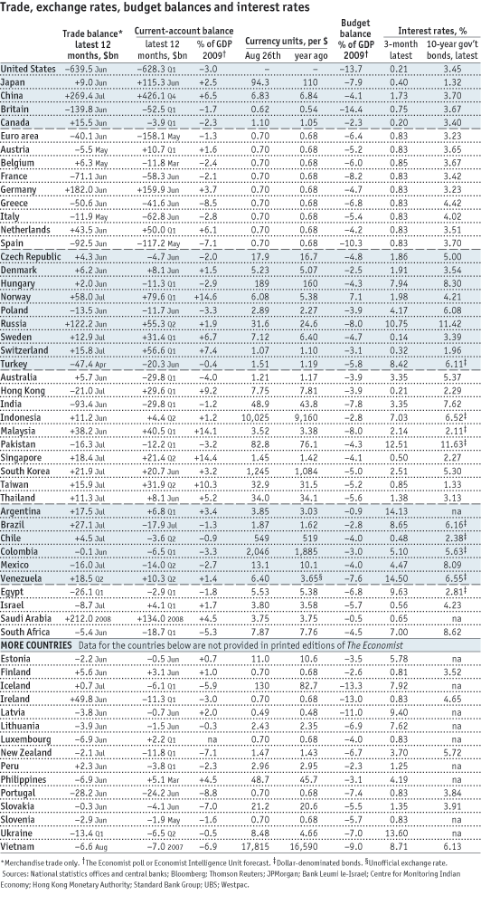

Slide 48
Conclusion
New experience for the democracy – dealing with a deep economic contraction
Not a short-term problem that will disappear in six months
Government has the resolve to act to protect jobs and the economy, as well as our people
Address both immediate and systemic issues
Shape of post-crisis world

Slide 49
Build partnerships to confront the challenge
Important role for parliament as the representatives of the people
  Regular reports to parliament, including through Statements to the House
  Role of PC in ensuring accountability
  Popularising the Framework Agreement
  Possible public hearings

