Slide 1
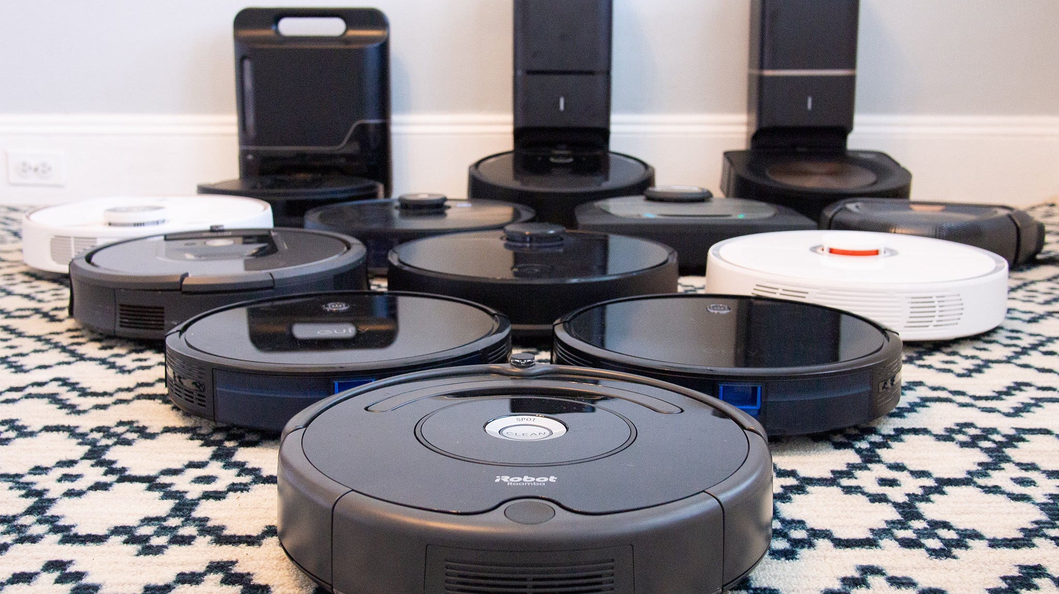
PYTR-214 Robot Vacuum Data Analysis
Explore use patterns of the typical robot user per country:
Are there geographic differences in robot usage?
Address any possible effects of data loss on my findings.
https://www.nytimes.com/wirecutter/reviews/best-robot-vacuum/
Photo: Liam McCabe

Slide 2
Agenda
Datasets
Geographic Differences
Number of robots
Robot fleet growth
Time of day usage
Mission outcomes
Time spent cleaning, charging, and paused
Mission number statistics
Data Loss
Total robot loss
Mission loss
Recommendations

Slide 3
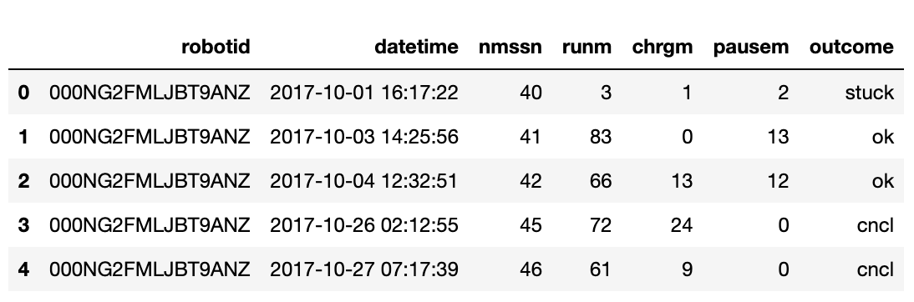
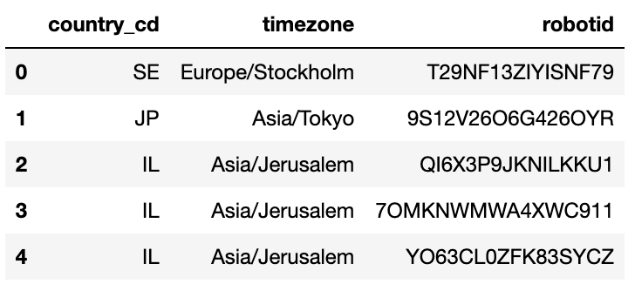
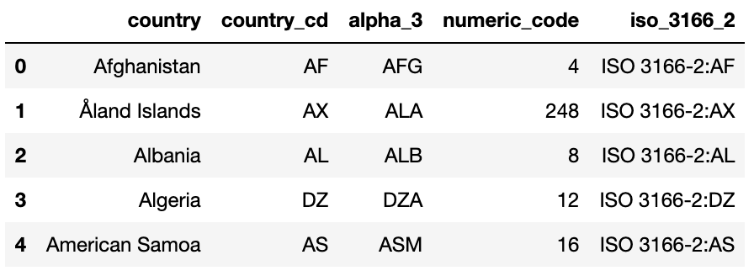
Datasets - Introduction
Mission data:
Dataset info:
Randomly generated
10,000 wifi-connected robots
367,679 rows (one row per mission)
Geographic location data:
ISO-country-codes data: https://gist.github.com/radcliff/f09c0f88344a7fcef373

Slide 4
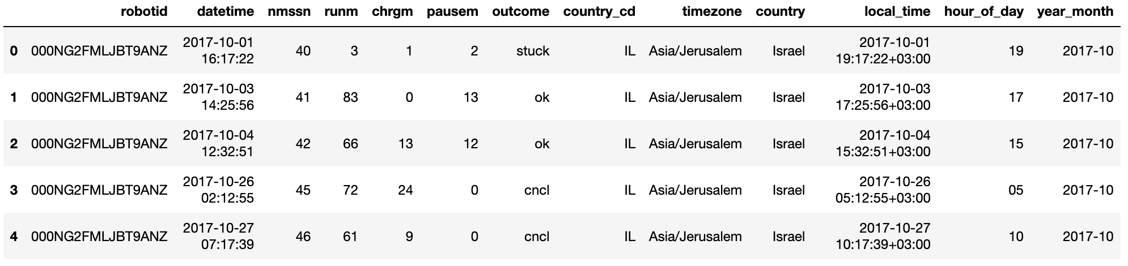
Datasets - Final DataFrame
Mission
Geo
ISO.
13 Columns x 367,679 rows

Slide 5
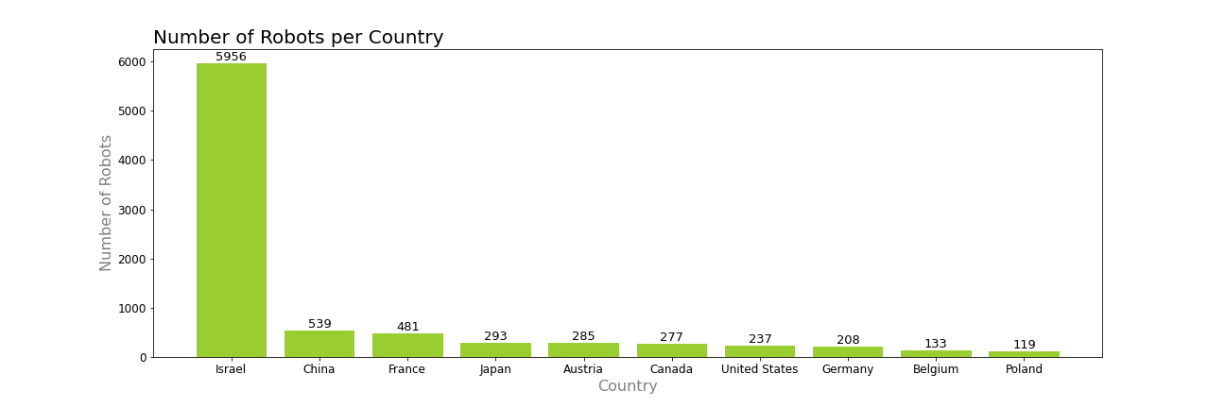
Geographic Differences – Robots per Country
60%
5.7%
3%
1.2%
Top 10 Countries
87%

Slide 6
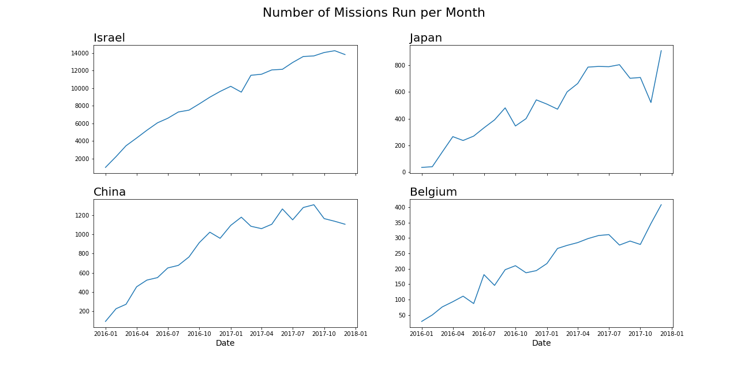
Geographic Differences – Robot Fleet Growth
Oct
Oct
Key Takeaways:
Israel and China are exiting the year with a slight decline, after long steady growth
Japan and Belgium are exiting the year with high growth

Slide 7
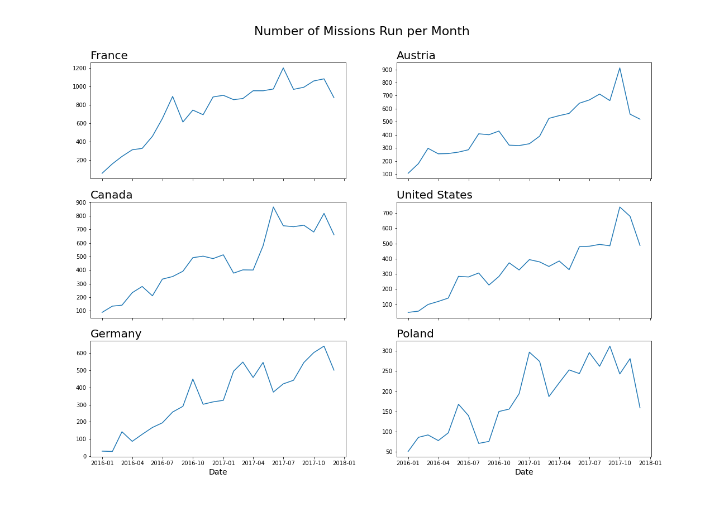
Geographic Differences – Robot Fleet Growth
Oct
Oct
Key Takeaways:
All 6 Countries are exiting the year with a sharp decline

Slide 8
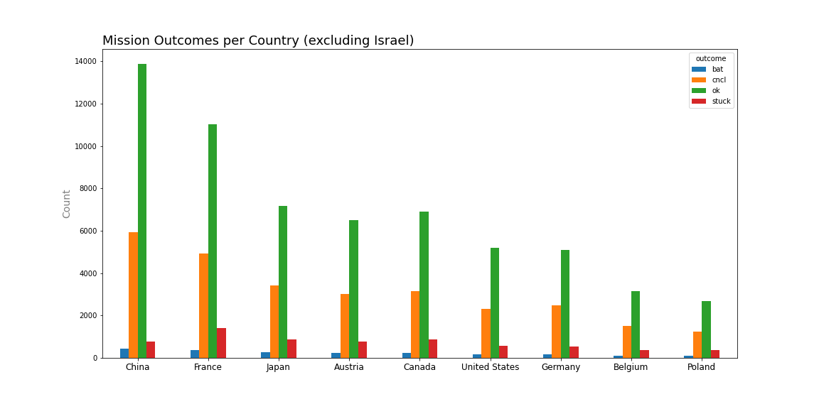
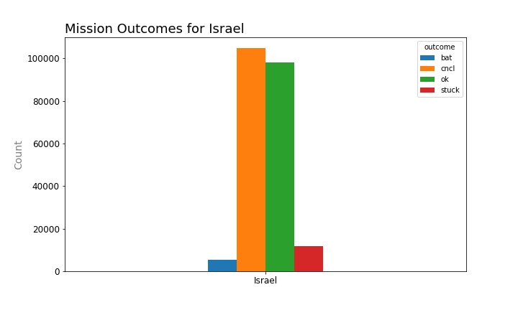
Geographic Differences – Mission Outcomes
Key Takeaways:
Israel has the highest rate of cancelled missions
France has an elevated level of missions resulting in the robot getting stuck
1
1
2

Slide 9
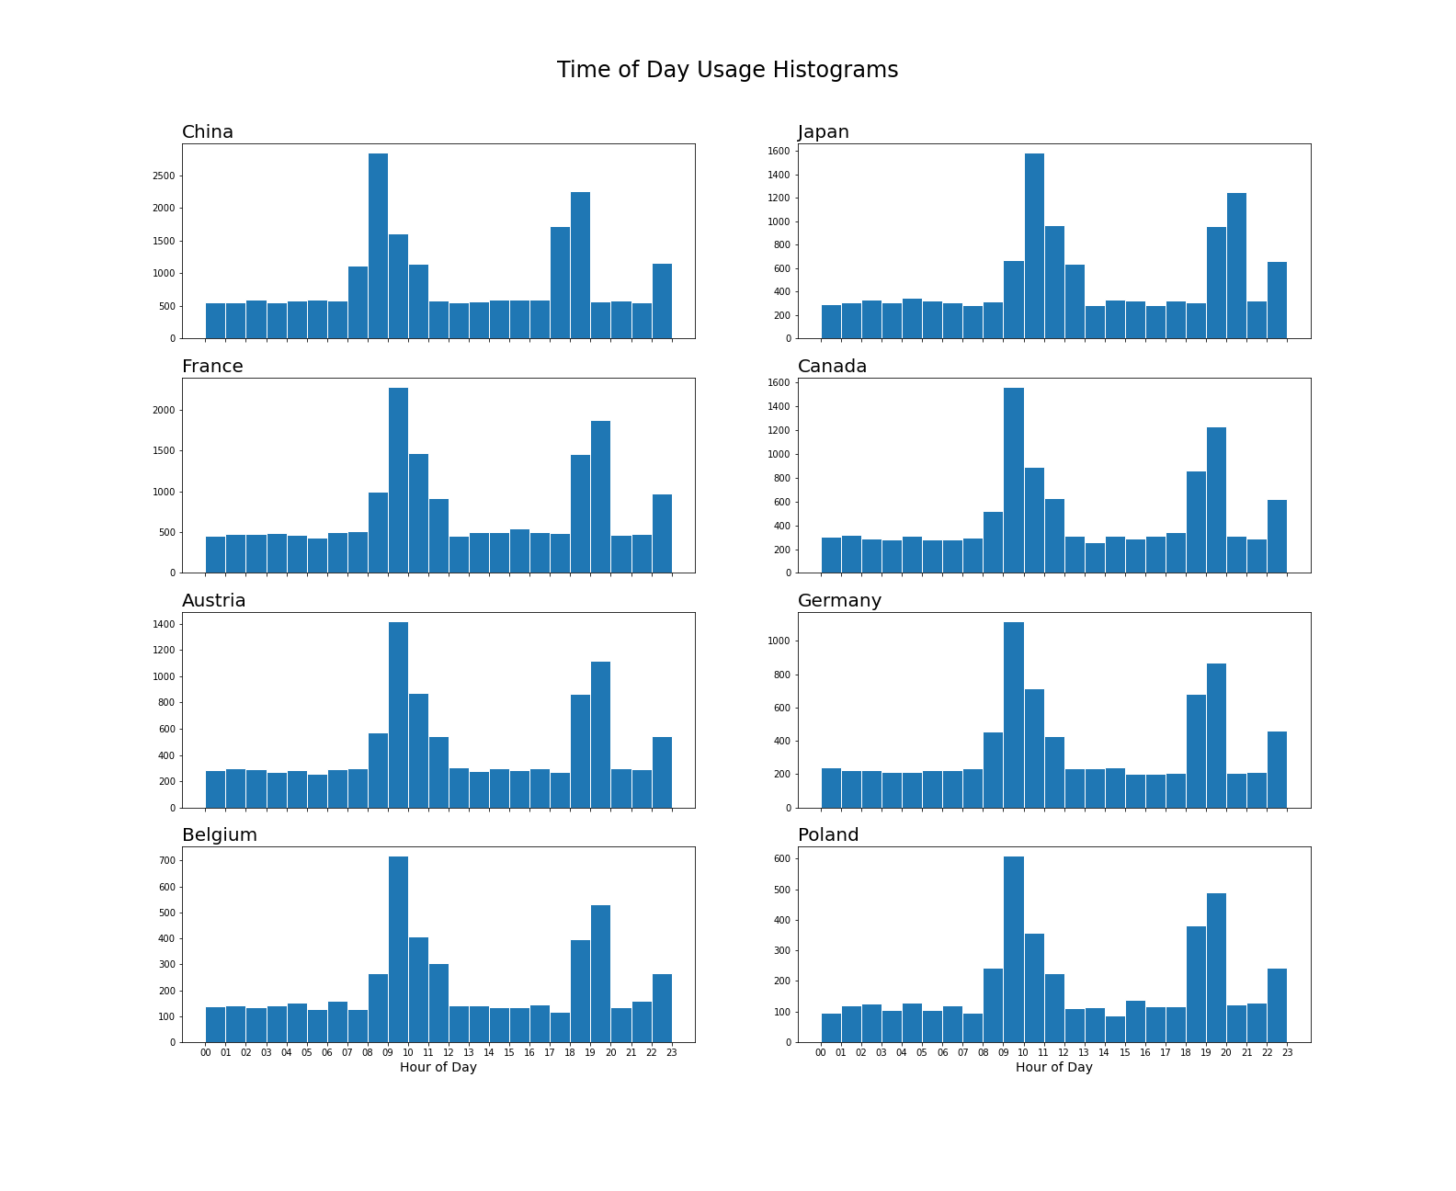
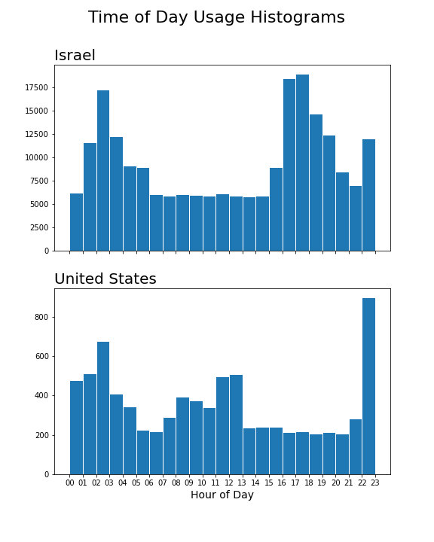
Geographic Differences – Time of Day Usage
8am
12pm
6pm
8am
12pm
6pm
6am
3pm

Slide 10
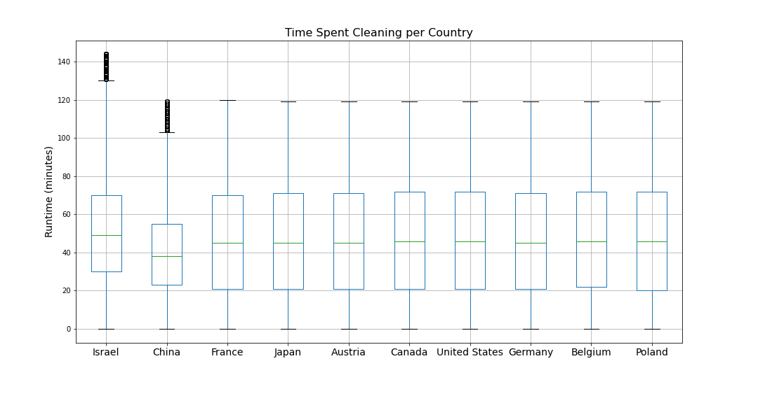
Geographic Differences – Time Spent Cleaning
Key Takeaways:
Israel and China have several outliers
China has less variability in the middle half of the data for time spent cleaning

Slide 11
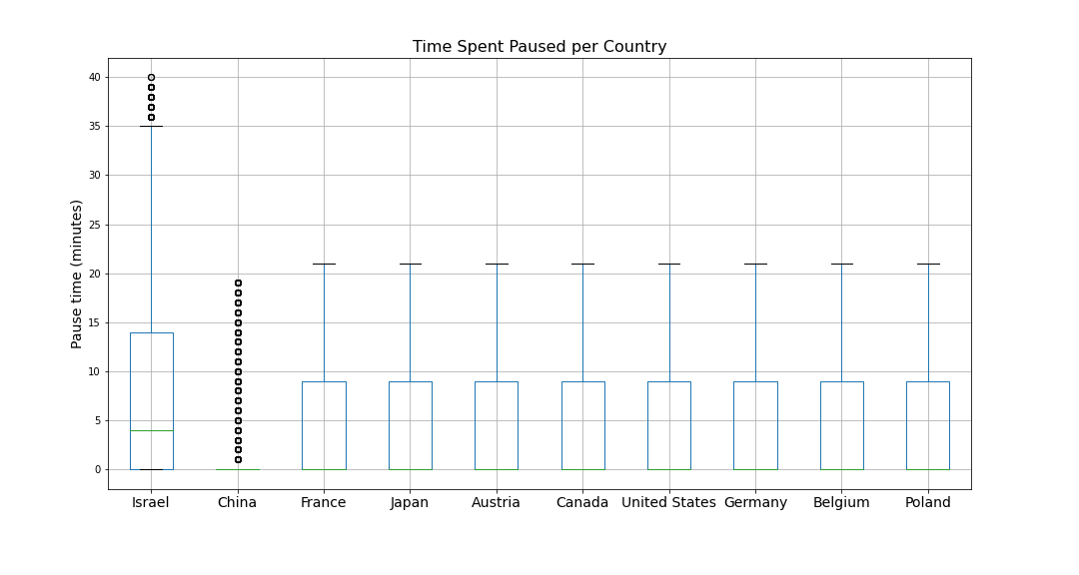
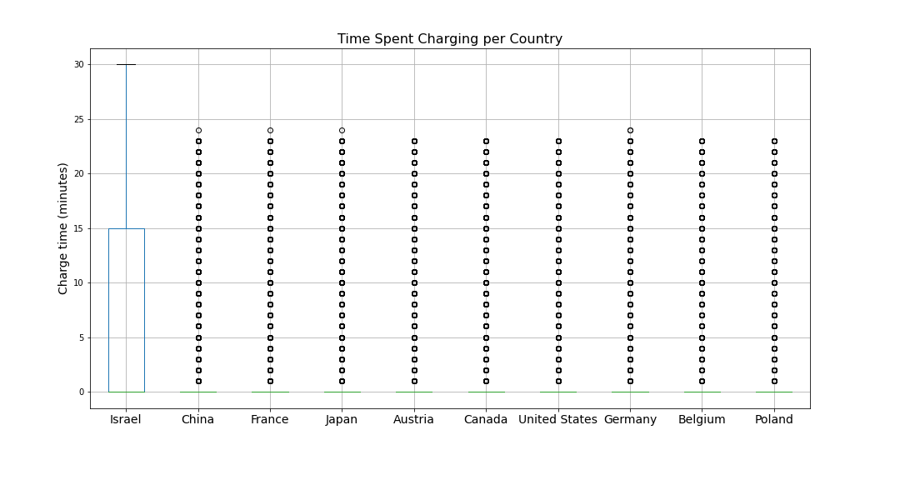
Geographic Differences – Time Spent Charging and Paused
Key Takeaways:
Robots in Israel spend more time paused and charging
Robots in China rarely spend time paused or charging
The remaining countries spend about 50% less time paused when compared to Israel

Slide 12
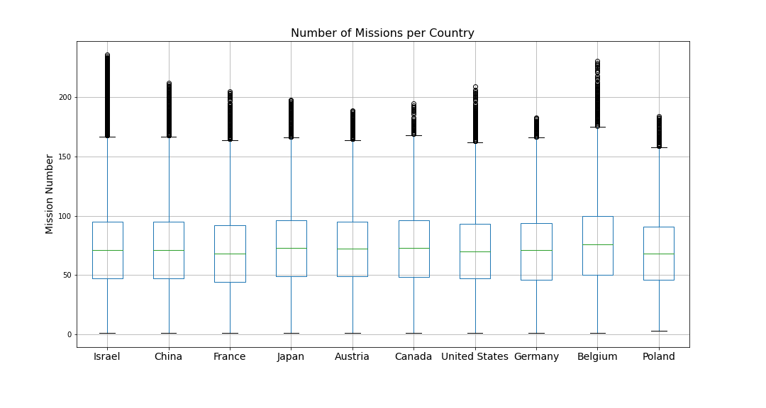
Geographic Differences – Number of Missions
Key Takeaways:
Most countries have mission data for mission #50 through #100, but it appears we might be lacking mission data prior to mission #50

Slide 13
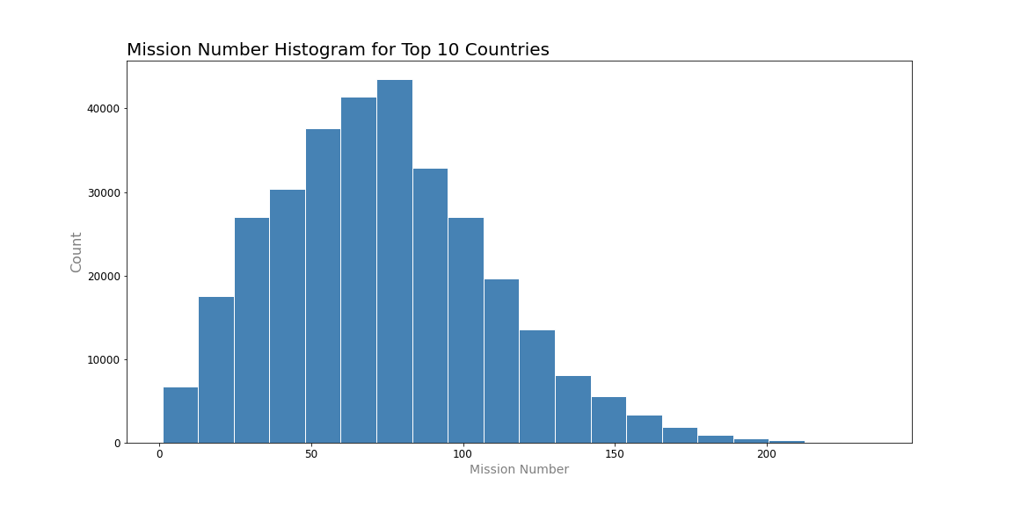
Data Loss – First 50 Missions
Key Takeaways:
Confirming suspicions in the boxplot, but seeing mission lost is prevalent in the first ~25 missions
#25

Slide 14
Data Loss – Mission Loss
43
44
Key Takeaways:
Here is an example of a robot with missing mission data. Not all missions have been recorded or reported.

Slide 15
Data Loss – Total Robot Loss
Left Join
Key Takeaways:
When performing a Left Join with the Geographic information on the left side, it revealed there was only mission data for 9,826 robots
With Mission Data on the left side, this is also confirmed by checking the length of unique robot ids, which returns 9,826
Geo
Data
10,000 Robots
Mission
Data
367,369 Missions

Slide 16
Recommendations
Final Recommendations:
Israel and the United States see a bulk of use during the early morning hours, so dampening the vacuum motor noise may be preferred to not wake others in the household.
Robots in Israel spend more time on average charging than other countries, so improved battery technology would be recommended to reduce how often robots need to charge.
Robots in France are getting stuck on obstacles more so than other countries. Further data would be need to be collected to determine the root cause and solution.
Given we appear to be missing a bulk of mission data prior to mission #25, maybe customers are having issues when first setting up the robot and connecting it to the cloud. This should be investigated further to confirm.
Lastly, further investigation would be recommended to determine the underlying cause of robot fleet growth or decline per Country.
Data Loss Comments:
There was a total loss of 174 Robots with no mission data reported. This could be due to a user never connecting their robot and using it as-is out of the box. Faulty equipment could also be a cause. A dataset containing only these robots has been created for customer care follow-up.
There are several robots with missing sequential mission data. Further investigation would need to be performed to determine if this is random behavior or if there is a pattern. This could be caused to due to internet outages or linked to robot software updates introducing unknown mission reporting bugs.

