Slide 1
AIM Order Blotter Integration into misFID Platform
William A. Rodriguez, MIT Class of 2018
BMET- Institutional Securities Technology
Manager – Robin Payne

Slide 2


Slide 3


Slide 4
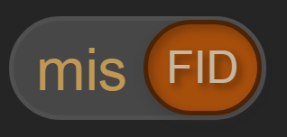

Tools for e-trading supervision

Slide 5
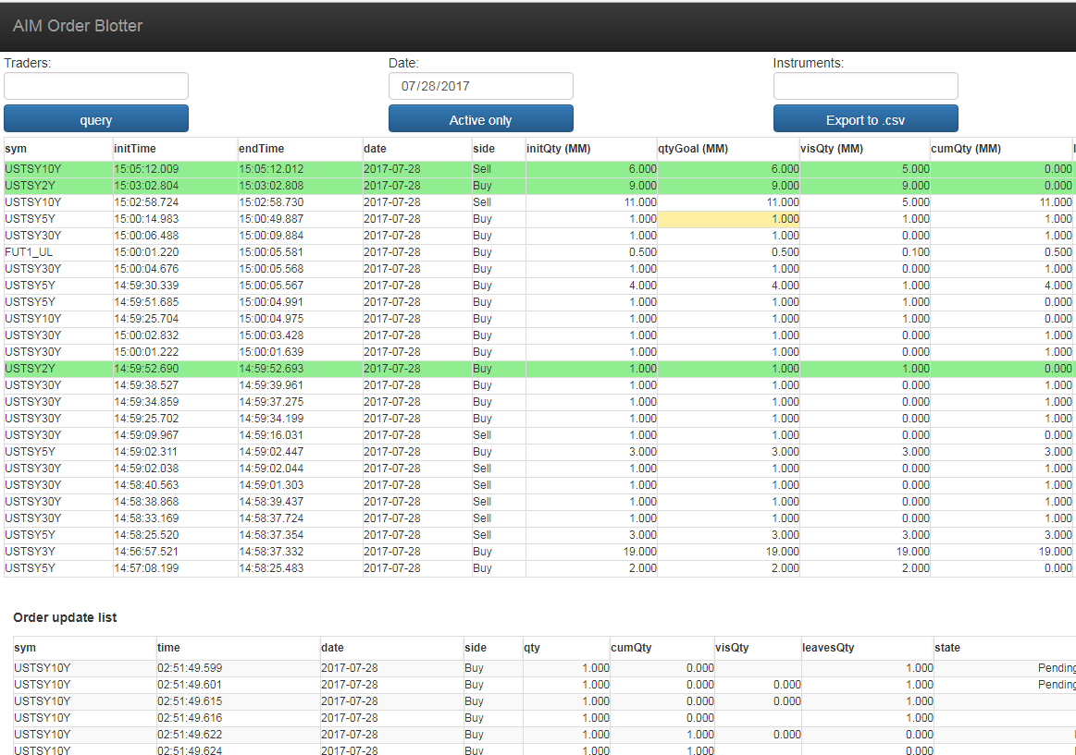
AIM Order Blotter

Slide 6
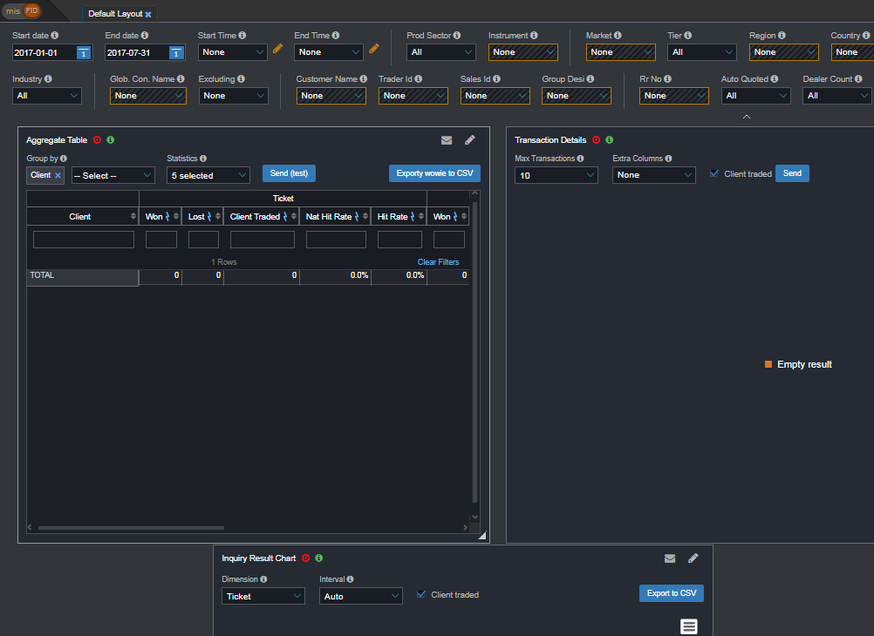
misFID Platform

Slide 7
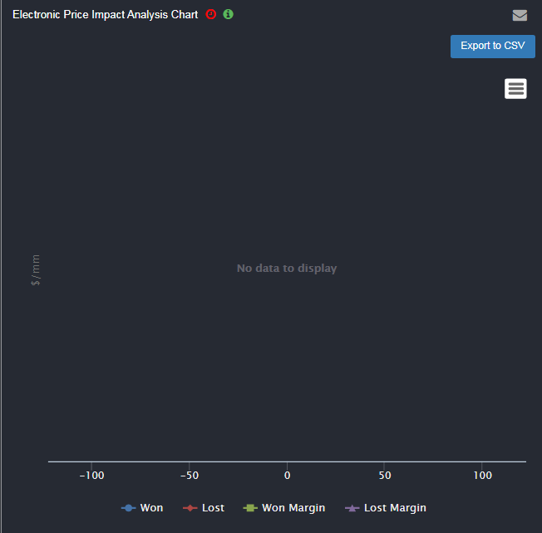

Widgets already in misFID platform

Slide 8
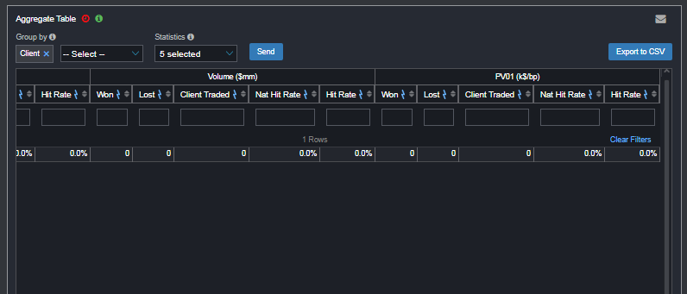
Widgets already in misFID platform

Slide 9
Problem
Standalone website, not in misFID Platform

Slide 11



How?

Slide 12
AIM Order Blotter

Slide 13
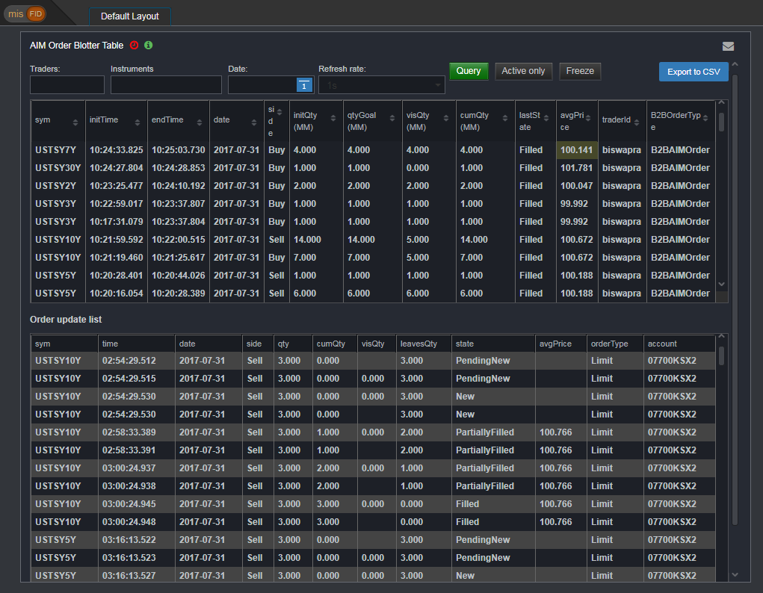

Slide 14
Why is it important?

Slide 15
Why is it important?
Automated Inventory Management Order Blotter – Used by traders to monitor automated trades, prevent disaster
Improves Efficiency
Traders no longer have to resort to using separate site
Evolution
Code is more readable, less redundant
Safer from bugs
Ready for change

Slide 16

Less of this..

Slide 17

…and more of this!

Slide 18
Takeaways & Acknowledgements
Learned how to build a website from the ground up
User Experience (UX) and User Interface (UI) exposure, Front + Back End development
Communication with a team across seas
Implemented a product in a platform with 200+ users
Learned a lot!
Special thanks to the NYC &
Budapest BMET team (Józsi, Aditi, Nora, Nusa, and others)
Human Resources Team,
and my manager, Robin Payne

Slide 19

Questions?

