Slide 1

How to make your own Discord Bot using Node.js and discord.js
William Santosa
Prof. Moulds
CSE 185S W2023
Notes:
Hi, my name is William Santosa. Today, I will be introducing you to developing a bot on a platform many of us consider to be an integral part of our lives. In other words, I will be teaching you all how to start making your very own discord bot.

Slide 2
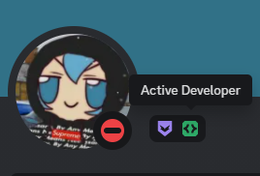
Why make a discord bot?
Automate repetitive or difficult tasks
Skills gained are applicable to other areas
Full Stack Web Applications
Other bots (Slack, WhatsApp bots, etc)
You get a cool profile badge! ☺
Fig. 1: Active Developer badge screenshot.
Notes:
So, before we start, I want to talk about why we should even make a bot in the first place. First of all, discord bots are useful in automating repetitive and difficult tasks. For example, I recently developed a bot that facilitated League of Legends 5v5 custom matches and stored player information in a relational database. After completing it, my friends and I were able to track our matches and create balanced teams with data-proven statistics. Secondly, the skills gained from developing a bot is very much so applicable to other areas of programming. For example, depending on the bot you develop you will have to work with backend and frontend components, which is useful in full stack web applications. Additionally, creating a bot on discord is very similar to creating a bot on other platforms like Slack, and development on chat bots will help you develop other kinds of bots much more easily, like WhatsApp chat bots.
As a bonus, you can also claim a cool profile badge that shows others the hard work you put into creating your bot.

Slide 3
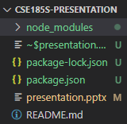
Setting Up
Download JavaScript and Node.js if you haven’t already
Run the following commands in the project directory
npm init
npm install discord.js
Fig. 2: Directory after running commands.
Notes:
Now, let’s learn how to set up our environment for developing the discord bot.
Firstly, download JavaScript and Node.js if you haven’t already. You can follow the link later to download them.
Next, assuming that your package manager is npm, run “npm init” in the project folder. Alternatively, you might have installed node using another manager like yarn or pnpm. In that case, run that package manager name then init instead. After that, run npm install discord.js to install the required node modules and add it as a dependency to your project.json file.
After running the commands, your directory should look like the screenshot displayed on the screen, minus the presentation and README file.

Slide 4
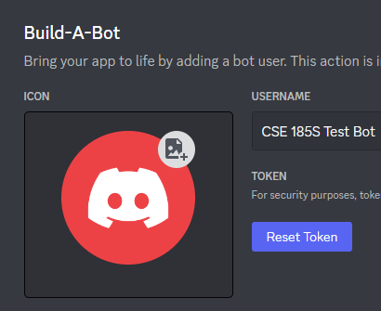
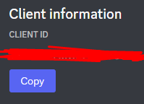
Setting Up (2)
Go to the discord developer portal
Click “New Application” -> Enter details -> Create
Press Bot -> Add Bot -> Reset Token -> Save the token
Press OAuth2 -> General -> Copy Client ID -> Save the Client ID
Fig. 3: Token screenshot.
Fig. 4: Client ID screenshot.

Slide 5
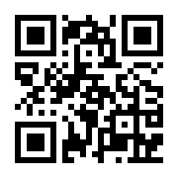
Questions/Answers
~ Class Discord ~ https://discord.gg/bebqR6wAzA

Slide 6
References
Fig. 1: Santosa, William. “Active Developer badge screenshot.” Online, 16 Jan. 2023. Accessed 16 Jan. 2023.
Fig. 2: Santosa, William. “Directory after running commands screenshot.” Online, 16 Jan. 2023. Accessed 16 Jan. 2023.

