Slide 1

How to make your own Discord Bot using Node.js and discord.js
William Santosa
Prof. Moulds
CSE 185S W2023
Notes:
Hi, my name is William Santosa. Today, I will be introducing you to developing a bot on a platform many of us consider to be an integral part of our lives. In other words, I will be teaching you all how to start making your very own discord bot.

Slide 2
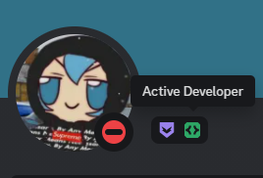
Why make a discord bot?
Automate repetitive or difficult tasks
Skills gained are applicable to other areas
Full Stack Web Applications
Other bots (Slack, WhatsApp bots, etc)
You get a cool profile badge! ☺
Fig. 1: Active Developer badge screenshot.
Notes:
So, before we start, I want to talk about why we should even make a bot in the first place. First of all, discord bots are useful in automating repetitive and difficult tasks. For example, I recently developed a bot that facilitated League of Legends 5v5 custom matches and stored player information in a relational database. After completing it, my friends and I were able to track our matches and create balanced teams with data-proven statistics. Secondly, the skills gained from developing a bot is very much so applicable to other areas of programming. For example, depending on the bot you develop you will have to work with backend and frontend components, which is useful in full stack web applications. Additionally, creating a bot on discord is very similar to creating a bot on other platforms like Slack, and development on chat bots will help you develop other kinds of bots much more easily, like WhatsApp chat bots.
As a bonus, you can also claim a cool profile badge that shows others the hard work you put into creating your bot.

Slide 3
Prerequisites
Some JavaScript knowledge
Some command line knowledge
(Optional) Full Stack experience
(Optional) Bot development experience

Slide 4
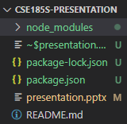
Setting up the Repository
Download JavaScript and Node.js if you haven’t already
Run the following commands in the project directory
npm init
npm install discord.js
Fig. 2: Directory after running commands.
Notes:
Now, let’s learn how to set up our environment for developing the discord bot.
Firstly, download JavaScript and Node.js if you haven’t already. You can follow the link later to download them.
Next, assuming that your package manager is npm, run “npm init” in the project folder. Alternatively, you might have installed node using another manager like yarn or pnpm. In that case, run that package manager name then init instead. After that, run npm install discord.js to install the required node modules and add it as a dependency to your project.json file.
After running the commands, your directory should look like the screenshot displayed on the screen, minus the presentation and README file.

Slide 5
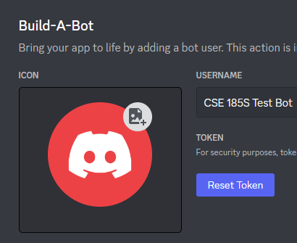
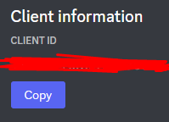
Authenticating the Bot
Go to the discord developer portal
Click “New Application” -> Enter details -> Create
Press Bot -> Add Bot -> Reset Token -> Save the token
Press OAuth2 -> General -> Copy Client ID -> Save the Client ID
Fig. 3: Token screenshot.
Fig. 4: Client ID screenshot.

Slide 6
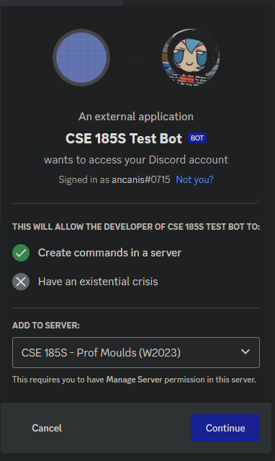
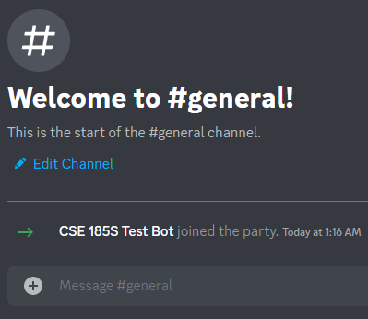
Adding the bot to your server
Press OAuth2 -> URL Generator
Check “bot” under SCOPES
Check “Administrator” under BOT PERMISSIONS
Copy the generated URL and invite it to your server
Fig. 5: Join message.
Fig. 6: Invitation screenshot.

Slide 7
Creating a few new files/folders
Create the following files in our project repository
deploy-commands.js
index.js
config.json
Create the following folders in our project repository
commands

Slide 8
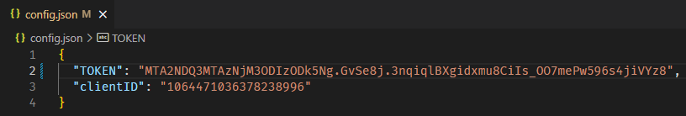
Creating the config.json (config file)
Create a config.json file in your project directory
Add your bot’s token and clientID to the config.json file
**MAKE SURE TO NOT UPLOAD THIS PUBLIC TO INTERNET** (use .gitignore to prevent accidentally pushing this to your token and clientID to repository)
Fig. 7: config.json file located in project directory.

Slide 9
Creating the index.js file (main file) (adapted source code)
// Require the necessary discord.js classes
const { Client, Events, GatewayIntentBits } = require('discord.js');
const { TOKEN } = require('./config.json');
// Create a new client instance
const client = new Client({ intents: [GatewayIntentBits.Guilds] });
// When the client is ready, run this code (only once)
// We use 'c' for the event parameter to keep it separate from the already defined 'client'
client.once(Events.ClientReady, c => {
console.log(`Ready! Logged in as ${c.user.tag}`);
});
// Log in to Discord with your client's token
client.login(TOKEN);

Slide 10
Creating the index.js file 2 (main file) (adapted source code)
const fs = require('node:fs');
const path = require('node:path');
client.commands = new Collection();
for (const file of commandFiles) {
const filePath = path.join(commandsPath, file);
const command = require(filePath);
// Set a new item in the Collection with the key as the command name and the value as the exported module
if ('data' in command && 'execute' in command) {
client.commands.set(command.data.name, command);
} else {
console.log(`[WARNING] The command at ${filePath} is missing a required "data" or "execute" property.`);
}
}

Slide 11
Creating the index.js file 3 (main file) (adapted source code)
client.on(Events.InteractionCreate, async interaction => {
if (!interaction.isChatInputCommand()) return;
const command = interaction.client.commands.get(interaction.commandName);
if (!command) {
console.error(`No command matching ${interaction.commandName} was found.`);
return;
}
try {
await command.execute(interaction);
} catch (error) {
console.error(error);
await interaction.reply({ content: 'There was an error while executing this command!', ephemeral: true });
}
});

Slide 12
Creating the deploy-commands.js file (deploy file) (adapted source code)
const { REST, Routes } = require('discord.js');
const { clientID, TOKEN } = require('./config.json');
const fs = require('node:fs');
const commands = [];
// Grab all the command files from the commands directory you created earlier
const commandFiles = fs.readdirSync('./commands').filter(file => file.endsWith('.js'));
// Grab the SlashCommandBuilder#toJSON() output of each command's data for deployment
for (const file of commandFiles) {
const command = require(`./commands/${file}`);
commands.push(command.data.toJSON());
}

Slide 13
Creating the deploy-commands.js file 2 (deploy file) (adapted source code)
// Construct and prepare an instance of the REST module
const rest = new REST({ version: '10' }).setToken(TOKEN);
// and deploy your commands!
(async () => {
try {
console.log(`Started refreshing ${commands.length} application (/) commands.`);
// The put method is used to fully refresh all commands in the guild with the current set
const data = await rest.put(
Routes.applicationCommands(clientID),
{ body: commands },
);
console.log(`Successfully reloaded ${data.length} application (/) commands.`);
} catch (error) {
// And of course, make sure you catch and log any errors!
console.error(error);
}
})();

Slide 14
Adding a slash command (hi.js) (adapted source code)
const { SlashCommandBuilder } = require('discord.js');
module.exports = {
data: new SlashCommandBuilder()
.setName('hi')
.setDescription('Responds with hello.'),
async execute(interaction) {
// interaction.user is the object representing the User who ran the command
// interaction.member is the GuildMember object, which represents the user in the specific guild
await interaction.reply(`Hello!`);
},
};

Slide 15
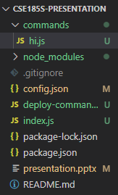
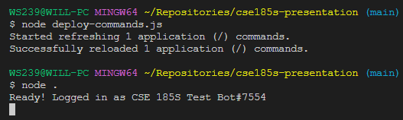
Directory Structure & Running the bot
Verify that your program structure looks the same
Run the following commands in project directory
node deploy-commands.js
node .
Fig. 9: Command line commands.
Fig. 8: Project directory.

Slide 16
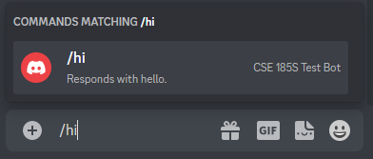
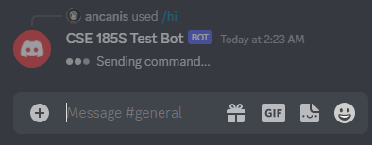
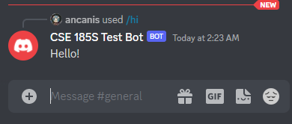
What it should look like
Fig. 10: Command prompt.
Fig. 11: Sending command.
Fig. 12: Response.

Slide 17
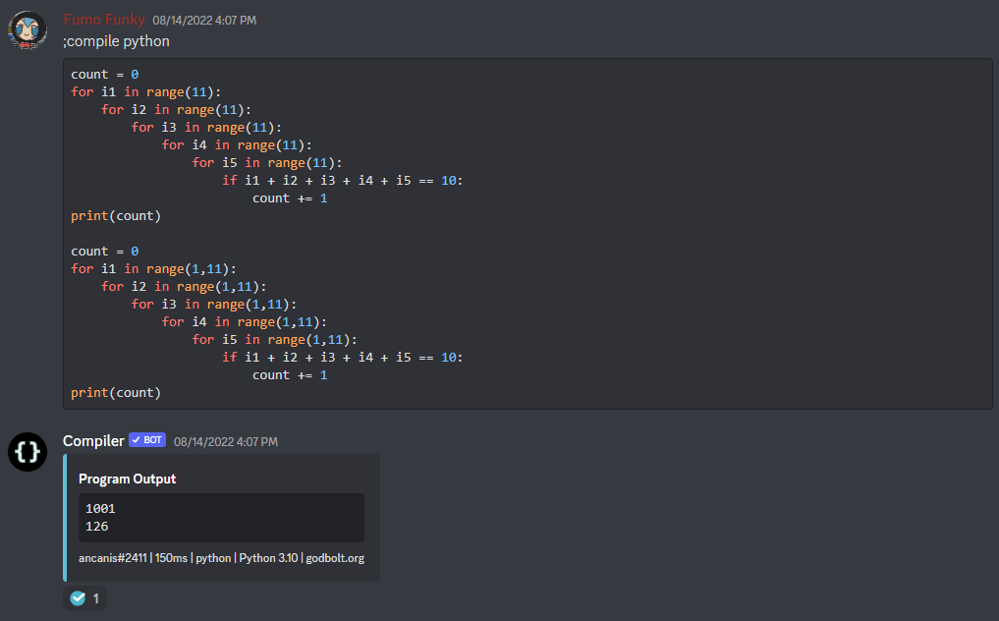
Examples
Fig. 13: Compiler bot.

Slide 18
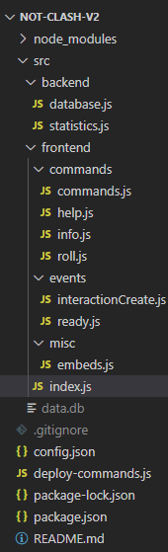
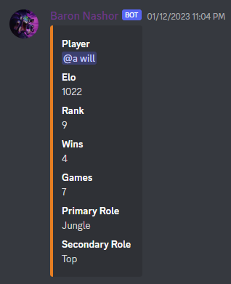
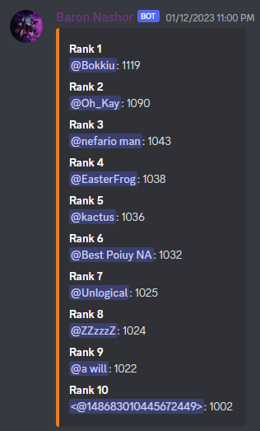
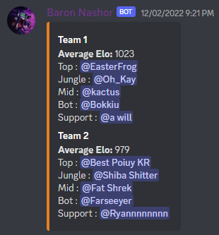
Examples
Fig. 16: Stats.
Fig. 14: Team creation.
Fig. 15: Leaderboard.
Fig. 17: Project repository.

Slide 19
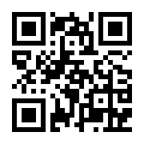
Questions/Answers
~ Class Discord ~ https://discord.gg/bebqR6wAzA

Slide 20
References
“Discord.js Guide.” Introduction | Discord.js Guide, https://discordjs.guide/.
“Discord Developer Portal.” Discord, https://discord.com/developers/docs/reference.
Figs. 1-17: Santosa, William. Assorted screenshots. Online, 16 Jan. 2023.

