Slide 1

How to make your own Discord Bot using Node.js and discord.js
William Santosa
Prof. Moulds
CSE 185S W2023
Notes:
Hi, my name is William Santosa and today, I will be teaching you all how to start developing your very own discord bot with Node and discord.js.

Slide 2

What is a discord bot?
A programmable user operating within a discord server that performs actions, automates tasks, and responds to events
Notes:
Before we start, I want to give a brief introduction on what a discord bot really is. From my experience in making these bots and google definitions, a discord bot is a programmable user operating within a discord server that performs actions, automates tasks, and responds to events. A high-level abstractive description of a discord bot would be a user in your server that when given an input, responds with a message.

Slide 3
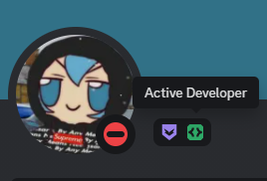
Why make a discord bot?
Decreases manual workload
Skills gained are applicable to other areas
Full Stack Web Applications
Other bots (Slack, WhatsApp bots, etc)
You get a cool profile badge! ☺
Fig. 1: Active Developer badge screenshot.
Notes:
So, why should we make a discord bot in the first place? Are they even useful? Well, they certainly are. First of all, discord bots are useful in automating repetitive and difficult tasks, which in turn decreases manual workload. For example, I recently developed a bot that facilitated League of Legends 5v5 custom matches and stored player information in a relational (MySQL) database. After completing it, my friends and I were able to track our matches and create balanced teams with data-proven statistics. Secondly, the skills gained from developing a bot is very much so applicable to other areas of programming. For example, depending on the bot you develop you will have to work with backend and frontend components, which is useful in full stack web applications. Additionally, creating a bot on discord is very similar to creating a bot on other platforms like Slack, and development on chat bots will help you develop other kinds of bots much more easily, like WhatsApp chat bots.
As a bonus, you can also claim a cool profile badge that shows others the hard work you put into creating your bot. The green badge that you see in the screenshot on the right is that badge.

Slide 4
Discord.py vs discord.js
Python
Faster to start with, but less flexible
Discord.py has been deprecated as of Aug 2021
JavaScript
More flexible
More options
Still being maintained and updated
Less documentation to read
Better available documentation
Notes:
Next, I want to talk about a popular question that almost everyone who has started developing discord bots has asked before. Should I use Python or JavaScript to make my discord bot? Having worked with both libraries, I believe that JavaScript is much better than Python to develop discord bots in. However, I will list out some pros and cons to both. To summarize, Python is faster to start with, as there is less documentation to read and code to write. However, the inherent messiness of Python code, its libraries, and event handling makes it much worse for larger project scopes. Additionally, the API wrapper for Python has been deprecated as of August 2021, meaning it will no longer be maintained or receive updates.
JavaScript is also a much more flexible option, as you can modularize your code in a very easy-to-follow and concise manner. Additionally, JavaScript also has a lot of options that Python doesn’t have, like select menus and Embedded message builders, and has much better documentation / API reference compared to Python. Plus, it is still being maintained and updated by its very active developer community.
In the end, both are good for their own separate use cases. Python is good if you want to make a small project and aren’t planning on developing on discord long-term. However, JavaScript is a much better option if you are planning on doing anything bigger than a simple bot, which is why I opted to teach you all with JavaScript instead of Python.

Slide 5
Prerequisites
Some JavaScript knowledge
Some command line (BASH) knowledge
(Optional) Full Stack experience
(Optional) Bot development experience
Notes:
Before we do anything else, I want to talk about some prerequisites for this tutorial. There isn’t much, but it is very useful to have at least the first two of these requirements.
The first is knowing some JavaScript so that the code is easy to follow.
Second is having some bash knowledge so that you can run commands, although even this isn’t really required.
And then some useful things to have would be full stack and bot development experience, as you can decide how to modularize your code for easier editing and clarity.

Slide 6
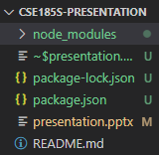
Setting up the Repository
Download JavaScript and Node.js if you haven’t already
Run the following commands in the project directory
npm init
npm install discord.js
Fig. 2: Directory after running commands.
Notes:
Now, let’s learn how to set up our environment for developing the discord bot.
Firstly, download JavaScript and Node.js if you haven’t already. You can follow the link later to download them.
Next, assuming that you’re using node package manager, run “npm init” in the project folder. Alternatively, you might have installed node using another manager like yarn or pnpm. In that case, run the equivalent command instead. Most likely, it’s the package manager’s acronym followed by a space and then “init”. Then, run npm install discord.js to install the required node modules and add it as a dependency to your project.json file.
After running the commands, your directory should look like the screenshot displayed on the screen, save for the presentation and README file.

Slide 7
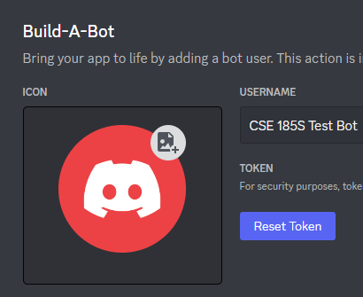
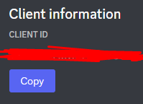
Authenticating the Bot
Go to the discord developer portal
Click “New Application” -> Enter details -> Create
Press Bot -> Add Bot -> Reset Token -> Save the token
Press OAuth2 -> General -> Copy Client ID -> Save the Client ID
Fig. 3: Token screenshot.
Fig. 4: Client ID screenshot.
Notes:
After that, we want to make sure we want to authenticate the bot. That means we need to grab the bot’s authentication token and client id and save it somewhere else.
To do that, we first head to the discord developer portal while logged in. Then, click new application, enter the name and details, and then press create. Following that, press bot, add bot, reset token, then save that token somewhere. To get the client id, press OAuth2, general, copy client id, and save the client id.

Slide 8
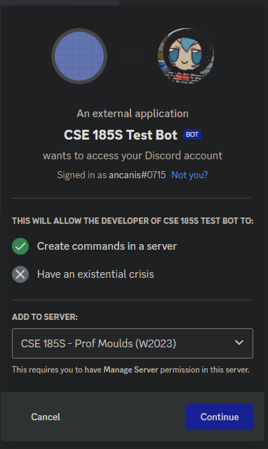
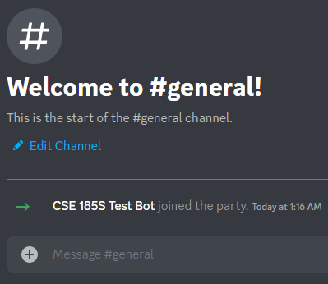
Adding the bot to your server
Press OAuth2 -> URL Generator
Check “bot” under SCOPES
Check “Administrator” under BOT PERMISSIONS
Copy the generated URL and invite it to your server
Fig. 5: Join message.
Fig. 6: Invitation screenshot.
Notes:
Then we can add this new user, the bot, to the server. Press OAuth2 then URL generator, check bot under SCOPES, check administrator under BOT PERMISSIONS (you may want to edit this when making your own bot later), then copy the generated URL and visit it to invite it to your server.

Slide 9
Creating a few new files/folders
Create the following files in our project repository
deploy-commands.js
index.js
config.json
Create the following folders in our project repository
commands
Notes:
From there, we must create a few new files and folders to finish setting everything up.
Create the deploy-commands.js, index.js, and config.json file in the project repository. Then create a folder called commands as well.

Slide 10
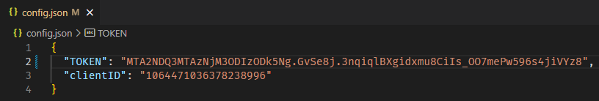
Creating the config.json (config file)
Create a config.json file in your project directory
Add your bot’s token and clientID to the config.json file
**MAKE SURE TO NOT UPLOAD THIS PUBLIC TO INTERNET** (use .gitignore to prevent accidentally pushing this to your token and clientID to repository)
Fig. 7: config.json file located in project directory.
Notes:
Following that, we work on populating the config.json file with the aforementioned authentication token and ClientID above. Note that you shouldn’t publish this to the internet, so if you are pushing this to a public repository, be sure not to add the version of the config.json file which contains your token and client id.

Slide 11
Creating the index.js file (main file) (adapted source code)
// Require the necessary discord.js classes
const { Client, Events, GatewayIntentBits } = require('discord.js');
const { TOKEN } = require('./config.json');
// Create a new client instance
const client = new Client({ intents: [GatewayIntentBits.Guilds] });
// When the client is ready, run this code (only once)
// We use 'c' for the event parameter to keep it separate from the already defined 'client'
client.once(Events.ClientReady, c => {
console.log(`Ready! Logged in as ${c.user.tag}`);
});
// Log in to Discord with your client's token
client.login(TOKEN);
Notes:
Now we need to make the index.js file which is the file ran when starting up your discord bot. What the code above is doing is grabbing the token we have saved in the config.json file, creating a new client logs in using that token, and when the client is loaded, it sends a message to the console that you have logged in.

Slide 12
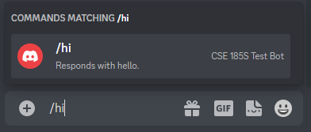
What is a slash command?
Notes:
Now before we move on, we should know what a slash command is. Basically, a slash command is a way to give the bot an input. There are a number of ways to use the slash command, allowing for optional and required arguments, but that’s just the basic gist of it.

Slide 13
Creating the index.js file 2 (main file) (adapted source code)
const fs = require('node:fs');
const path = require('node:path');
client.commands = new Collection();
for (const file of commandFiles) {
const filePath = path.join(commandsPath, file);
const command = require(filePath);
// Set a new item in the Collection with the key as the command name and the value as the exported module
if ('data' in command && 'execute' in command) {
client.commands.set(command.data.name, command);
} else {
console.log(`[WARNING] The command at ${filePath} is missing a required "data" or "execute" property.`);
}
}
Notes:
Now, we add support for the slash commands to the main file. What this is doing is looking through the commands folder that we have previous initialized and checking if both the ‘data’ and ‘execute’ keys are in the exported module object. If it exists, then the client sets the slash command so that it can later be used in the discord server. If not, then it will send a warning message into the console.

Slide 14
Creating the index.js file 3 (main file) (adapted source code)
client.on(Events.InteractionCreate, async interaction => {
if (!interaction.isChatInputCommand()) return;
const command = interaction.client.commands.get(interaction.commandName);
if (!command) {
console.error(`No command matching ${interaction.commandName} was found.`);
return;
}
try {
await command.execute(interaction);
} catch (error) {
console.error(error);
await interaction.reply({ content: 'There was an error while executing this command!', ephemeral: true });
}
});
Notes:
Then, we create an event where it checks for every chat message that the bot is in, it will check if that chat message is an input command, or in other words, a slash command. If so, then it will check if the command exists, and if it does, then it will execute the code that is associated with the command.

Slide 15
Creating the deploy-commands.js file (deploy file) (adapted source code)
const { REST, Routes } = require('discord.js');
const { clientID, TOKEN } = require('./config.json');
const fs = require('node:fs');
const commands = [];
// Grab all the command files from the commands directory you created earlier
const commandFiles = fs.readdirSync('./commands').filter(file => file.endsWith('.js'));
// Grab the SlashCommandBuilder#toJSON() output of each command's data for deployment
for (const file of commandFiles) {
const command = require(`./commands/${file}`);
commands.push(command.data.toJSON());
}
Notes:
To create the deploy-commands.js file and display the commands on discord, we import the required modules and look through our command folder for all of the available commands. Then, it pushes it the commands array for later usage.

Slide 16
Creating the deploy-commands.js file 2 (deploy file) (adapted source code)
// Construct and prepare an instance of the REST module
const rest = new REST({ version: '10' }).setToken(TOKEN);
// and deploy your commands!
(async () => {
try {
console.log(`Started refreshing ${commands.length} application (/) commands.`);
// The put method is used to fully refresh all commands in the guild with the current set
const data = await rest.put(
Routes.applicationCommands(clientID),
{ body: commands },
);
console.log(`Successfully reloaded ${data.length} application (/) commands.`);
} catch (error) {
// And of course, make sure you catch and log any errors!
console.error(error);
}
})();
Notes:
This code then constructs a REST module and deploys the commands to our bot. This allows users to use the command and have it actually be displayed when typing slash and then the command name on discord.

Slide 17
Adding a slash command (hi.js) (adapted source code)
const { SlashCommandBuilder } = require('discord.js');
module.exports = {
data: new SlashCommandBuilder()
.setName('hi')
.setDescription('Responds with hello.'),
async execute(interaction) {
// interaction.user is the object representing the User who ran the command
// interaction.member is the GuildMember object, which represents the user in the specific guild
await interaction.reply(`Hello!`);
},
};
Notes:
Finally, we add a simple slash command to our commands folder. This is just a simple program called “hi” with a description of “Responds with hello” and replies with “Hello!” to the user who used the command. Note that we need two key fields in our export, data and execute, which is later files we mentioned before to create interactions with the user.

Slide 18
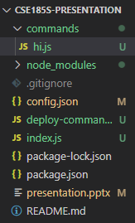
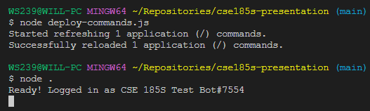
Directory Structure & Running the bot
Verify that your program structure looks the same
Run the following commands in project directory
node deploy-commands.js
node .
Fig. 9: Command line commands.
Fig. 8: Project directory.
Notes:
After completing all of these steps, you should have a directory that looks like figure 8 and running the commands
node deploy-commands.js
node .
Should deploy the commands and start up the bot.

Slide 19
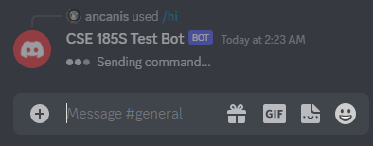
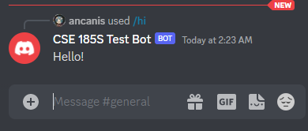
Running the commands on your Discord Server
Fig. 10: Command prompt.
Fig. 11: Sending command.
Fig. 12: Response.
Notes:
And this is what running the commands on your discord server should look like. If you type /hi, it should display the name of the command, the description, and the bot that is executing the command. Then, you’ll see a prompt which states that it’s still processing the command, followed by a response of “Hello!”

Slide 20
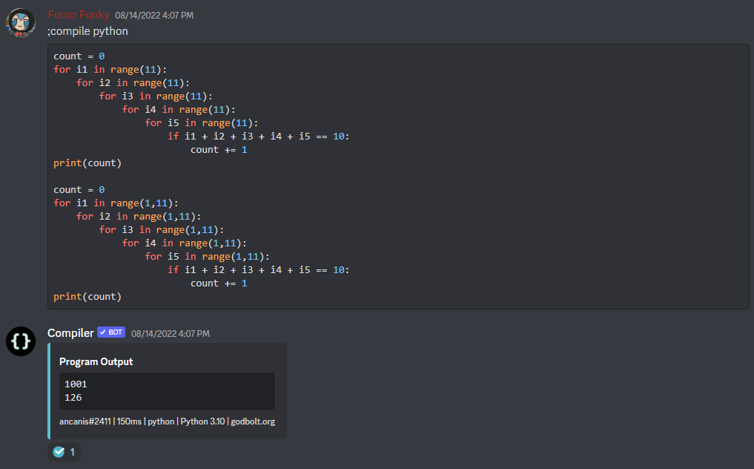
Examples
Fig. 13: Compiler bot.
Notes:
This is an example of a compiler bot. You write a program in a code block and then by using the command compile, you can get an output in chat. In this example specifically, I am compiling a bad python for loop and printing the result.

Slide 21
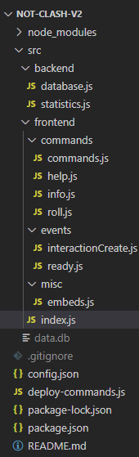
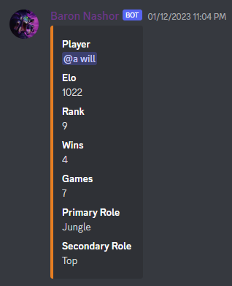
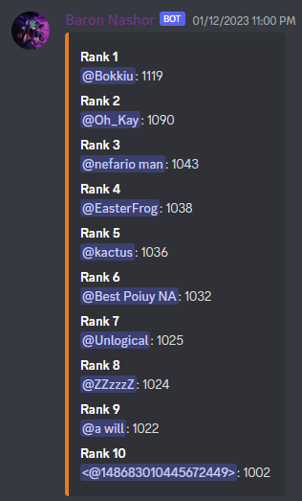
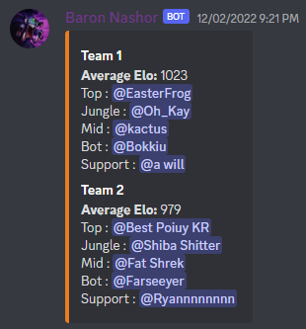
Examples
Fig. 16: Stats.
Fig. 14: Team creation.
Fig. 15: Leaderboard.
Fig. 17: Project repository.
Notes:
This one is a project I was working on. I mentioned earlier I made a League of Legends bot that facilitated 5v5 custom matches and stored them in a relational database. These are some of the replies that the bot sends when dealing with the commands, and on the right is the project that I’m currently working on which is basically just expanding the functionality and clarity of the bot.

Slide 22
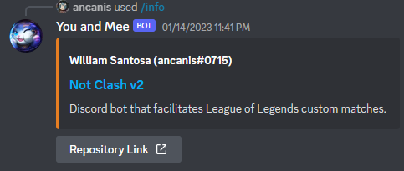
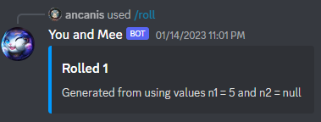
Examples
Fig. 18: Information message.
Fig. 19: Roll a dice command.

Slide 23
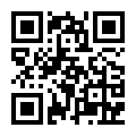
Questions/Answers
~ Class Discord ~ https://discord.gg/bebqR6wAzA
Notes:
And that concludes my presentation. Does anyone have any questions?

Slide 24
References
“Discord.js Guide.” Introduction | Discord.js Guide, https://discordjs.guide/.
“Discord Developer Portal.” Discord, https://discord.com/developers/docs/reference.
Figs. 1-19: Santosa, William. Assorted screenshots. Online, 16 Jan. 2023.

