Slide 1
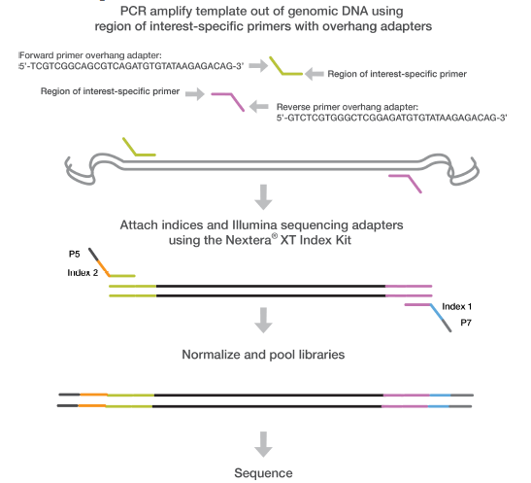
Notes:
An overview of Illumina’s 16S workflow. From the library prep guide.

Slide 2


515F_mod: TCGTCGGCAGCGTCAGATGTGTATAAGAGACAGGTGCCAGCMGCCGCGGTAA
Overhang adaptors
Region-of-interest specific primers
806R_mod: GTCTCGTGGGCTCGGAGATGTGTATAAGAGACAGGGACTACHVGGGTWTCTAAT
Notes:
The primers we used for round 1 PCR, with overhang adaptors and region-specific primers in different colored boxes.
Our raw MiSeq data (.fastq files delivered from sequencing center) still have the region-specific primers (I assumer overhang adaptors were trimmed off). You can see the forward primer (in green) at the beginning of read1 and the reverse primer (also in green) at the beginning of read2 of a read pair.

Slide 3
Run make.contigs
Create oligos file to give Mothur the primer sequences we want to trim
Run trim.seqs
Notes:
How can we get rid of these primer sequences? Mothur has tools to help.
http://www.mothur.org/wiki/Main_Page
From the forums: http://www.mothur.org/forum/viewtopic.php?f=3&t=3831&p=12191&hilit=primer#p12191

Slide 4
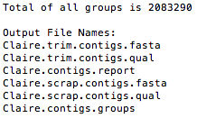
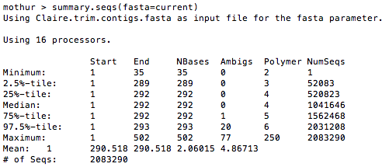
Run make.contigs
Create oligos file to give Mothur the primer sequences we want to trim
Run trim.seqs
Notes:
Make.contigs command and output.
Note the longer than expected median sequence length (292). We sequenced the V4 region, so we expect ~250 bp sequences. (This was what initially clued us in that we needed to do some trimming.)

Slide 5
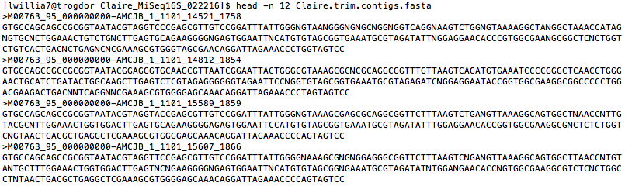
Run make.contigs
Create oligos file to give Mothur the primer sequences we want to trim
Run trim.seqs
515F_mod: TCGTCGGCAGCGTCAGATGTGTATAAGAGACAGGTGCCAGCMGCCGCGGTAA
Overhang adaptors
Region-of-interest specific primers
806R_mod: GTCTCGTGGGCTCGGAGATGTGTATAAGAGACAGGGACTACHVGGGTWTCTAAT
Notes:
If we look at the .fasta output from make.contigs (Claire.trim.contigs.fasta), we can see the forward and reverse primers at the end of the sequences. These need to be trimmed!

Slide 6

Run make.contigs
Create oligos file to give Mothur the primer sequences we want to trim
Run trim.seqs
515F_mod: TCGTCGGCAGCGTCAGATGTGTATAAGAGACAGGTGCCAGCMGCCGCGGTAA
Overhang adaptors
Region-of-interest specific primers
806R_mod: GTCTCGTGGGCTCGGAGATGTGTATAAGAGACAGGGACTACHVGGGTWTCTAAT
Notes:
Mothur needs a file of the primer sequences (an oligos file).

Slide 7

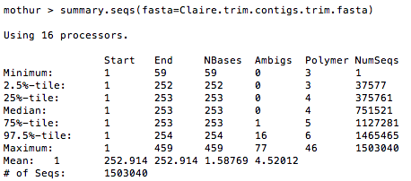
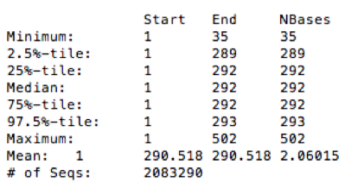
Run make.contigs
Create oligos file to give Mothur the primer sequences we want to trim
Run trim.seqs
Output from make.contigs for comparison
Notes:
Now we can run trim.seqs with the oligos file.
Our median sequence length is now 253, which looks a lot more reasonable.

Slide 8

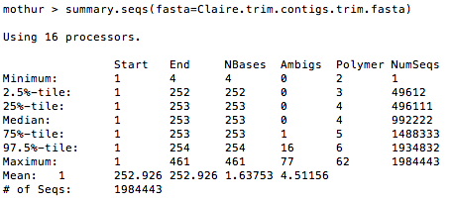
Run make.contigs
Create oligos file to give Mothur the primer sequences we want to trim
Run trim.seqs WITH PDIFFS=2 (allows up to 2 mismatches in primer sequences)
Output from make.contigs for comparison
Notes:
We can set the trim.seqs command to tolerate mismatches in the primer sequences, and we probably should do this to account for possible sequencing error in these regions. The forum post used pdiffs=2 (tolerates up to 2 mismatches), so we’ll do this.
In the output, median sequence length is still ~250 bp, so that’s good.
Notice that we have more sequences in total (# of Seqs) when we allowed mismatches vs when we didn’t (previous slide).

Slide 9

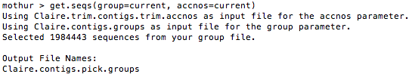

Run make.contigs
Create oligos file to give Mothur the primer sequences we want to trim
Run trim.seqs WITH PDIFFS=2 (allows up to 2 mismatches in primer sequences)
Create groups file (for screen.seqs) listing ONLY those sequences that had primers removed
Output from make.contigs
Output from get.seqs
Notes:
Following the forum post, we now want to construct a group that includes only those sequences for which primer sequences were successfully removed. (Maybe there’s a sequence with three errors in the primer regions, and so the primer sequences weren’t trimmed. We don’t want to include that in our downstream analysis.)
The list.seqs and get.seqs command creates a .groups file that we can use with the next step (screen.seqs).
Next step:
mothur > screen.seqs(fasta=Claire.trim.contigs.trim.fasta, group=Claire.contigs.pick.groups, maxambig=0, minlength=?, maxlength=275)
(Note: The fasta file for screen.seqs was generated by the trim.seqs command.)

