Slide 1
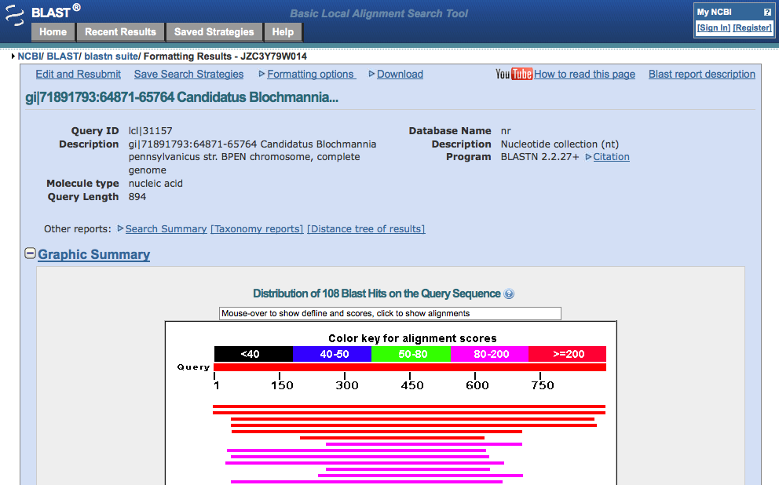
BLAST
(Basic Local Alignment Search Tool)
Notes:
one of most commonly used tools in genomics
powerful method to compare sequences from across the tree of life

Slide 2
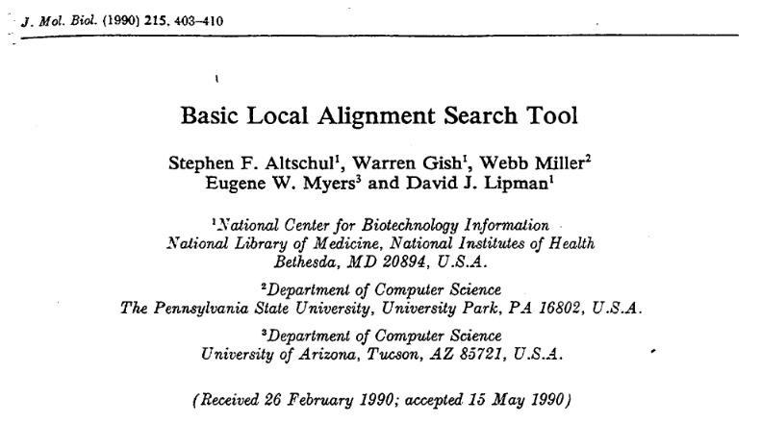
BLAST paper

Slide 3
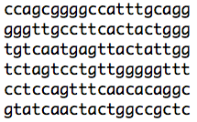
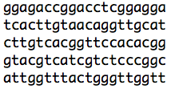
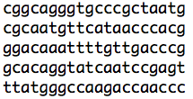
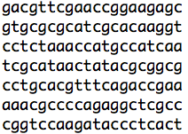
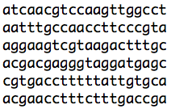

What does BLAST do?
Alignment program to find regions of similarity between sequences (both nucleotide and amino acid sequences)
GTTCATA
Notes:
simplified example of the purpose of BLAST - take an input sequence and match it against a very large database of sequences
enables incredibly fast searches of huge amounts of sequence data

Slide 4
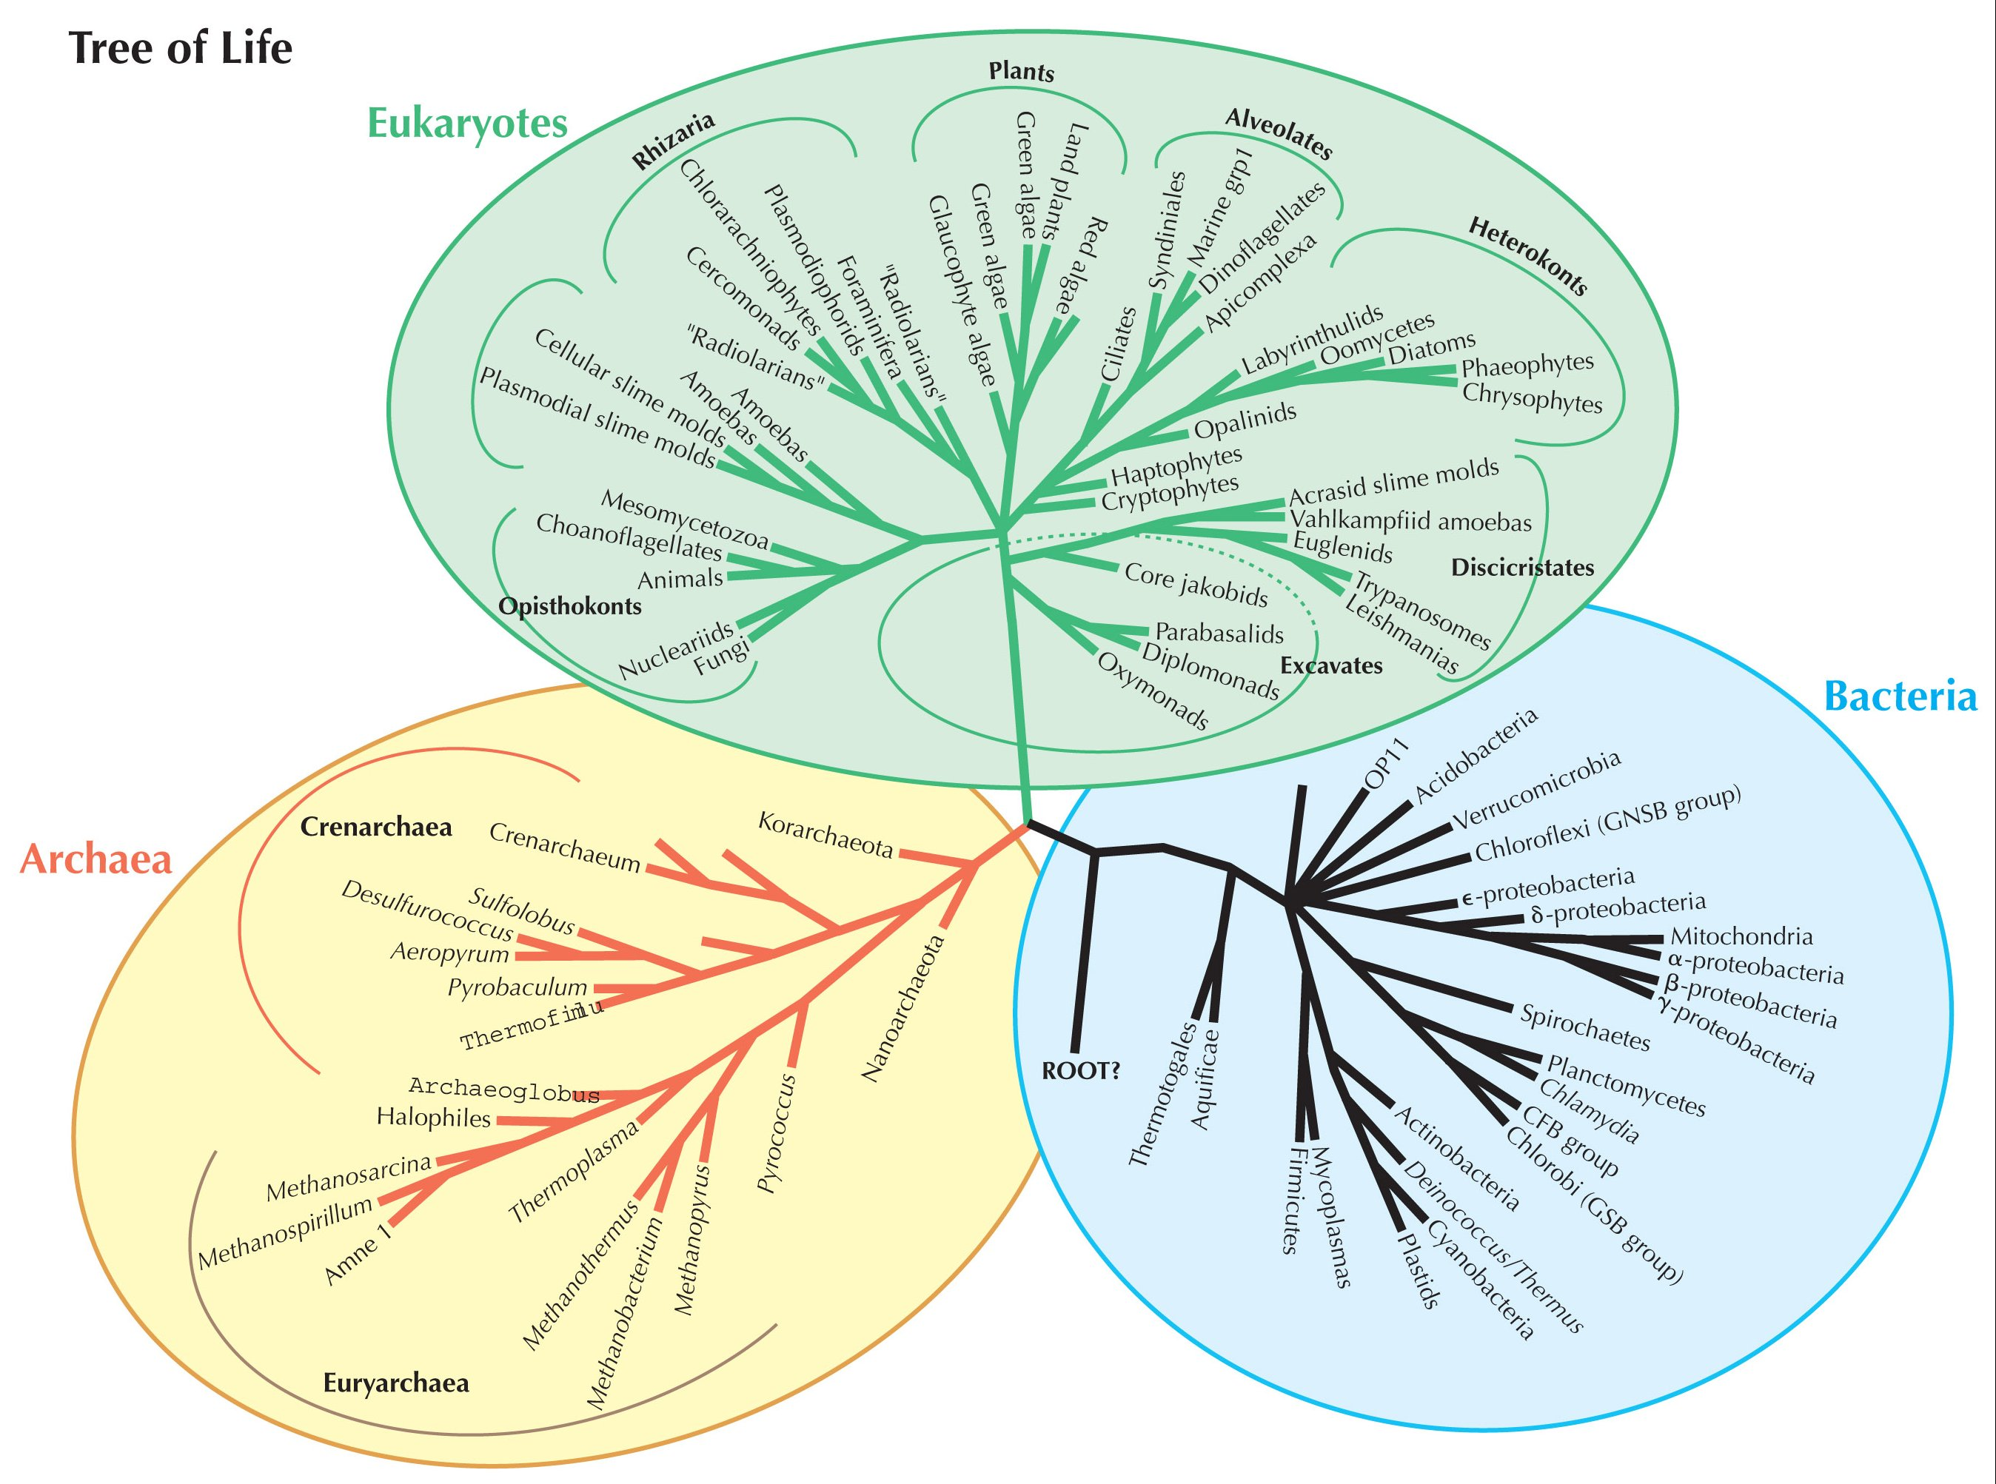
Why is BLAST important?
myoglobin
hemoglobin
protoglobin
Notes:
important tool to help us understand biodiversity and the evolution of life on Earth
for example, myoglobin and hemoglobin in humans - both are globins (heme-containing globular proteins that bind and transport molecular oxygen); myoglobin is found in muscle, and hemoglobin is found in blood
Protoglobin in globin protein in archaea

Slide 5
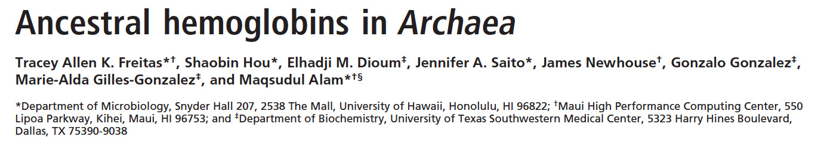
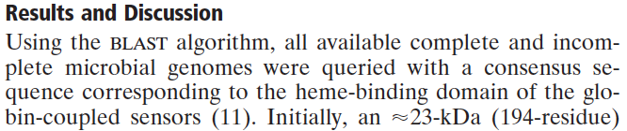
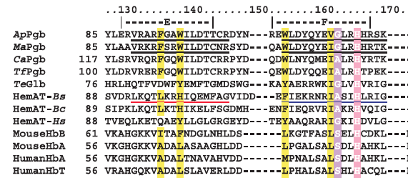
Evolution of human globins from archaeal protein?
Notes:
paper from Proceedings of National Academy of Sciences 2004
authors used BLAST to identify bacterial and archaeal protoglobins (possible ancestors of mammalian globin proteins)
Ap, Ma, HemAT-Hs - archaea
Ca, Tf, Te, HemAT-Bs, HemAT-Bc - bacteria
notice the type of sequence the authors are comparing (lining up = ‘alignment’) Is it a nucleotide or protein sequence?
Remember that there are 60 sense codons and only 20 amino acids…therefore, more than one codon can code for the same amino acid. For this reason, protein sequences are MORE conserved between different species than nucleotide sequences.

Slide 6
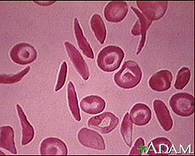
In “real time”: BLAST, hemoglobin and disease
Leu Thr Pro Glu Glu Lys Ser
Normal Hemoglobin (Hb A) CTG ACT CCT GAG GAG AAG TCT
Mutant Hemoglobin (Hb S) CTG ACT CCT GTG GAG AAG TCT
Leu Thr Pro Val Glu Lys Ser
Notes:
mutation in beta-hemoglobin results in sickled red blood cells

Slide 7
The basics of a BLAST search
Three parts to a BLAST search
The query (input sequence)
The subject (database of sequences)
The BLAST program

Slide 8

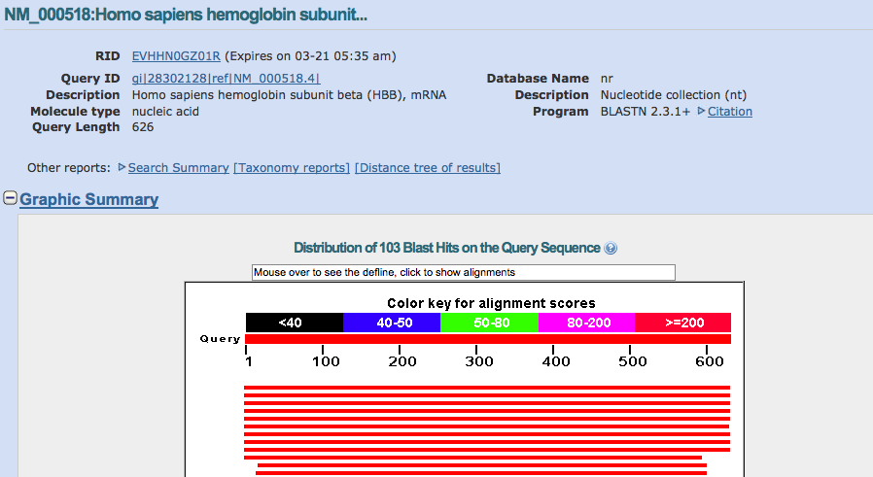
The basics of a BLAST search: the query
Query can be any nucleotide or protein sequence
(partial or full)
QUERY
RESULT

Slide 9

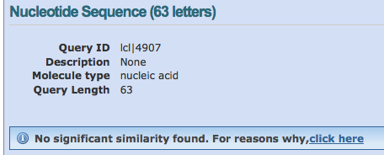
The basics of a BLAST search: the query
Query can be any nucleotide or protein sequence
(partial or full)
QUERY
RESULT
Notes:
but…if you put junk in, you will get junk out!

Slide 10
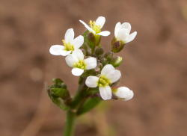
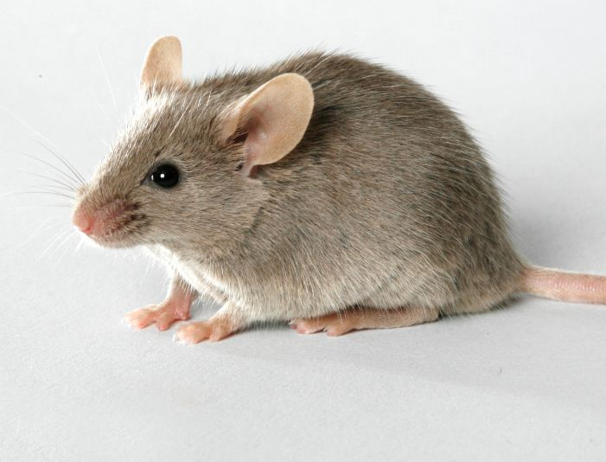
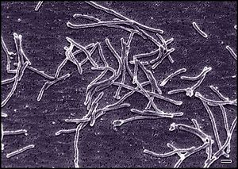

The basics of a BLAST search: the subject
GenBank database = Web-based book of life
Repository for almost ALL genes and genomes
ever sequenced
207,018,196,067 bp of sequence information in GenBank
6,973,738,433 people on Earth (2011)
Notes:
GenBank is incredible amount of DNA information about life on Earth freely available on the Web
Arabidopsis, mouse, Thermus aquaticus (bacteria), norovirus
GenBank numbers are for August 2012 - from Benson et al. 2013 NAR
population numbers are from World Bank 2011 estimate

Slide 11

The basics of a BLAST search: the BLAST program
How does BLAST match a query sequence to sequences within the GenBank database (subject)?
Step 1:
break the query sequence into subsets (or “words”)
partial sequence of plant phosphoglucomutase
example credit: Phil McClean (North Dakota State University)

Slide 12

The basics of a BLAST search: the BLAST program
How does BLAST match a query sequence to sequences within the GenBank database?
Step 2:
compare each word against sequence in database
plant phosphoglucomutase “words”
partial sequence of rabbit phosphoglucomutase
exact match isn’t necessary - instead, matches are
determined by a specific scoring matrix
example credit: Phil McClean (North Dakota State University)
Notes:
this step is done for each sequence in the database - incredibly fast search!
different scoring matrices have been developed using real sequence data…we won’t go into detail about the scoring matrix today

Slide 13
The basics of a BLAST search: the BLAST program
How does BLAST match a query sequence to sequences within the GenBank database?
Step 3:
extend match until score drops below certain value
partial sequence of plant phosphoglucomutase
NLYENFVQATFNALTAEKV
N+ EN++Q+ + + +
NYAENTIQSIISTVEPAQR
alignment
partial sequence of rabbit phosphoglucomutase
+ symbol means that the two amino acids
have similar chemical properties
example credit: Phil McClean (North Dakota State University)
Notes:
this process generates an alignment between the query sequence and the database or subject sequence
a little later, we will talk about how to use the BLAST score output to decide whether an alignment is “good” (meaningful)

Slide 14
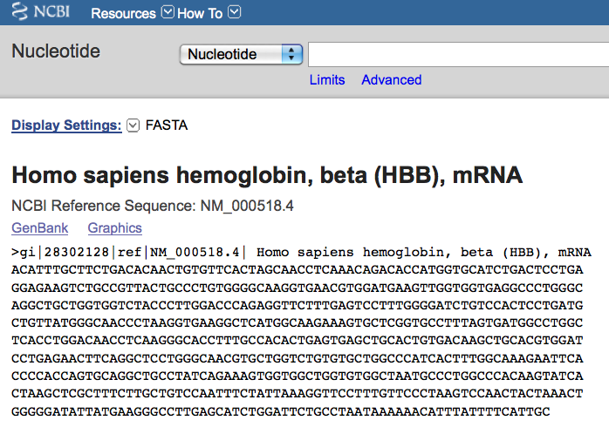
BLAST walk-through using beta-hemoglobin gene
Using BLAST, can we find related globin genes?

Slide 15
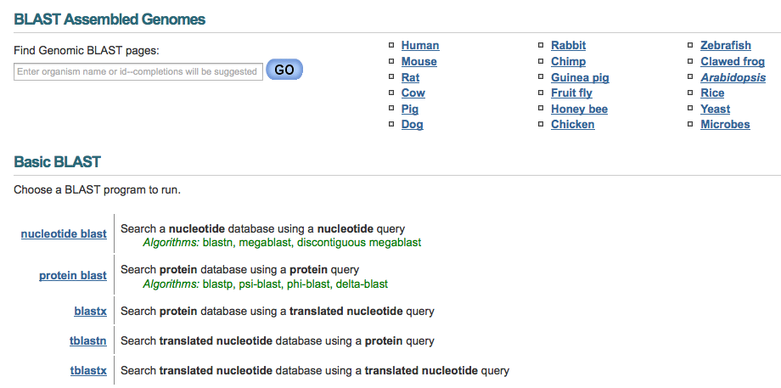
BLAST walk-through: the frontpage
blast.ncbi.nlm.nih.gov
Notes:
top section (BLAST assembled genomes) is used if you want to search against the whole genome of one particular species
for now we will use the larger GenBank database (instead of limiting ourselves to sequence data from one species only)
from this page, we will select one of the five available BLAST programs, depending on our needs

Slide 16
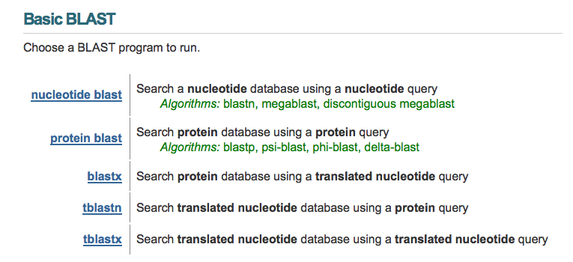
BLAST walk-through: the BLAST programs
Notes:
selecting a BLAST program depends on the kind of comparison you want to do
if you have a nucleotide sequence and you want to find similar nucleotide sequences in the GenBank database, use nucleotide BLAST (also known as BLASTN)
if you have a protein sequence and you want to find similar protein sequences in the GenBank database, use protein BLAST (also known as BLASTP)
the other three BLAST programs are helpful for broader searches; we will work through examples of these later
for this example, we will use nucleotide BLAST (BLASTN) to do a BLAST search with the human beta-hemoglobin gene

Slide 17
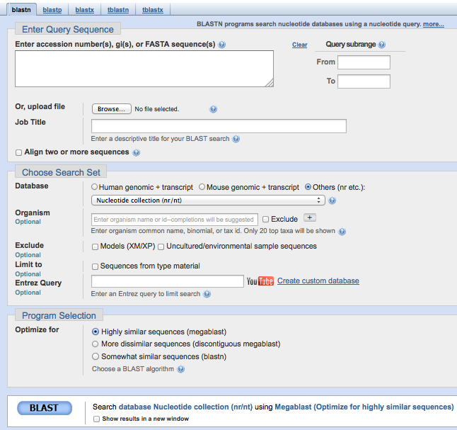
BLAST walk-through: the BLASTN search page
1
2
3
Notes:
there are three main sections to the BLASTN search page…let’s look at each of these and how they affect our BLAST search

Slide 18
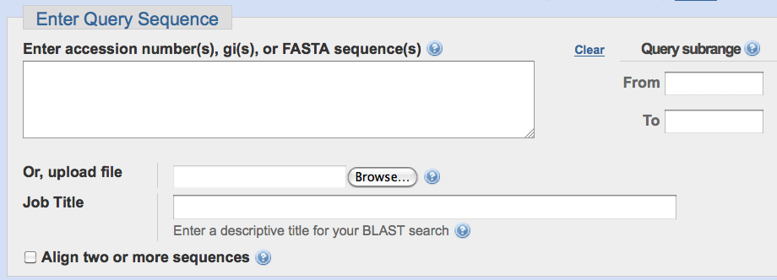
BLAST walk-through: Enter Query Sequence
Notes:
when I use BLAST, I usually copy and paste a sequence into the query box.
You can also upload a file containing a sequence.
We probably won’t use the Query subrange function (which limits the search to only a portion of the query sequence).
You don’t need to supply a Job Title, but it can help if you are planning to do multiple searches, because you can retrieve previous searches during a session.

Slide 19
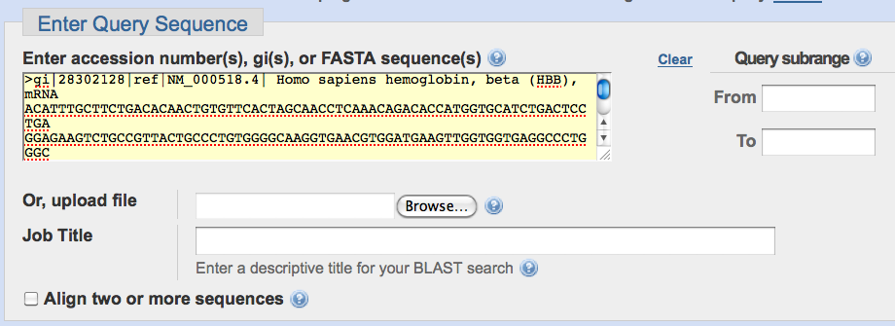
BLAST walk-through: Enter Query Sequence
Notes:
here, I pasted the nucleotide sequence for the human beta-hemoglobin gene

Slide 20
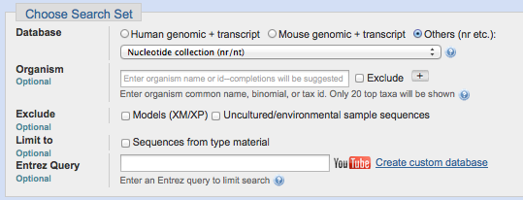
BLAST walk-through: Choose Search Set
Notes:
the most important setting here is the Database setting.
Selecting human genomic+transcript or mouse genomic+transcript limits your search to either human or mouse sequences. Not very helpful for our purposes, so we will select “Others”.
But…we have a lot of options under “Others”.

Slide 21
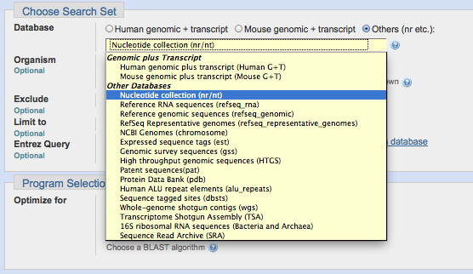
BLAST walk-through: Choose Search Set
Notes:
Ignore the Genomic plus Transcript options (these are same as the two options we already discussed)
Nucleotide collection is the largest set of sequences. It is supposed to be “non-redundant” (in other words, no duplicate sequences). However, the sequences may not all be high quality. Sometimes sequences are deposited in GenBank and there are questions about the source of the DNA, etc. Even so, this can be a helpful database to search.
Reference RNA sequences and reference genomic sequences should be higher quality and more trustworthy. The RNA sequence database includes gene sequences that code for mRNA, tRNA, rRNA, etc. The genomic sequence database includes only whole genomes (viruses, plasmids, bacteria, mammals, etc.)
The NCBI Genomes database includes chromosomes only (so no viruses or plasmids).
For now, let’s use the reference genomic sequences database for our search.
BUT…you should think about how the database you use may affect your search results when you are doing your own BLAST searches!

Slide 22
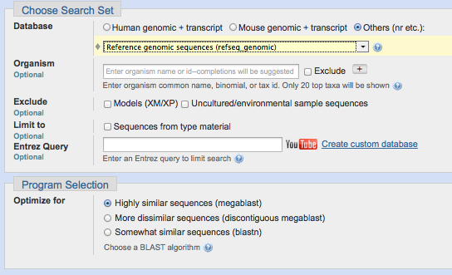
BLAST walk-through: Choose Search Set
Notes:
for now, we will ignore the Optional settings (Organism, Exclude, Limit to, Entrez Query)
these are ways to limit your search to particular groups of organisms within the database

Slide 23
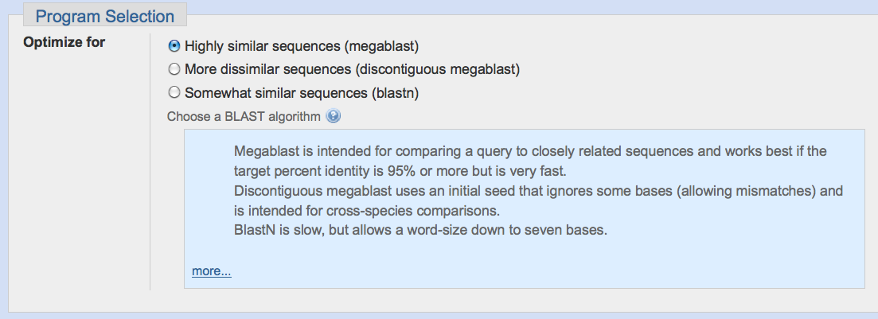
BLAST walk-through: Program Selection
Notes:
the light blue window will pop up if you click the question mark next to “Choose a BLAST algorithm”
we want to see if we can find related globin genes in a broad group of organisms, so let’s use BLASTN (somewhat similar)

Slide 24
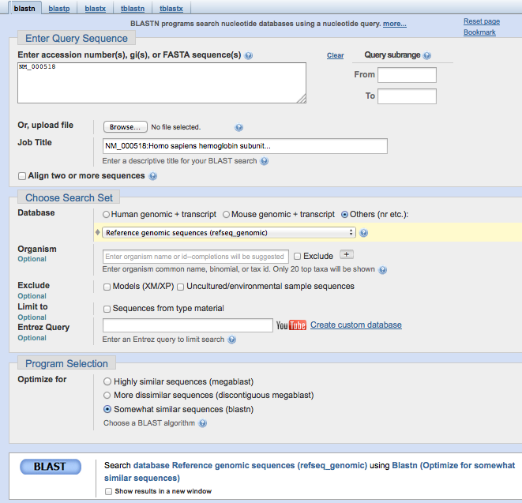
BLAST walk-through: the BLASTN search

Slide 25
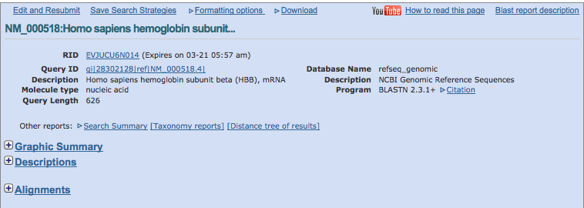
BLAST walk-through: BLASTN search results
1
2
3
Notes:
there are three main sections within the BLASTN results page…let’s look at each of these

Slide 26
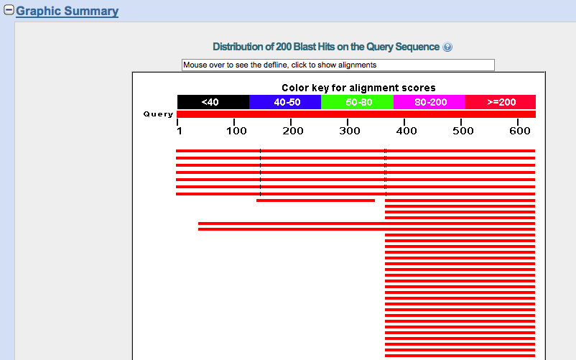
BLAST walk-through: Graphic Summary
query sequence
“hits” - sequences in database with high scoring matches
Notes:
look at color key above query sequence - this gives you a general sense of how well the hit matches the query sequence…in this case, all the hits are red, so they all have scores >=200 (the best possible value in the color key).
what do you notice about how the hit sequences align to the query sequence? (coverage)
remember…BLAST is a LOCAL alignment program. This means that it will not automatically align the query and the subject sequence from the beginning to the end.

Slide 27
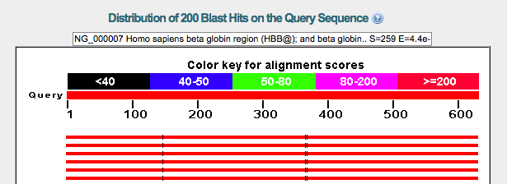
BLAST walk-through: Graphic Summary
Notes:
if you hover over each hit, the identity of the sequence will appear in the box above the graphic
you can click on the hit to go to the alignment at the bottom of the page

Slide 28
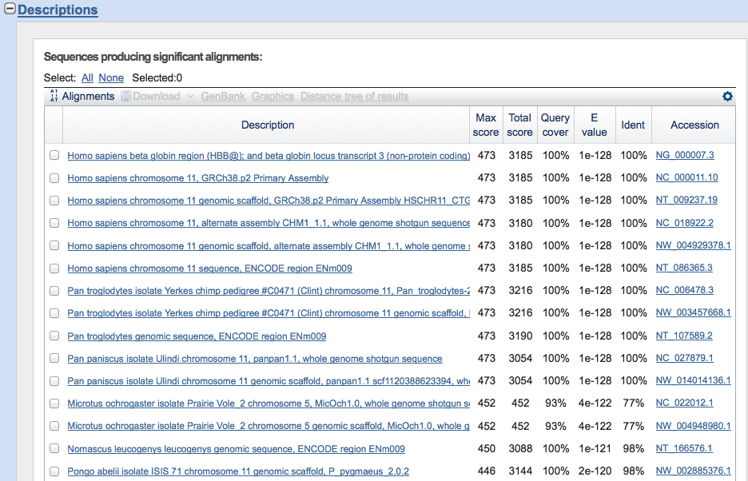
BLAST walk-through: Descriptions
chimpanzee
bonobo
gibbon
orangutan
Notes:
this is the MOST important part of the BLAST search results. This section provides important information that you will use to evaluate the quality of the alignment.
Remember…BLAST is just a tool that produces alignments and outputs different ways of assessing the alignment. YOU, as the scientist, need to consider the output and make a decision about the results.
First…look at the identities of the sequences with matches.
Homo sapiens = us (that’s expected)
and…we also see hits to other primates
how do we evaluate these hits? let’s look at the columns on the right

Slide 29
BLAST walk-through: Descriptions
prairie vole
Notes:
this is the MOST important part of the BLAST search results. This section provides important information that you will use to evaluate the quality of the alignment.
Remember…BLAST is just a tool that produces alignments and outputs different ways of assessing the alignment. YOU, as the scientist, need to consider the output and make a decision about the results.
First…look at the identities of the sequences with matches.
Homo sapiens = us (that’s expected)
and…we also see hits to other primates
We also see hits to prairie vole. Hmmm..
how do we evaluate these hits? let’s look at the columns on the right

Slide 30
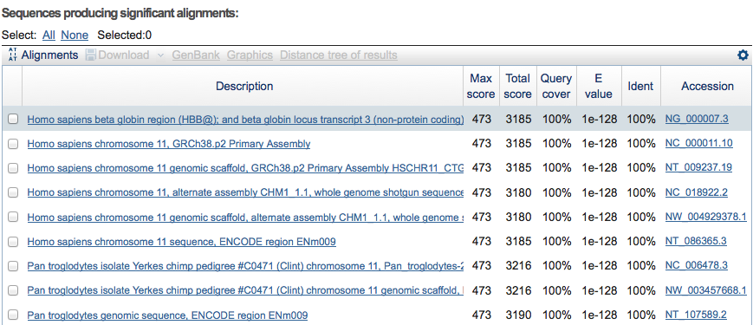
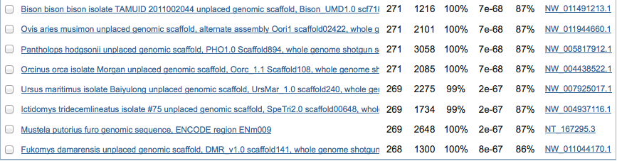
BLAST walk-through: Descriptions
Notes:
this is the top and bottom section of the Descriptions panel for this BLAST search
For simplicity, let’s focus on the total score and ignore the max score. The higher the total score, the better the alignment.
Query coverage shows you how much of the query sequence is covered by the alignment with the subject or hit sequence (remember the graphical display?)
E-value is very important for determining the quality of the alignment. This value basically tells you the likelihood that this alignment could happen by chance. A smaller e-value is much better. So, for the first hit in the list, the likelihood that you would get the same alignment between those two sequences by chance ALONE is ridiculously small.

Slide 31
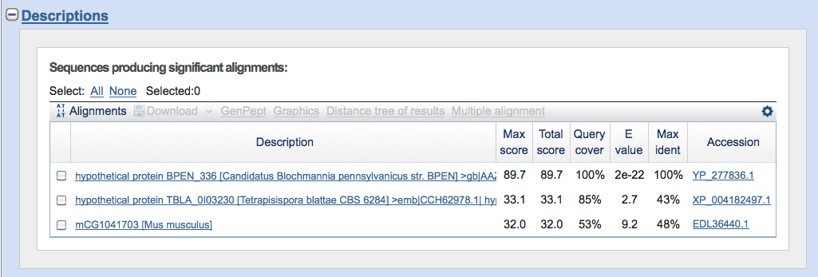
BLAST walk-through: bad e-value example
e-values guidelines for annotation:
BLASTP = e-05 or smaller
Notes:
sometimes BLAST will report an alignment but the e-value is VERY high…remember, YOU have to consider the output from BLAST and make a decision. The e-values above basically mean that there are 1:1 odds that you could get the same alignment by chance alone. Knowing this, do you believe that these two genes are really similar?

Slide 32
BLAST walk-through: Descriptions
Notes:
finally, identity shows you the highest identity for the alignment. In the top hit, the sequences are 100% identical along the alignment. For the hits at the bottom, the query and subject sequences are between 86-87% identical.
REMEMBER…this is along the length of the alignment ONLY! Not necessarily the full sequences! Why? Because BLAST is a local alignment program.

Slide 33
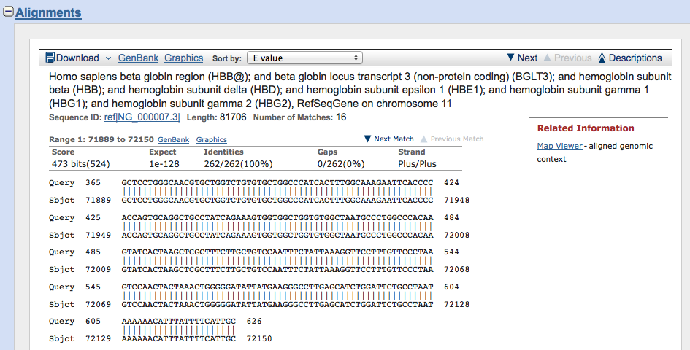
BLAST walk-through: Alignments
Notes:
The last section of the results page.
Shows the actual alignment (again, note that it is a partial alignment because BLAST is a local alignment program).
Also has links to more information about the subject sequence.

Slide 34
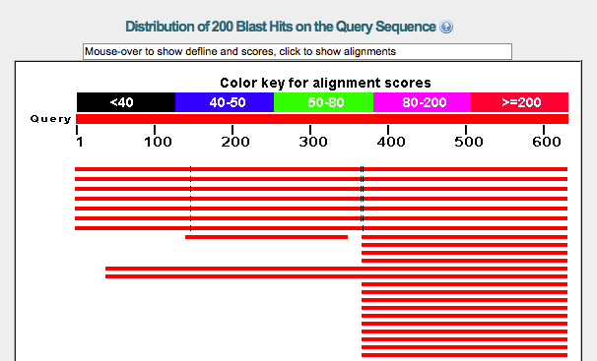
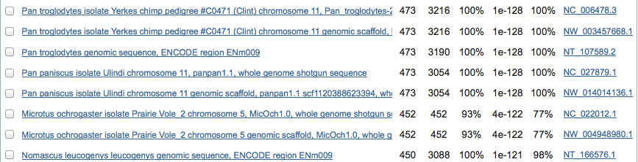
BLAST walk-through: Conclusion
So, based on this walk-through…
Did we find related genes for human beta-hemoglobin?
YES!

