Slide 1


Slide 2
What are Pseudo-classes?
A pseudo-class is used to define a special state of an element.
For example, it can be used to:
Style an element when a user hovers over it
Style visited and unvisited links differently
Style an element when it gets focus

Slide 3
Syntax
The syntax of pseudo-classes:
selector:pseudo-class { property:value; }

Slide 4
Links
http://www.w3schools.com/Css/css_pseudo_classes.asp
https://css-tricks.com/snippets/css/link-pseudo-classes-in-order/
https://www.tutorialspoint.com/css/css_pseudo_classes.htm

Slide 5
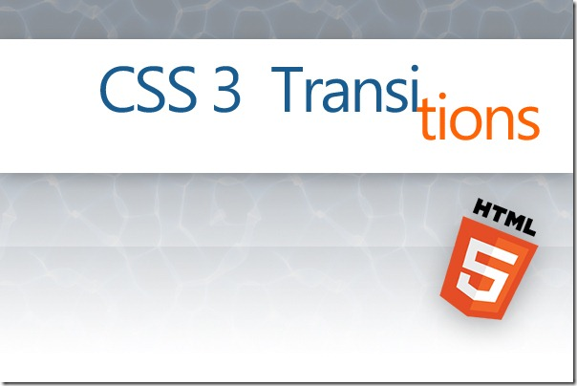

Slide 6
Contents
CSS3 transitions allows you to change property values smoothly (from one value to another), over a given duration.

Slide 7
To create a transition effect, you must specify two things: the CSS property you want to add an effect to the duration of the effect Note: If the duration part is not specified, the transition will have no effect, because the default value is 0.
How to Use CSS3 Transitions

Slide 8
Links
https://www.w3.org/TR/css3-transitions
http://www.w3schools.com/css/css3_transitions.asp

Slide 9
CSS3
Transforms

Slide 10
CSS3 Transforms
CSS3 transforms allow you to translate, rotate, scale, and skew elements.
A transformation is an effect that lets an element change shape, size and position.
CSS3 supports 2D and 3D transformations.

Slide 11
CSS3 Transforms
The translate() method moves an element from its current position (according to the parameters given for the X-axis and the Y-axis).
The rotate() method rotates an element clockwise or counter-clockwise according to a given degree.

Slide 12
CSS3 Transforms
The scale() method increases or decreases the size of an element (according to the parameters given for the width and height).
The skewX() method skews an element along the X-axis by the given angle.
The skewY() method skews an element along the Y-axis by the given angle.

Slide 13
Links
http://www.w3schools.com/cssref/css3_pr_transform.asp
http://www.w3schools.com/css/css3_2dtransforms.asp
http://www.w3schools.com/css/css3_3dtransforms.asp

