Slide 1
Intelligent Risk Dual-Core Engine for Virtual Bank
A Decision System Fusing Multi-Modal AI Underwriting with Dynamic Provision Optimization

Slide 2
Section X: Methodology and Experiments

Slide 3
Section X: Methodology and Experiments
This part shows the 2 components and their connection of the Virtual Bank loan recovery process. Experiments are to show the advantage of our model.

Slide 4
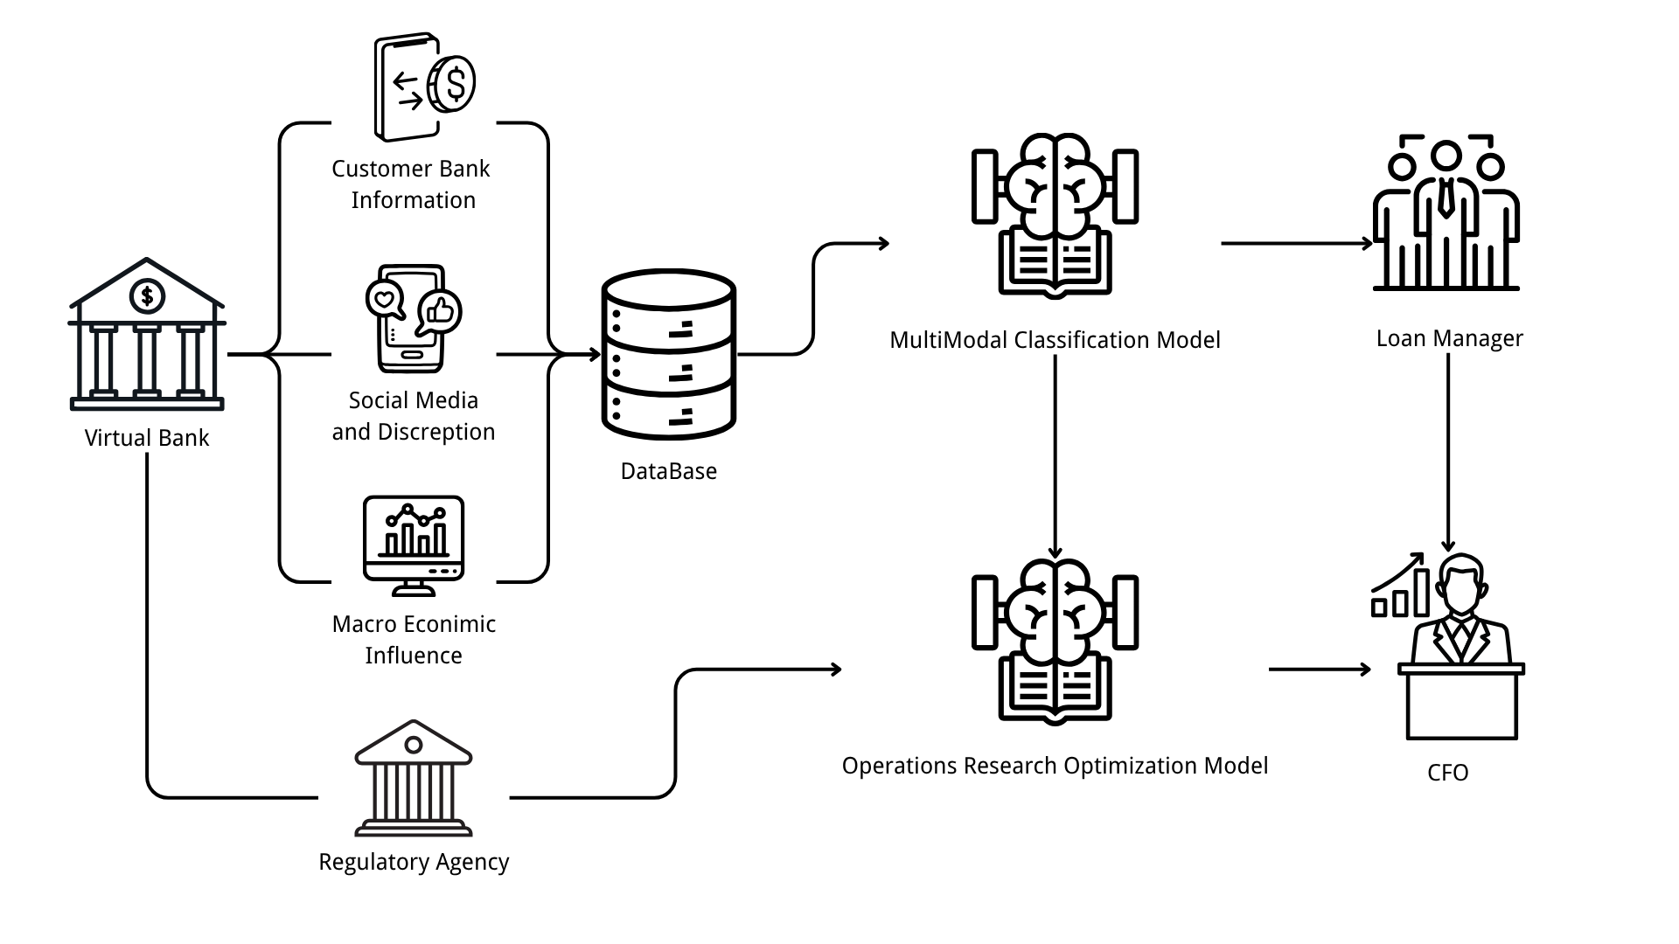
Section X: Methodology and Experiment
Guoxuan Sun
Target Definition & Motivation
Figure X: Business Process Framework
Notes:
Before we get this part start, I have to emphasize that due to diversified data exploration of Virtual Bank and advanced method to deal with it, we create a novel machine learning construction to maximize the precision of loan recovery prediction. Based on it, we then calculate a more accurate provision allocation using a optimization model.

Slide 5
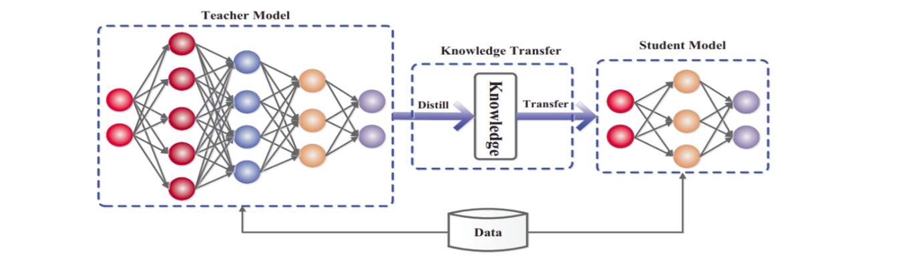
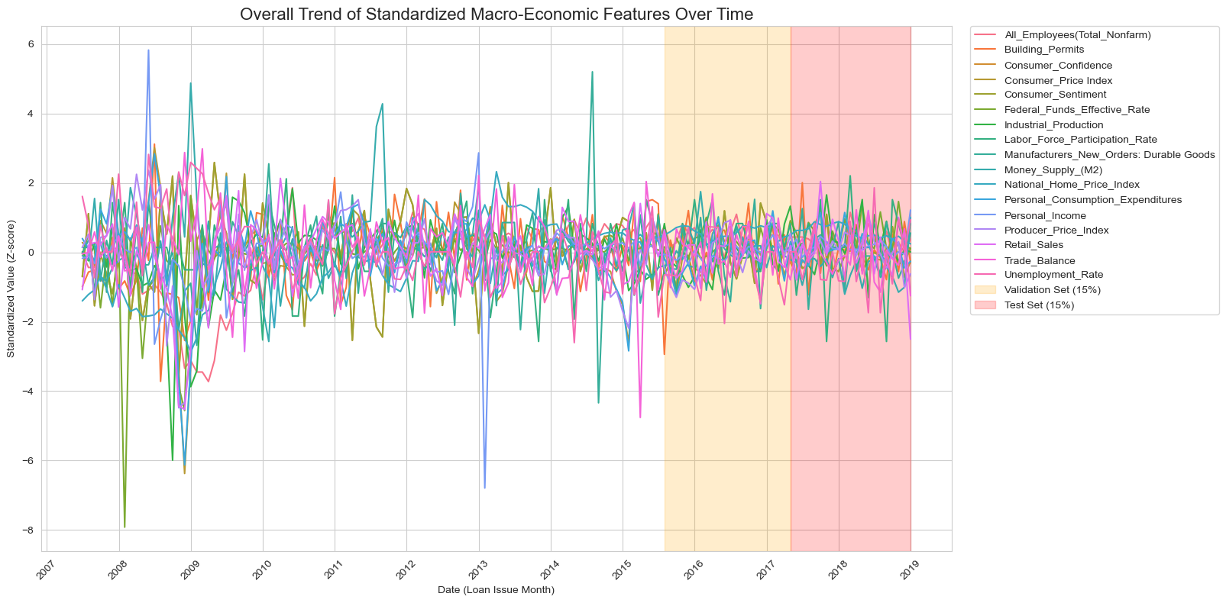


Section X: Methodology and Experiment
Guoxuan Sun
Data re-operation
As a trainer with 10 years of experience, I’ve built a stable career, but like many, I’ve accumulated credit card debt over time. Renting my home ...
QwQ-32B
Figure X: Macro ratio
Figure X: Customers discreption data generation
Notes:
Our model construction begin with data re-operation in 3 steps.
First, we clean up 18 attribute columns that cause data leaks.
Second, we choose all the macro attributes instead of using dimensionality reduction, because we found it doesn`t matter for both prediction and explainbility.
Finanly, learned from LLM refined method partially, we modified and generated a text embedding by leveraging prompts of Qwen, which are created by exsisting texts and panel information to describe borrowing reason.
So, we have 3 data inputs.

Slide 6
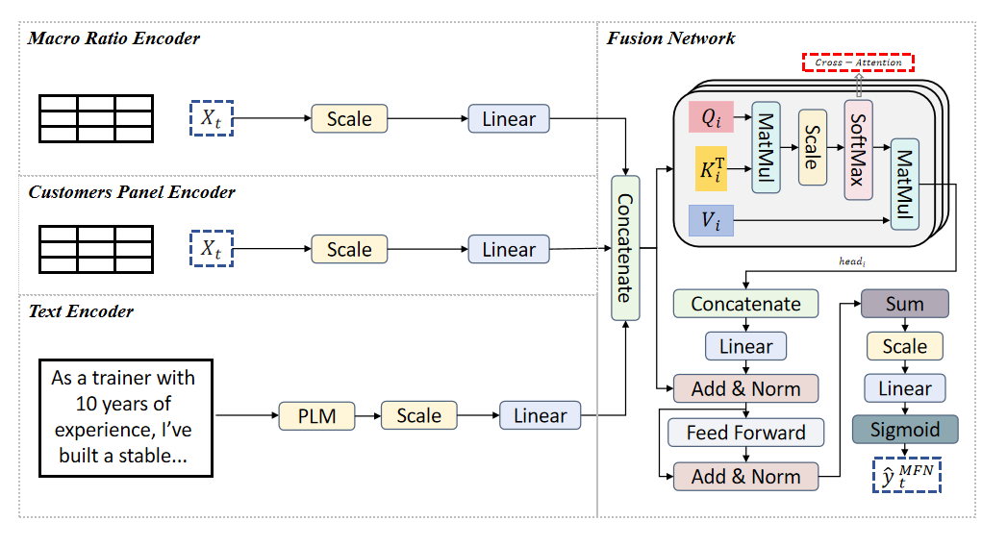
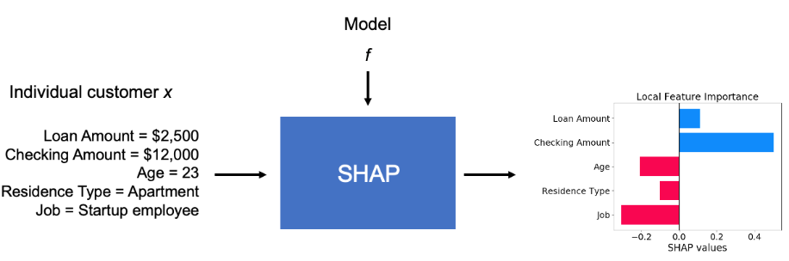
Section X: Methodology and Experiment
Guoxuan Sun
Model Construction
Figure X: Model Construction Framework
Notes:
Then, we need a novel model to handle with different data inputs. Our purpose is we can achieve a good and acceptable result， and can tell the stakeholders why this model make such judgement, because stakeholder especially in finance field do not like ‘black box’. So, the parts highlighted in red are the crucial components that undermine the black box effects.

Slide 7
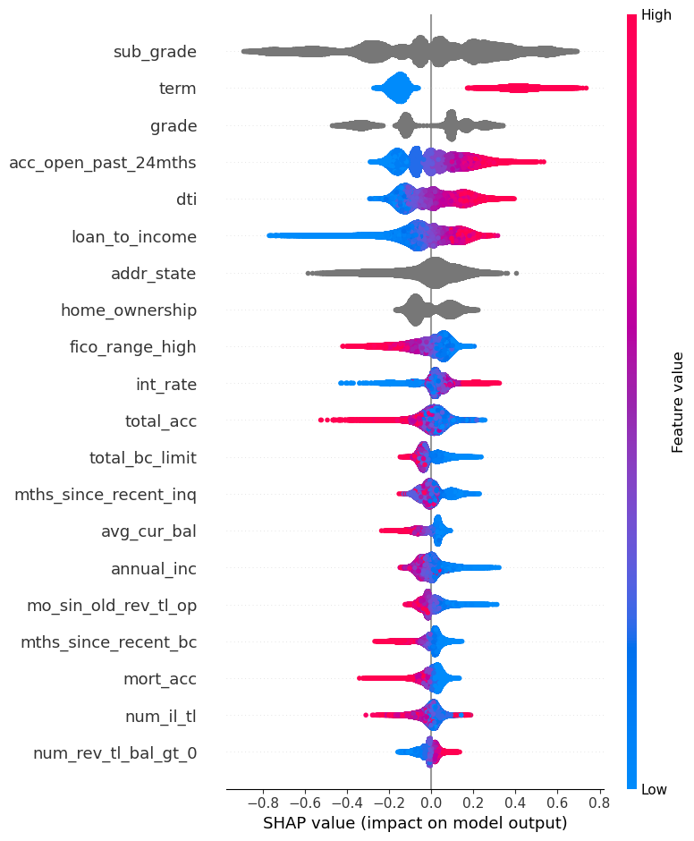
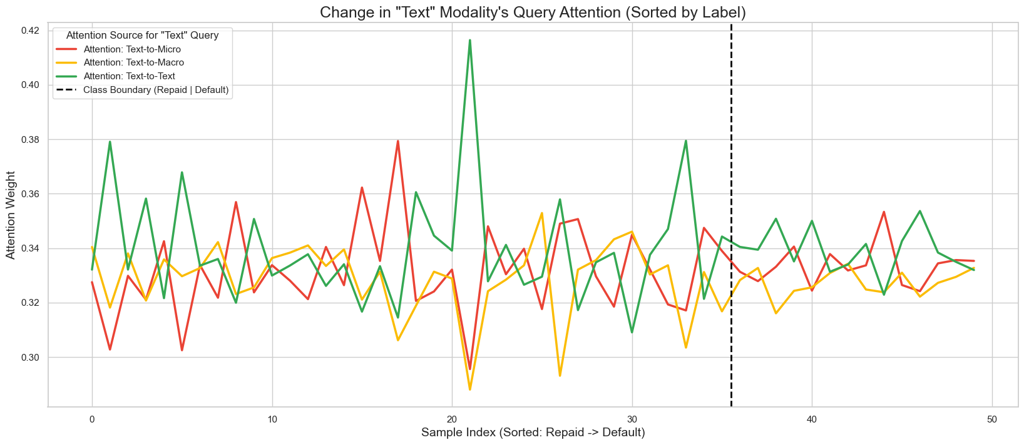
Section X: Methodology and Experiment
Guoxuan Sun
Experiment Results
Metric | Result (Mean ± Std)
ROC-AUC | 0.7207 ± 0.0023
MCC | 0.1799 ± 0.0342
Accuracy | 0.7817 ± 0.0023
Table X: Model Result
Figure X: Model explainability
Notes:
Fortunately, we got expected results.
Here I want to show more about explanability. It contains 2 parts. The left shows how attributes affects of every sample judgement. The right shows 3 inputs correlation of every sample prediction, which means based on that, reseachers can mine potential general patteren of each judgement.

Slide 8
Section X: Methodology and Experiment
Guoxuan Sun
Baseline and Comparation
Modality | Best Model | ROC-AUC (Mean ± Std) | MCC (Mean ± Std) | Accuracy (Mean ± Std)
Micro-Data (Structured) | GradientBoosting | 0.7211 ± 0.0026 | 0.1787 ± 0.0082 | 0.7834 ± 0.0015
Text-Data (Embeddings) | LogisticRegression | 0.6673 ± 0.0042 | 0.2016 ± 0.0043 | 0.6274 ± 0.0031
Macro-Data (Economic) | LogisticRegression | 0.5236 ± 0.0047 | 0.0305 ± 0.0061 | 0.6397 ± 0.0541
Multi-Modal (Fusion) | MultiModalFusionModel | 0.7207 ± 0.0023 | 0.1799 ± 0.0342 | 0.7817 ± 0.0023
Table X: Comparative experiments
Notes:
Through comparative experiments, we were able to verify that our model achieved acceptable results. In simpler terms, we mitigated the black-box effect while maintaining optimal performance.

Slide 9




Section X: Methodology and Experiment
Guoxuan Sun
The "Tri-Conflict" of Bank Provisioning
The Core Problem: How much money (Provision) should a bank set aside for future loan losses?
  Decision Variable：
  Objective Function：
  Constraints
    (a) Regulatory Constraint (Constraint_PCR):
    (b) Management Constraint (Constraint_P&L):
    (c) Boundary Constraint (Bounds):
  Method：SLSQP
Notes:
The more accurate loan recovery results we obtained before, can be used to release idle funds by more precisely adjusting the bank's provision coverage ratio. Here, in optmization model, our judgement model more precise the green highlighted parameters. This optimization model is aim to find the best provision by minimizing the total cost within 3 constraints. Among the constraints, the risk constraint is a soft constraint written in the objective, while the other 2 are solid which means they must be fulfilled.

Slide 10
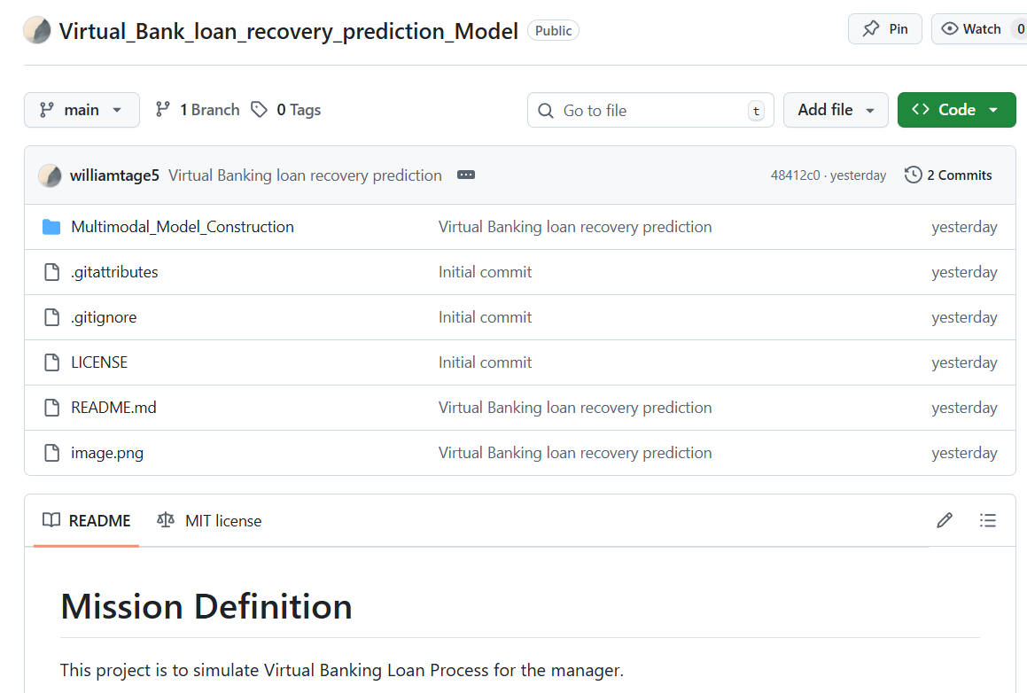
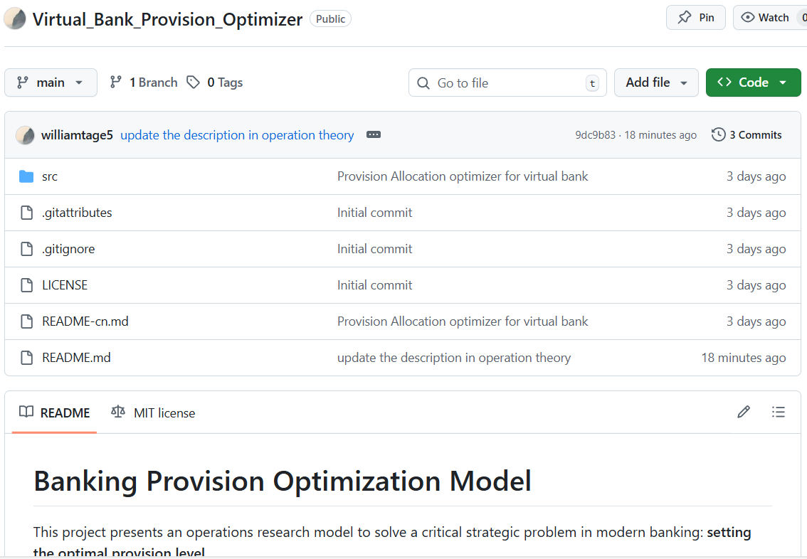
Section X: Methodology and Experiment
Guoxuan Sun
To see more details and codes of methodology:
https://github.com/williamtage5/Virtual_Bank_loan_recovery_prediction_Model
https://github.com/williamtage5/Virtual_Bank_Provision_Optimizer
Notes:
Due to time limitation, I cannot talk to much about details, if you are interested, please visit my link.

