Slide 1
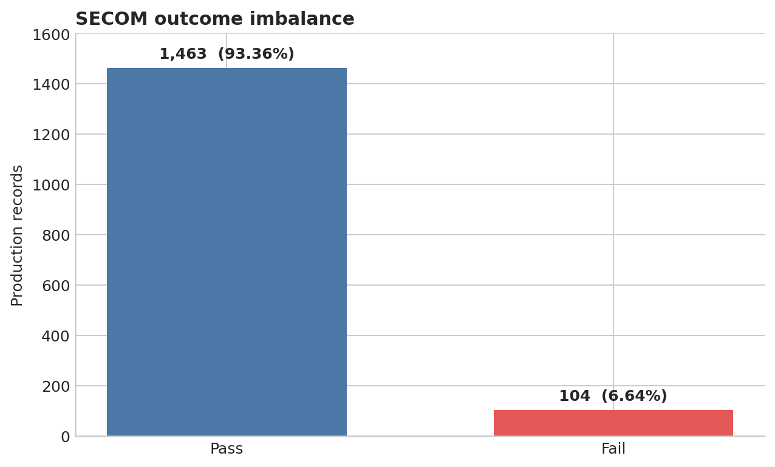
Semiconductor Process Yield & Anomaly Triage
Rare-event ranking under small-n, high-dimensional manufacturing constraints
OPERATING QUESTION
If engineers can review 10% of records, how many failures concentrate at the top?
Official UCI SECOM data (2008)
Useful for demonstrating disciplined validation; not representative of a modern production fab.
1,567 records | 104 failures | 590 anonymous measurements
SEMICON Taiwan case study | 1/3
Notes:
60-second talk track - part 1
I framed this as an operational ranking problem, not a generic classifier: if engineers can inspect only ten percent of records, can a model concentrate failures there? The public UCI SECOM data are old and anonymous, so this is a methods case study, not a claim about current fab performance.
[Sources]
- UCI SECOM dataset: https://archive.ics.uci.edu/dataset/179/secom
- UCI DOI: https://doi.org/10.24432/C54305

Slide 2
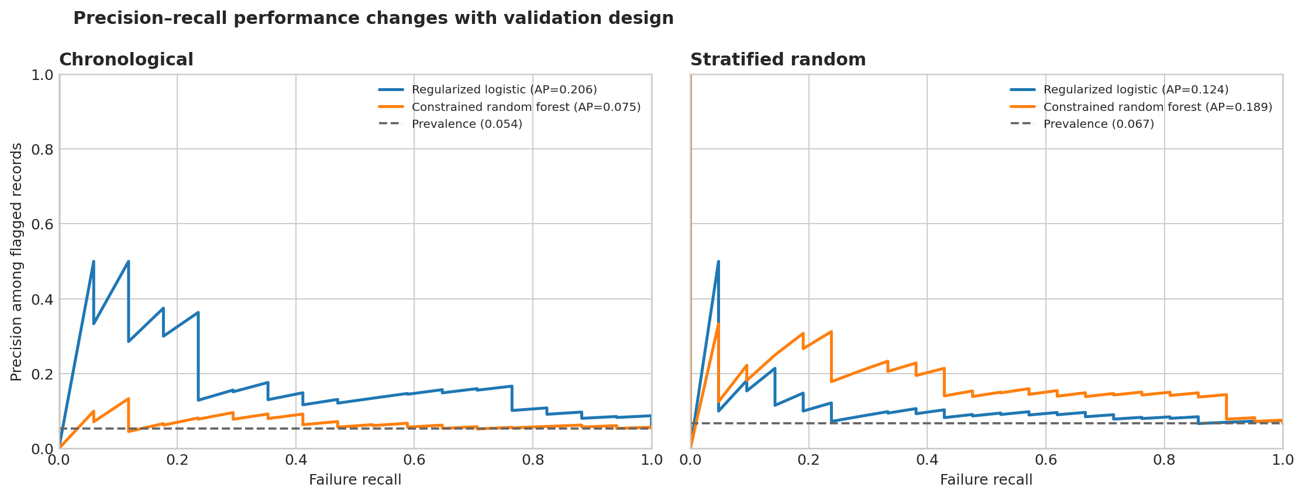
Time-aware validation changes the model story
0.206
average precision
vs 0.054 holdout prevalence
5 of 17
failures captured
within 32 reviewed records (10%)
Primary: first 80% train / last 20% test
Sensitivity: stratified random 80/20. The model ranking reverses across the two views.
Core finding
Regularized logistic leads chronologically; the forest leads under random splitting.
SEMICON Taiwan case study | 2/3
Notes:
60-second talk track - part 2
I used a chronological holdout as the primary test and a stratified random split only as sensitivity analysis. Under time-aware validation, regularized logistic regression reached 0.206 average precision against 0.054 prevalence, and the top ten percent captured five of seventeen failures. The forest looks better only under random splitting. That ranking reversal is the most important result: validation design materially changes the conclusion.
[Sources]
- Project-generated precision-recall results using the official UCI SECOM files
- Scikit-learn model evaluation: https://scikit-learn.org/stable/modules/model_evaluation.html
- Average precision: https://scikit-learn.org/stable/modules/generated/sklearn.metrics.average_precision_score.html

Slide 3
A triage hypothesis—not a root-cause claim
The anonymous features support predictive association only.
EVIDENCE
LEAKAGE CONTROLS
2.9x lift at a 10% review budget
AP 95% bootstrap interval: 0.108–0.424
Train-only feature filtering, imputation and scaling
Fixed model settings and capacity rule
LIMITS
NEXT EXPERIMENT
2008 anonymous data; only 17 holdout failures
No tool, recipe, product, chamber or lot context
Validate on newer forward cohorts
Join process context and capture reviewer feedback
Deployment question: what review capacity and false-alarm cost should set the threshold?
SEMICON Taiwan case study | 3/3
Notes:
60-second talk track - part 3
I would deploy this only as a triage hypothesis. All preprocessing was fit on training data, uncertainty is wide, and anonymous variables cannot be called physical root causes. The next step would be prospective validation on newer cohorts with tool, chamber, recipe, product and maintenance context, plus feedback from engineers reviewing the ranked queue. My deployment question is how review capacity and false-alarm costs should determine the operating threshold.
[Sources]
- UCI SECOM dataset: https://archive.ics.uci.edu/dataset/179/secom
- Scikit-learn Pipeline: https://scikit-learn.org/stable/modules/generated/sklearn.pipeline.Pipeline.html
- Decision threshold guidance: https://scikit-learn.org/stable/modules/classification_threshold.html

