Slide 1
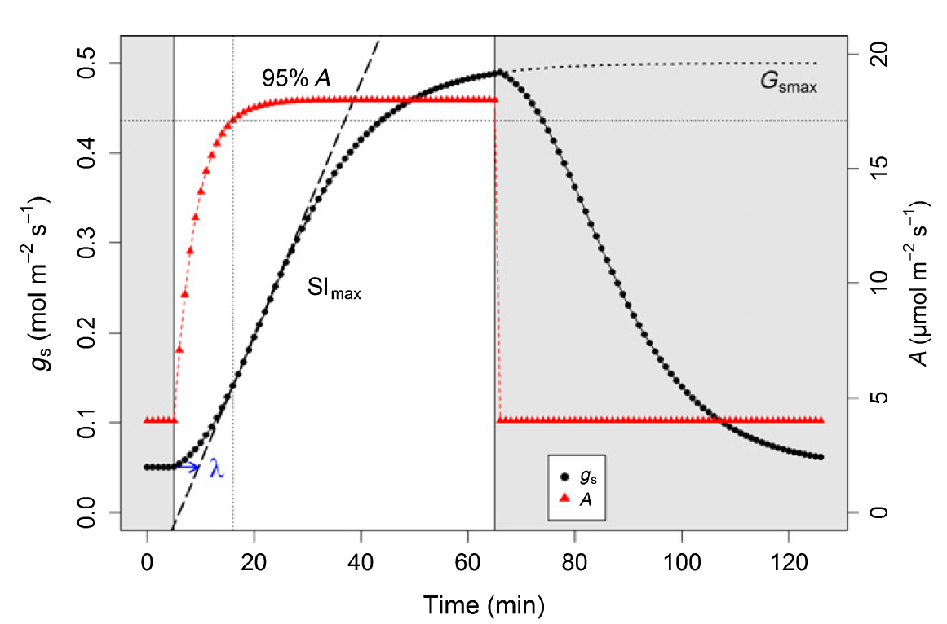




$${r_{0}}_{d}$$
g_{smax}
A_{max}
A₉₅
$$S{l_{max}}_{i}$$
A₀
$${r_{0}}_{i}$$
$$λ_{i}$$
g_{smin}
T_{95%}A

