Slide 1
Shared Memory Pool for Representors
William Tu, Michal Swiatkowski, and Yossi Kuperman
Nvidia and Intel
NetDev 0x18, 2024

Slide 2
Switchdev Fast Path
Legacy mode supports basic L2 features (mac/vlan)
Switchdev supports advanced hardware offloads
Vports (VFs/SFs) are switchdev ports and connected to VM
Handle most of the traffic in hardware

Slide 3
Switchdev Slow Path
Runs on host, or in SmartNIC embedded CPU
Each vport has its own representor port (repr)
Reprs attach to OVS or Linux bridge
Handles first couple packets of a connection
Insert/delete/update rules into switchdev
Repr is the control plane of the vport (representee)

Slide 4
Challenges
When creating thousands of SFs/VFs with representors:
NIC does not have enough hardware queues
Intel ICE supports up to 1K queues
Consume too much memory
Memory is not enough on BlueField SmartNIC or IPU

Slide 5
Experiment (1/2)
How much memory a representor netdev consumes?
Create 200 SF-rep
Setup RXQs and UP:
Get memory differences
for i in {100..200}; do
devlink port add pci/0000:08:00.0 flavour pcisf pfnum 0 sfnum $i
done
for i in {100..200}; do
ethtool -L $dev combined 1 // number of channel/rxq
ethtool -G $dev rx 1024 // RXQ depth
ip link set dev $dev up
done
$ sar –r 1
04:51:08 PM kbmemfree kbavail …
04:51:09 PM 31179532 31321476

Slide 6
Experiment (2/2)
How much memory a representor netdev consumes?
FW pages
Page pool:
/proc/slabinfo, meminfo
/sys/kernel/debug/mlx5/0000\:08\:00.0/pages/fw_pages_total
./tools/net/ynl/cli.py --spec Documentation/netlink/specs/netdev.yaml --dump page-pool-get
{'id': 20,
'ifindex': 10,
'inflight': 448, // 512
'inflight-mem’: 1,835,008,
'napi-id': 518},

Slide 7
Representor Memory Consumption
1 channel/RXQ, with 1024 RXQ depth: 2.86MB
1K representors: 2.86GB
2 channels is around double: 5GB
Page pool consumes 1.83MB out of 2.86MB
50% saving if we use 512!
 | 1Q Memory total | Kernel Page Pool (MB) RXQ | FW (MB) | 2Q Memory
Q64 | 1.88 | 0.78 | 0.113 | 2.895
Q128 | 1.1 | 0.2 | 0.113 | 2.835
Q256 | 1.3 | 0.4 | 0.114 | 2.915
Q512 | 1.805 | 0.78 | 0.114 | 2.99
Q1024 | 2.86 | 1.83 | 0.114 | 5.025
Q2048 | 4.935 | 3.93 | 0.115 | 9.25

Slide 8
NIC RX Memory Pre-allocation
A NIC has multiple RXQs (circular rings), usually number of cores
Each RXQ pre-allocates a set of RXQ buffers, for handling burstness, or processing delay
The total memory consists of
Buffer size * number of queues * queue depth
4K * 4 * 1024 = 16MB
Each RXQ has its own Linux page pool, for re-allocating new pages after processing
RXQ depth impacts performance!

Slide 9
Design1: Shared RXQ of PF
Solve the Hardware Queues Limitation
Don’t allocate any RXQs for representors
Redirect all representor’s traffic to PF or uplink representor -> shared RXQ of PF
PF reconstruct the original packet’s information, ex: vport id
Huge memory and queue saving
TX can also reuse/redirect to PF’s TX queue

Slide 10
Design1: Fairness Issue
Sharing causes Starving!
Assume traffic all goes into slow-path
VM1 runs DPDK-pktgen
VM2 runs ping
All the buffers of RXQs of PF are used by VM1
VM2 get zero slow-path bandwidth ☹
Idea: why not use tc QoS? Meter rate limiter?

Slide 11
Design2: Adjustable RXQ
save memory by dynamic allocation
Current: always refill to full
Currently
Driver always refill rxq to full, ex: default 1024 buffers
Performance drop if rxq depth is too shadow, ex: 64
But what if there is little traffic? Then we waste lots of memory
Idea: Don’t always allocate to full rxq size → save memory!
Performance impact: First burst of traffic definitely lost
Keep a low watermark, ex: minimum guarantee 128 buffers (2*NAPI_BUDGET)
Keep high watermark, max buffers of a device
Dev1 Dev2 Dev-n
…
…
…
…
Propose: dynamic refill
Dev1 Dev2 Dev-n
low
watermark
…
…
…
…
high
watermark
Notes:
net/mlx5e: Remove the outer loop when allocating legacy RQ WQEs Legacy RQ WQEs are allocated in a loop in small batches (8 WQEs). As partial batches are allowed, there is no point to have a loop in a loop, so the outer loop is removed, and the batch size is increased up to the total number of WQEs to allocate, still not smaller than 8. Signed-off-by: Maxim Mikityanskiy <maximmi@nvidia.com>
[216820.772591] mlx5_core 0000:08:00.0: END mlx5e_post_rx_wqes: cur_sz 1024 1024 count(allocated) 256
[216849.765036] mlx5_core 0000:08:00.0: mlx5e_post_rx_wqes: head 256 tail 512 wqe_bulk 256 cur q sz 768 in_napi 0
[216849.767590] mlx5_core 0000:08:00.0: END mlx5e_post_rx_wqes: cur_sz 1024 1024 count(allocated) 256
[216849.770092] mlx5_core 0000:08:00.0: mlx5e_post_rx_wqes: head 256 tail 512 wqe_bulk 256 cur q sz 768 in_napi 0
[216849.772585] mlx5_core 0000:08:00.0: END mlx5e_post_rx_wqes: cur_sz 1024 1024 count(allocated) 256
[216853.841038] mlx5_core 0000:08:00.0: mlx5e_post_rx_wqes: head 512 tail 768 wqe_bulk 256 cur q sz 768 in_napi 0
[216853.843448] mlx5_core 0000:08:00.0: END mlx5e_post_rx_wqes: cur_sz 1024 1024 count(allocated) 256

Slide 12
Quick Evaluation (1/2)
Fixed High Watermark
Two servers connected back-to-back, single iperf TCP throughput on CX-5
Hardware offload disabled, all traffic go to slow-path OVS
Statically change RXQ depth (ethtool –G rx) from 64 to 2048

Slide 13
Quick Evaluation (2/2)
Dynamically Adjust the RXQ Depth
Simple algorithm:
When in NAPI-interrupt: save memory by not refill, or refill up to low_watermark
When in NAPI-busy: fallback to default behavior, driver refill to FULL
The first burst definitely drops, but we’ll catch up

Slide 14
Design2+: Adjustable RXQ with Shared Page Pool
Problem: The later-created representors might get no memory
Current: each RXQ has its own page pool
Propose: all RXQs use the same page pool
Challenge: Need to track each RXQ usage and need lock
Use for representors (shared single DMA device) or virtual devices (veth)
How about fairness?

Slide 15

Fairness with Shared Page Pool
Borrow the idea from hardware switch
Shared Buffer in Hardware Switch
Each output port has a logical queue
The logical queue decides the budge/usage of the output port
Dynamic Threshold: adjust queue depth based on current usage
For switchdev
Logical queue -> RXQ
Port -> representor netdev
Shared Buffer -> shared page pool
Dynamic Threshold
Limit a port’s shared memory usage to :
Shared Memory Switch with
multiple output ports
port1
Shared Buffer
port2
…
portN
Paper: Dynamic Queue Length Thresholds for Shared-Memory Packet Switches

Slide 16
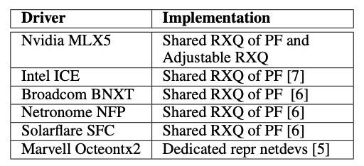
New Devlink Attribute: spool-mode
None, Basic (Shared RXQ of PF), SPP (Shared Page Pool)
Memory is important -> use shared RXQ, QoS is important -> use adjustable RXQ or dedicated
New switch attribute: spool-mode
drivers need to implement modes or -ENOSUPP
# dedicated repr netdev, ex: Octeontx2
$ devlink dev eswitch set pci/0000:08:00.0 \
mode switchdev spool-mode none
# Shared RXQ with PF, ex: ICE
$ devlink dev eswitch set pci/0000:08:00.0 \
mode switchdev spool-mode basic
$ devlink dev eswitch set pci/0000:08:00.0 \
mode switchdev spool-mode spp
Notes:
include/net/page_pool.h:#define PP_ALLOC_CACHE_SIZE 128
diff --git a/include/net/page_pool.h b/include/net/page_pool.h
index edcc22605842..a65346df8a13 100644
--- a/include/net/page_pool.h
+++ b/include/net/page_pool.h
@@ -64,7 +64,7 @@
* cache is already full (or partly full) then the XDP_DROP recycles
* would have to take a slower code path.
*/
-#define PP_ALLOC_CACHE_SIZE 128
+#define PP_ALLOC_CACHE_SIZE 512
#define PP_ALLOC_CACHE_REFILL 64
struct pp_alloc_cache {
u32 count;

Slide 17
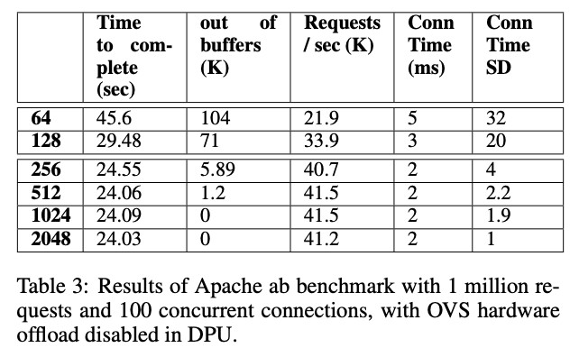
Evaluation-1: Static RXQ, 64 - 2048
Apache ab benchmark with 1 million requests 100 concurrency, with different RXQ depth
Time to complete (sec): total time taken for completing the 1 million requests.
out of buffers (K): a firmware counter, rx out of buffer, re- porting number of packets dropped due to no RXQ buffer available.
Requests (K) / sec: average HTTP requests per seconds
Connection Time (ms) and SD: average connection time, including connect, processing, and waiting, of the 1 million connections and their standard deviation (SD).
Notes:
Time to complete (sec): total time taken for completing the 1 million requests.
out of buffers (K): a firmware counter, rx out of buffer, re- porting number of packets dropped due to no RXQ buffer available.
Requests (K) / sec: average HTTP requests per seconds
Connection Time (ms) and SD: average connection time, including connect, processing, and waiting, of the 1 million connections and their standard deviation (SD).

Slide 18
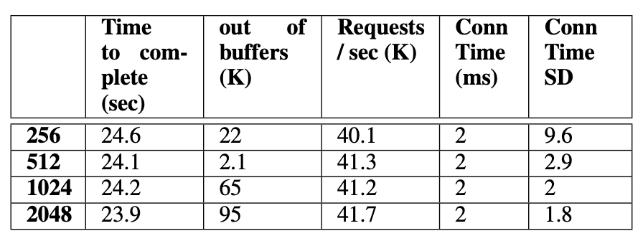
Evaluation-2: Static RXQ vs Adjustable RXQ
Apache ab benchmark with 1 million requests 100 concurrency, with different RXQ depth
Out of buffers showing more packets are dropped
Higher jittering
Average time to complete is similar
Notes:
Time to complete (sec): total time taken for completing the 1 million requests.
out of buffers (K): a firmware counter, rx out of buffer, re- porting number of packets dropped due to no RXQ buffer available.
Requests (K) / sec: average HTTP requests per seconds
Connection Time (ms) and SD: average connection time, including connect, processing, and waiting, of the 1 million connections and their standard deviation (SD).

Slide 19
Conclusion

Slide 20
Thank you!

Slide 21
OFED: Uplink Rep’s RQ for all other RQs
Uplink RQ’s to service all RX packets destined for non-uplink representors (SF/VF/PF)
Control plane
Devlink enable at switchdev mode/ or disable
Maintain xarray for vport id to representor netdev struct
Data plane: Steering
Insert pet header of 8 bytes (2 bytes contains new ethertype)
Copy 2 bytes of source vport that is stored in reg_c0
Set uplink as destination vport
Data Plane: driver
Get vport id from rx buffer, lookup netdev struct using vport id
Strip the 8 bytes from SKB and patch the SKB with correct netdev

Slide 22
Scaling uplink REP’s rx Queues
Targeting 1K SFs
REP1
REP2
REPn
rxqs
rxqs
rxqs
No Shared RQ
each repr has its own rxq, ex: 2 channel/2 rxqs
1k representors has total 2k rxqs
Each rep’s flow through its own rxhash
With Shared RQ on BlueField-3
PF creates 16 rxqs (max limited by CPUs)
Traffic from all representors uses the same rxhash and decides which rxq
Idea: increase 16 to more, ex: 128
Lower the chance for hash collision, depth depends on NAPI scheduler
NAPI schedule natively provides fairness for each queue
16 queues with 1024 entries is different than 128 queues with 64 entries!
Can we hash based on vport_id? If yes, it’s the same as no-sharedrq
Existing ethtool controls everything, no extra knob needed?
...
No SharedRQ
rxhash
rxhash
rxhash
Packets steered to its own TIR
Uplink-REP
rxqs
...
SharedRQ
rxhash
RFC: https://git-nbu.nvidia.com/r/c/upstream/linux/+/1099459
Packets from all representors
Notes:
From Parav
I think of following.
All switches operating using outputing queuing method, i.e based on the output queue, it dequeues and switches the packet. In our case, a netdev rxq to be dequeued based on the output port. So each RQ resembles the output queue.
above #1 gives us the fairness in processing packets regardless of their burst of packets from one or multiple VMs.
TIR creation should be optimized to support the needed scale
A meter on the RMP or RQ ensures that a burst does not starve other VMs. (buffer fairness)

Slide 23
Intel ICE driver
Both repr’s rx and tx are handled by PF repr
Currently no ECPF, only runs on host PF (wait for IPU)
TX
Goal: repr’s tx is sent to corresponding vport’s rx
Idea
“bypass” the steering block, tell the hardware to send directly to LAN or vport.
Steps
Repr call ice_xmit
Use skb->dst field to save vport id
Then dev_queue_xmit(skb)
Uplink tx xmit function set vport id in tx descriptor
ice_xmit_frame_ring() -> ice_eswitch_set_target_vsi()
Before Michal’s patch, a special “control plane vport” is created, with N queues assigned for N repr
With 1k SF, the control plane vport couldn’t create 1k queues -> move to shared queue design with PF
RX
Slow-path traffic handles by PF
Steps:
Redirect to uplink rep by seting rx descriptor id to uplink
Maintain xarray for vport id to repr netdev
Notes:
https://patchwork.kernel.org/project/netdevbpf/patch/20240125125314.852914-4-michal.swiatkowski@linux.intel.com/
In ice we have a mechanism to "bypass" steering block. Using it we can tell the hardware to send the packet directly to LAN, or steer it to other vport. It is set in Tx descriptor. skb->dst field is used to pass the correct vport ID to uplink Tx function to allow this to happen. If you want to look at ice code: in ice_txrx.c file ice_xmit_frame_ring() -> ice_eswitch_set_target_vsi() in case operation mode is switchdev (we need this also for uplink Tx traffic to always go outside). in ice_eswitch.c file ice_eswitch_set_target_vsi() -> the descriptor is filled with correct data. ice_eswitch_port_start_xmit() -> the vport number is set in skb->dst based on netdev data struct.

Slide 24
RMP (Receive Memory Pool)
Shared the WQEs pool
RMP allows multiple RQ to associated with a pool of WQEs
Every RQ can see packets from all RQs
Single NAPI is good enough to receive all packets
Use uplink-rep NAPI to receive all packets
RMP + scaling uplink rxhash design
Create RMP, create rep-rqs, redirect to uplink-rep
Uplink-rep create multiple rxqs, rely on rxhash to distribute
Vport id not in PET, but in CQE
Q: hash / match definer on vport_id (saved in user_index)?
Q: hit FW overhead (CREATE_TIR/MODIFY_RQT)?
Rep1-rq
Rep2-rq
Uplink-REP
1
rxqs
2
1
1
2
...
2
2
Shared pool of WQEs
rxhash
Set: MLX5_SET(rqc, rqc, user_index, rpriv->rep->vport);
Get: vport_rep = be32_to_cpu(cqe->user_index);
Packets from all representors
Notes:
+ vport_rep = be32_to_cpu(cqe->user_index);

Slide 25
Jakub’s Proposal
https://people.kernel.org/kuba/nic-memory-reserve
Idea
We could therefore have smaller dedicated queues, and a larger “reserve” – a queue from which every Rx queue can draw
but which requires additional synchronization on the host side
The NIC would try to use the 512 entries dedicated to each queue first
but if they run out (due to a packet burst or a scheduling delay) it could use the entries from the reserve.
NAPI-for-shared-pool
NAPI
Challenges
Same flow in dedicated/reserve queue
Ordering: process dedicated first, then reserve
Two napi processes the same flow
Conditions to trigger steering rule
Reserve
Dedicated
Steering rule
Notes:
if doing Jakub's proposal: 1. NAPI checks dedicated queue, if full, redirect incoming packet to use reserve pool 2. NAPI process packets from dedicated queue 3. dedicated queue is fully processed, NAPI refill new buffers to dedicated q 4. redirect incoming packets back to use dedicated queue 5. NAPI process reserve pool 6. NAPI back to processes dedicated queue

