Slide 1

Revisiting the Open vSwitch Dataplane Ten Years Later
William Tu*, Yi-Hung Wei*, Gianni Antichi⁺, Ben Pfaff*
VMware, US*
Queen Mary University of London, UK⁺
ACM SIGCOMM 2021

Slide 2

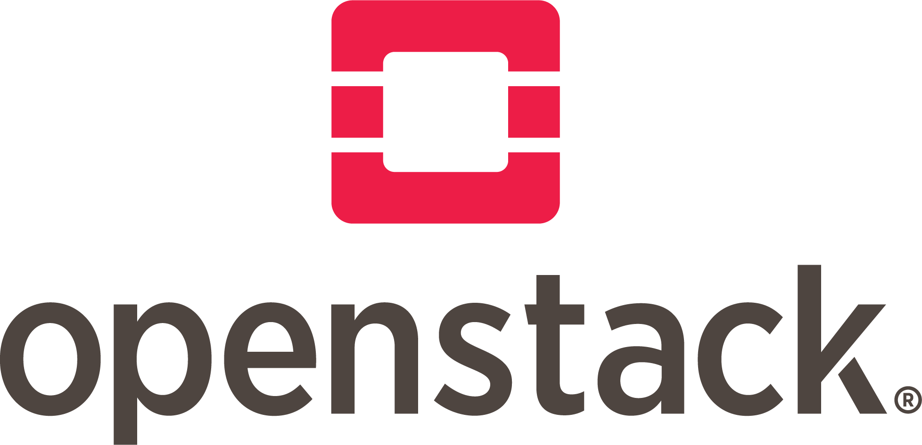
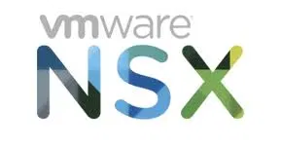
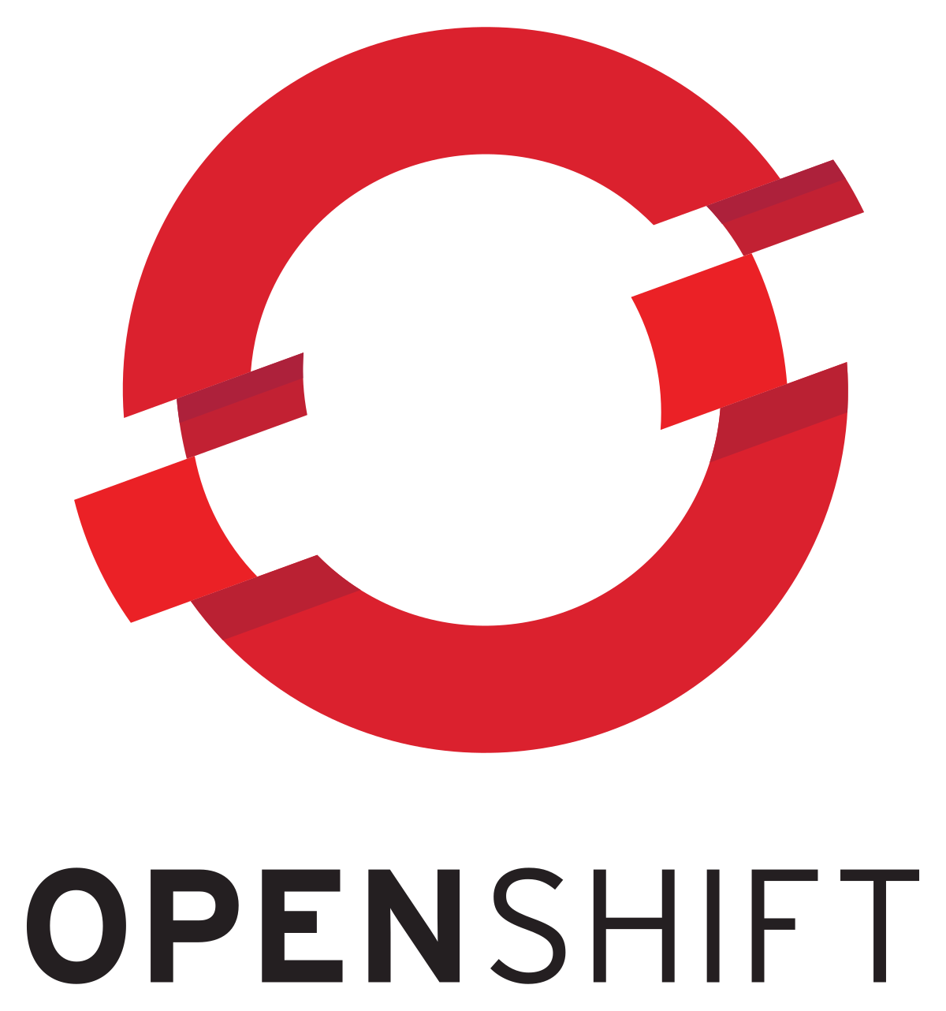

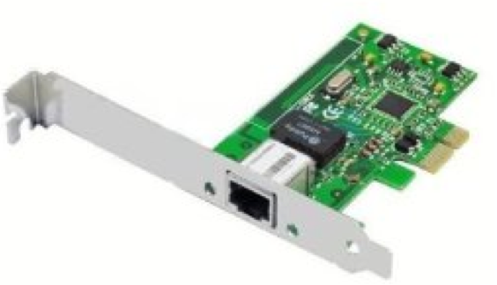

What is Open vSwitch (OVS)?
An open-source software switch runs on multiple platforms
SDN Controller
ovs-vswitchd
VMs or
Containers
Slow Path
Fast Path
OVS Datapath
And many research projects!
NSDI’15: The Design and Implementation of Open vSwitch
Notes:
This is how the existing kernel work, then next slide this is how the bpf program work
Ovs dp consists of three components, parse, lookup and actions
previous approach
Potential Benefits
Extend new OVS features quickly
Reduce the maintenance and compatibility issue

Slide 3

Classic OVS design (A Split User/Kernel)
Performance
Before DPDK/netmap, most performant way to
do packet I/O at that time.
ovs-vswitchd
Maintainability
Developer needs permission from Linux kernel community and OVS community.
Userspace
Kernel
OVS Kernel Module
Operability
OVS upgrade or bug fixes need to be on both components and rebooting is required.

Slide 4

OVS eBPF Datapath
Networking
Tools
ovs-vswitchd
OVS eBPF
Datapath
Performance
10-20% performance degradation, depending on the implementations.
rtnetlink,
syscall
Userspace
eth0
Maintainability
Developer only needs to work with OVS and OVS community to add new features.
Kernel Space
Network
Stack
Operability
OVS upgrade or bug fixes done by replacing the new eBPF datapath. Tools remains working.
Device Driver
OVS with eBPF Datapath
Control path
Data path
ACM OSR’17: Building an extensible Open vSwitch datapath

Slide 5
OVS-DPDK: Userspace Datapath
Performance
Closed to line-rate performance, ideal for high performance network appliance use cases.
DPDK Library
Networking
Tools
OVS Datapath
Driver
Maintainability
Developer only needs to work with OVS and OVS community to add new features.
eth0
Userspace
Kernel Space
Operability
Manage two separate network configs: DPDK and Linux Kernel. Existing networking tools might not work on DPDK.
Control path
Data path
OVS with DPDK

Slide 6
OVS Userspace Datapath with AF_XDP
Networking
Tools
OVS Datapath
Performance
Fast packet processing in XDP, or DPDK-like performance when by-pass kernel w. AF_XDP
rtnetlink,
syscall
AF_XDP
Maintainability
Developer only needs to work with OVS and OVS community to add new features.
eth0
Userspace
Kernel Space
Network Stack
Operability
Easier upgrade, bug fixes, and deployment. Networking tools remains working.
Device
Driver
XDP
OVS with AF_XDP
Control path
Data path

Slide 7
Implementation and Evaluation
Naively apply AF_XDP socket has some performance overhead
See section 3 about optimizations
Performance Evaluation
A. VMware NSX production platform
with Intel NIC
B. Forwarding/Transaction rate using
packet generator with Mellanox NIC
OVS Entity on NSX Platform | Count
Geneve Tunnel | 291
Virtual ports (VMs per host) | 15
OpenFlow Rules | 103,302
OpenFlow Tables | 40
Matching fields among all rules | 31
Artifacts: https://github.com/williamtu/sigcomm21-ovs-artifacts

Slide 8

Evaluation: VM Performance
ovs-vswitchd
vhostuser
VMs
Userspace
OVS Datapath
DPDK, AF_XDP
Zero-copy NIC to userspace datapath and to VMs.
Kernel Space
Device
Driver
XDP
NIC
ovs-vswitchd
VMs
Kernel
Packet copying from kernel to userspace using tap device.
Userspace
Kernel Space
OVS Datapath
tap
Device Driver
NIC

Slide 9


Evaluation: Container Performance
ovs-vswitchd
Containers
Userspace
OVS Datapath
DPDK
High latency due to packet traversing kernel and userspace.
Kernel Space
veth
NIC
ovs-vswitchd
Containers
Kernel, AF_XDP
Better performance due to keep packets in kernel using kernel module or XDP program!
Userspace
OVS Datapath
Kernel Space
Device
Driver
veth
XDP
NIC

Slide 10
Lesson Learned and Conclusion
AF_XDP is not always the fastest option
AF_XDP is not yet available for Windows
Easier patching, development and troubleshooting
Easier packaging and validation using CI/CD
A better cross-platform design

Slide 11
Try it out! $git clone https://github.com/openvswitch/ovs.git
Questions?

Slide 12



Development/Bugfix Process
Linux Kernel
Community
OVS Out-of-tree
module
Upstream
(days/weeks)
New Datapath Feature
Latest Linux Kernel 5.14
Backport / Maintenance
Release with new kernel
(months/years)
New feature
works now
Ex: 20.04 runs 5.11 kernel
https://ubuntu.com/about/release-cycle

Slide 13
Out-of-tree Kernel Module
A new datapath feature requires
Catch up latest kernel (Backports)
Add the code about new feature
Hard to validate its correctness
Enterprise customer not allow 3rd party module
Takeaway #2: An “out-of-tree” kernel module
does not fix problems caused by a split
user/kernel software switch design.

Slide 14
Kernel-by-Pass and eBPF Datapath
DPDK
Huge performance benefits
Simplify upgrade and feature dev.
Not compatible with existing tools due to userspace driver
OVS eBPF datapath[1]
Solve the maintainability issue
Limited feature support
Some performance penalty
[1] Building an extensible Open vSwitch datapath

Slide 15
In this talk
We shared our experience in supporting and running OVS
Maintenance, operation, deployment, performance.
Revisit the design decision made 10 years ago
A split user/kernel model, out-of-tree module
The evolution of OVS dataplane and our new design
Kernel by-pass technologies DPDK and AF_XDP
All source code are up-streamed!
https://github.com/openvswitch/ovs

Slide 16
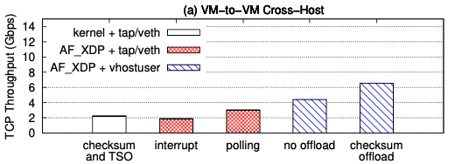
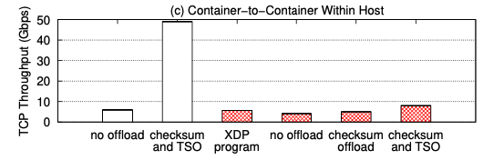
Performance of VM (cross-host) and Container (within-host)
Outcome #1.1
OVS AF_XDP outperforms in-kernel OVS by 2.4x
within a host, rising to about 3x across host
Outcome #1.2
For containers, in-kernel OVS remains faster than AF_XDP for TCP workloads due to checksum and TSO support.

Slide 17
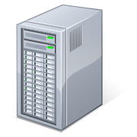
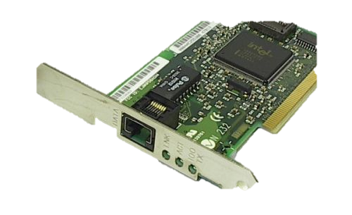
Testbed and Performance Evaluation
25Gbps Link
sender
12-core Intel Xeon
E5 2620 2.4GHz
32GB memory
DPDK packet generator
Connect-X 6Dx
T-REX traffic gen
Connect-X
6Dx
+ Datapath configurations
Configurations
Kernel: OVS connects to VMs with tap devices and to container with veth.
DPDK: OVS with DPDK mlx5 driver, connects to VMs with vhostuser and containers with DPDK AF_PACKET
AF_XDP: OVS with AF_XDP, connects to VM with vhostuser and containers using vhostuser/XDP program
Notes:
Compare Linux kernel 4.9-rc3

Slide 18
Latency/trans. rate between one host and VM/container
VM Setup across Hosts
Container Setup within a Host
Outcome#3: OVS with AF_XDP performs better than Kernel across host for VM case,
and similar to DPDK for virtual network both across and within hosts

