Slide 1
Towards Understanding the Public Gists on GitHub
Master Project Defense
Weiliang Wang
April 2016
Chair:
Dr. Alona Fyshe
Committee:
Dr. Daniel M. German (Supervisor)
Dr. Alex Thomo
Notes:
Good afternoon everybody. Thanks for coming to my oral examination.
My name is Weiliang. I’m a project-based master student in computer science. Today I’m going to present what I did for my project, which is “Toward Understanding the Public Gists on GitHub”

Slide 2

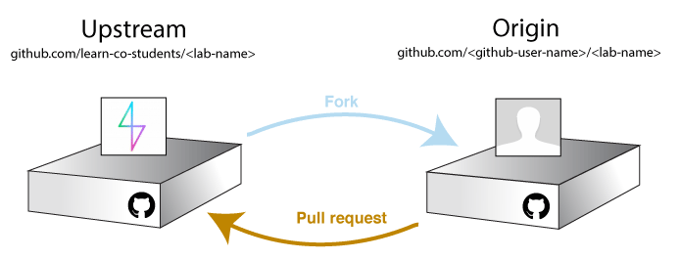
Background
GitHub
Git repository
Commit, fork, pull request, etc
Collaboration
GitHub Logo
Image Source: https://github.com/learn-co-curriculum/submitting-a-lab-osx
Notes:
First I’ll talk about the background of this study.
(Intro to GitHub)
So we know that GitHub is a really popular source code hosting website. It’s based on the version control tool Git, and each GitHub project is a Git repository, so you can utilize all the Git features such as commit, fork pull request, etc. If you look at the example in this picture, say, you found a very interesting project that you want to contribute to. You can fork it so that you have a full copy of the original repository. Now you can commit changes to this repository, and finally, if you want to merge your changes back to the original repository, you have to send a pull request to the original repository. So this is one work flow that demonstrates how people collaborate.
So apart from the Git features, GitHub has lots of other features, such as code reviews, bug tracking, etc. All these features make software development easier and developer’s collaboration convenient.

Slide 3
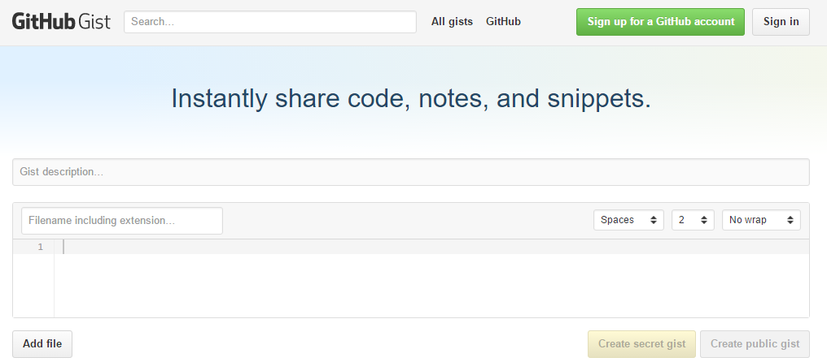
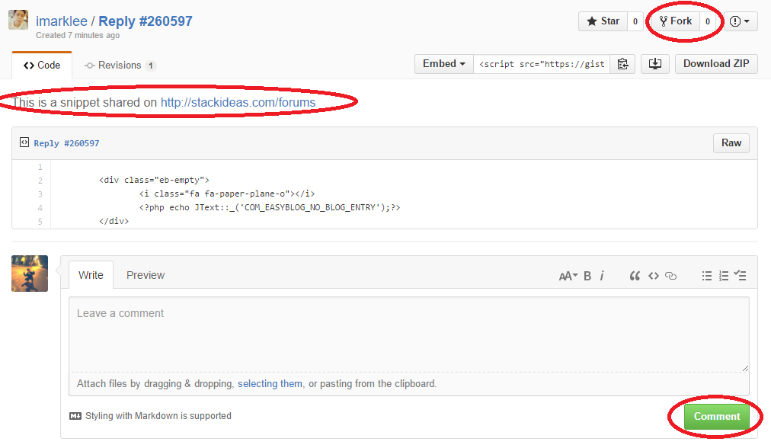
Background
Gists
codes, notes and snippets
Git repository: commit, fork, etc
third-party applications/plugins
GistBox, Wordpress, IDE’s
no related research
https://gist.github.com/imarklee/921a4fd2a0d4156dfaa6
Notes:
(Intro to Gists)
Among all the GitHub features, there’s one called Gists. Gists are expected to be code pieces, notes or snippets, just like the slogan shows.
Apart from that, one Gist is essentially a Git repository, so that it can utilize all the Git features that I just mentioned. This picture shows the UI of an Gist on GitHub website. The top-left is the name of this Gist in the format of author/gist-name. It has a description, and followed by the files contained in this Gist. Apparently this Gist only contains one file. So the author could commit changes to these files. Apart from that, visitors can fork this Gist, or make comments. So that’s what you can do with a Gist.
There are already some third-party applications that are to make it easier to create, manage and share Gists, such as GistBox…
Although Gists are getting popular, there was no study about it in any aspects. So this is a great research topic and opportunity.

Slide 4
Research Questions
What do Gists look like?
Basic information in terms of size, file counts, collaboration, etc.
How are Gists being used?
How individuals use Gists.
Notes:
Although we know what Gists are expected to be and to be used, it’s not necessary the same with the reality.
In order to figure that out, I came up with these two research questions.
One of them is What do Gists look like. The purpose is to provide basic information of Gists using different metrics, such as Gists size, files count in Gists, users' collaboration on Gists, and so on.
The other is How are Gists are being used. This is to find out how individuals use Gists whether or not in the way that GitHub expects.

Slide 5
Study Steps
Quantitative
Meta-data
Qualitative
Manual inspection of Gists content
Qualitative
Search results of how people use Gists
content
Data Collection
GitHub API
GHTorrent
Notes:
Here is the study steps. I first collected enough Gists data for later analysis. Then I made quantitative analysis around the metadata and content of the downloaded Gists. That’s followed by the qualitative analysis of the Gists content. And finally there was a qualitative analysis of how people use Gists. I’ll talk about the details one by one.

Slide 6
Data Collection
GitHub API
GHTorrent
mirror of GitHub data in both MySQL and MongoDB format
No datasets of Gists
GHTorrent user dataset
(2,572,370 users after filtering)
Download Gists of each user using GitHub API
Metadata of 618,393 Gists
(793,891 files)
Randomly sampled users (562,993)
32,786 have Gists
(144,073 Gists)
Notes:
The data collection took advantage of GitHub API and GHTorrent.
By GitHub API, you can download metadata of public GitHub projects or Gists by sending HTTP Requests.
GHTorrent is a project that aims to provide a mirror of GitHub's data. It provides datasets of GitHub users, repositories, commits, comments, etc. in both MySQL and MongoDB format. Unfortunately, it doesn’t provide GitHub Gists.
So I came up with this flow to get Gists data…
The second branch is kind of compliment to the first branch.

Slide 7
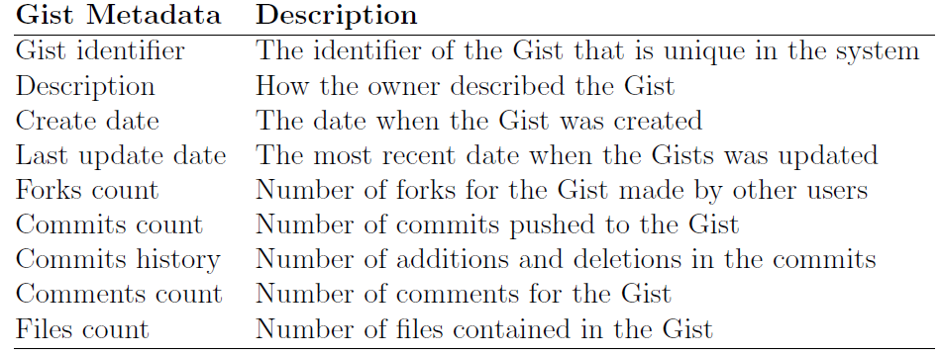
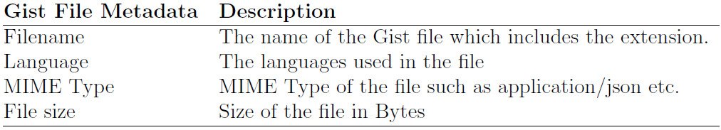
Data Collection
Notes:
This shows the information queried from the metadata of each Gist and each Gist file.

Slide 8
Quantitative Analysis of Gists Metadata
Goal: to find patterns and characteristics of Gists from metadata.
Analyzed 618,393 Gists and 793,891 files contained.
How many Gists does each user own?
How many les are there in a Gist?
How large is a Gist?
How many lines of code are there in a Gist file?
What languages are used in a Gist?
How many commits/forks/comments are there per Gist?
How often do users update their Gists?

Slide 9
Qualitative Analysis of Gists
Randomly chose 400 from those 618,393 Gists, and manually code them one by one.
Coding in terms of Gist content
Coding in terms of Gist file relationships in a Gist

Slide 10
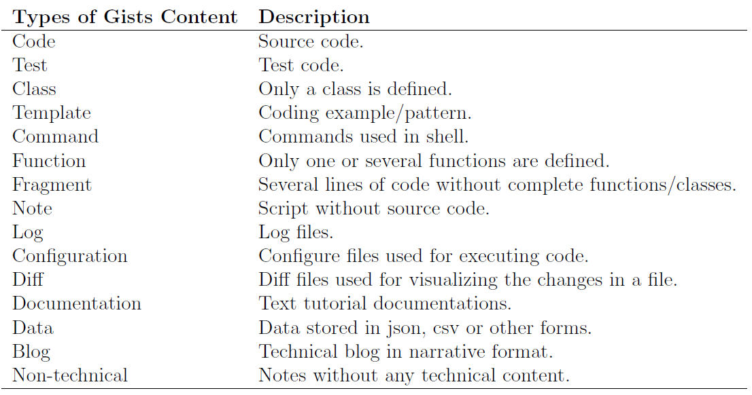
Qualitative Analysis of Gists
Coding in terms of Gist content

Slide 11
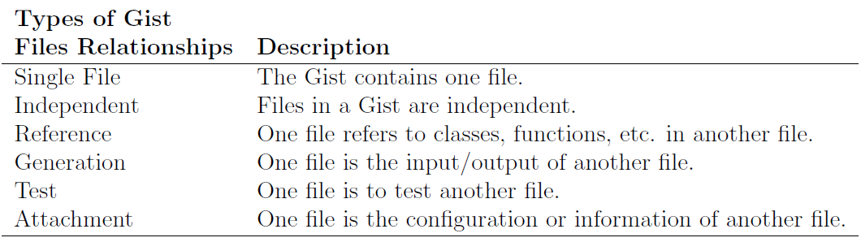
Qualitative Analysis of Gists
Coding in terms of Gist file relationships in a Gist

Slide 12
Qualitative Analysis of Gists Usage
Search for “GitHub Gist” from:
Web pages (Google)
Twitter

Slide 13
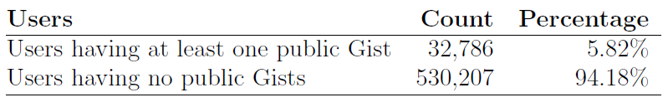
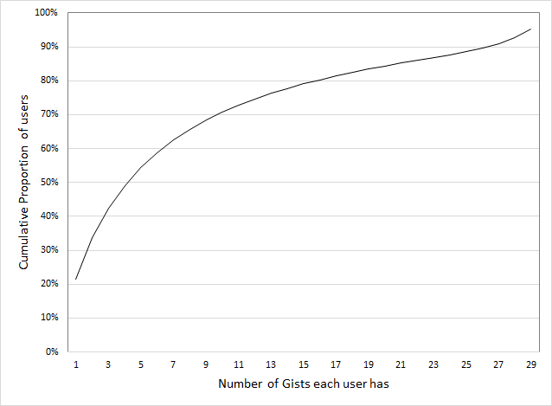
Results – What do Gists look like?
Users and Their Gists
50% of the users have less than 5 public Gists.
70% have less than 10 public Gists.
Only 4% of users have 30 or more public Gists.

Slide 14
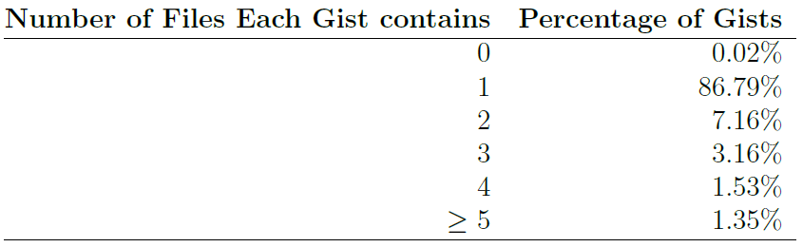
Results – What do Gists look like?
Content of Gists – file counts
There also existed Gists containing a lot of files (for example, one with 1,001 files)

Slide 15
Results – What do Gists look like?
Content of Gists – Gist file types
113 MIME types
257 languages

Slide 16
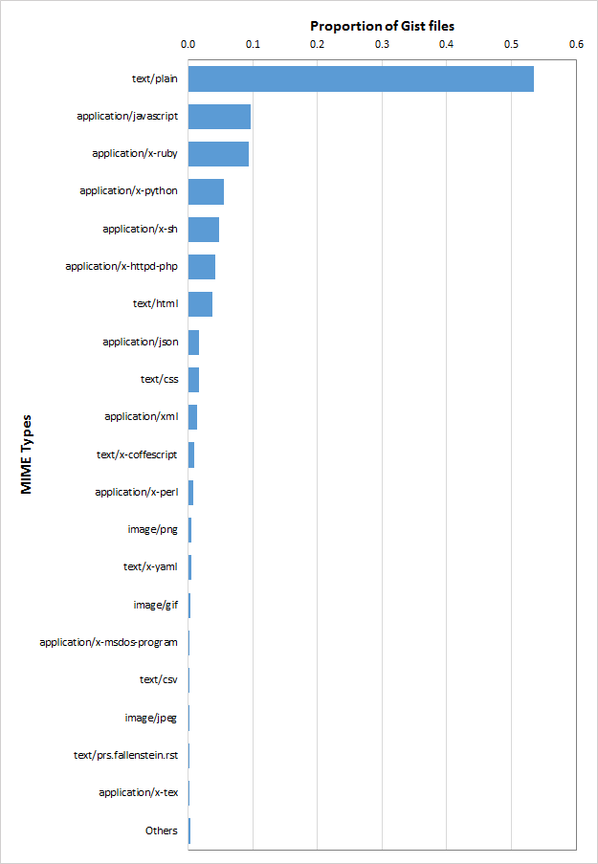
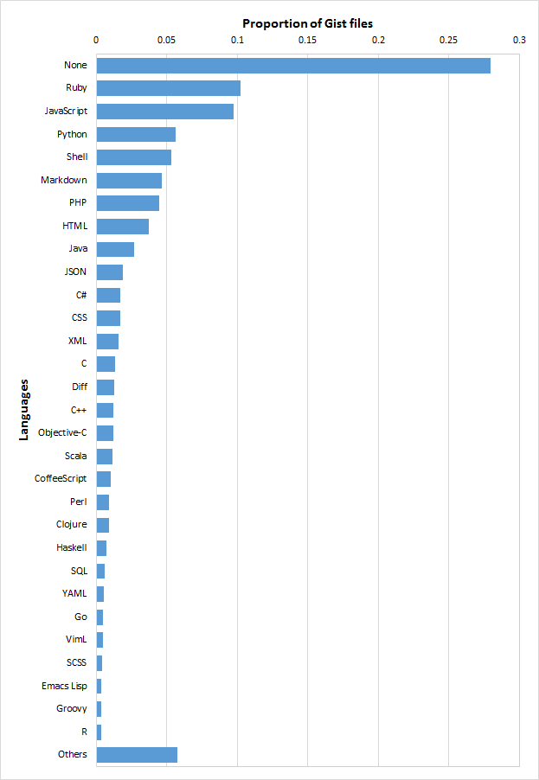

Slide 17
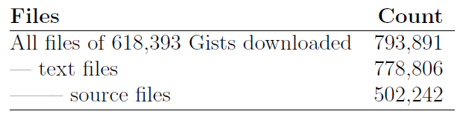
Results – What do Gists look like?
Content of Gists – file size
Bytes
Number of lines
Source lines of code
* Source recognized by CLOC

Slide 18
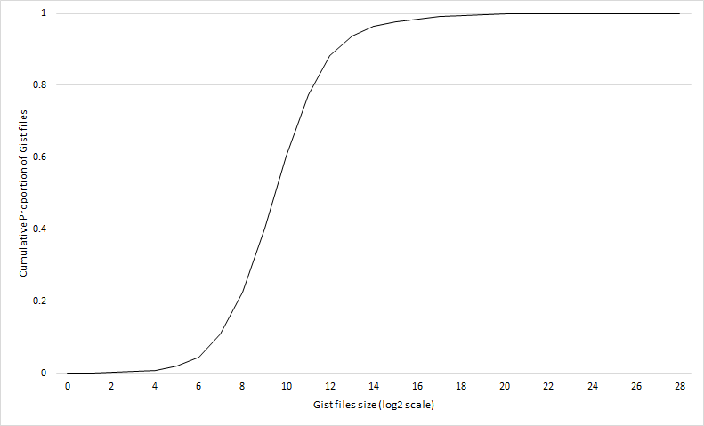
Results – What do Gists look like?
Content of Gists – file size by Bytes
The median value is 714 Bytes (quartiles: 287, 1830).
There exist outliers: 0.17% of Gist files are over 1MB.

Slide 19
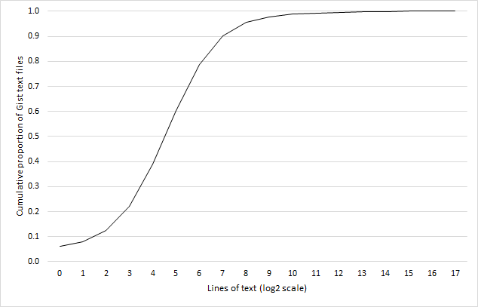
Results – What do Gists look like?
Content of Gists – file size by lines of code
The median value is 23 lines (quartiles are 10, 55).
87.1% of them have less than 100 lines.

Slide 20
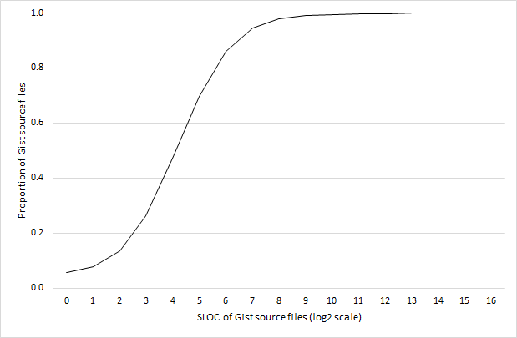
Results – What do Gists look like?
Content of Gists – file size by SLOC (source lines of code)
The median value is 18 lines (quartiles are 8, 39).
54.8% of them have less than 20 SLOCs, and 92.1% have less than 100.

Slide 21
Results – What do Gists look like?
Content of Gists – uniqueness of Gist file
Uniqueness detection used CLOC (based on Digest:MD5)
97.5% of all Gist text files were detected as unique.
➔ 2.5% of text Gist files were duplicates.

Slide 22
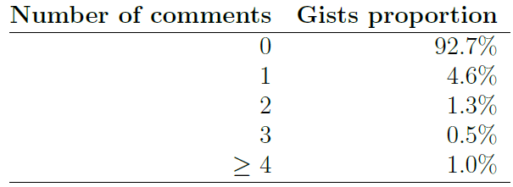
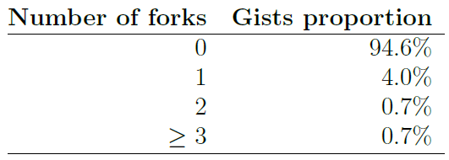
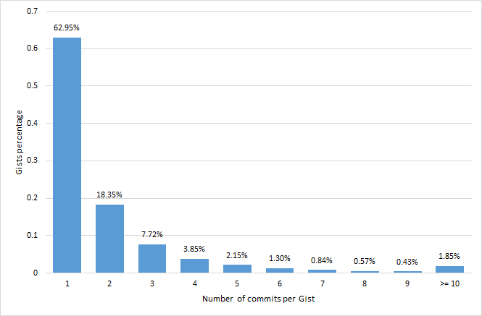
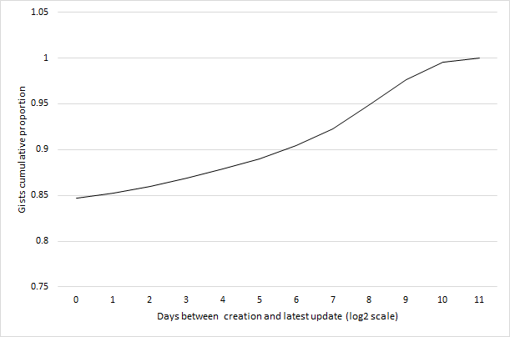
Results – What do Gists look like?
Activity

Slide 23
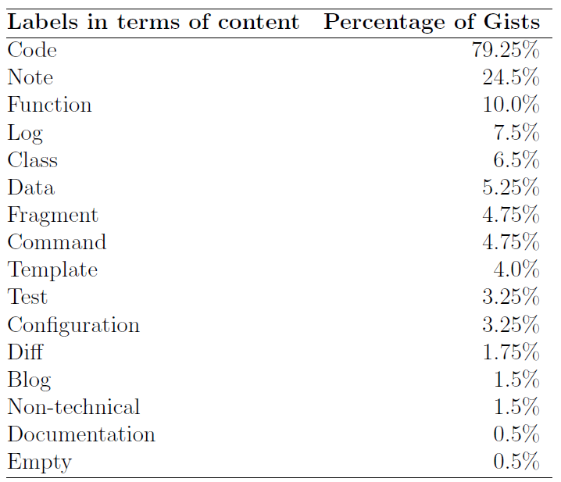
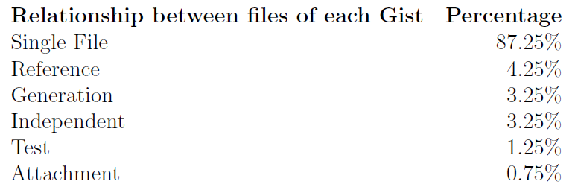
Results – What do Gists look like?
Manual inspection of Gists content

Slide 24
Results – How are Gists being used?
Being embedded in blogs
“I think I might start using GitHub Gists in my blog posts. Thinking about how to integrate it smoothly.”
Version-controlled list
“GitHub Gists are a great way to keep version-controlled lists (in this case, US states I've visited)”
“I recently discovered what appears to be the best yet simplest way to keep a to-do list: a GitHub Gist.”
Drafting
“Every once in a while I think I wish I could ‘draft’ a pull-request, issue, or comment on GitHub, then I remember that private Gists exist.”

Slide 25
Results – How are Gists being used?
Saving notes/tips
“I've been saving my learning as gists because blogging is a barrier: https://gist.github.com/Greg-Boggs”
“Useful fiddles and gists collected from #AngularJS forum discussions https://github.com/angular/angular.js/wiki/JSFiddle-Examples...”
Sharing files
User A to user B: “Can you show me what your application.xml looks like for your ios+android game? Need to know what info is needed to compile.”
User B replied user A: “I can put it on GitHub Gists sometime soon, remind me in a few days if I forget...”

Slide 26
Results – Summary
Majority of GitHub users don't use public Gists.
Gists usually contain small files.
Gists content shows a great variety.
Users don't collaborate on Gists.
Gists are being used for a variety of purposes.

Slide 27
Limitations and Future works
Limitations:
Private Gists are not covered.
The subjective manual coding in qualitative analysis could introduce error.
Search engine.
Future Works:
What users think about Gists: interviews etc.
Where the reusable components are from.
Comparison between Gists and other similar tools.

Slide 28
Publish
Improved and published by Dr. German and other researchers.
Weiliang Wang, G. Poo-Caamano, E. Wilde, and D.M. German. What is the gist? understanding the use of public gists on github. In Mining Software Repositories (MSR), 2015 IEEE/ACM 12th Working Conference on, pages 314{323, May 2015.

Slide 29
Questions

