Slide 1
Corvid Density & Population Trends at Big Basin, 2003 - 2017
Bill Webb
Marbled Murrelet Recovery Zone 6 Management Meeting
November 30, 2017

Slide 2
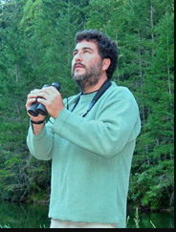
Background
Corvids surveyed 2003 – 2008, 2012
Study designed by David Suddjian
Big Basin, Portola, Butano & Memorial
Are corvid populations subsidized?
Is management in parks effective in reducing corvid populations?

Slide 3
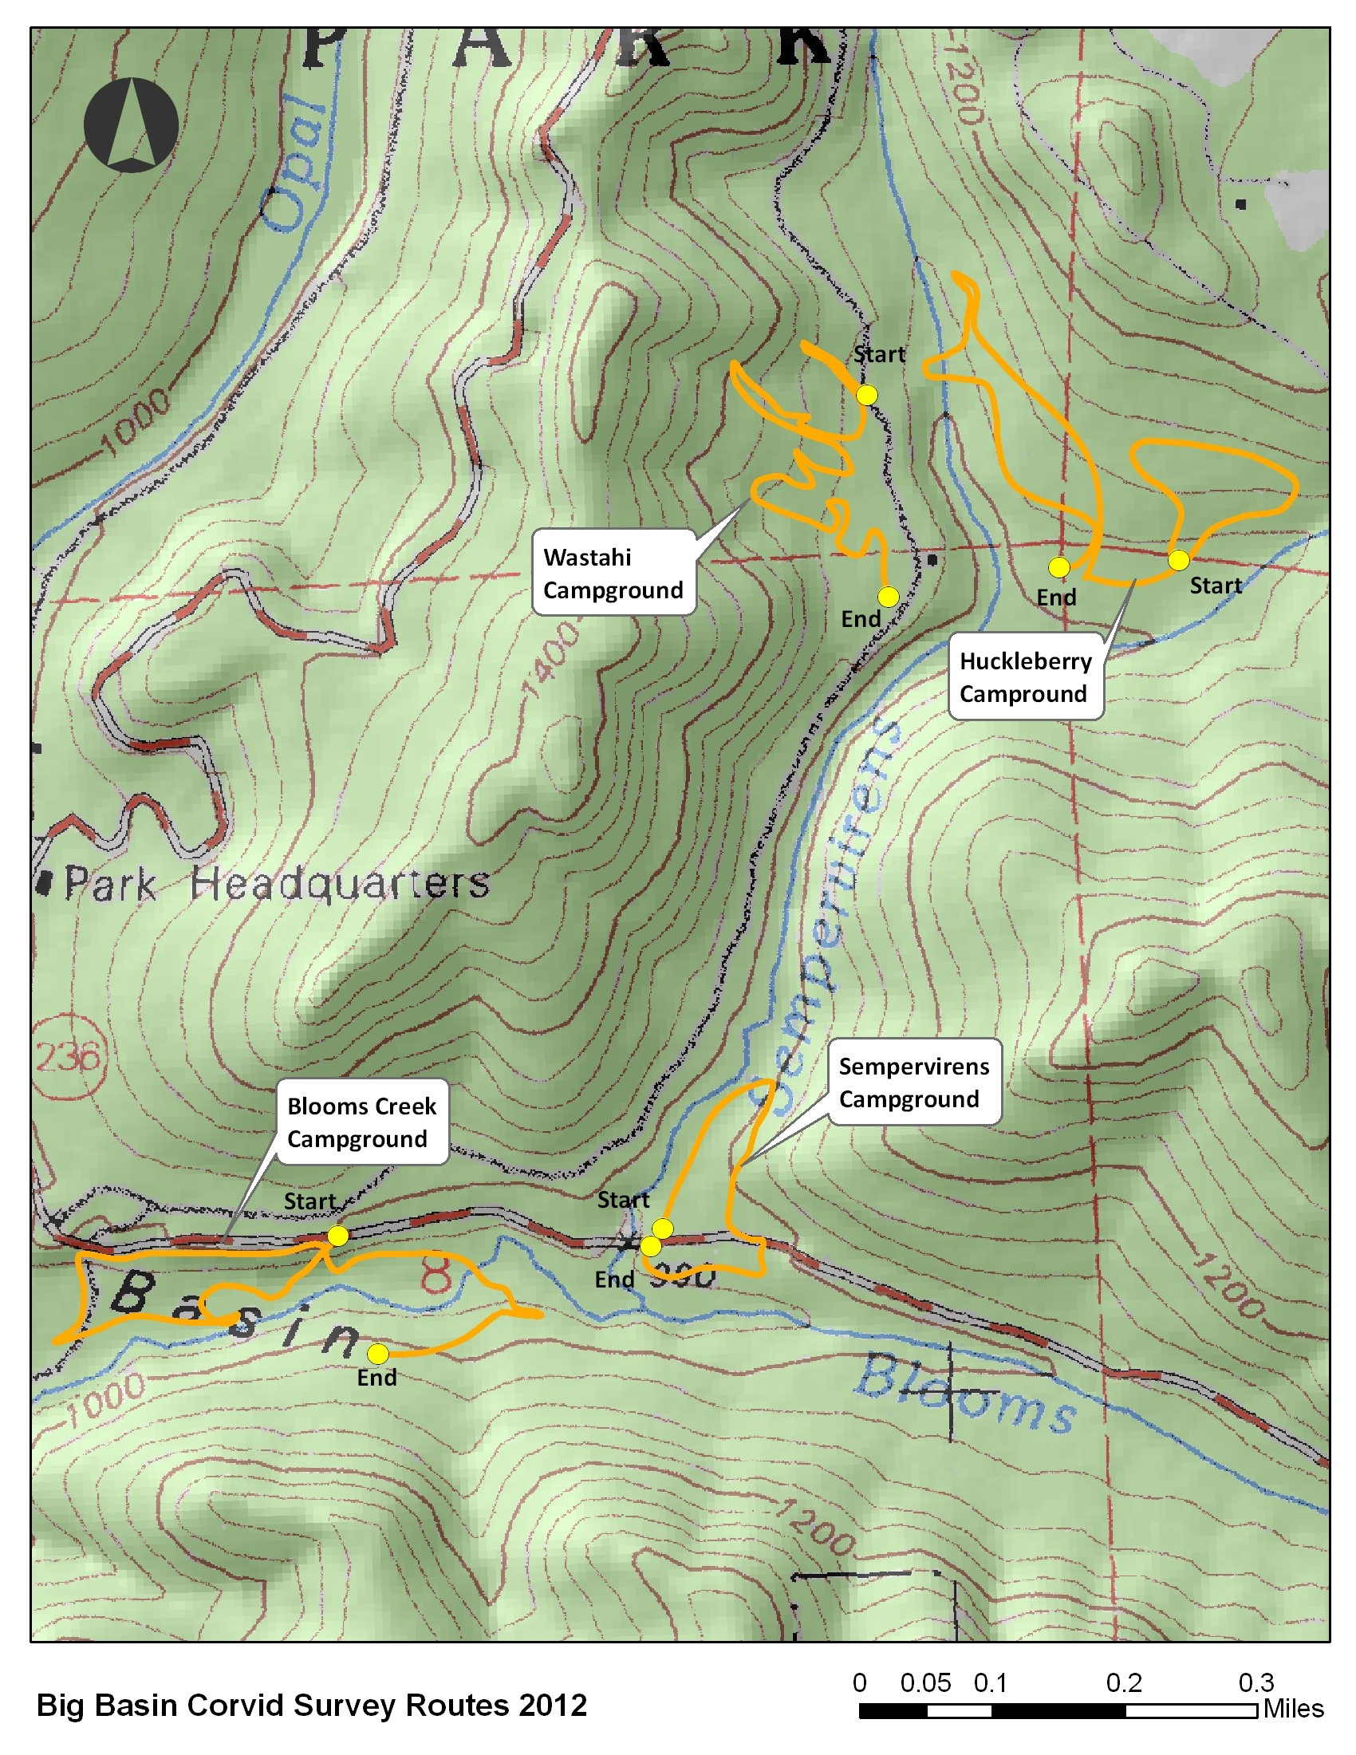
Survey Methods 2003 - 2012
10 survey Plots: campground (4) & control (6)
Area search method
Observers walk plots & count all birds
Estimate max. # corvids/plot
Density can be calculated using plot size which varies
Halbert, P. 2012. Summary of 2012 Corvid Monitoring Surveys in the Santa Cruz Mountains

Slide 4
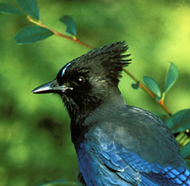


2017 Data Collection
Distance sampling (mostly)
Fewer sources of potential error
Fixed survey stations
Record all species
Estimate distance to corvids
10 min. observation window
Provides density estimates independent of plot size

Slide 5
2017 Field Work
June - August
Surveyed each plot once using area search (n = 10)
Established 2 - 6 survey stations/plot (plot size varies)
Surveyed each plot 4x – distance sampling (n = 133)

Slide 6
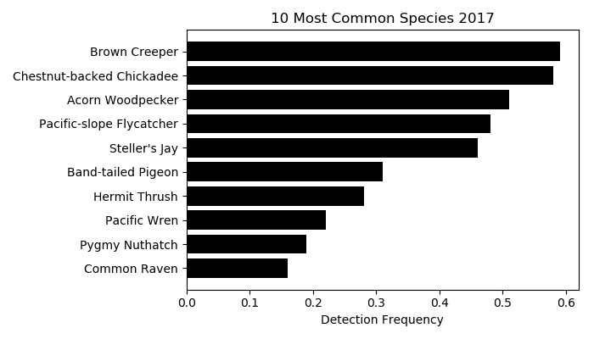
2017 Diversity & Abundance
25 avian species detected
Steller’s jays
5th most common
Detected on 46% of all points
Ravens
10th most common
Detected on 16% of all points

Slide 7
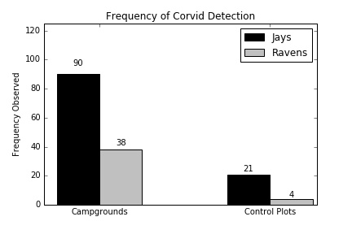
2017: Corvids Observed More in Campgrounds
Greater bird diversity in control plots vs. campgrounds ( t₄₅₈ = -4.21; p < 0.001)
Jays observed more frequently in campgrounds (χ²₁ = 24.13, p < 0.001)
Ravens observed more frequently in campgrounds (χ²₁ = 55.09, p <0.001)

Slide 8
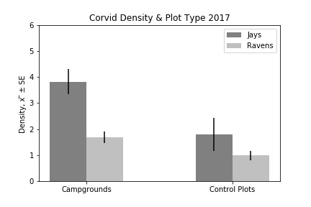
2017: Corvids More Abundant in Campgrounds
Density estimates from distance sampling
Jay density greater in campgrounds (Z = 2.63, p = 0.008)
Raven density greater in campgrounds (Z = 2.46, p = 0.01).

Slide 9
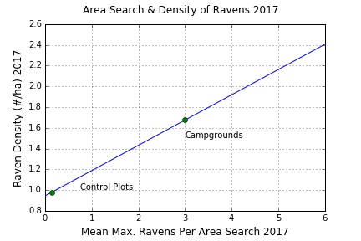
Estimating Population Trends 2003 - 2017
Compared 2017 area search data & 2017 distance sampling data
Generated “conversion factor” comparing max. # individuals(area search) & density (distance sampling)
Estimated density for pre-2017 surveys
Used OLS to detect significant trends 2003 - 2017
y = 0.2434x + 0.9449

Slide 10
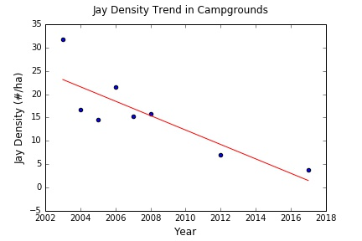
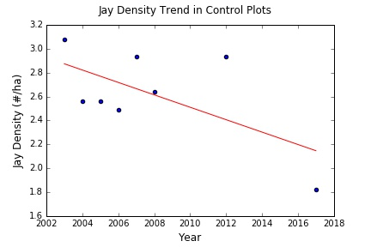
Jay Population Trends 2003 - 2017
Jay density declined in campgrounds (R² = 0.70, p = 0.009).
Jay density did NOT change in control plots (R² = 0.38, p = 0.096)

Slide 11
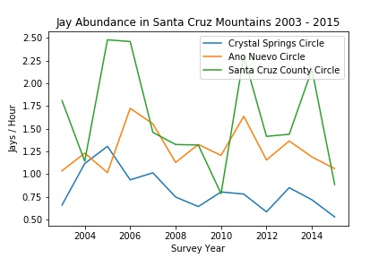
Jay Abundance Santa Cruz Mountains 2003 - 2015
CBC data
Suggests stable or declining abundance*
Differs from jay trends in campgrounds
Park management efforts could be working (for jays)
*Subject to statistical analysis

Slide 12
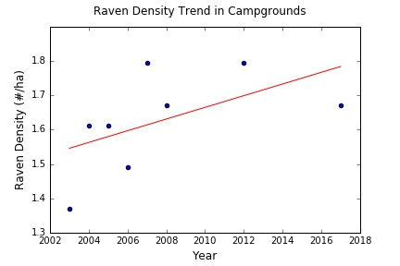
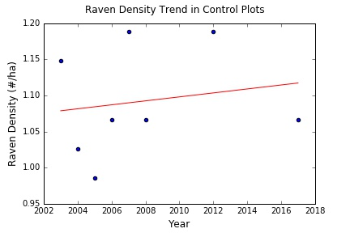
Raven Population Trends 2003 - 2017
Raven density did NOT change in campgrounds (R² = 0.30, p = 0.176)
Raven density did NOT change in control plots (R² = 0.03, p = 0.746)

Slide 13
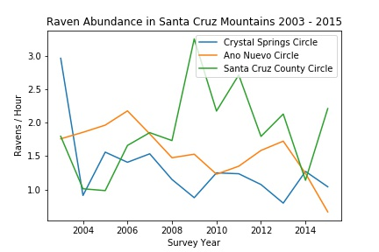
Raven Abundance Santa Cruz Mountains 2003 - 2015
CBC data
Suggests stable or declining abundance*
Similar to raven trends at Big Basin
Park management may not be working (for ravens)
*Subject to statistical analysis

Slide 14
Landscape-scale Most Relevant for Raven Populations
Ravens are long-lived and wide-ranging
Raven populations respond to landscape-scale and regional processes
Study plots probably too small to capture dynamics of raven populations
Corvid management within parks alone likely insufficient to affect raven populations

Slide 15
Summary
Avian community at Big Basin more diverse in control plots
Corvids occur more frequently & are more abundant in campgrounds
Jay density declined in campgrounds 2003 - 2017
Raven density remained unchanged 2003 -2017
Current management within parks alone might only be effective for jays

Slide 16
Thanks!
Questions?

Slide 18
Potential Sources of Survey Errors
Source | Area Search | Distance Sampling
Bird movement | X | X
Observer movement | X
Reduced detectability due to distance | X
Survey time | X
Plot area | X
Failure to count all birds | X

Slide 19
1.) Park Corvid Surveys– Top Priority
Monitor the effectiveness corvid management in parks
Re-initiate corvid surveys
Distance sampling
Less biased compared to other methods
Analyze existing & future survey data

Slide 20
2.) Identify & Reduce Park & Landscape-scale Food Subsidies
Park Scale:
Continue Crumb-Clean Campaign & similar efforts within parks
Landscape-scale:
Conduct landscape-scale corvid surveys
Identify subsides for ravens & crows near parks
Homes, ranches, farms, & road-kill
Develop & encourage BMP’s for property owners

Slide 21
3.) Identify & Reduce Regional Food Subsidies
Increasing crow & raven populations also driven by regional processes
Regional-scale:
Identify point subsidies:
Landfills, sewage treatment plants, etc.
Anything that attracts & subsidizes large numbers of crows & ravens
Conduct corvid surveys at potential point subsidies
Develop & encourage BMP’s for property managers
Effective for ravens at landfills in Mojave Desert

Slide 22
4.) Use CTA on Ravens
Conditioned taste aversion (CTA) to MAMU eggs and/or nestlings
CTA shown effective for ravens*
“Train” ravens to avoid MAMU nests
“Trained” territorial holders exclude untrained ravens
Potential long-lasting effects given raven longevity (15+ years)
Nicolaus, L. K. 1987. American Midland Naturalist 117:405-419.
Avery et al. 1995. Colonial Waterbirds 18:131-138.

Slide 23
5.) Fill Basic Knowledge Gaps
Ecology & behavior of local raven & crow populations mostly unstudied
Potential topics to address:
Diet
Habitat use
Demography – survival & reproduction
Predatory behavior: Do ravens remember & return to MAMU nest sites?

