Slide 1
One wet month does not prove a wetter climate
•
Fictional Example Town: 100 mm in September
•
Assumed September baseline: 80 mm
•
One month cannot establish a long-term change
Sources: S1 | Full links and speaking notes in the notes pane
Practical Work Delivery with Multiple AIs • Fictional learning example
1
Notes:
Can one wet September tell us that our local climate is getting wetter? By itself, no. The Met Office explains that a region's climate is usually defined over 30 years. Our conclusion follows from that distinction between short-term weather and longer-term climate; it is not a measured local finding. Throughout this presentation, Example Town and its September rainfall of 100 mm are fictional. The September baseline of 80 mm is also assumed for the exercise, rather than calculated from observations. These figures help explain a comparison, but they provide no evidence about rainfall in our own community.
S1 — Met Office, What is climate?: https://weather.metoffice.gov.uk/climate/climate-explained/what-is-climate
Sources (read 29 September 2026):
S1 What is climate? — https://weather.metoffice.gov.uk/climate/climate-explained/what-is-climate
Canonical research: https://williamwklee.atlassian.net/wiki/spaces/DEV/pages/77561914 version5; report text originatedv3
Fictional example. No local trend or forecast established.

Slide 2
Compare September with September
•
Use the same calendar month across years
•
Our assumed baseline covers 1991–2020
•
Keep examples separate from observations
Sources: S1, S2 | Full links and speaking notes in the notes pane
Practical Work Delivery with Multiple AIs • Fictional learning example
2
Notes:
A monthly rainfall normal is an average for the same calendar month across a reference period. A September normal for 1991–2020 averages September rainfall across those 30 years. It is not an average of 30 consecutive months. NOAA explains the use of a uniform 30-year period for official U.S. climate normals. We use that source to explain the method, not to supply UK rainfall data or observations for Example Town. Here, 80 mm remains an assumed September average. A useful comparison makes the place, calendar month, reference period and origin of the figures clear.
S1 — Met Office, What is climate?: https://weather.metoffice.gov.uk/climate/climate-explained/what-is-climate
S2 — NOAA NCEI, U.S. Climate Normals: https://www.ncei.noaa.gov/products/land-based-station/us-climate-normals
Sources (read 29 September 2026):
S1 What is climate? — https://weather.metoffice.gov.uk/climate/climate-explained/what-is-climate
S2 U.S. Climate Normals — https://www.ncei.noaa.gov/products/land-based-station/us-climate-normals
Canonical research: https://williamwklee.atlassian.net/wiki/spaces/DEV/pages/77561914 version5; report text originatedv3
Fictional example. No local trend or forecast established.

Slide 3
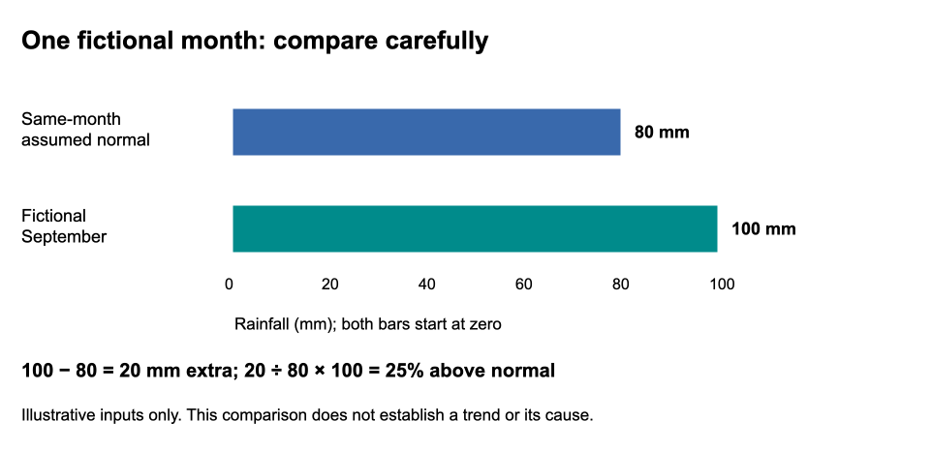
25 percent above the baseline
Sources: S2 | Full links and speaking notes in the notes pane
Practical Work Delivery with Multiple AIs • Fictional learning example
3
Notes:
Read the comparison in three steps. First, subtract the assumed baseline from the fictional total: 100 mm − 80 mm = 20 mm. Second, express that extra rainfall relative to the baseline: 20 ÷ 80 × 100 = 25 percent above the baseline. Third, express the whole total relative to the baseline: 100 ÷ 80 × 100 = 125 percent of the baseline. The words 'above' and 'of' answer different questions. These calculations use the supplied fictional inputs; NOAA supplies the explanation of normals, not these numbers. The comparison alone tells us neither how rare this month would be nor whether rainfall is increasing over time.
S2 — NOAA NCEI, U.S. Climate Normals: https://www.ncei.noaa.gov/products/land-based-station/us-climate-normals
Sources (read 29 September 2026):
S2 U.S. Climate Normals — https://www.ncei.noaa.gov/products/land-based-station/us-climate-normals
Canonical research: https://williamwklee.atlassian.net/wiki/spaces/DEV/pages/77561914 version5; report text originatedv3
Fictional example. No local trend or forecast established.

Slide 4
Three different questions
•
Anomaly: how far from the usual amount?
•
Trend: how is rainfall changing over years?
•
Attribution: what influenced the event?
Sources: S1, S2, S3, S4 | Full links and speaking notes in the notes pane
Practical Work Delivery with Multiple AIs • Fictional learning example
4
Notes:
An anomaly is a difference from a baseline: in our example, September is 20 mm above its assumed normal. A trend describes change over time. Comparing one month with an average does not show how rainfall changed through the years. Attribution investigates causes. NOAA explains that it requires multiple lines of evidence. Individual weather events can be investigated for a climate-change influence: the Met Office describes studies comparing simulations with and without human influence, alongside observations and other inputs. It would therefore be wrong to say that individual events can never be linked to climate change. No attribution analysis was performed for this fictional month.
S1 — Met Office, What is climate?: https://weather.metoffice.gov.uk/climate/climate-explained/what-is-climate
S2 — NOAA NCEI, U.S. Climate Normals: https://www.ncei.noaa.gov/products/land-based-station/us-climate-normals
S3 — NOAA Physical Sciences Laboratory, Why Attribution?: https://psl.noaa.gov/csi/why/
S4 — Met Office, Attributing extreme weather to climate change: https://www.metoffice.gov.uk/research/climate/understanding-climate/attributing-extreme-weather-to-climate-change
Sources (read 29 September 2026):
S1 What is climate? — https://weather.metoffice.gov.uk/climate/climate-explained/what-is-climate
S2 U.S. Climate Normals — https://www.ncei.noaa.gov/products/land-based-station/us-climate-normals
S3 Why Attribution? — https://psl.noaa.gov/csi/why/
S4 Attributing extreme weather to climate change — https://www.metoffice.gov.uk/research/climate/understanding-climate/attributing-extreme-weather-to-climate-change
Canonical research: https://williamwklee.atlassian.net/wiki/spaces/DEV/pages/77561914 version5; report text originatedv3
Fictional example. No local trend or forecast established.

Slide 5
What would we need to know?
•
Local rainfall records covering many years
•
Details of measurement changes and gaps
•
How much rainfall varies, and how certain we are
Sources: S1, S2 | Full links and speaking notes in the notes pane
Practical Work Delivery with Multiple AIs • Fictional learning example
5
Notes:
To investigate a local trend, we would need a long rainfall record, comparing the same calendar months, seasons or annual totals as appropriate to the question. We would also need information about station moves, instruments, measurement methods and missing observations to assess whether the measurements are comparable. Analysis would need to account for uncertainty in observations, the baseline and any estimated trend. These are proposed evidence requirements from the supplied report, not work completed here. To judge whether a month is rare or extreme, we would also need the distribution and variability of local rainfall. Two totals cannot answer those questions. S1 and S2 provide the background on climate timescales and normals, rather than a completed local assessment.
S1 — Met Office, What is climate?: https://weather.metoffice.gov.uk/climate/climate-explained/what-is-climate
S2 — NOAA NCEI, U.S. Climate Normals: https://www.ncei.noaa.gov/products/land-based-station/us-climate-normals
Sources (read 29 September 2026):
S1 What is climate? — https://weather.metoffice.gov.uk/climate/climate-explained/what-is-climate
S2 U.S. Climate Normals — https://www.ncei.noaa.gov/products/land-based-station/us-climate-normals
Canonical research: https://williamwklee.atlassian.net/wiki/spaces/DEV/pages/77561914 version5; report text originatedv3
Fictional example. No local trend or forecast established.

Slide 6
A clear message to share
•
Our fictional September is 25 percent above baseline
•
One wet month does not establish a wetter climate
•
Local conclusions need long-term records and analysis
Sources: S1, S2 | Full links and speaking notes in the notes pane
Practical Work Delivery with Multiple AIs • Fictional learning example
6
Notes:
Suggested newsletter wording: 'In our fictional example, September rainfall was 100 mm—20 mm, or 25 percent, above the assumed September baseline. One wet month does not establish a wetter climate; a reliable long-term local record and analysis are needed.' Keep the words 'fictional' and 'assumed' when sharing the figures so readers understand where they come from. The example explains how to compare a monthly total with a baseline. It provides no measured local trend, attribution result or forecast. The practical next step for a real local question would be to obtain suitable observations and analyse them over time.
S1 — Met Office, What is climate?: https://weather.metoffice.gov.uk/climate/climate-explained/what-is-climate
S2 — NOAA NCEI, U.S. Climate Normals: https://www.ncei.noaa.gov/products/land-based-station/us-climate-normals
Sources (read 29 September 2026):
S1 What is climate? — https://weather.metoffice.gov.uk/climate/climate-explained/what-is-climate
S2 U.S. Climate Normals — https://www.ncei.noaa.gov/products/land-based-station/us-climate-normals
Canonical research: https://williamwklee.atlassian.net/wiki/spaces/DEV/pages/77561914 version5; report text originatedv3
Fictional example. No local trend or forecast established.

