Slide 1
One wet month proves a wetter climate
•
A short briefing for our community group
•
Fictional Example Town:100mm in September
•
Compared with an assumed80mm September baseline
Sources: S1 | Full links and speaking notes in the notes pane
Practical Work Delivery with Multiple AIs • Fictional learning example
1
Notes:
The figures are illustrative, not measured local data. The seed deliberately contains an unsupported title.
Sources (read29September2026):
S1 What is climate? — https://weather.metoffice.gov.uk/climate/climate-explained/what-is-climate
Canonical research: https://williamwklee.atlassian.net/wiki/spaces/DEV/pages/77561914 version5; report text originatedv3
Fictional example. No local trend or forecast established.

Slide 2
Compare like with like
•
Use the same calendar month
•
State the baseline period and place
•
Keep assumed inputs separate from observations
Sources: S1, S2 | Full links and speaking notes in the notes pane
Practical Work Delivery with Multiple AIs • Fictional learning example
2
Notes:
Our80mmSeptembernormal is assumed for illustration. NOAA explains30yearnormals for the U.S.; it does not supply data for this fictional town.
Sources (read29September2026):
S1 What is climate? — https://weather.metoffice.gov.uk/climate/climate-explained/what-is-climate
S2 U.S. Climate Normals — https://www.ncei.noaa.gov/products/land-based-station/us-climate-normals
Canonical research: https://williamwklee.atlassian.net/wiki/spaces/DEV/pages/77561914 version5; report text originatedv3
Fictional example. No local trend or forecast established.

Slide 3
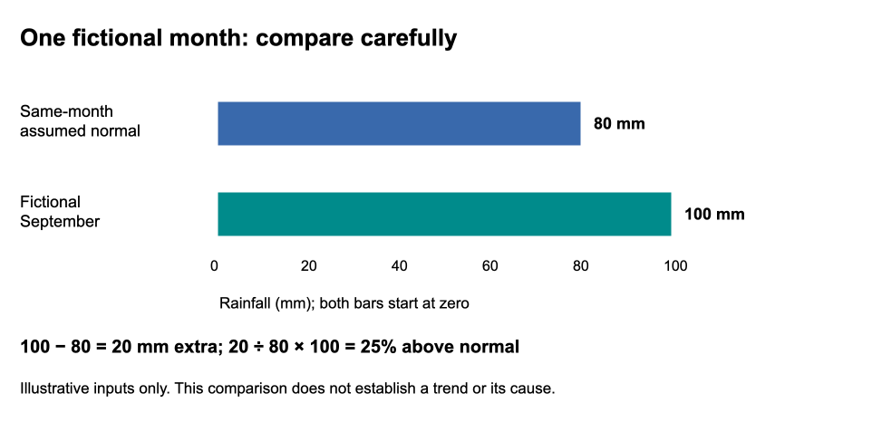
100mm is125% above the baseline
Sources: S2 | Full links and speaking notes in the notes pane
Practical Work Delivery with Multiple AIs • Fictional learning example
3
Notes:
The chart separately shows20mmextra and25percentabove. The headline is deliberately inconsistent with it.
Sources (read29September2026):
S2 U.S. Climate Normals — https://www.ncei.noaa.gov/products/land-based-station/us-climate-normals
Canonical research: https://williamwklee.atlassian.net/wiki/spaces/DEV/pages/77561914 version5; report text originatedv3
Fictional example. No local trend or forecast established.

Slide 4
Three different questions
•
Anomaly: how far from the baseline?
•
Trend: what changes across years?
•
Attribution: what influenced the event?
Sources: S1, S3, S4 | Full links and speaking notes in the notes pane
Practical Work Delivery with Multiple AIs • Fictional learning example
4
Notes:
A monthly anomaly does not establish a trend. Event-specific attribution is possible with appropriate observations,models and multiple evidence lines; no such study was done here.
Sources (read29September2026):
S1 What is climate? — https://weather.metoffice.gov.uk/climate/climate-explained/what-is-climate
S3 Why Attribution? — https://psl.noaa.gov/csi/why/
S4 Attributing extreme weather to climate change — https://www.metoffice.gov.uk/research/climate/understanding-climate/attributing-extreme-weather-to-climate-change
Canonical research: https://williamwklee.atlassian.net/wiki/spaces/DEV/pages/77561914 version5; report text originatedv3
Fictional example. No local trend or forecast established.

Slide 5
What we still need
•
A comparable long local rainfall record
•
Station, instrument and missing-data history
•
Uncertainty and a suitable analysis
Sources: S1, S3 | Full links and speaking notes in the notes pane
Practical Work Delivery with Multiple AIs • Fictional learning example
5
Notes:
These are proposed evidence needs, not work performed in this illustration. Two totals do not establish rarity or whether a month is extreme.
Sources (read29September2026):
S1 What is climate? — https://weather.metoffice.gov.uk/climate/climate-explained/what-is-climate
S3 Why Attribution? — https://psl.noaa.gov/csi/why/
Canonical research: https://williamwklee.atlassian.net/wiki/spaces/DEV/pages/77561914 version5; report text originatedv3
Fictional example. No local trend or forecast established.

Slide 6
Publish the checked version
•
Describe the comparison without inventing a trend
•
Keep report, sources and all findings together
•
Check the rendered deck matches its editable source
Sources: S1, S2, S3, S4 | Full links and speaking notes in the notes pane
Practical Work Delivery with Multiple AIs • Fictional learning example
6
Notes:
Suggested wording: our fictional month is25percentabove an assumed baseline; it does not by itself prove a wetter climate. This is a teaching presentation, not a forecast or public announcement.
Sources (read29September2026):
S1 What is climate? — https://weather.metoffice.gov.uk/climate/climate-explained/what-is-climate
S2 U.S. Climate Normals — https://www.ncei.noaa.gov/products/land-based-station/us-climate-normals
S3 Why Attribution? — https://psl.noaa.gov/csi/why/
S4 Attributing extreme weather to climate change — https://www.metoffice.gov.uk/research/climate/understanding-climate/attributing-extreme-weather-to-climate-change
Canonical research: https://williamwklee.atlassian.net/wiki/spaces/DEV/pages/77561914 version5; report text originatedv3
Fictional example. No local trend or forecast established.

