Slide 1
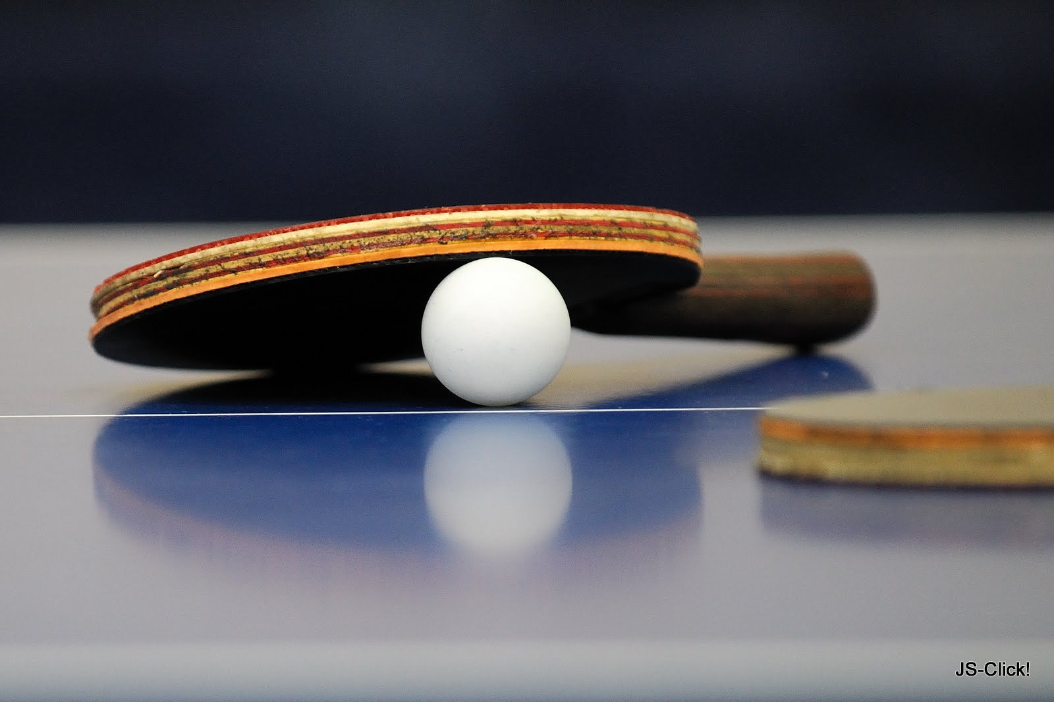
MIT Table Tennis Club
Club hours spring 2015:
Tuesdays & Thursdays, 8-10pm
T-club Lounge
Saturdays, 6-9pm
DuPont gym

