Slide 1
Saliency Adaptive Player

Slide 2
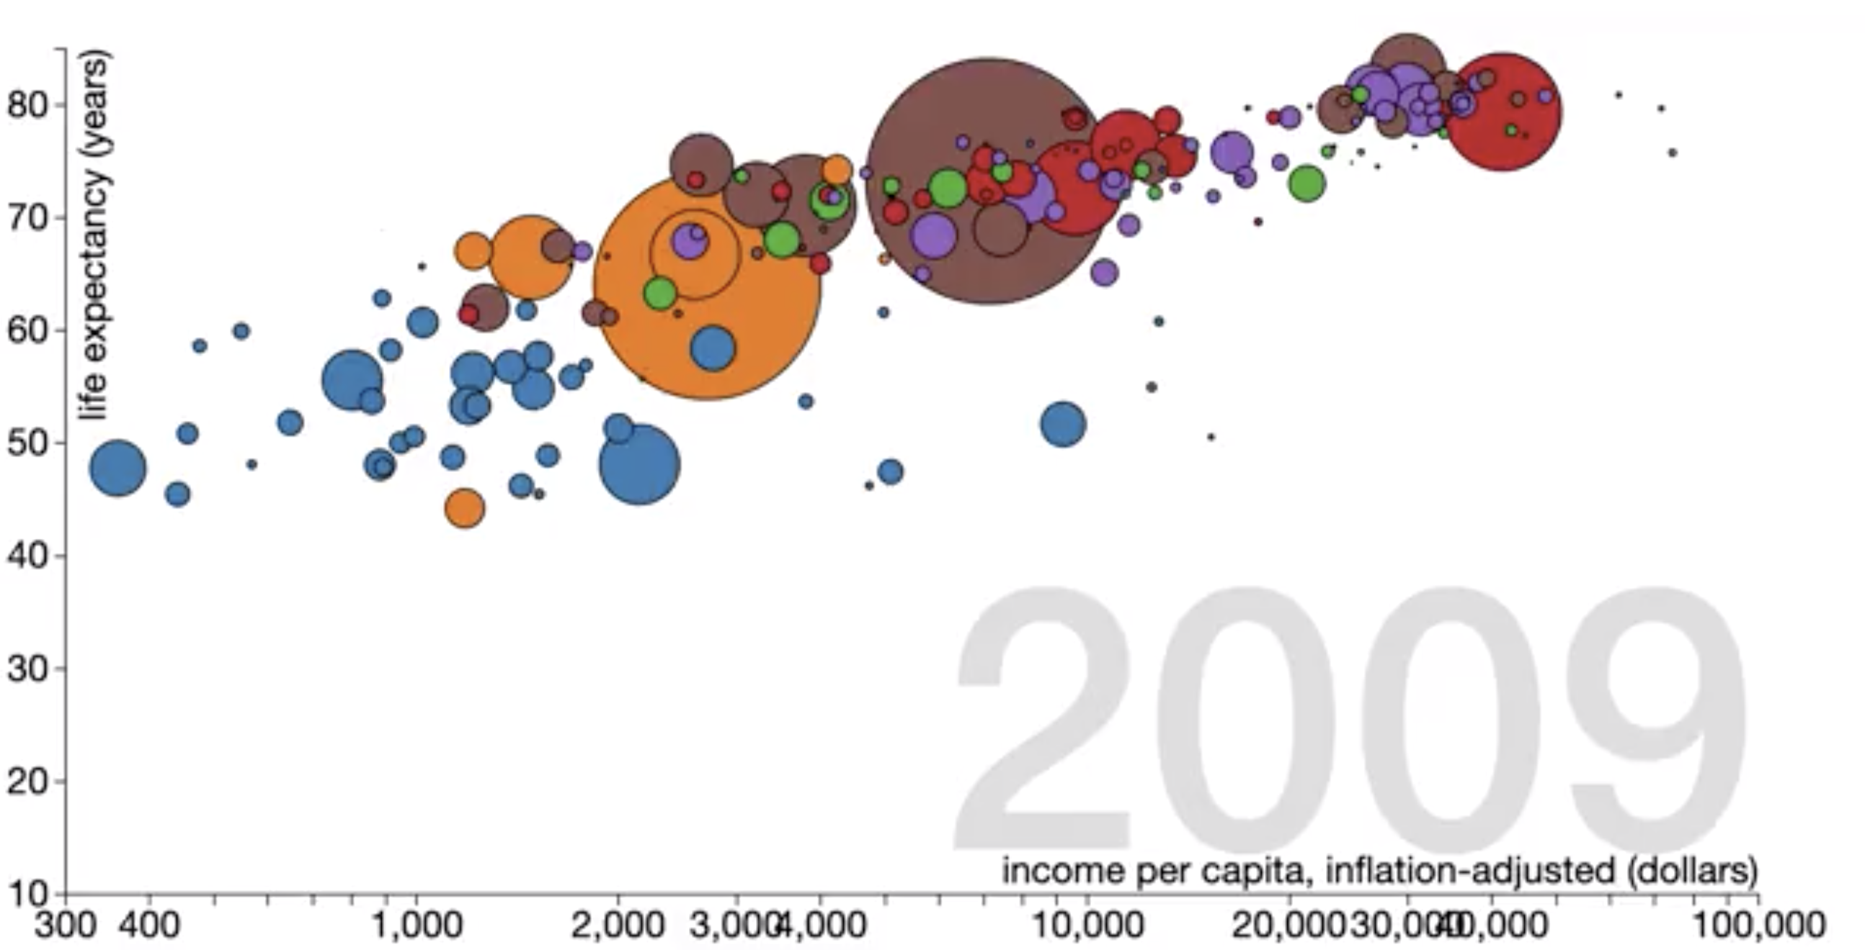
Explanation of data set

Slide 3
Did India have a life expectancy over 40 years in 1920? F

Slide 4
One Play through

Slide 5
Did China have a life expectancy lower than Indian from 1930-1940? F
Did China have an income per capita of more than 4000 dollars in 1980? F

Slide 6
One Play through

Slide 7
Did one European country have the largest increase in life expectancy? T
Did one European country have the largest decrease in life expectancy at one point? T

Slide 8
One Play through

Slide 9
Do you like the system? Please rate the system from 1-5 in integer intervals.

