Slide 1
Research in Video Encoding and Streaming
“A Conditional-Probability-Distribution Model for Bandwidth Estimation with Application in Live Video Streaming”
ESTR4999 – Oral Presentation
Weijia Zheng, 1155124322
Department of Information Engineering, CUHK
April 25, 2022

Slide 2
Outline
Preliminaries
Current Related Works of Bandwidth Estimation
Our Works on the Problem
Motivations of Our Model
Method in Details
Simulation Results
Conclusions and Future Works

Slide 3
Preliminaries (From ESTR4998 Presentation) - An Overall Picture of Video Encoding and Streaming
Video frames generated at the uploader side are sent to the server.
The server then made the video trace received into different copies as different players may have different network quality and demands.
We will mainly focus on the uploading part.
Live Video Uploader
Video Trace
Data
Video Trace
Data
Vid Trace
Vid Trace
Vid Trace
Uplink Network
Player 1
Server
Downlink Network
Adapt/decide
Encoding Bitrate
Player 2
…

Slide 4
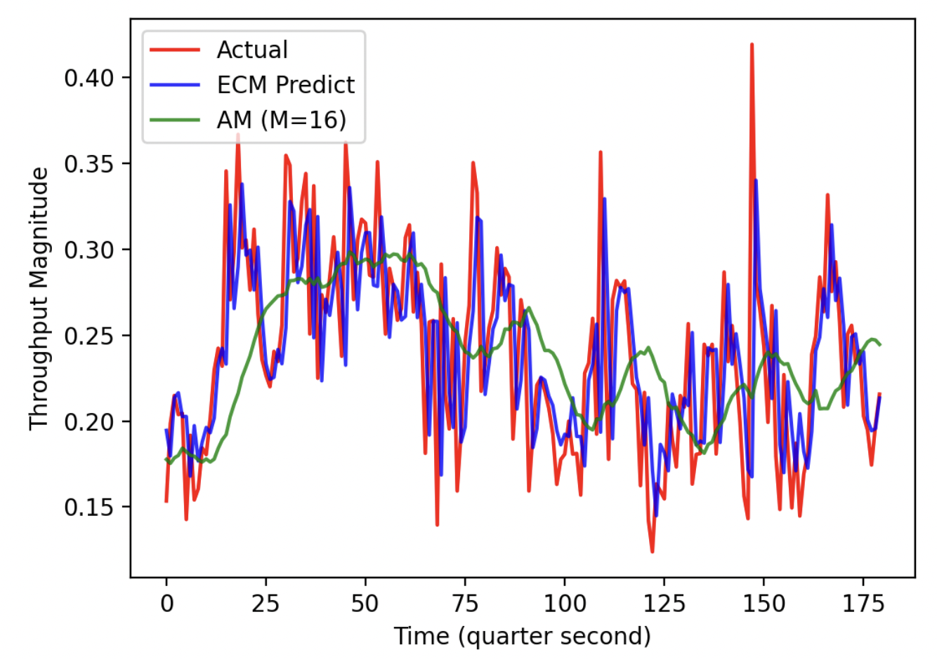
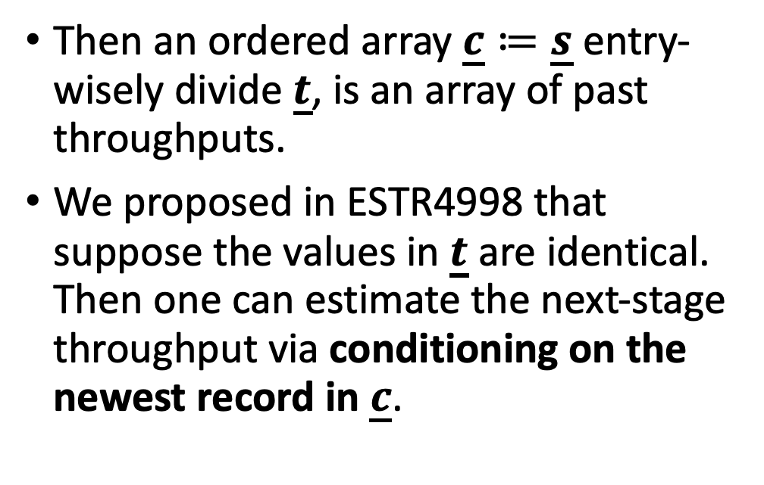
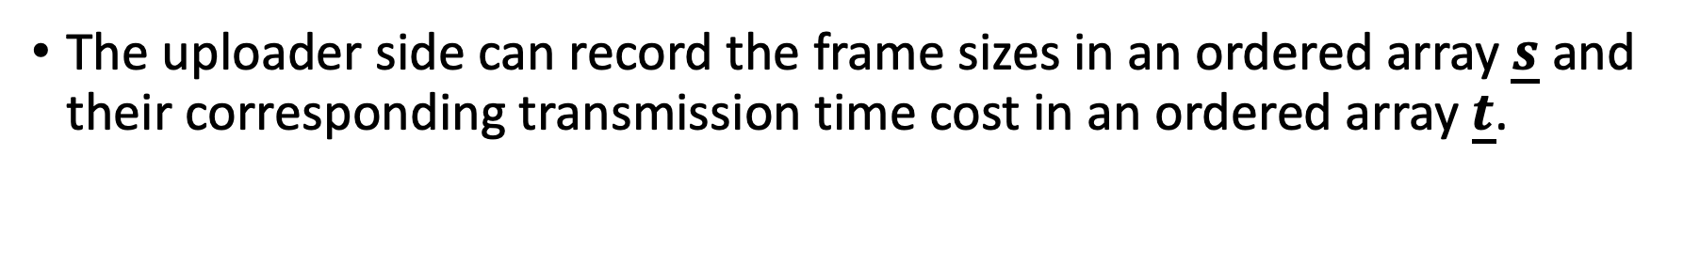
Preliminaries - What Did We Propose in ESTR4998?
The uploader side can record the frame sizes in an ordered array $\underline{s}$ and their corresponding transmission time cost in an ordered array $\underline{t}$.
Then an ordered array $\underline{c}≔\underline{s}$ entry-wisely divide $\underline{t}$, is an array of past throughputs.
We proposed in ESTR4998 that suppose the values in $\underline{t}$ are identical. Then one can estimate the next-stage throughput via conditioning on the newest record in $\underline{c}$.

Slide 5
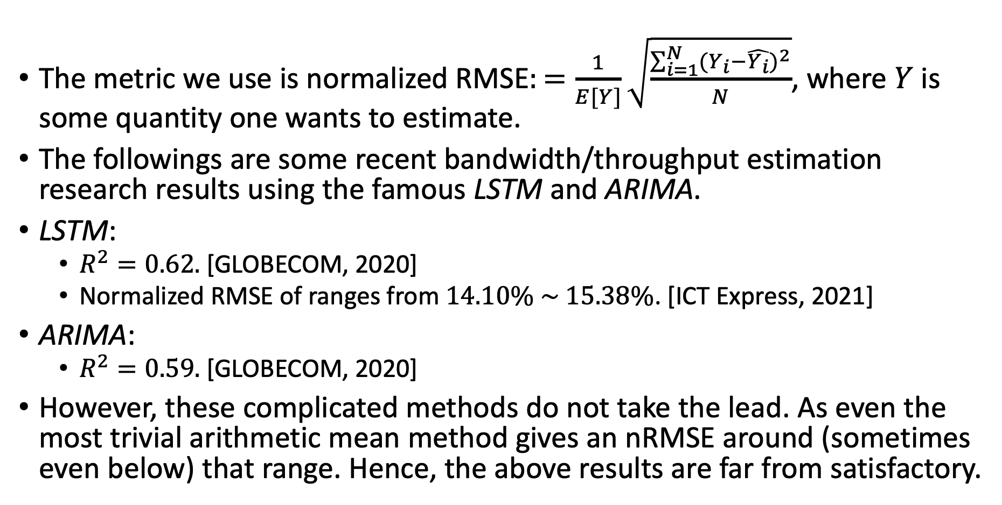
Current Related Works of Bandwidth Estimation
The metric we use is normalized RMSE$:=\frac{1}{E[Y]}\sqrt{\frac{\sum_{i=1}^{N}{{(Y_{i}−\hat{Y_{i}})}^{2}}}{N}}$, where $Y$ is some quantity one wants to estimate.
The followings are some recent bandwidth/throughput estimation research results using the famous LSTM and ARIMA.
LSTM:
$R^{2}=0.62.$ [GLOBECOM, 2020]
Normalized RMSE of ranges from $14.10\% \sim 15.38\%$. [ICT Express, 2021]
ARIMA:
$R^{2}=0.59.$ [GLOBECOM, 2020]
However, these complicated methods do not take the lead. As even the most trivial arithmetic mean method gives an nRMSE around (sometimes even below) that range. Hence, the above results are far from satisfactory.

Slide 6

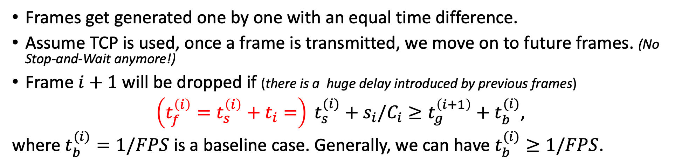



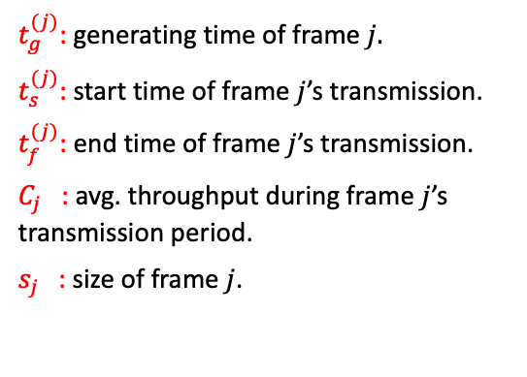


Preliminaries (Re-visit) - How Do Frames Transmit?
Frames get generated one by one with an equal time difference.
Assume TCP is used, once a frame is transmitted, we move on to future frames. (No Stop-and-Wait anymore!)
Frame $i+1$ will be dropped if (there is a huge delay introduced by previous frames)
$\left(t_{f}^{\left(i\right)}=t_{s}^{\left(i\right)}+t_{i}=\right) t_{s}^{(i)}+s_{i}/C_{i}≥t_{g}^{\left(i+1\right)}+t_{b}^{(i)}$,
where $t_{b}^{(i)}=1/FPS$ is a baseline case. Generally, we can have $t_{b}^{(i)}≥1/FPS$.
1/FPS
1/FPS
$t_{g}^{(j)}$: generating time of frame $j.$
$t_{s}^{(j)}$: start time of frame $j$’s transmission.
$t_{f}^{(j)}$: end time of frame $j$’s transmission.
$C_{j}$ : avg. throughput during frame $j$’s transmission period.
$s_{j}$ : size of frame $j$.
Uploader
$$t_{i}=s_{i}/C_{i}$$
$$t_{g}^{(i)}$$
$$t_{g}^{(i+1)}$$
$$t_{g}^{(i+2)}$$
$$t_{s}^{(i)}$$
$$t_{f}^{(i)}$$

Slide 8
Introduction - A Brief Recap of ESTR4998 Presentation
In the presentation of ESTR4998, we talked about how do video frames get transmitted to the server.

