Slide 1
Research in Video Encoding and Streaming
ESTR4999 Oral Presentation
Thesis Report Title:
“A Conditional-Probability-Distribution Model for Bandwidth Estimation with Application in Live Video Streaming”
Student: Weijia Zheng Supervisor: Jack Y. B. Lee
Department of Information Engineering, CUHK
April 25, 2022

Slide 2
Outline
Preliminaries
Current Status of Bandwidth Estimation
Our Solution
Simulation Results
Conclusions and Future Works

Slide 3
Preliminaries (From ESTR4998 Presentation) - An Overall Picture of Video Encoding and Streaming
Video frames generated at the uploader side are transmitted to the server.
The server then made the video trace received into different copies as different players may have different network quality and demands.
We will mainly focus on the uploading part.
Bandwidth estimation matters because poorly estimated bandwidth will lead to either a low bitrate of video or a high frame loss rate.
Live Video Uploader
Video Trace
Data
Video Trace
Data
Vid Trace
Vid Trace
Vid Trace
Uplink Network
Player 1
Server
Downlink Network
Player 2
Adapt/decide
Encoding Bitrate
…

Slide 4
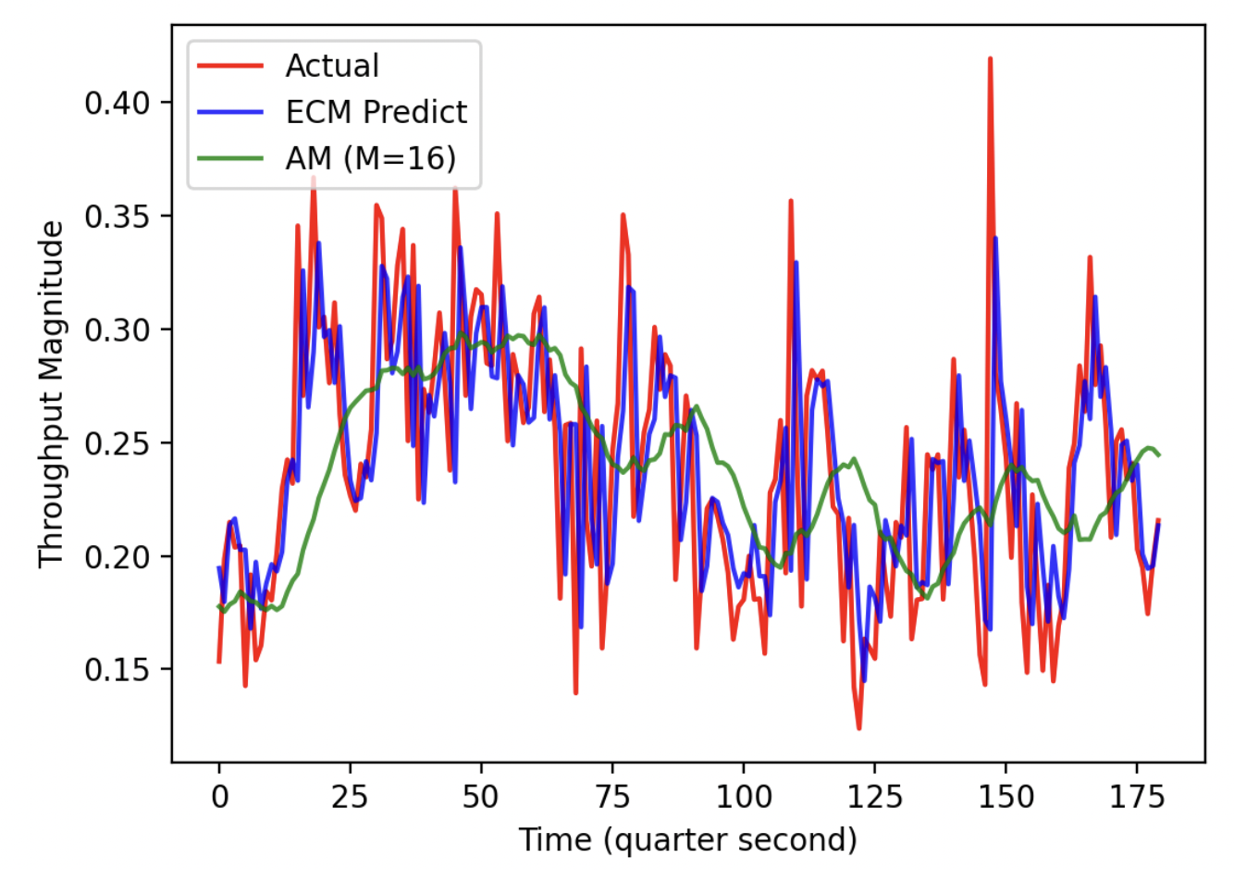
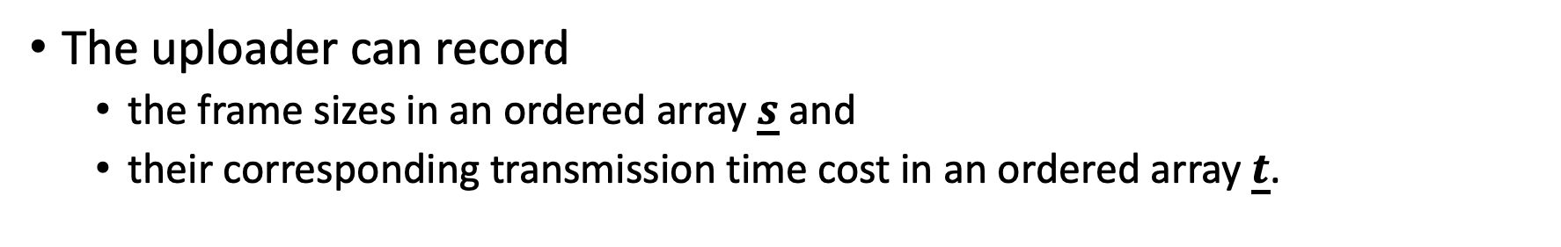
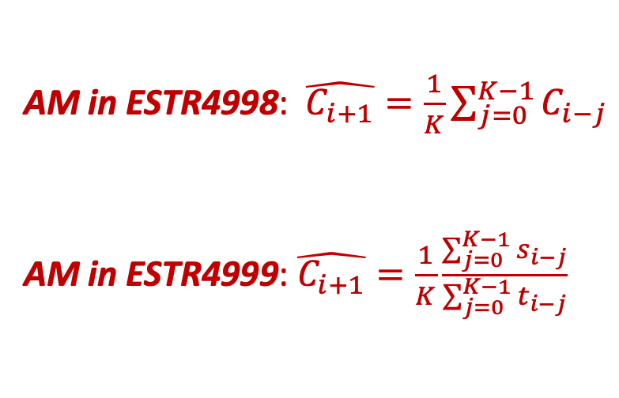
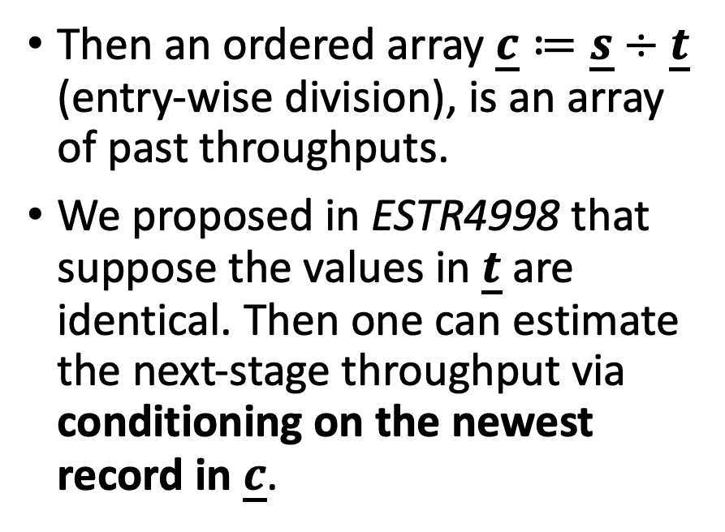
Preliminaries - What Did We Propose in ESTR4998?
AM in ESTR4998: $\hat{C_{i+1}}=\frac{1}{K}\sum_{j=0}^{K−1}{C_{i−j}}$
AM in ESTR4999: $\hat{C_{i+1}}=\frac{1}{K}\frac{\sum_{j=0}^{K−1}{s_{i−j}}}{\sum_{j=0}^{K−1}{t_{i−j}}}$
The uploader can record
the frame sizes in an ordered array $\underline{s}$ and
their corresponding transmission time cost in an ordered array $\underline{t}$.
Then an ordered array $\underline{c}≔\underline{s}÷\underline{t}$ (entry-wise division), is an array of past throughputs.
We proposed in ESTR4998 that suppose the values in $\underline{t}$ are identical. Then one can estimate the next-stage throughput via conditioning on the newest record in $\underline{c}$.

Slide 5
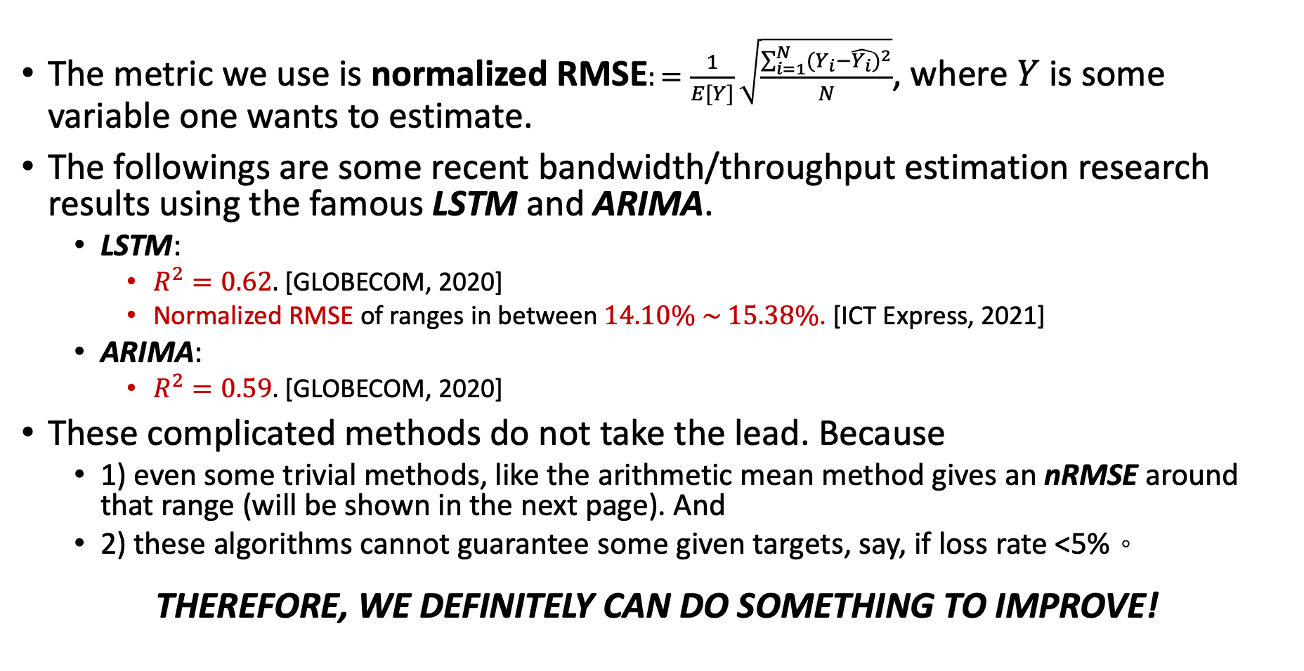
Current Status of Bandwidth Estimation - LSTM and ARIMA
The metric we use is normalized RMSE$:=\frac{1}{E[Y]}\sqrt{\frac{\sum_{i=1}^{N}{{(Y_{i}−\hat{Y_{i}})}^{2}}}{N}}$, where $Y$ is some variable one wants to estimate.
The followings are some recent bandwidth/throughput estimation research results using the famous LSTM and ARIMA.
LSTM:
$R^{2}=0.62.$ [GLOBECOM, 2020]
Normalized RMSE of ranges in between $14.10\% \sim 15.38\%$. [ICT Express, 2021]
ARIMA:
$R^{2}=0.59.$ [GLOBECOM, 2020]
These complicated methods do not take the lead. Because
1) even some trivial methods, like the arithmetic mean method gives an nRMSE around that range (will be shown in the next page). And
2) these algorithms cannot guarantee some given targets, say, if loss rate <5%。
THEREFORE, WE DEFINITELY CAN DO SOMETHING TO IMPROVE!

Slide 6
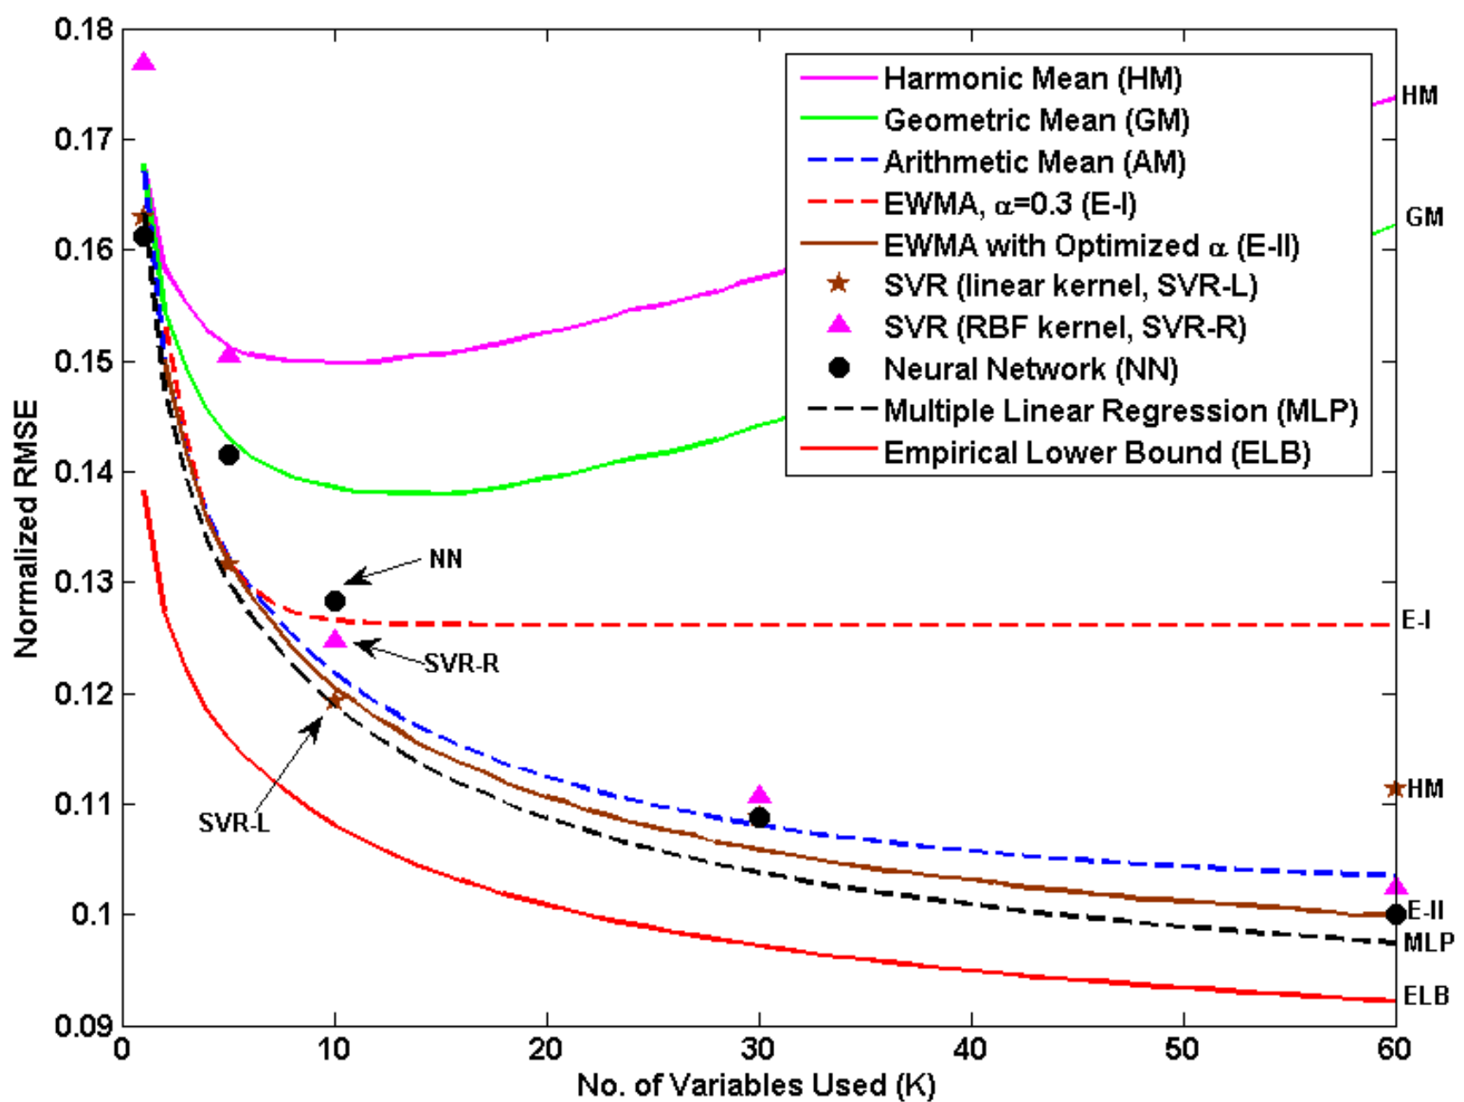
Current Status of Bandwidth Estimation - Arithmetic Mean
On the RHS is a plot showing different algorithms’ normalized RMSE.
The normalized RMSE of the arithmetic mean is about 11%.
Certainly, these kinds of metrics vary from data sets.

Slide 7

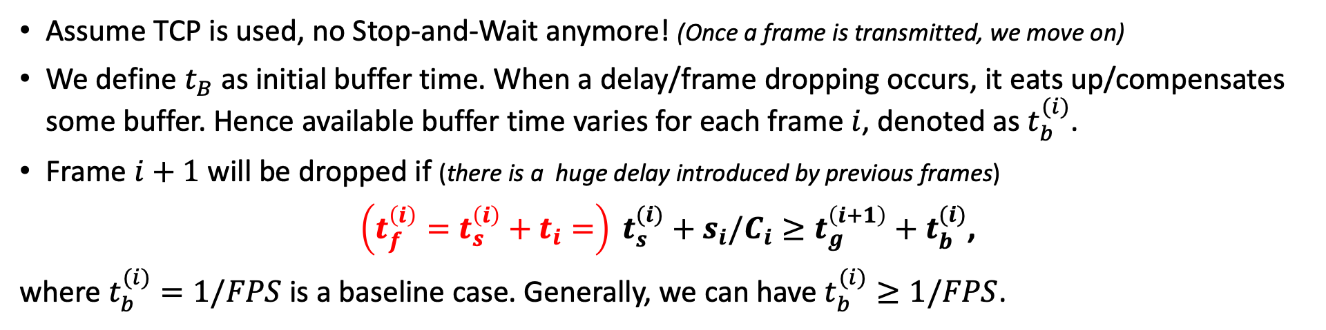



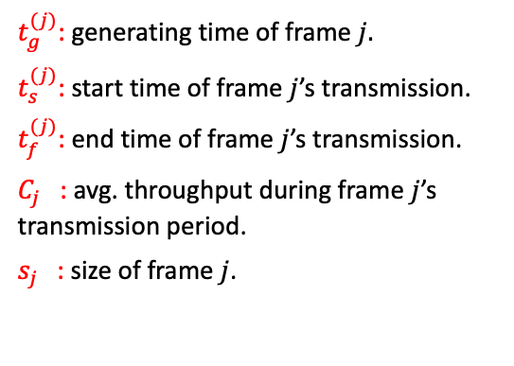


Our Solution - Analysis on the Frame Droppings Condition
Assume TCP is used, no Stop-and-Wait anymore! (Once a frame is transmitted, we move on)
We define $t_{B}$ as initial buffer time. When a delay/frame dropping occurs, it eats up/compensates some buffer. Hence available buffer time varies for each frame $i$, denoted as $t_{b}^{(i)}$.
Frame $i+1$ will be dropped if (there is a huge delay introduced by previous frames)
$\left(t_{f}^{\left(i\right)}=t_{s}^{\left(i\right)}+t_{i}=\right) t_{s}^{(i)}+s_{i}/C_{i}≥t_{g}^{\left(i+1\right)}+t_{b}^{(i)}$,
where $t_{b}^{(i)}=1/FPS$ is a baseline case. Generally, we can have $t_{b}^{(i)}≥1/FPS$.
1/FPS
1/FPS
$t_{g}^{(j)}$: generating time of frame $j.$
$t_{s}^{(j)}$: start time of frame $j$’s transmission.
$t_{f}^{(j)}$: end time of frame $j$’s transmission.
$C_{j}$ : avg. throughput during frame $j$’s transmission period.
$s_{j}$ : size of frame $j$.
Uploader
$$t_{i}=s_{i}/C_{i}$$
$$t_{g}^{(i)}$$
$$t_{g}^{(i+1)}$$
$$t_{g}^{(i+2)}$$
$$t_{s}^{(i)}$$
$$t_{f}^{(i)}$$

Slide 8
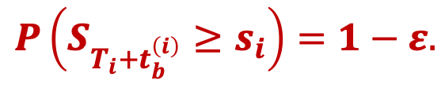
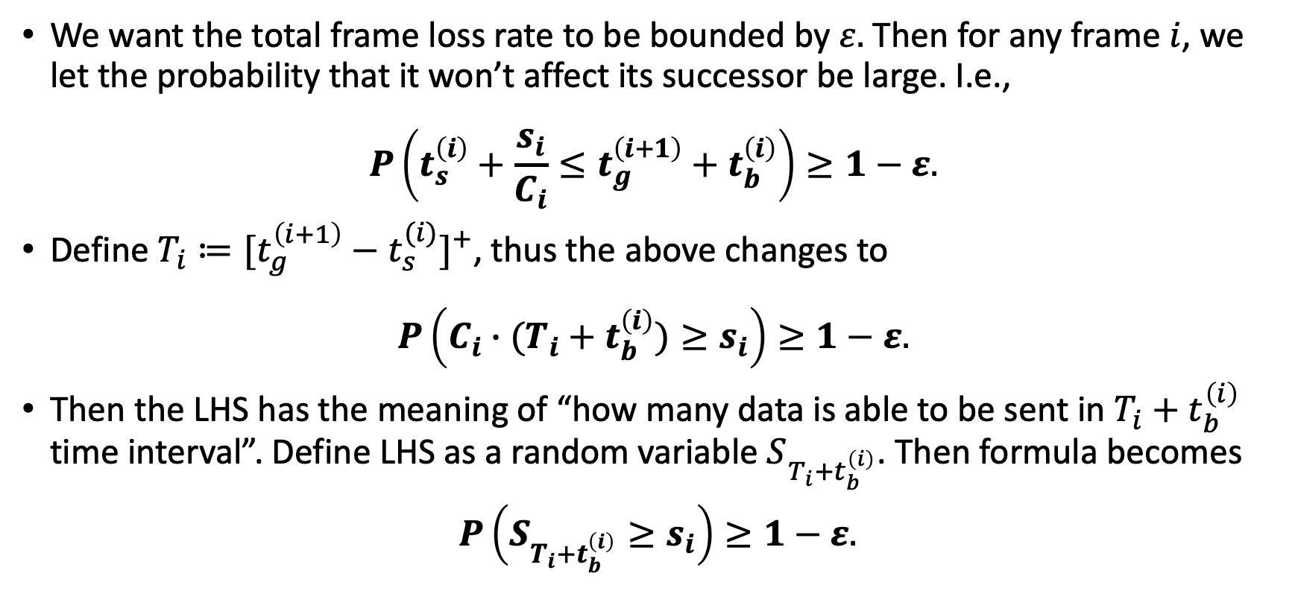
Our Solution - Derive a Probability Formula
We want the total frame loss rate to be bounded by $ε.$ Then for any frame $i$, we let the probability that it won’t affect its successor be large. I.e.,
$$P\left(t_{s}^{\left(i\right)}+\frac{s_{i}}{C_{i}}≤t_{g}^{\left(i+1\right)}+t_{b}^{\left(i\right)}\right)≥1−ε.$$
Define $T_{i}≔{[t_{g}^{\left(i+1\right)}−t_{s}^{(i)}]}^{+}$, thus the above changes to
$$P\left(C_{i}∙(T_{i}+t_{b}^{\left(i\right)})≥s_{i}\right)≥1−ε.$$
Then the LHS has the meaning of “how many data is able to be sent in $T_{i}+t_{b}^{\left(i\right)}$ time interval”. Define LHS as a random variable $S_{T_{i}+t_{b}^{\left(i\right)}}$. Then formula becomes
$P\left(S_{T_{i}+t_{b}^{\left(i\right)}}≥s_{i}\right)≥1−ε.$
$$P\left(S_{T_{i}+t_{b}^{\left(i\right)}}≥s_{i}\right)=1−ε.$$

Slide 9
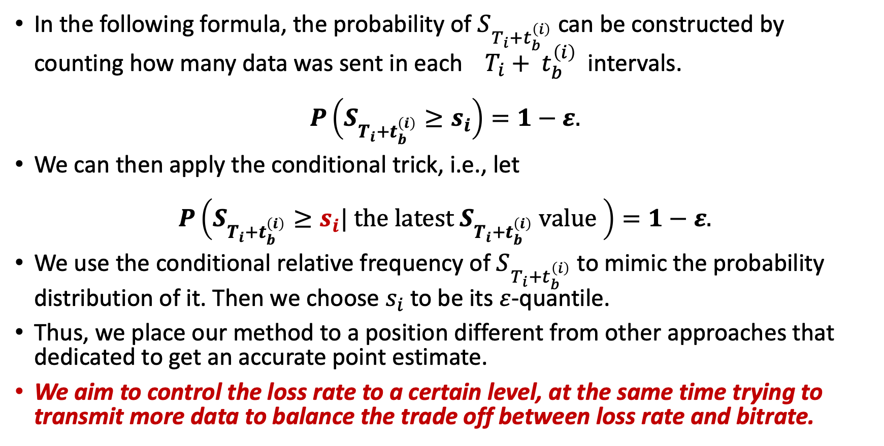
Our Solution - Derive a Probability Formula
In the following formula, the probability of $S_{T_{i}+t_{b}^{\left(i\right)}}$ can be constructed by counting how many data was sent in each $T_{i}+ t_{b}^{\left(i\right)}$ intervals.
$$P\left(S_{T_{i}+t_{b}^{\left(i\right)}}≥s_{i}\right)=1−ε.$$
We can then apply the conditional trick, i.e., let
$$P\left(S_{T_{i}+t_{b}^{\left(i\right)}}≥s_{i}| the latest S_{T_{i}+t_{b}^{\left(i\right)}} value \right)=1−ε.$$
We use the conditional relative frequency of $S_{T_{i}+t_{b}^{\left(i\right)}}$ to mimic the probability distribution of it. Then we choose $s_{i}$ to be its $ε$-quantile.
Thus, we place our method to a position different from other approaches that dedicated to get an accurate point estimate.
We aim to control the loss rate to a certain level, at the same time trying to transmit more data to balance the trade off between loss rate and bitrate.

Slide 10
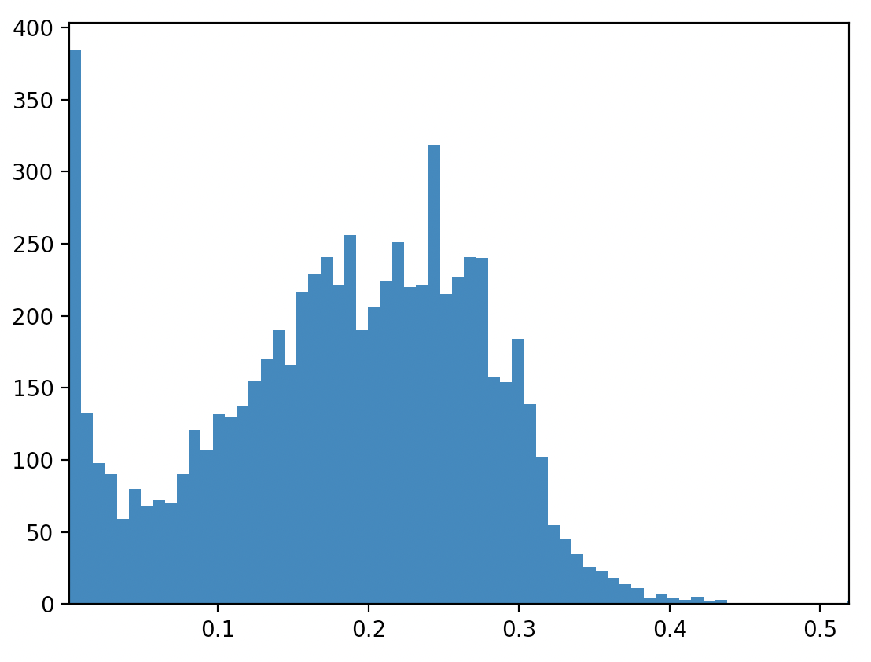
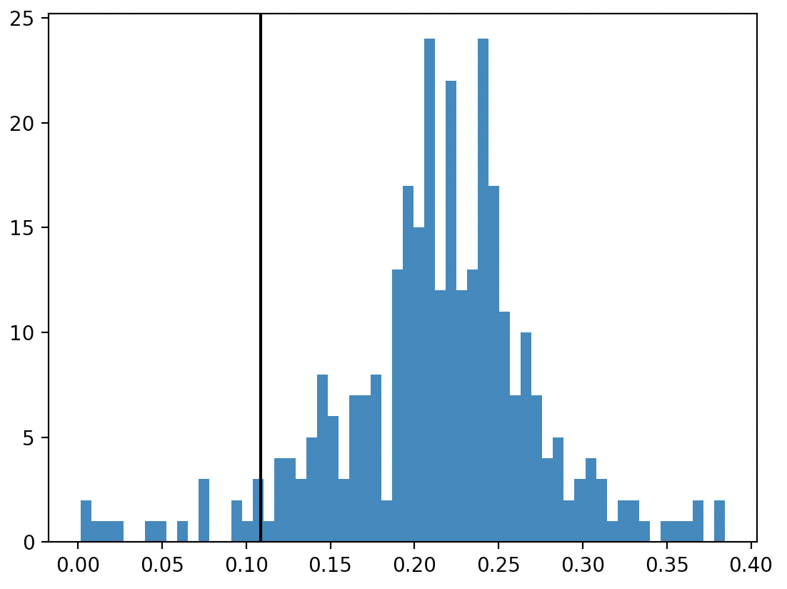
Our Solution - Demo Pictures of Marginal and Conditional PDF
An example of marginal empirical probability distribution.
0.05 quantile value
conditioning
The corresponding conditional empirical distribution.

Slide 11
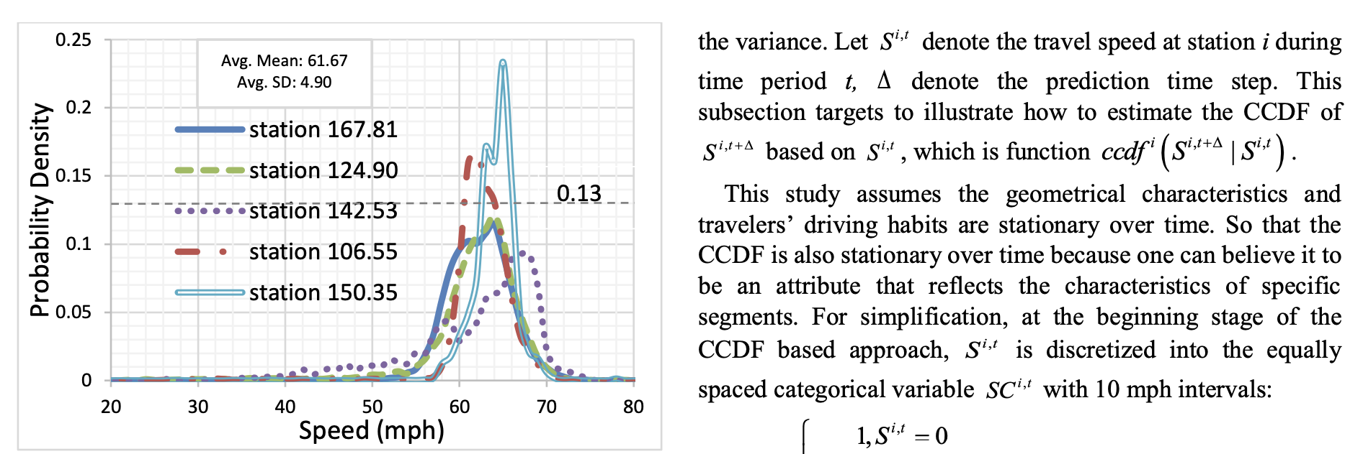
Our Solution - Side Note: Why Bother Using the Conditioning?
Because such trick/idea appears in some short-term estimating problem in other fields. E.g., speed estimation on highways.

Slide 12
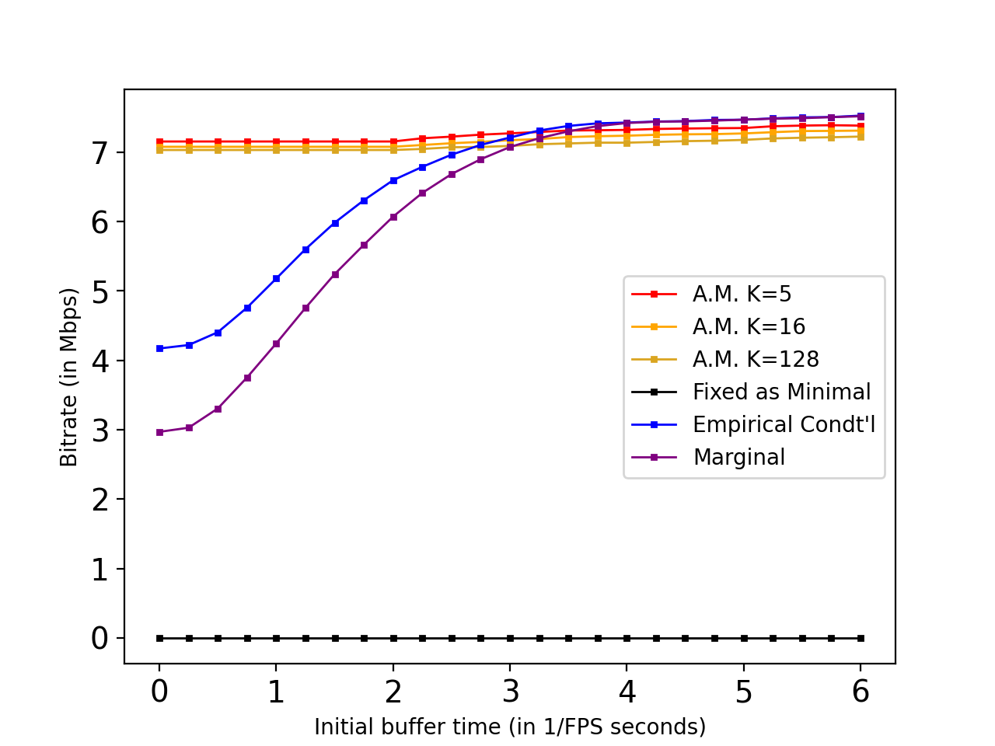
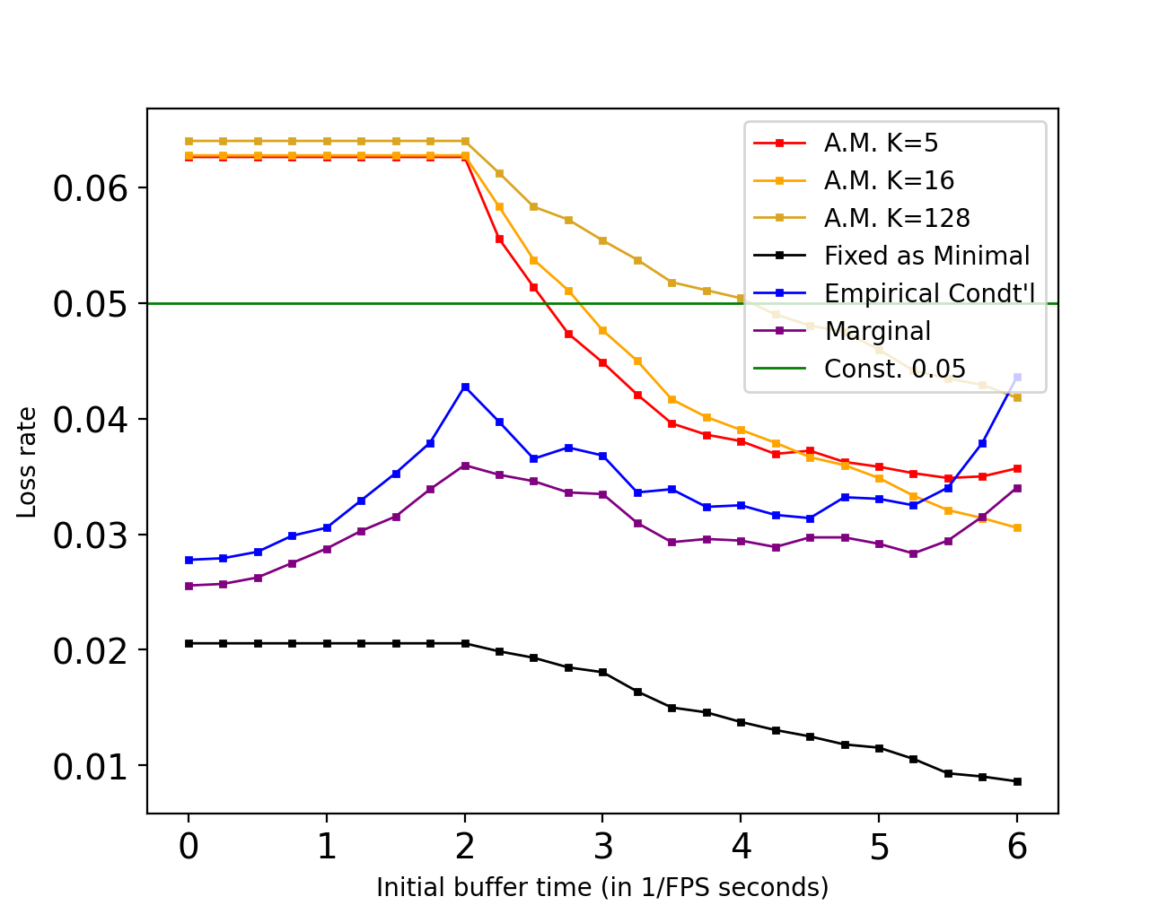
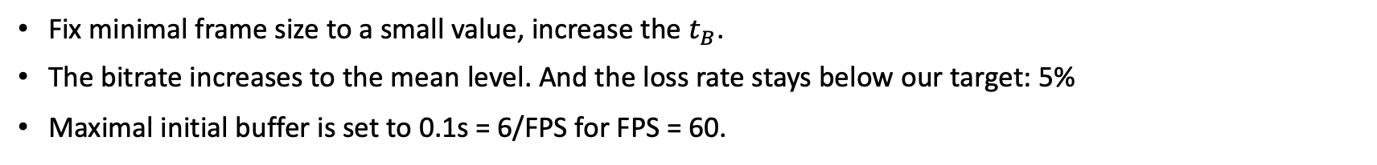
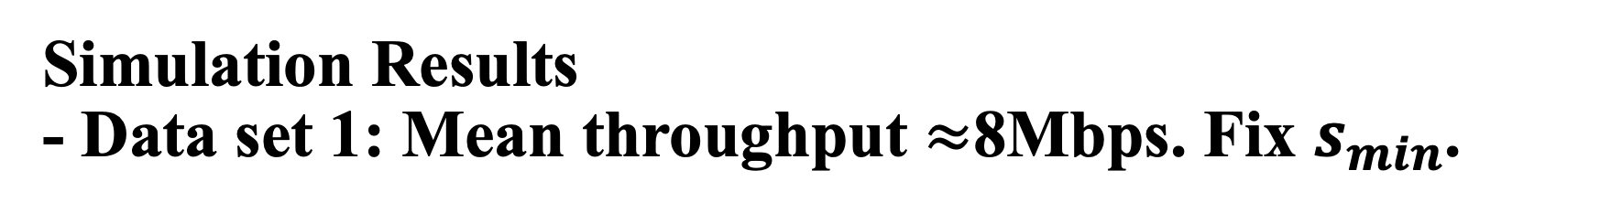
Simulation Results - Data set 1: Mean throughput $≈$8Mbps. Fix $s_{min}$.
Fix minimal frame size to a small value, increase the $t_{B}$.
The bitrate increases to the mean level. And the loss rate stays below our target: 5%
Maximal initial buffer is set to 0.1s = 6/FPS for FPS = 60.

Slide 13
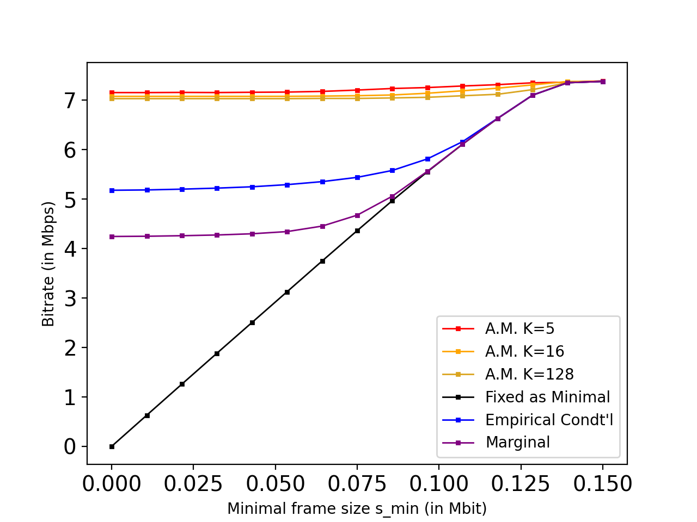
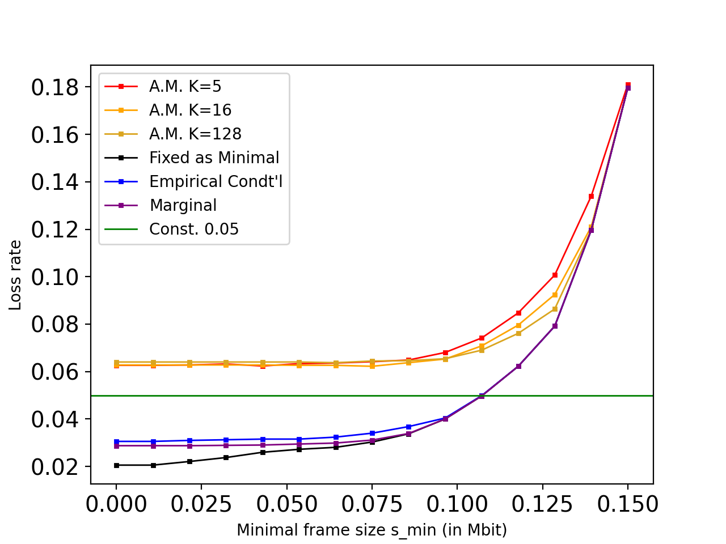
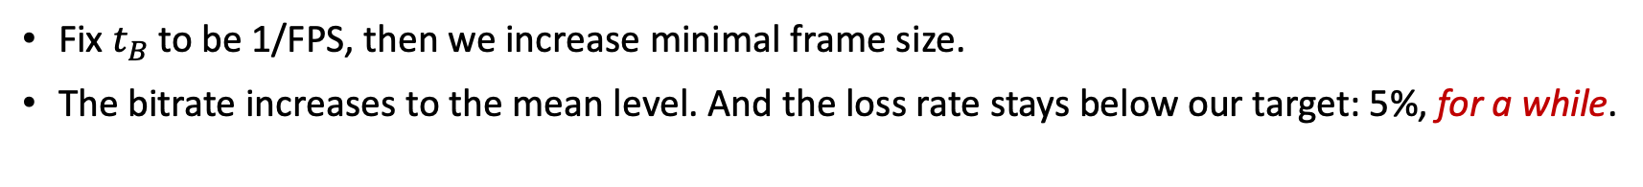
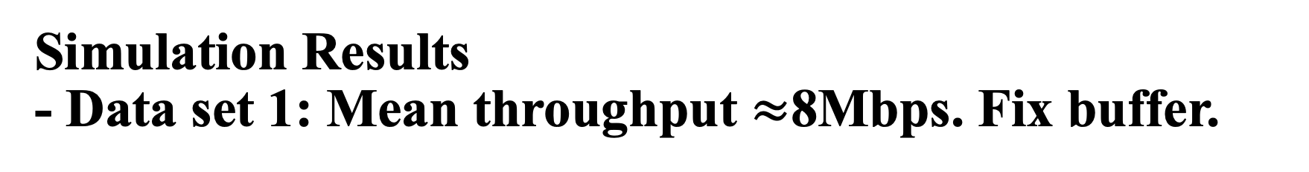
Simulation Results - Data set 1: Mean throughput $≈$8Mbps. Fix buffer.
Fix $t_{B}$ to be 1/FPS, then we increase minimal frame size.
The bitrate increases to the mean level. And the loss rate stays below our target: 5%, for a while.

Slide 14
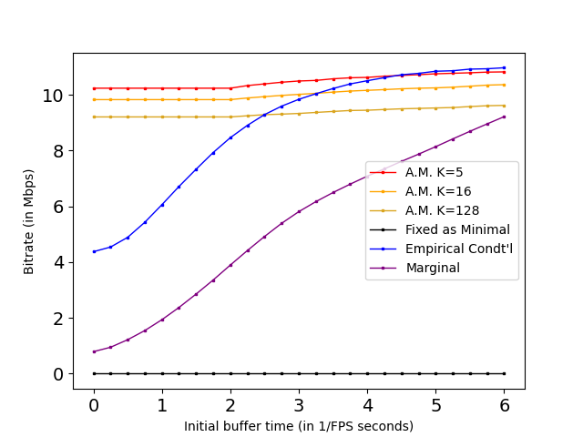
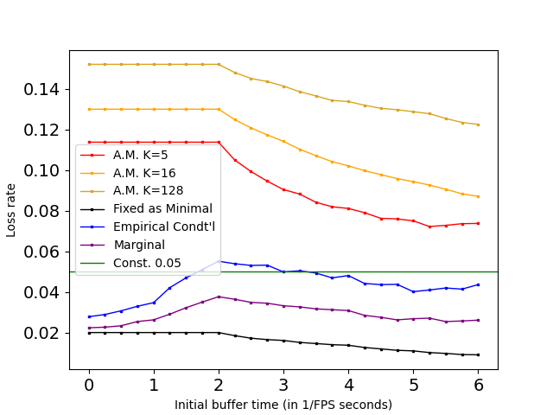
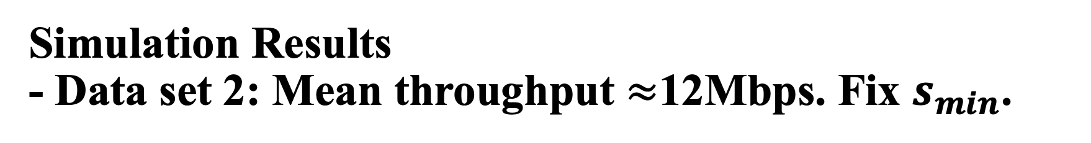
Simulation Results - Data set 2: Mean throughput $≈$12Mbps. Fix $s_{min}$.
Everything shows pretty much the same trend as 2 pages ago.

Slide 15
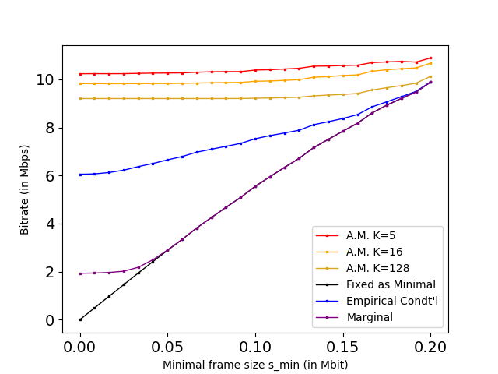
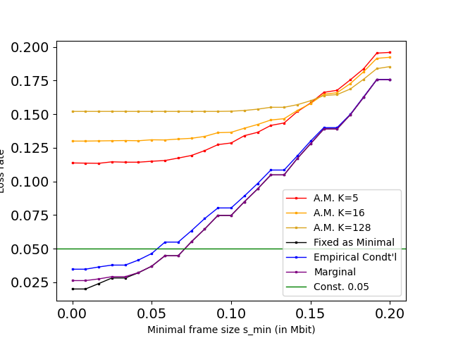
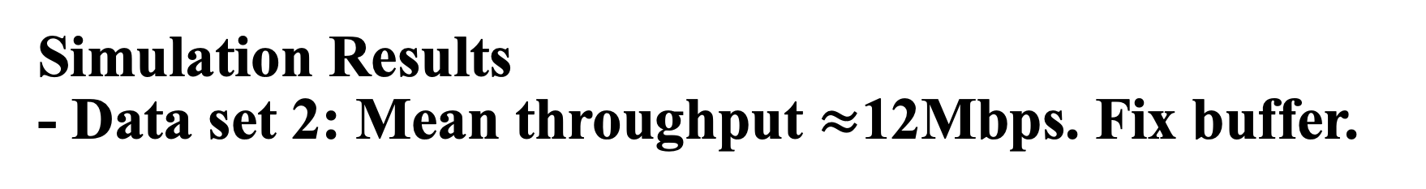
Simulation Results - Data set 2: Mean throughput $≈$12Mbps. Fix buffer.
Again, everything shows pretty much the same trade off as before.

Slide 16
Conclusion and Future Works
We proposed and demonstrated a history-based short-term bandwidth predicting method which has its practical value in live video streaming.
Our method uses the empirical conditional probability to find the largest frame size while eliminating the probability of introducing a frame dropping under a network.
Possible improvements to enhance this method’s robustness.
giving a more concrete theoretical proof of the conditioning method
better implementations of the algorithm in both space and time complexities
ways to obtain more reliable past data
Etc.

Slide 17
That’s an end. Thanks for your time!
謝謝各位的聆聽。

