Slide 1

Titanic
MACHINE LEARNING FROM DISASTER

Slide 2



913 CREW MEMBERS
1316 PASSENGERS
20 LIFEBOATS
Notes:
I guess everyone would know what the Titanic was – just some interesting facts to get us started. There were 913 crew members and 1316 passengers making a total of roughly over 2000 people. The only problem was there were only 20 lifeboats. 20 lifeboats was estimated to only seat 1/3 of all passengers. Many lifeboats were not fully loaded when they left because the crew were not properly trained. As a result over 1500 people died upon collision – mostly due to the fatally cold water.

Slide 3
Goal?
Predict if a passenger will survive a Titanic
Notes:
So our goal today? To predict if a passenger will survive a Titanic – what do I mean by a Titanic? That just means we will be working out whether a hypothetical passenger we place on board the Titianic that night, would’ve survived the night.
Think of this way. Everybody knows the movie adaptation of the Titanic – James Cameron
Imagine the last scene – the lady is lying on the piece of debris and Jack, our hero is trying to get out of the water, so he doesn’t freeze to death. And the question now to consider is – if Jack were a rich 60 year old, Asian lady, first class passegner – would he have survived – would he instead be on a lifeboat – that is the question we’re asking today.

Slide 4

“Machine learning involves building models of data”
Source: Python Data science Handbook by Joe VanderPlas
Notes:
To answer that question we need to use machine learning – we’re going to build a mathematical model of data we have available about the passengers actually on board the Titanic, then use that model to predict whether our hypothetical Jack would survive.

Slide 5



IMPORT AND CLEAN DATA
TRAIN MODEL
OUTPUT RESULTS

Slide 6
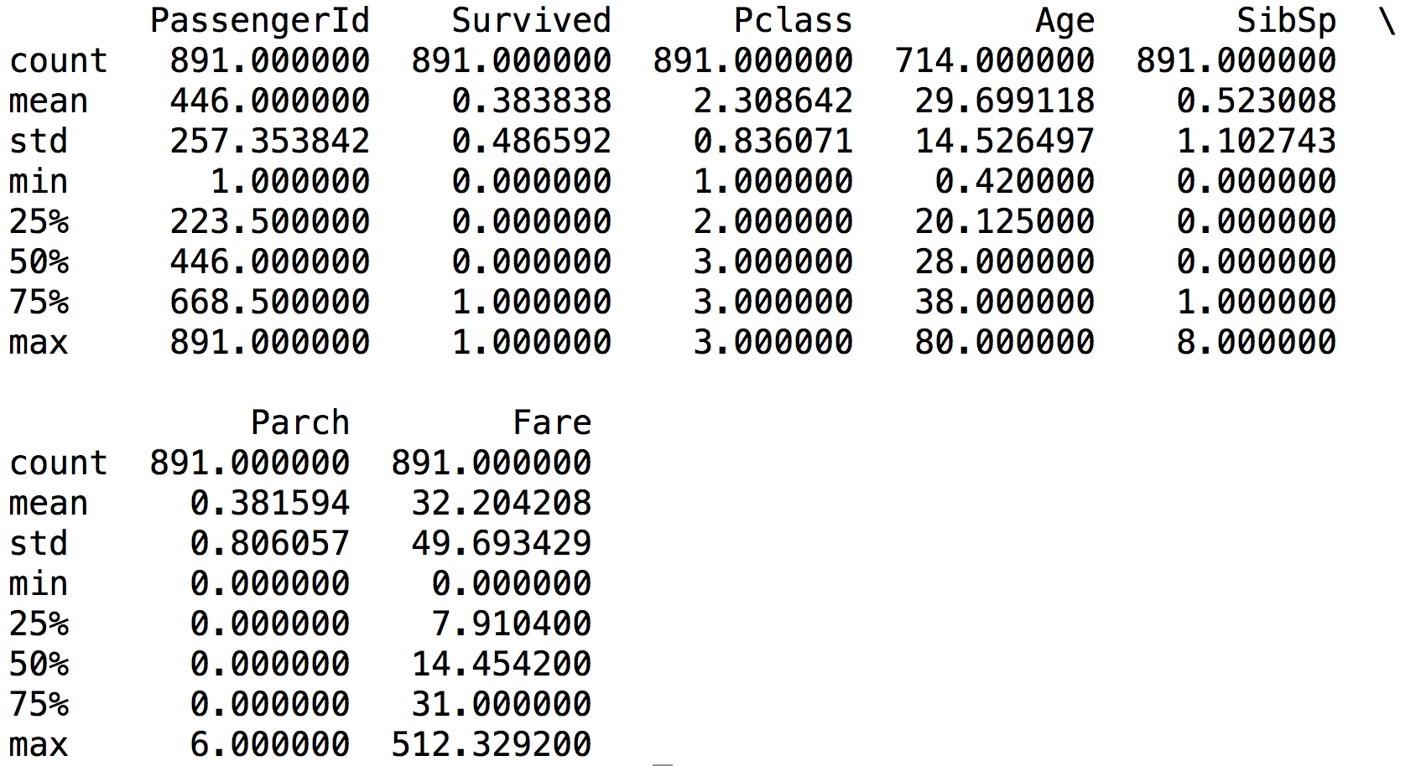
IMPORT AND CLEAN DATA
>>>import pandas as pd
trainingdata = pd.read_csv("train.csv")
print(trainingdata.describe())

Slide 7
IMPORT AND CLEAN DATA
FEATURES
There are 6 columns of data that can be used as predictors - however are not significant
The age column is missing data – need to fill in
Mixture of categorical and numerical data

Slide 8


IMPORT AND CLEAN DATA
CLEANING:
Fill in missing Age values with median value
Replace categorical data with dummy variables
Remove insignificant predictors
FEATURE ENGINEERING
Extract title from the “Name” column and map each title to a dummy variable

Slide 9
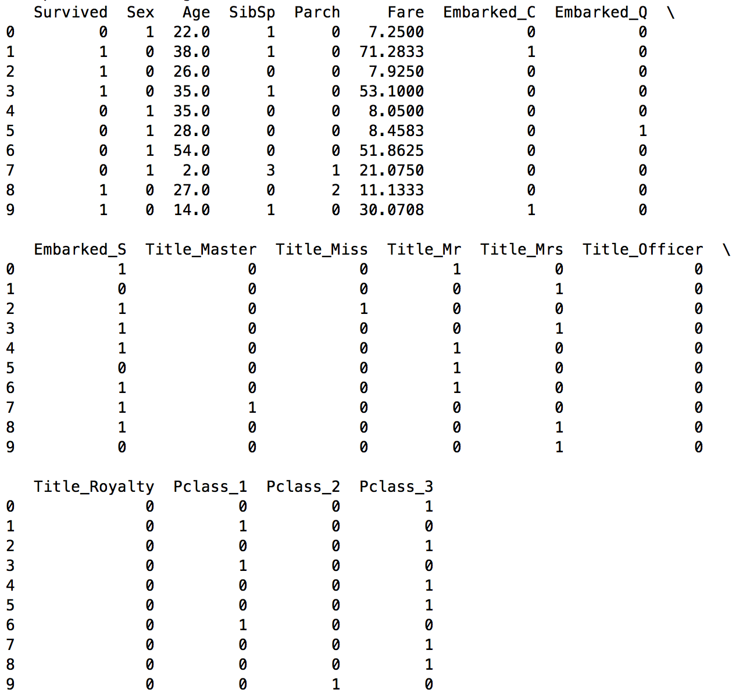
IMPORT AND CLEAN DATA: THE RESULT

Slide 10
TRAIN MODEL

Slide 11


TRAIN MODEL
LOGISTIC REGRESSION
RANDOM FOREST
Notes:
We have two mathematical models we can build with the data that we can then use to predict whether some hypothetical person would survive.

Slide 12
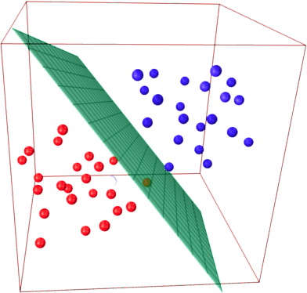
TRAIN MODEL
LOGISTIC REGRESSION MODEL
“Logistic Regression is a type of classification algorithm involving a linear discriminant.”

Slide 13
TRAIN MODEL
LOGISTIC REGRESSION MODEL
ADVANTAGES | DISAVANTAGES
Designed for situations where the dependent variable is categorical Works well when the explanatory variables are also binary | Requires large sample size to achieve stable, reliable results – more than 50 data points per predictor Does not require interval data

Slide 14


TRAIN MODEL
RANDOM FOREST
DECISION TREE
RANDOM FOREST

Slide 15
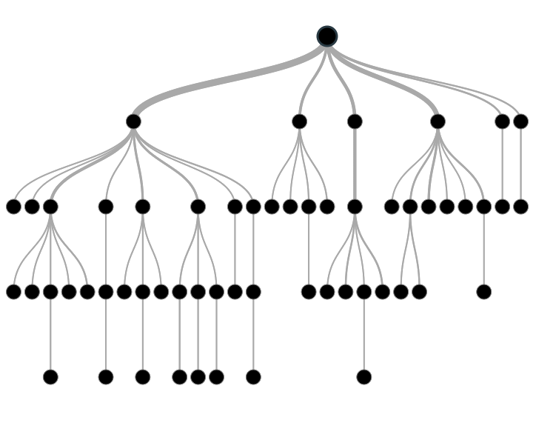
TRAIN MODEL
RANDOM FOREST
DECISION TREE
ROOT
DECISION NODE
TERMINAL NODE/ LEAF

Slide 16
TRAIN MODEL
RANDOM FOREST
ADVANTAGES | DISAVANTAGES
Easy to understand and explain Can handle both numerical and categorical data | Tendency to overfit Can have poor speed performance – need to build large ensembles for better model

Slide 17
TRAIN MODEL
>>> model.fit(train_cols, trainingdata["Survived"])
predicted = model.predict(testdata)

Slide 18
OUTPUT RESULTS

Slide 19
OUTPUT RESULTS
LOGISTIC REGRESSION
RANDOM FOREST
0.74641
0.79425

Slide 20
TITANIC: OVERVIEW
AIM: To predict whether, given a set a characteristics, a person would survive a disaster similar to the Titanic
Cleaning and feature engineering
Training models – decision tree had higher accuracy

