Slide 1
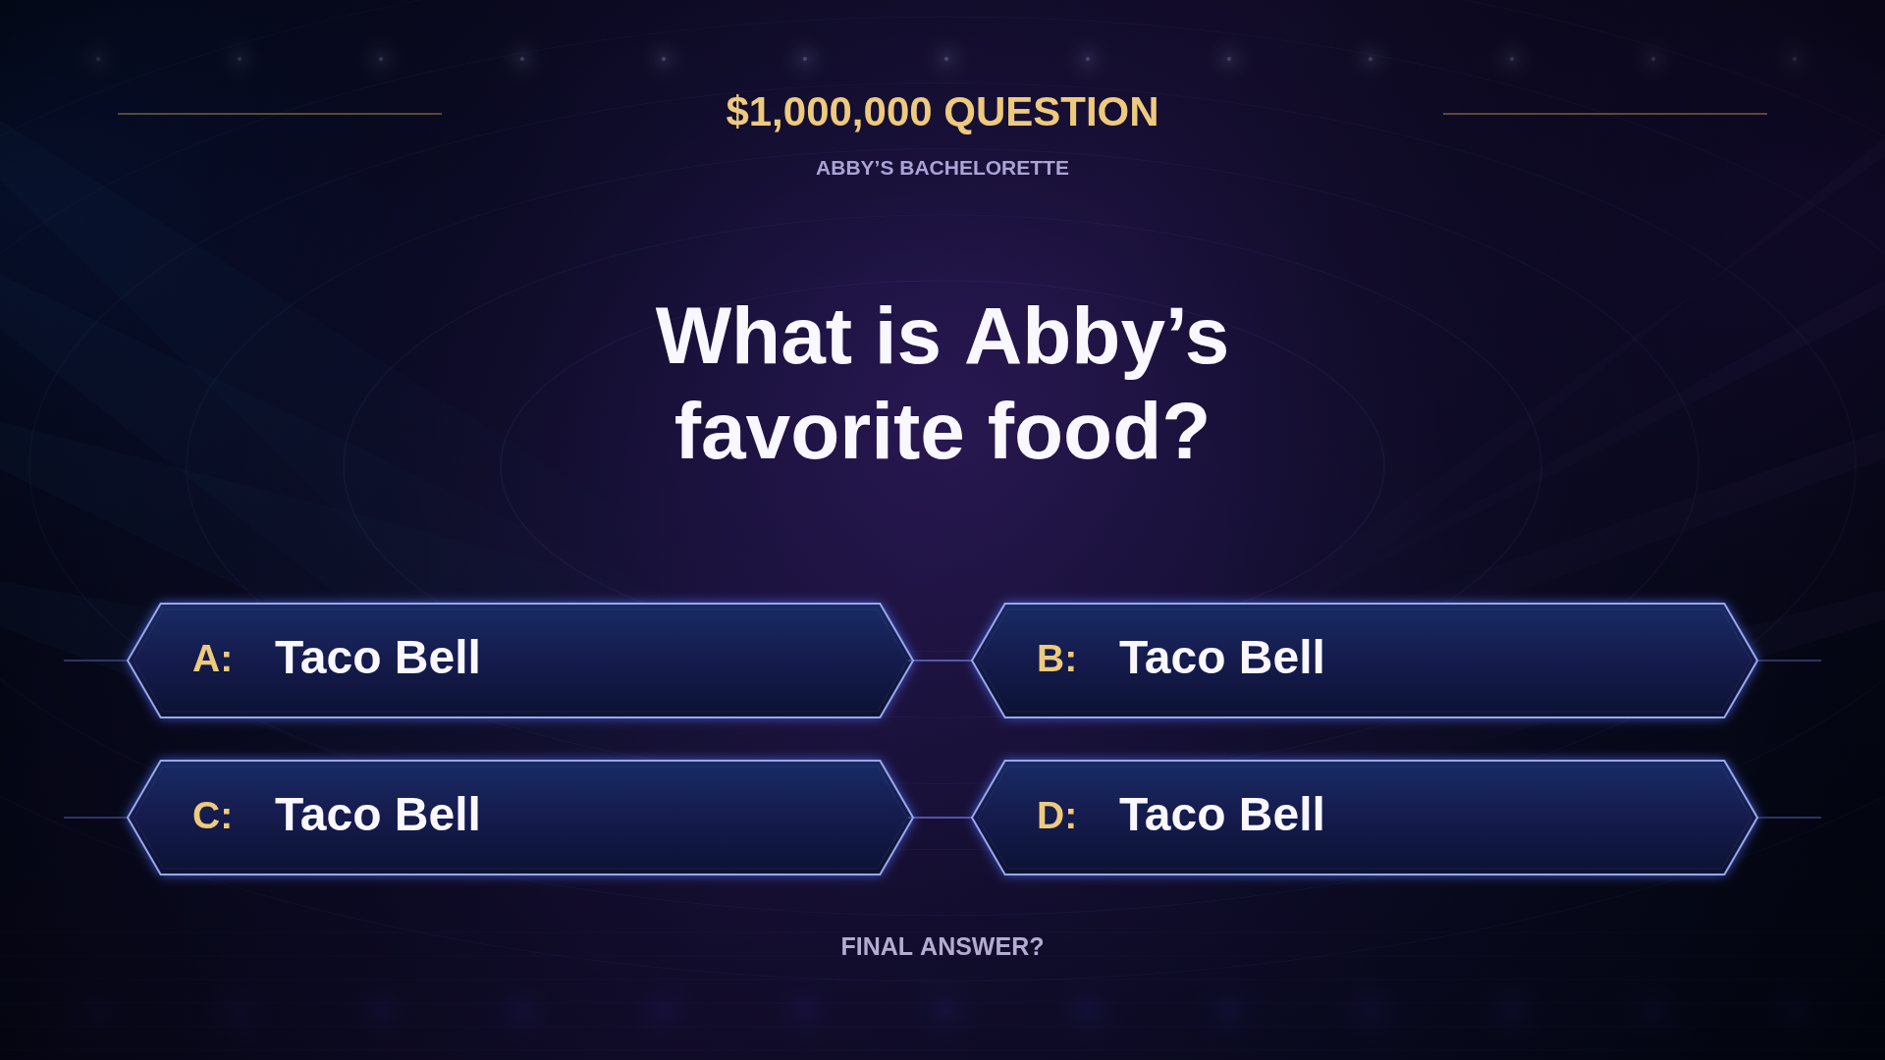
Notes:
Static question screen. All four answers are intentionally Taco Bell.

Slide 2
Notes:
Click to play the silent 30-second animation. Timing is a preview: replace or retime to the recorded answer and phone-a-friend call. Original footage has not been altered.

